Slide 1



Water Quality Prediction
NAME: Dipchandri Ghosh
STUDENT REGISTRATION ID: STU68249441d8b4d1747227713

Slide 2

Learning Objectives
Understand Water Pollution Parameters- Identify major pollutants (O₂, NO₃, NO₂, SO₄, PO₄, Cl⁻) and their relevance to environmental monitoring.
Analyze and Clean Real Data- Work on historical pollution data (2000-2021) for water quality parameters, identify missing values and perform computer analysis to clean the data.
Use Machine Learning Model to make Multi-Output Predictions- Build a Random Forest (RF) model for multi-output predictions to predict levels of pollutants (O₂, NO₃, NO₂, SO₄, PO₄, Cl⁻).
Build Interactive Prediction App- Create a user-driven Streamlit web application to predict pollutant levels, by year and station ID.
Align Input Features with Model Inputs- Join data utilizing feature alignment and one-hot encoding so the model receives inputs it has been trained to accept.
Deploy predictions in real-time- Create dynamic predictions using a saved `.pkl` model and have the predictions delivered according to user inputs.
Practical Experience with ML tools- Gain practical experience employing Python libraries, like Pandas, Scikit-learn, Joblib and Streamlit throughout a real-world processing pipeline.
GOAL
Source :
www.freepik.com/

Slide 3
Tools and Technology used
1. Development Environment-
Python 3.x
Jupyter Notebook
Streamlit
2. Libraries
Scikit-learn – ML model (Random Forest)
Pandas, NumPy – Data handling
Joblib, Pickle – Model saving/loading
3. Files & Formats
PB_All_2000_2021.csv – Dataset
pollution_model.pkl – Trained model
model_columns.pkl – Feature structure
app.py – Streamlit app script
WaterQualityPred.ipynb – Model notebook

Slide 4
Methodology
1. Data collection-
* Consists of a historical water quality dataset (2000-2021).
2. Data preprocessing
* We handled missing data.
* One-hot encoded the station IDs.
* Aligned our features in accordance with our model requirement.
3. Model training
* We trained a random forest regressor for a multi-output prediction.
* The target output was the pollutant levels (O₂, NO₃, NO₂, SO₄, PO₄, Cl⁻).
4. Model saving
* We saved our trained model and feature columns with `joblib`.
5. Web app development
* Developed an interactive UI with Streamlit
* We collected the user input (year + station ID) and returned predicted pollutant levels.

Slide 5
Problem Statement:
The access to purified water is vital for human life and the preservation of the planet. Monitoring the quality of water at every location and time is not easy due to :
Limited manual monitoring capacity
Difficulties in acquiring pertinent pollutant information in real time
Current absence of predictive tools for future water quality

Slide 6
Solution:
We created a machine learning-based prediction system that estimates water pollutant levels arising from historical data.
Solution Features
Random Forest Regressor trained on historical data to predict at least six pollutants: O₂, NO₃, NO₂, SO₄, PO₄, Cl⁻
Input: Year and Station ID
Output: Predicted concentration levels of pollutants
Interactive Web Application
Built with Streamlit
Easy-to-use interface with opportunity to make predictions in real-time
Allows user to add input and display pollutant levels in an instant

Slide 7
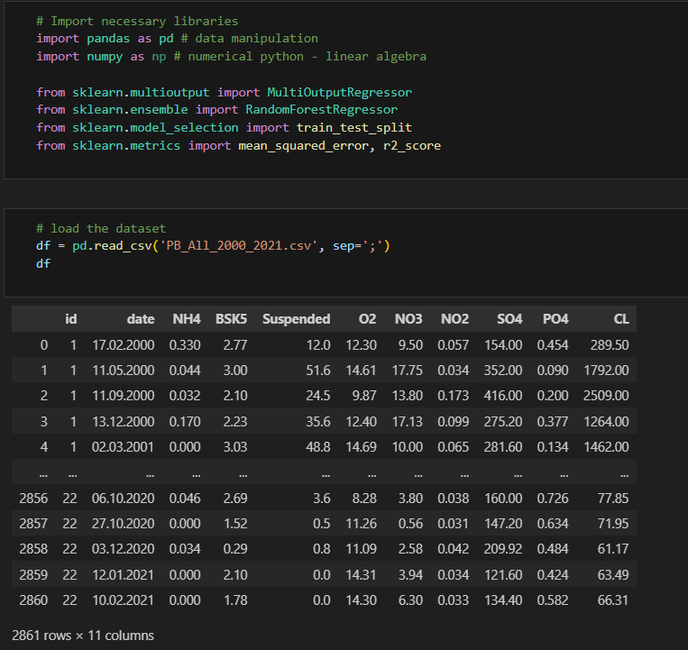
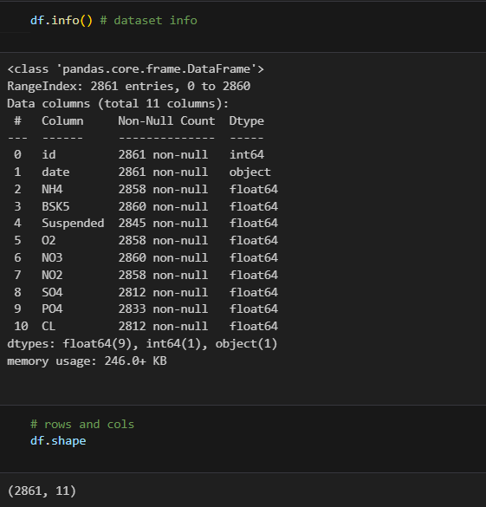
Screenshot of Output:
Source Code:

Slide 8
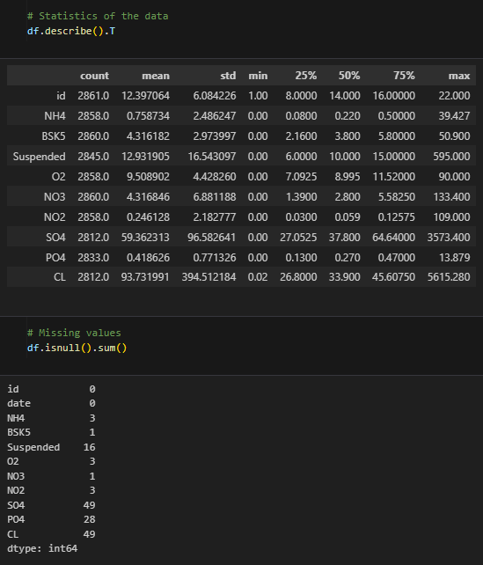
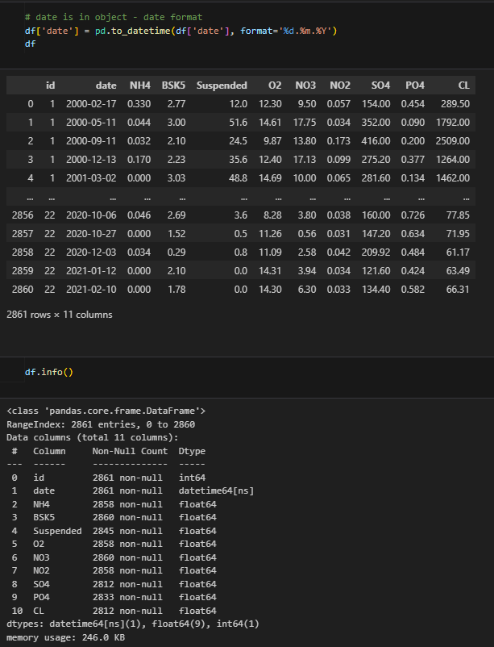
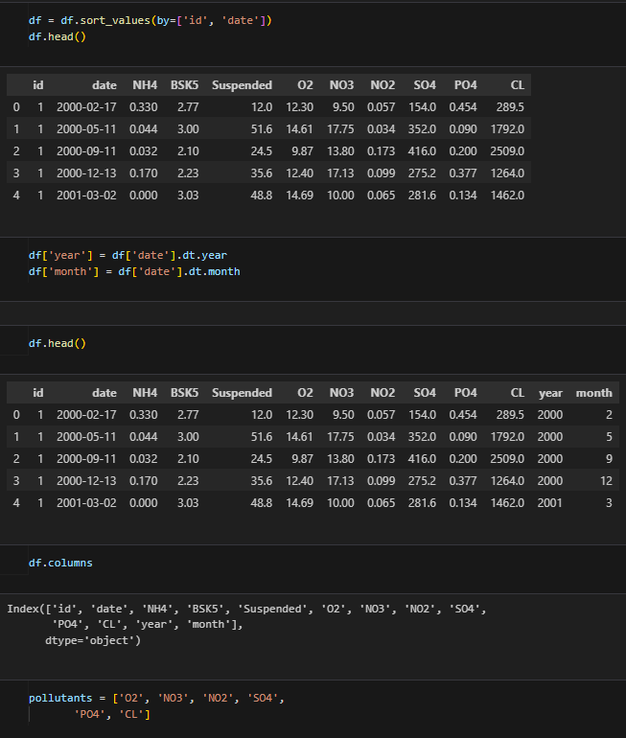
Screenshot of Output:
Source Code:

Slide 9
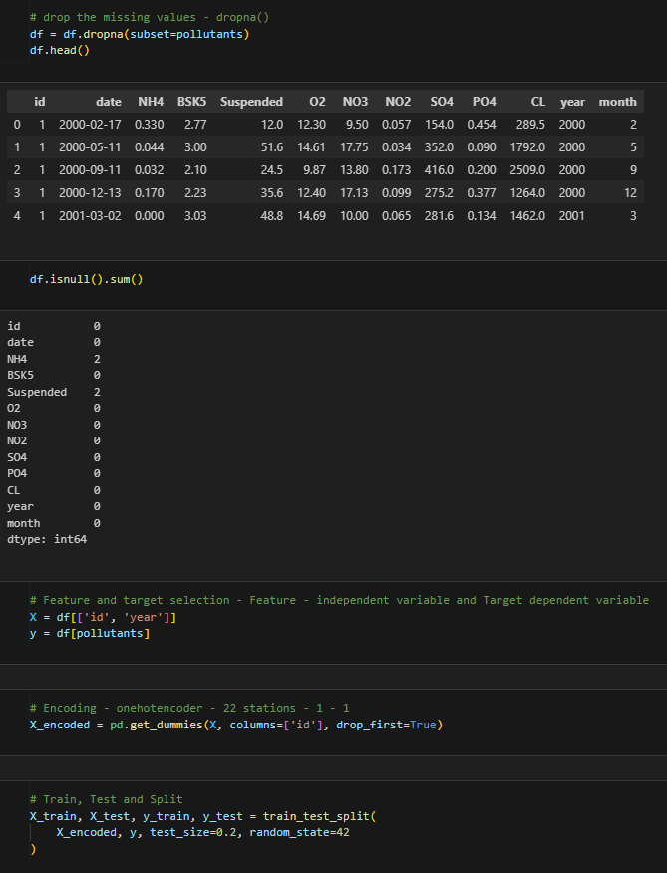
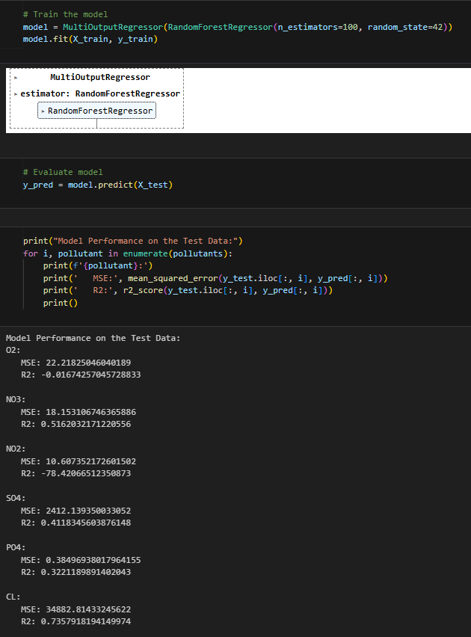
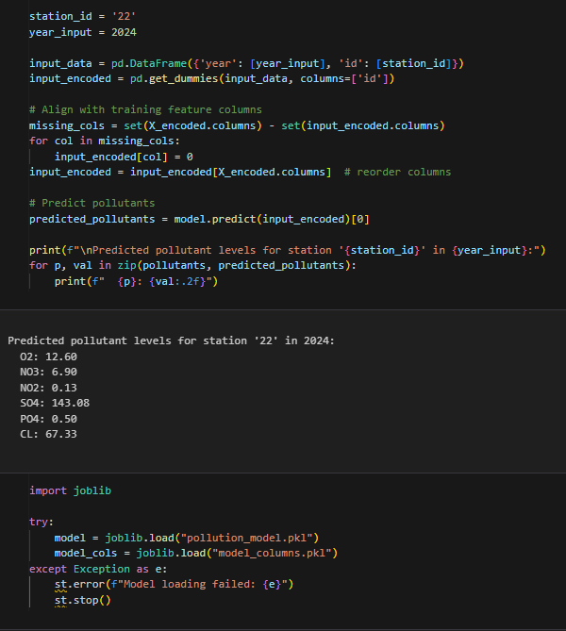
Screenshot of Output:
Source Code:

Slide 10
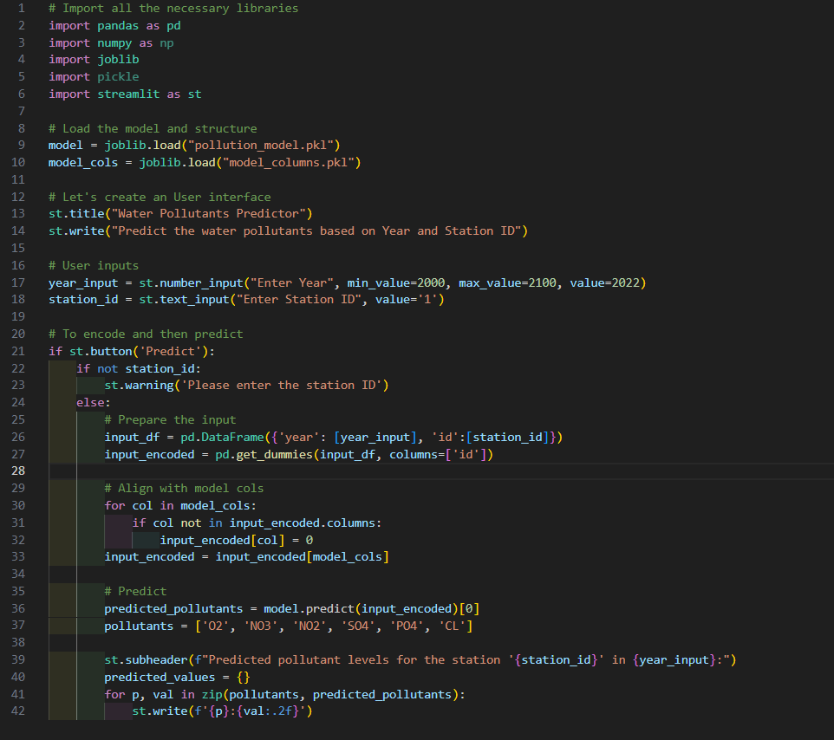
Screenshot of Output:
Deployment Code:

Slide 11
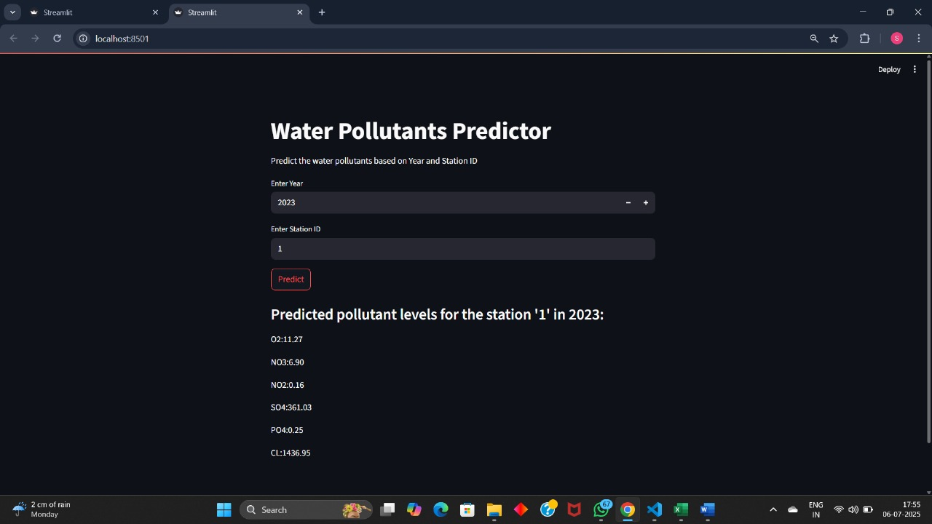
Screenshot of Output:
Streamlit Application Output:

Slide 12
Conclusion:
Developed machine learning model (Random Forest) to predict key water contaminants.
Predicted 6 contaminants using year and station ID.
Made a user-friendly web app using Streamlit.
Use this program to monitor water quality quicker with data driven decisions.
Future Scope:
Increase the number of input features, such as temperature, rainfall, land use data.
Add real-time sensor data for real-time monitoring.
Expand the model to additional locations and pollutants.
Implement a cloud deployment for easy access and scalability to users.
Enable alerts and recommendations for pollution control.
GitHub Repository Link: https://github.com/DipchandriGhosh/Water_Quality_Prediction-AICTE_Edunet-Shell_Skills4Future/tree/main/AICTE-Edunet-Shell_Skill4Future_Internship_Water_Quality_Prediction

Slide 13
Thank You!

