Slide 1
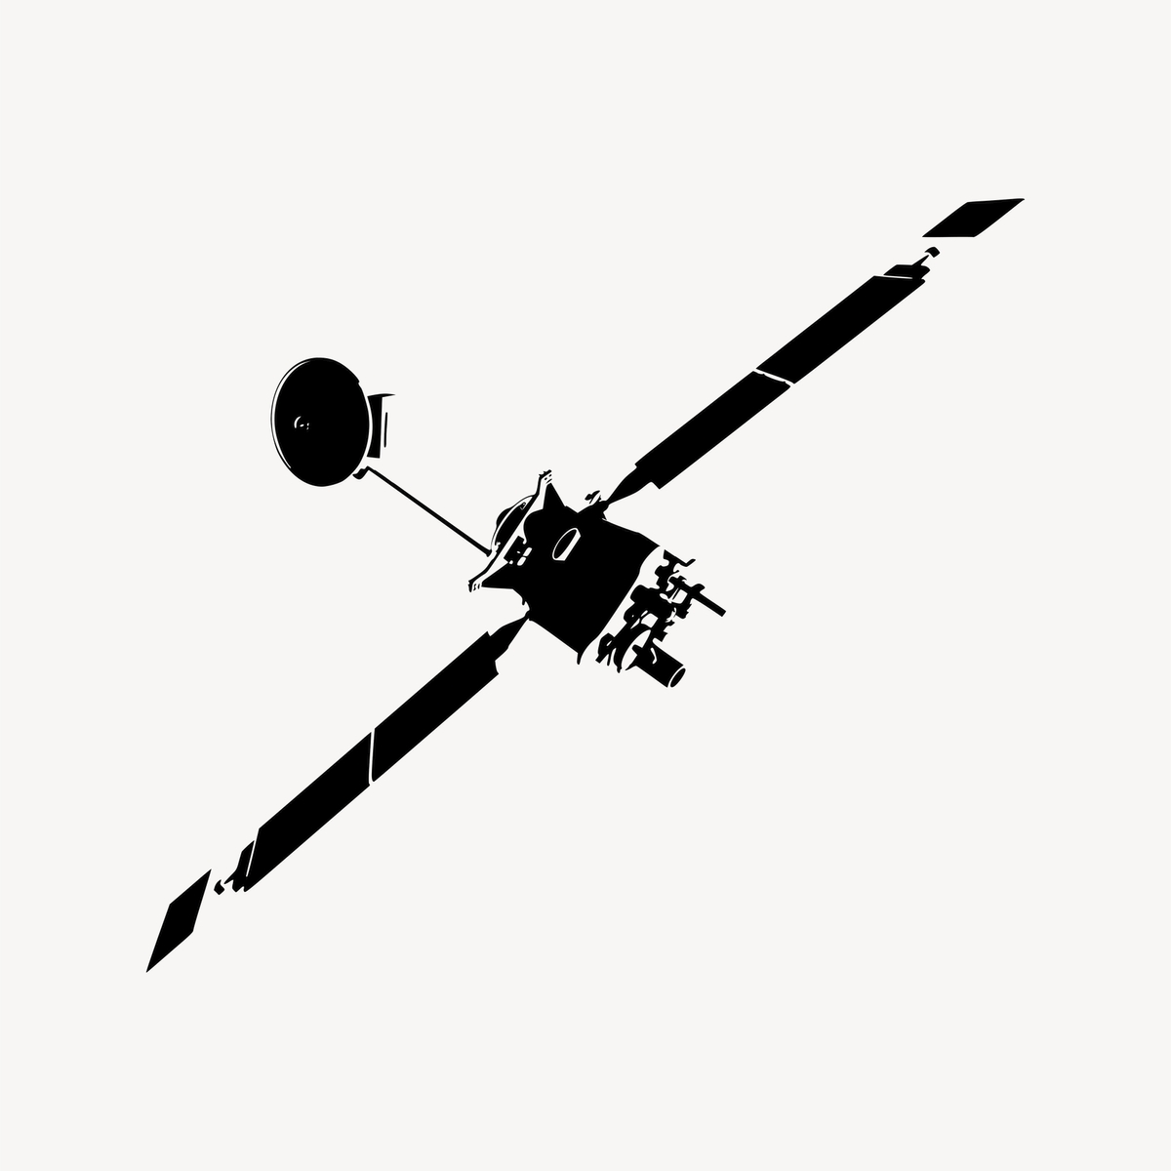
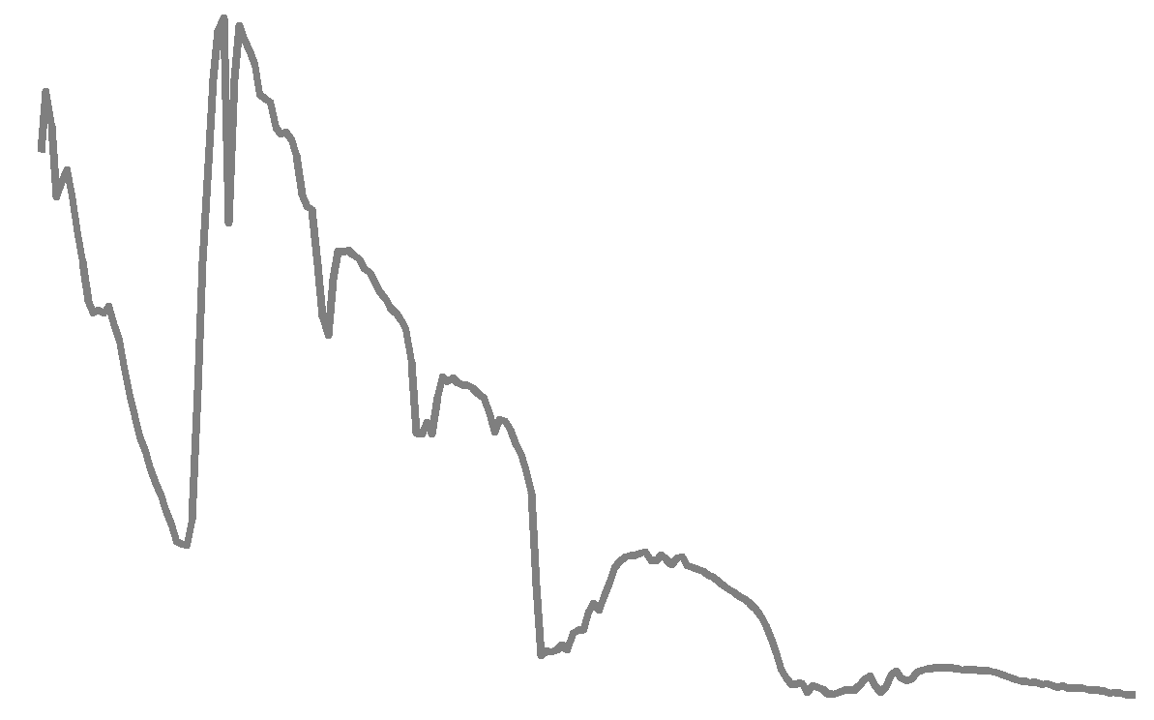

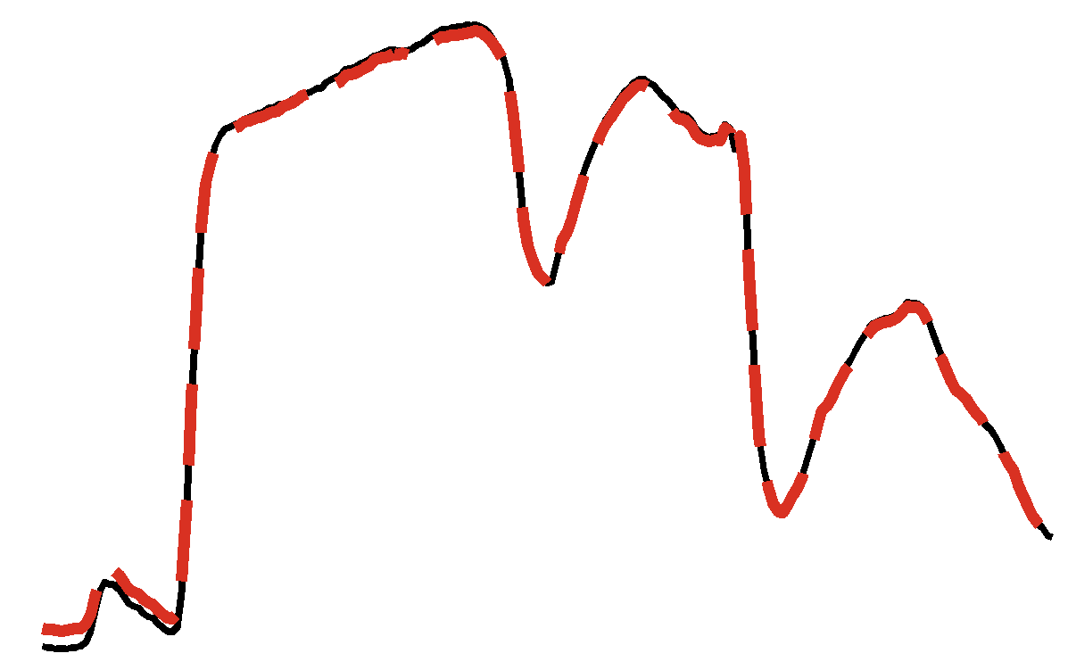
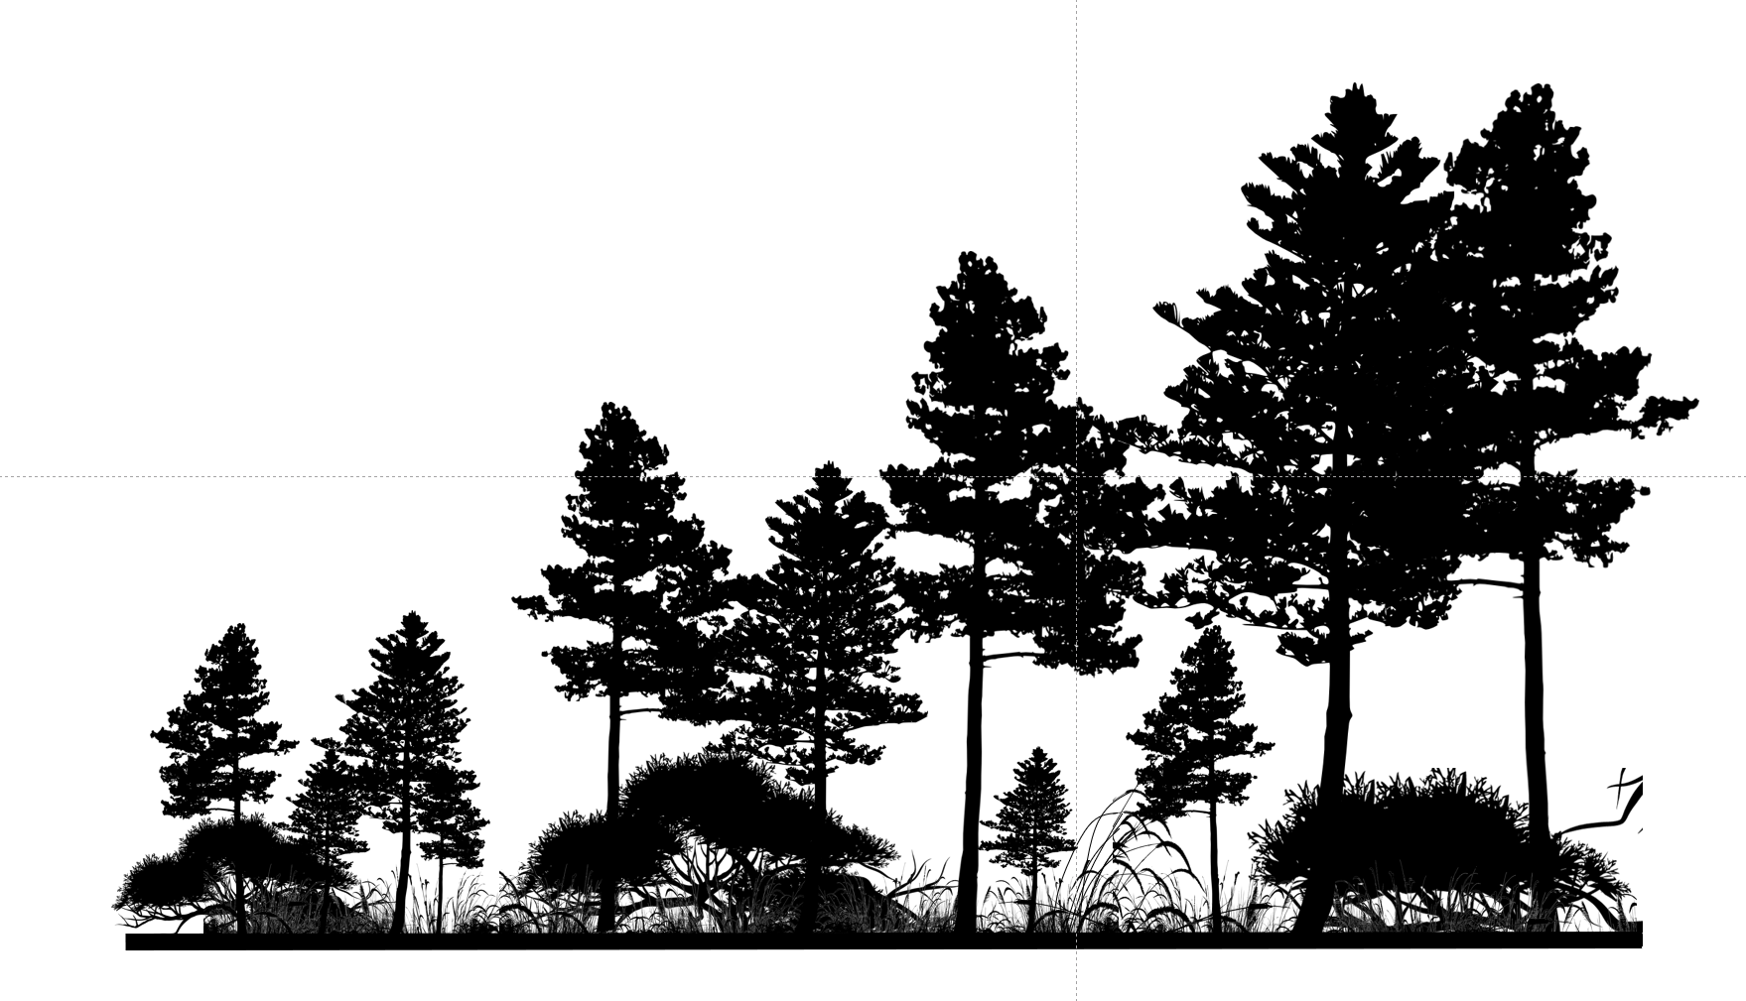
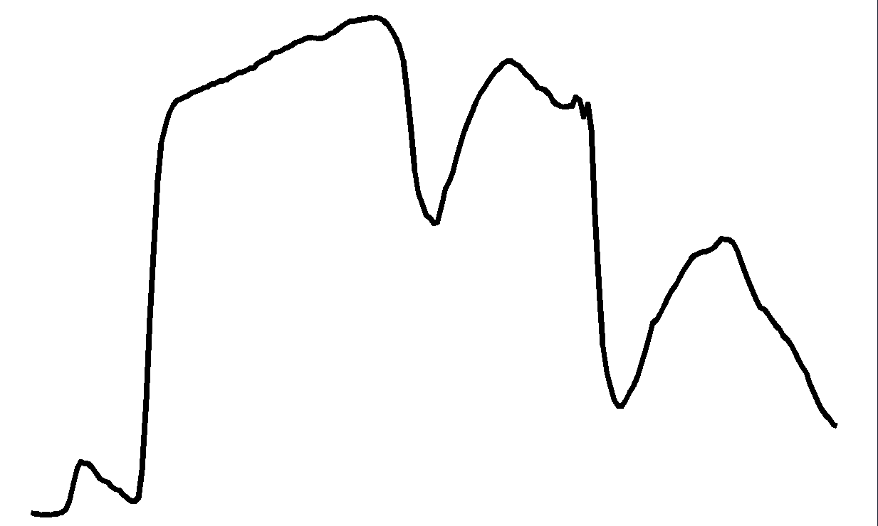
B)
Hypertrace
Estimated at-sensor radiances from the ISOFIT method. Noise is introduced from the sensor and atmosphere. For spaceborne missions, this is the signal measured since nature’s reflectances (panel A) are unknown.
A)
Simulated (noiseless) top-of-canopy reflectance spectra from the DGVM represents nature’s forward function, independent from measure-ment error. These are impossible to measure in reality thus are simulated.
C)
H₂O
AOT
H₂O
H₂O
AOT
H₂O
AOT
Noisy retrieved reflectance (red) from the ISOFIT forward function (OE routine), trans-lated from the at-sensor radiances (panel B). These are the best-estimate of nature’s spectral properties (as in panel A).
AOT
H₂O

Slide 2
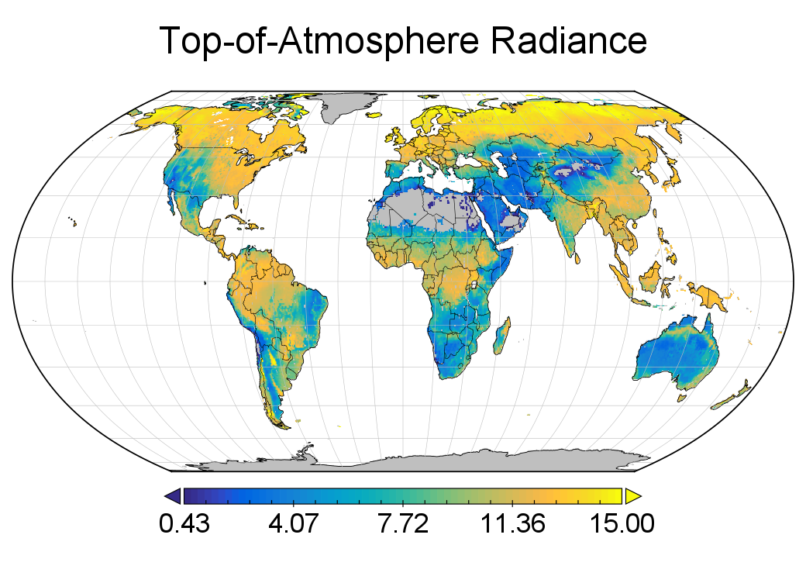
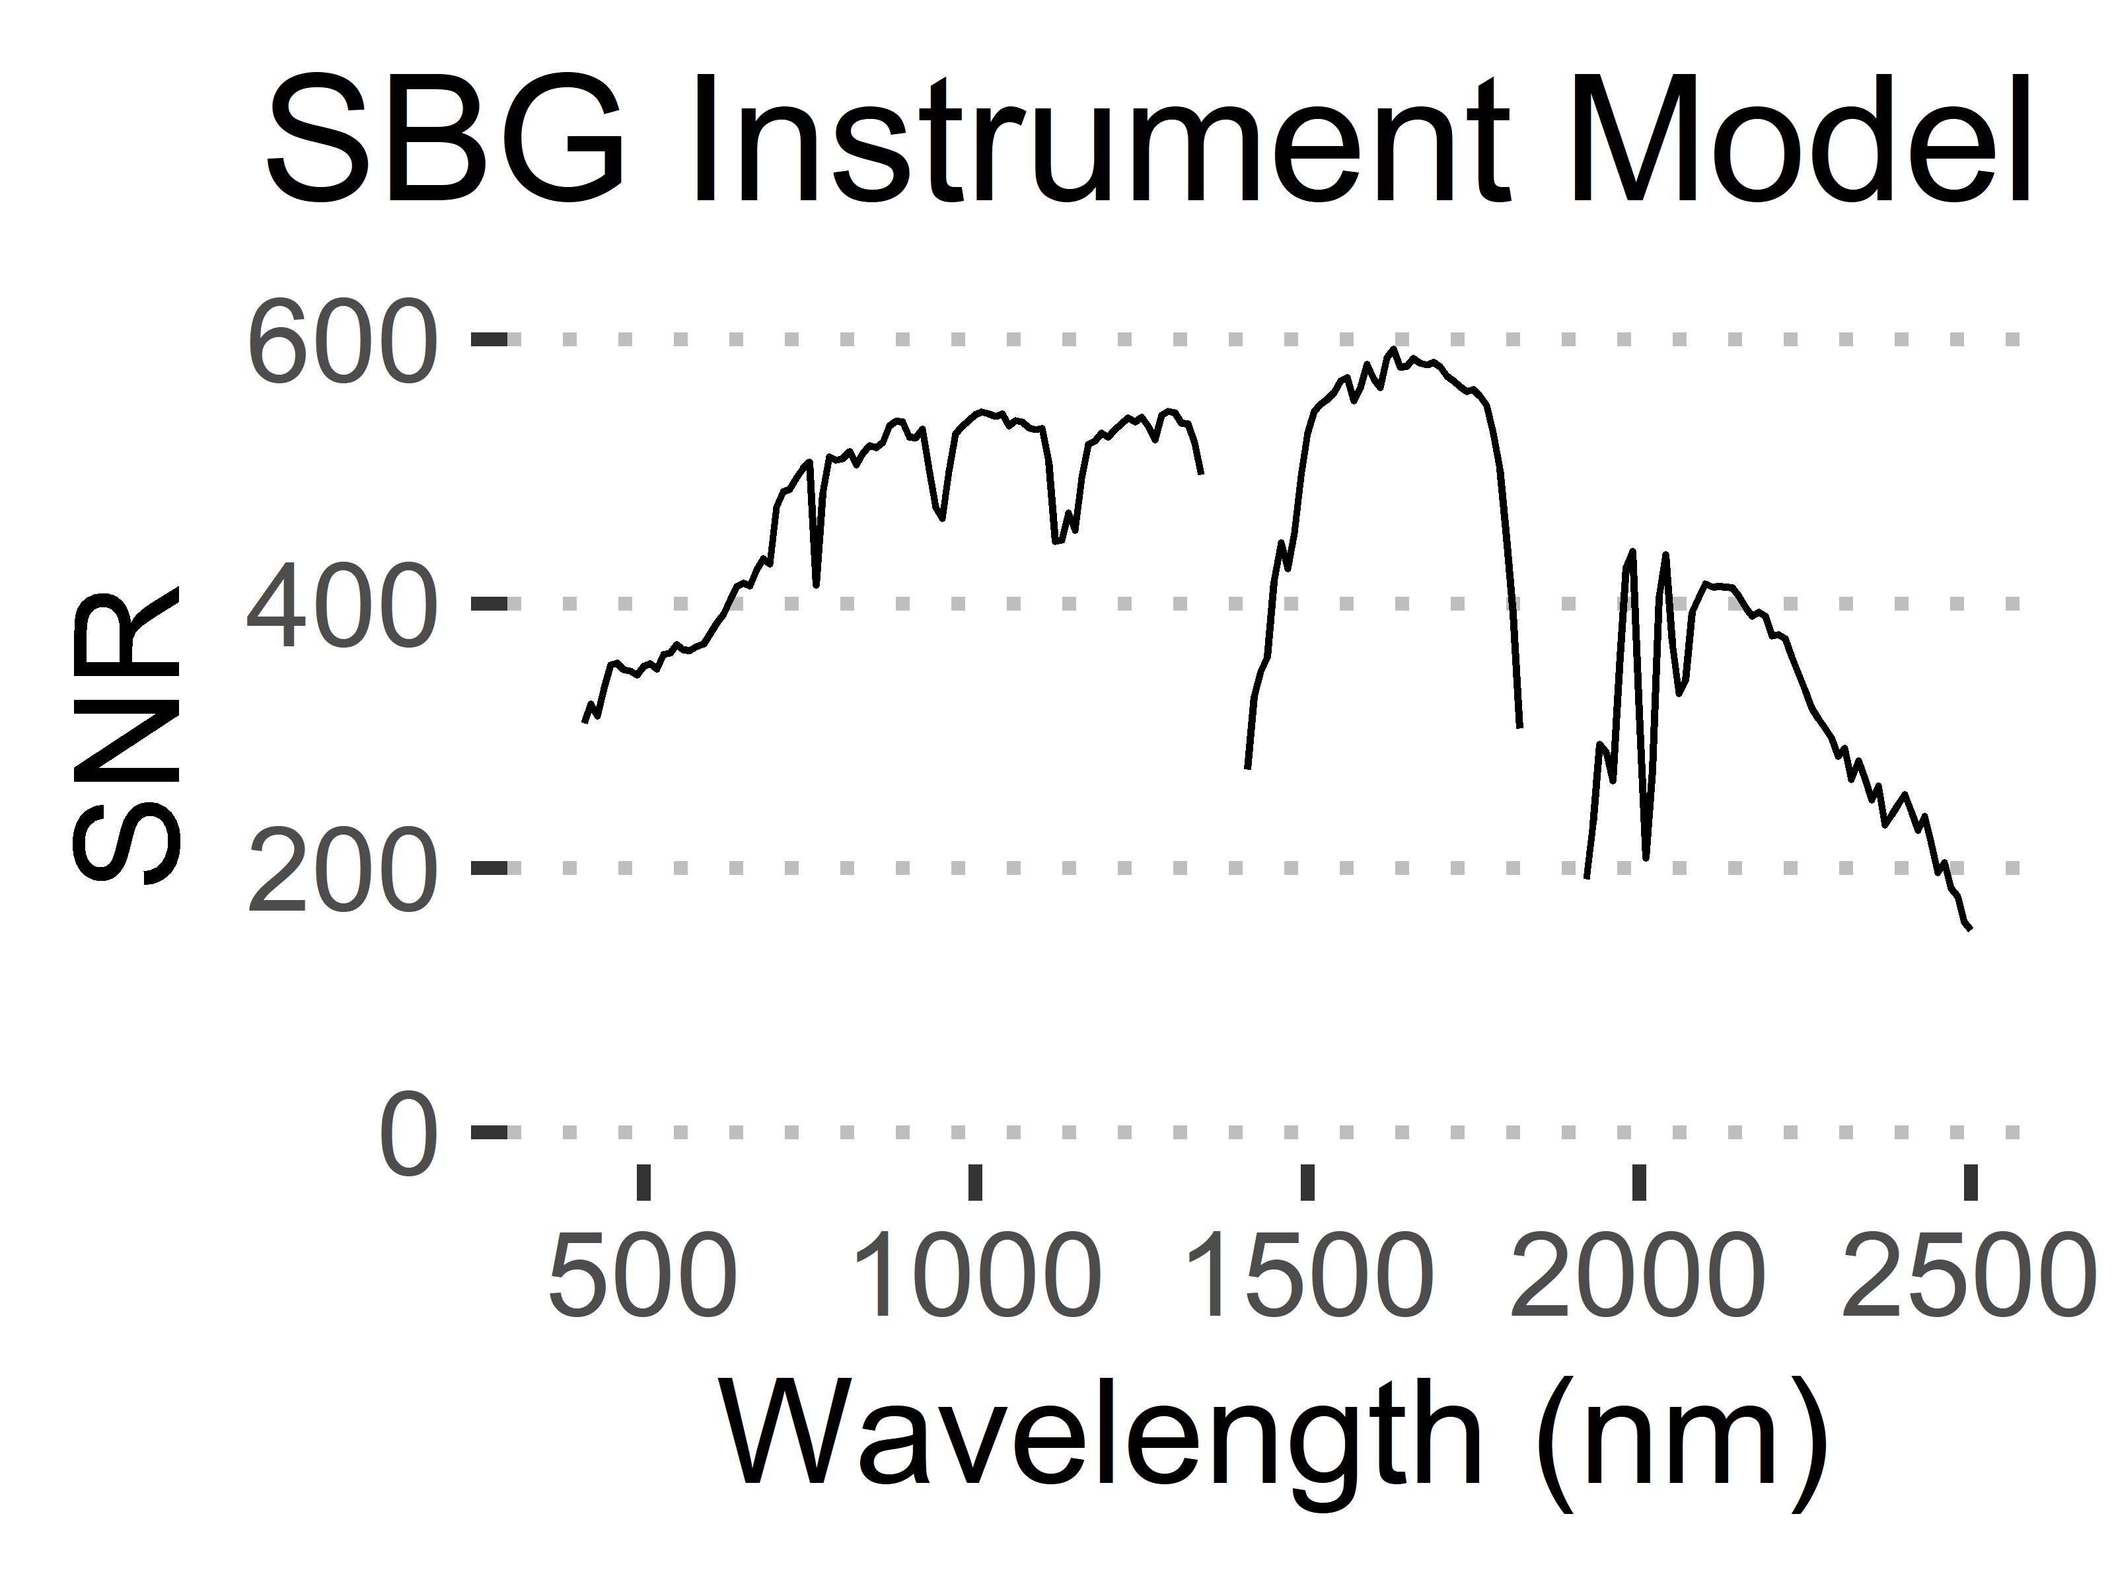
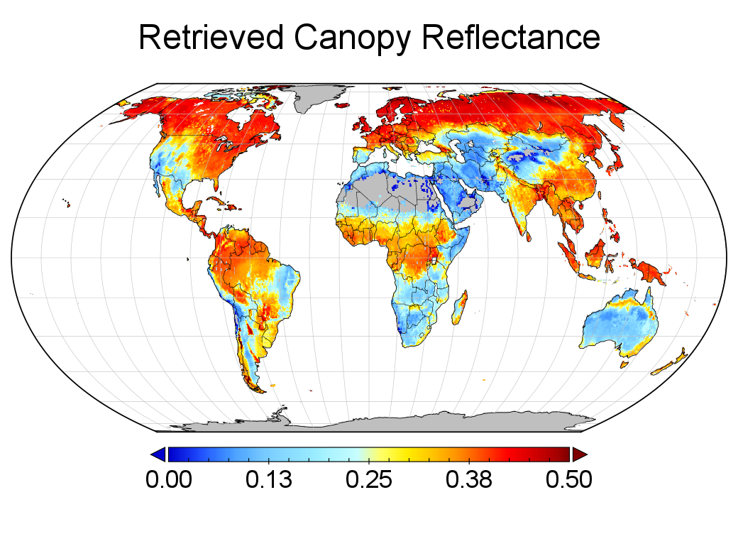
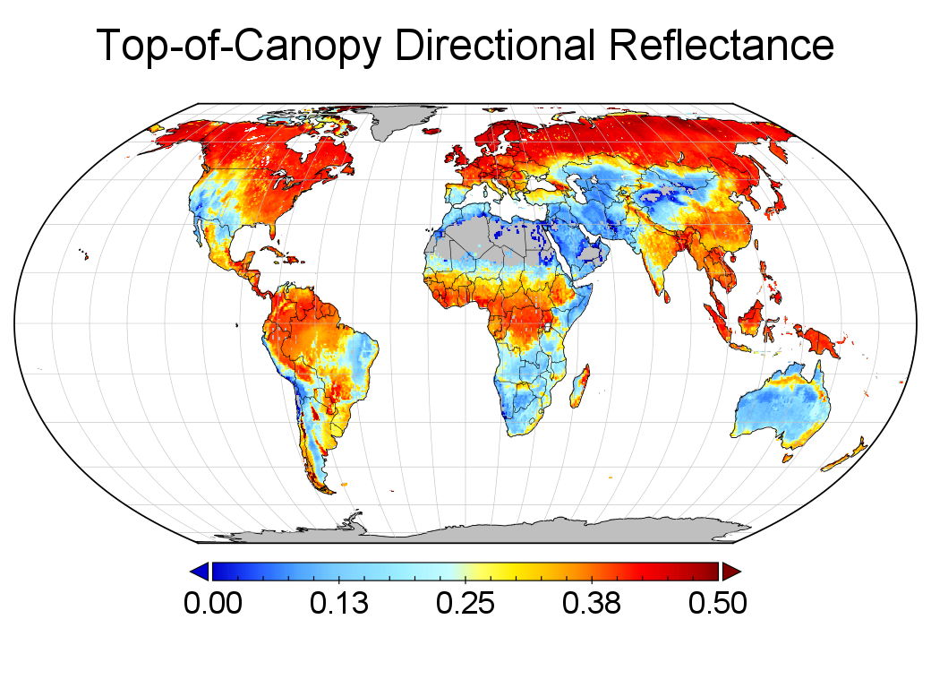
B)
Estimated at-sensor radiances from the forward model. Noise is introduced from the sensor and atmosphere. For spaceborne missions, this is the signal measured.
A)
Simulated (noiseless) top-of-canopy reflectance spectra from the DGVM represents nature’s forward function, independent from measurement error. These are theoretically impossible to measure thus are simulated.
C)
H₂O
AOT
H₂O
H₂O
AOT
H₂O
AOT
H₂O
AOT
H₂O
Noisy retrieved reflectance from the ISOFIT RTM inversion, translated from at-sensor radiances (panel B). These are the best-estimate of nature’s spectral properties.

