Slide 1
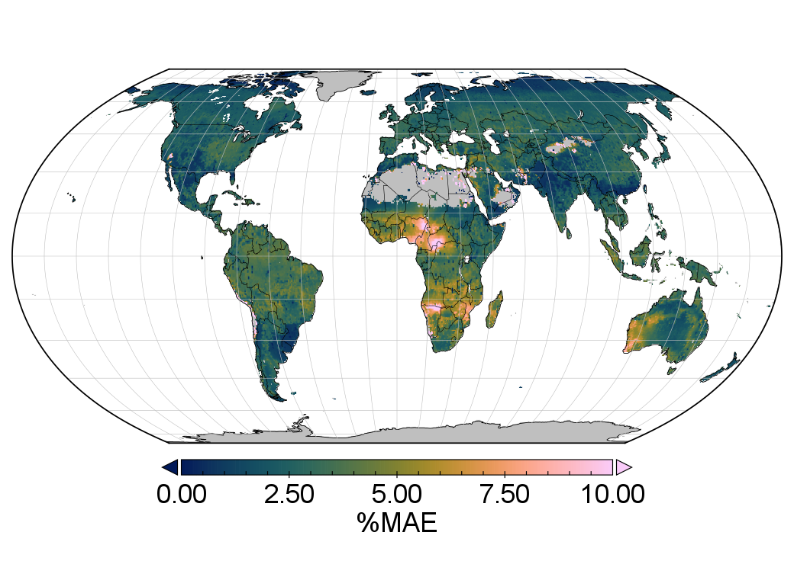
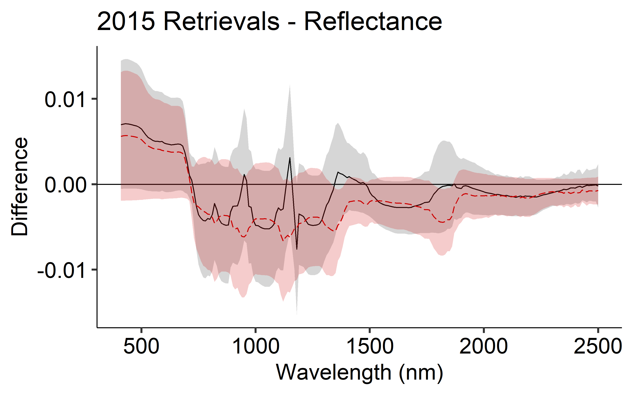
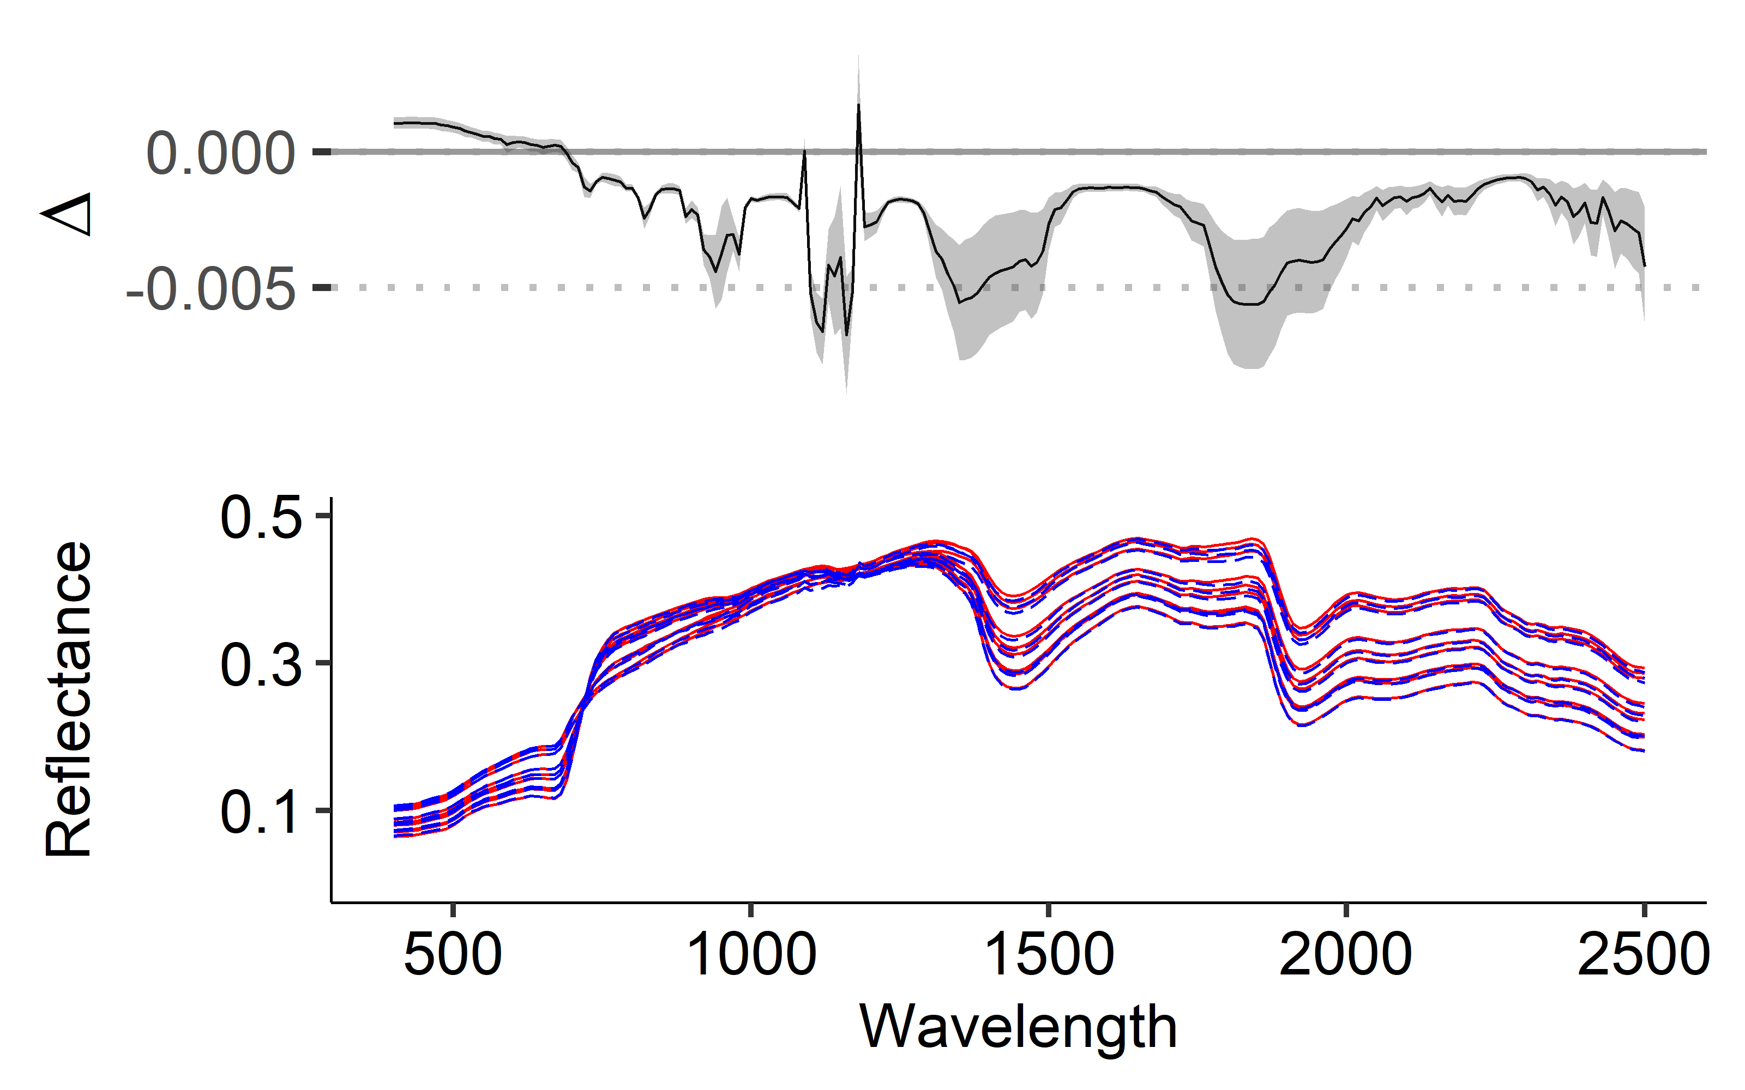
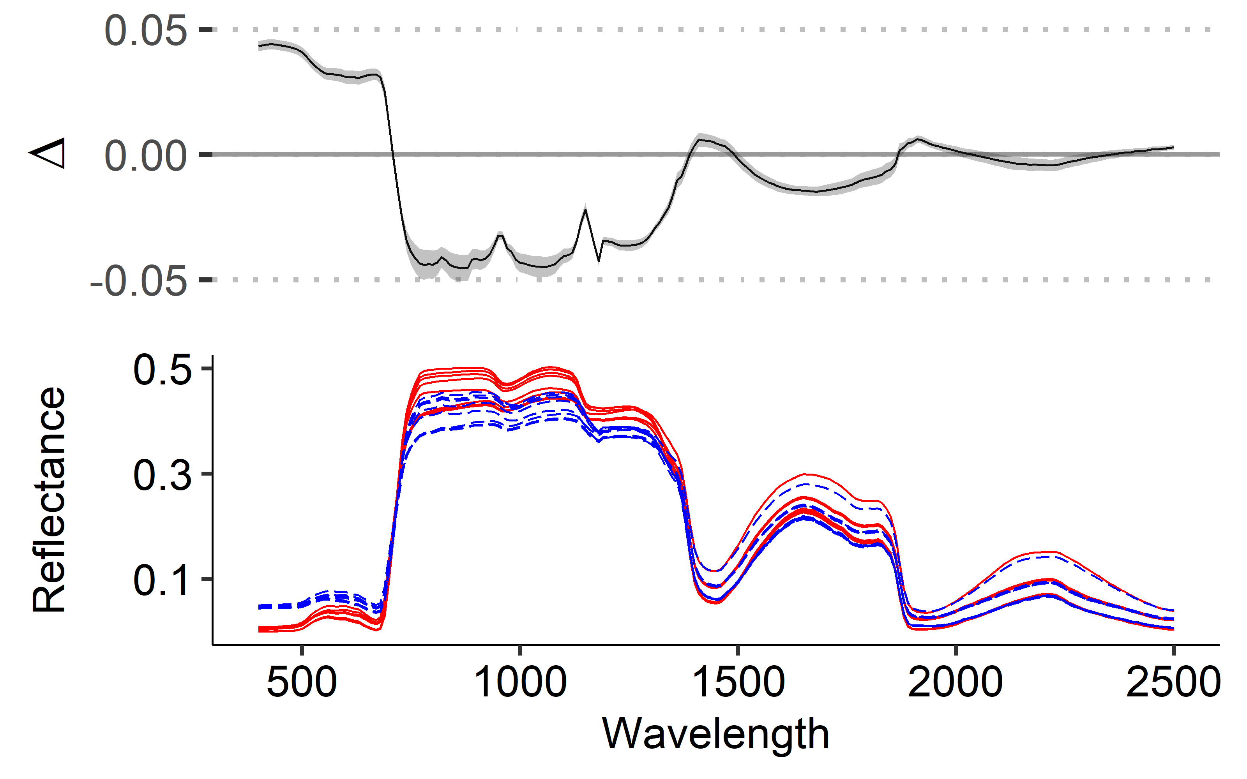
A)
Average Percent Error
(Across Wavelength)
B)
Average Difference
(Across Pixel)
Instrument bypass
D
C
C)
D)
Simulated Retrieved
Simulated Retrieved

