Slide 1
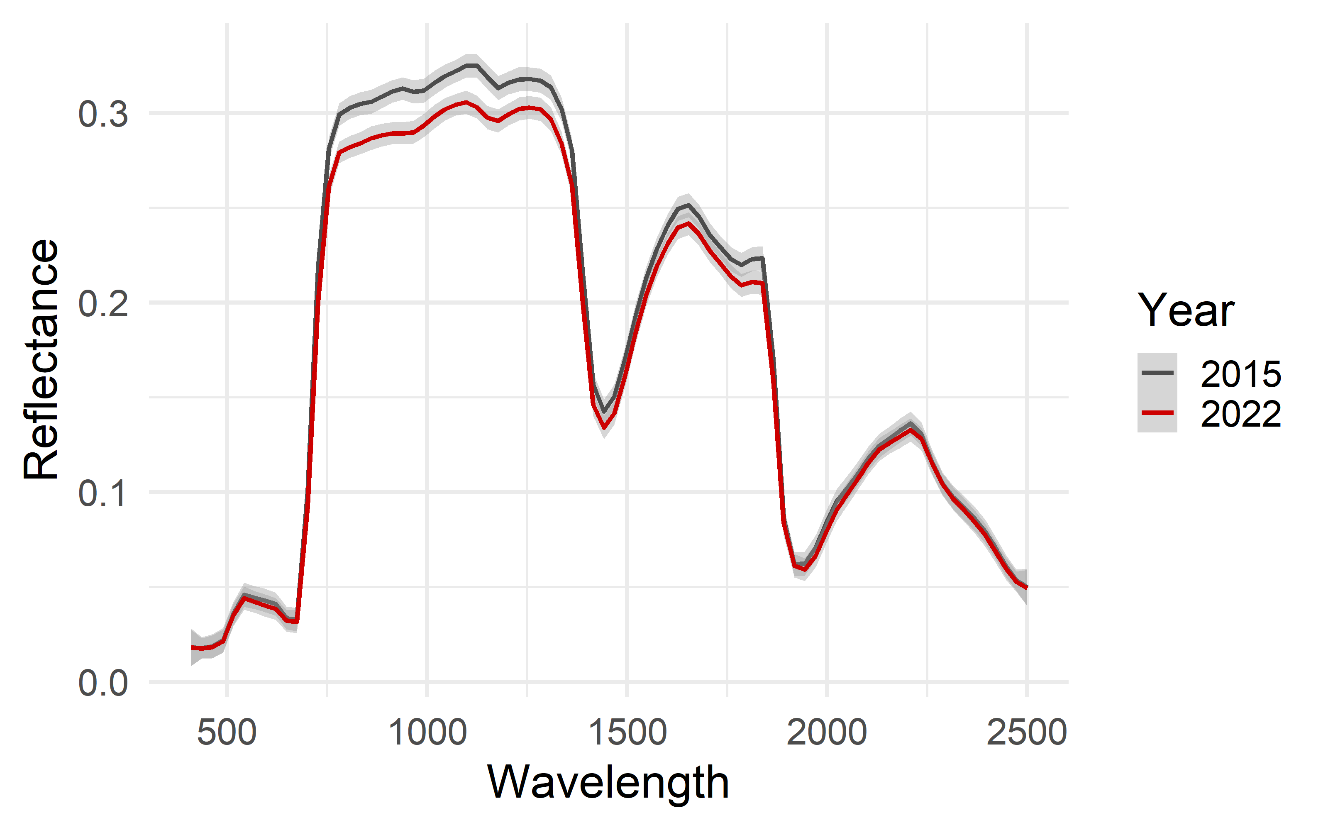
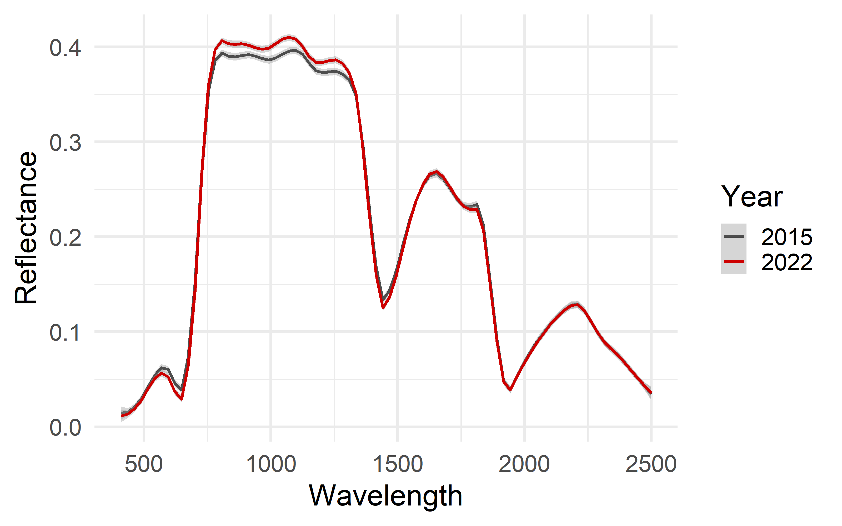
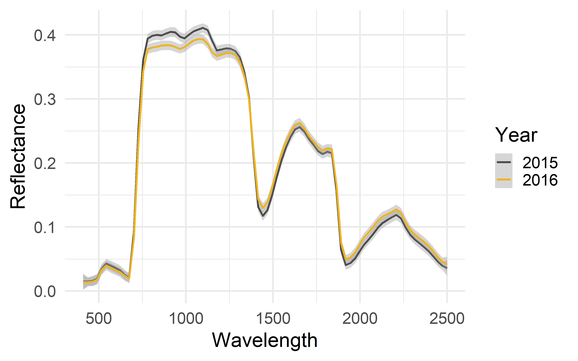
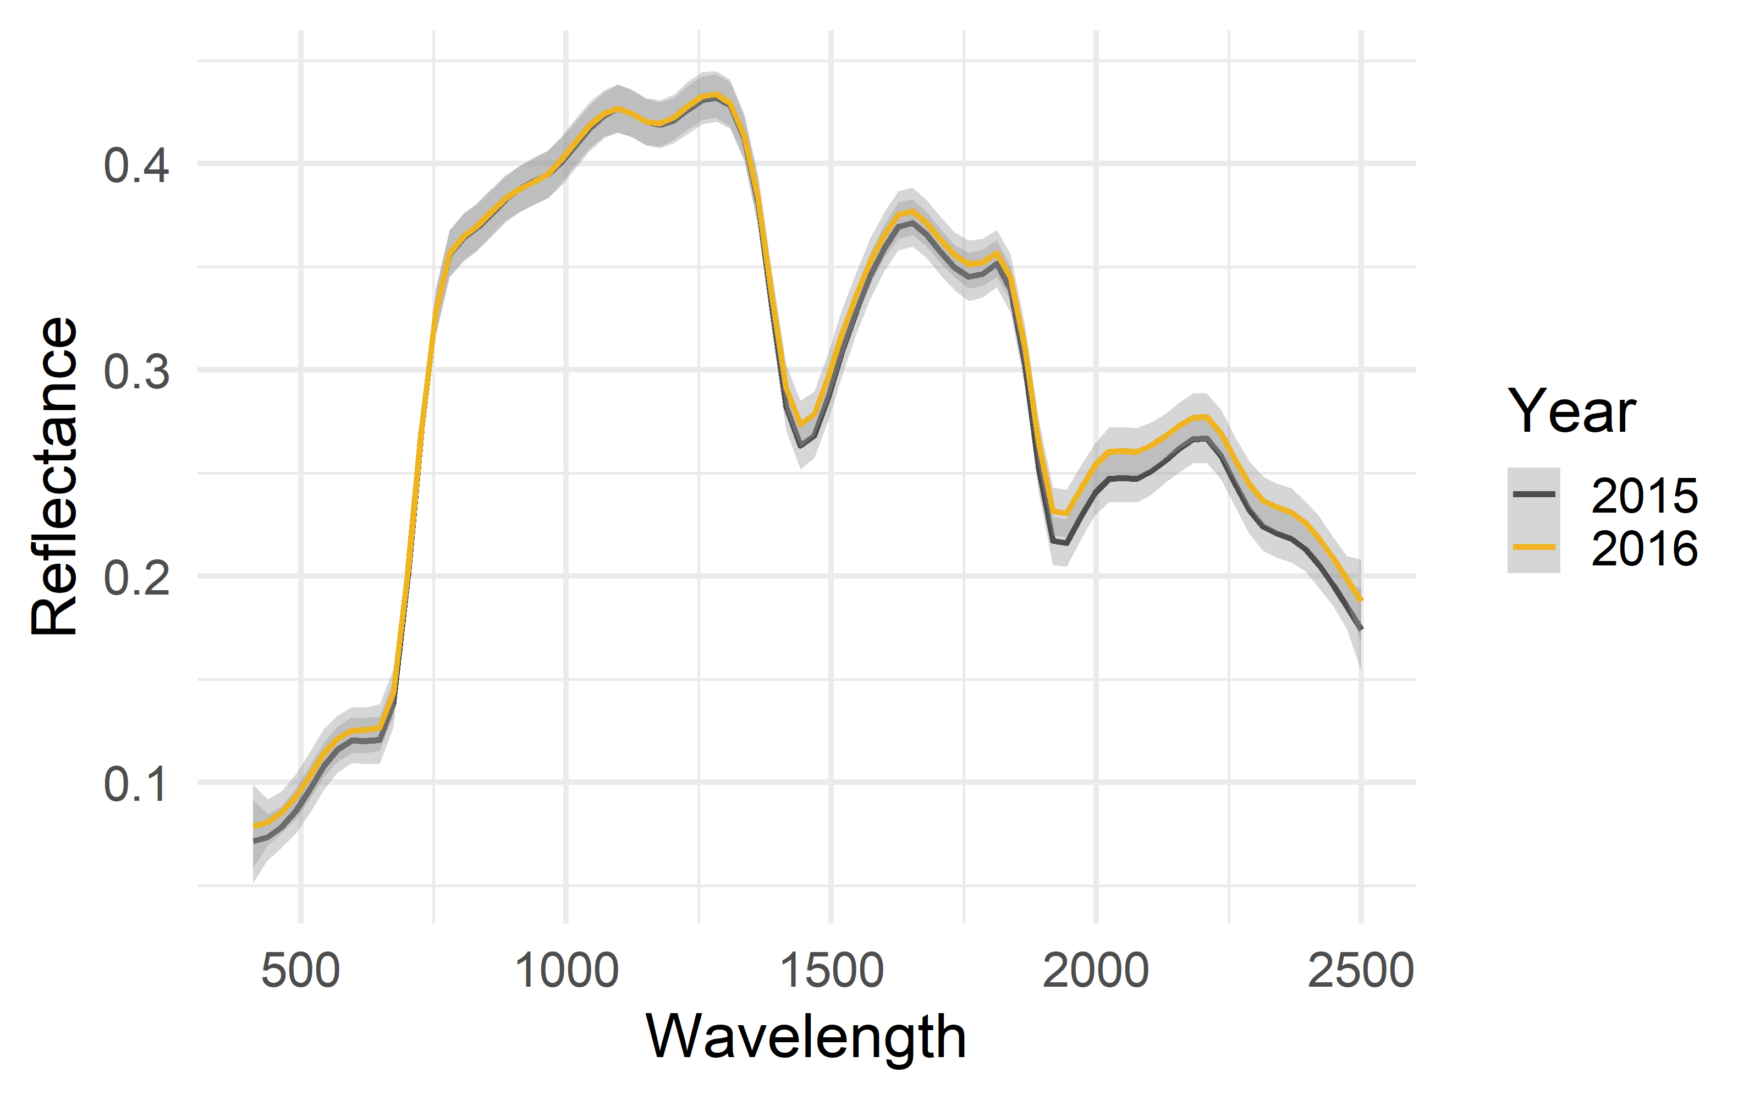
A) Region 1 – Northwestern North America
B) Region 2 – Northeastern Europe
C) Region 3 – Western Europe
D) Region 4 – New Zealand

