Slide 1
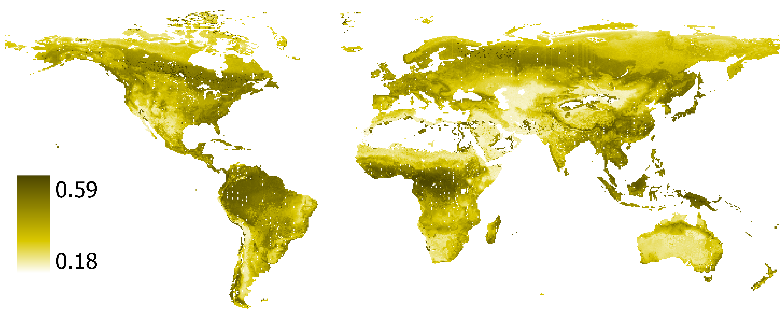
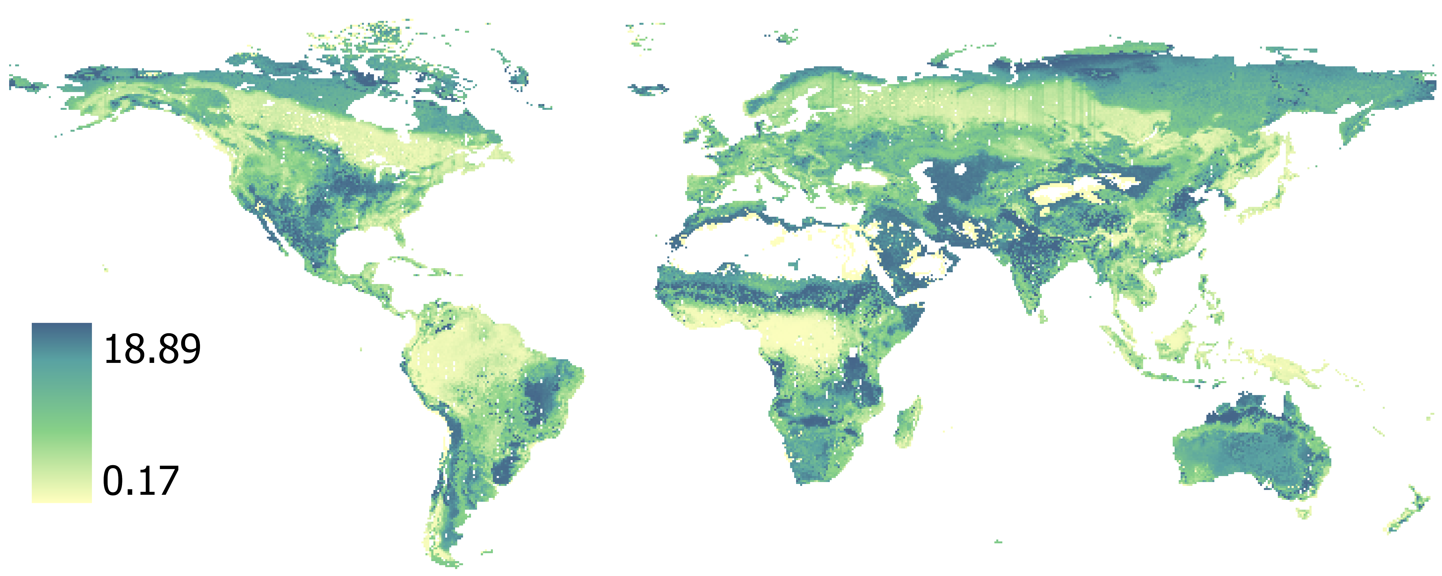
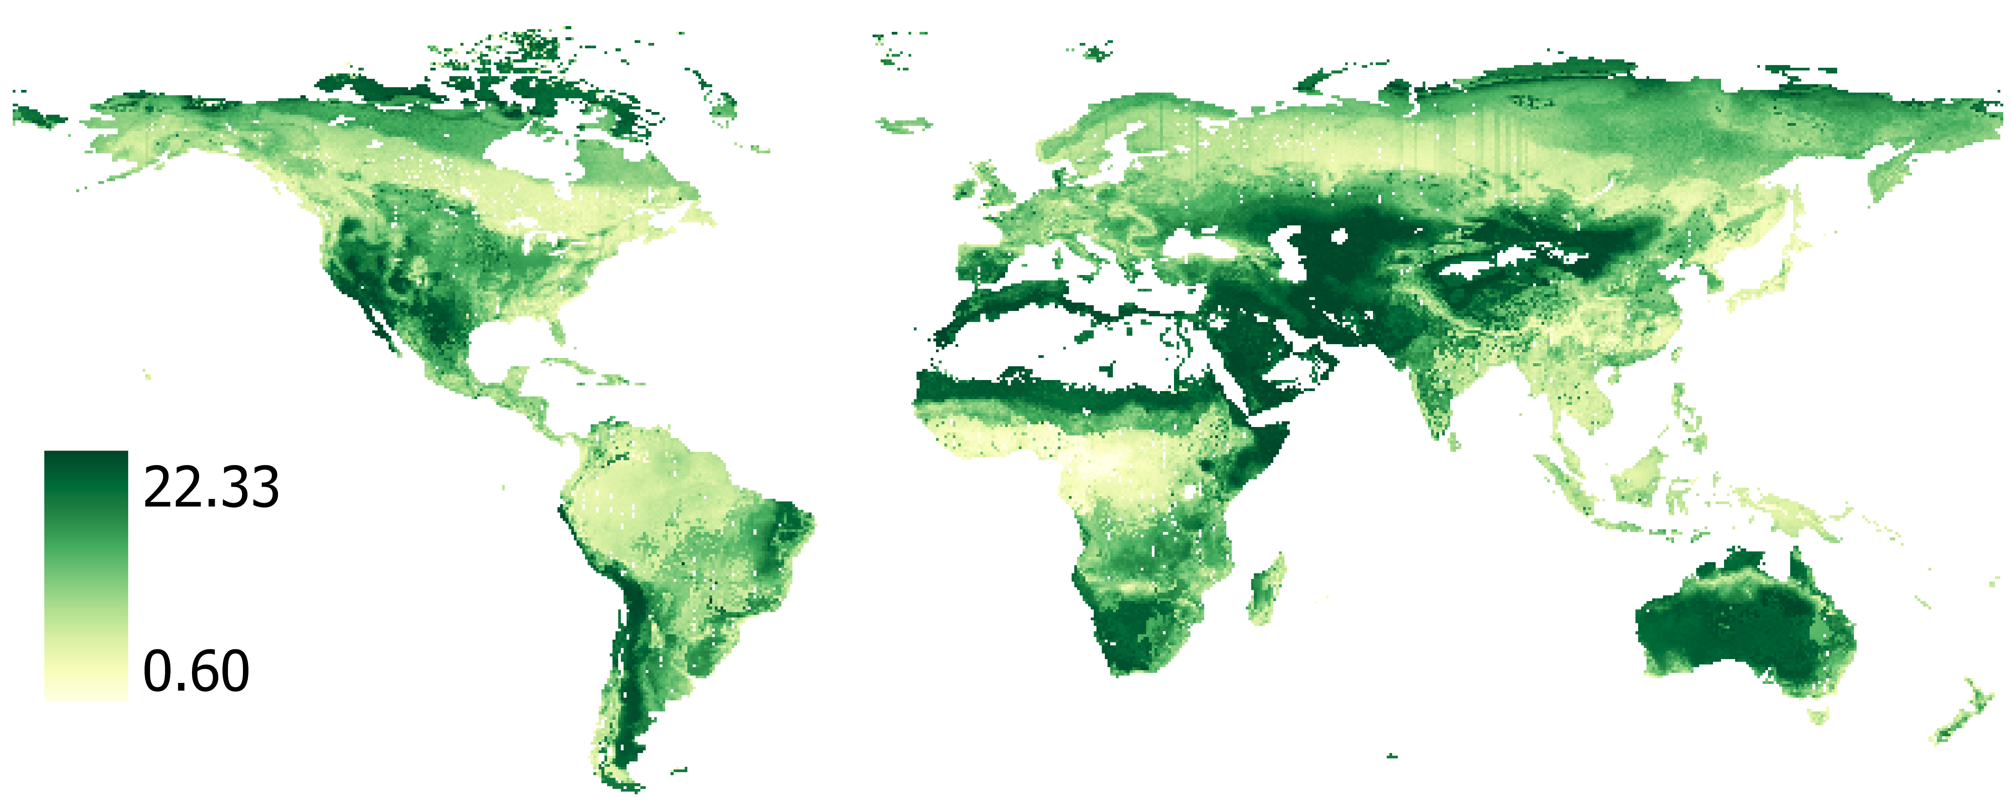
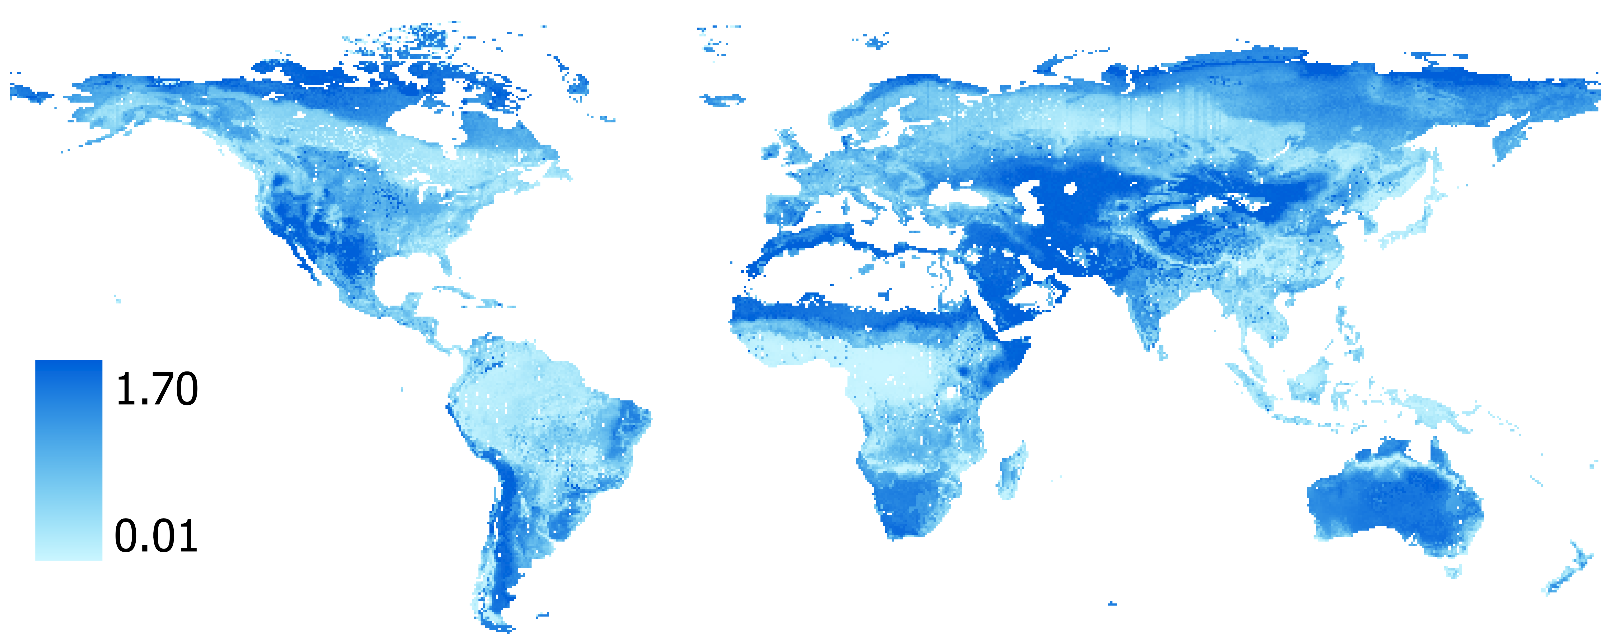
A) Leaf Dry Matter Content
B) Specific Leaf Area (SLA)
(g/g)
(mm²/mg)
C) Leaf N Content
D) Leaf P Content
(mg/g)
(mg/g)

