Slide 1
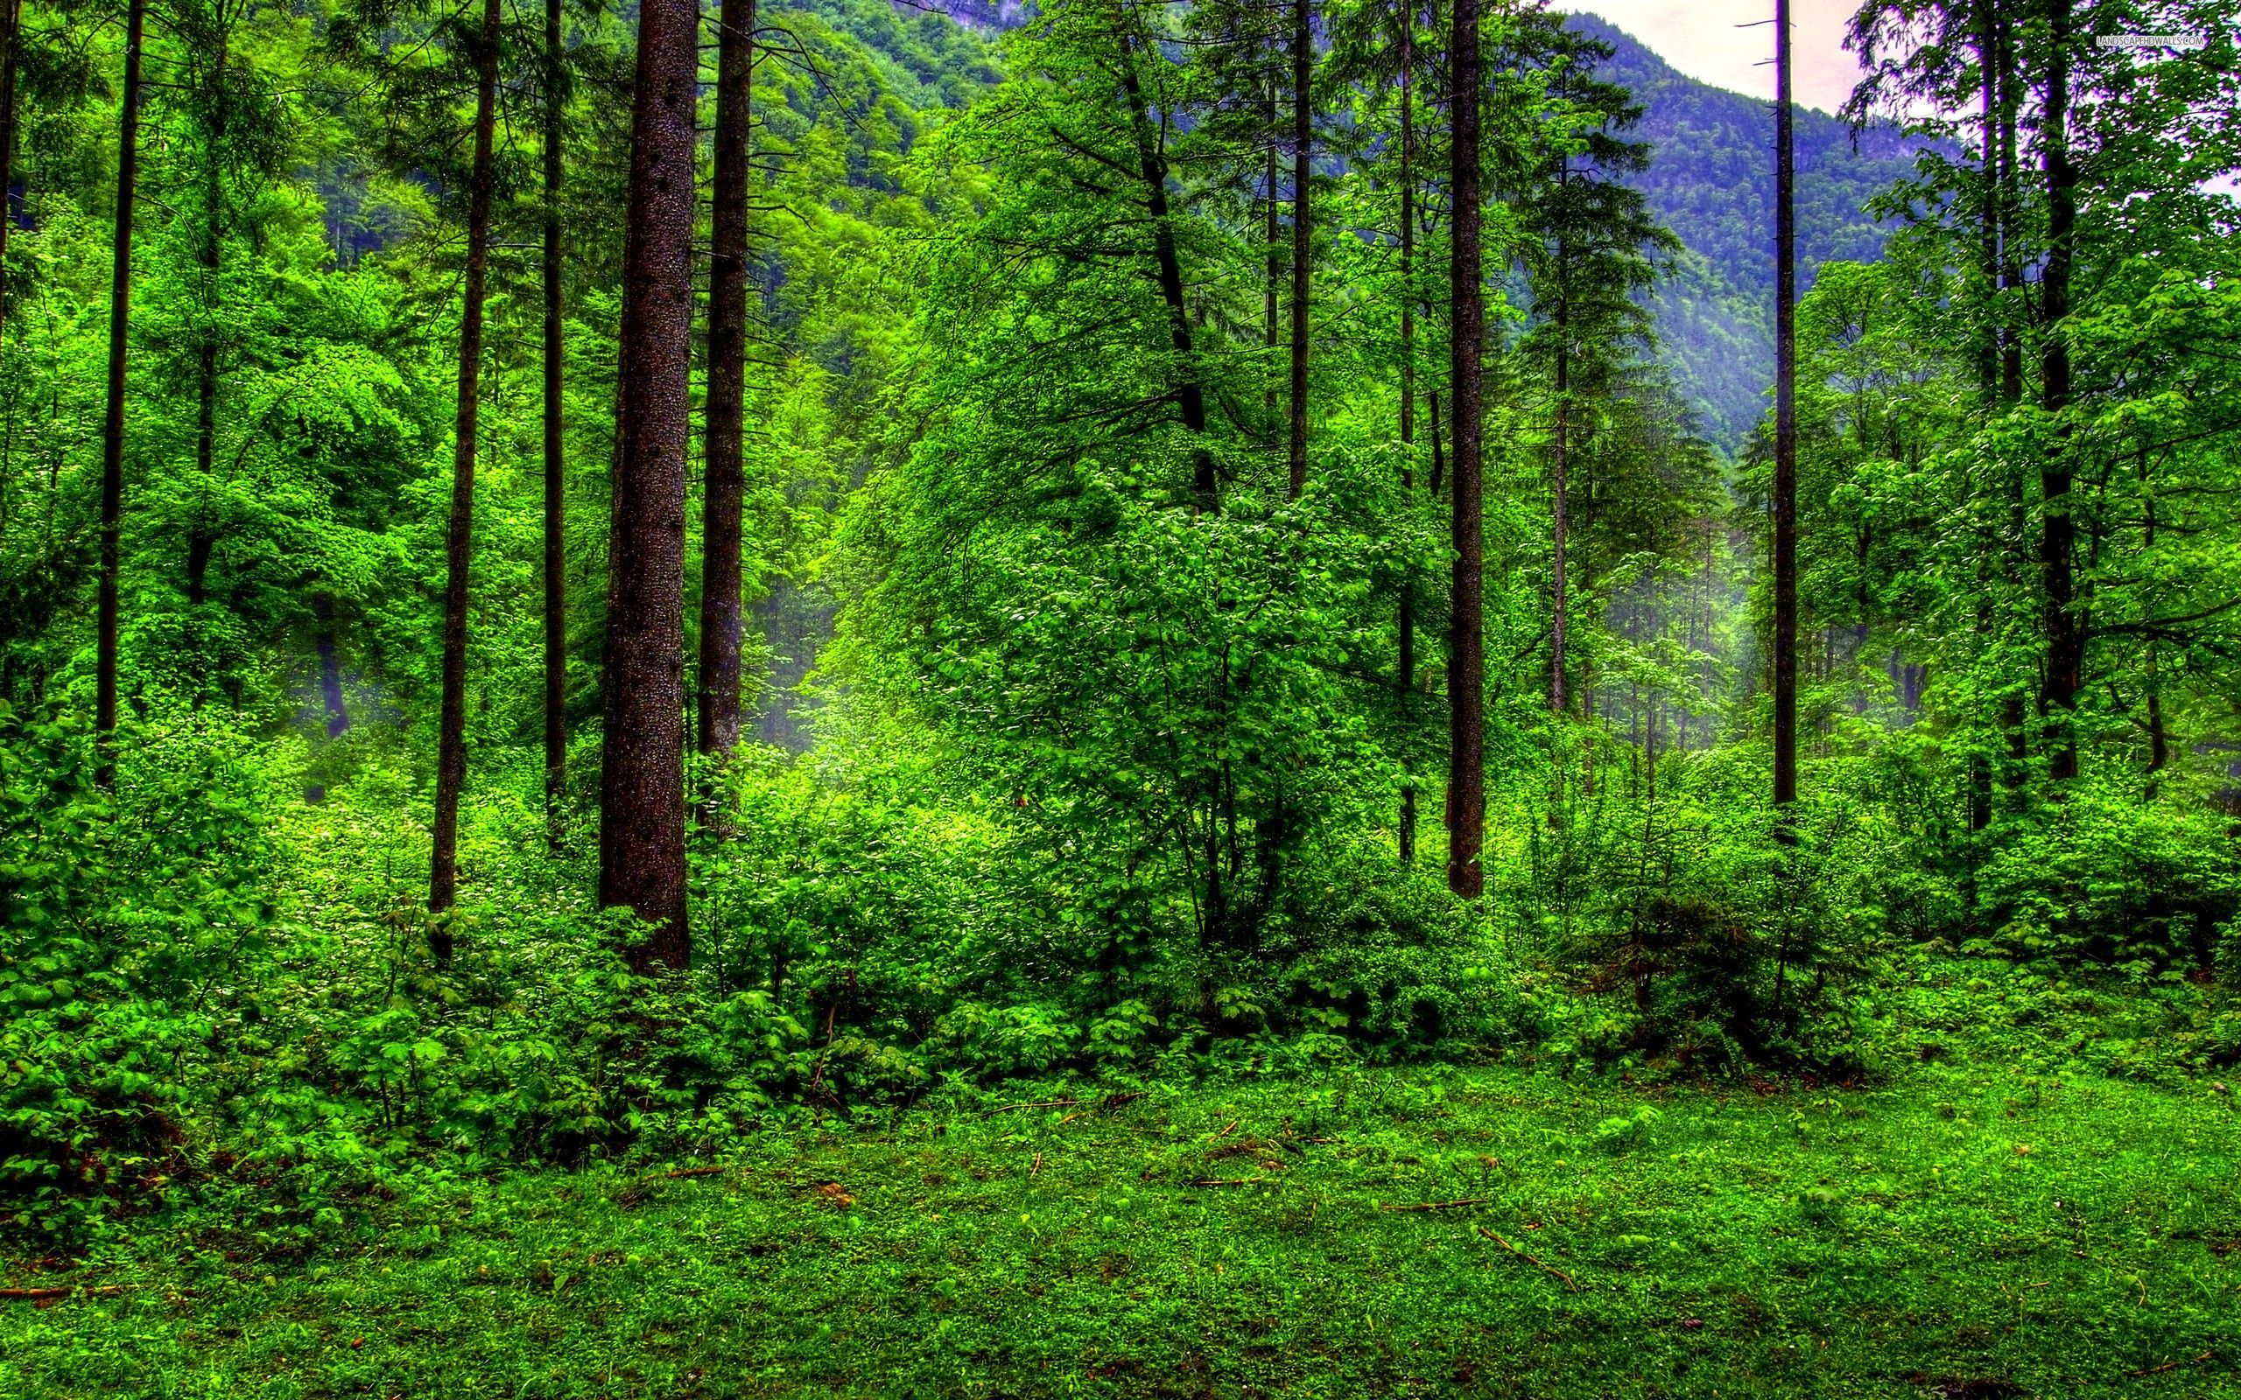
FOREST APP
By Green_Coders

Slide 2
Problem Context
App to help user raise forest issues directly to concerned authorities.
Concerned Authority
Forest Department
User
Any person having atleast a mobile phone

Slide 3
Where to Use
In forest
When to Use
If any person notices
cutting trees
dirty/litter environment
poaching
fire
any other type of discrepancy
in the forest, he may use the app

Slide 4
Solution
Concept
An app for everyone to raise complaint to Forest Department.
App should be usable even when Internet connection is poor or not available.
App should be user friendly and affordable.

Slide 5
Solution
Design
App will first try to find internet connectivity. If it is not connected to the internet, app will display button to call the concerned authority, clicking on which he/she can give missed call to Forest Department.
Upon missed call, FD will either call back or auto-generated callback will be triggered.

Slide 6
Solution
Design
If it is connected, then app will open the website in the mobile’s browser.
Any one can raise a complaint by uploading a photo/video of the complaint(optional) and sending a message.

Slide 7
Solution
Design
After user submits complaint, he/she will be given a complaint ID which will be saved in his browser cookie.
User can check his complaint status, i.e. whether his/her problem is solved.

Slide 8
Solution
Design
Admin, i.e. FD people can check the list of complaints. They can update the status of every complaint according to how much the problem is solved.

Slide 9
Solution
Software Stack
Apache
PHP
MYSQL
Java
XML
Services and Libraries
Google Map API
Geolocation API
PHPMailer

Slide 10
Solution
Scope of Improvement
To make app available for all types of devices.
Whenever user gives missed call, he/she will get 50 MB data for accessing the app.

Slide 11
Questions

Slide 12
Thank you!!

