Slide 1

AWS Lambda
By Ryan Mwangi

Slide 2

Function
AWS Lambda is a cloud computing service that lets developers run code without managing servers.
It automatically manages the compute resources, making it the fastest way to turn an idea into a modern, production, serverless applications.

Slide 3
Overall Capacity
Lambda supports up to 10GB of memory
It allocates CPU allocates CPU power proportionally to the amount of memory provisioned
Can be elastic depending on quota requested, can either increase or decrease

Slide 4
Languages supported
The following are some languages that lambda supports: 1. Java 2. Python 3. Node.js 4. Ruby 5. Go 6. Power shell(Command Line)

Slide 5
Strengths
No need for managing servers: As it is a PAAS, all maintenance for servers is done by AWS
Automatic scaling: Automatically respond to code execution requests at any scale, from a dozen events per day to hundreds of thousands per second.
Pay-as-you-go: No need to pay upfront, save cost by paying only for the compute time you use
Provisioned concurrency: Makes functions available immediately, avoiding latency issues

Slide 6
Weaknesses
Unsupported languages: Some languages excluding to the aforementioned ones may not be supported, like C# and C++
Memory limits: There’s a maximum amount of RAM allocated to a lambda function
Execution time: There are time limits on Lambda functioj invocation
Can experience vendor lock in: when a customer is unable to switch to a different product or service from a vendor without significant costs.

Slide 7
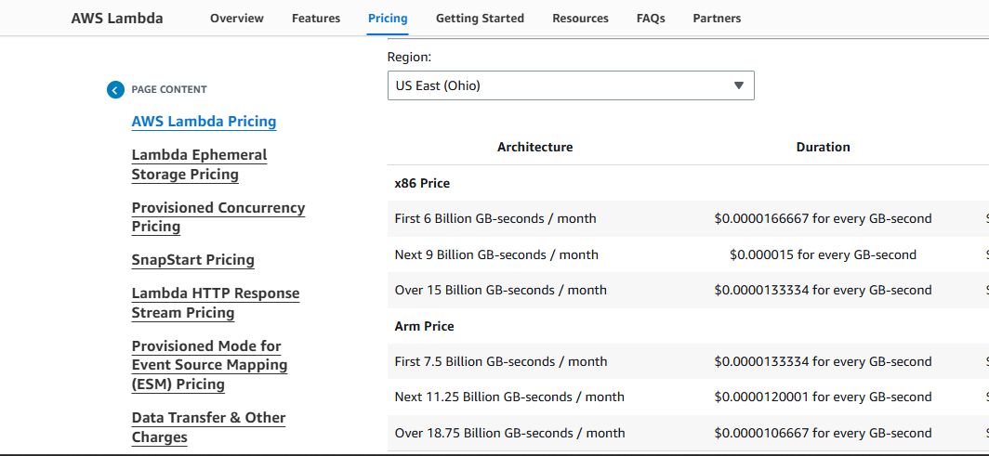
Pricing models

Slide 8
Comparison with Microsoft Azure
Lambda is offered by AWS while Azure is offered by Microsoft
Azure supports languages mainly supported/used in the Microsoft development space like C#, Javascript and typescript
Azure has a standard memory allocation which is 1.5GB (with premium option up to 14GB) while in Lambda, you’d have to first specify memory allocation when creating a function (up to 3GB max)

Slide 9
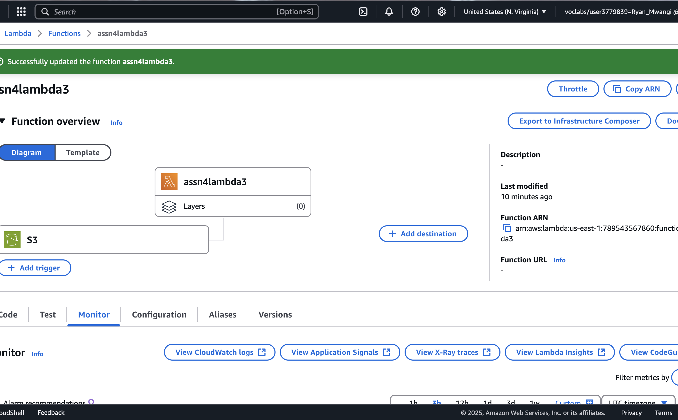
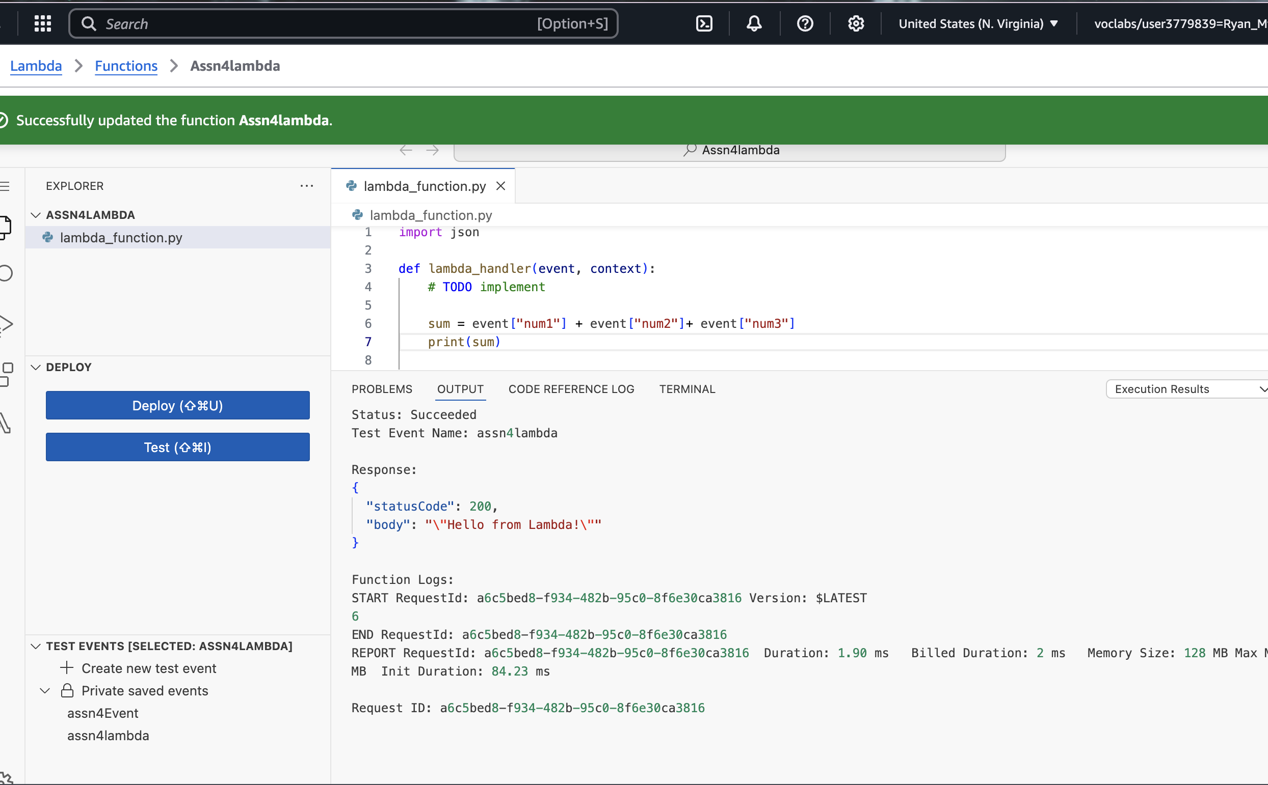
Pictures

