Slide 1
Diffusion approximation to render SSS materials

Slide 2
Radiative transfer parametrization
Absorption coefficient σ_{a} Measure of the rate of the ray (photon) of losing its energy
Scattering coefficient: σ_{s} Probability of the scattering (changing direction) event to happen
Sometimes extinction coefficient is used instead of absorption: σ_{t} where σ_{t} = σ_{s}+ σ_{a}
Phase function: p(θ) Describes the direction in which scattering is likely to happen
In general, all σ parameters and p are wavelength dependent. But we are not talking about it for now.

Slide 3
Radiative transfer parametrization
Measurements data
Measurement data for σ_{a}, σ_{s} and phase function for some materials are available from different sources (Jensen’01, Narasimhan’06, Gkioulekas’13)
Can be used in brute force MC integration
But artistic friendly parametrization should not contain words like phase function and extinction. That is why another set of parameters is derived.
Last year Disney presented great result of extending their famous Disney BRDF model with subsurface scattering and simple SSS parametrization

Slide 4
Single scattering
Accounts only the first scattering event inside the media
Dominant in optically thin substances with large mean free path length (i.e. small scattering coefficient )
Forward scattering

Slide 5
Single scattering
Accounts only the first scattering event inside the media
Dominant in optically thin substances with large mean free path length (i.e. small scattering coefficient )
Backward scattering

Slide 6
Multiple scattering
Simulates many scattering events
Happens when albedo is high (low absorption) and scattering coefficient is high (low distance travelled between scattering events)

Slide 7
Separation of Single and Multi scattering
Single scattering is relatively cheap to integrate using Monte Carlo
But it is too expensive to simulate all scattering events in multiple scattering scenario directly
The Diffusion Approximation was purposed for multi scattering simulation

Slide 8
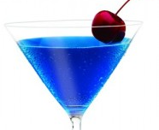
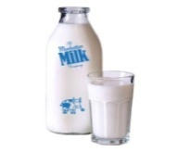
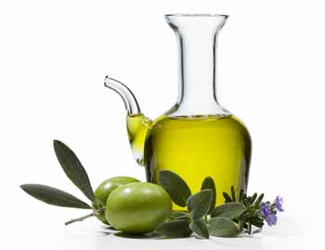
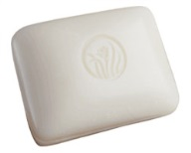
Diffusion Approximation
The popular method of approximation of the brute force Monte Carlo simulation of low translucent materials
Introduced as applicable method for computer graphics by Jensen in 2001. But originally was discussed even since 70’s
Was improved in 2011 and 2013 by d’Eon and Habel
Diffusion approximation works really fast and fine. But as most approximations has it’s limitations: DA only works well in high-albedo media


thin
thick


non-dilutable
solids

Slide 9
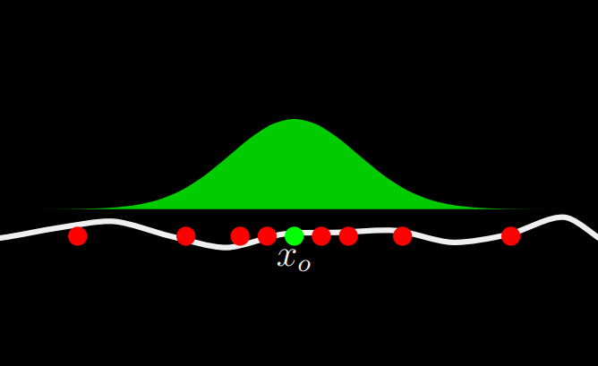
BSSRDF
B+ Scattering-Surface +RDF
Requires integration not only over incident direction but also over the area of the object
Two pass point cache methods are discussed a lot
Recently couple of other more robust methods were purposed without using point clouds
Original Jensen’s approach is to assume that the surface is flat at each point of integration

Slide 10
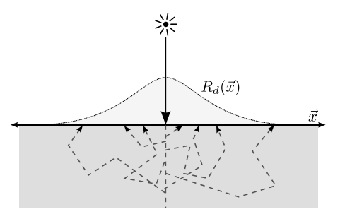
Diffusion profile
The form of this function can acquired by direct measurement or MC integration and then approximated
The most popular cubic and sum of Gaussians approximations fit the measured data for certain configurations really well

Slide 11
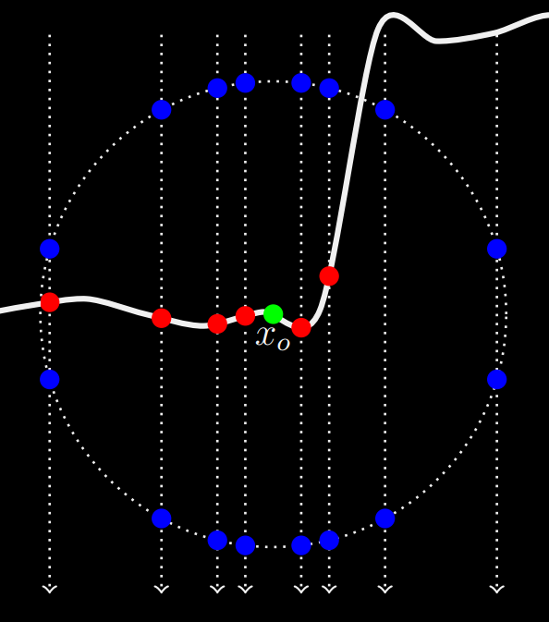
BSSRDF importance sampling
I’ve decided to prototype one of the modern approaches of BSSRDF surface integration with different diffusion profiles
I would like to present fancy pictures and more interesting details at the next research review

Slide 12
Used images from the following sources:
Benedikt Bitterli 2013, BSSRDF Explorer: A rendering framework for the BSSRDF
King, Kulla, Conty, Fajardo 2013, BSSRDF Importance Sampling
Gkioulekas et al. 2013, Inverse Volume Rendering with Material Dictionaries

