Slide 1

Programming 6G4Z0020
Web 1B : Code-a-long
Variables
Notes:
Dr David McLean – lecturer and researcher (google scholar) and programming for a long time – professionally and as an academic

Slide 2
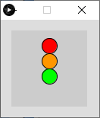
Exercise : traffic lights
Draw this ?
Design?
Notes:
Walk through design

Slide 3
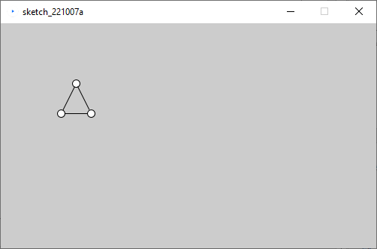
Exercise
Write a program to draw this shape, using x,y variables
Design?
First question : what should x,y represent?
Notes:
Do together – walk through design

Slide 4
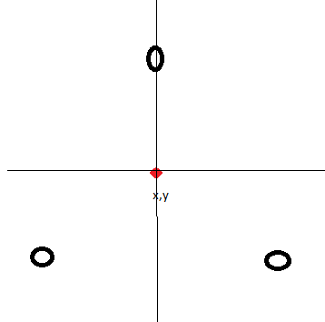
Design Help

