Slide 1

Programming
Webinar2A: Code a long,
Nested Loops
Learning Objectives
Variables
Sequence of commands
syntax
Repetition
Problem solving

Slide 2
Examples
e.g.1
for(int i=0; i<10; i++)
{
println(i);
}
e.g. 2
for(int i=100; i>0; i=i-10)
{
println(i);
}
e.g. 3
int x = 10;
size(300,100);
fill(0);
for(int i=100; i>0; i=i-10)
{
text(""+i,x,20);
x=x+25;
}

Slide 3
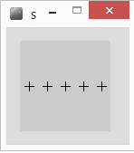
Draw 5 crosses
float x=10;
float y=50;
line(x-5,y,x+5,y);
line(x,y-5,x,y+5);
Draws a cross
centre at x,y
float x=10;
float y=50;
for(int i=0;i<5;i++)
{
line(x-5,y,x+5,y); // Draw cross
line(x,y-5,x,y+5);
x=x+20; //move right a bit
}
PseudoCode - English
For 5 repetitions
{
Draw a cross
Move right a bit
}

Slide 4
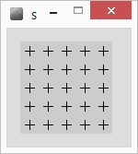
Nested For Loop
You can put one loop inside another
Here I want to draw 5 lines of crosses
Increasing y after each line
A for loop
Each line of crosses consists of 5 crosses
Another for loop
For 5 repetitions
{
For 5 repetitions
{
Draw a cross
Move right a bit
}
Move down a bit
}
PseudoCode - English
For 5 repetitions
{
Draw a line of crosses
Move down a bit
}

Slide 5
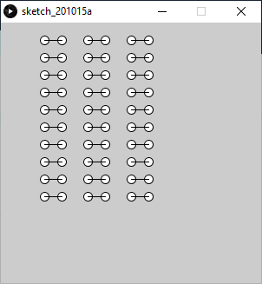
How?
Design:

Slide 6
Tidy up - Refactor
Refactor – tidy up the code
Use x and y as counters within for loops
for (int y=10; y<100; y=y+20)
{
for(int x=10; x<100; x=x+20)
{
line(x-5, y, x+5, y); //draw cross
line(x,y-5,x,y+5);
}
}
same result, fewer variables,
easier to understand the code?

Slide 7
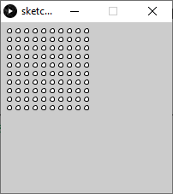
Exercise
How do we code this pattern?
Design steps

Slide 8
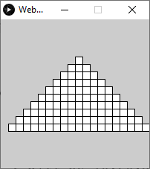
Exercise
How do we code this pattern?
Design steps

