Slide 1

Programming
Webinar code a long :
Loops with Conditionals
https://codingbat.com/java/

Slide 2
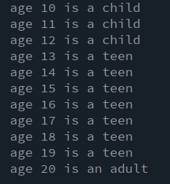
Child, Teen, Adult
For each age 10 to 20 display
Child for ages less than 13
Teen for ages 13-19
Adult for ages 20 plus

Slide 3
Debug - fix the code
float x=35,y=30;
float diameter=60;
size(320,100);
for{ i<5; i++};
fill(0,0,255);
ellipse(x,y, diameter, diameter);
fill(255,255,255)
ellipse(x,y, diameter*2/3);
fill(255,0,0);
ellipse(x,y, diameter/3, diameter/3);
x=x+60;

Slide 4
Fizz-Buzz : conditional in loop
"Fizz-Buzz test" is an interview question to test basic coding skills.
Count through a range of numbers, if number divisible by 3 we output the word “Fizz”, if divisible by 5 we output “Buzz”, if divisible by 3 AND 5 we output FIZZBUZZ, otherwise the number itself
Design?

