Slide 1

Code-a-long : Top Down Design
Writing better structured programs
Problem solving – problem decomposition
Functions : return a value
Notes:
How to think and solve general problems, not just programming

Slide 2
Modular Code
Last Few Weeks
sequence & variables
loops,
Boolean expressions,
if statements
Learning Objectives
Top Down Design – Stepwise refinement
writing procedures
void setup()

Slide 3
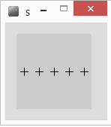
Revision
float x=10;
float y=50;
for(int i=0;i<5;i++)
{
line(x-5,y,x+5,y);
line(x,y-5,x,y+5);
x=x+20;
}
What does it do?
PseudoCode - English
For 5 repetitions
{
Draw a cross
Move right a bit
}
New
Command?

Slide 4
Code Block becomes Procedure
int x=10;
int y=50;
void cross()
{
line(x-5,y,x+5,y);
line(x,y-5,x,y+5);
}
void setup()
{
for(int i=0;i<5;i++)
{
cross();
x=x+20;
}
}
Declare & assign
variables outside
int x=10;
int y=50;
void setup()
{
for(int i=0;i<5;i++)
{
//draw cross
line(x-5,y,x+5,y);
line(x,y-5,x,y+5);
x=x+20;
}
}
Program starts here
Control passes
to procedure
When finished
Goes back to
where it was called

Slide 5
Top Down Design
Also known as Stepwise Refinement, Problem Decomposition
Breaking down a problem into subproblems – recursively
Refine(problem)
If problem can be stated (unambiguously) as code
done – keep statement
Else
{
take problem and break into set of subproblems
For each subproblem
Refine(subproblem)
}
Define program in terms of headings
Take each

Slide 6
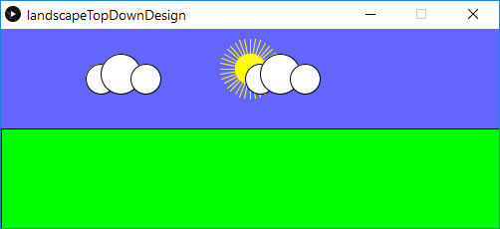
Exercise: Landscape, 3 levels
Draw Land
Fill(green)
Draw rectangle
Draw Sky
Blue background
Sun
Cloud(position 1)
Cloud(position 2)
Sun
Fill (yellow), stroke
Rays – for loop
circle
Landscape
Draw Sky
Draw Land
Cloud(x, y)
Fill(white)
circle(x,y,medium)
circle(x+?,y-?,large)
circle(x+?,y-?,small)
Notes:
Have a go

Slide 7
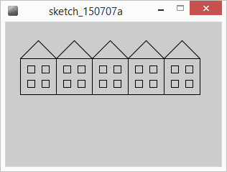
Exercise : Draw houses
Use the ideas and procedures to draw a terrace of houses
Top down design?
Pseudocode
Triangle, square

Slide 8
Summary
Problem decomposition
Top down design
Stepwise refinement
Help to design code solutions
Functions
Using, writing
Color type

