Slide 1
CICD Project for WEB Dev
Andrii Bondar
EPAM DEVOPS EXT KHAI Winter 2019-2020

Slide 2
For whom?
This project is intended for frontend developers, in particular for template developers for CMS (Content Management System) Prestashop.
This project allows you to automatically install СMS on the server, upload the template that is currently being developed.
This project allows you to test this template, show it to your customer, deploy to prod server.

Slide 3





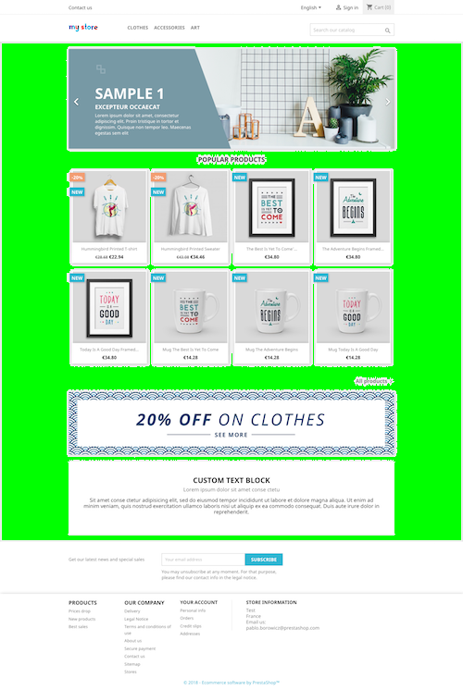

csslint
php -l
deploy
Developer
deploy
github-webhook
git push master

Slide 4
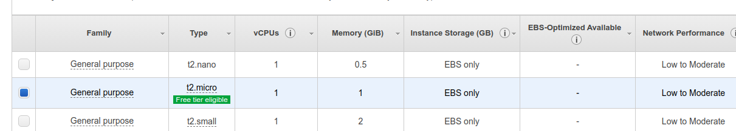
What we need?
EC2 instance for LAMP (Apache, MySQL, PHP and another requirements will be installed automatically)
EC2 instance for Docker (Docker will be installed automatically)
EC2 instance for Jenkins with credentials to manage 2 previous instances

Slide 5
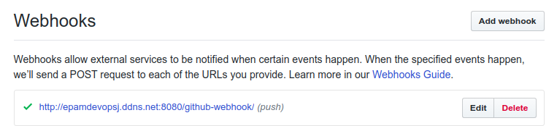
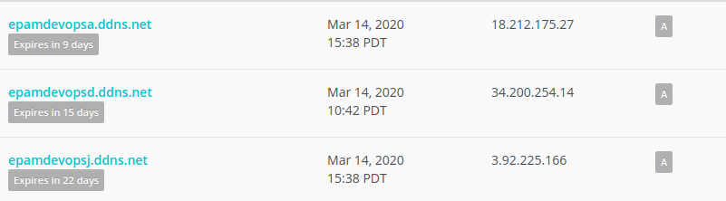
Webhook from theme’s repository
Setup dynamic DNS for instances with Apache, Docker and Jenkins:

Slide 6
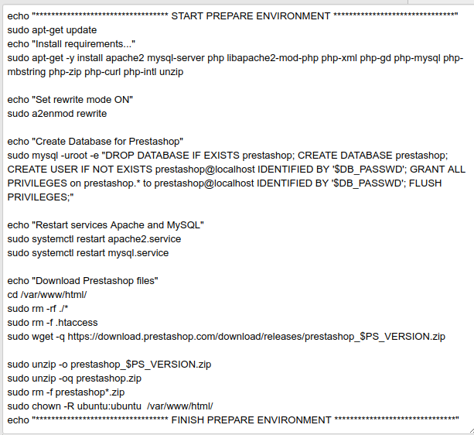
Deploy to LAMP server
Update repositories
Install Apache, MySQL, PHP and another requirements
MySQL: Create User, create Database for Prestashop, grant all privileges to this Database for User
Download and unzip Presatshop install files

Slide 7
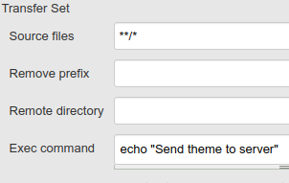
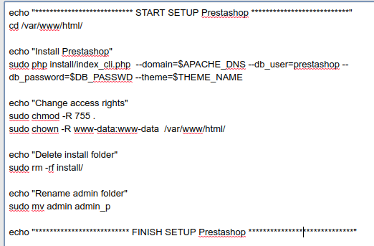
Install CMS:
Upload New Theme folder to Apache folder
Install Prestashop using CLI
Remove install folder
Rename default admin folder

Slide 8
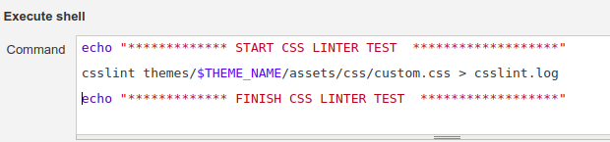
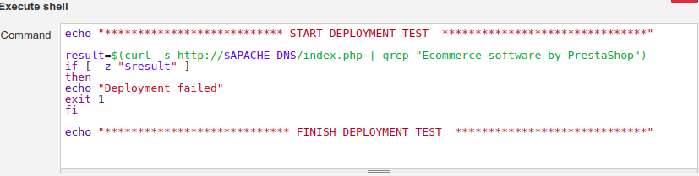
Testing:
Linter test is used before deploy, such as csslint
After deployment, site availability is also checked

Slide 9
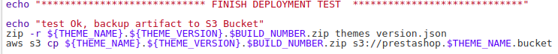
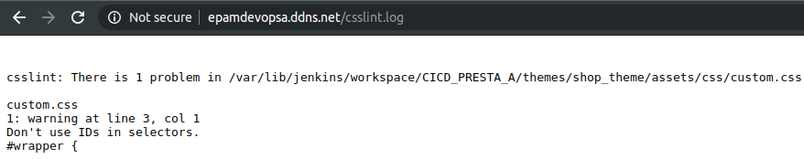
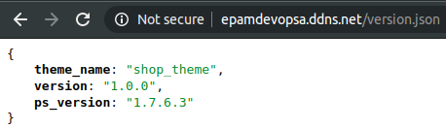
If Build CICD_PRESTA_A finishes without errors, artifact deploy to S3 bucket. Now developers can test New Theme on LAMP sever
After successful testing we can run next Build CICD_PRESTA_D and deploy New Theme to server with Docker

Slide 10
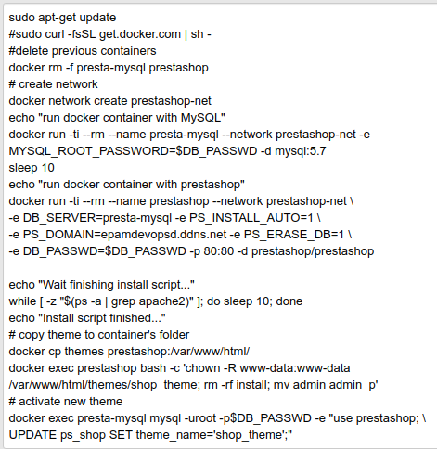
Deploy to Docker server
Update repositories
Install Docker and docker-compose
Create a network for containers to communicate
Docker Run Mysql image
MySQL: create Database for Prestashop
Docker Run Prestashop, use New Theme folder as source for Prestashop container, install Prestashop

Slide 11
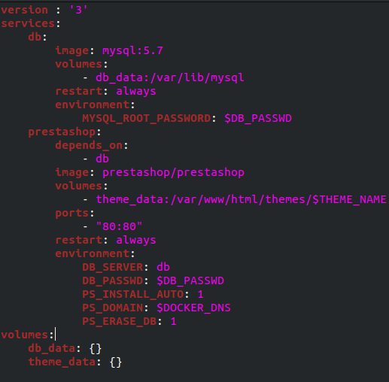
Docker-compose.yml for run containers:

Slide 12
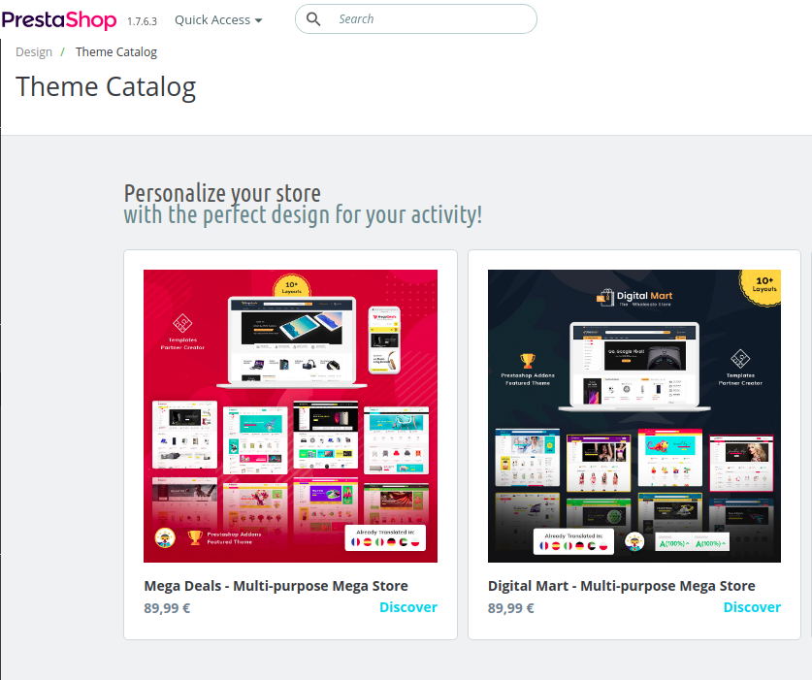
What next?
We can upload our New Theme to the Prestashop Theme Catalog for sale

Slide 13
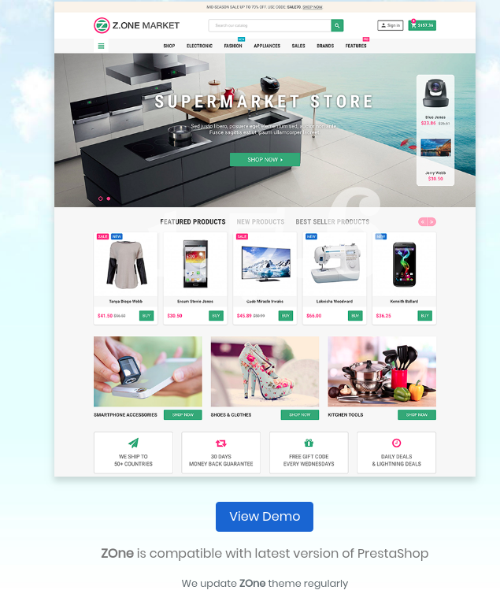
What next?
We can use installed server with Prestashop as Demo site with our theme.
We can also configure our Jenkins to automatically install other types of CMS, for example Wordpress, and deploy a new theme for it.

Slide 14
Thank you!
Your questions, please

