Slide 1
Topview of Scanner
Increasing Azimuth
Goes Clockwise
Antenna
0 mark

Slide 2
#2: cntr az = 0
Fov az = 270,
Covers all but upper left quadrant
Topview of Scanner
Increasing Azimuth
Goes Clockwise
Antenna
0 mark

Slide 3
#14: cntr az = 0, fov az = 90
Topview of Scanner
Increasing Azimuth
Goes Clockwise
Antenna
#23
#21
0 mark
#22

Slide 4
#18: cntr az = 0
Fov az = 360
Topview of Scanner
Increasing Azimuth
Goes Clockwise
Antenna
0 mark

Slide 5
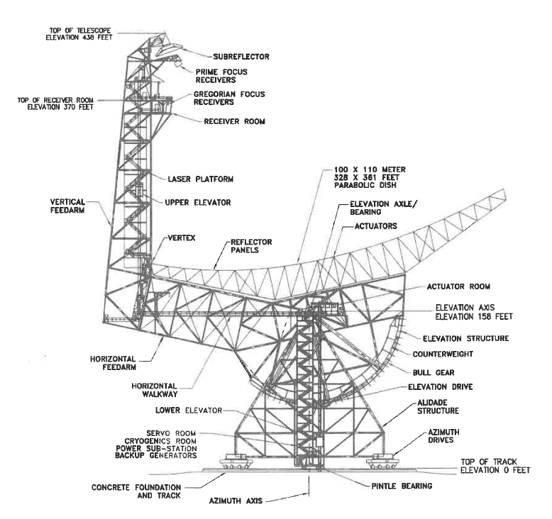
El cntr = 45, El fov = 90
Flat mount
10 degree mount

