Slide 1


Matrix
Component
Framework‏
June 30, 20155

Slide 2
What is the Matrix?
The question Neo asked Tinity...well yes, but also...
A feature rich, yet lightweight component framework
Technologies include:
ØMQ for communications
YAML for configuration and message format
Boost for regex parsing
C++11, templated for flexibility and efficientcy
Written to (optionally) support Xenomai RTOS
Autoconf build system
Inspired by OROCOS, OpenCPI, Hashpipe, Atlas, ...

Slide 3
Why Matrix?
Targets for use:
Vegas Pulsar & GBT Servo Control
Component models well understood, lots of implementations
Many of the candidates were centered on CORBA
We like ØMQ, and also need Xenomai compatibility
Want lightweight but flexible
Forces Modularity
Components need not know their peers, only the datatype
Makes module testing/debugging easier
Data transport implementation abstracted out

Slide 4
Component Framework Concepts
Architect
Keymaster
RT Services
(optional)
App. Component
Configuration,
Control & Status
App. Component
Configuration,
Control & Status
App. Component
Configuration,
Control & Status
RT-callback
Data
Source
Data
Source
Data
Sink
Data
Source
Data
Sink
Other data sinks

Slide 5
Component Framework Concepts
Special Matrix objects: Keymaster and Architect
Components Contain the following Interfaces:
  YAML-based Keymaster for control/configuration/status
  Data Flow Sources/Sinks
Component base class utilities
Control/Initialization sequencing
Provides the minimum set of states for Architect control
Data sink to source mapping

Slide 6
‘Generic Component’
Well defined Keymaster and
Configuration Interface
Optional Real-time
services
interface
Well defined basic states allows
Component reuse even if
Application Controllers differ
Control/Status/
Keymaster I/F
RT Entry pts
Base State
Machine
Application
Specific
Code
D
A
T
A
D
A
T
A
Generalized connection configuration
Supports both 0MQ and RT transports

Slide 7
The Architect/Controller
The Architect is the creator or builder of the Component’s ‘world’
Architect is instantiated by main program
The Architect automatically creates the Keymaster
The Keymaster is queried for the configuration
The Architect creates Components using a virtual constructor pattern
Architect Performs configuration control, then orchestrates startup
Default implementation in framework, but extensible
Not yet implemented but planned: Component loading from dynamic libraries

Slide 8
‘The Keymaster’
Keymaster stores both ‘static’ configuration data as well as runtime state.
  Bootstraps from a YAML format initialization file.
Implemented as key-value store. Keymaster is unaware of the information it stores. Clients may get/put/delete by key.
Keymaster is dynamic: publishes changes to all subscribers
Components report status and state changes to Keymaster (and in turn to Controller)
Keymaster presents well defined interface to clients, Controllers, and Components using 0MQ
  Keymaster clients may be written in any language that supports 0MQ (Python & C++ clients provided)

Slide 9
Keymaster (cont.)
Data representation in YAML (YAML Ain’t Markup Language)*
  human readable
  data serialization standard
  well supported by multiple libraries
static configuration
  YAML config file
dynamic state; YAML nodes kept in Keymaster memory
* yaml.org

Slide 10
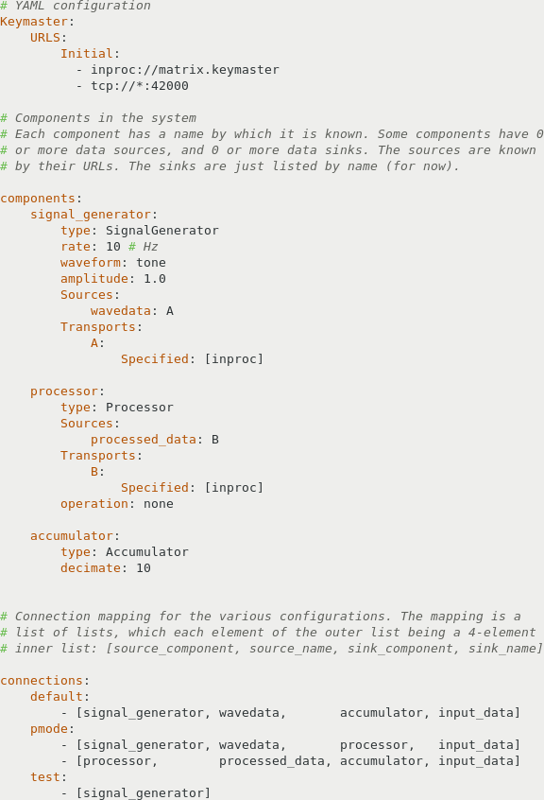
Sample Keymaster Initialization File
Keymaster configuration
Application components
Connections
(operating modes)

Slide 11
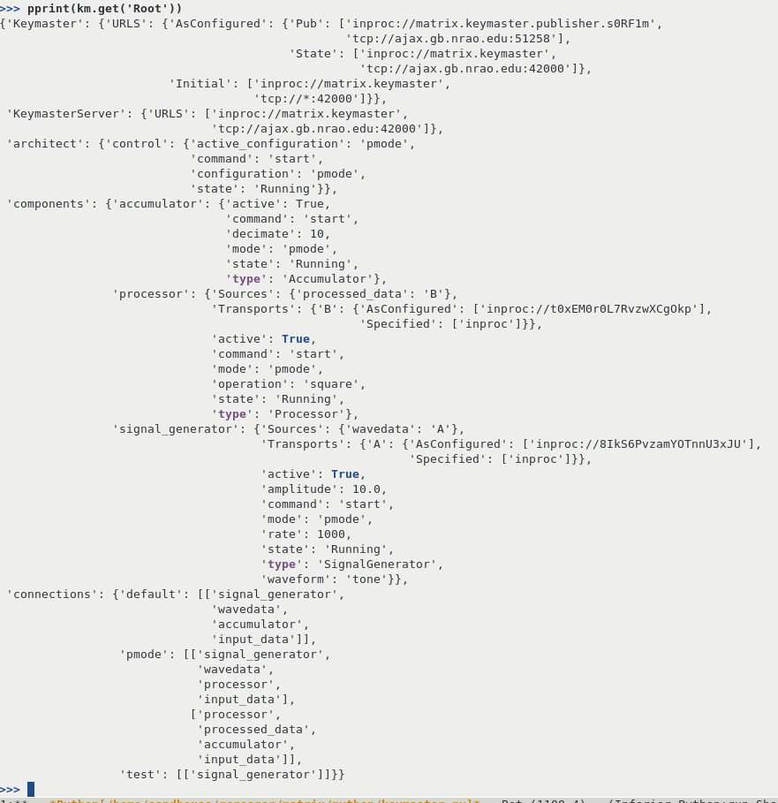

Slide 12
Data Source/Sinks
Configuration file lists available data sinks
Routing lists enumerate the source to sink connections and protocol
Components must agree on binary data format
Implementation of data transport is specified by 0MQ style urls,
Transports include:
  0MQ tcp
  0MQ ipc
  0MQ inproc
  And (non-0MQ) ‘rtinproc’
Sources may bind to multiple transports.
Publish/Subscribe semantics
Interface via a strategy pattern, hiding the details of the transport layer.

Slide 13
Component States
Created
  Initial state
  Cannot be re-entered
Standby
  Connections made to Keymaster
  Sources are bound to Publishers
  Sinks unconnected
  System-mode can be set only in this state
Ready
  Component Data Sources/Sinks connected
  Fully initialized and ready to run
Running
  Data flows, Components process data

Slide 14
Component Control Events
get_ready
  Only from Standby state
  Components should connect Data Sinks to Sources
  Possibly connect to external devices
  Once complete they should enter the Ready state
do_standby
  Only Issued from the Ready state
  Should reverse the effect of ‘get_ready’ by disconnecting sinks from sources.
  Only state where system mode can be set
start
  Begin processing data
stop
  Component should stop processing data

Slide 15
Component States
Running
Standby
Ready
Created

Slide 16
Finite State Machine
Used in Architect/Component base classes, but available for applications
Templated – Type specifies data representation for states and events
  Typical types are strings (readability) and integer enumerations (efficiency)
User-specified class method callbacks for:
  Predicates – Should the state change be allowed?
  Actions – Callback on leaving/entering a state
  Arc-Actions – Callback when following state transition (arc)
Two styles of stimuli supported:
  Events based – output is dependent upon current state and event
    In state X, if event Y is received and predicates validate, transition to state Z
  Pattern Matched - based on current state and predicates, select the transition which satisfies all of its predicates

Slide 17
Additional Libraries/Services
Thread/Mutex/Semaphore/TCondition templates
  Abstracts thread creation and synchronization primitives
  Currently uses pthreads, stepping stone to std::thread (C++11/14)
  Provides optional thread creation hook for Xenomai
Time Library
  Time using 64 bit nanoseconds since Jan 1, 1970
  Doesn’t roll over for 200+ years from now
Misc:
  NAN utilities – math exception free NAN comparisons
  ThreadLock – unlocks synchronized types on scope exit
  Tsemfifo – protected FIFO (similar to std::deque)

Slide 18
HPC program Example
LBW spectral-line
HBW spectral-line
INCO Pulsar
LBW self-test
CODD Pulsar
Architect
Keymaster
LBW Spectral
line (GPU)
test data
generator
cpu
accumulator
spectral line
FITS writer
CODD
pulsar processor
(GPU)
nettask
PSR
FITS writer
INCO
pulsar processor
(GPU)

Slide 19
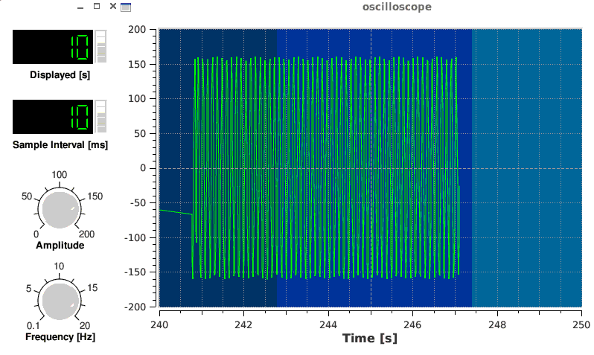
Simple Example
Signal Generator
Processing
Accumulator
Keymaster

Slide 20
GBT Servo Replacement Project Components
IRIG Clock
[1]
To:
A/D’s & D/A’s
Fault Analysis
Control Arbitor
Watchdog(s)
KeyMaster
To:
All Components
Architect
Encoder-Az
[2]
PID-Az
[10]
D/A-Az
[16]
Encoder-El
[3]
PID-El
[11]
D/A-El
A/D-Az
[4]
[17]
[3]
Servo Monitor Log
Faults
A/D-El
[5]
[12]
From:
A/D’s & D/A’s
Encoders
CPU Thermal
Monitor
[6]
Control
[20]
[19]
Fault Logging
Autostow
[18]
[13]
[7]
ACU I/F
From:
A/D’s & D/A’s
Fault Analysis
Control Arbitor
Watchdog(s)
ACU I/F
[8]
[14]
PLC I/F
Watchdog
Watchdog
OCU I/F
[15]
Watchdog
[9]
[21]

Slide 21
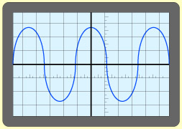
Simple Example
Signal Generator
Processing
Accumulator
Keymaster
Signal generator, Processing and Accumulator are the Components
Signal generator has data source ‘wavedata’
Processing has data source ‘processed_data’
Accumulator reads sink, sends its output to source 'output_signal'
Qwt scope contains a sink from which it reads 'output_signal' for display
Scope controls use Keymaster interface to control Signal Generator

Slide 22
The Matrix
Questions?

Slide 23
Typical Initialization Sequence
Process created, Architect created
Architect creates Keymaster
Keymaster loads configuration file
Architect creates the components listed
Components subscribe to Keymaster Pub/Sub and Req/Reply Interfaces
Components bind sources with protocols listed in configuration
Components report ‘Standby’ state to Keymaster.
Architect waits for all components to enter ‘Standby’ state.
Based upon the 'system mode', a subset of Components is selected
Architect posts ‘get_ready’ event to Keymaster (and in turn to the subset of Components)
Active Components initiate connection of sinks to sources
Components report ‘Ready’ state to Keymaster
Architect posts ‘start’ to Keymaster (and in turn to Components)
Components enter ‘Running’ state (and report to Keymaster)
Components process data

Slide 24
Component Sequence cont.
Controller posts ‘stop’ to Keymaster (and in turn Components)
Controller waits until all Components enter the ‘Ready’ state
Controller posts ‘prepare’ to Keymaster
Components enter ‘Ready’ state and report state to Keymaster
Controller posts ‘start’ to Keymaster
Components enter ‘Running’ state and report state to Keymaster

Slide 25
Optional Real-time Scheduler Service
NOTE: Supports this, but not included in Matrix
Where real-time requirements are required, periodic RT-scheduling is available
Currently implementing RT via Xenomai, however, Prempt-RT Linux (RT patches to normal linux kernel) is also supported via Posix.
Setup Sequence:
Component sends callback registration request with scheduling attributes
RT-Scheduler creates the RT thread.
If only an RT-thread is required, the callback need not return
If periodic calling is desired, the callback will be run at the periodic rate, and must return when complete.
RT data interchange must use the rtinproc transport, using other transports will disable real-time context and switch to soft-rt context.

Slide 26
Optional Real-time Transport
Real-time transport is setup in non-rt context using 0MQ inproc protocol
Component sinks provide a buffer (FIFO buffer) to the source publisher
Publishing is performed in the context of the Component’s RT thread
Publish call will block until buffers have been copied
Unread buffers will be over-written (unlike 0MQ semantics)
Soft-RT to Hard-RT supported using rtinproc transport

