Slide 1
CSE 111 Fall 2024: Project Checkpoint 1
Mining Company Database
Matthew McCabe and Kyle Shyffer
https://github.com/GreenBuick/Project-Database

Slide 2
Synopsis
The project is a database for a mining company which is designed for transactions between the company and its customers. The customers will be able to view the materials at locations and commission services at locations. The company will additionally hold information about sales and equipment used in services. Our tables will include customers, sales, equipment, services, materials, and mining locations.

Slide 3
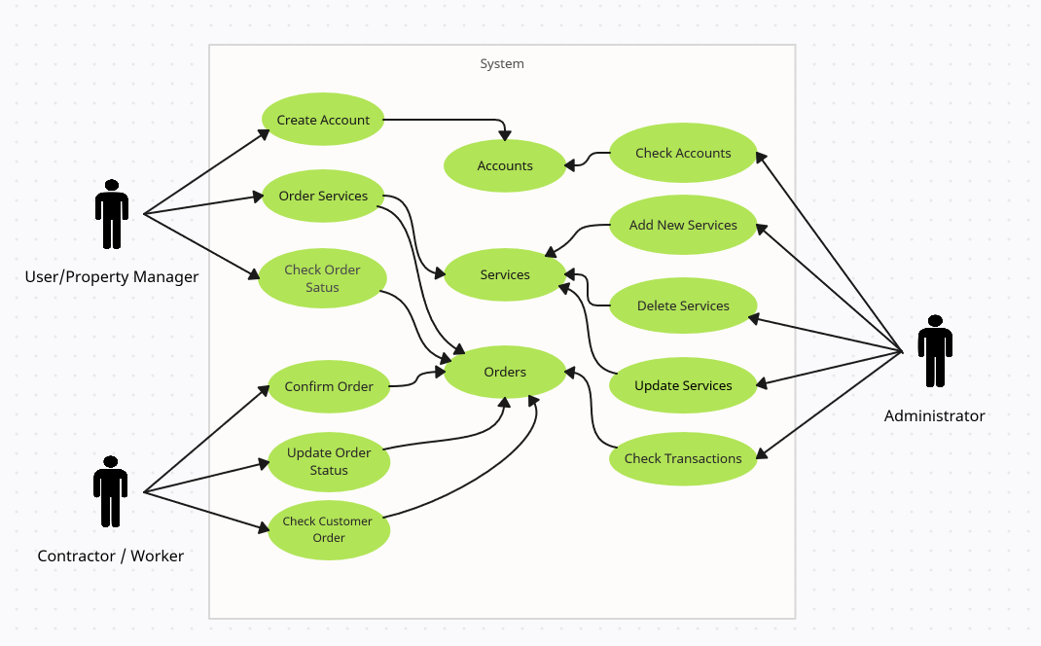
Use Case Diagram
The main use case of this database is the streamlining of transactions between customers and the mining company.

Slide 4
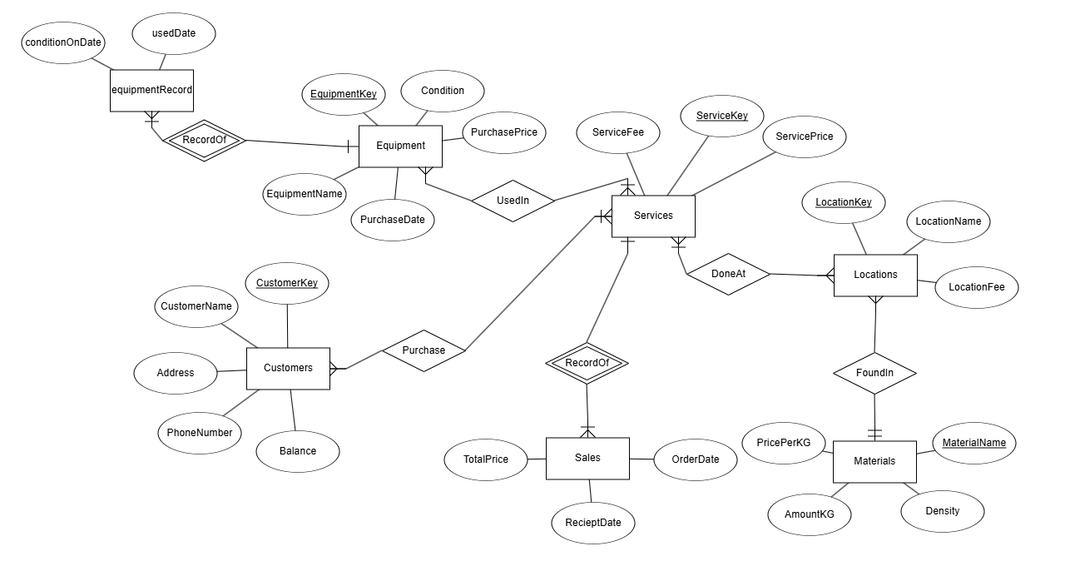
ER Diagram

Slide 5
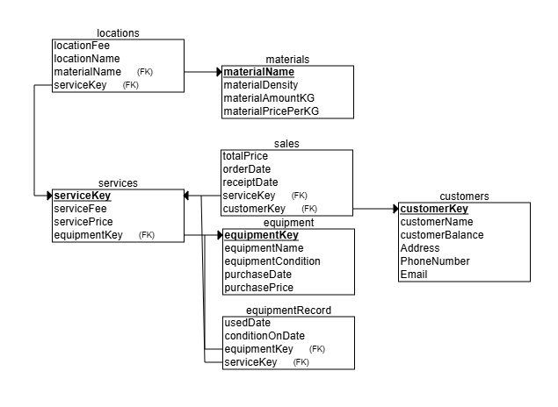
Relational Schema

Slide 6
Q/A Time

