Slide 1
CSE 111 Fall 2024: Project Checkpoint 1
Mining Company Database
Matthew McCabe and Kyle Shyffer
https://github.com/GreenBuick/Project-Database

Slide 2
Synopsis
The project is a database for a mining company involving tables for their services (prices, duration, etc.), mining locations (including statistics about types of minerals and density), and past mining operations. Our tables will include region, nation, customers, sales, services, and mining locations.

Slide 3
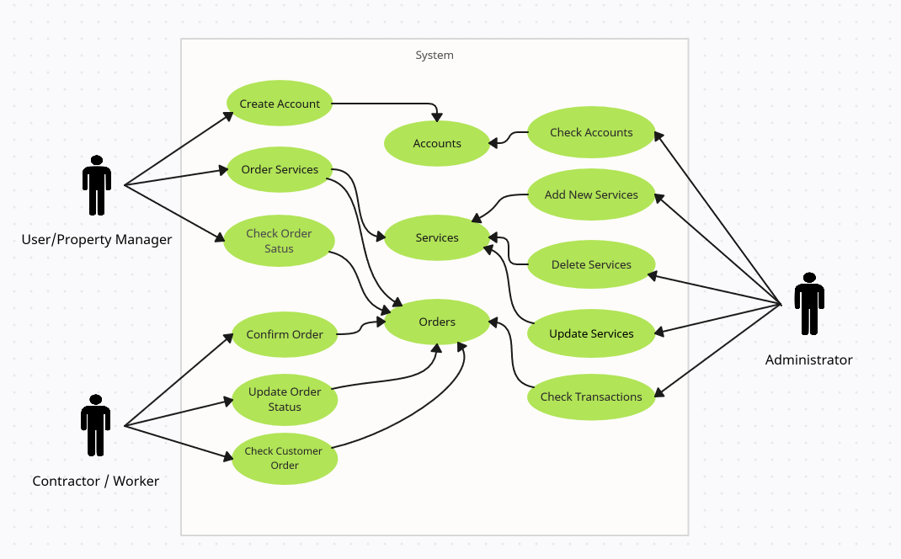
Use Case Diagram
The main use case of this database is the streamlining of transactions between customers and the mining company.

Slide 4
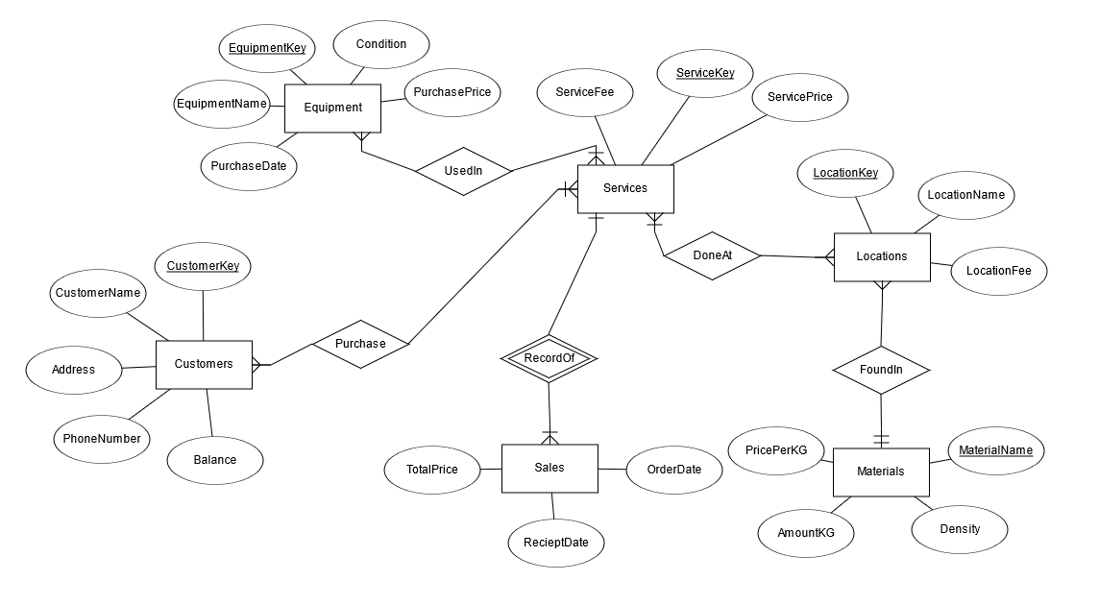
ER Diagram

Slide 5
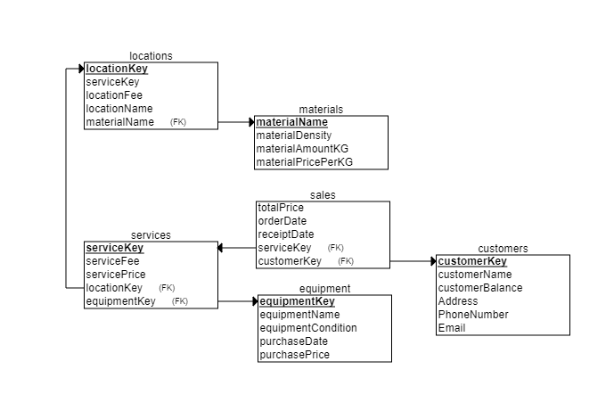
Relational Schema

Slide 6
Q/A Time

