Slide 1
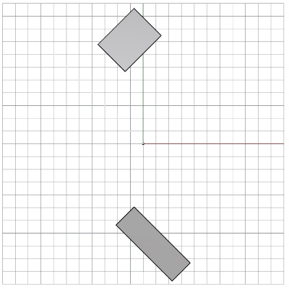
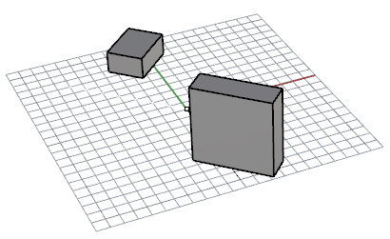
Note: The particular buildings below are an example, and don’t represent the actually geometry given. See Slide 3 for that.
The user enters in values for the following parameters.
Only Site Orientation is a dropdown.
Everything relative to global origin 0,0,0.
Offset X and Y give a starting point to draw the building.
Length is the X dimension centered on the starting point.
Width is the Y dimension moving away from the endpoints of the Length.
Only rectangles allowed.
Site rotation point is the midpoint of the rectangle (Length/2, Width/2, Z=0).
Both a 2D view and 3d view is shown, updating simultaneously.
Grid shown. X,Y,Z axis shown. Positive Y is North.
Site Context
Adjacent Buildings:
Building 1
Offset X:
(0,0,0)
ft
-50
Offset Y:
ft
100
y
Length:
ft
30
x
Width:
ft
30
ft
Height:
40
Site Orientation:
45
˚
(0,0,0)
y
z
x

Slide 2
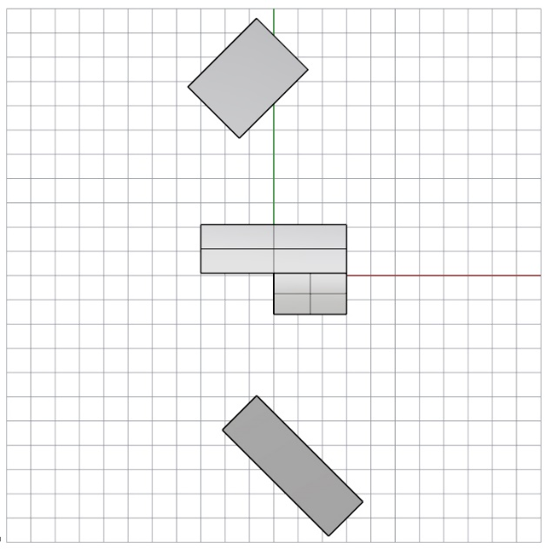
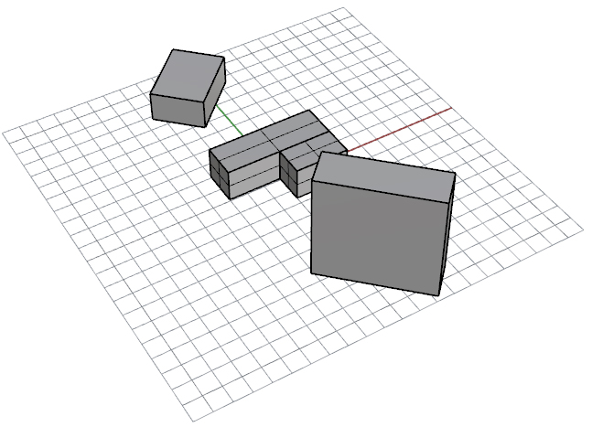

Geometry
Step 3: Floor Area is automatically calculated: Building Area/#of Floors
Step 4: The user selects Floor Height from dropdown.
Step 2: The user selects the number of floor from dropdown..
Note: We auto-generate interior walls to perimeter/core zoning. With Footprint Shape, Parametric Relationship, Footprint Dimension Independent parameter (red), and Perimeter Depth these walls can be generated.
Step 1: The user enters in values for the total building area.
Step 5: The user selects Perimeter Depth from dropdown.
Building Area:
Floor Height:
# of Floors:
Floor Area
Perimeter Depth:
8100
ft2
3
2700
12
ft
10
ft
Footprint Shape:
Parametric Relationship
WWR:
Overhang Depth:
Orientation:
L-Shape
L-Shape-1
30
%
3
ft
180
˚
If you think the order of the inputs should be changed for visualization generation effectiveness, let me know.
Step 6: The user selects Footprint Shape from dropdown.
Step 7: The user selects Parametric Relationship from dropdown. These are pre-defined equations to drive the building footprint dimensions.
3d view has “N, S, E, and W” visually identified for the sides of the building based on orientation: North is assigned if surface normal is plus or minus 45 degrees off Y-axis, West if 46 to 135 deg, etc. If building rotated, surface orientations are updated if needed.
Footprint Dimensions:
Length 1 (X1):
ft
60
Length 2 (X2):
ft
30
N
E
Geometric shape always centered on global origin using midpoint of X and Y extents.
X1
Y2=0.5*Y1
W
(0,0,0)
Y1=X1
ft
60
Width 1 (Y1):
S
X2 = (Floor Area-((0.5*X1)*X1))\(X1-(0.5*X1))
ft
Width 2 (Y2):
30
y
z
y
Floor Area:
ft2
y
x
2700
x
Step 8: Once the parametric relationship is selected, the footprint and equations show up here (note this is already rotated 180, the original L shape was pointed up). Shape can show up with fixed proportions, then will update once independent parameter typed in.
Step 9: Once parametric relationship is selected, the appropriate independent (red) and dependent (grey) inputs show up. Floor area is auto-filled to match above. All fields are blank until the user types in a value for independent parameter. Once filled in the equations are used to calculate the values of the dependent parameters.
Note: The particular buildings above are an example, and don’t represent the actually geometry given. See Slide 3 for that.

Slide 3
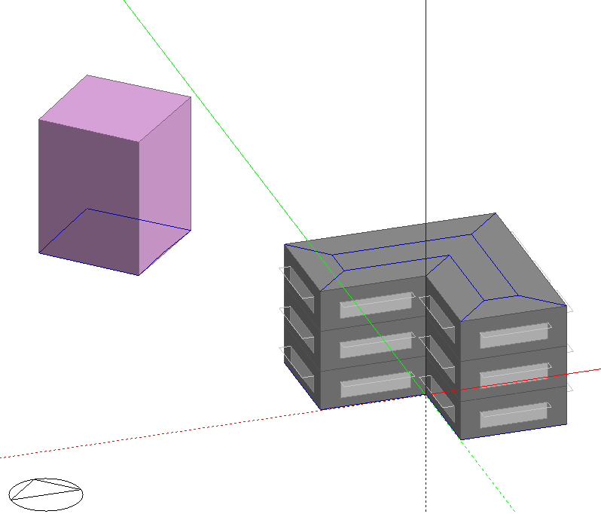
This is what the shading building and main building should actually look like with the input values in previous 2 slides.
We would like to be able to toggle on and off the view of the interior walls on the roof.
We would like an opacity slider like the gbJSON viewer.
Overhangs should be opaque surfaces (different color from walls and roof.
We’d like the windows to be transparent.
Arrows show perimeter depth.

