Slide 1
Guilt Trip
Team Members:
Abhishek Divekar
Ajitesh Chandak
Paras Avkirkar
Sandesh Shetty
Swachhand Lokhande
Mumbai, India

Slide 2
The Problem:
To add the crucial element of accountability when it comes to maintaining a sustainable model:
How to reduce your carbon footprint with every journey you make.

Slide 3
Our solution:
We have created the Android app Guilt Trip, which tracks the movements of the host using the phone’s internal GPS location service.
We then couple this with the mode of travel that they intent to use.
We have tried to create the best possible user experience. While tracking, we allow for changes in the mode of transport: suppose, for example, the user plans on walking to the train station, arriving by train, then taking a taxi to his actual destination. The app allows for such sudden changes with minimal disturbance to the user.
The user is also free to use their phone, the app runs in the background during this time.

Slide 4
Finally, on completing the journey, the user given a review of how his chosen mode (or modes) of travel affect the environment. This data has been scoured from the web, and we have even taken human input (from taxi-drivers) for the metric multiplier for our conversions, to enable as high accuracy as possible.
We have chosen the conventional unit - kg of C02 emitted – to express this quantity.
But a number is meaningless. The need for a human touch is necessary. And so we have added a few specialized snippets – generated by us – to describe what your carbon level rating actually means: whether you should alter your route, change your mode of transport, or sell your car and buy something less polluting, like a petroleum plant. Or if you’ve been doing things right all along.

Slide 5
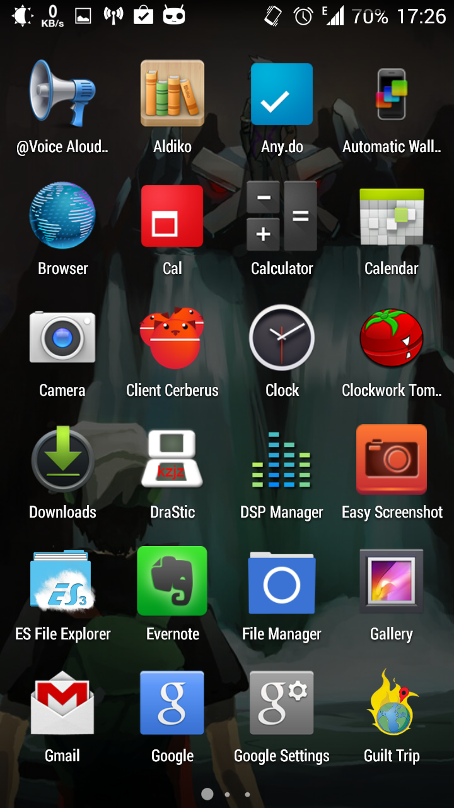
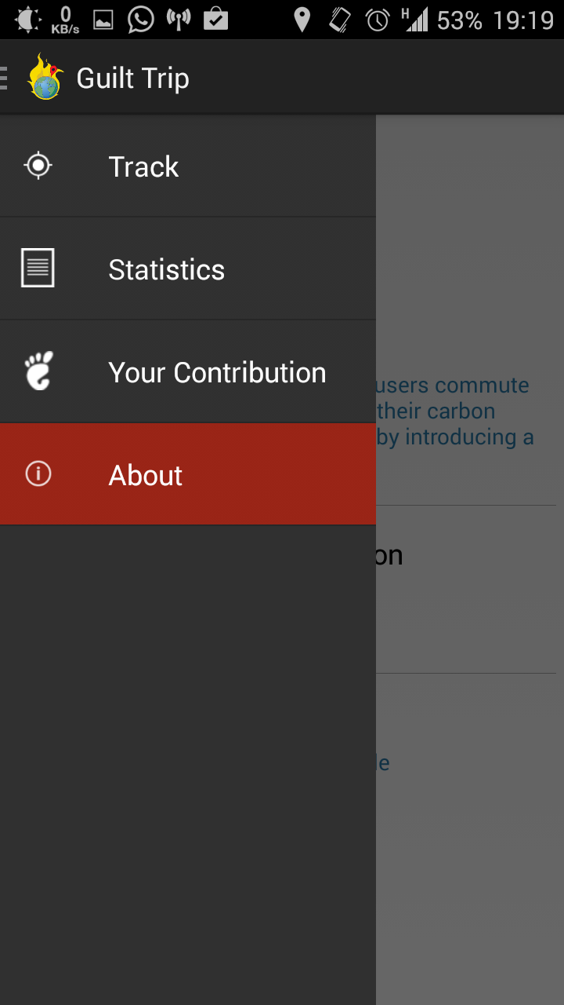
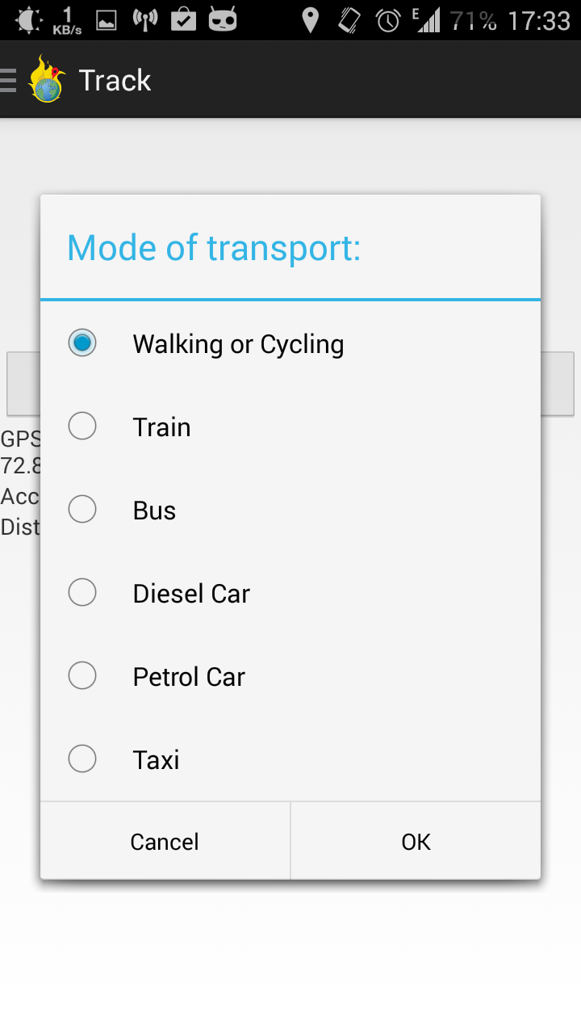

Slide 6
Progress:
We have successfully built both the UI and the implementation for our Android application.
Testing by both foot an vehicle shows that the GPS software is accurate within 8% of the actual distance, and 5% for longer journeys. We hope to improve this to an exact.
Our timer for the application follows the phone’s natural clock, and it is designed for ease-of-use. Even first-time users of our app will find it concise and to-the-point in it’s features while maintaining functionality.

Slide 7
Progress:
Our mode of user-accountability is unique in its implementation.
We choose a relatable way to try and encourage our users towards being better people. The snippets are aimed at being humorous (no one wants to feel like the bad guy) but also at getting the message across: that we could be better people, waste less, and save more, while protecting the environment.
We would like to continue developing and thinking of how to incentivize users of our app into making small changes in their lives that will benefit the environment, and then presenting them in the most non-intrusive way possible.

Slide 8
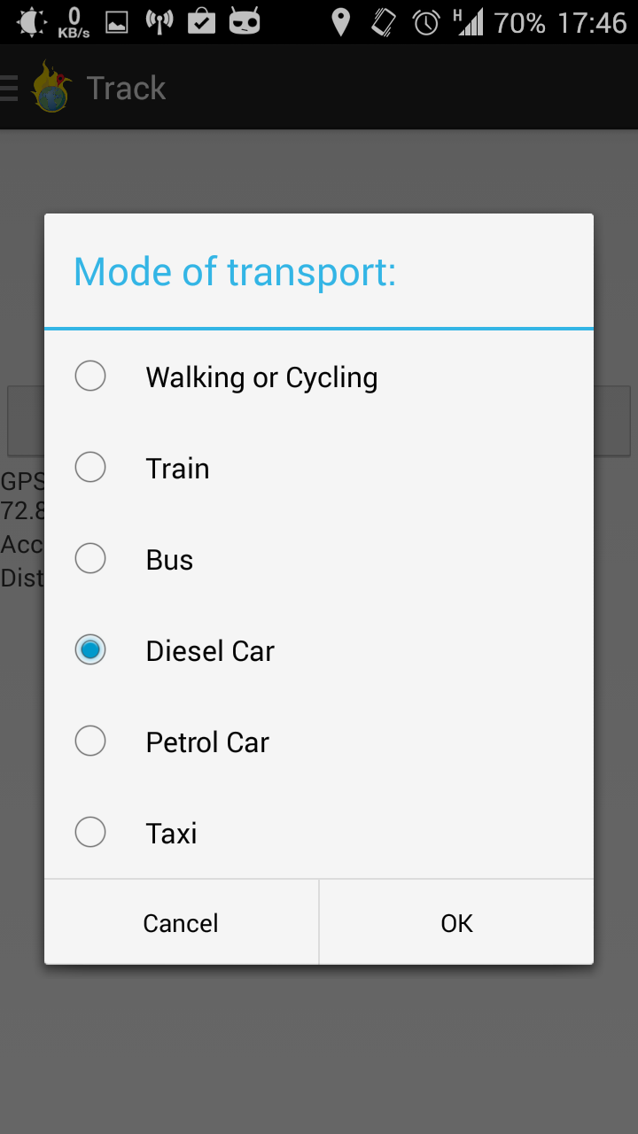
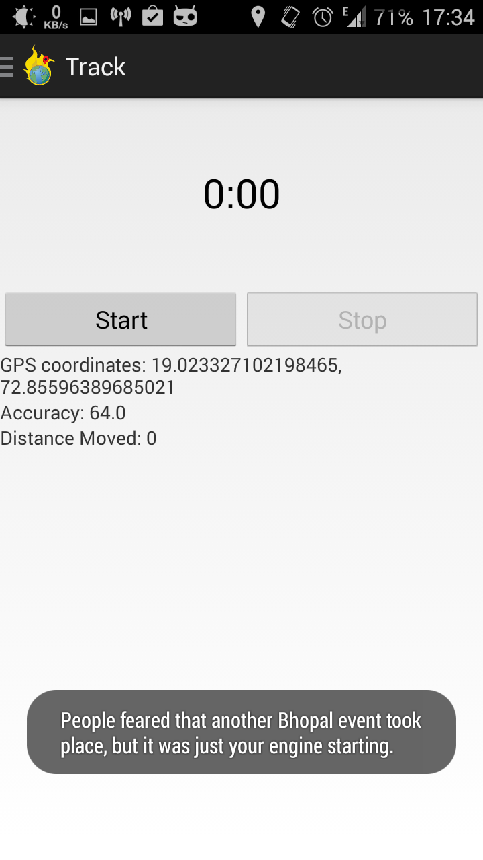
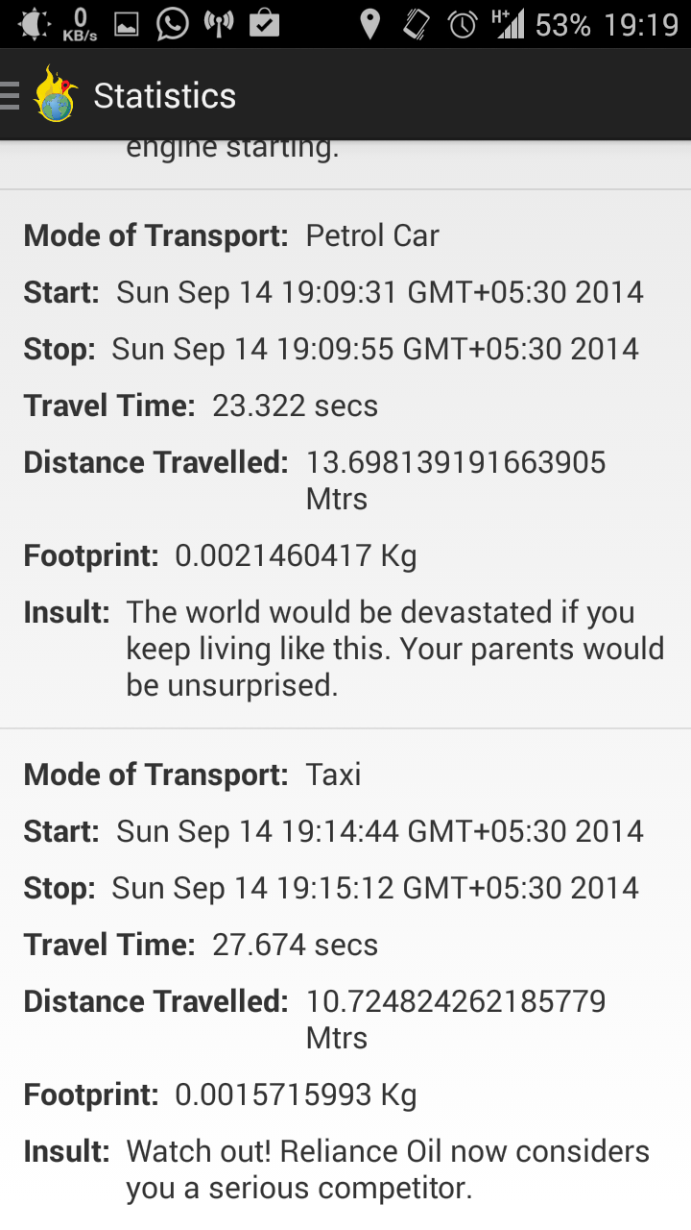

Slide 9
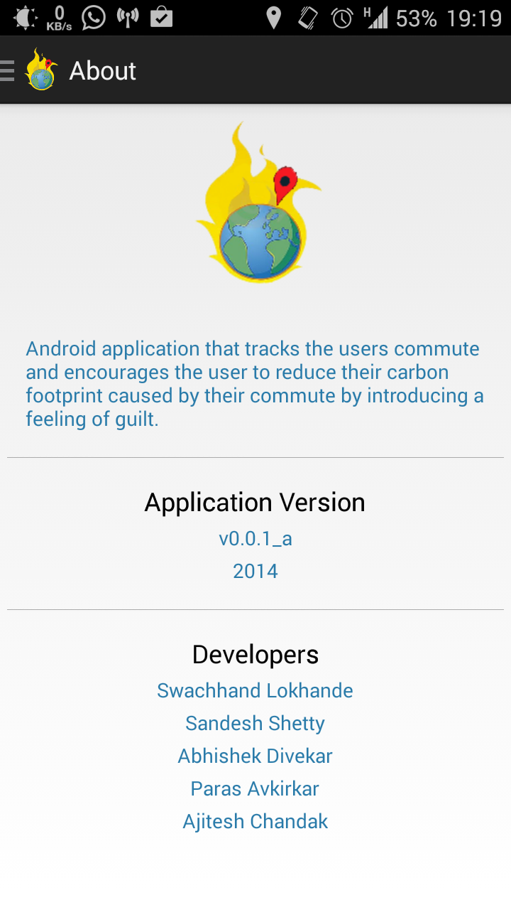

Slide 10
Thank You!

