Slide 1
Latest Deep Learning OCR with Keras and Supervisely

Slide 2
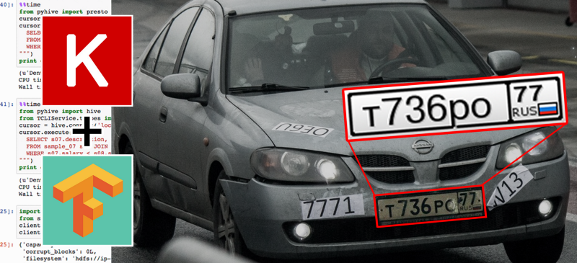
Latest Deep Learning OCR with Keras and Supervisely

Slide 3
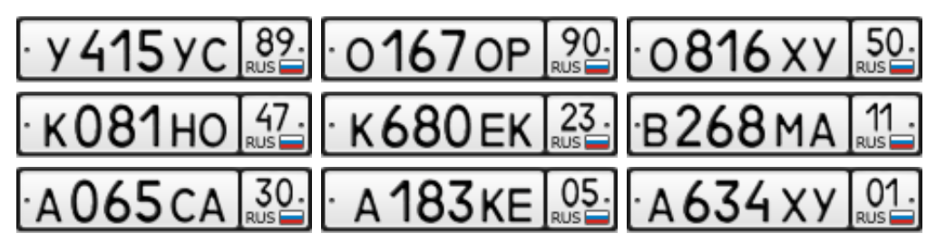
Where to get training data?

Slide 4
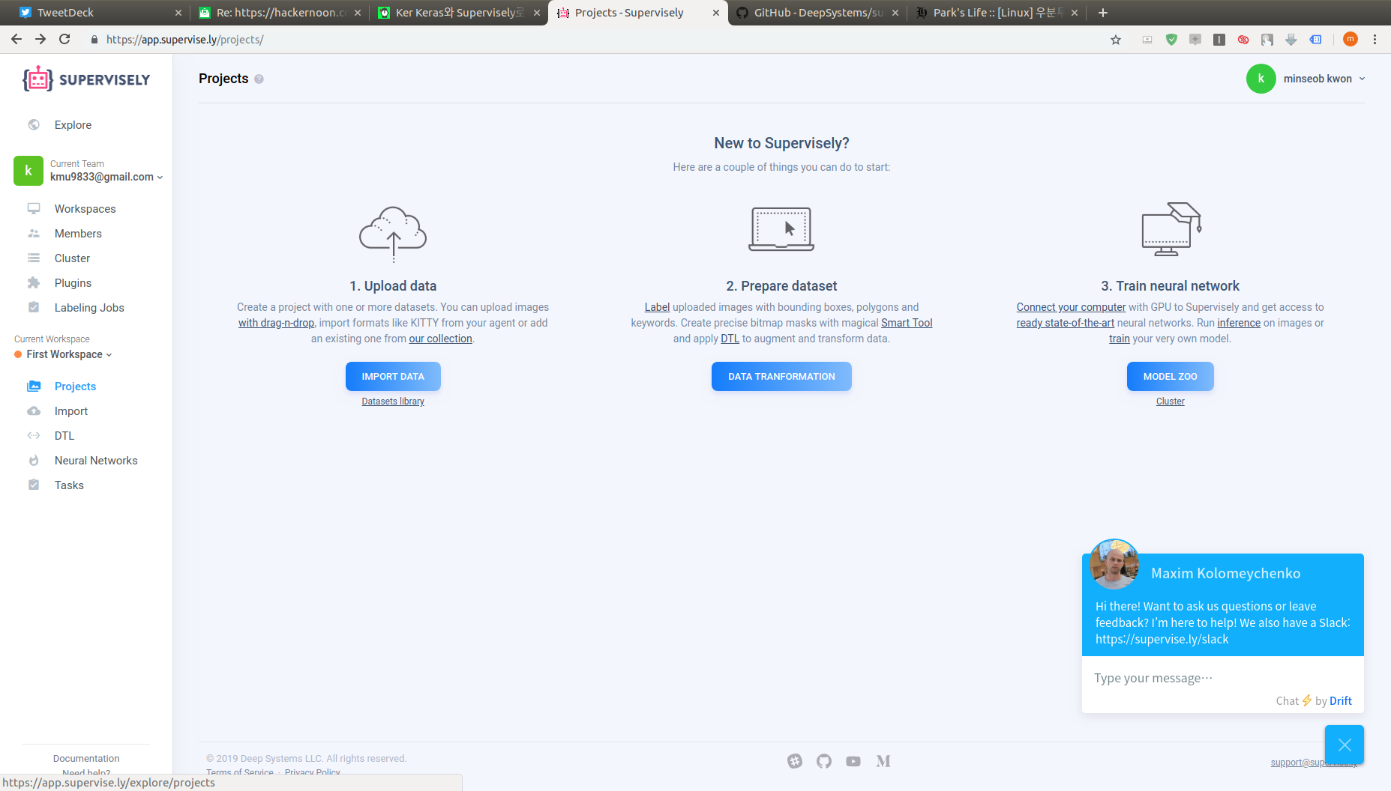
Where to get training data?

Slide 5
Where to get training data?

Slide 6
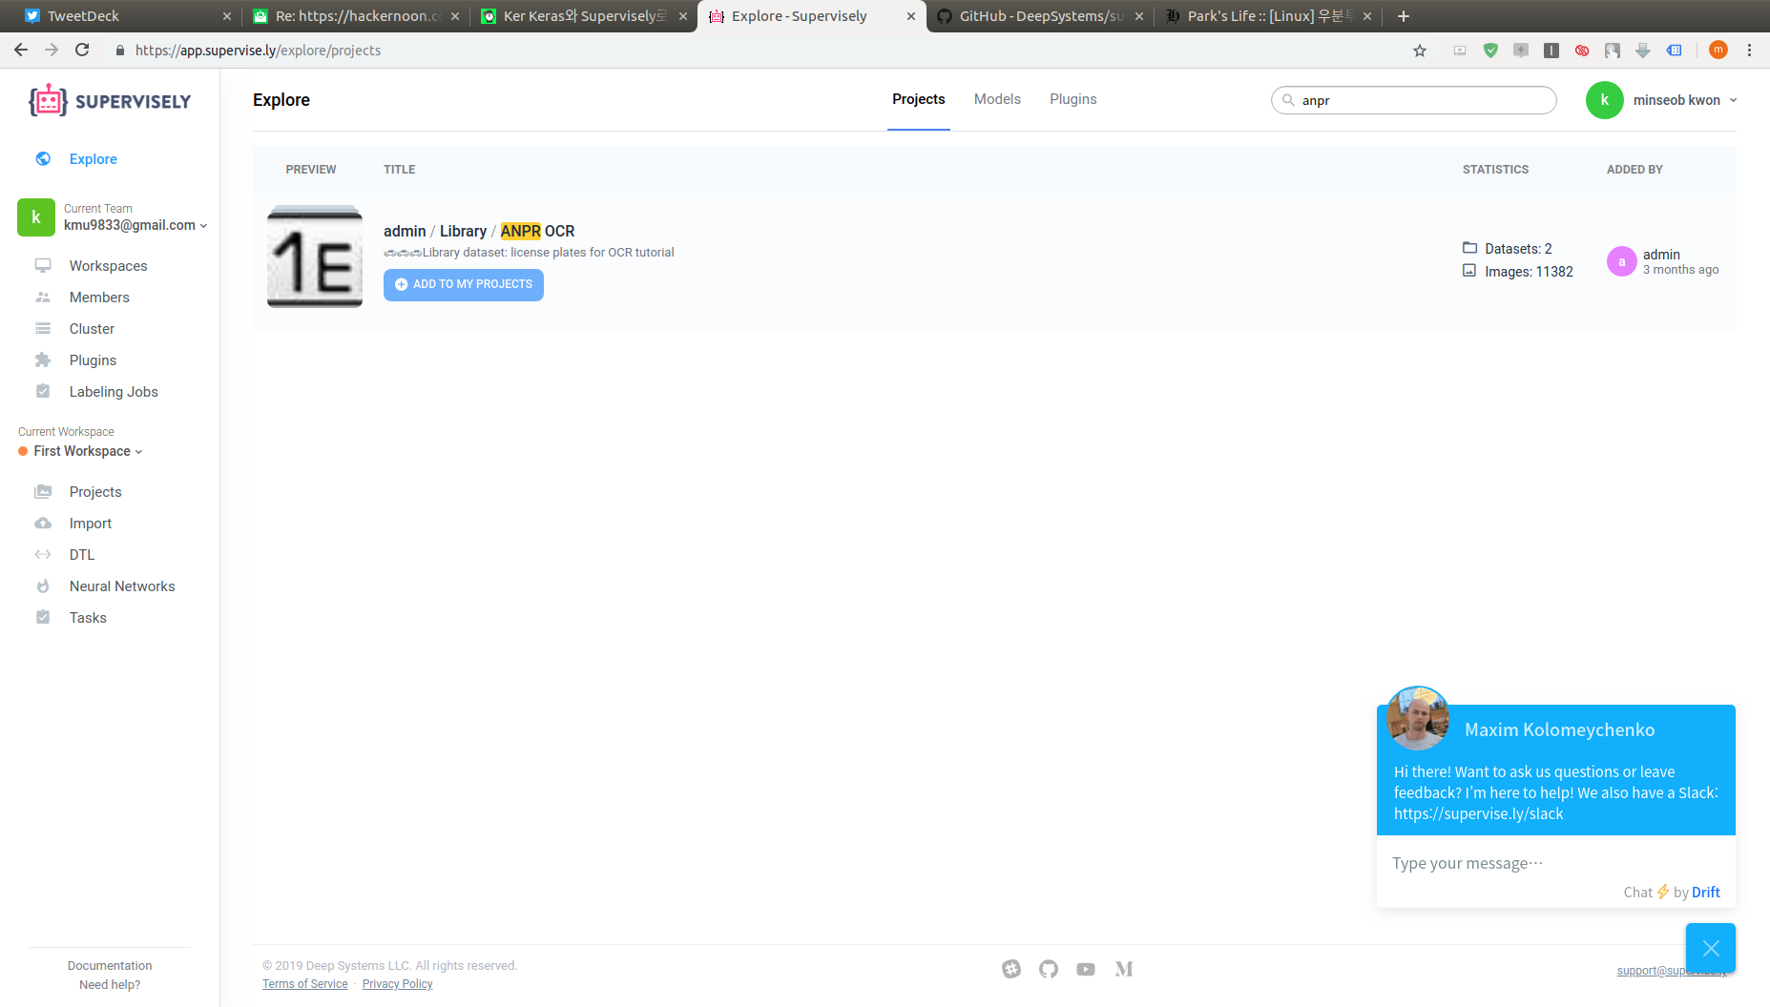
Where to get training data?

Slide 7
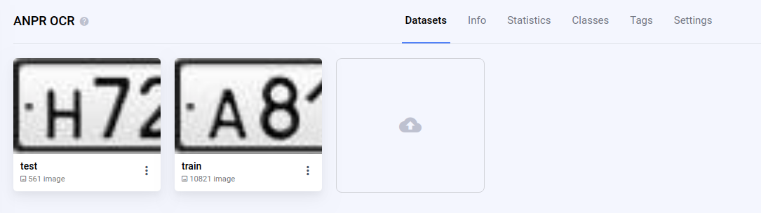
Where to get training data?

Slide 8
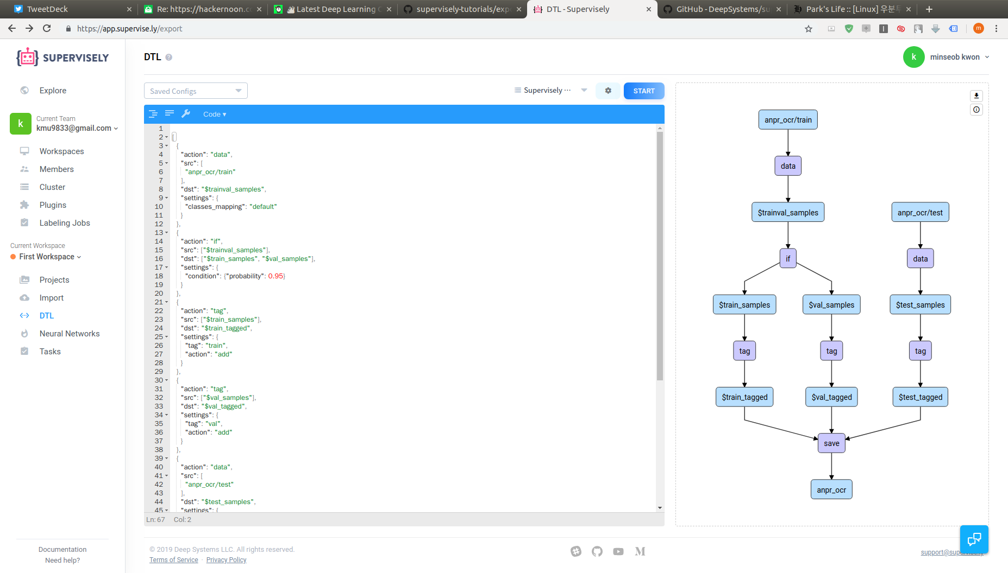
Where to get training data?

Slide 9
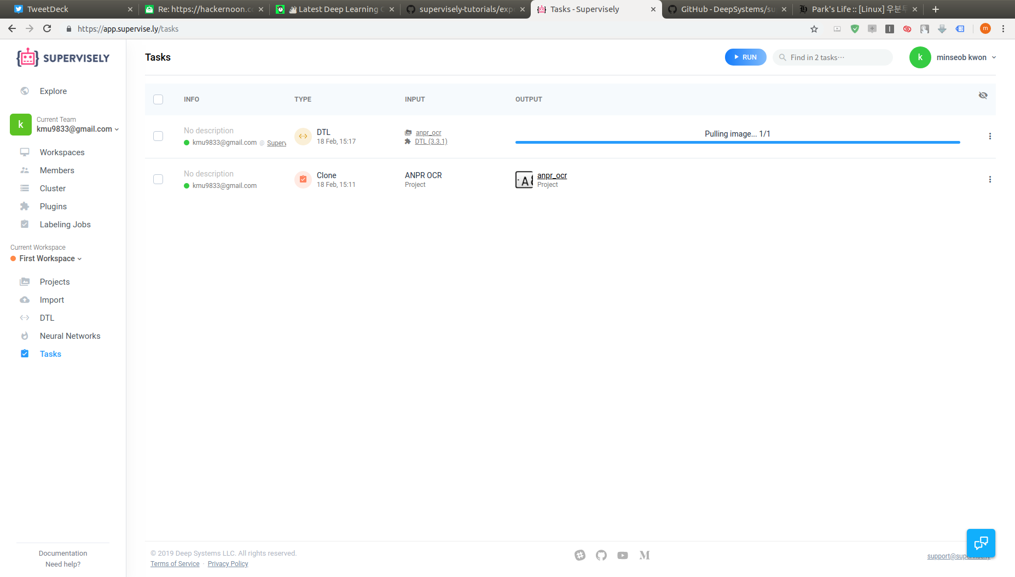
Where to get training data?

Slide 10
git clone https://github.com/DeepSystems/supervisely-tutorials.git
cd supervisely-tutorials/anpr_ocr

