Slide 1
text-detection-ctpn

Slide 2
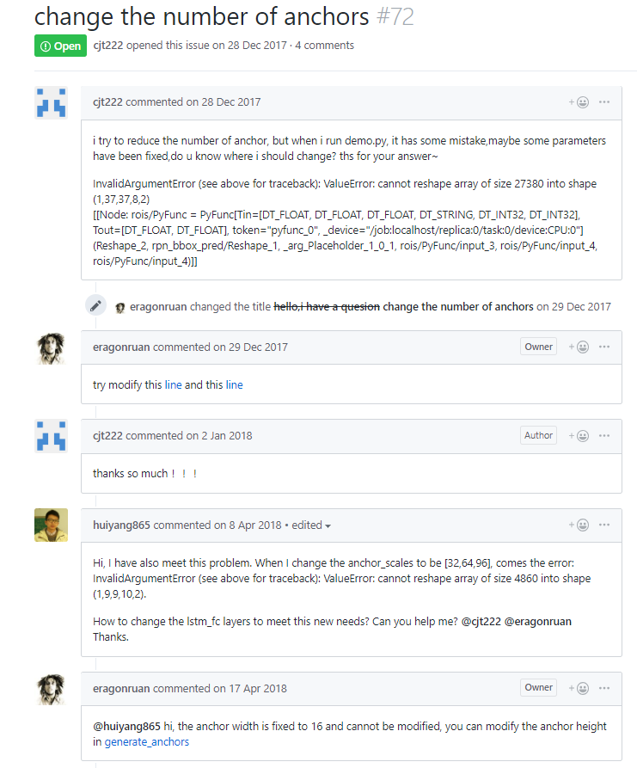
Anchor

Slide 3
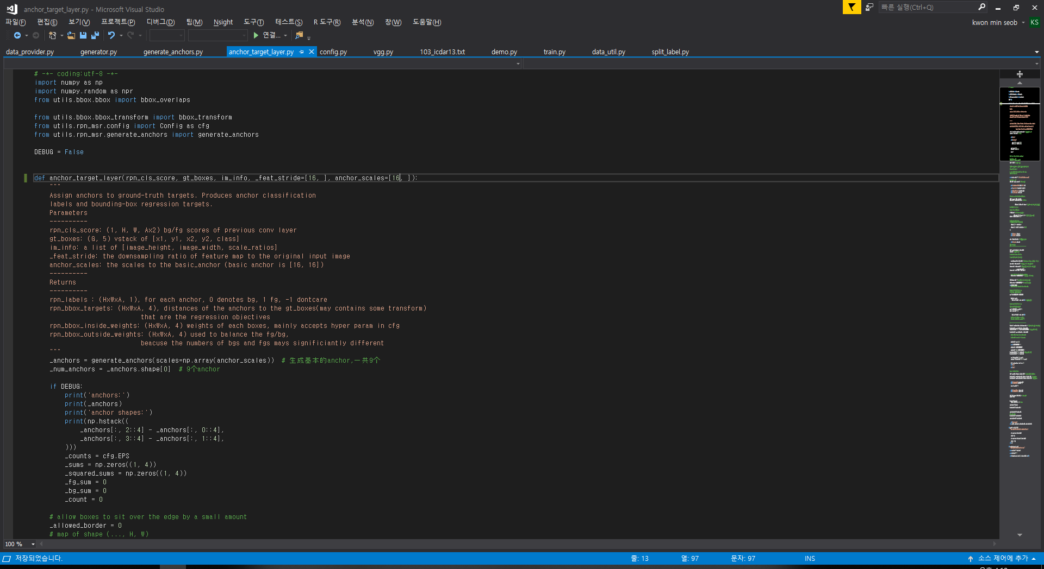

Anchor – anchor_target_layer.py

Slide 4
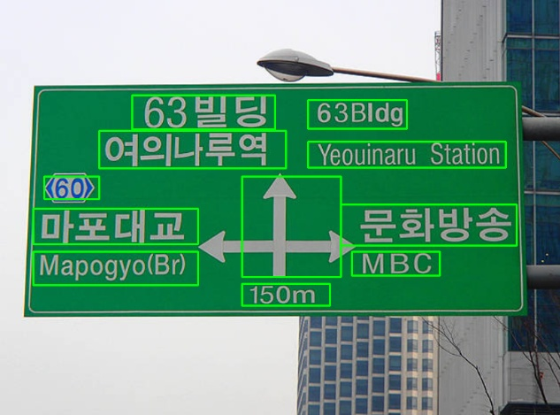

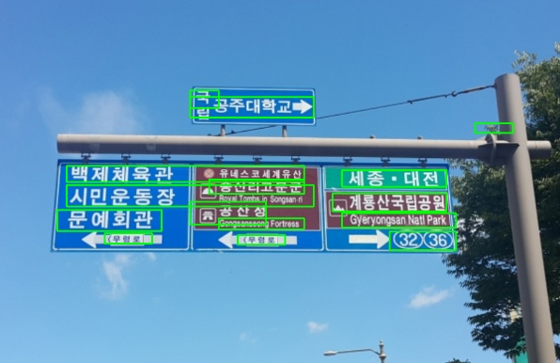

Anchor 16 -> 3

Slide 5

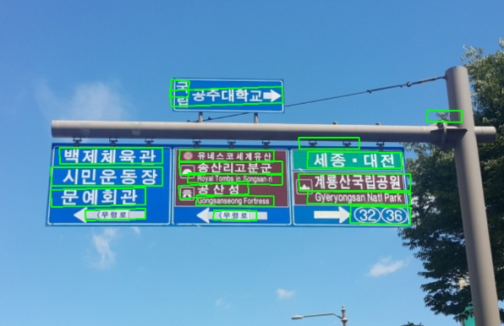
Anchor 3 -> 48

Slide 6
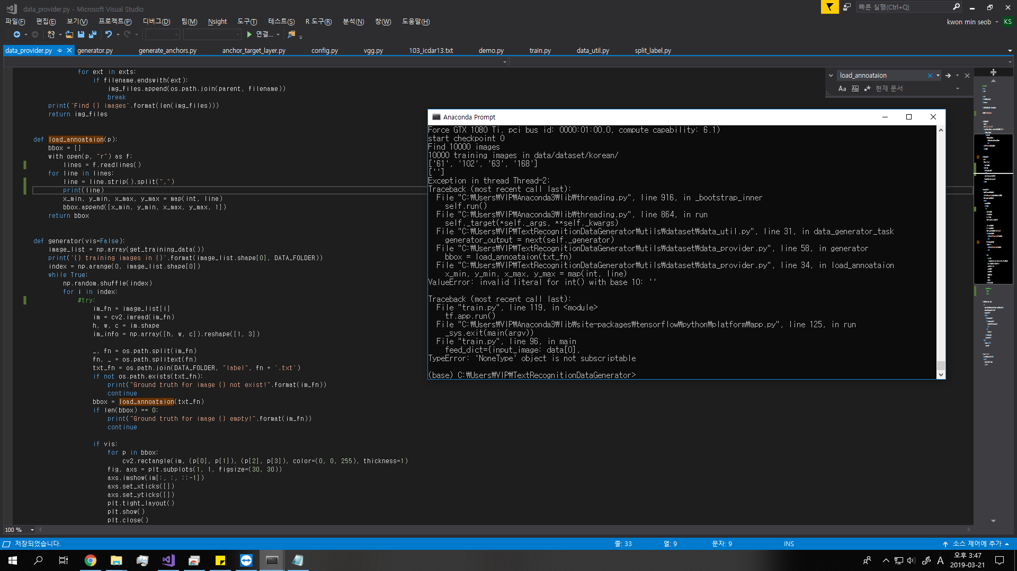
Korean datasets

Slide 7
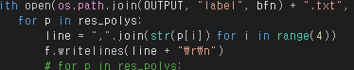
Korean datasets

