Slide 1
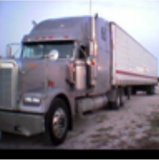
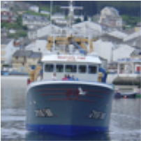
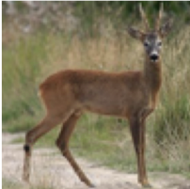
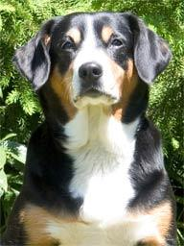
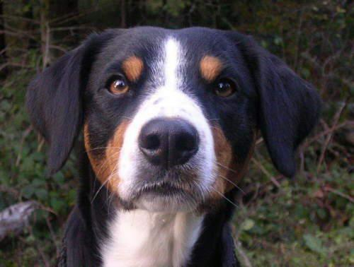
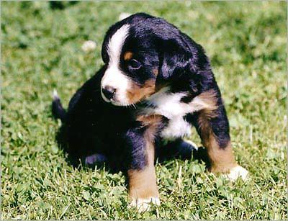
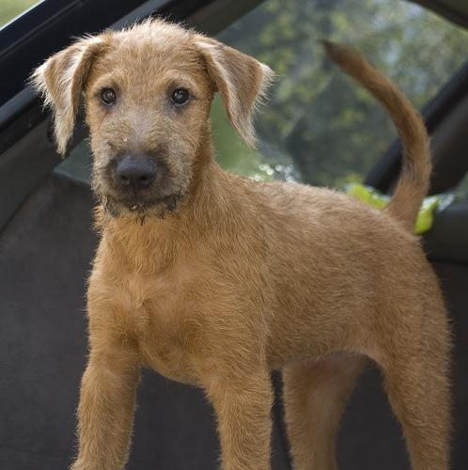
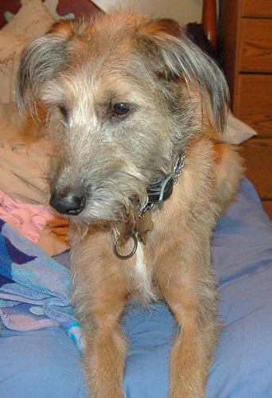
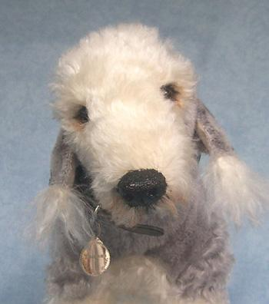
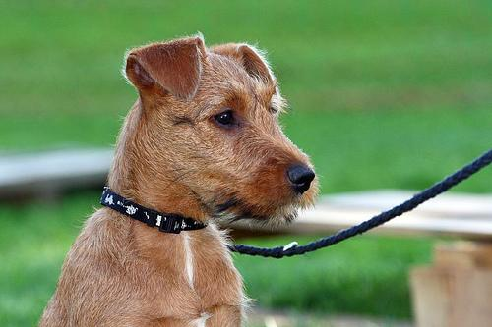
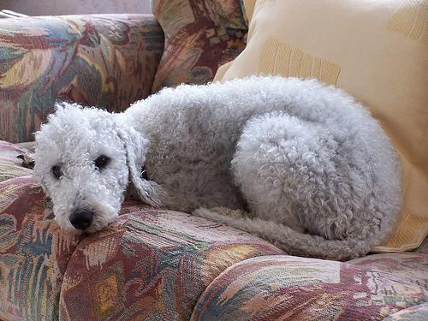
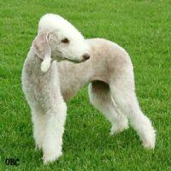

















Multi-scale Feature Extraction
Gaussian Graph Construction and Fusion
$$F_{1}$$
Stage 1
Graph $G_{1}$
$$F_{2}$$
$$Z_{2}$$
Stage 2
Geometry
Feature
Graph $G_{2}$
$$Z_{1}$$
ConvNeXt
Gaussian kernel
$$F_{3}$$
$$Z_{3}$$
Stage 3
$$Z_{4}$$
input images
Graph $G_{3}$
AR Fusion
$$F_{4}$$
GraphSAGE
Encoder
Stage 4
Graph $G_{4}$
Semantic Feature
Spectral Clustering
Dual Self-Expressiveness
$$C_{S}$$
$$SE_S$$
$$C_{F}=w_{1}C_{S}+w_{2}C_{G}$$
Consistency constraint
Adaptive Fusion
$$C_{G}$$
$$SE_G$$
Fused_affinity Matrix

