Slide 1
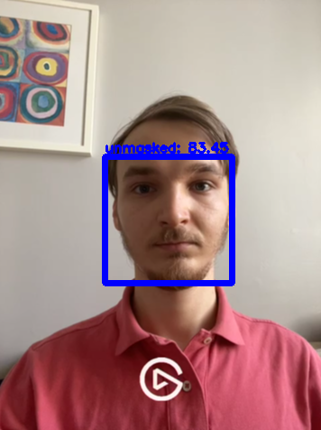
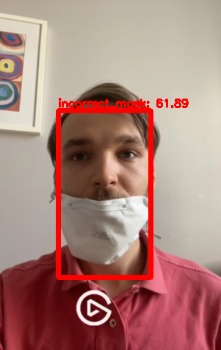
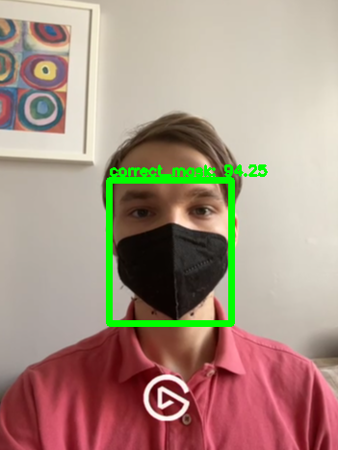
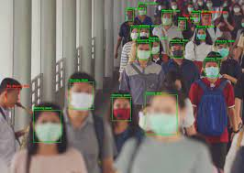
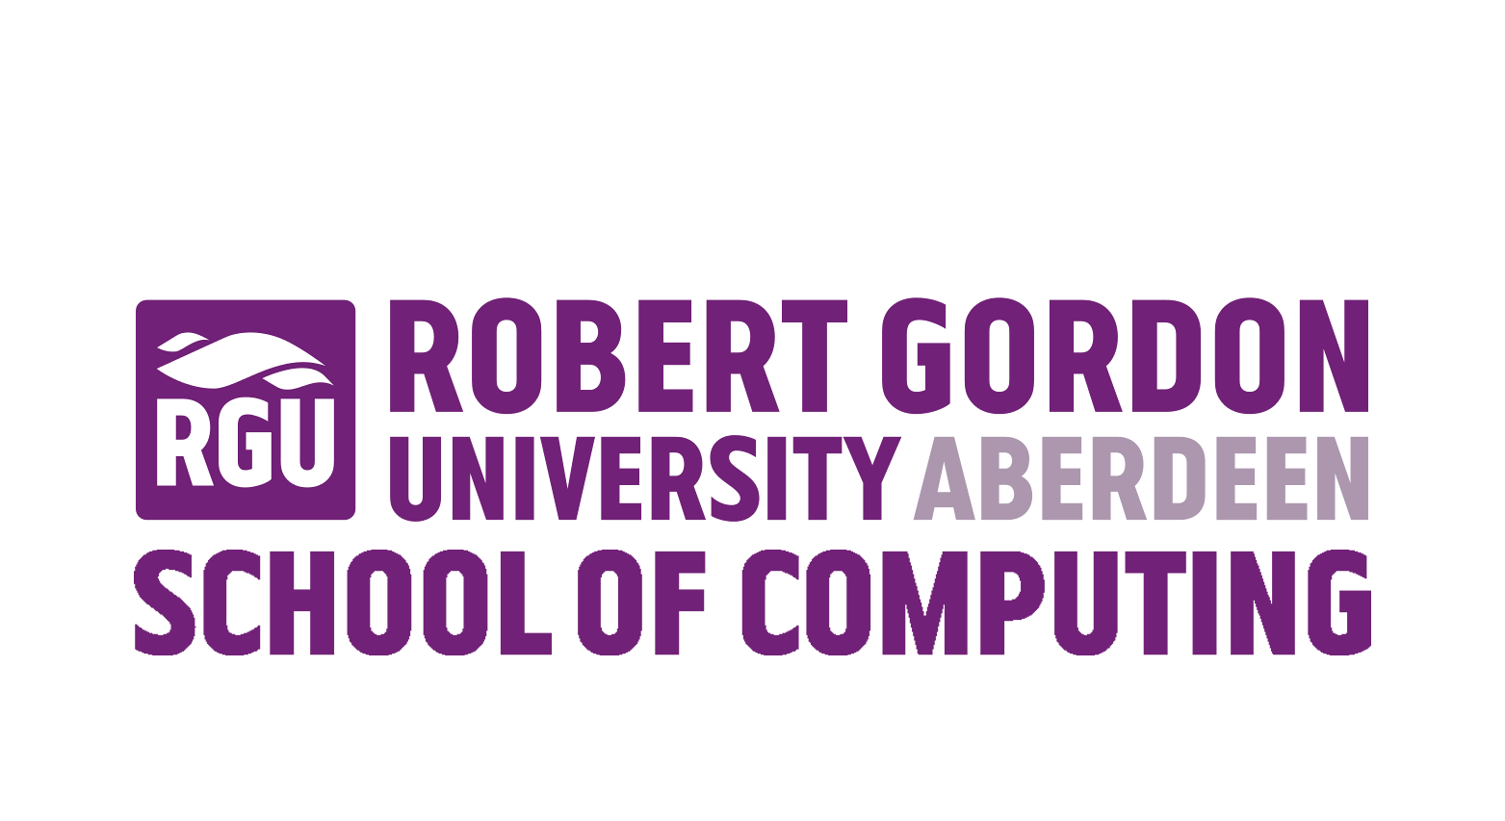
Mobile application used to detect the correct face mask wearing based on face recognition.
Rokas Budreika & Carlos Moreno-Garcia
Introduction
Methods
Conclusion
Nowadays more and more people come across problems that could affect their health. Because of the particle pollution in the air, the risk of getting sick with chronic diseases are getting higher, especially in countries like China. Flu virus can also cause the pandemic and negatively affect public life. These days predominant Covid-19 pandemic causes to take drastic actions, which would stop spreading of virus, to save people’s lives and to let to continue development of economy. Protective face masks are recommended or even necessary tool to stop spread of flu and Covid-19 viruses. Protective masks also help from particle pollution. However, not all of the people are concerned enough to wear masks when it is necessary or simply wear them incorrectly. Thinking about bigger picture and to protect the public health from upcoming health issues and possible death, especially pandemic time, we have to raise higher number of people wearing the masks.
Living this high-tech century, where AI (artificial intelligence) is becoming more popular, efficient and effective as a tool, we can use this tool to ensure face masks wearing. Using neural networks and machine learning technology, we can create AI method, which would monitor places where there are a lot of people. The main function of this method would be to decide if a person wearing a face mask and if he/she wearing it correctly. Using this information, we can use it as a tool to decrease number of people without face masks or wearing incorrectly. We can use this system within robots in shopping centres, which not only consult, navigate people but also would ask to wear face mask or adjust face mask to wear correctly.
I have used neural networks (ANNs) which are a subset of machine learning and are at the heart of deep learning algorithms. Neural networks rely on training data to learn and improve their accuracy over time.
To more concrete, I have used convolutional neural networks (CNN) which is specifically used for image recognition and processing.
I have also used Image Segmentation, this is a task of clustering parts of an image together that belong to the same object class. This process is also called pixel-level classification. Image segmentation plays a central role in a broad range of real-world computer vision applications.
Finally, I have used You Only Look Once (YOLO) algorithm that employs CNNs to detect objects in real-time 45 frames per second (FPS) speed. As the name suggest, the algorithm requires only a single forward propagation through a neural network to detect objects. Prediction is done in a single algorithm run.
I have deemed this project a successful-failure. Even though time did not allow me to deploy fully functional mobile application, I have learnt important lessons concerning the development process and mobile application would be in near upcoming future. When project started I have underestimated size of the project, and delays on progress should be anticipated and the issues can be expected. This project has taught me how to deal with these problems.
A success I have accomplished is my fully functional windows PC version system that can detect and classify if a person is wearing a face mask and if wearing it correctly.
I have successfully deployed, used and compared YOLO v4 and YOLO v4 tiny algorithms. YOLO v4 tiny was supposed to run on mobile application, while YOLO v4 on PC.
Figures and Results
Acknowledgments
Researching and trying to make this project I have found out that YOLO algorithm is key element for this project. I have tried to compare my deployed YOLO v4, YOLO v4 tiny models with other already made projects. YOLO v4 is way more accurate classifying if the person is wearing facemask or not and if wearing it incorrectly than using YOLO v4 tiny, which is more suitable for mobile system due to using less memory resources. Numbers that I have achieved is during the learning period of the AI and only from photos. After trying it out on real-time surveillance these numbers on average were lower. Following I have compared the algorithms accuracies and it was quite obvious I will use YOLO v4 (full version) for my project. Since, the accuracy numbers is quite fitting for a success of this project. Below are given detailed information.
I would like to express my special thanks of gratitude to my teacher Carlos Moreno-Garcia as well as school of Computing that gave me the golden opportunity to do this wonderful project on the topic of Computer Vision, which helped me in doing a lot of research and I come to know about so many new things.
I am really thankful for this.
I would also like to thank to everyone else who helped and supported me.
Project Aim
This project is about preserving public health. To do so I will deploy a functioning system, which can detect and classify if a person is wearing a mask and if he/she wearing it correctly. This project is important for all companies that have public areas where people gather, from workplaces to attractions.
No. |  | ResNet-50 with Decision Trees, SVM and ensemble method | YOLO v2 with ResNet-50 | MaskedFace-Net | My Project YOLOv4 (full version) | My Project YOLOv4 tiny
1 | Used Algorithms | “ResNet-50” “Decision Trees” “SVM” “Ensemble” | “ResNet-50” “YOLO v2” “SGDM” “ADAM” | It is not publicly available. Given only “gif” of prototype | “OpenCV”
2 | Capability to recognise face masks | + | + | + | + | +
3 | Capability to recognise if face mask is worn correctly | - | - | + | + | +
4 | Testing Accuracy | 99.64% | 81% | 98% | 88% | 43%
References
„Keras & TensorFlow 2”.Link https://keras.io/about
Deep Learning and Image segmentation. Link https://viso.ai/deep-learning/image-segmentation-using-deep-learning/
More on YOLO v4, v3, v2 methods and similar project. Link GitHub - AlexeyAB/darknet: YOLOv4 / Scaled-YOLOv4 / YOLO - Neural Networks for Object Detection (Windows and Linux version of Darknet )
Computer Science

