Slide 1
RahmanMemberVault
A Clean-Architecture .NET 9 Member Management API
Md Mustafizur Rahman
Senior Developer Advocate Candidate

Slide 2
Agenda
Problem Statement & Goals
Solution Overview
Architecture Deep-Dive
Quick demo of End Points
Key Features
Testing
CI/CD & Deployment
Future Roadmap
Q&A

Slide 3



Problem Statement & Goals
HTTP GET
HTTP PUT
HTTP DELETE
Centralized Member Records Management System.
At least Read, Update and Delete a member
Api Documentation
Remote repository in Github
Cloud hosting
Member Records

Slide 4




High-Level Solution Overview
Client
API
Database

Slide 5

Architecture
Domain/Core
Entity/Model
Interfaces
DTOs
Services ( Business logic )
Mappings ( DTO ←→Entity )
Validators
Application
Infrastructure
Db Context
Migrations
Repository
Presentation/Api
Api Controllers
Dependency Injection
Exception Handling

Slide 6
End Points
Method | Endpoint | Description
GET | /api/v1/member | Retrieve all members
GET | /api/v1/member/{id} | Retrieve member by ID
POST | /api/v1/member | Create a new member
PUT | /api/v1/member/{id} | Update a membe
DELETE | /api/v1/member/{id} | Delete a member

Slide 7
Demo Time

Slide 8
Key Features
Robust Validation: DTO → FluentValidation
Global Error Handling: User-friendly + unexpected errors w/ tracking IDs
Swagger Everywhere: Interactive spec in prod & dev
Ease of Deployment: GitHub Actions CI/CD pipeline automates building, testing, and deploying to Azure Web Apps.
Provider-Agnostic: Swap DB by config

Slide 9
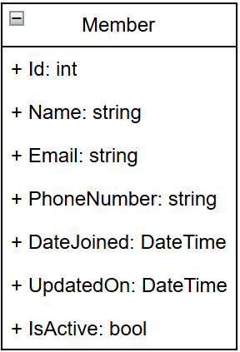
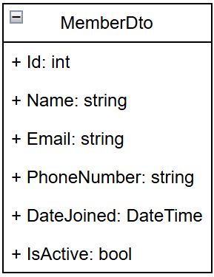
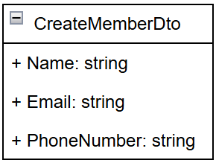
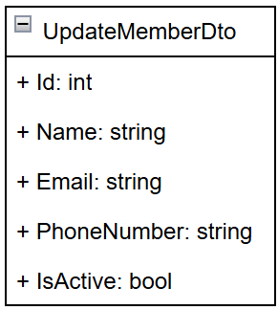
Member Entity And DTOs

Slide 10
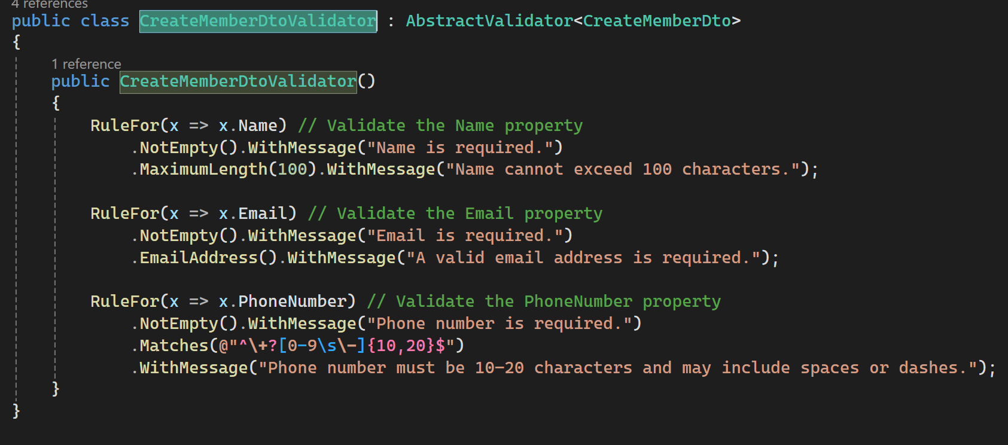
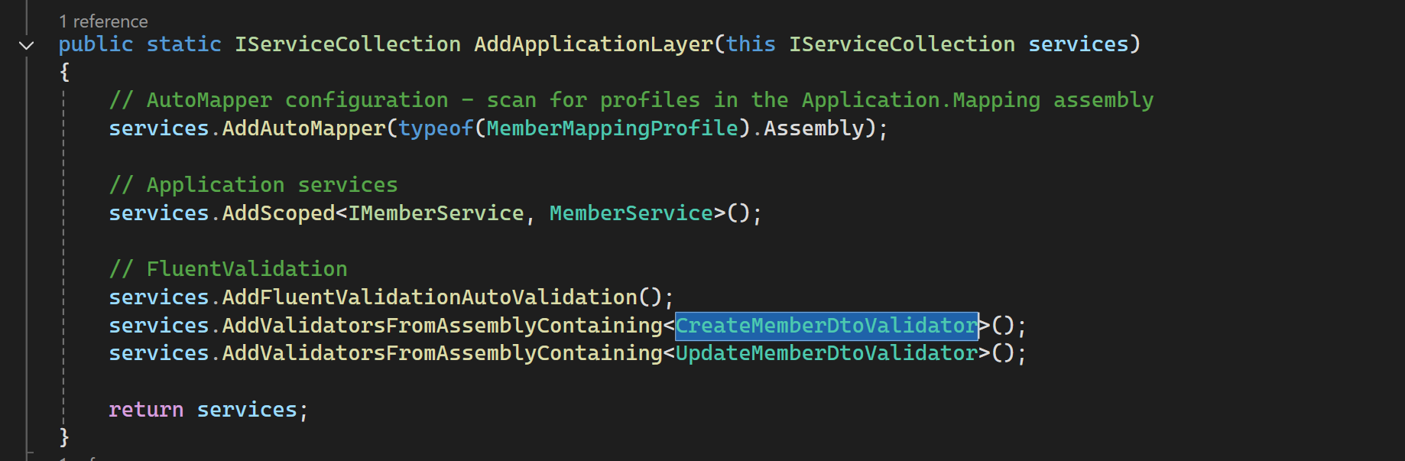
Code Walk-Through (Create Validation)

Slide 11
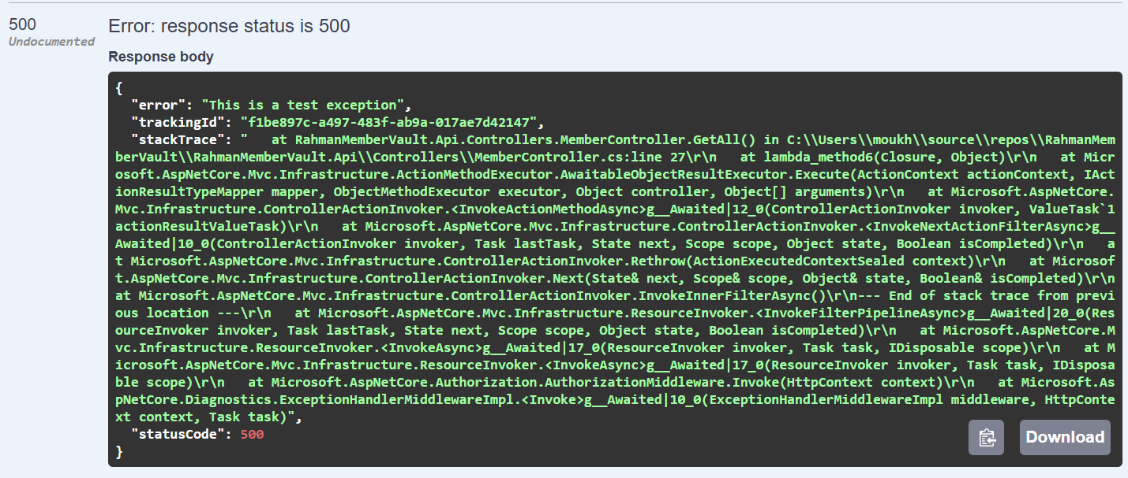
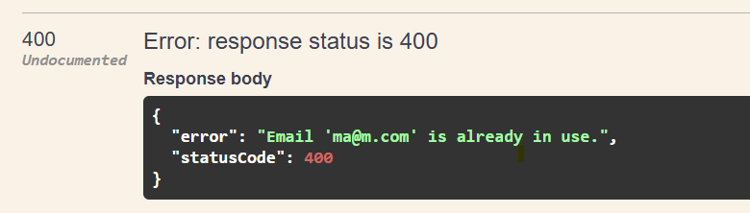
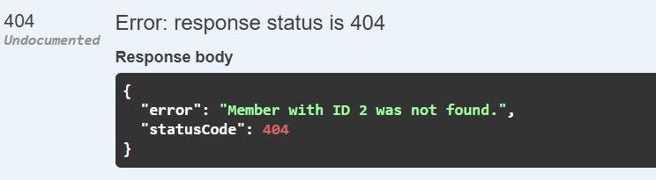
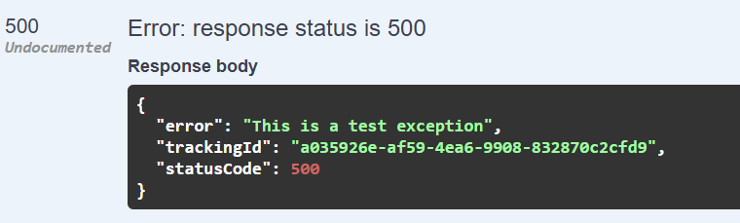
Exception handler
Development
Global Exception Handling using IExceptionHandler
Keeps controllers and business logic clean and focused.
Error handling becomes a dedicated concern handled in one place.
Provides uniform JSON responses for errors (e.g., 404, 400, 500).
Easy to include tracking IDs, timestamps, and helpful error details for debugging.
Makes it easier to unit test how different exception types are handled, compared to scattered try-catch blocks.
Handled exception
Unhandled exception
Prod

Slide 12
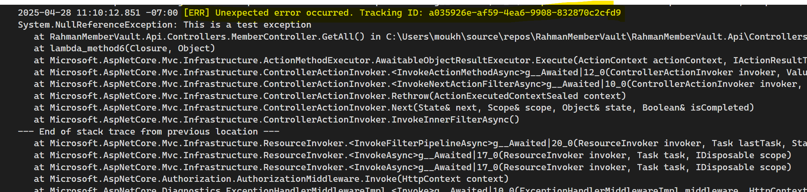

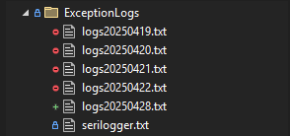
Logging

Slide 13
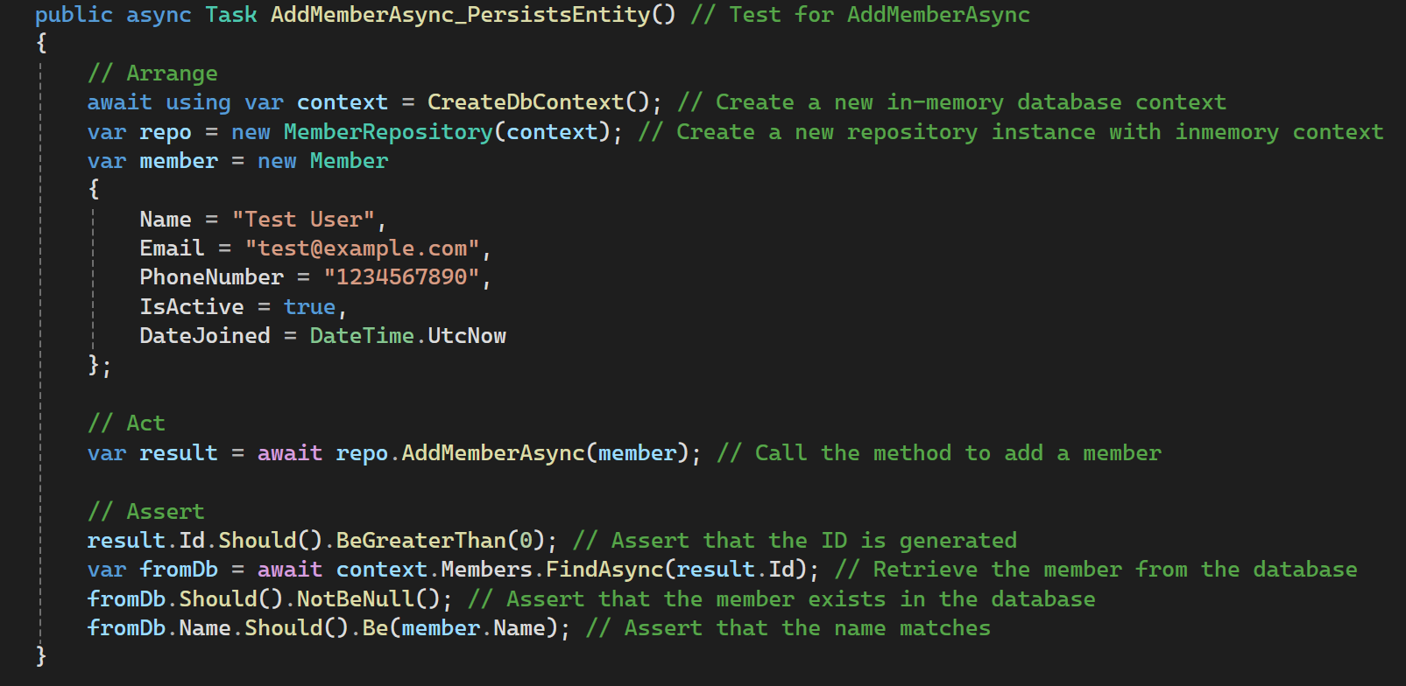
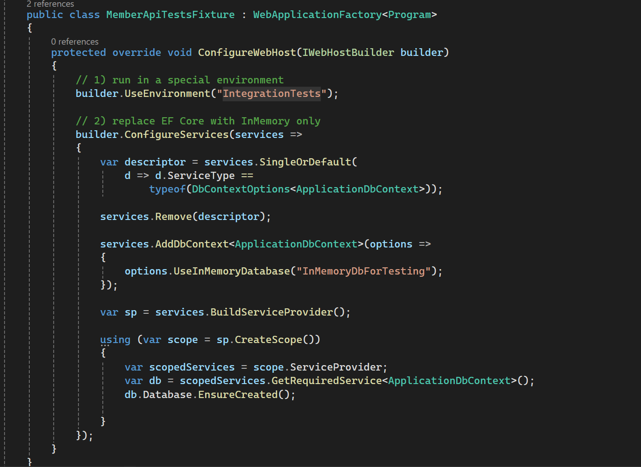
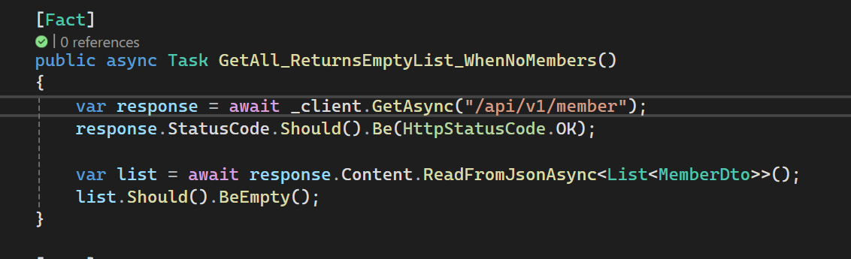
Testing Strategy
Unit
Controllers
Services
Integration
MemberApiTestsFixture
MemberApiTests
Repository
Validators
To Avoid DbContext registering twice
To Ensure fresh db in every test case
Add new db
Making sure new db created

Slide 14
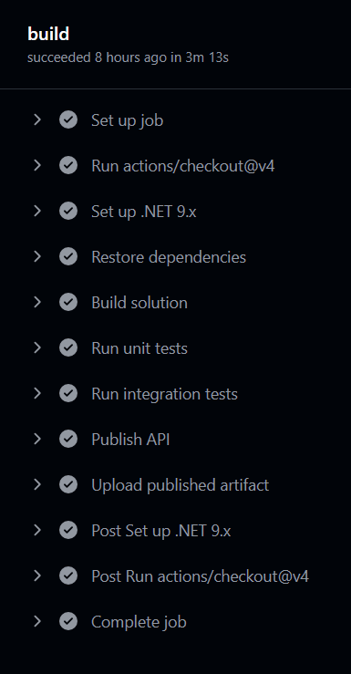
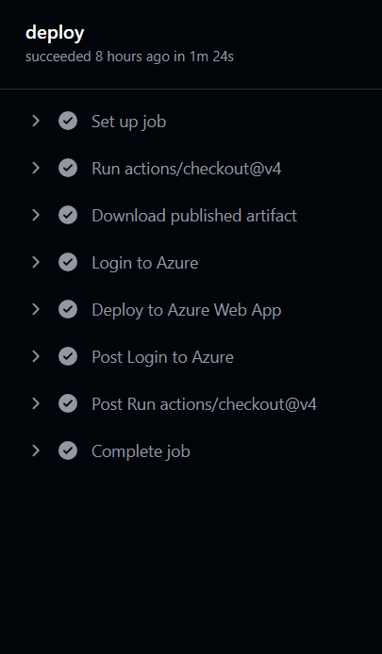
CI/CD & Deployment
Local
GitHub Repo
Github Actions
Azure app Services

Slide 15
Provided Documentations
Read ME
Overview
API Reference
Authentication Information
Data Transfer Objects
Getting Started
API Endpoints (v1)
Testing & Deployment
Support & Troubleshooting
Solution Brief
Problem Statement
Architecture at a Glance
Roadmap / Next Steps
Key Benefits
Endpoints URL , Request Body, Parameters, Validation Rules and Response Examples
Swagger
Api End point.
Examples and build In Api test capabilities.

Slide 16
Future Roadmap
Switch to MS SQL server
Paging & filtering on GET
Authentication / Authorization
CQRS with MediatR
Switch to database logging
Implement Caching if needed

Slide 17


