Slide 1
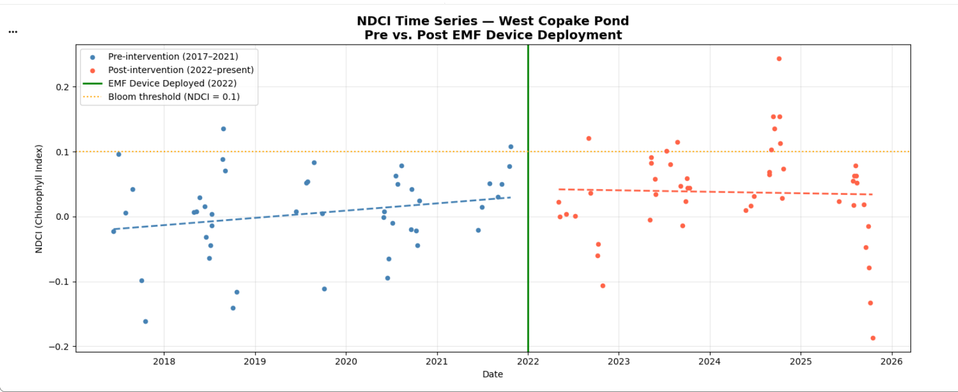
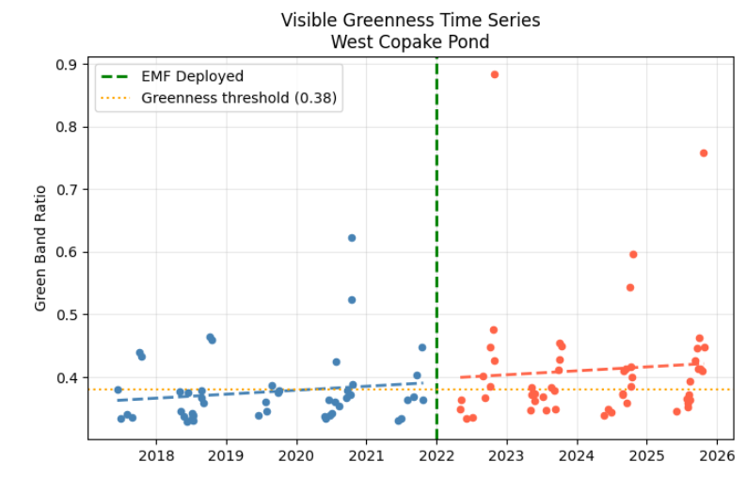
Does EMF Technology Suppress Harmful Algal Blooms?
A Satellite-Based Assessment of Chrysler Pond
Purpose:
Harmful algal blooms (HABs) pose serious threats to freshwater ecosystems and public health. Since 2022, an electromagnetic frequency (EMF) device has been seasonally deployed at Chrysler Pond, NY with the goal of suppressing bloom formation. This project uses 8 years of Sentinel-2 satellite imagery to independently evaluate whether measurable changes in water quality followed the device's deployment.
NDCI Time Series
The Normalized Difference Chlorophyll Index (NDCI) measures algal chlorophyll concentration using Sentinel-2 Band 5 and Band 4 reflectance. Values above 0.1 indicate active bloom conditions.Across 95 cloud-filtered scenes from 2017–2025, post-intervention years show a higher frequency of scenes exceeding the bloom threshold (16 vs. 5 pre-intervention).
Visible Greenness
The green band ratio measures the proportion of visible green light reflected from the water surface, a direct indicator of algal tinting visible to the naked eye. The post-2022 period shows both an elevated mean and an upward trend in greenness, supported by the NDCI findings.
Overall Findings:
Both satellite metrics indicate elevated algal activity in the post-intervention period. While 2022 and 2025 show encouraging low values, 2024 was the worst bloom year from the period observed. Weather alone (temp r=0.53, p=0.14) does not fully explain the anomaly. Satellite evidence is insufficient to confirm device efficacy. Longer monitoring and controlled comparison are warranted.

