Slide 1
INTRODUCTION TO SPARK AND PYSPARK

Slide 2
The 3 V's of Big Data
✓ Big Data refers to large and complex data sets that cannot be easily processed using traditional data processing applications.
Volume: Size of the data
Variety: Different sources and formats
Velocity: Speed of the data

Slide 3
Big Data concepts and Terminology
Clustered computing : Collection of resources of multiple machines
Parallel computing : Simultaneous computation on single computer
Distributed computing : Collection of nodes (networked computers) that run in parallel
Batch processing : Breaking the job into small pieces and running them on individual
machines
Real-time processing : Immediate processing of data

Slide 4
Big Data processing systems
Hadoop/MapReduce:
Scalable and fault tolerant framework written in Java
Open sourceBatch processing
Apache Spark:
General purpose and lightning fast cluster computing system
Open source
Both batch and real-time data processing
Note: Apache Spark is nowadays preferred over Hadoop/MapReduce

Slide 5
Why Apache Spark?
Speed
Ease of Use
Fault Tolerance
Unified Processing Engine
Scalability

Slide 6
The Role of Apache Spark in Big Data Processing
In-Memory Computing
Versatility
Advanced Analytics
Efficient Data Processing

Slide 7
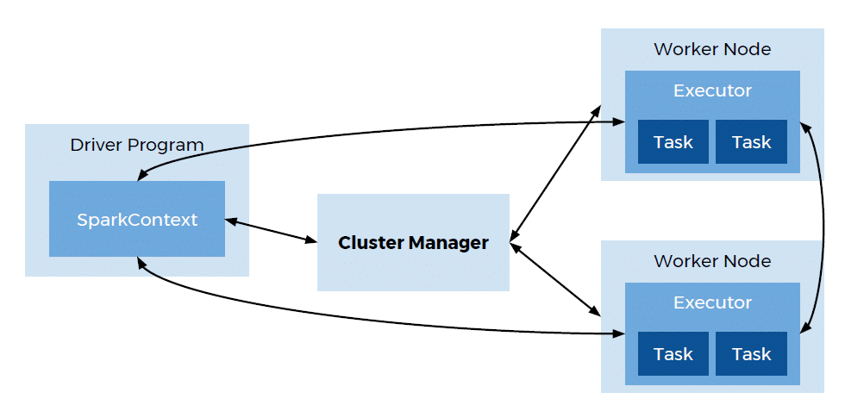
Architecture of Apache Spark
Cluster Manager: Spark relies on a cluster manager to allocate resources and schedule tasks across the cluster.
Driver Program: Coordinates the execution of tasks and maintains the overall execution state.
Executor: Manage the execution of individual tasks, store data in memory or disk, and communicate with the driver program.
4. Worker Node: Host one or more executors and are responsible for executing tasks and storing data.

Slide 8
RDDs (Resilient Distributed Datasets): The Basic Concept of Spark
Immutable Distributed Collections: distributed collections of immutable objects spread across multiple nodes in a cluster.
Fault Tolerance: RDDs are fault-tolerant by nature.
Lazy Evaluation: RDDs support lazy evaluation, meaning transformations on RDDs are not computed immediately.
Partitioning: RDDs are divided into partitions, which are basic units of parallelism in Spark.
Transformation Operations: RDDs support two types of operations: transformations and actions.
Actions: Actions are operations that trigger the execution of transformations and return results to the driver program, such as count, collect, and saveAsTextFile.

Slide 9
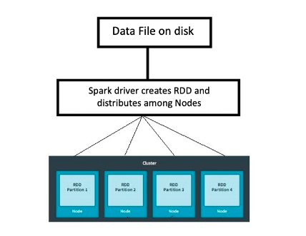
More on RDD
RDD = Resilient Distributed Datasets
Resilient: Ability to withstand failures
Distributed: Spanning across multiple machines
Datasets: Collection of partitioned data e.g, Arrays, Tables, Tuples etc.,

Slide 10
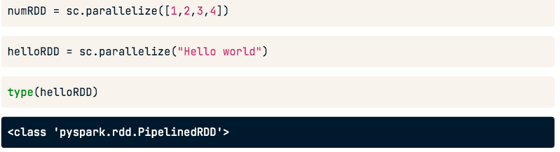
Parallelized collection (parallelizing)
parallelize() for creating RDDs from python lists

Slide 11
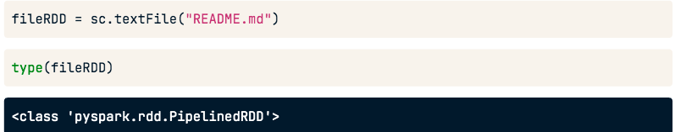
From external datasets
textFile() for creating RDDs from external datasets

Slide 12
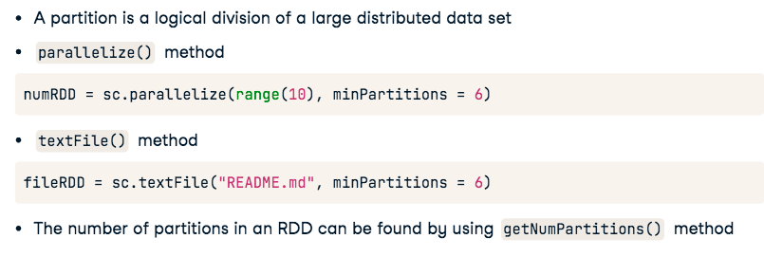
Understanding Partitioning in PySpark

Slide 13

Overview of PySpark operations
Transformations create new RDDs
Actions perform computation on the RDDs

Slide 14
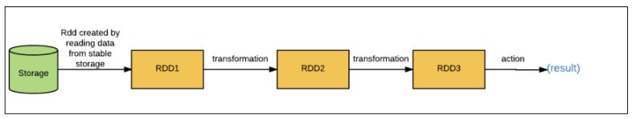
RDD Transformations
Transformations follow Lazy evaluation
Basic RDD Transformations →map(), filter(), flatMap(), and union()

Slide 15
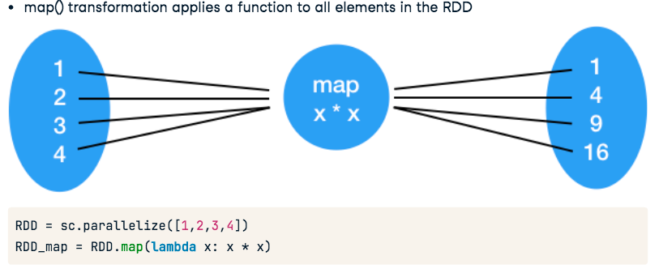
map() Transformation

Slide 16
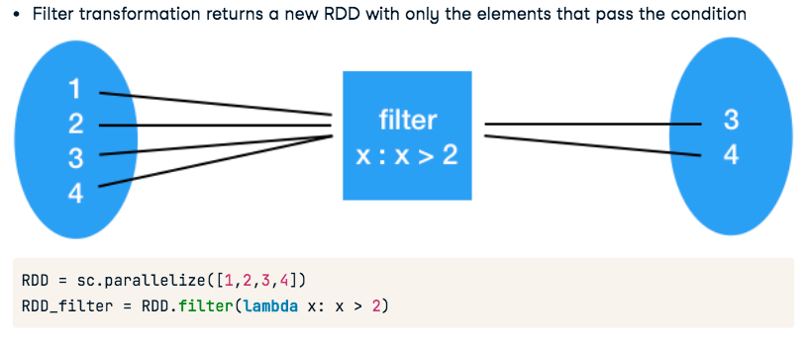
filter() Transformation

Slide 17
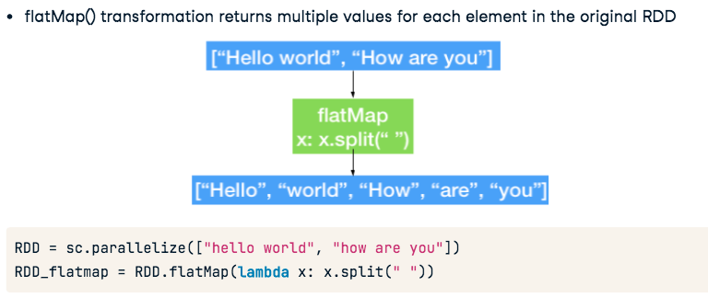
flatMap() Transformation

Slide 18
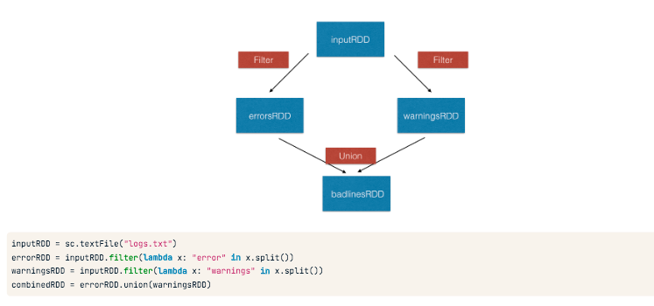
union() Transformation

Slide 19
RDD Actions
They are operations that return a value after running a computation on the RDD
Basic RDD Actions
collect()
take(N)
first()
count()

Slide 20
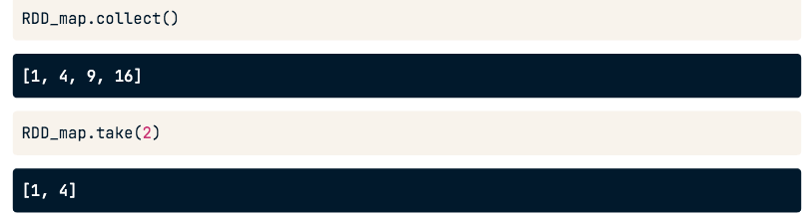
collect() and take()
Actions
collect() return all the elements of the dataset as an array
take(N) returns an array with the first N elements of the dataset

Slide 21
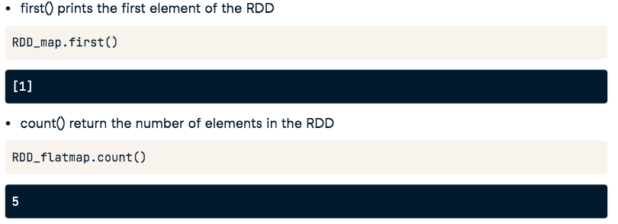
first() and count() Actions

Slide 22
Introduction to pair RDDs in PySpark
Real life datasets are usually key/value pairs
Each row is a key and maps to one or more values
Pair RDD is a special data structure to work with this kind of datasets
Pair RDD: Key is the identifier and value is the data

Slide 23
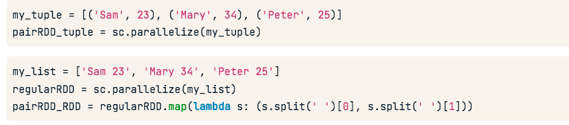
Creating pair RDDs
Two common ways to create pair RDDs
  From a list of key-value tuple
  From a regular RDD
Get the data into key/value form for paired RDD

Slide 24
Transformations on pair RDDs
All regular transformations work on pair RDD
Have to pass functions that operate on key value pairs rather than on individual elements
Examples of paired RDD Transformations
reduceByKey(func): Combine values with the same key
groupByKey(): Group values with the same key
sortByKey(): Return an RDD sorted by the key
join(): Join two pair RDDs based on their key

Slide 25
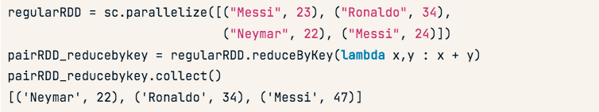
reduceByKey() transformation
reduceByKey() transformation combines values with the same key
It runs parallel operations for each key in the dataset
It is a transformation and not action

Slide 26

sortByKey() transformation
sortByKey() operation orders pair RDD by key
It returns an RDD sorted by key in ascending or descending order

Slide 27
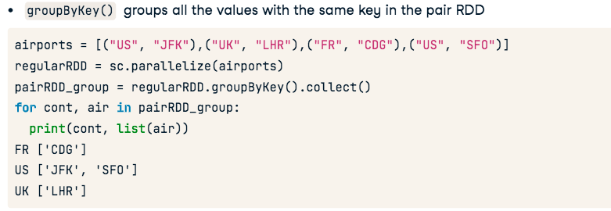
groupByKey() transformation

Slide 28
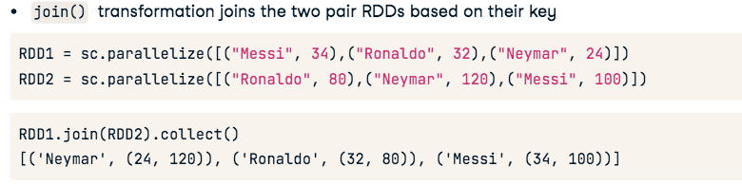
join() transformation

Slide 29
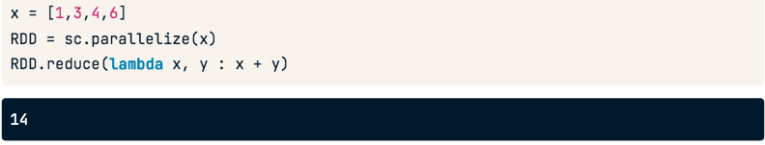
reduce() action
reduce(func) action is used for aggregating the elements of a regular RDD
The function should be commutative (changing the order of the operands does not changethe result) and associative
An example of reduce() action in PySpark

Slide 30
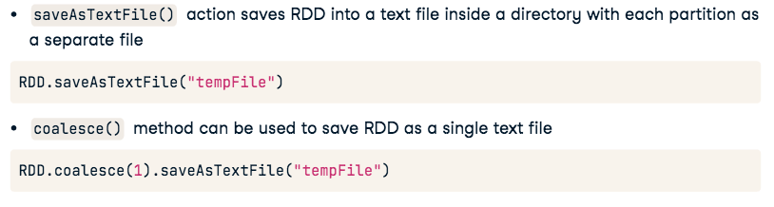
saveAsTextFile() action

Slide 31
Action Operations on pair RDDs
RDD actions available for PySpark pair RDDs
Pair RDD actions leverage the key-value data
Few examples of pair RDD actions include
  countByKey()
  collectAsMap()

Slide 32

countByKey() action
collectAsMap() return the key-value pairs in the RDD as a dictionary
Example of collectAsMap() on a simple tuple

Slide 33
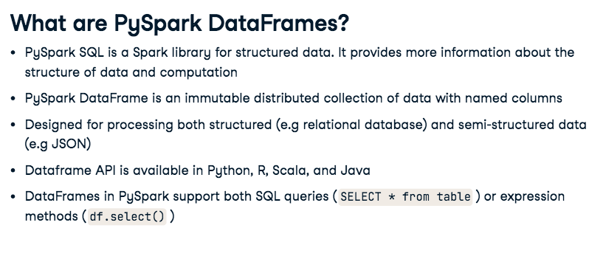

Slide 34
SparkSession - Entry point for DataFrame API
SparkContext is the main entry point for creating RDDs
SparkSession provides a single point of entry to interact with Spark DataFrames
SparkSession is used to create DataFrame, register DataFrames, execute SQL queries
SparkSession is available in PySpark shell as spark

Slide 35
Creating DataFrames in PySpark
Two different methods of creating DataFrames in PySpark
  From existing RDDs using SparkSession's createDataFrame() method
  From various data sources (CSV, JSON, TXT) using SparkSession's read method
Schema controls the data and helps DataFrames to optimize queries
Schema provides information about column name, type of data in the column, empty values
etc.,

Slide 36
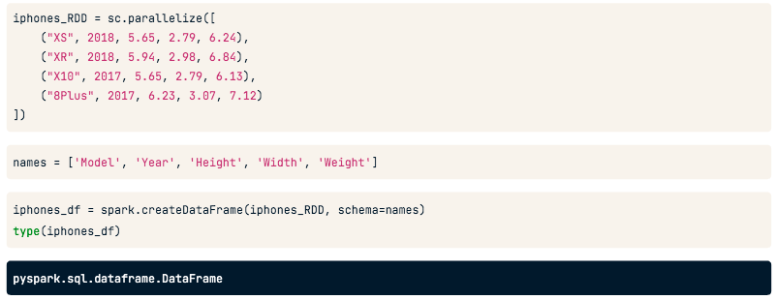
Create a DataFrame from RDD

Slide 37
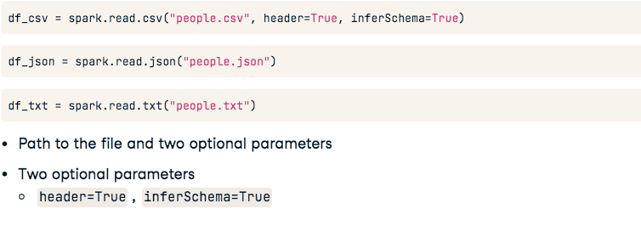
Create a DataFrame from reading a CSV/JSON/TXT

Slide 38
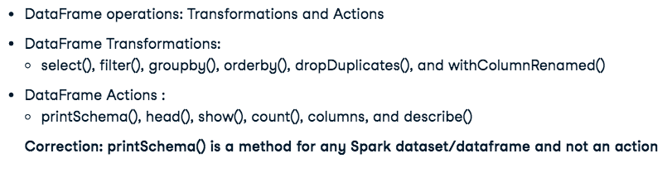
DataFrame operators in PySpark

Slide 39
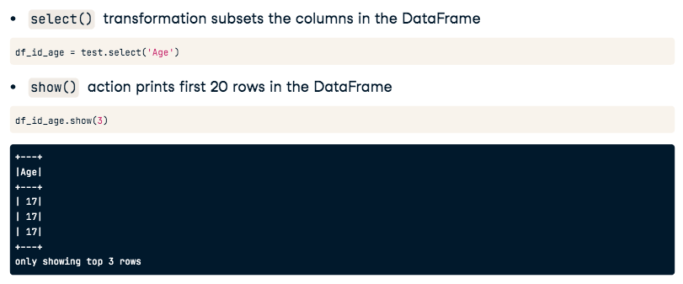
DataFrame operators in PySpark

Slide 40
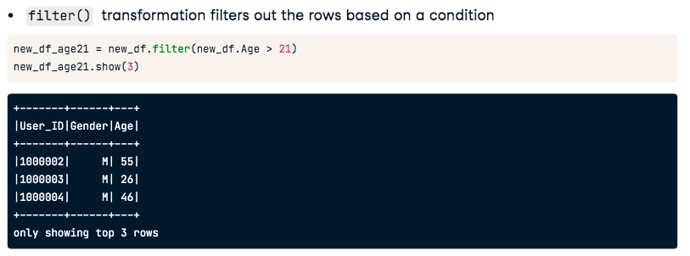
filter() and show() operations

Slide 41
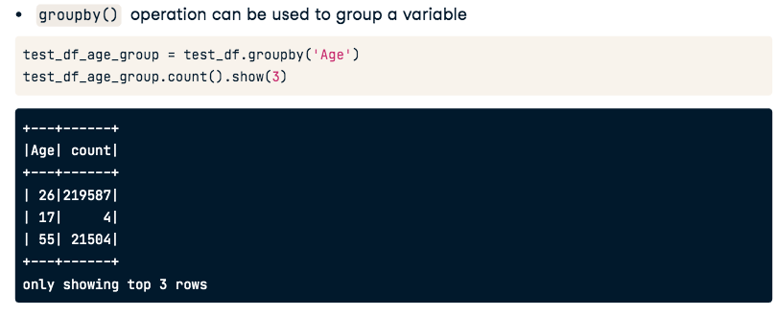
groupby() and count() operations

Slide 42
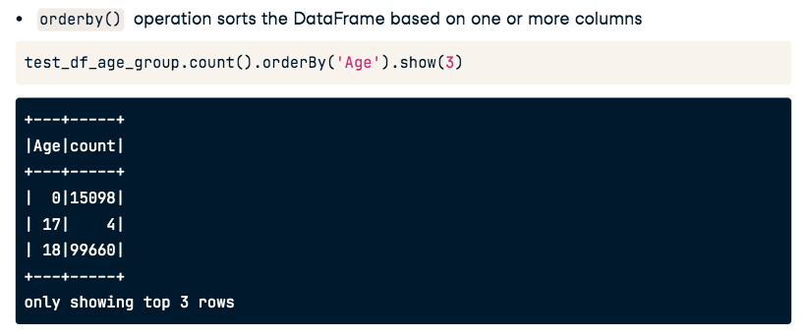
orderby() Transformations

Slide 43
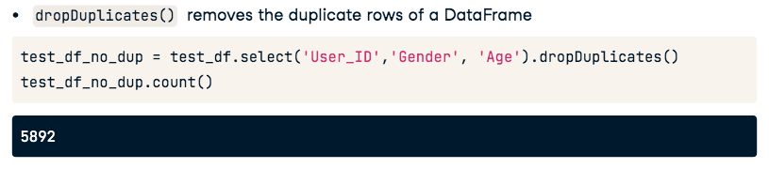
dropDuplicates()

Slide 44
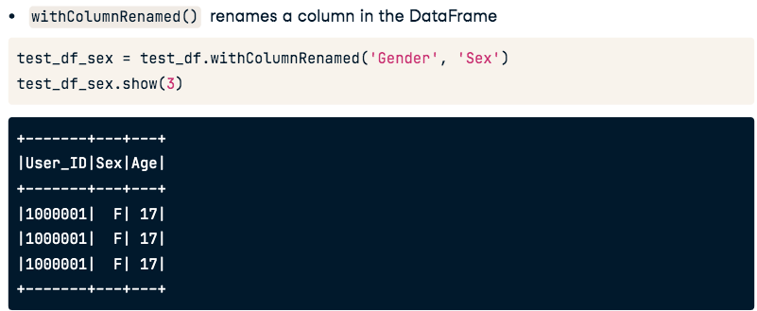
withColumnRenamed Transformations

Slide 45
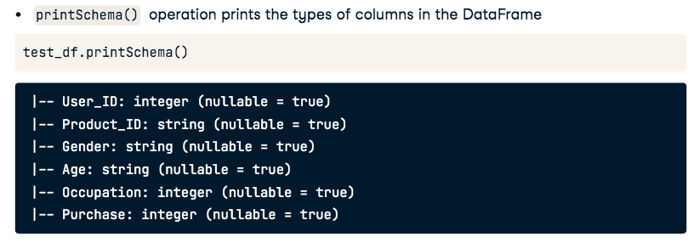
printSchema()

Slide 46
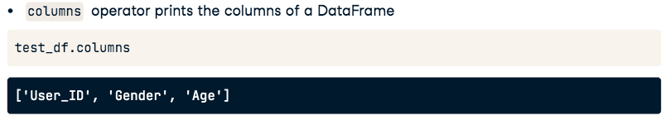
columns actions

Slide 47
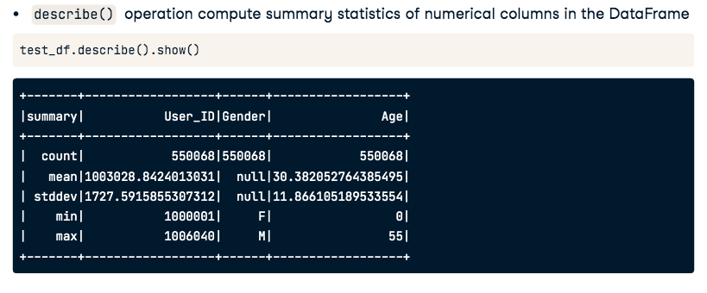
describe() actions

Slide 48
DataFrame API vs SQL queries
In PySpark You can interact with SparkSQL through DataFrame API and SQL queries
The DataFrame API provides a programmatic domain-specific language (DSL) for data
DataFrame transformations and actions are easier to construct programmatically
SQL queries can be concise and easier to understand and portable
The operations on DataFrames can also be done using SQL queries

Slide 49
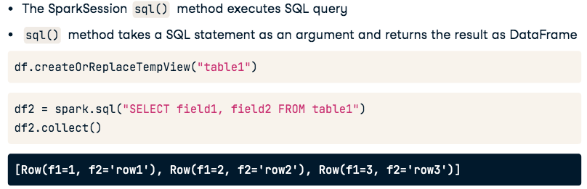
Executing SQL Queries

Slide 50
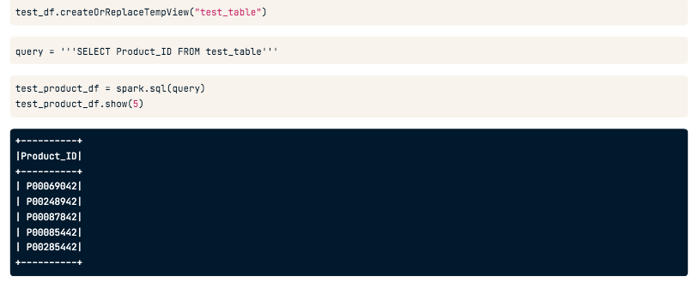
Executing SQL Queries

Slide 51
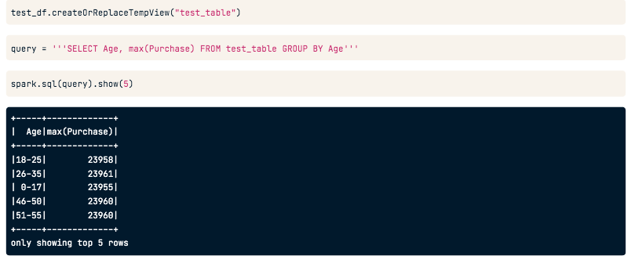
Summarizing and grouping data using SQL queries

Slide 52
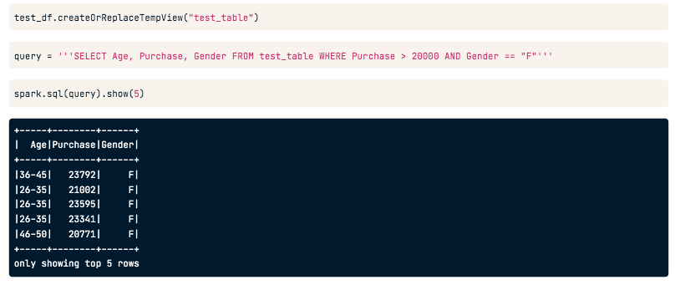
Filtering columns using SQL queries

Slide 53
What is Data visualization?
Data visualization is a way of representing your data in graphs or charts
Open source plotting tools to aid visualization in Python:
  Matplotlib, Seaborn, Bokeh etc.,
Plotting graphs using PySpark DataFrames is done using three methods
  pyspark_dist_explore library
  toPandas()
  HandySpark library

Slide 54
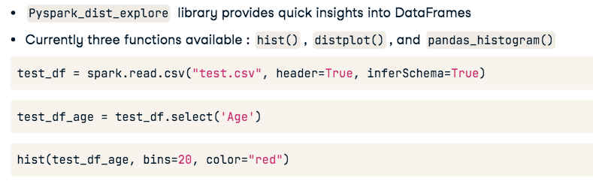
Data Visualization using Pyspark_dist_explore

Slide 55
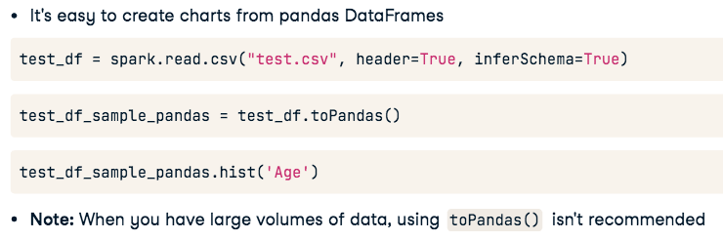
Using Pandas for plotting DataFrames

Slide 56
Pandas DataFrame vs PySpark DataFrame
Pandas DataFrames are in-memory, single-server based structures and operations on PySpark run in parallel
The result is generated as we apply any operation in Pandas whereas operations in PySpark DataFrame are lazy evaluation
Pandas DataFrame as mutable and PySpark DataFrames are immutable
Pandas API support more operations than PySpark Dataframe API

Slide 57
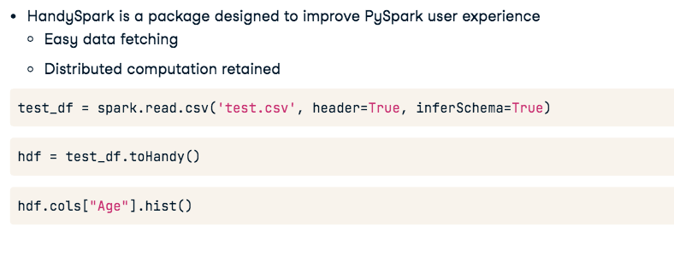
HandySpark method of visualization

Slide 58
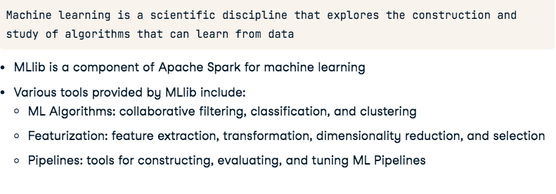
What is PySpark MLlib?

Slide 59
Why PySpark MLlib?
Scikit-learn is a popular Python library for data mining and machine learning
Scikit-learn algorithms only work for small datasets on a single machine
Spark's MLlib algorithms are designed for parallel processing on a cluster
Supports languages such as Scala, Java, and R
Provides a high-level API to build machine learning pipelines

Slide 60
PySpark MLlib Algorithms
Classification (Binary and Multiclass) and Regression : Linear SVMs, logistic regression,
decision trees, random forests, gradient-boosted trees, naive Bayes, linear least squares,
Lasso, ridge regression, isotonic regression
Collaborative filtering : Alternating least squares (ALS)
Clustering : K-means, Gaussian mixture, Bisecting K-means and Streaming K-Means

Slide 61
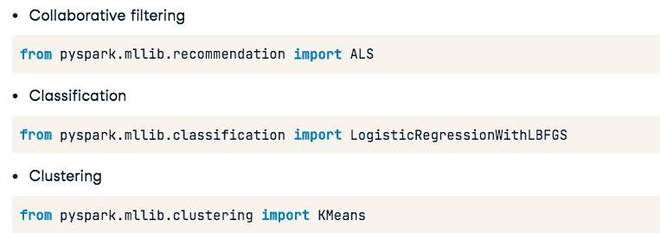
PySpark MLlib imports

Slide 62
What is Collaborative filtering?
Collaborative filtering is finding users that share common interests
Collaborative filtering is commonly used for recommender systems
Collaborative filtering approaches:
User-User Collaborative filtering : Finds users that are similar to the target user
Item-Item Collaborative filtering : Finds and recommends items that are similar to items
with the target user

Slide 63
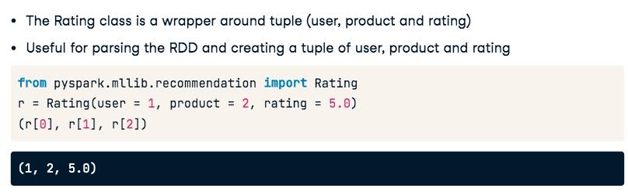
Rating class in pyspark.mllib.recommendationsubmodule

Slide 64
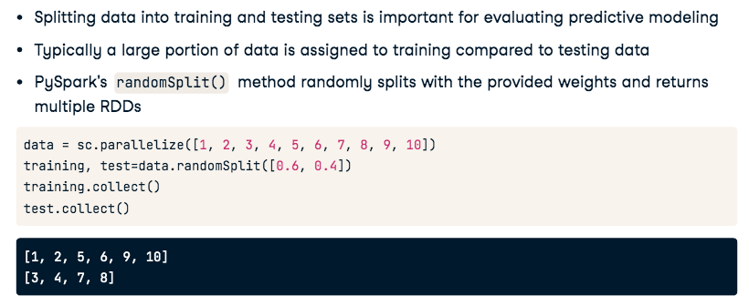
Splitting the data using randomSplit()

Slide 65
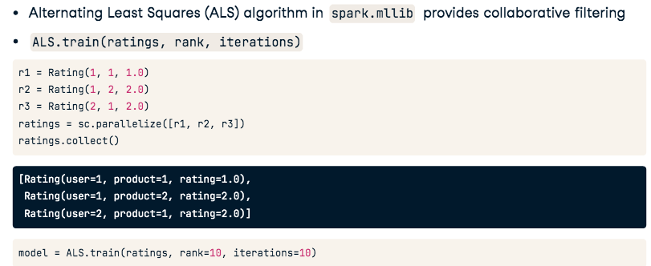
Alternating Least Squares (ALS)

Slide 66
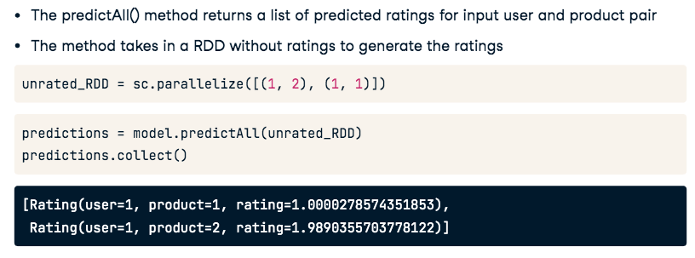
predictAll()

Slide 67
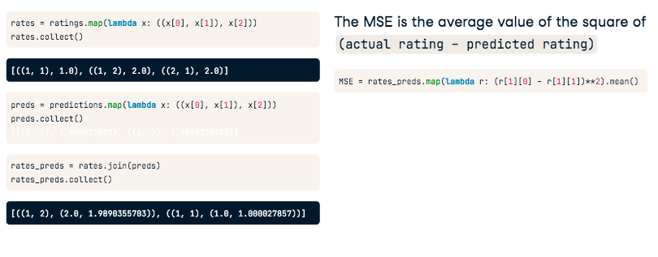
Model evaluation

Slide 68
Transformations and Actions in Spark
Transformations: Transformations are operations that create a new RDD by applying a function to each element of the original RDD. Examples of transformations include map, filter, flat Map, and sortBy Key.
Narrow Transformations: Narrow transformations produce RDDs where each output partition depends on only one input partition. Examples include map and filter, which can be executed in parallel without shuffling data across partitions.
Wide Transformations: Wide transformations, also known as shuffle operations, require data to be shuffled across partitions. Examples include group By Key and join, which involve data reorganization and may incur network I/O.
Actions: Actions are operations that trigger the execution of transformations and return results to the driver program. Actions force the evaluation of RDDs and typically initiate the execution of the Spark job. Examples include count, collect, and save As Text File.
Lazy Evaluation: Spark uses lazy evaluation to optimize computation. Transformations are not executed immediately but are instead queued up until an action is called. This allows Spark to optimize execution plans and minimize unnecessary computations.

Slide 69
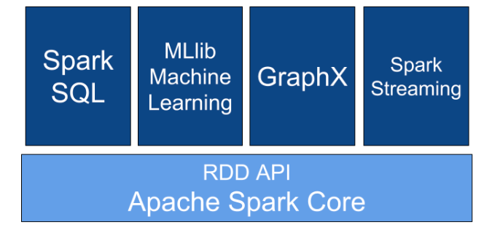
Apache Spark Components

Slide 70
Prerequisites for the Installation of PySpark
Python: Ensure Python is installed on your system. You can download Python from the official website or use a package manager like Anaconda.
Java: PySpark relies on the Java Virtual Machine (JVM) for execution. Make sure you have Java Development Kit (JDK) installed on your system. PySpark typically works well with JDK 8 or later versions.
Apache Spark: PySpark is a Python API for Apache Spark. You need to have Apache Spark installed on your system. You can download Spark from the official website or use a package manager like Apache Hadoop.

Slide 71
Installation of PySpark
Using pip:
You can install PySpark using pip, the Python package manager. Open a terminal or command prompt and run the following command: pip install pyspark
Using Conda:
If you are using Anaconda, you can install PySpark using conda. Run the following command in Anaconda Prompt: conda install -c conda-forge pyspark

Slide 72
Configuring PySpark for Local Development
Environment Variables: Set up environment variables such as JAVA_HOME and SPARK_HOME pointing to the Java and Spark installations, respectively. These variables are necessary for PySpark to locate the required dependencies.
Python Environment: Ensure that your Python environment is correctly configured to include PySpark in the PYTHONPATH. You may need to update the PYTHONPATH variable or modify your Python interpreter configuration file (e.g., .bashrc, .bash_profile, or .profile) to include the PySpark library.
Testing Installation: After installation and configuration, test your PySpark setup by launching a Python interpreter and importing the pyspark module. If successful, you should be able to interact with PySpark APIs without errors.

Slide 73
Why PySpark?
Pythonic Syntax: PySpark provides a Pythonic interface for Apache Spark, making it accessible to Python developers.
Integration with Python Ecosystem: PySpark seamlessly integrates with popular Python libraries such as Pandas, NumPy, and Matplotlib.
Large Developer Community: Python boasts a large and active developer community, which contributes to the growth and development of PySpark.
Flexible and Dynamic: Python's dynamic typing and flexibility allow for rapid prototyping and experimentation with data processing pipelines in PySpark.
Interactive Data Exploration: PySpark's interactive shell (PySpark Shell or pyspark) enables interactive data exploration and experimentation directly from the command line or Jupyter notebooks.

Slide 74
PySpark Compared to Other Spark APIs
Ease of Learning: PySpark's Pythonic syntax and familiarity with Python make it easier to learn.
Integration with Python Ecosystem: PySpark seamlessly integrates with the vast ecosystem of Python libraries.
Productivity and Rapid Prototyping: Python's dynamic nature and concise syntax enhance productivity and enable rapid prototyping in PySpark.
Performance: While Scala may offer slightly better performance due to its static typing and JVM optimization.
Community Support: Python has a large and active developer community, providing extensive resources, tutorials, and community support for PySpark.

Slide 75
Using PySpark for Big Data Analysis and Processing
Scalable Data Processing: PySpark enables scalable processing of large-scale datasets by leveraging Spark's distributed computing capabilities.
Data Transformation and Cleaning: PySpark provides powerful APIs for data transformation and cleaning, allowing users to preprocess raw data, filter out anomalies, and prepare data for downstream analysis or machine learning.
Advanced Analytics: With PySpark, users can perform advanced analytics tasks such as statistical analysis, predictive modeling, and machine learning on big data.
Real-time Stream Processing: PySpark Streaming enables real-time stream processing of data streams from various sources such as Kafka, Flume, and TCP sockets.
Graph Processing: PySpark GraphX provides APIs for graph processing and analysis, allowing users to model and analyze complex relationships and networks within large-scale datasets.

Slide 76
SparkSession and SparkContext
SparkContext (sc): SparkContext is the entry point to any Spark functionality. It represents the connection to a Spark cluster and coordinates the execution of Spark jobs. In older versions of Spark, SparkContext was the primary entry point for Spark applications.
SparkSession: SparkSession is introduced in Spark 2.0 as a unified entry point for interacting with Spark functionality. It encapsulates SparkContext and provides a simplified API for working with Spark features. SparkSession is used to create DataFrames, interact with Spark SQL, and execute Spark jobs.

Slide 77
The Main Data Structures in PySpark
DataFrames: DataFrames are distributed collections of structured data organized into named columns. They are similar to tables in relational databases or data frames in R/Python Pandas. DataFrames provide a higher-level API for working with structured data and are optimized for both batch and interactive processing.
Datasets: Datasets are a newer addition to Spark and represent a distributed collection of data with strong typing. Datasets combine the benefits of DataFrames with the advantages of strong typing, allowing for type-safe, object-oriented programming constructs. Datasets are available in both Java and Scala, but in PySpark, Datasets are represented as DataFrames.

Slide 78
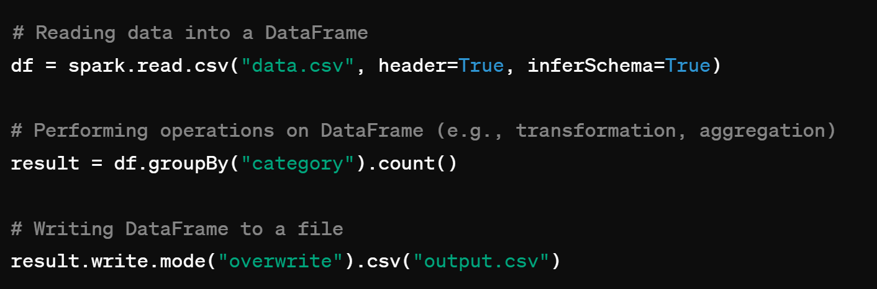
Reading and Writing Data with PySpark
Reading Data: You can use methods like spark.read.csv(), spark.read.json(), spark.read.jdbc(), etc., to read data into DataFrames.
Writing Data: Similarly, PySpark allows you to write data to different output formats and destinations using methods like DataFrame.write.format().
Example:

Slide 79
Data Cleansing and Manipulation with DataFrames
Missing Values Handling: provides methods to handle missing or null values in DataFrames, such as na.drop() to drop rows with null values, na.fill() to fill null values with specified values, and na.replace() to replace null values with custom values.
Column Operations: support various column operations, including adding new columns with calculated values using arithmetic or string manipulation, renaming columns using with ColumnRenamed(), and dropping columns with drop().
Filtering Data: filtering of Data Frame rows based on specified conditions using methods like filter() or using SQL-like syntax with where().
Data Type Conversion: allow for converting data types of columns using methods like cast() to convert a column to a different data type, ensuring data consistency and compatibility with downstream operations.
String Manipulation: PySpark provides string manipulation functions (e.g., substring(), split(), concat()) to perform operations on string columns within DataFrames.
Handling Duplicates: DataFrames offer methods such as dropDuplicates() to remove duplicate rows based on specified columns, ensuring data quality and integrity during data processing pipelines.

Slide 80
Aggregation and Grouping of Data
GroupBy Operation: allows grouping of DataFrame rows based on one or more columns.
Aggregation Functions: DataFrames support various aggregation functions such as count(), sum(), avg(), min(), max(), etc. .
Window Functions: PySpark offers window functions (e.g., window(), over()) to perform aggregation operations over specified window partitions, enabling advanced analytical calculations such as running totals, moving averages, and rank calculations.
Pivot Tables: DataFrames support pivot operations using the pivot() method, allowing users to transform row values into column headers and aggregate data accordingly, facilitating the creation of summary tables and reports.
Rollup and Cube Operations: PySpark supports rollup and cube operations to generate multi-level aggregations and subtotals across dimensions specified by grouping columns, providing flexibility in summarizing and analyzing data.

Slide 81
Join Operations and Other Advanced Manipulation Techniques
Join Types: inner join, outer join (left, right, full), semi-join, anti-join, etc., e.
Broadcast Joins: PySpark optimizes join operations using broadcast joins for smaller DataFrames that can fit into memory across all nodes, improving performance by reducing data shuffling and network overhead.
Partitioning and Bucketing: Users can optimize join performance by partitioning and bucketing DataFrames based on join keys, reducing data movement and improving data locality during join operations.
Union and Concatenation: union() and concat()
Sampling and Filtering: sample())
Advanced Data Manipulation Techniques: window functions, cross joins, Cartesian joins, and recursive queries, empowering users to perform complex data transformations and analyses on large-scale datasets.

Slide 82
PySpark with Common Data Analysis Libraries
PySpark DataFrames and Pandas DataFrames: Pandas() and createDataFrame()
Data Exploration and Preprocessing: Users can utilize Pandas for initial data exploration, summary statistics, and preprocessing tasks on smaller subsets of data before scaling up analysis with PySpark.
Integration with Matplotlib for Visualization: PySpark can be integrated with Matplotlib, a popular data visualization library in Python, to create a wide range of charts and plots directly from PySpark DataFrames.
Pandas UDFs for Custom Analysis: PySpark's Pandas User Defined Functions (UDFs) enable users to apply custom analysis and visualization functions written in Pandas to PySpark DataFrames efficiently.

Slide 83
Creating Charts and Visualizations from Spark Data
Aggregation and Grouping: PySpark allows users to perform data aggregation and grouping operations to summarize data before visualization.
Matplotlib Integration: PySpark's integration with Matplotlib enables users to create charts and visualizations directly from PySpark DataFrames.
Scalable Visualization: PySpark's distributed computing capabilities enable users to create visualizations from large-scale datasets that exceed the memory capacity of a single machine.
Interactive Visualization with Jupyter Notebooks: PySpark integrates seamlessly with Jupyter Notebooks, enabling users to create interactive visualizations using Matplotlib within a notebook environment.

Slide 84
Introduction to MLlib, Spark's Machine Learning Library
Overview of MLlib: MLlib is Spark's scalable machine learning library designed for large-scale distributed machine learning tasks.
Scalability and Performance: MLlib leverages Spark's distributed computing framework to parallelize machine learning algorithms across multiple nodes in a cluster, enabling efficient processing of large-scale datasets.
Integration with PySpark: MLlib is seamlessly integrated with PySpark, enabling Python developers to leverage Spark's machine learning capabilities directly from their Python code..

Slide 85
MLlib Algorithms for Classification, Regression, Clustering
Classification Algorithms: logistic regression, decision trees, random forests, gradient-boosted trees, support vector machines (SVM), and naive Bayes.
Regression Algorithms: MLlib provides regression algorithms such as linear regression, decision trees for regression, gradient-boosted trees for regression, and isotonic regression.
Clustering Algorithms: MLlib includes clustering algorithms such as k-means, Gaussian mixture models (GMM), and hierarchical clustering.
Dimensionality Reduction: MLlib provides dimensionality reduction techniques such as principal component analysis (PCA) and singular value decomposition (SVD).
Model Selection and Evaluation: MLlib includes tools for model selection and evaluation, such as cross-validation, hyperparameter tuning, and metrics for evaluating model performance (e.g., accuracy, precision, recall, F1-score, RMSE).

Slide 86
Practical Application of MLlib for Model Creation and Evaluation
Data Preparation
Model Training
Model Evaluation
Deployment and Integration
Iterative Development

Slide 87
Performance Considerations of PySpark Applications
Data Serialization: Choose appropriate serialization formats (e.g., Apache Arrow, Parquet) to optimize data transfer between the Python interpreter and Spark executors, minimizing serialization overhead and improving performance.
Partitioning: Optimize data partitioning to ensure efficient data distribution and minimize data skew. Use appropriate partitioning strategies (e.g., hash partitioning, range partitioning) based on data characteristics and processing requirements to achieve balanced workload distribution across cluster nodes.
Memory Management: Tune memory settings such as executor memory, driver memory, and shuffle memory to allocate sufficient resources for Spark tasks while avoiding memory contention and out-of-memory errors.
Resource Allocation: Configure Spark resource allocation settings (e.g., executor cores, executor instances, task concurrency) based on cluster capacity and workload characteristics to achieve optimal resource utilization and maximize throughput.

Slide 88
Tuning Spark Jobs for Improved Performance and Scalability
Execution Plan Analysis: Analyze Spark execution plans using tools like Spark UI or Spark History Server to identify bottlenecks, resource contention, and inefficient stages in Spark jobs.
Partitioning and Repartitioning: Repartition and coalesce DataFrames as needed to control data distribution and optimize partitioning for join operations, aggregations, and parallel processing.
Broadcast Variables: Use broadcast variables to efficiently distribute read-only data (e.g., small lookup tables) to all worker nodes, reducing data transfer and improving join performance for large datasets.
Parallelism and Concurrency: Adjust parallelism settings (e.g., parallelism level, task concurrency) to control the degree of parallelism and concurrency in Spark jobs, optimizing resource utilization and reducing job execution time.

Slide 89
Best Practices for Optimizing PySpark Code
Use DataFrame APIs: Prefer DataFrame APIs over RDD APIs for data manipulation and transformation tasks.
Avoid UDFs: Minimize the use of user-defined functions (UDFs) whenever possible.
Pipeline Operations: Chain together multiple DataFrame operations into a single transformation pipeline to minimize intermediate data materialization and optimize query execution.
Predicate Pushdown: Leverage predicate pushdown optimization by filtering data early in the query execution plan using DataFrame filters or SQL WHERE clauses to reduce the amount of data processed and improve query performance.
Memory Management: Monitor memory usage and garbage collection overhead using Spark monitoring tools and adjust memory settings accordingly to avoid memory-related performance issues.

Slide 90
Summary of Key Points
PySpark provides a powerful framework for distributed data processing and machine learning, leveraging the scalability and performance of Apache Spark.
Core concepts such as DataFrames, Spark MLlib, and optimization techniques are essential for developing efficient PySpark applications.
PySpark integrates seamlessly with Python libraries like Pandas and Matplotlib, enabling interactive data analysis and visualization.
Optimizing PySpark applications involves considerations such as data serialization, partitioning, memory management, and job tuning to achieve better performance and scalability.
Continuous learning and staying updated with the latest developments in the Spark ecosystem are crucial for maximizing the benefits of PySpark.

Slide 91
Resources and Training Opportunities for Spark and PySpark
Official Apache Spark Documentation: The official documentation provides comprehensive guides, tutorials, and API references for Apache Spark and PySpark.
Online Courses: Platforms like Coursera, edX, Udemy, and DataCamp offer courses on Spark and PySpark covering various topics from beginner to advanced levels.
Books: Books such as "Learning Spark" by Holden Karau, Andy Konwinski, Patrick Wendell, and Matei Zaharia provide in-depth insights into Apache Spark and PySpark concepts.
Community Forums: Participate in community forums like Stack Overflow, Apache Spark mailing lists, and Reddit communities to seek help, share knowledge, and stay updated with the latest trends.
Meetups and Conferences: Attend Spark meetups, conferences (e.g., Spark + AI Summit), and workshops to network with experts, learn best practices, and gain practical insights into Spark and PySpark.

Slide 92
Future Developments and Trends in the Spark Community
Enhanced Streaming Capabilities: Continuous development in Spark Structured Streaming for real-time data processing, with advancements in event-time processing, state management, and integration with external systems.
Unified Analytics Platform: Continued efforts towards building a unified analytics platform with seamless integration of Spark SQL, MLlib, GraphX, and streaming capabilities for end-to-end data processing and analytics workflows.
Performance Optimization: Ongoing optimization efforts to improve Spark's performance, scalability, and resource utilization through innovations in memory management, query optimization, and distributed computing techniques.
AI and Machine Learning: Integration of advanced machine learning and deep learning frameworks with Spark for distributed training and inference, enabling scalable AI applications on large-scale datasets.
Kubernetes Integration: Increasing adoption of Kubernetes for containerized deployment of Spark clusters, providing flexibility, resource isolation, and scalability for running Spark workloads in containerized environments.

