Slide 1
Trees

Slide 2
Tree Definitions and Properties

Slide 3
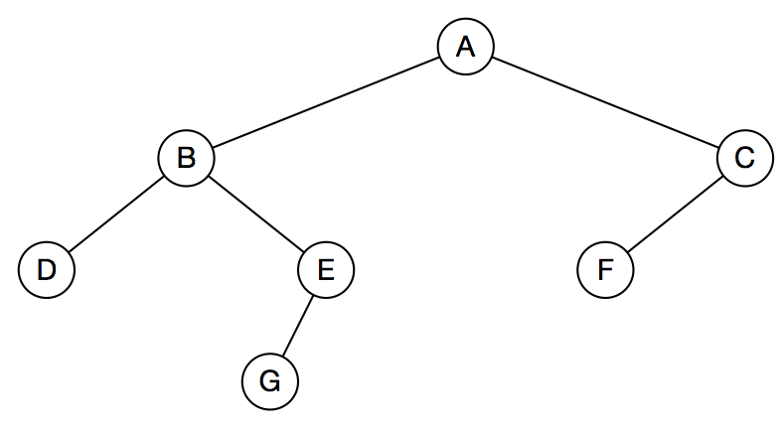
Example Tree
Notes:
<number>

Slide 4
A tree is an abstract data type that stores elements in a hierarchy.
Every element, except the top, has a parent and zero or more children.
The top element is called the root.
A tree can be empty; no root, no parents, no children.
A tree can have only one node—just a root.
Children of the same parent are siblings.
A node is called a leaf if it has no children.
Nodes above leaves are called internal nodes.
Nodes have ancestors and descendants
A child is also a subtree
Notes:
<number>

Slide 5
An edge is a parent-child pair of nodes.
An edge is implemented with links (pointers)
A path is a connected set of edges—parent to child to grandchild and so on.
Tree nodes have:
keys that identify them
associated data
Trees are ordered if there is a linear ordering (by key) of the children of each node.
All really useful trees are ordered—it makes them searchable.
Notes:
<number>

Slide 6
Binary Tree
Every node has 0, 1, or 2 children
A child is a left child or a right child
Tree is ordered: left children precede right children
There are left subtrees and right subtrees

Slide 7
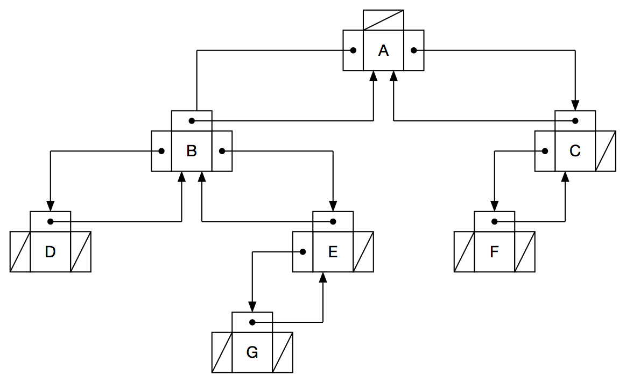

Slide 8
Types of Trees
Full:
every node contains 0 or 2 children.
Complete:
all levels, except possibly the last level, are completely full
all nodes in the last level are as far left as possible.
Perfect:
all internal nodes have 2 children
all leaf nodes are at the same level

Slide 9
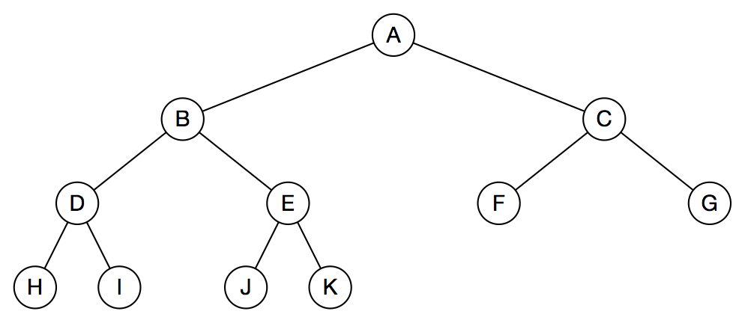
Complete Tree

Slide 10
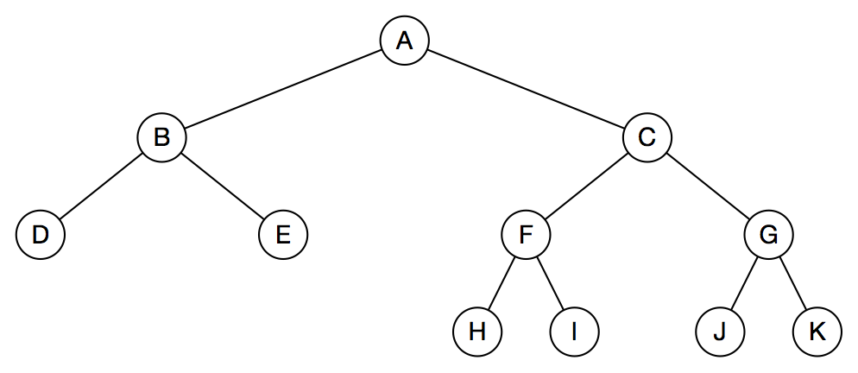
Full Tree

Slide 11
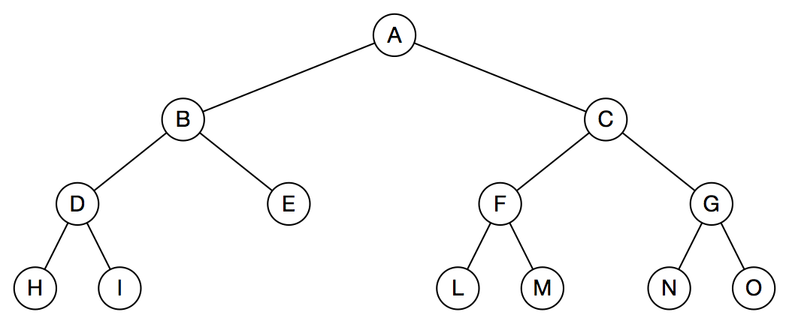
Full Tree

Slide 12
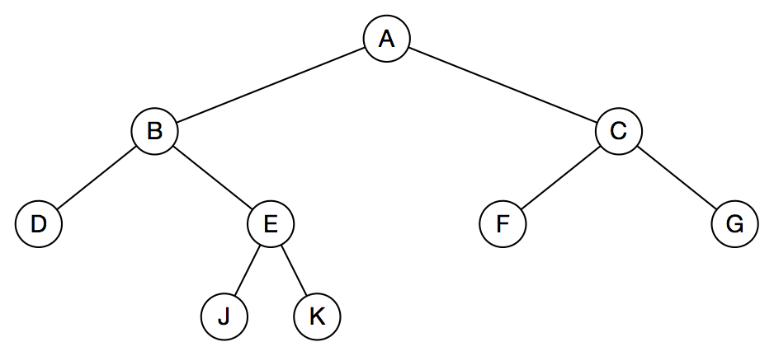
Full Tree

Slide 13
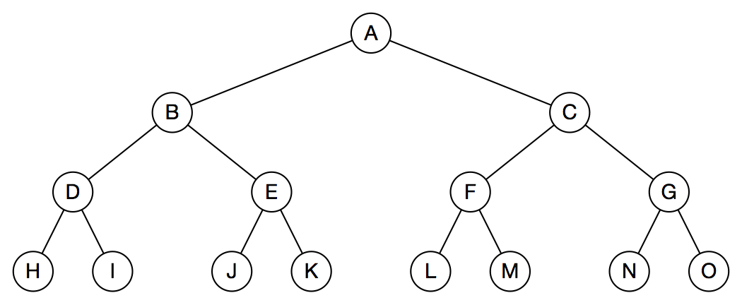
Perfect Tree

Slide 14
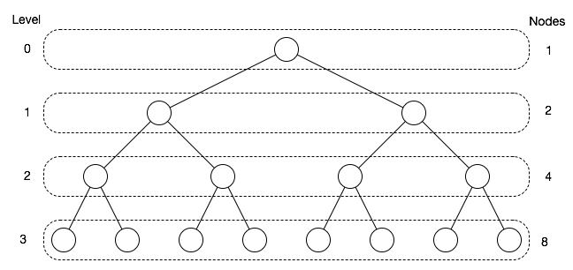
Properties of Binary Trees
nodes = n = 15;
h = height = 4
h = ceiling(log₂(n)) = ceiling(log₂(15)) = ceiling(3.9) = 4

Slide 15
Binary Search Trees

Slide 16
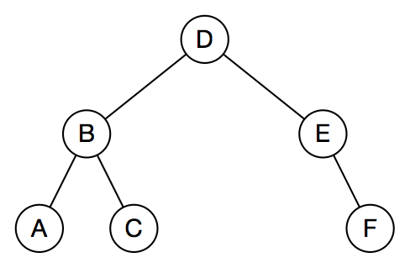
Example Search Tree
Trees are made up of smaller trees— subtrees. Node B is the root of a subtree; so is A.
Internal nodes (circles) and leaves (boxes) contain keys and values; keys are node identifiers that are searched for.
Left subtree’s keys are less than the root’s key, right subtree’s keys are greater.

Slide 17
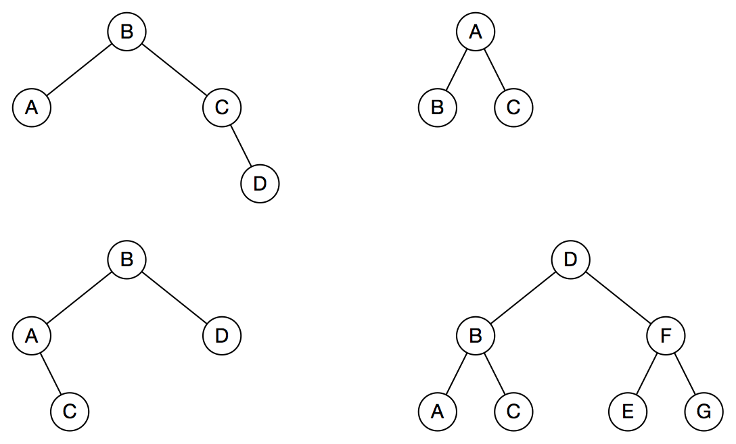
Examples: Binary Search Tree, Yes or No?

Slide 18
Examples: Some Are Binary Search Trees, Some Are Not
BST
Not BST;
B > A
Not BST;
C > B
BST
Notes:
<number>

Slide 19
C++ Implementation

Slide 20
template<typename K, typename V>
struct Node
{
Node(const K& key, const V& value, Node<K, V>* parentPtr)
: key_(key), value_(value), parentPtr_(parentPtr),
leftPtr_(nullptr), rightPtr_(nullptr) { }
K key_;
Node* leftPtr_;
Node* parentPtr_;
Node* rightPtr_;
V value_;
};
Notes:
<number>

Slide 21
template<typename K, typename V>
class BinarySearchTree
{
public: BinarySearchTree() : rootPtr_(nullptr) { }
bool Empty() const;
bool Erase(const K& key);
Node<K, V>* Find(const K& key) const;
bool Insert(const K& key, const V& value);
int Size() const;
private:
Node<K, V>* rootPtr_;
int size_;
};

Slide 22
Find
Navigate left and right down the tree
At each node, compare node key to search key
If they match, search terminates successfully
If search key is less, go down to left subtree
If search key is greater, go down to right subtree
If no match has been found when bottom of tree is reached (no left or right subtree to descend to), search terminates unsuccessfully.
Note for the future: the leaf where the search fails is the point where :
the key would have been
a node with that key should be inserted

Slide 23
template<typename K, typename V>
Node* BinarySearchTree<K, V>::Find(const K& key)
{
Node<K, V>* nodePtr;
nodePtr = rootPtr_;
while (nodePtr != nullptr)
{
if (key == nodePtr->key_)
return(nodePtr);
else if (key < nodePtr->key_))
nodePtr = nodePtr->left_;
else
nodePtr = nodePtr->right_;
}
return(nullptr);
}

Slide 24
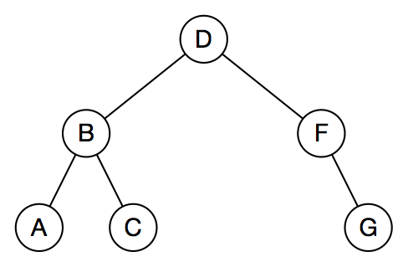
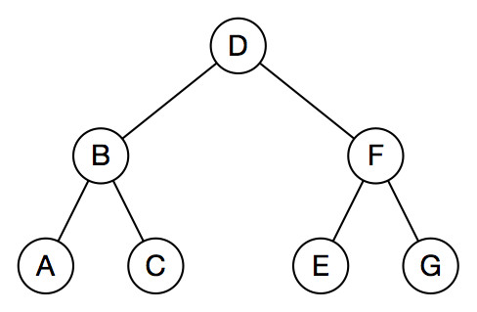
Insert
Before node E is inserted
After node E is inserted

Slide 25
template<typename K, typename V>
bool BinarySearchTree<K, V>::Insert(const K& key, const V& value)
{
Node<K, V>* nodePtr;
bool success = true;
if (rootPtr_ == nullptr)
{
rootPtr_ = new Node<K, V>(key, value, nullptr);
size_ = 1;
}
else
{
nodePtr = rootPtr_;
while (true)
{

Slide 26
if (key < nodePtr->key_)
{
if (nodePtr->leftPtr_ == nullptr)
{
nodePtr->leftPtr_ = new Node<K, V>(key, value, nodePtr);
break;
}
else
{
nodePtr = nodePtr->leftPtr_;
}
}
Notes:
<number>

Slide 27
else if (key > nodePtr->key_)
{
if (nodePtr->rightPtr_ == nullptr)
{
nodePtr->rightPtr_ = new Node<K, V>(key, value, nodePtr);
break;
}
else
{
nodePtr = nodePtr->rightPtr_;
}
}

Slide 28
else
{
success = false;
break;
}
}
}
return(success);
}

Slide 29
Erase
The most complicated operation.
Removing a node leaves a hole that must be filled.
Filling the hole involves promoting another node, internal or leaf.
Three different situations, depending on number of node’s children: two, one, or none.

Slide 30
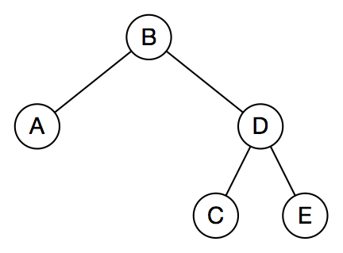
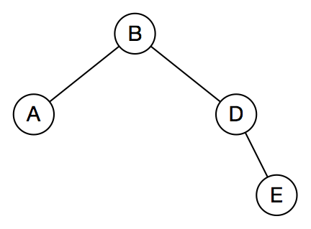
No Children—Node is a Leaf
Before node C is erased
After node C is erased

Slide 31
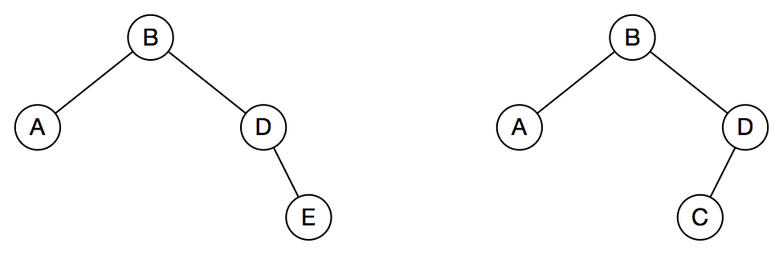
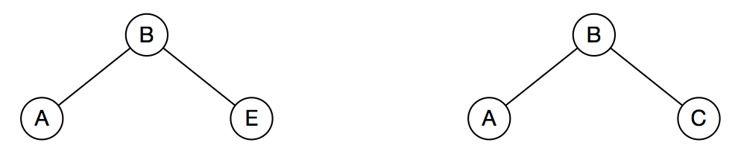
One Child
Two complementary variations
Erase node D by promoting its single child

Slide 32
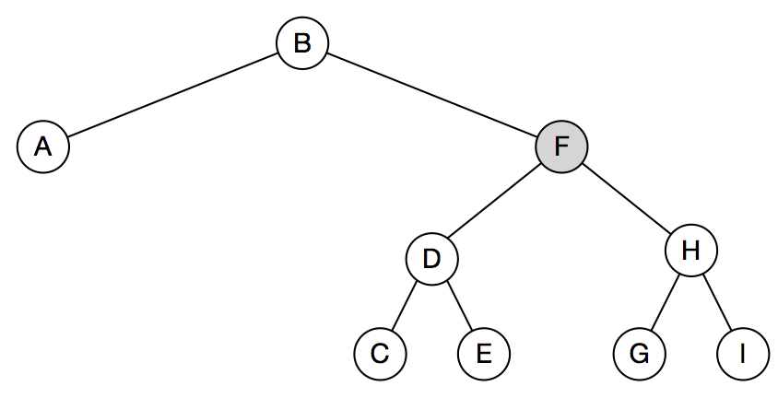
Two Children
Most complicated case; there's no single child to promote.
Node F should be replaced by its logical successor, node G.
Find F’s successor by going right, then left, left,…

Slide 33
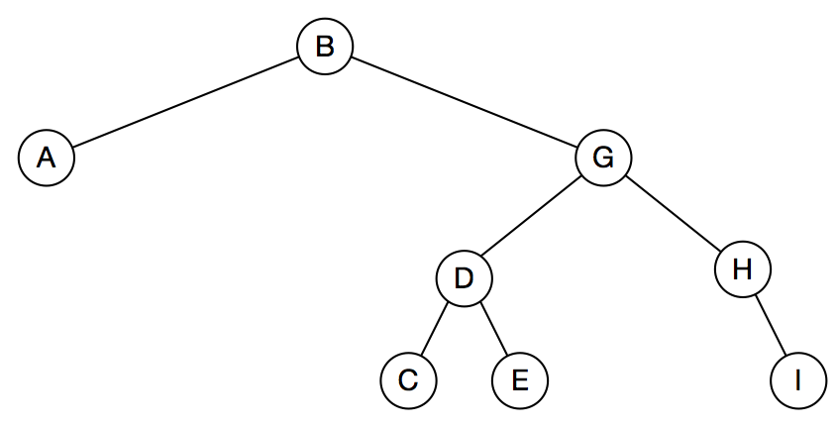
Node G won’t be linked into node F’s position; its key and value will be copied.
Old node G will be deleted.

Slide 34
template<typename K, typename V>
bool BinarySearchTree<K, V>::Erase(const K& key)
{
Node<K, V>* childPtr;
Node<K, V>* deletePtr = nullptr;
Node<K, V>* nodePtr;
Node<K, V>* parentPtr;
Node<K, V>* successorPtr;
nodePtr = rootPtr_;
while (nodePtr != nullptr) // Search for node
{
if (nodePtr->key_ == key) // Node found
{
deletePtr = nodePtr;
parentPtr = nodePtr->parentPtr_;
Notes:
<number>

Slide 35
// Is it a leaf?
if (!nodePtr->leftPtr_ && !nodePtr->rightPtr_)
{
if (parentPtr == nullptr) // Node is root
{
rootPtr_ = nullptr;
}
else if (parentPtr->leftPtr_ == nodePtr)
{
parentPtr->leftPtr_ = nullptr;
}
else
{
parentPtr->rightPtr_ = nullptr;
}
}

Slide 36
// Does it have only a left child?
else if (nodePtr->leftPtr_ && !nodePtr->rightPtr_)
{
childPtr = nodePtr->leftPtr_;
if (!parentPtr) // Node is root
{
rootPtr_ = childPtr;
}
else if (parentPtr->leftPtr_ == nodePtr)
{
parentPtr->leftPtr_ = childPtr;
}
else
{
parentPtr->rightPtr_ = childPtr;
}
childPtr->parentPtr_ = parentPtr;
}

Slide 37
// Does it have only a right child?
else if (!nodePtr->leftPtr_ && nodePtr->rightPtr_)
{
childPtr = nodePtr->rightPtr_;
if (!parentPtr) // Node is root
{
rootPtr_ = childPtr;
}
else if (parentPtr->leftPtr_ == nodePtr)
{
parentPtr->leftPtr_ = childPtr;
}
else
{
parentPtr->rightPtr_ = childPtr;
}
childPtr->parentPtr_ = parentPtr;
}

Slide 38
// It has two children.
else
{
// Find successor (leftmost child of right subtree)
successorPtr = nodePtr->rightPtr_;
while (successorPtr->leftPtr_ != nullptr)
{
successorPtr = successorPtr->leftPtr_;
}
nodePtr->key_ = successorPtr->key_;
nodePtr->value_ = successorPtr->value_;
parentPtr = successorPtr->parentPtr_;
parentPtr->leftPtr_ = nullptr;
deletePtr = successorPtr;
}
break;
}

Slide 39
else if (nodePtr->key_ < key) // Search right
{
nodePtr = nodePtr->rightPtr_;
}
else // Search left
{
nodePtr = nodePtr->leftPtr_;
}
}
if (deletePtr != nullptr)
{
delete deletePtr;
return(true);
}
else
{
return(false);
}
}

Slide 40
Tree Traversal Algorithms

Slide 41
Traversal Algorithms
Traversals are systematic ways to “visit” tree nodes and their children.
A “visit” accesses a node’s data, perhaps to display it or return it.
Three algorithms:
Preorder: visit a node, then its left and right children
Postorder: visit a node’s left and right children, then the node itself
Inorder: visit a node's left child, the the node itself, then the node's right child.

