Slide 1
installations
ID
accountID
installationName
activityCode
registryCode
addressMain
addressSecondary
postalCode
city
countryCode
latitude
longitude
parentCompany
subsidiaryCompany
permitDateEntry
permitDateExpiry
permitID
eprtrID
isAircraftOperator
designatorICAO
ec748_2009Code
monitoringID
monitoringFirstYear
monitoringExpiry
compliance
installationID
registryCode
phase
year
verified
surrendered
allocated
allocatedNewEntrance
allocated10c
complianceCode
verifiedUpdated
transactions
ID
transactionID
transactionDate
transactionTypeMainCode
transactionTypeSupplementaryCode
transferringAccountID
acquiringAccountID
numberUnits
unitType
originatingRegistryCode
orginalCommitmentPeriod
applicableCommitmentPeriod
LULUCFActivity
projectID
track
expiryDate
accounts
ID
accountName
registryCode
accountType
accountHolderName
commitmentPeriod
accountOpen
accountOpeningDate
accountClosingDate
companyRegistrationNumber

Slide 2
transaction
id
transactionID
date
transactionTypeMain_id
transactionTypeSupplementary_id
transferringAccount_id
acquiringAccount_id
unitType_id
project_id
amount
account
id
name
registry_id
accountHolder_id
accountType_id
isOpen
openingDate
closingDate
commitmentPeriod
companyRegistrationNumber
isRegisteredEutl
installation_id
installation
id
name
registry_id
activity_id
parentCompany
subsidiaryCompany
permitID
permitDateEntry
addressMain
addressSecondary
postalCode
city
country_id
latitudeGoogle
longitudeGoogle
nace_id
entitlement
compliance
installation_id
year
compliance_id
allocatedFree
allocatedNewEntrance
allocatedTotal
allocated10c
verified
surrendered
surrender
id
installation_id
year
unitType_id
amount
originatingRegistry_id
project_id
holder
id
name
addressMain
addressSecondary
postalCode
city
country_id
N

Slide 3
transaction
id
transactionID
date
transactionTypeMain_id
transactionTypeSupplementary_id
transferringAccount_id
acquiringAccount_id
unitType_id
project_id
amount
account
id
name
registry_id
accountHolder_id
accountType_id
isOpen
openingDate
closingDate
commitmentPeriod
companyRegistrationNumber
isRegisteredEutl
installation_id
installation
id
name
registry_id
activity_id
parentCompany
subsidiaryCompany
permitID
permitDateEntry
addressMain
addressSecondary
postalCode
city
country_id
latitudeGoogle
longitudeGoogle
nace_id
entitlement
1:N
compliance
installation_id
year
compliance_id
allocatedFree
allocatedNewEntrance
allocatedTotal
allocated10c
verified
surrendered
N:1
N:1
N:1
1:N
1:N
surrender
id
installation_id
year
unitType_id
amount
originatingRegistry_id
project_id
holder
id
name
addressMain
addressSecondary
postalCode
city
country_id

Slide 4
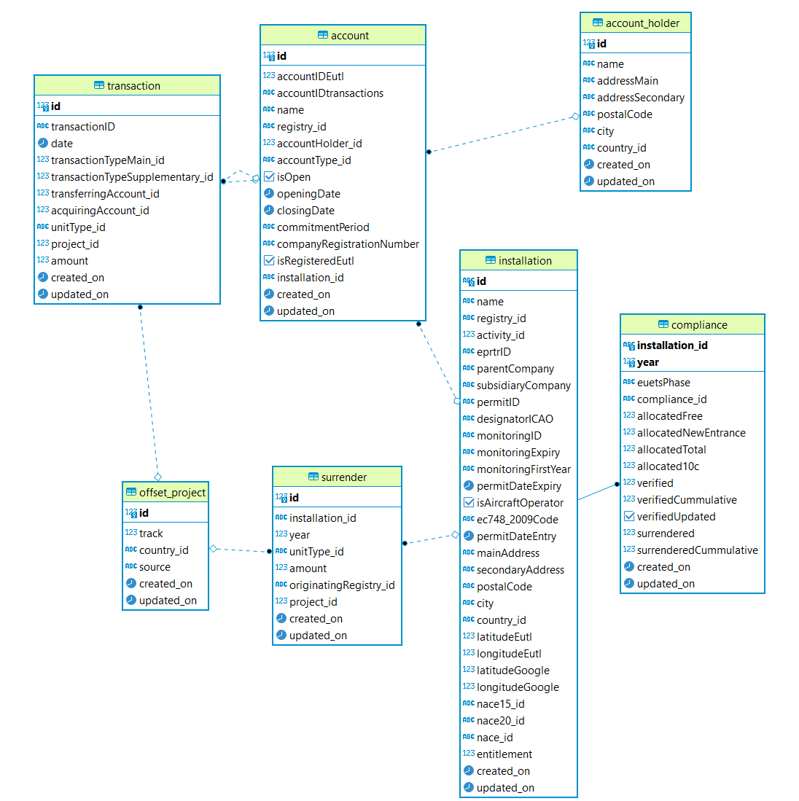

Slide 5

European Union Transaction Log
Account Holders
Account Holders
Companies
Person Holding Accounts
Administrative Accounts
Transactions
Regulatory Authorities
Operator Holding Accounts
Account Holders
Account Holders
Companies
Account Holders
Installations

Slide 6
European Union Transaction Log
Person Holding Account
Administrative Account
Transactions
Regulatory Authority
Operator Holding Account
Account Holder
Account Holder
Company
Installation

Slide 7
Person Holding Account
Administrative Account
Transactions
Operator Holding Account
Account Holder
Account Holder
Installation

Slide 8
European Union Transaction Log
Account Holders
Account Holders
Companies
Person Holding Accounts
Administrative Accounts
Transactions
Regulatory Authorities
Operator Holding Accounts
Account Holders
Account Holders
Companies
Account Holders
Installations

