Slide 1


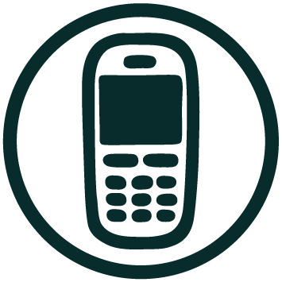








Communication map Worksheet
Name: Gender: Age:
Channels | When? How often do you use this channel? | What? What type of information do you share and consume? | Why? What is the reason? (eg getting informed, social, etc) | Who? With who do you use this channel?
Smartphone | Daily - Weekly - Monthly - Rarely - Never
Old phone | Daily - Weekly - Monthly - Rarely - Never
Laptop | Daily - Weekly - Monthly - Rarely - Never
Computer | Daily - Weekly - Monthly - Rarely - Never
Tablet | Daily - Weekly - Monthly - Rarely - Never
Radio | Daily - Weekly - Monthly - Rarely - Never
TV | Daily - Weekly - Monthly - Rarely - Never
Face 2 Face | Daily - Weekly - Monthly - Rarely - Never
Pen & paper | Daily - Weekly - Monthly - Rarely - Never
Print | Daily - Weekly - Monthly - Rarely - Never

