Slide 1
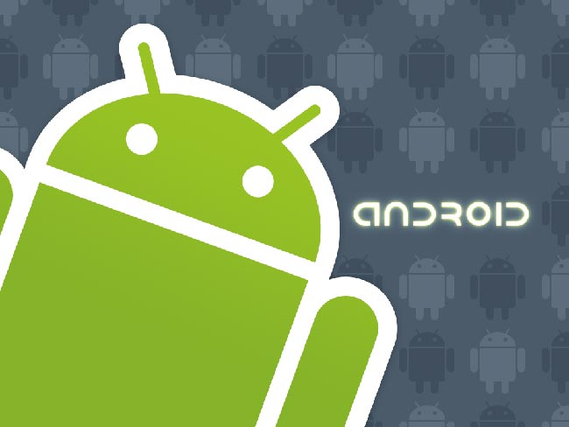
Android

Slide 2
Outline
1. What is Android ?
2. Different Versions
3. Concurrency
4. Programming
5. Conclusion

Slide 3
Outline
1. What is Android ?
2. Different Versions
3. Concurrency
4. Programming
5. Conclusion

Slide 4
What is Android ?
Operating System
Linux
Smartphones, tablet computer
Google
Notes:
Android is an operating system based on linux,
designed primarily for touchscreen mobile devices such as smartphone and tablet computer.
It’s currently developped by google initially developed by android inc.
Whom was purchased by google in 2005.
Google released the android code source as open source.
Android has a large community of developpers writing applications also named « Appz » that extend the functionnality of devices, written primarily in a customized version of java. They are available for download through Google Play.
There were approximately 700,000 apps available for android and the estimated number of application downloaded from Google Play was 25 billion.

Slide 5
Outline
1. What is Android ?
2. Different Versions
3. Concurrency
4. Programming
5. Conclusion

Slide 6
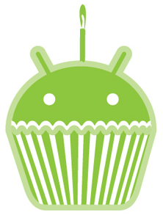
Different Versions
Cupcake(1.5)
April 2009
Video recording
Support for widget
Auto-rotation option

Slide 7
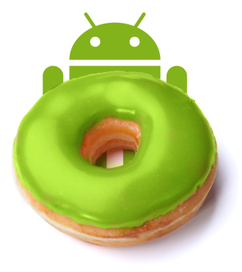
Different Versions
Donut(1.6)
September 2009
Multi-lingual speech
Synthesis engine

Slide 8
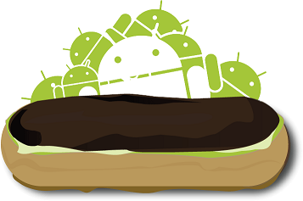
Different Versions
Eclair(2.1)
October 2009
Account sync
Mail, contact, …
Multi-touch events

Slide 9
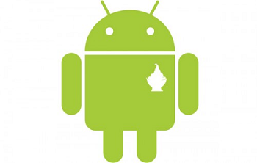
Different Versions
FroYo(2.2)
May 2010
Speed, memory
And performance optimization
Flash support
USB tethering and wifi hotspot

Slide 10
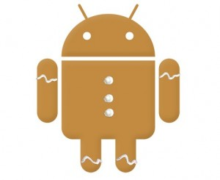
Different Versions
Gingerbread(2.3)
December 2010
Support for more
Sensors
Support multiple camera (front-facing)
Audio, graphical and input enhancement
for game developpers

Slide 11

Different Versions
Honeycomb(3.0 – 3.1)
May 2011
Optimized tablet support
Support for multi-core processor
Automatic updates

Slide 12
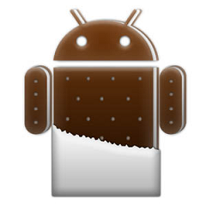
Different Versions
Ice Cream Sandwich(4,0)
December 2011
Interface user friendlier
Add-hoc networks

Slide 13
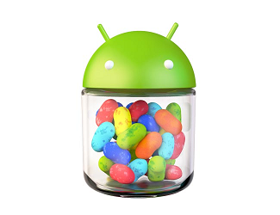
Different Versions
Jelly Bean(4.1 – 4.2)
July 2012
Support for
bi-directionnal text
Improved voice recognition
Support for wireless display

Slide 14
Outline
1. What is Android ?
2. Different Versions
3. Concurrency
4. Programming
5. Conclusion

Slide 15
Concurrency
IOS
Interface
AppStore vs Google Play
Social network
Videos
Map
Voice recognition, cloud, …
Windows Phone
BlackBerry OS
Notes:
For the interface and the different possibilities of personalisation, android and ios are pretty equals, android keep in its jelly bean version the interface of icre cream sandwich when ios6 keep the same interface as before too.
So, they are on equalities for the interface.
appStore vs Google play: the appStore has an advance because it’s online since 2008, a few month before google play. So the appStore is bigger than the google Play for now.
For the social network, ios6 is faster than android to share pictures on facebook and twitter, it’s a little bit user friendlier than android because ios have a special widget to share on social network when a picture is taken, while on android we can share pictures etc only when we are in the gallery for example.
So IOS6 is better than android for that too.
For ios6, we don’t have a really good experience to watch movie or else, we don’t have too an app to watch videos on youtube because of the concurrency between google and apple.
For android we have a really good experience, much more fluid than ios6, so Android win this comparison.
Android have a way better cartography than android who let map from ios like a draft when we compare them.

Slide 16
Outline
1. What is Android ?
2. Different Versions
3. Concurrency
4. Programming
5. Conclusion

Slide 17
Programming
Provide a SDK for developpers
Easy to use
Contains libraries, documentation, example, etc.
Emulator

Slide 18
Outline
1. What is Android ?
2. Different Versions
3. Concurrency
4. Programming
5. Conclusion

Slide 19
Conclusion
Android is very user friendly
Multiple layer for more content
Easy sdk for developpers
My opinion: Coding with android SDK is very funny, and enjoyable.

