Slide 1
Project
By Michelle Green-Okoroh

Slide 2
Which region buys more items
From this Chart we know that people from the West buy more Item than the Central, South and East.

Slide 3
Which region buys more items
From this Chart we know that people Central Region are from the consumer segment more than Corporate and Home Office.

Slide 4
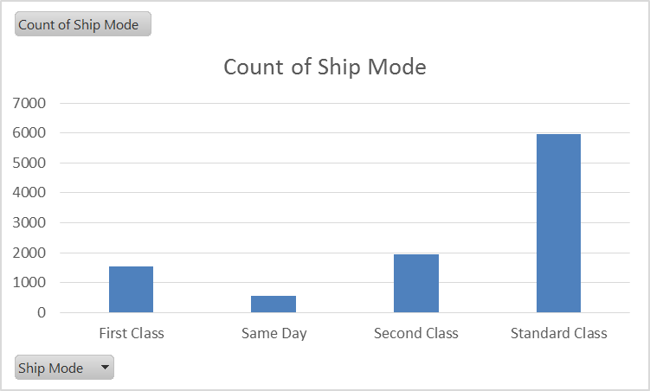
Which Ship mode is most preferred
From this Chart we know that people prefer Standard Class than any other class.

Slide 5
Which Ship mode is most preferred
From these chart we can see that people used CA rather than US.

