Slide 1
Projects
By Michelle Green-Okoroh

Slide 2
Introduction
My name is Michelle Green-Okoroh
I am a web developer
I am presenting all the Projects I have made so far.

Slide 3
What I have learnt
I have learnt how to make mini-websites, how to design a UI(user interface design). How to build a small app, and solve some problems using code.

Slide 4
What I have learnt ; tools and packages
I have used many tools ;
Figma (UI design)
Thunkable (app development)
Code pen (code environment)
Anymod (code environment)
Flask (Python)
Bootstrap (Web Design)

Slide 5
How I can apply what I’ve learnt
I will apply what I’ve learnt by building apps that will solve problems and also building company websites.

Slide 6
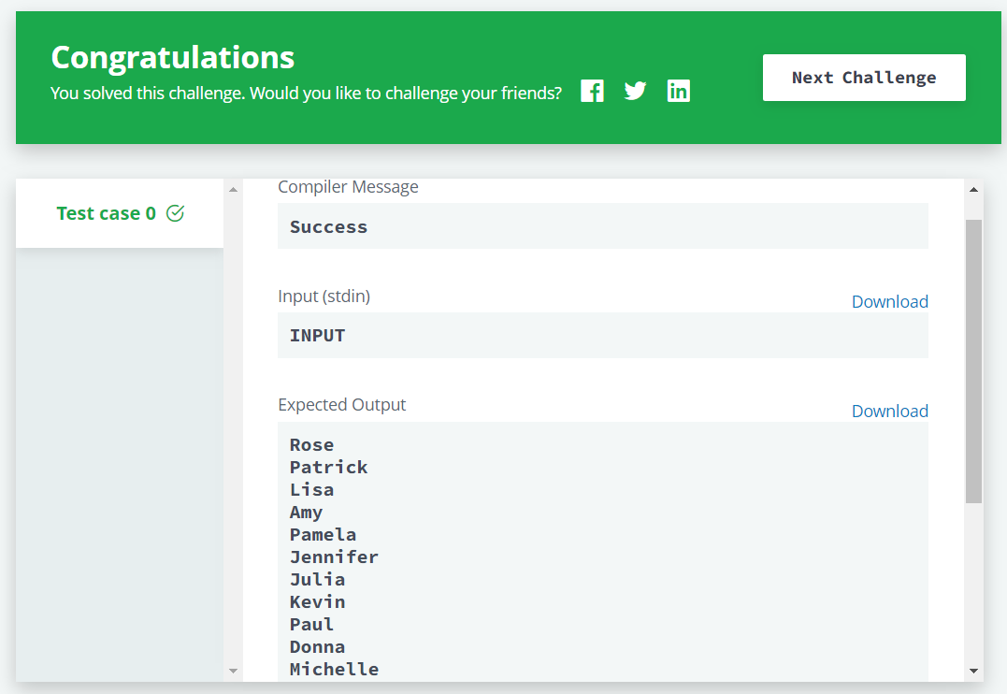
My projects
Hacker Rank

Slide 7
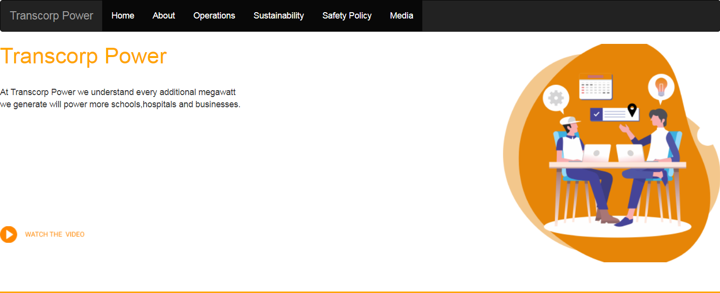
My projects
Transcorp Power

Slide 8
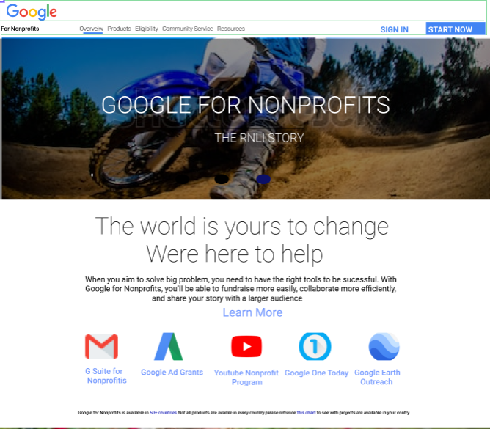
My projects
Google for Non-Profits

Slide 9
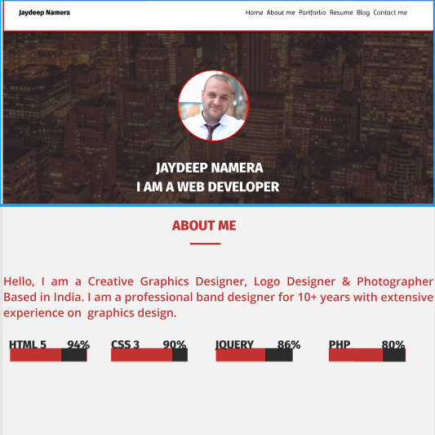
My projects
Jaydeep Namera

Slide 10

My projects
Nigeria America Chamber of Commerce

Slide 11
Assignment completion rate
85% out 100%

Slide 12
What I intend to learn
I want to learn robotics and build robots and androids assistants for human help / use.

