Slide 1
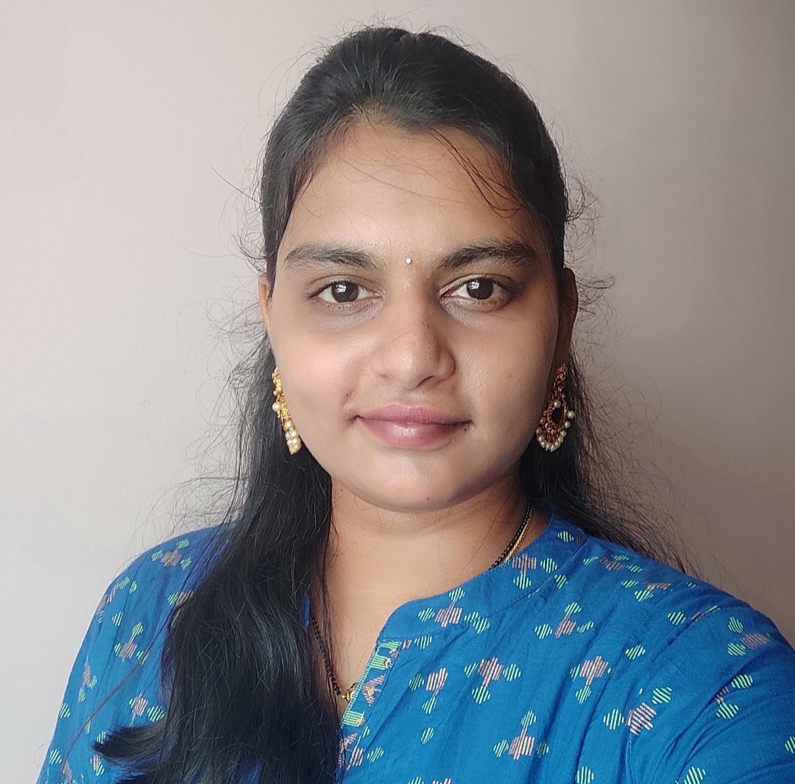


TEJASWI SUKHAVASI
Analyst/Software Engineer
BACHELOR OF TECHNOLOGY
2016-2020
Skills: Java
Spring Boot
Spring MVC
MERN Stack:
NodeJS
MongoDB
Database:
Sql database:mysql
No SQL database – MongoDB
Web Technologies:
HTML5
CSS3
Javascript
AddOns:
Github
Maven
Postman
Additional skills:
Leadership Qualities
Quick Learner
Team management
Bangalore
sukhavasitejaswi@gmail.com
+91 7702423835
A4
Eager to work in a team of dedicated people and serve a key role in the enhancement and development of the project.
Software Engineer who is Strong in design and integration with intuitive problem-solving skills. Passionate about implementing and launching new projects.
Ready to learn new technologies and implement them to further improve my knowledge.
Has working knowledge on Angular and Java Microservice Development using Spring framework on an intermediate level.
Check out my work on GitHub & Video Profile
https://github.com/Greentej?tab=repositories
Shopping cart system:
Completed end to end case study of shopping cart system along with JWT authentication, Swagger and payment testing. . Material-UI and ANGULAR used for user interface.
HTML CSS JAVASCRIPT for web developers at DEGREED
Completed this course with 98.6% and Designed responsive shopping cart website using HTML5 CSS3 ANGULAR

