Slide 1
Next JS
Subramanian Murugan

Slide 2
Session Agenda
Components
Routing Fundamentals

Slide 3
Components
In Next Every thing is component

Slide 4
File Conventions

Slide 5
Component Hierarchy
page.js
layout.js
nested layout (layout.js)
template.js
error.js (React error boundary)
loading.js (React suspense boundary)
not-found.js (React error boundary)

Slide 6
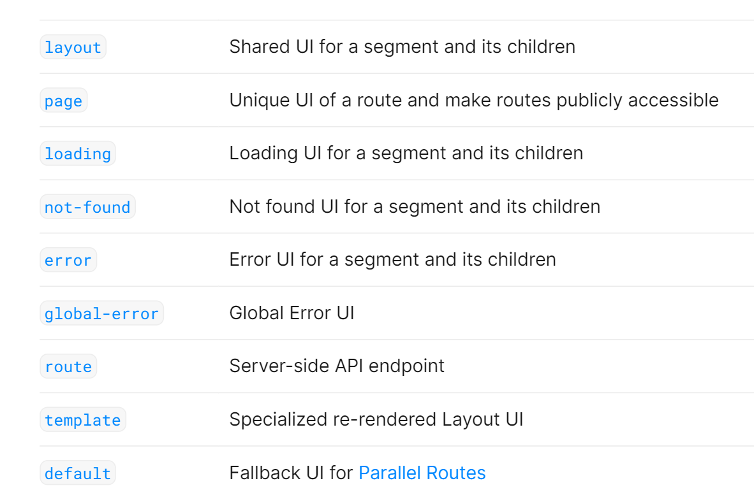

Slide 7
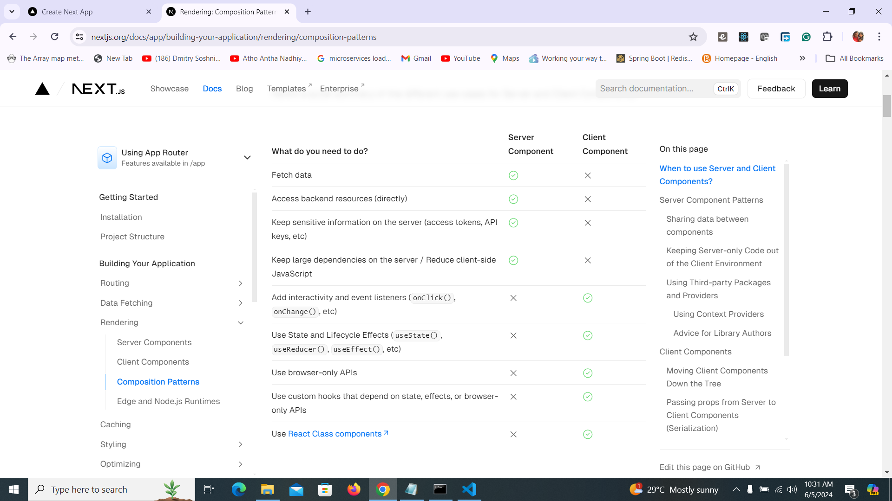

Slide 8
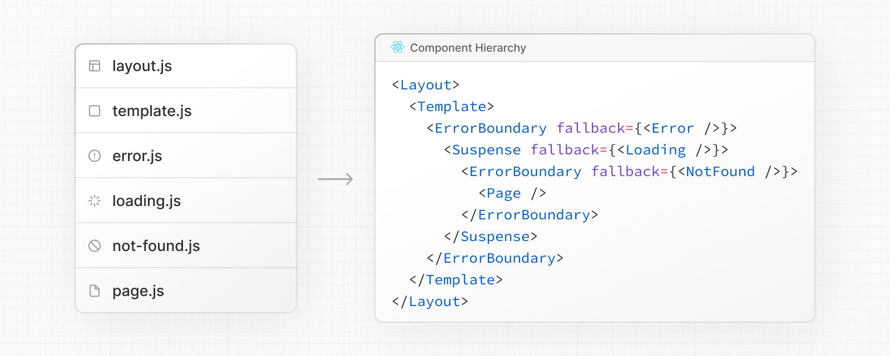

Slide 9
In a nested route, the components of a segment will be nested inside the components of its parent segment

Slide 10
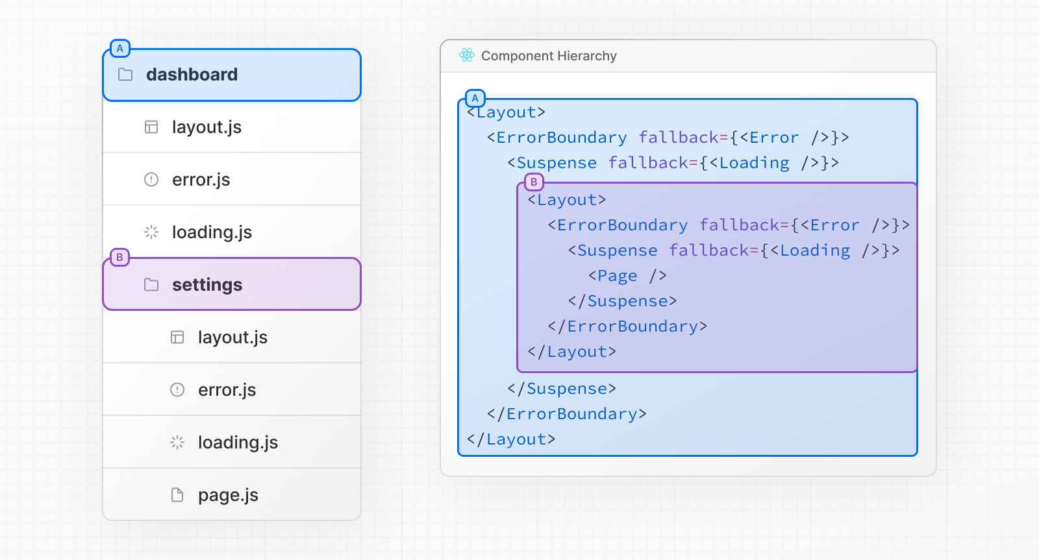

Slide 11
Co location
In addition to special files, you have the option to colocate your own files (e.g. components, styles, tests, etc) inside folders in the app directory.

Slide 12
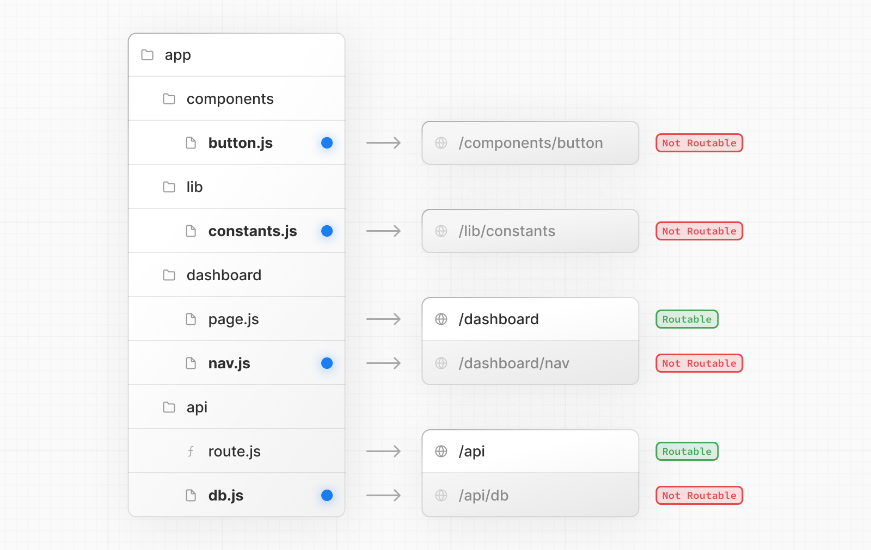

Slide 13
Component Types
Server components
Client Components

Slide 14
Routing Fundamentals

Slide 15
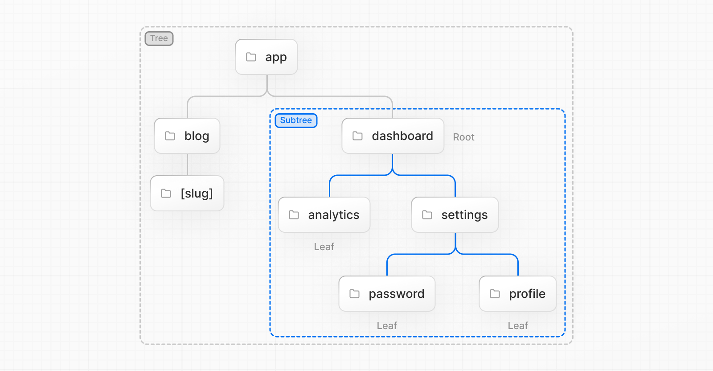

Slide 16
Tree
A convention for visualizing a hierarchical structure. For example, a component tree with parent and children components, a folder structure, etc.

Slide 17
Subtree
Part of a tree, starting at a new root (first) and ending at the leaves (last).

Slide 18
Root
The first node in a tree or subtree, such as a root layout.

Slide 19
Leaf
Nodes in a subtree that have no children, such as the last segment in a URL path.

Slide 20


Slide 21
URL Segment
Part of the URL path delimited by slashes

Slide 22
URL Path
Part of the URL that comes after the domain (composed of segments).

Slide 23
URL Path
Part of the URL that comes after the domain (composed of segments).

Slide 24
Roles of Folders and Files
Next.js uses a file-system based router where
Folders are used to define routes.
A route is a single path of nested folders, following the file-system hierarchy from the root folder down to a final leaf folder that includes a page.js
Files are used to create UI that is shown for a route segment.

Slide 25
Nested Routing
To create a nested route, you can nest folders inside each other.
For example, you can add a new /dashboard/settings route by nesting two new folders in the app directory.

Slide 26
Nested Routing
The /dashboard/settings route is composed of three segments:
/ (Root segment)
dashboard (Segment)
settings (Leaf segment)

Slide 27
Home Route

Slide 28
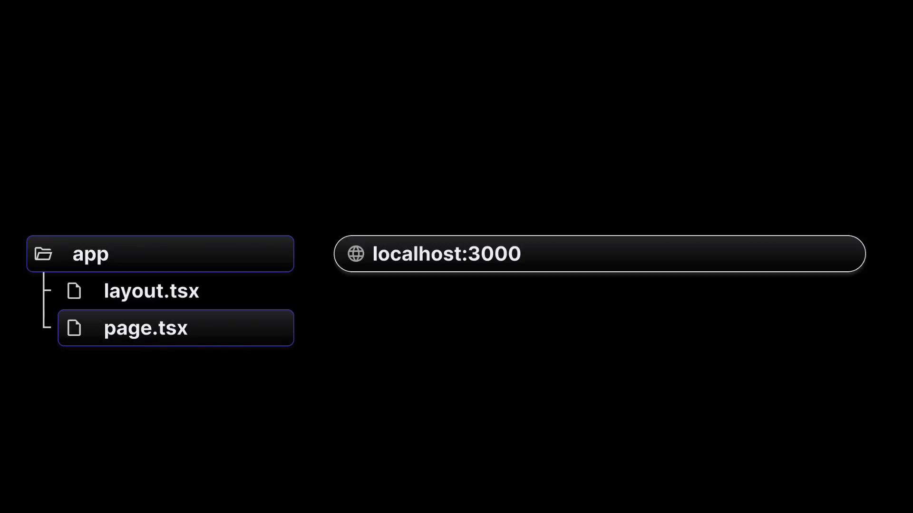

Slide 29
Additional Routes

Slide 30
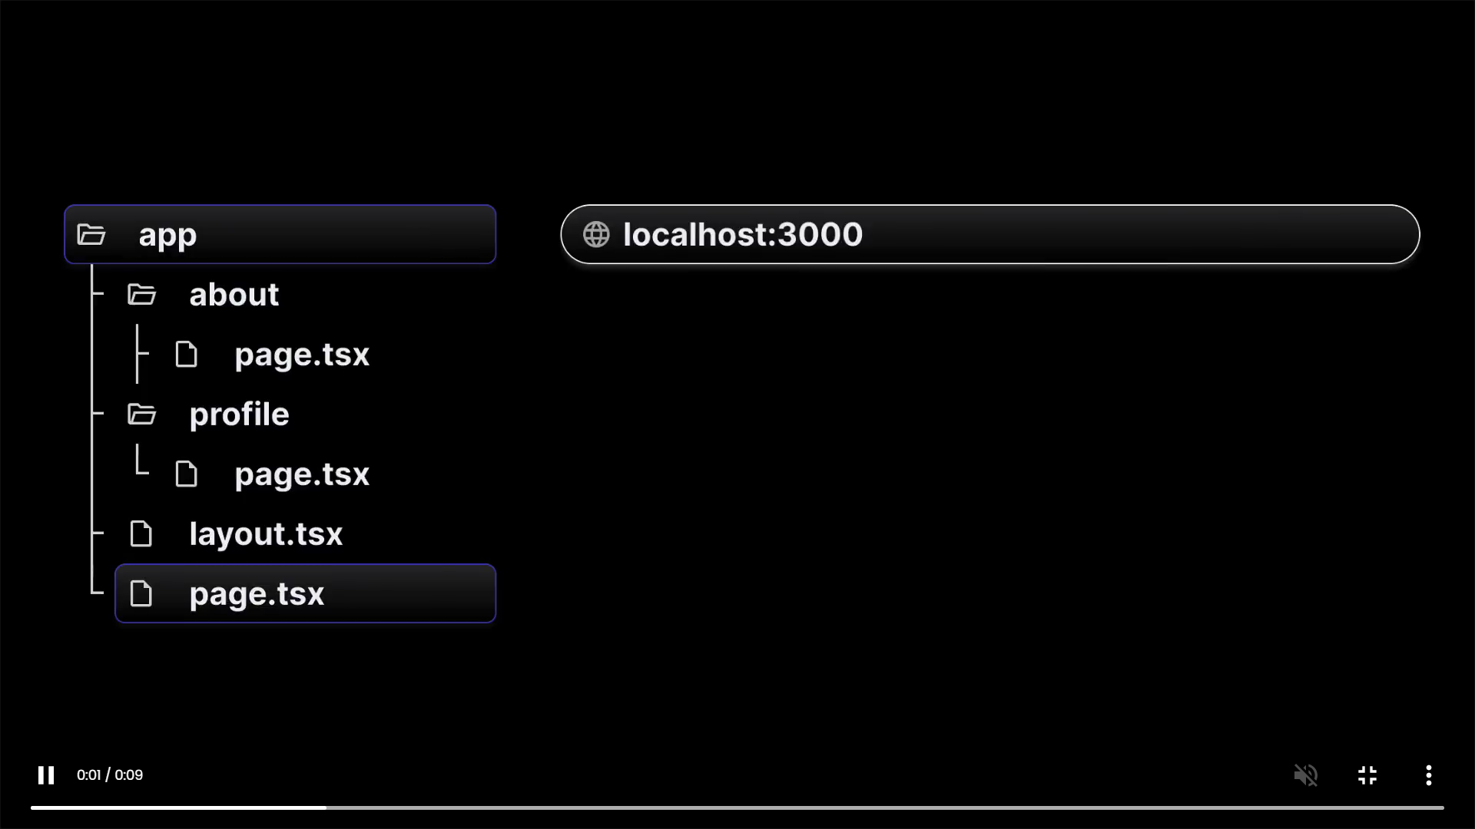

Slide 31


Slide 32
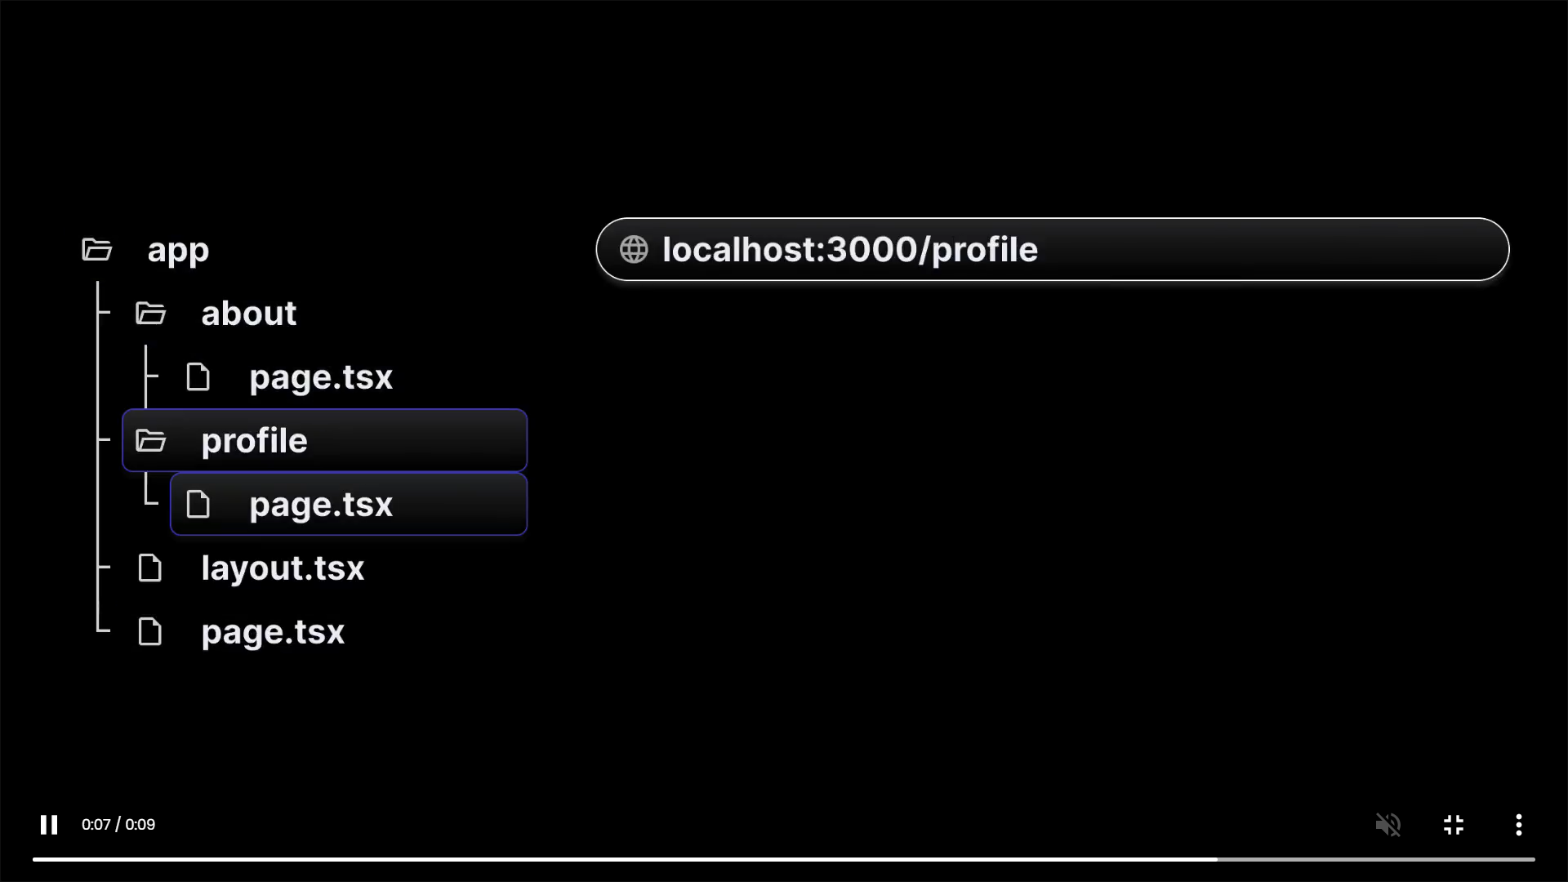

Slide 33
src/app/about/page.js
import Image from 'next/image'
import styles from '../page.module.css'
export default function Home() {
return (
<main className={styles.main}>
<h1>about</h1>
</main>
)
}
http://localhost:3000/about

Slide 34
Nested Routes

Slide 35
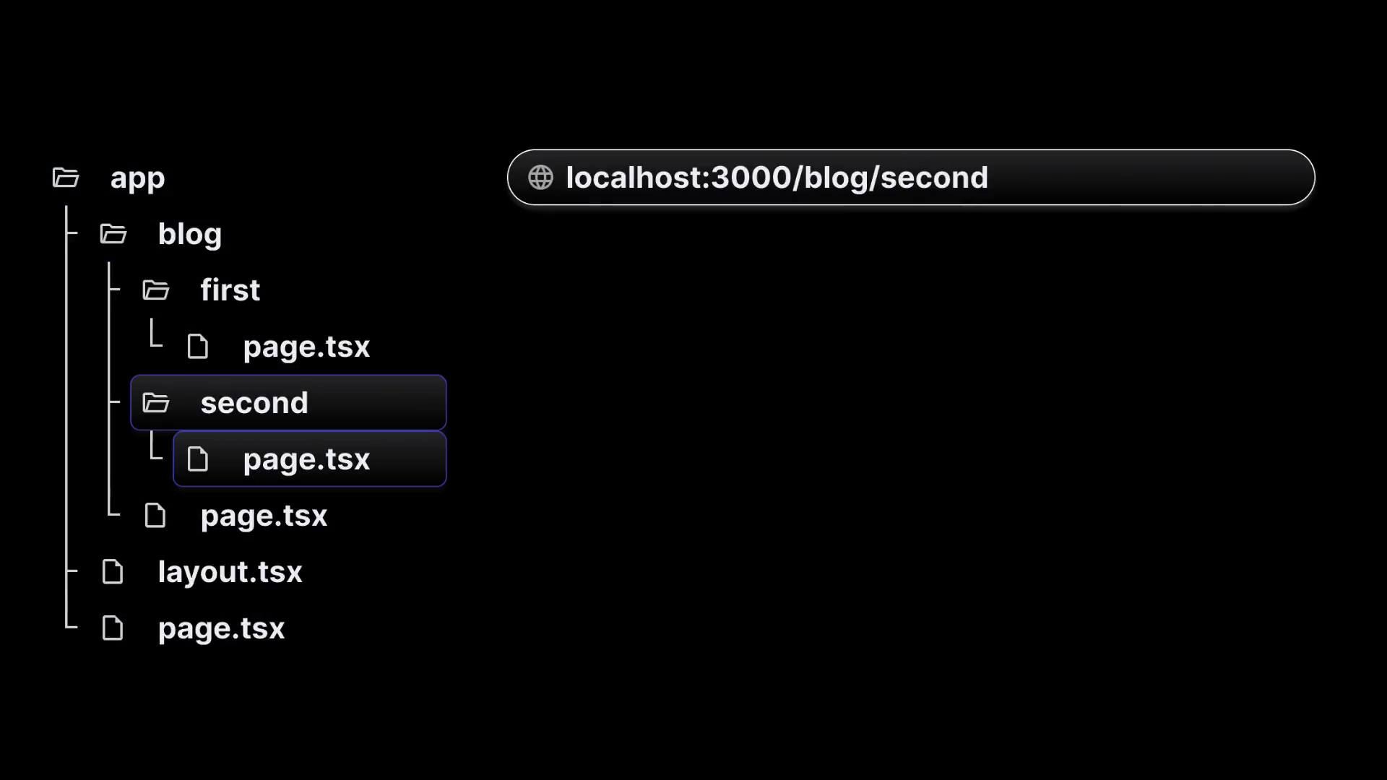

Slide 36
Dynamic Routes

Slide 37
When you don't know the exact segment names ahead of time and want to create routes from dynamic data, you can use Dynamic Segments that are filled in at request time or prerendered at build time.

Slide 38
A Dynamic Segment can be created by wrapping a folder's name in square brackets: [folderName]. For example, [id] or [slug]. Dynamic Segments are passed as the params prop to layout, page, route, and generateMetadata functions..

Slide 39
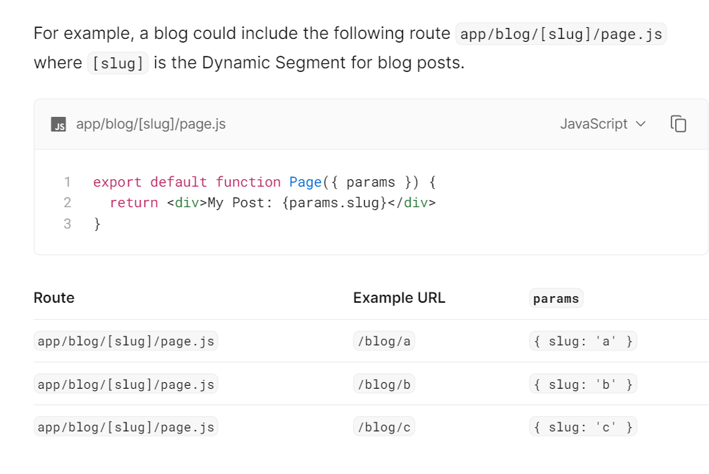

Slide 40
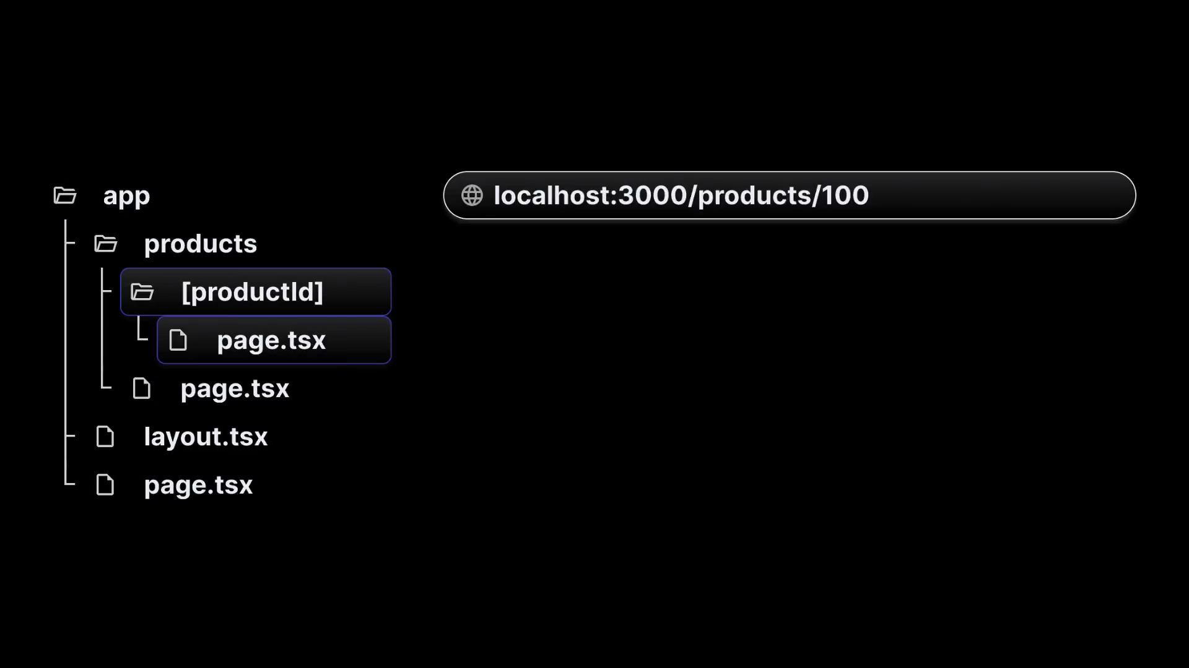

Slide 41
Nested Dynamic Routing

Slide 42
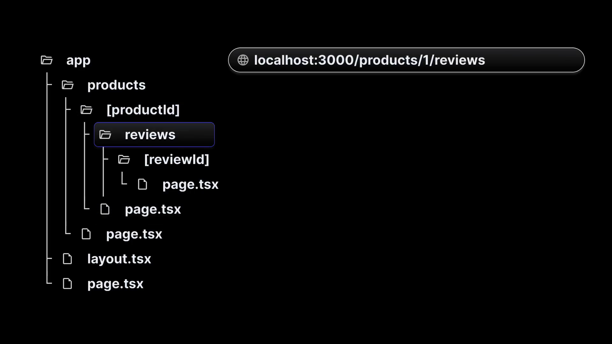

Slide 43
Static Site Generation -SSG

Slide 44
Generating Static Params
The generateStaticParams function can be used in combination with dynamic route segments to define the list of route segment parameters that will be statically generated at build time instead of on-demand at request time.

Slide 45
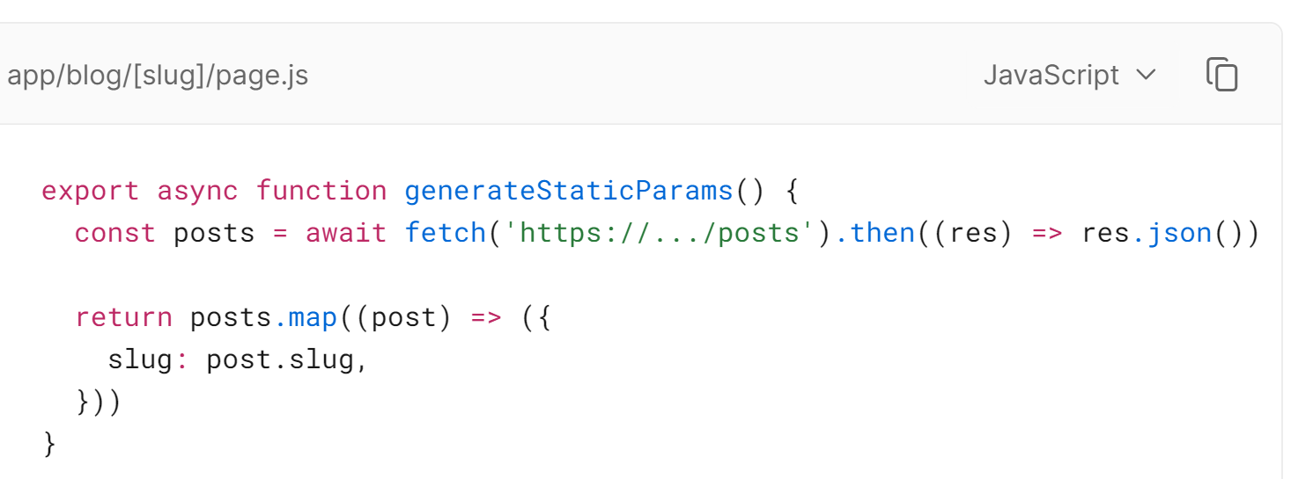

Slide 46
app / todos/page.js
import TODOS from './todos'
import Link from 'next/link'
export default function TodosPage() {
return <>
<h1>Todos Page</h1>
<ul>
{TODOS.map(todo => {
return <li>
<Link href={`/todos/${todo.id}`}>{todo.title}</Link>
</li>
})}
</ul>
</>
}

Slide 47
app / todos/[id]/page.js
import TODOS from '../todos'
export default function TodoPage(props) {
return <div>
<h1>Todo Details </h1>
<p>{JSON.stringify(props.params)}</p>
</div>
}
export function generateStaticParams() {
return TODOS.map(todo => {
let id = todo.id.toString()
return {
id
}
})
}

Slide 48
The primary benefit of the generateStaticParams function is its smart retrieval of data. If content is fetched within the generateStaticParams function using a fetch request, the requests are automatically memoized. This means a fetch request with the same arguments across multiple generateStaticParams, Layouts, and Pages will only be made once, which decreases build times

Slide 49
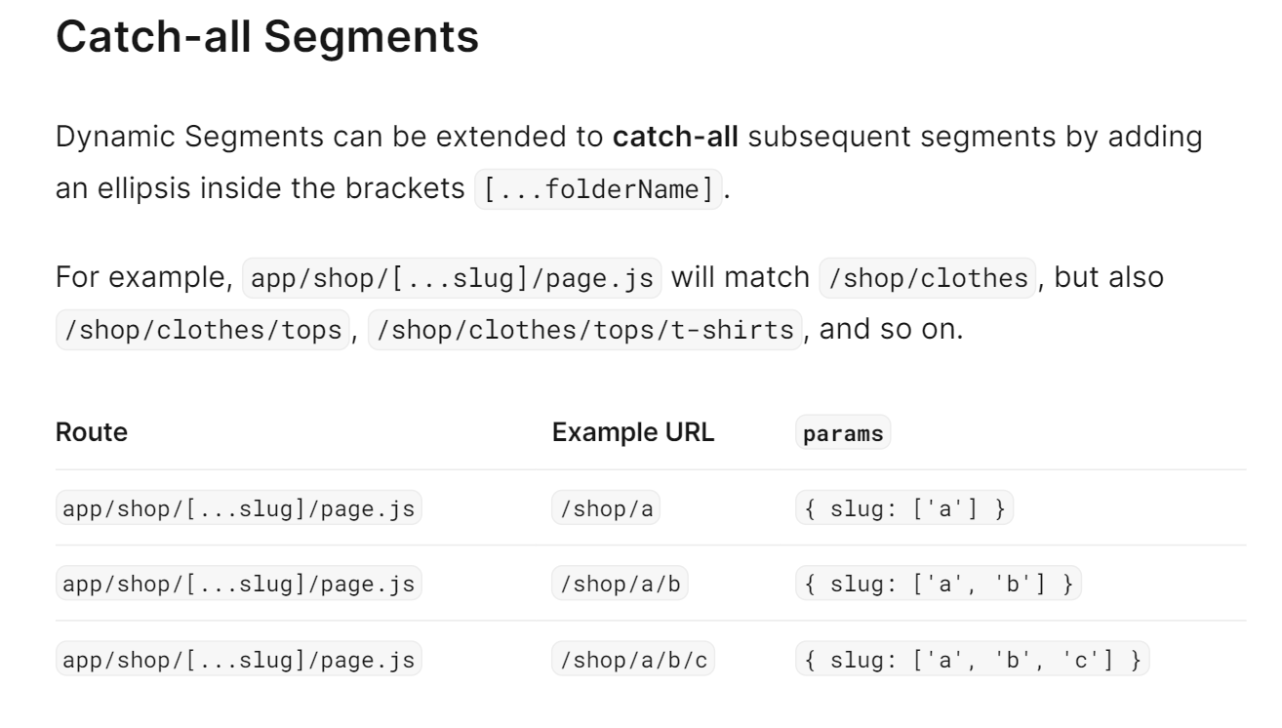

Slide 50
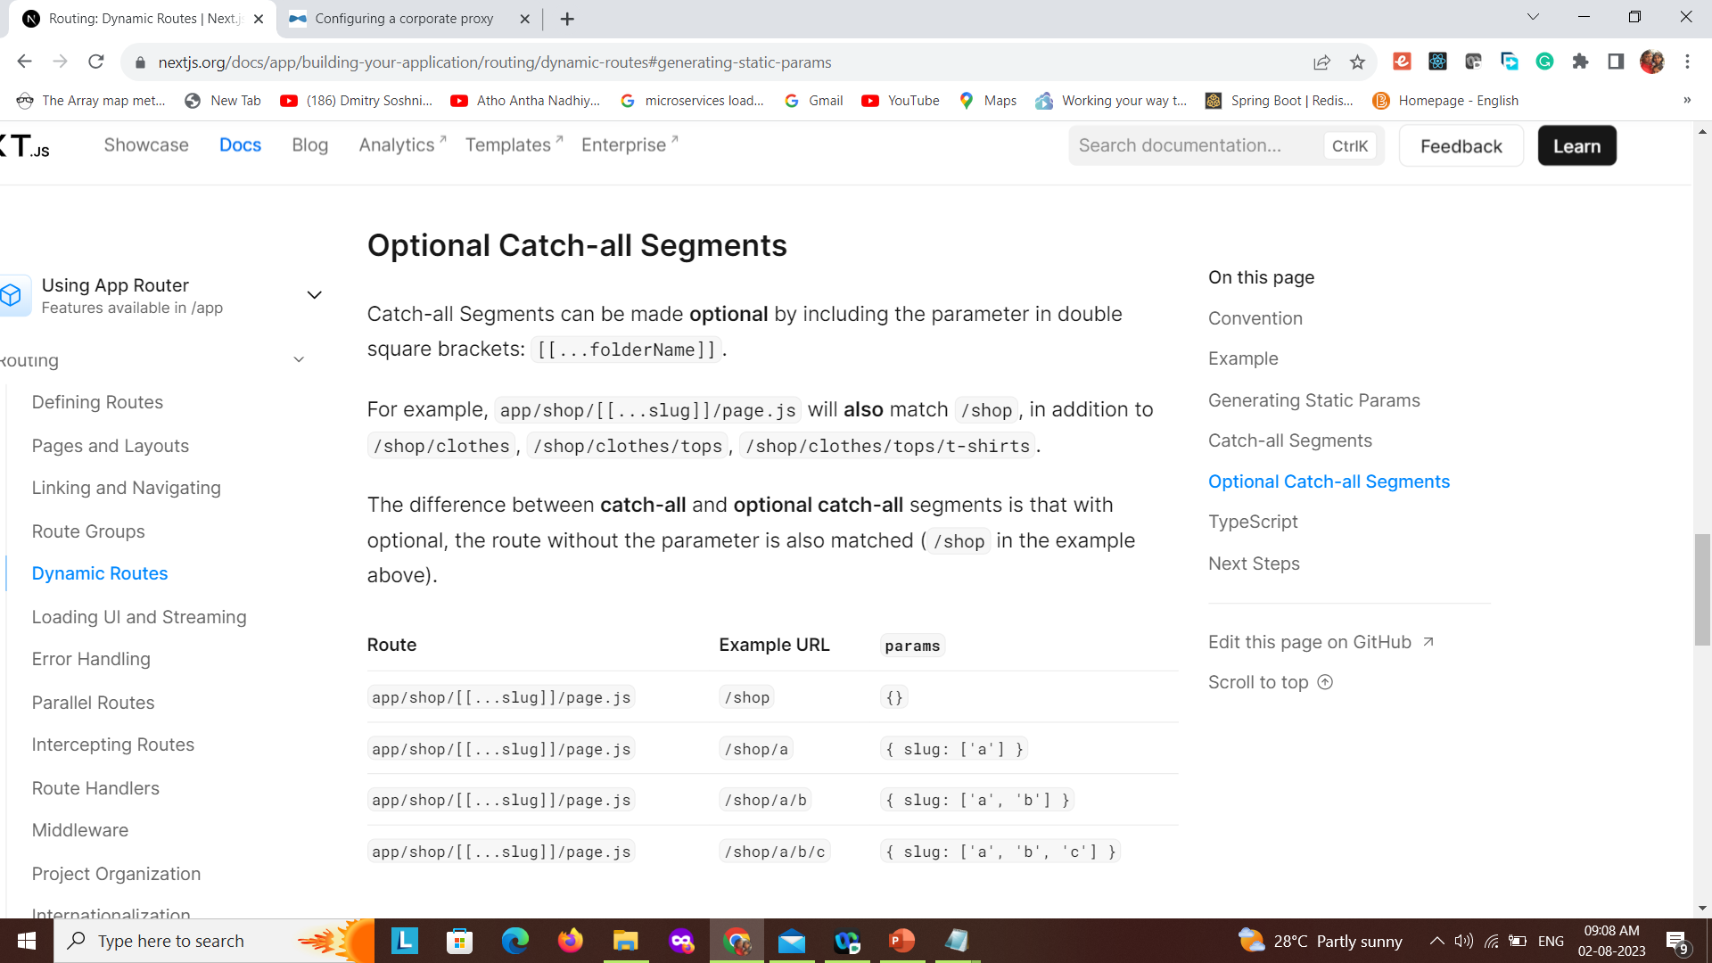

Slide 51
Linking and Navigation

Slide 52
Ways to Navigate
Using the <Link> Component
Using the useRouter Hook

Slide 53
<Link> Component
<Link> is a built-in component that extends the HTML <a> tag to provide prefetching and client-side navigation between routes.
It is the primary way to navigate between routes in Next.js
import Link from 'next/link'
export default function Page() {
return <Link href="/dashboard">Dashboard</Link>
}

Slide 54
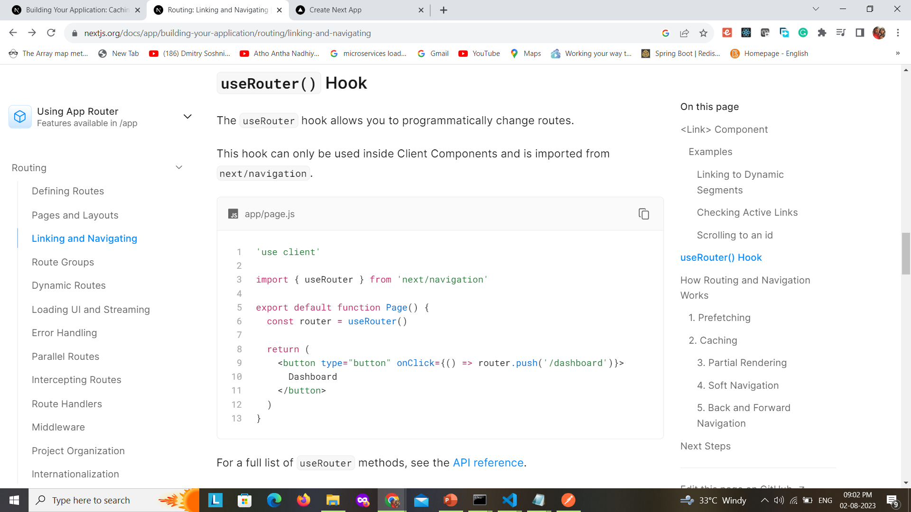
'use client';
import { useRouter } from "next/navigation"
export default function Navigator() {
const router = useRouter();
return <div>
<button onClick={() => {
router.push('/comments')
}}>Post</button>
</div>
}

Slide 55
Route Groups

Slide 56
Route Group to prevent the folder from being included in the route's URL path.

Slide 57
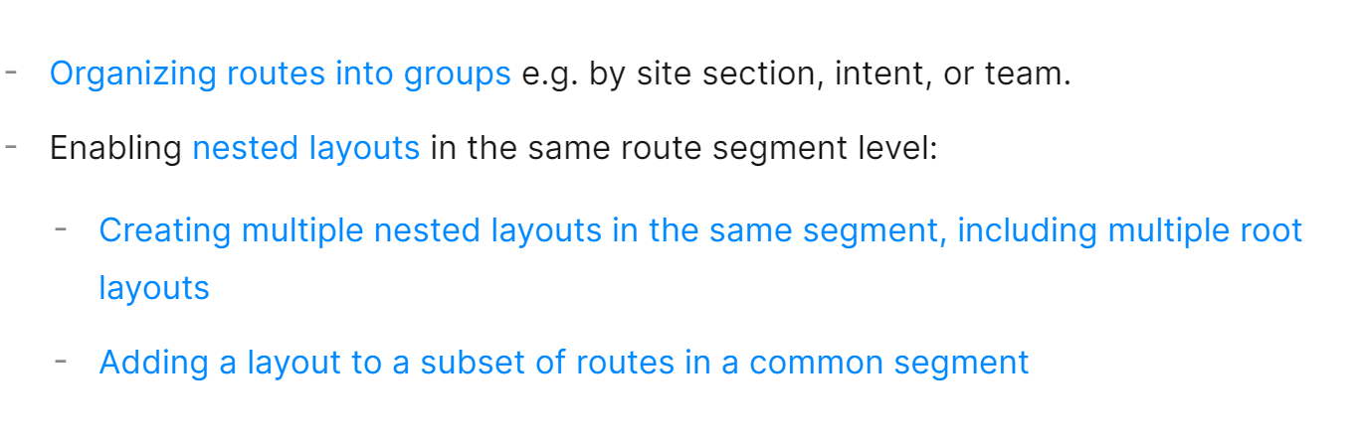
Advantages of Route Groups

Slide 58
Convention A route group can be created by wrapping a folder's name in parenthesis: (folderName)

Slide 59
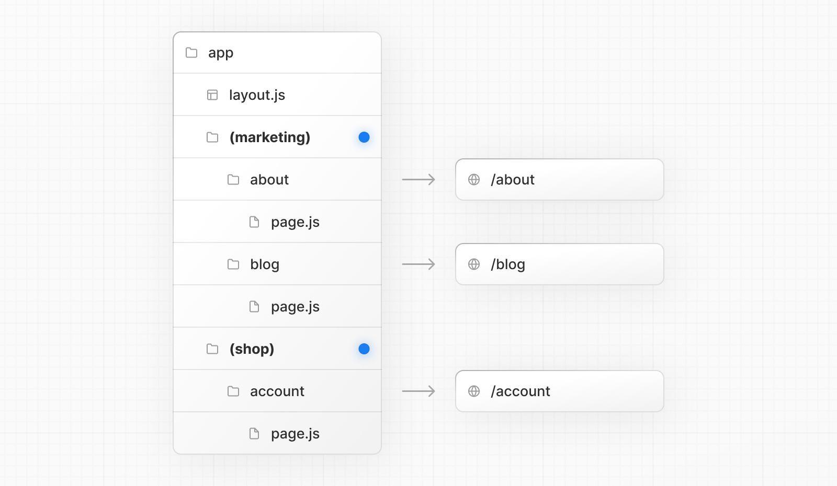

Slide 60
Sharing layout for Same Group

Slide 61
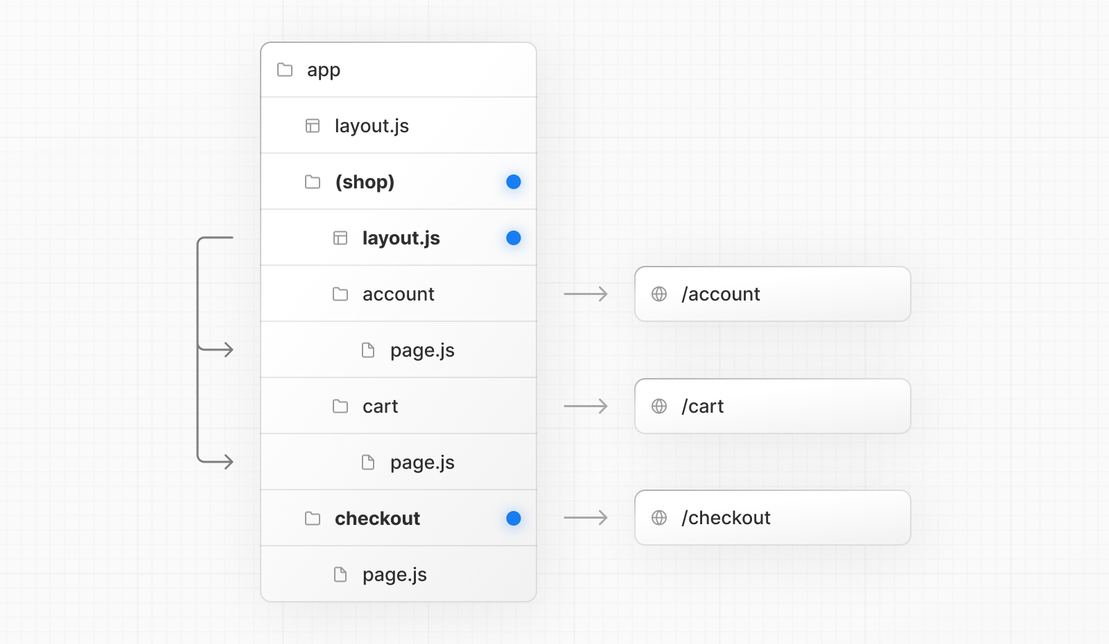

Slide 62
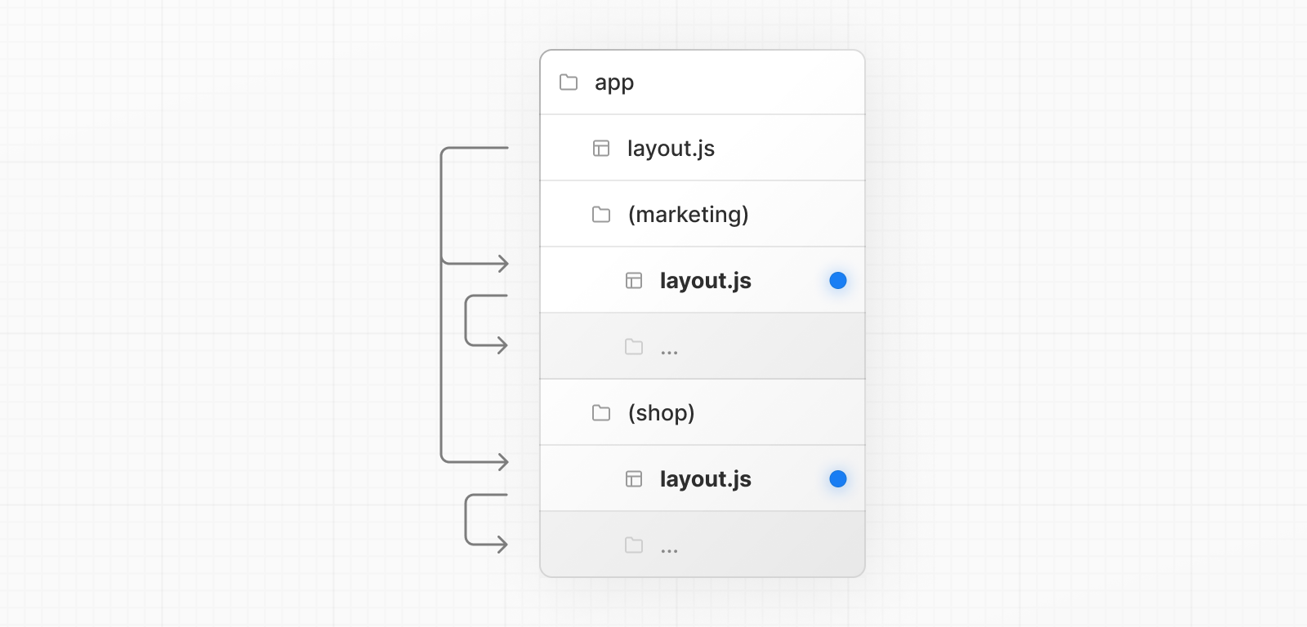
Even though routes inside (marketing) and (shop) share the same URL hierarchy, you can create a different layout for each group by adding a layout.js file inside their folders.

Slide 63
Opting specific segments into a layout

Slide 65
Creating multiple root layouts

Slide 66
To create multiple root layouts, remove the top-level layout.js file, and add a layout.js file inside each route groups. This is useful for partitioning an application into sections that have a completely different UI or experience. The <html> and <body> tags need to be added to each root layout.

Slide 67
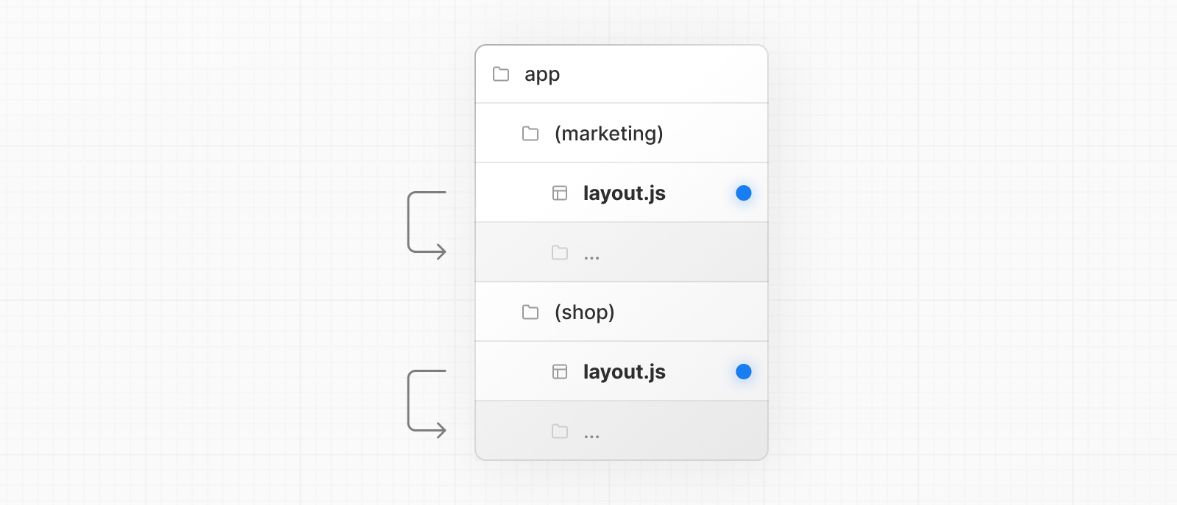
. Both (marketing) and (shop) have their own root layout

Slide 68
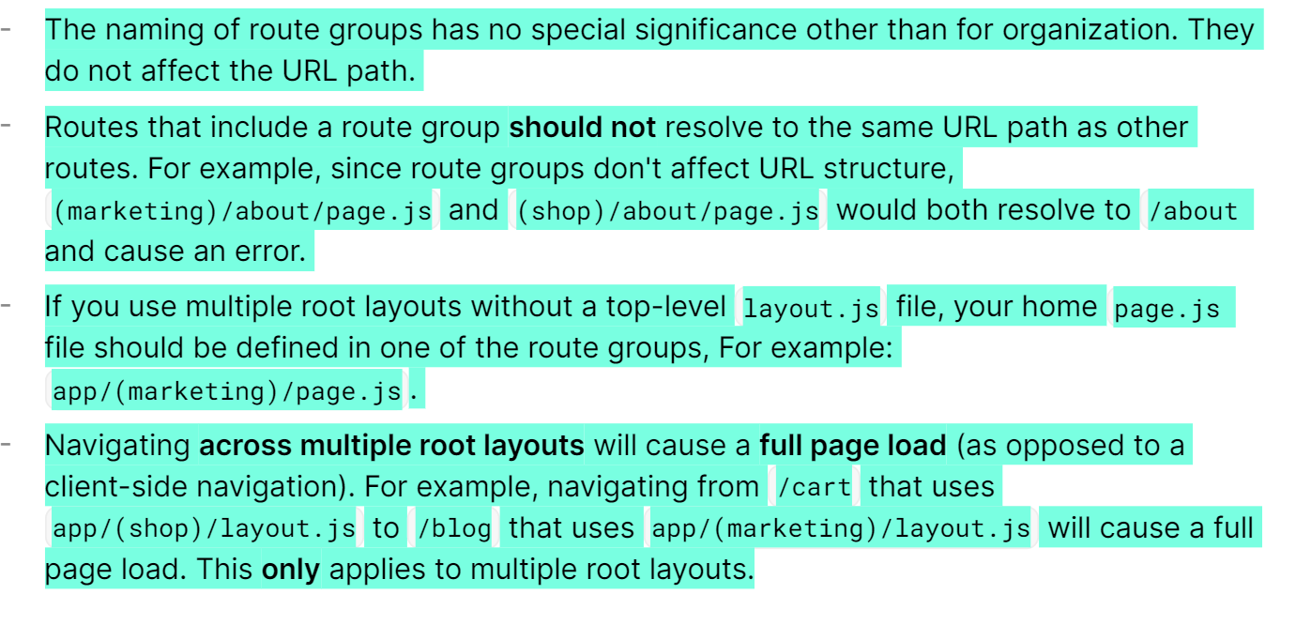

Slide 69
Parallel Routes

Slide 70
Parallel Routing allows you to simultaneously or conditionally render one or more pages in the same layout. For highly dynamic sections of an app, such as dashboards and feeds on social sites, Parallel Routing can be used to implement complex routing patterns.

Slide 71
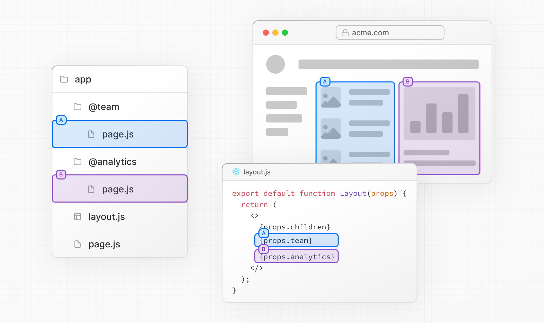

Slide 72
Conditional Rendering

Slide 73
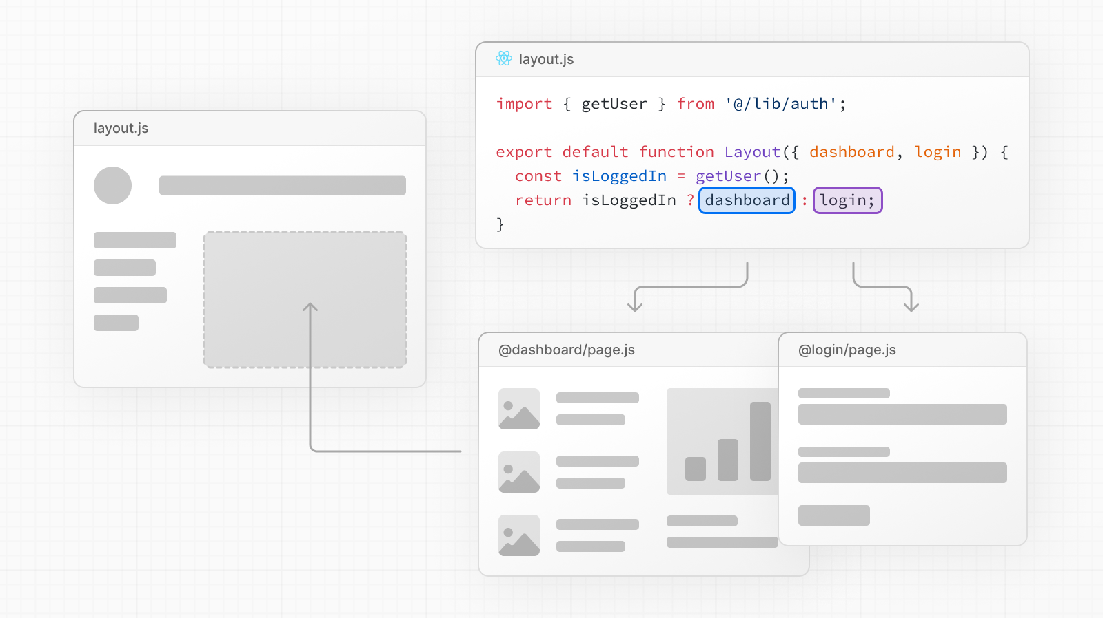

Slide 74
Unmatched Routes

Slide 75
By default, the content rendered within a slot will match the current URL. In the case of an unmatched slot, the content that Next.js renders differs based on the routing technique and folder structure.

Slide 76
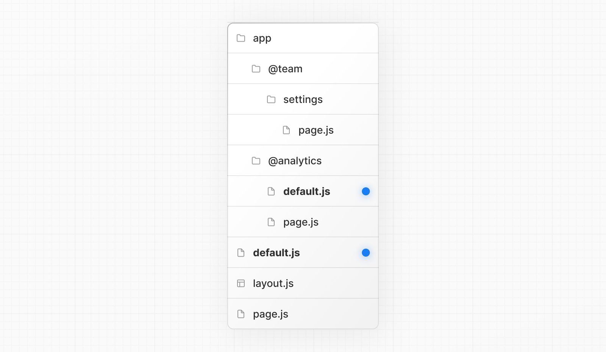

Slide 77
Intercepting Routes

Slide 78
Intercepting routes allows you to load a route within the current layout while keeping the context for the current page. This routing paradigm can be useful when you want to "intercept" a certain route to show a different route.

Slide 79
For example, when clicking on a photo from within a feed, a modal overlaying the feed should show up with the photo. In this case, Next.js intercepts the /feed route and "masks" this URL to show /photo/123 instead.

Slide 80
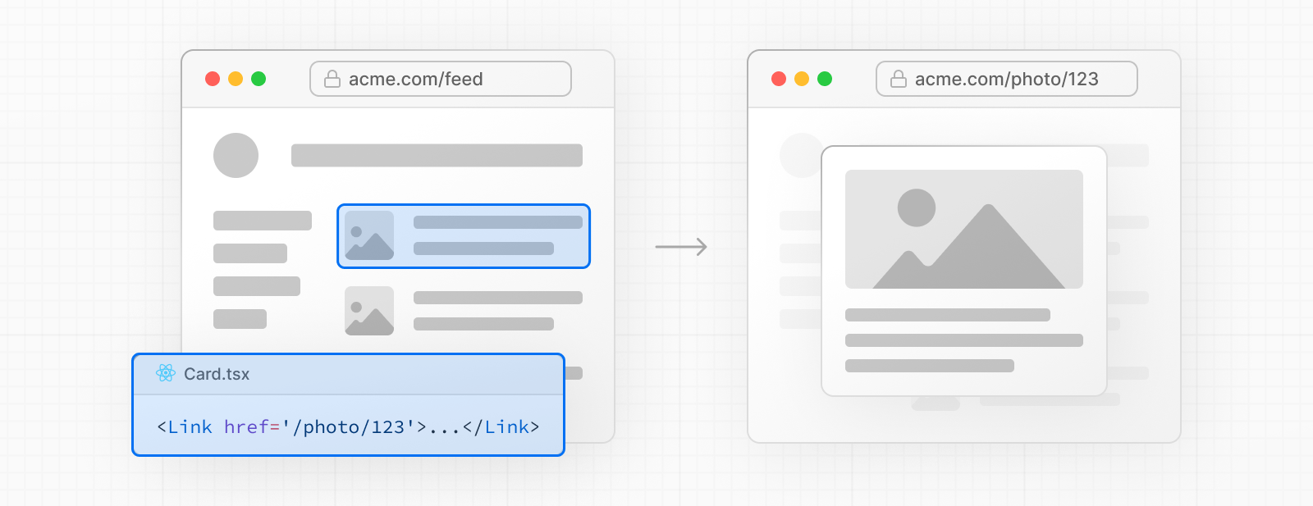

Slide 81
However, when navigating to the photo by clicking a shareable URL or by refreshing the page, the entire photo page should render instead of the modal. No route interception should occur.

Slide 82
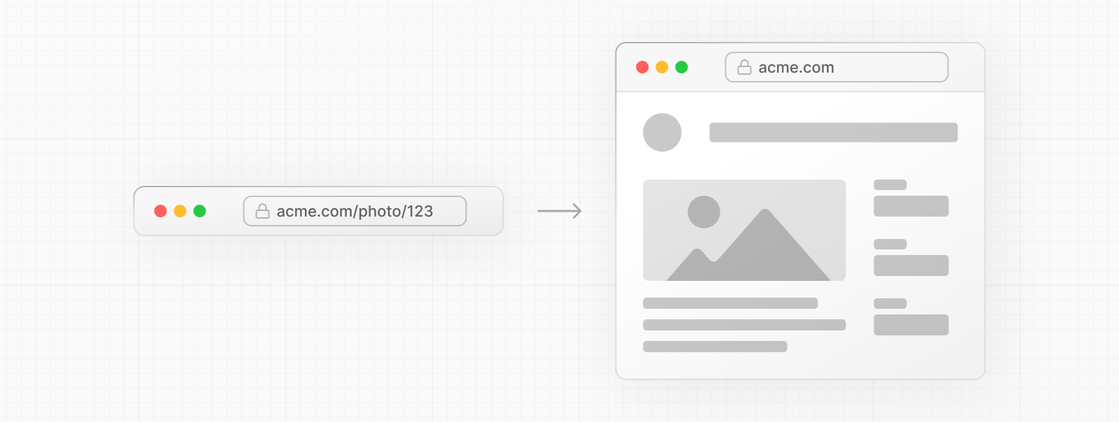

Slide 83
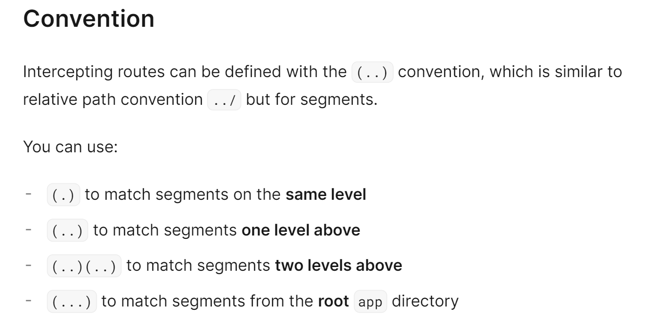

Slide 84
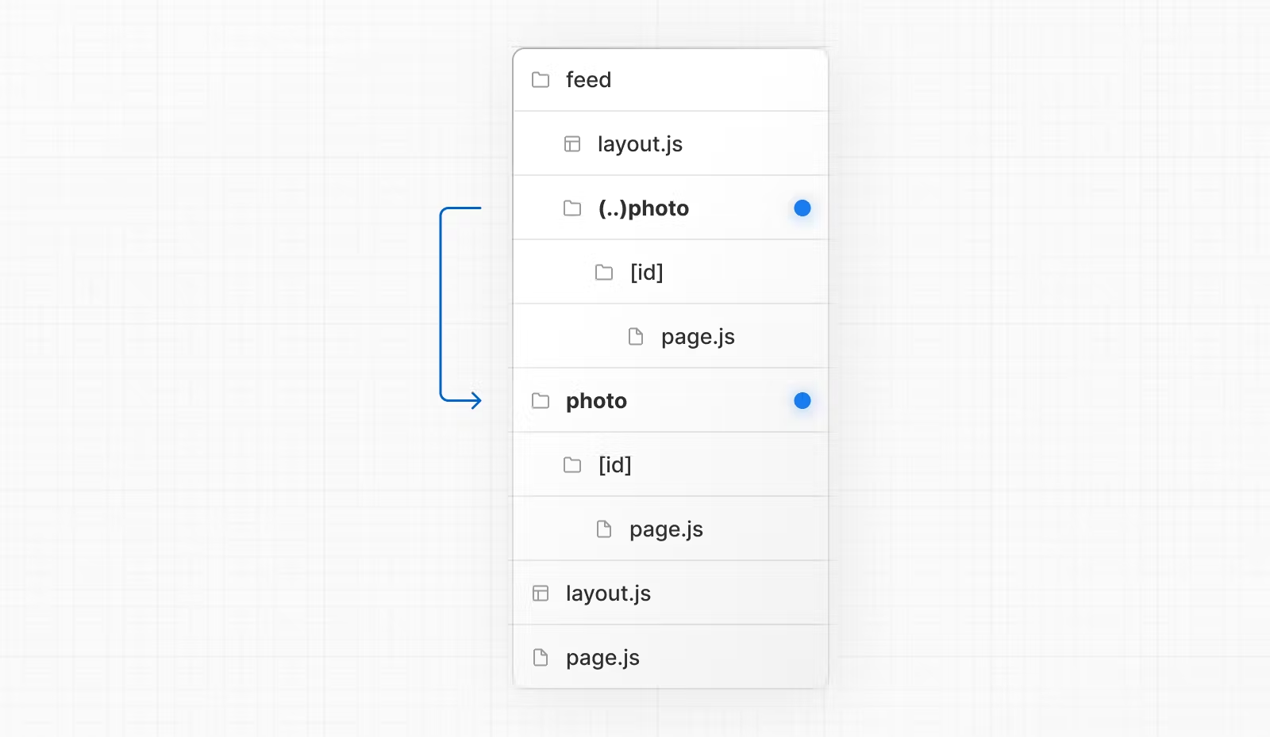
For example, you can intercept the photo segment from within the feed segment by creating a (..)photo directory.

Slide 85
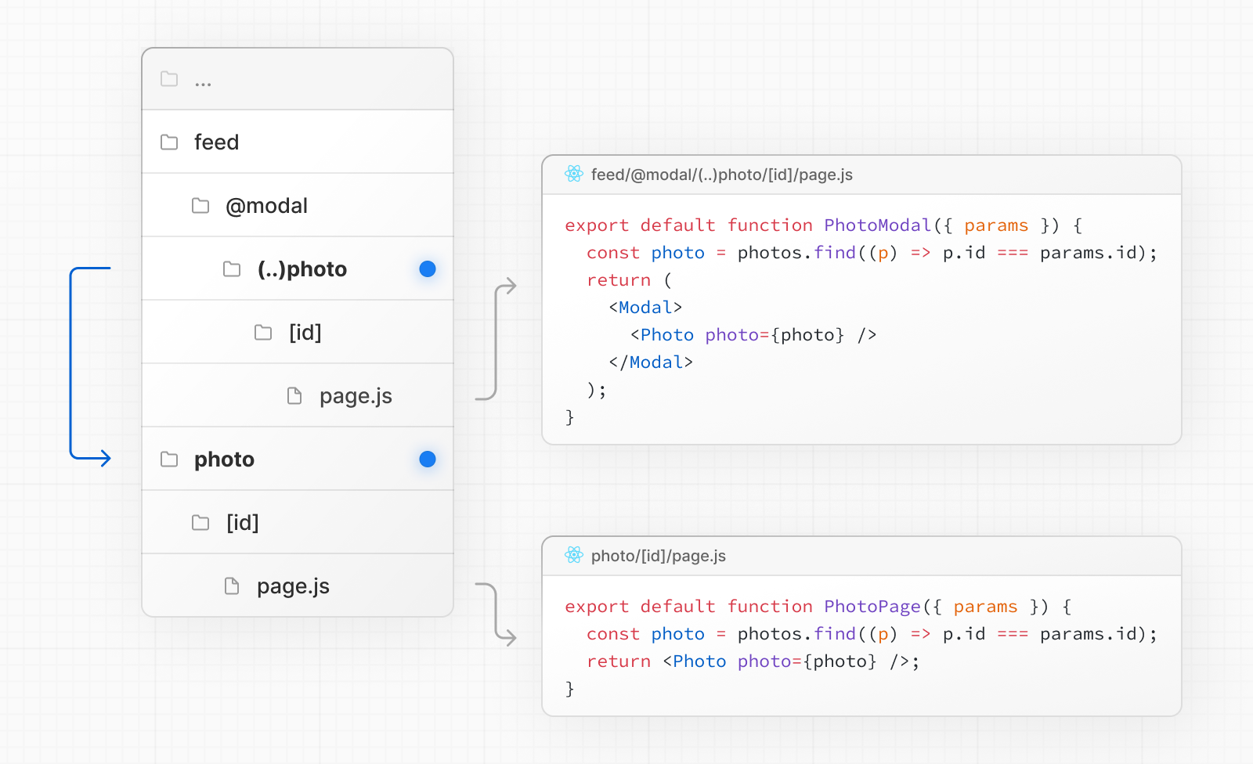
s

Slide 86
Loading UI and Streaming

Slide 87
The special file loading.js helps you create meaningful Loading UI with React Suspense. With this convention, you can show an instant loading state from the server while the content of a route segment loads. The new content is automatically swapped in once rendering is complete.

Slide 88
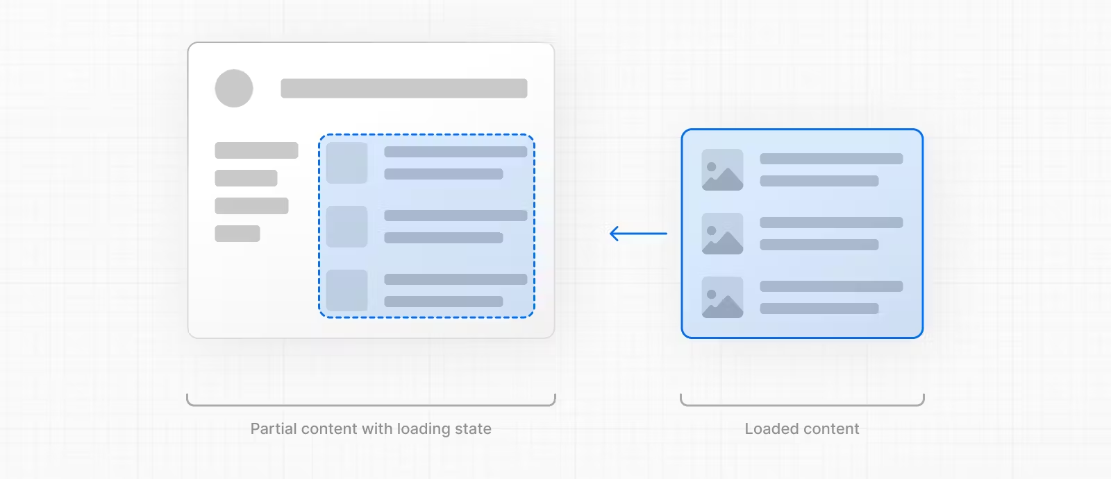

Slide 89
Instant Loading States

Slide 90
An instant loading state is fallback UI that is shown immediately upon navigation. You can pre-render loading indicators such as skeletons and spinners, or a small but meaningful part of future screens such as a cover photo, title, etc. This helps users understand the app is responding and provides a better user experience. Create a loading state by adding a loading.js file inside a folder.

Slide 91


Slide 92
export default function Loading() {
// You can add any UI inside Loading, including a Skeleton.
return <LoadingSkeleton />
}

Slide 93
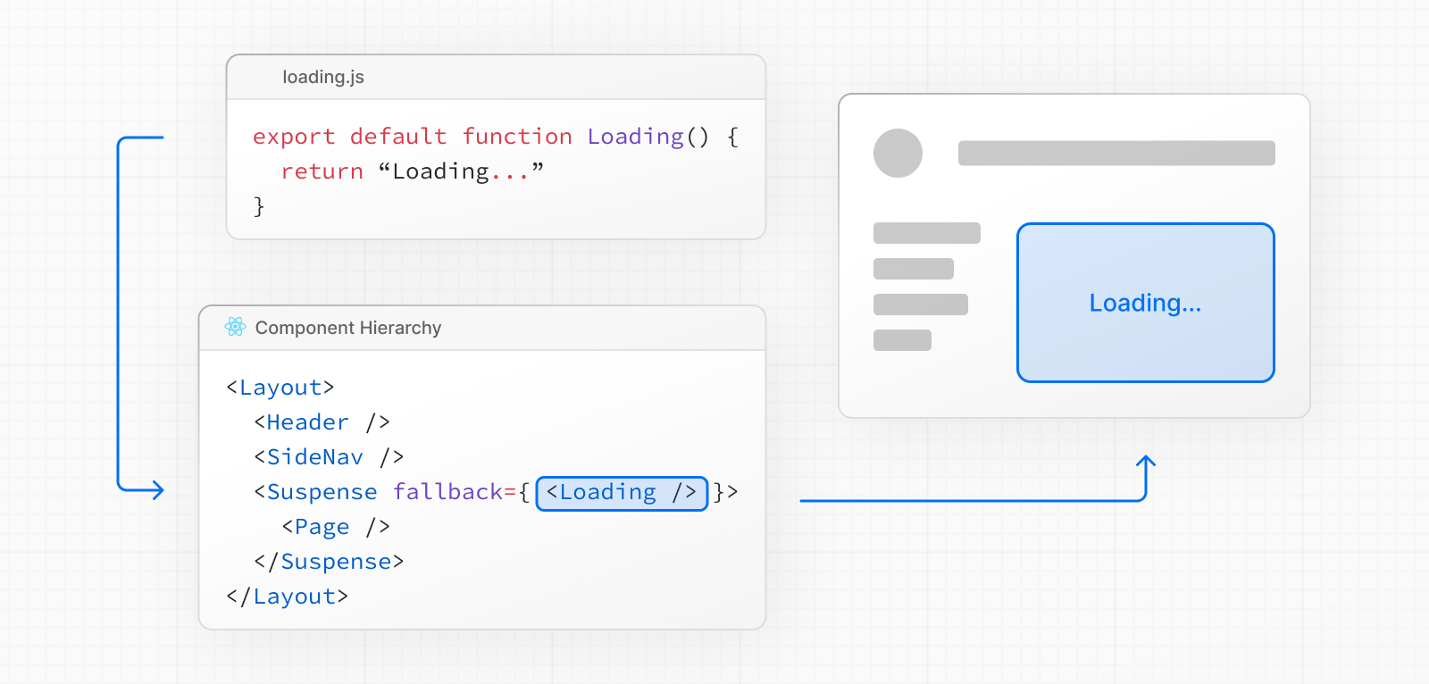

Slide 94
Streaming

Slide 95
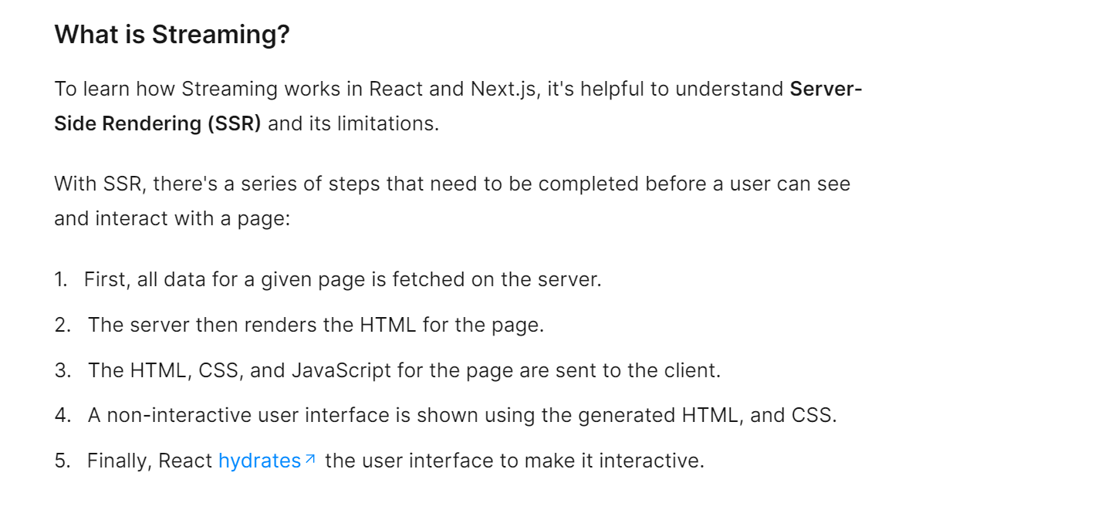

Slide 96
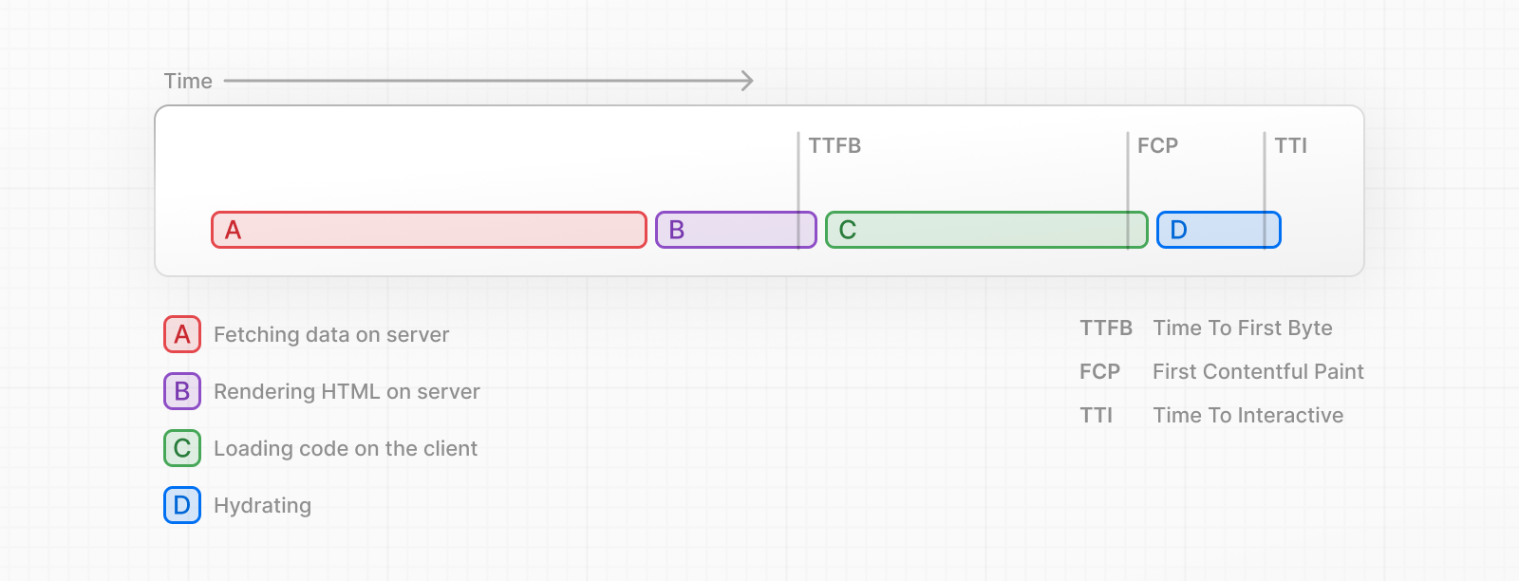

Slide 97
These steps are sequential and blocking, meaning the server can only render the HTML for a page once all the data has been fetched. On the client, React can only hydrate the UI once the code for all components in the page has been downloaded. SSR with React and Next.js helps improve the perceived loading performance by showing a non-interactive page to the user as soon as possible.

Slide 98
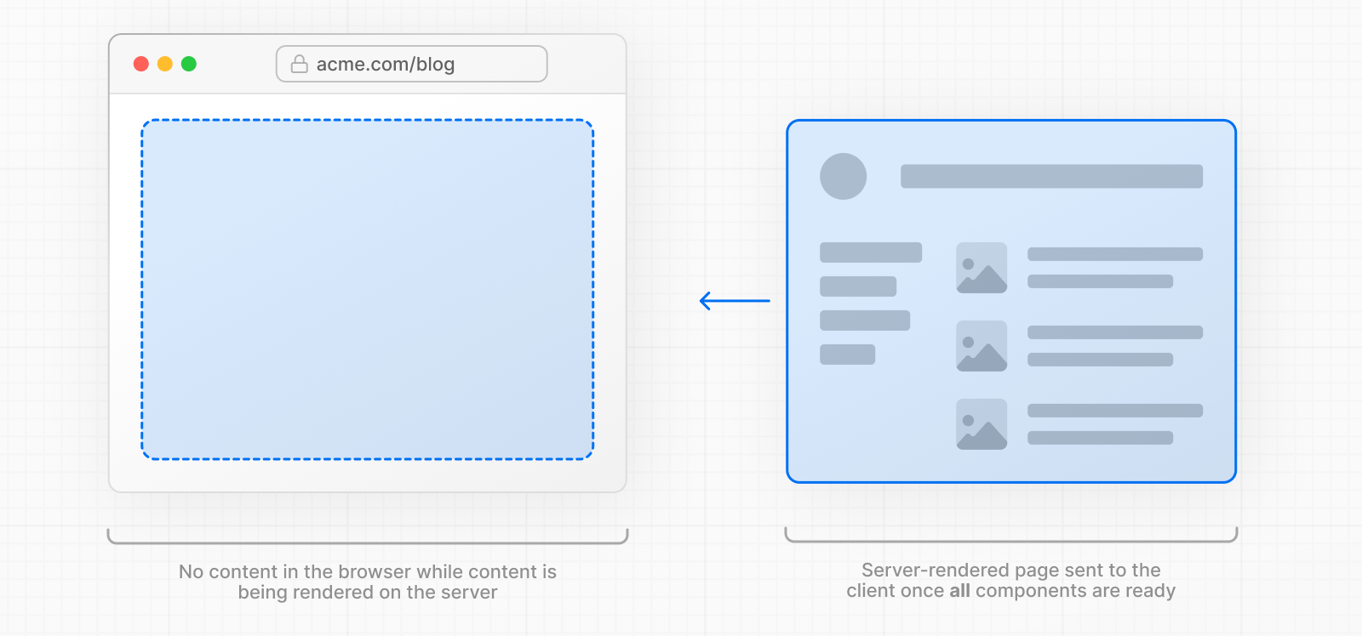
However, it can still be slow as all data fetching on server needs to be completed before the page can be shown to the user.

Slide 99
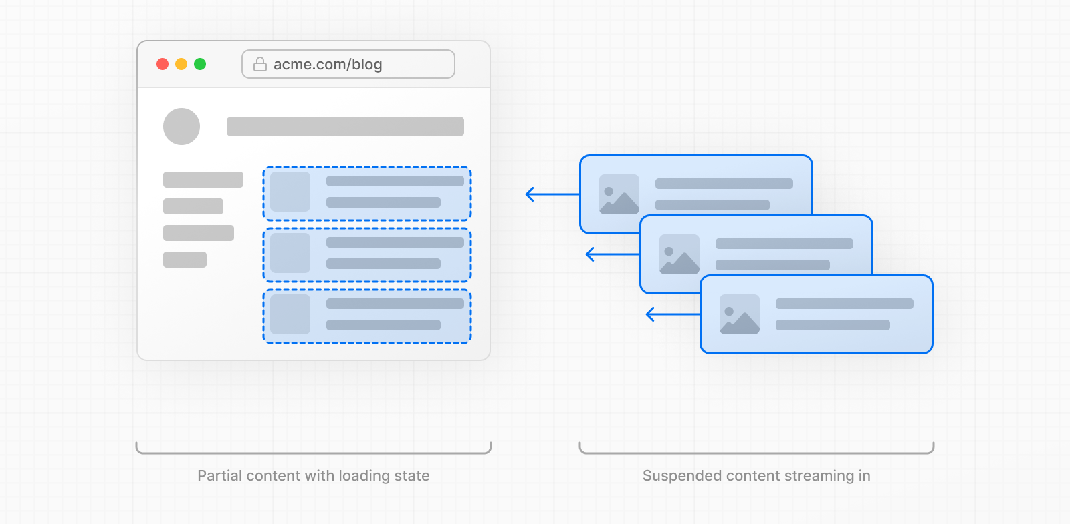

Streaming allows you to break down the page's HTML into smaller chunks and progressively send those chunks from the server to the client

Slide 100
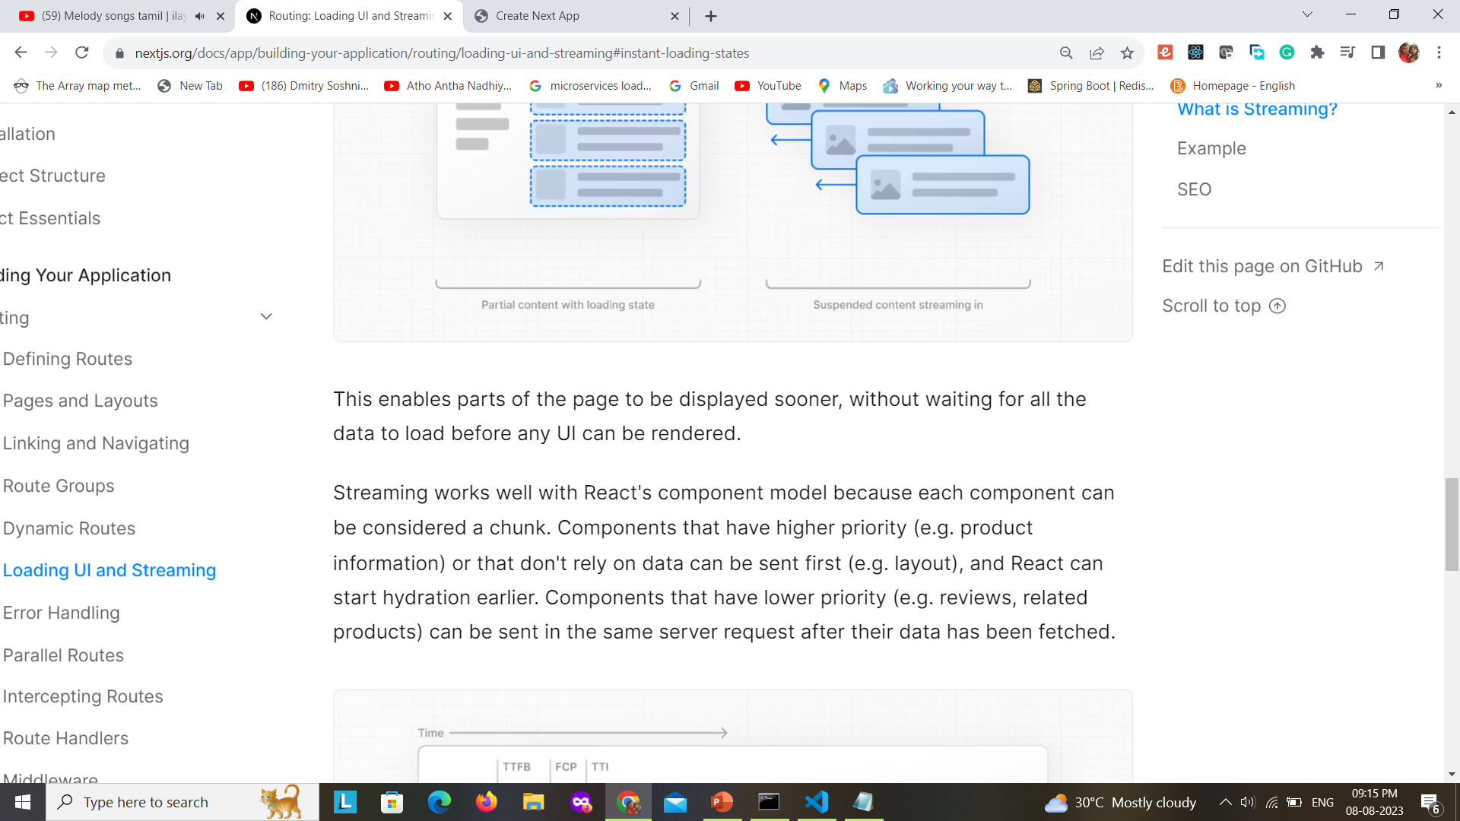


Slide 101
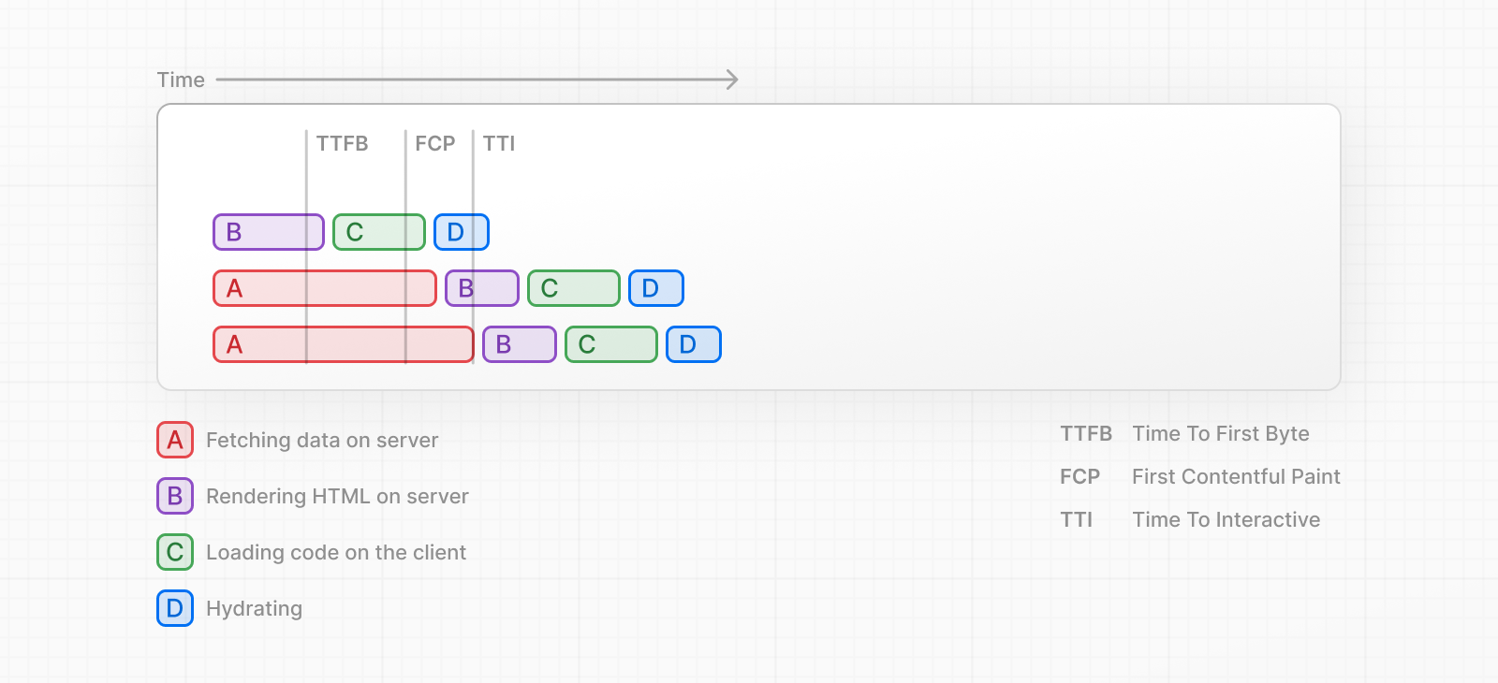
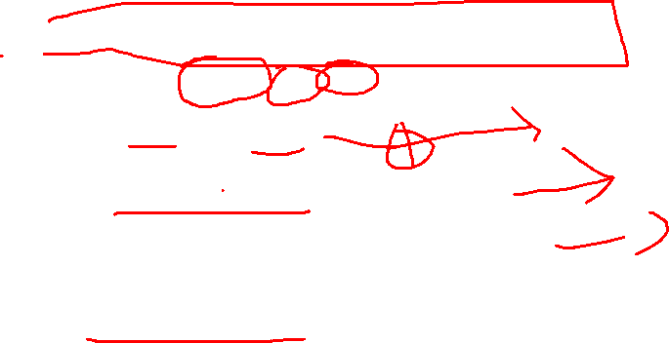

Slide 102
Streaming is particularly beneficial when you want to prevent long data requests from blocking the page from rendering as it can reduce the Time To First Byte (TTFB) and First Contentful Paint (FCP). It also helps improve Time to Interactive (TTI), especially on slower devices.

Slide 103
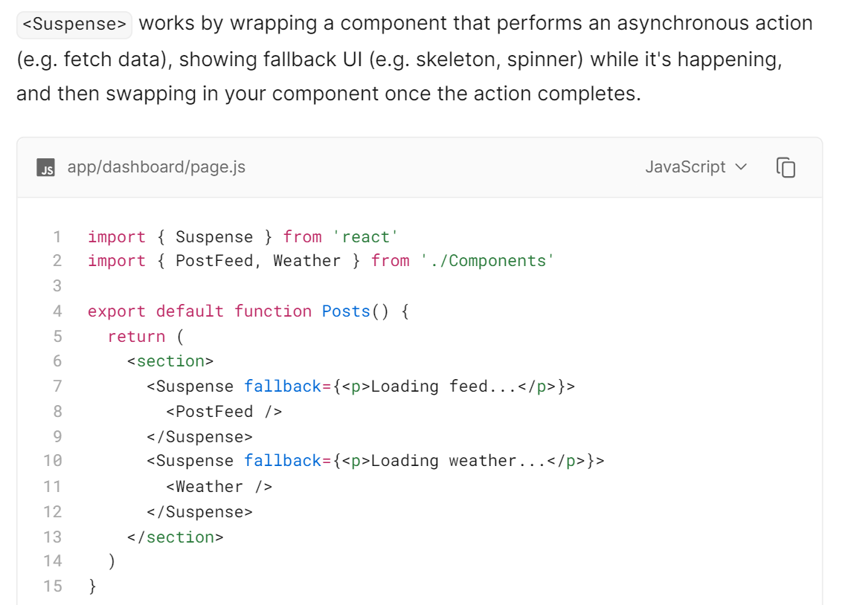

Slide 104
By using Suspense, you get the benefits of:
Streaming Server Rendering - Progressively rendering HTML from the server to the client.
Selective Hydration - React prioritizes what components to make interactive first based on user interaction.

Slide 105
SEO

Slide 106
Metadata Object and generate Metadata Options

Slide 107
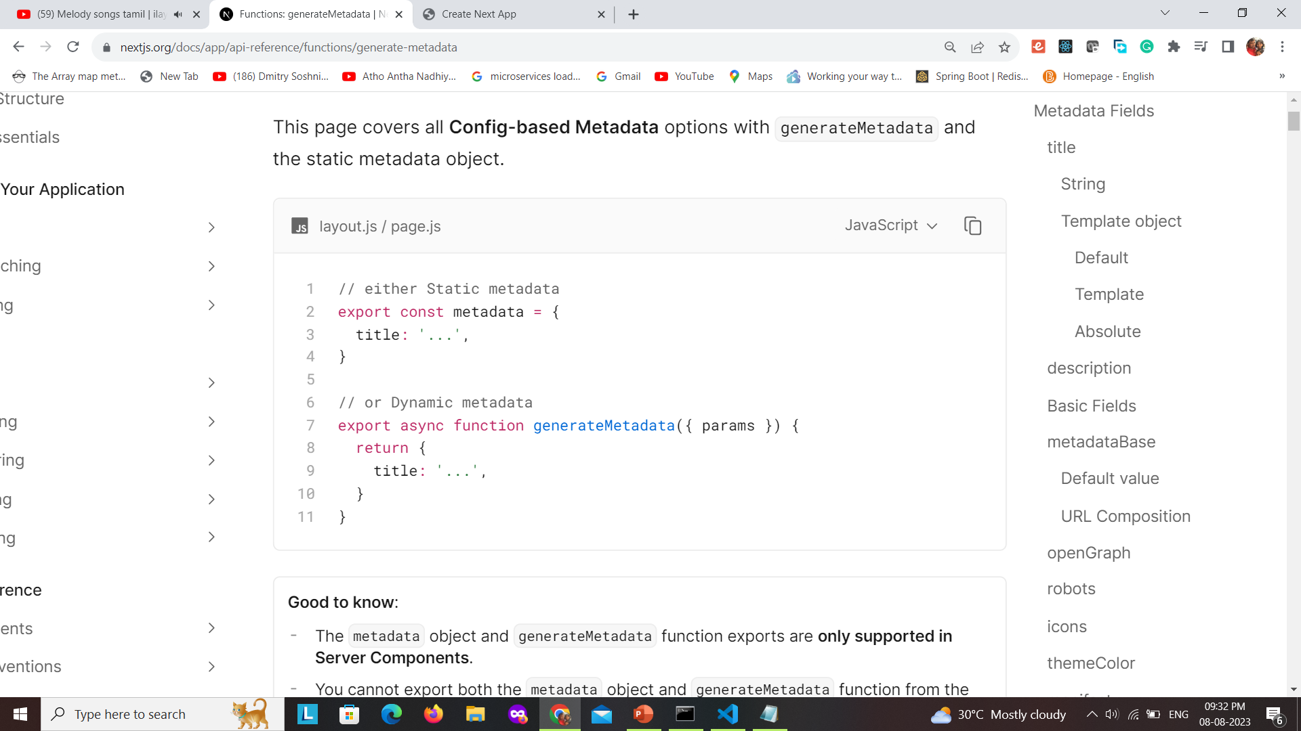

Slide 108
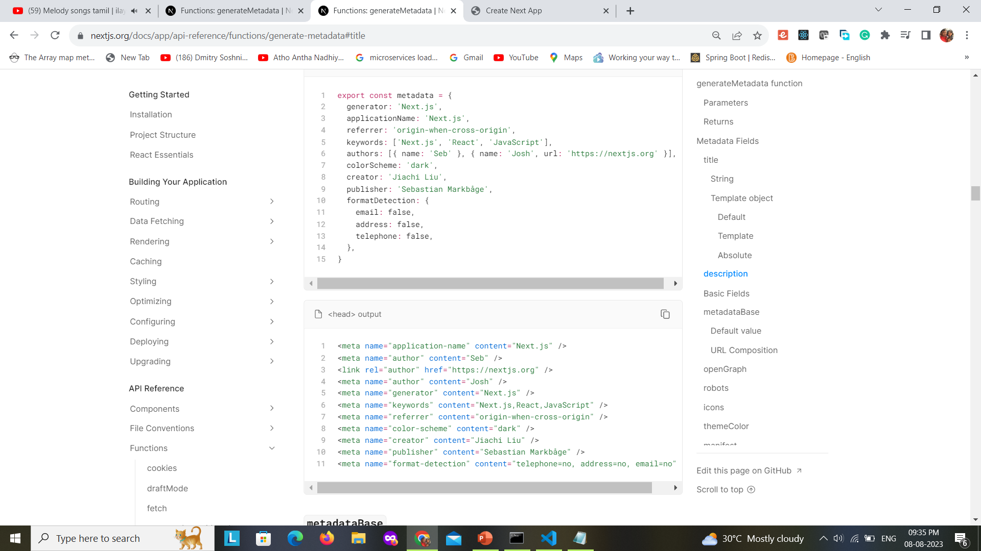

Slide 109
export async function generateMetadata({ params, searchParams }, parent) {
// read route params
const id = params.id
// fetch data
const response = await fetch(`https://jsonplaceholder.typicode.com/todos/${id}`)
const todo = await response.json()
console.log(todo)
return {
title: `Todo - ${todo.id}`
}
}

Slide 110
Styling

Slide 111
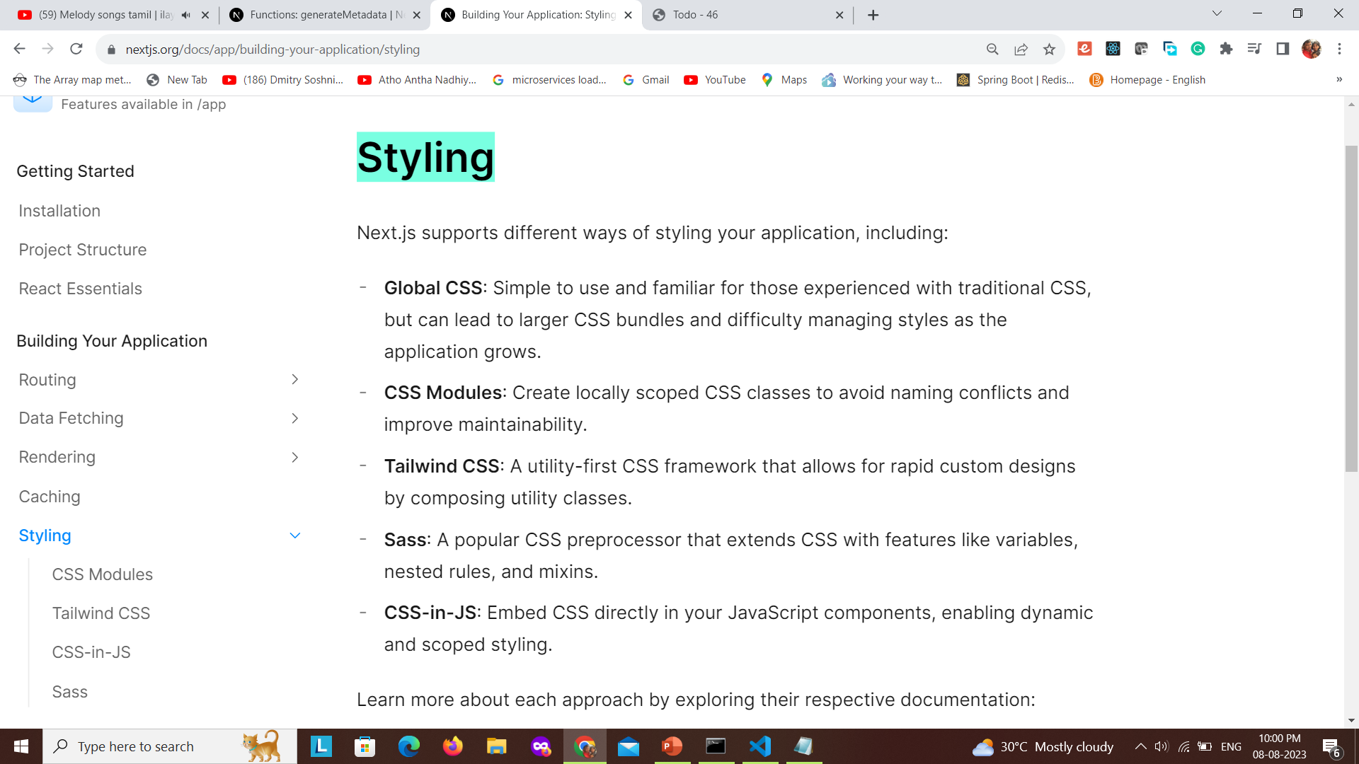

Slide 112
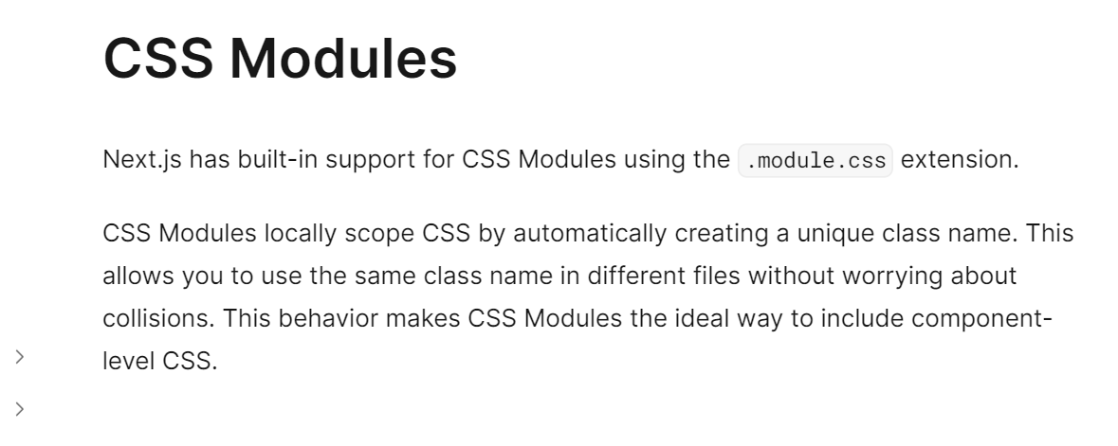

Slide 113
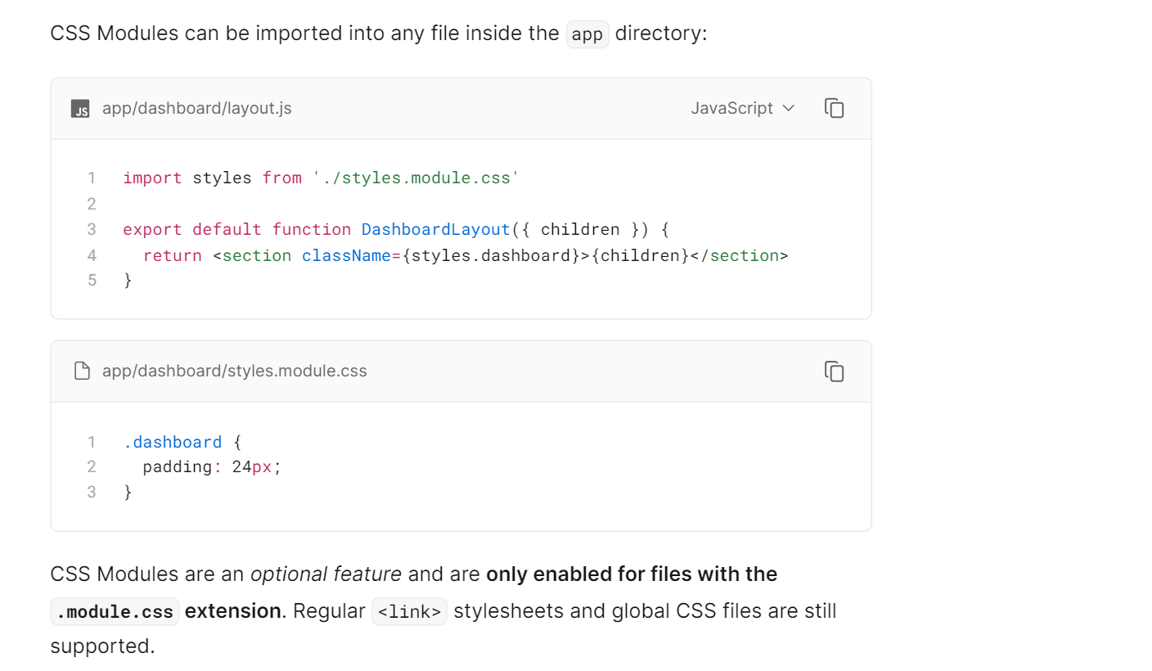

Slide 114
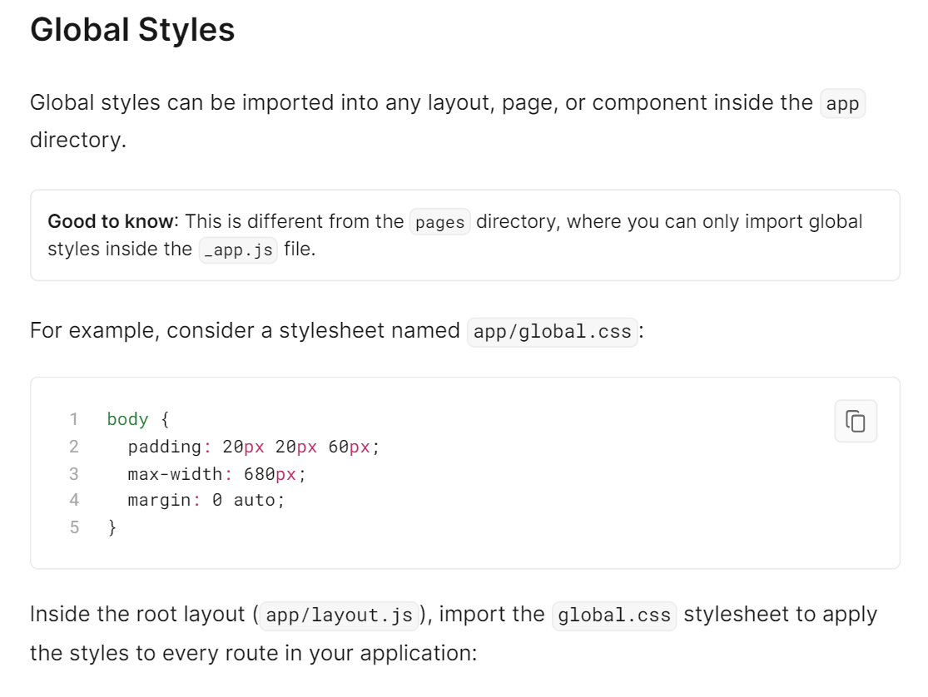

Slide 115
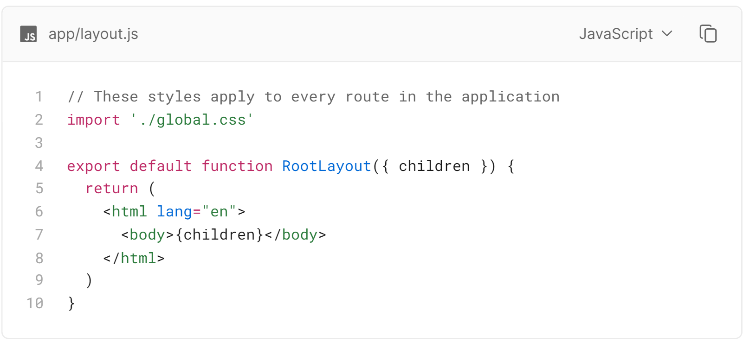

Slide 116
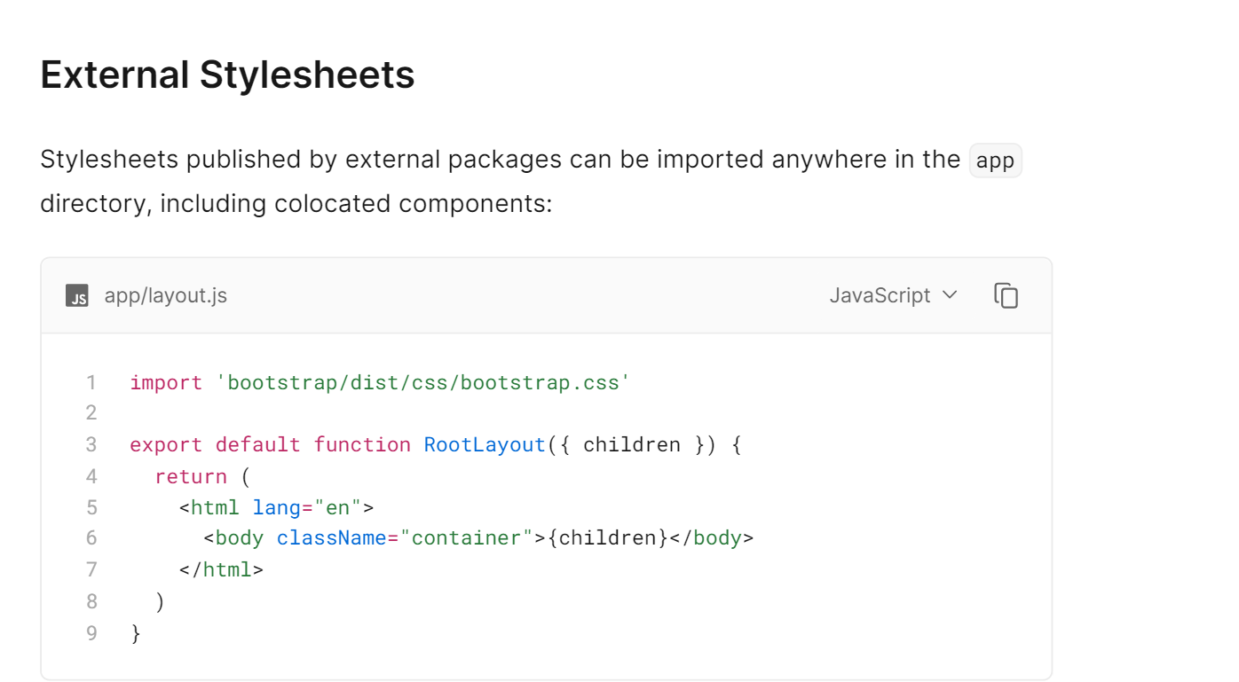

Slide 117
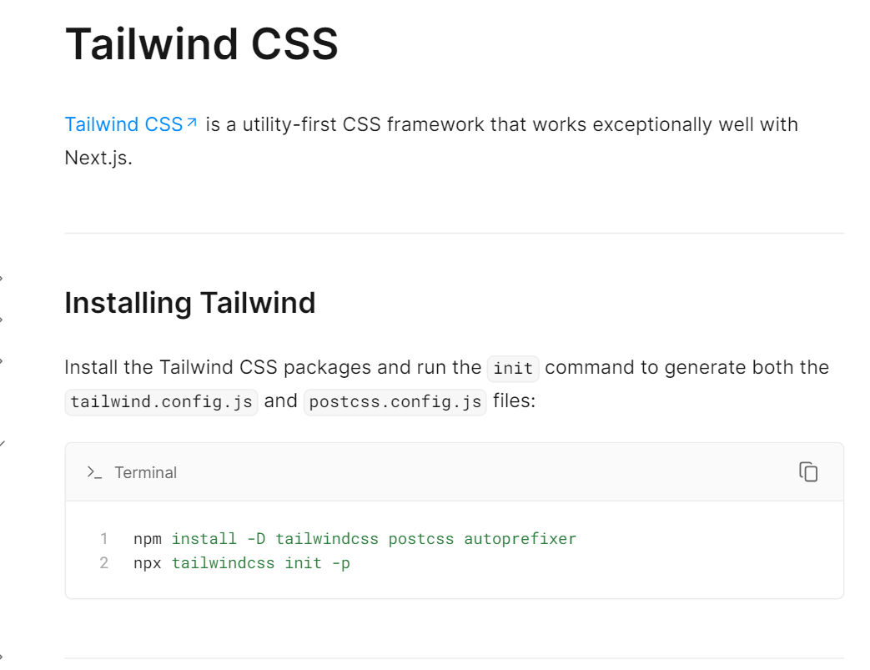

Slide 118


Slide 119


Slide 120


Slide 121
Google Fonts

Slide 122


Slide 123

Thank You
Subramanian Murugan

