Slide 1
Non Blocking Applications
Subramanian Murugan

Slide 2
IO Demystification

Slide 3
IO
Input/output (IO) refers to interaction with devices such as a hard drive, network
Generally anything that is not happening in the CPU is called IO
When you call an API that requests data from IO, you will not get a response instantly, but with some delay
This delay can be very small for requesting a file on a hard drive, and much longer when requesting data from a network

Slide 4
File Descriptors IO Low Level Implementation

Slide 5
OS IO Layer Architecture
Application-Tomcat
User Space
Kernel space – File Descriptors
Device Drivers
IO Device -1
Network -Device
IO Device -2

Slide 6
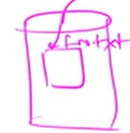

Slide 7
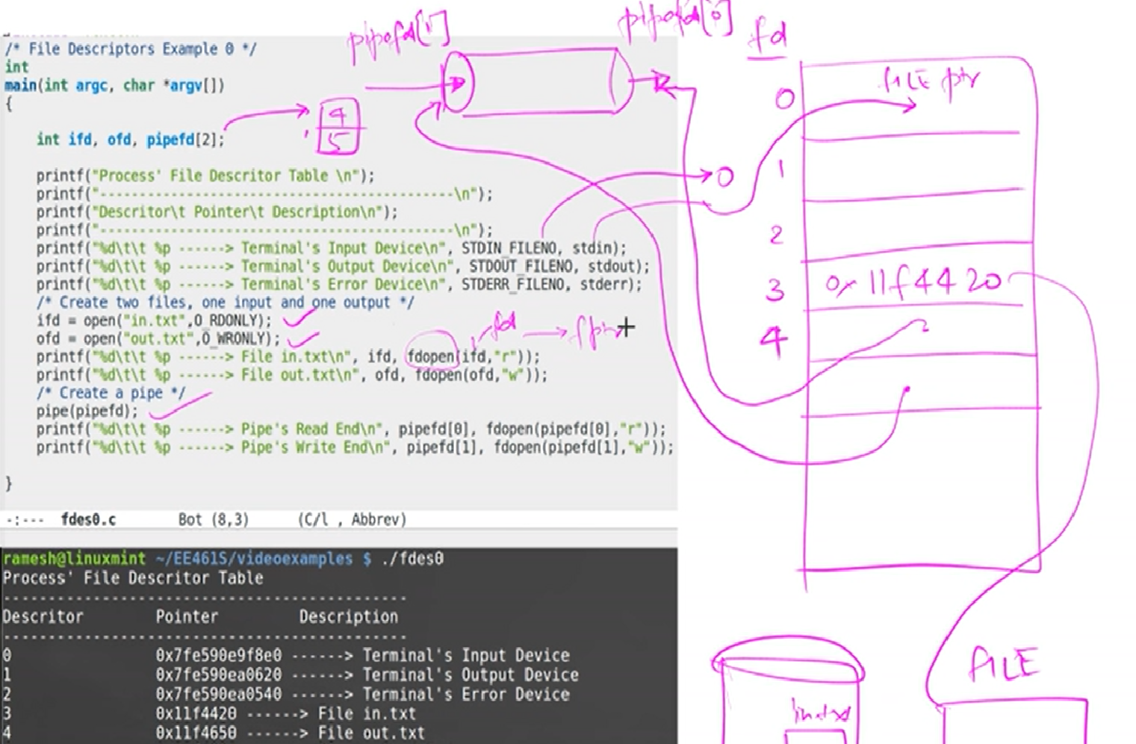
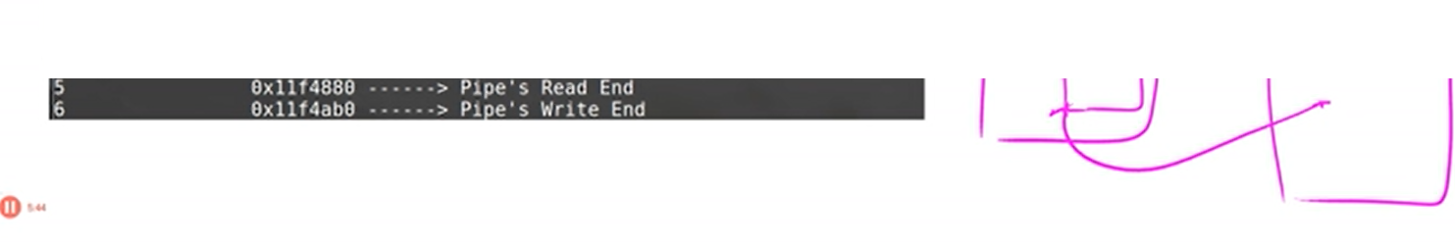

Slide 8
Two distinct phases for an input operation
Waiting for the data to be ready. This involves waiting for data to arrive on the network. When the packet arrives, it is copied into a buffer within the kernel.
Copying the data from the kernel to the process. This means copying the (ready) data from the kernel's buffer into our application buffer

Slide 9
IO Models
Only we are going to discuss Blocking IO and IO Multiplexing
Blocking I/O
Nonblocking I/O
Signal driven I/O (SIGIO)
Asynchronous I/O (The POSIX aio_ functions)
I/O multiplexing
Select
Poll
Epoll / Kqueue/IOCP

Slide 10
Blocking IO

Slide 11
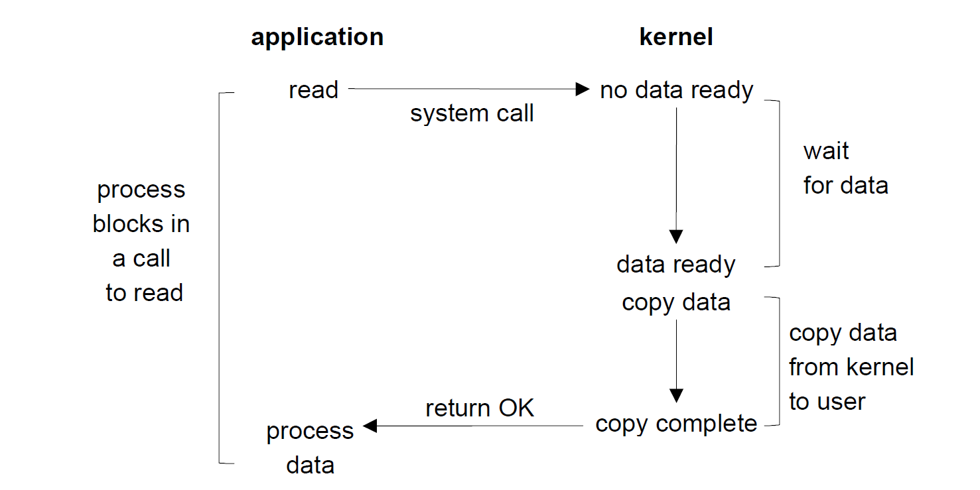

Slide 12
Threading Models and IO
Modern Process (JVM) By default is Multi threaded
IO operations can be multi threaded.

Slide 13
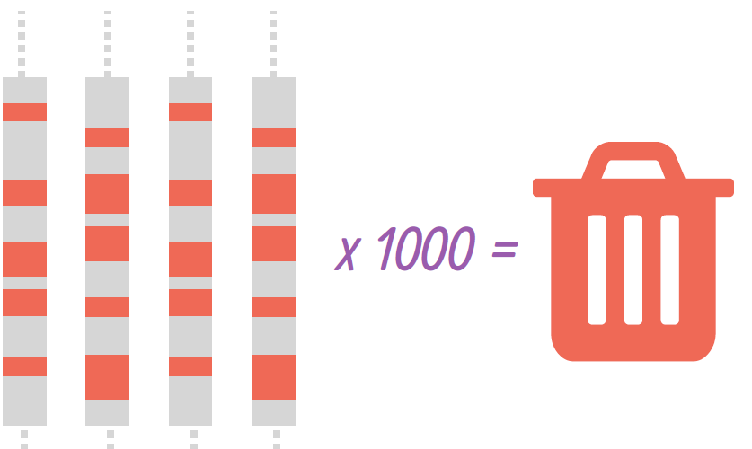
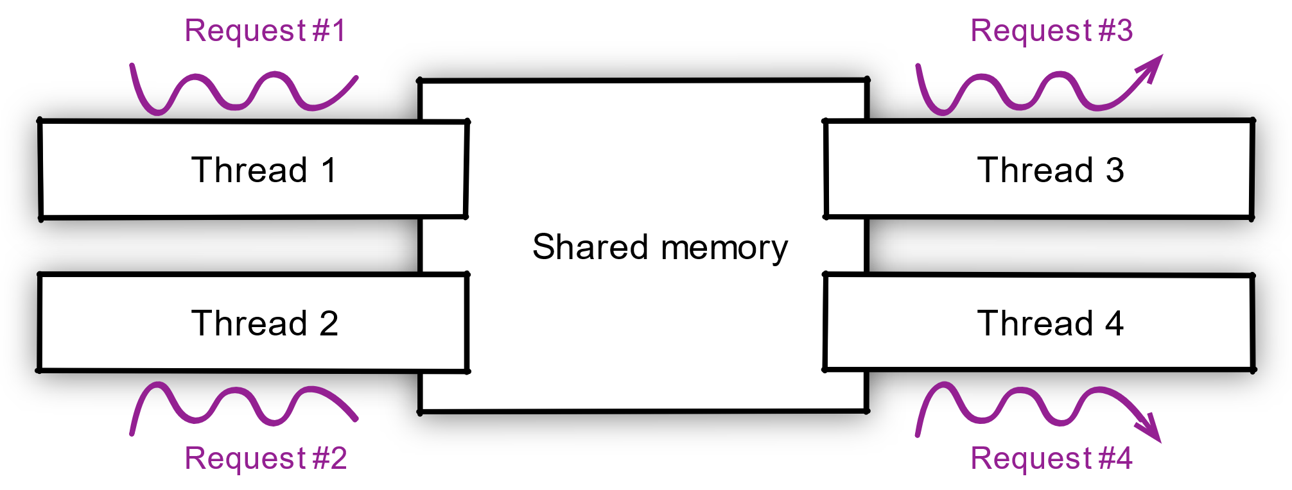
Networking IO In Java : Tomcat
How does Tomcat handles http request for a client?
Tomcat creates or allocates a thread per Client

Slide 14
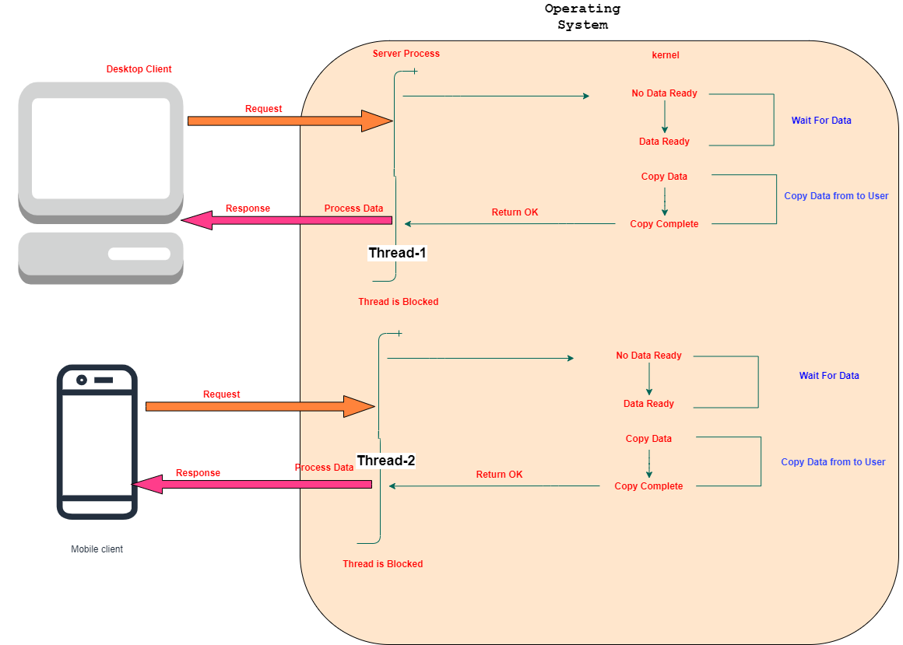
Multi Threading and Blocking io

Slide 15
Multi-threading is “simple” but limited
What hap­pens as the work­load grows be­yond mod­er­ate work­loads? (see the C10k prob­lem)
you start mak­ing your op­er­at­ing sys­tem ker­nel suf­fer be­cause there is too much con­text switch­ing work with in-​flight re­quests.
Calling an API that requests data from IO will cause the running thread to “block”, i.e. it is waiting until the requested data has returned to the caller.
When a thread is blocked in Linux, it will be put in a Sleep state by the kernel until data has returned to the caller.
The C10k problem is the problem of optimizing network sockets to handle a large number of clients at the same time

Slide 16
Multi-threading is “simple” but limited
Threads in sleep state immediately give up its access to the CPU, so to not waste CPU time.
After IO is ready, the thread is taken out of the Sleep state and put in Runnable state.
Threads in this state are eligible to be executed on the CPU again.
The thread scheduler will put the thread on a CPU when one is available. The process of taking threads on and off the CPU is called context switching.

Slide 17
Multi-threading is “simple” but limited
Some of your threads will be blocked be­cause they are wait­ing on I/O op­er­a­tions to com­plete, some will be ready to han­dle I/O re­sults, and some will be in the mid­dle of doing CPU-​intensive tasks.
Mod­ern ker­nels have very good sched­ulers, but you can­not ex­pect them to deal with 50 000 threads as eas­ily as they would do with 5 000. Also, threads aren’t cheap: cre­at­ing a thread takes a few mil­lisec­onds, and a new thread eats about 1MB of mem­ory.

Slide 18
Blocking IO is default
Every Operating system by default provides blocking io calls.
The Programming languages follows the same io calls.
C10K Problem changed way of thinking about concurrency in application development.

Slide 19
Blocking system calls – Linux OS
Accept
 | accept a connection on a socket
open
 | open for reading and writing
read / readv / pread
 | read from a file
write / writev / pwrite
 | write on a file
send / sendto / sendmsg
 | send a message from a socket
recv / recvfrom / recvmsg
 | receive a message from a socket

Slide 20
IO Multiplexing IO With many Sources

Slide 21
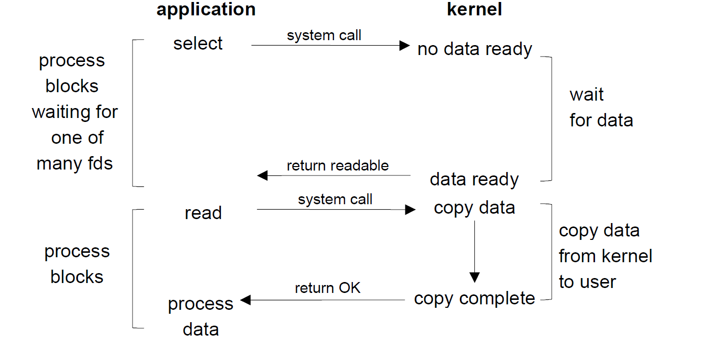

Slide 22
Watching multiple file descriptors and choose among them which fd is ready for reading or writing in socket

Slide 23
IO Monitoring calls
Select
Poll
Epoll, kqueue, IOCP

Slide 24
select
Suppose one Server connected to multiple clients. Server is waiting in a queue to read multiple client data from socket. But in Queue 1 read function has no data and 2nd function has data. Then select function monitors all file fds, permits to server read data from second file descriptor.
select() allows a program to monitor multiple file descriptors, waiting until one or more of the file descriptors become "ready" for some class of I/O operation (e.g., input possible).
A file descriptor is considered ready if it is possible to perform a corresponding I/O operation (e.g., read(2), or a sufficiently small write(2)) without blocking.

Slide 25
poll
poll( ) does not require that the user calculate the value of the highest- numbered file descriptor +1
poll( ) is more efficient for large-valued file descriptors. Imagine watching a single file descriptor with the value 900 via select()—the kernel would have to check each bit of each passed-in set, up to the 900th bit.
select( )’s file descriptor sets are statically sized.
With select( ), the file descriptor sets are reconstructed on return, so each subsequent call must reinitialize them. The poll( ) system call separates the input (events field) from the output (revents field), allowing the array to be reused without change.
The timeout parameter to select( ) is undefined on return. Portable code needs to reinitialize it. This is not an issue with pselect( )
select( ) is more portable, as some Unix systems do not support poll( )

Slide 26
Event Loop
While/for infinite loop to watch list of fds
If something happens, notify to application process.
Application process may have been waiting for io notification.
Kernel emits notification called “Event”

Slide 27
Events and Listeners
Object / Structure contains notification along with data.
Event listeners are already registered in the application to process it.
Event listeners will be executed by a thread called “event loop thread” as events arrives.

Slide 28
epoll - I/O event notification facility
The epoll API performs a similar task to poll
Monitoring multiple file descriptors to see if I/O is possible on any of them.
The epoll API can be used either as an edge-triggered or a level-triggered interface and scales well to large numbers of watched file descriptors.

Slide 29
epoll - I/O event notification facility
The interest list (sometimes also called the epoll set):
The set of file descriptors that the process has registered an interest in monitoring.
The ready list :
The set of file descriptors that are "ready" for I/O. The ready list is a subset of (or, more precisely, a set of references to) the file descriptors in the interest list. The ready list is dynamically populated by the kernel as a result of I/O activity on those file descriptors.

Slide 30
IO Multiplexing implementations on os
Epoll – Linux
Kqueue –Open BSD including mac
IOCP - Windows

Slide 31
Java and io
Java does not support for non blocking api until java 7.
Java 7 Added new non blocking version of IO called NIO.

Slide 32
Problems with NIO
It does not provide higher-level protocol-specific helpers, like for writing HTTP clients and servers.
Also, java.nio does not prescribe a threading model, which is still important to properly utilize CPU cores, handle asynchronous I/O events, and articulate the application processing logic.
This is why, in practice, developers rarely deal with Java NIO

Slide 33
Netty
Netty is a NIO client server framework which enables quick and easy development of network applications such as protocol servers and clients

Slide 34
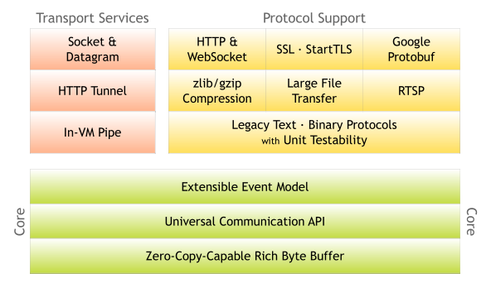
Netty

Slide 35
Birth of Vertx Project
Vertx was born to simulate Node.js Capability on JVM. initially it was named "Node.X"
A core project, called vertx-core, provides the APIs for asynchronous programming, non-blocking I/O, streaming, and convenient access to networked protocols such as TCP, UDP, DNS, HTTP or Web Sockets,
Vertx is industry ready , polyglot toolkit for building Nonblocking, evented io applications.
Vertx has been built on the top of Netty Core

Slide 36
Vertx binds Netty at Core , Netty communicates Epoll, Kqueue, IOCP Framework

Slide 37
Vertx
Netty Core
NIO - JVM
Epoll
KQueue
IOCP

Slide 38
Vertx Concurrency Model

Slide 39
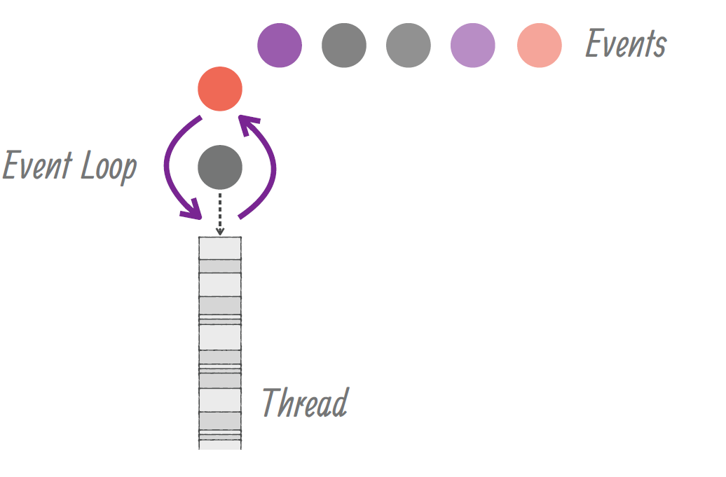
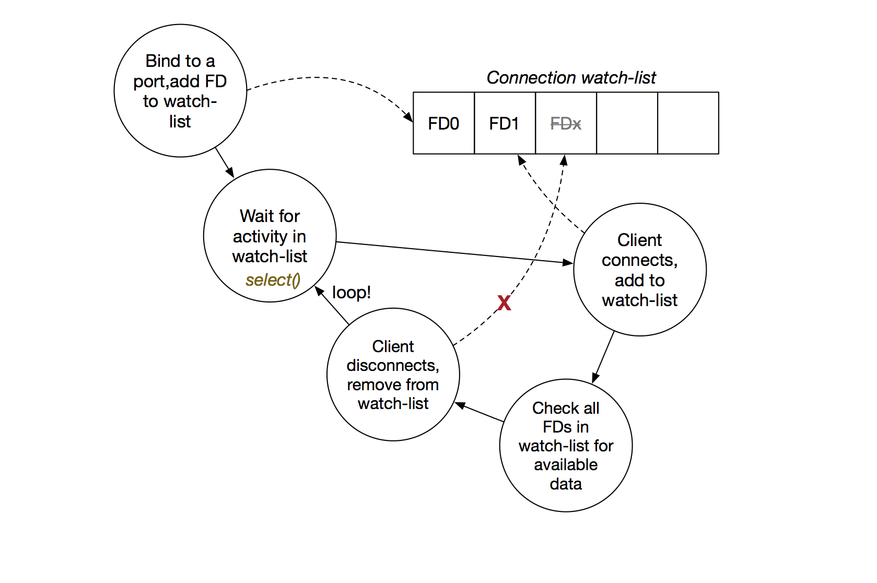
Vertx Runtime
Operating System

Slide 40
12*2=24

Slide 41
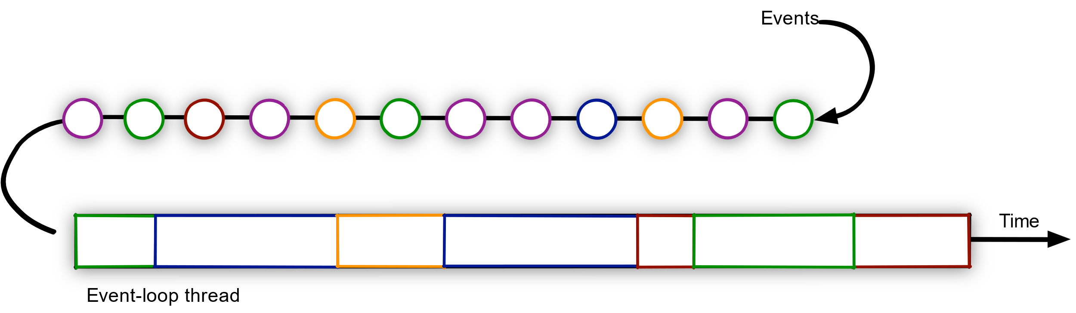

Slide 42
Events and Callbacks
Callbacks are functions/api registered to handle event notification.
Callbacks are registered in the task queues.
As soon as event arrived , Event loop thread assign handler to deliver results to caller.

Slide 43
Vertx is not Framework or lib but toolkit
Tool Kit you can embed into any java application , into Spring you can, Into Quarkus You can

Slide 44
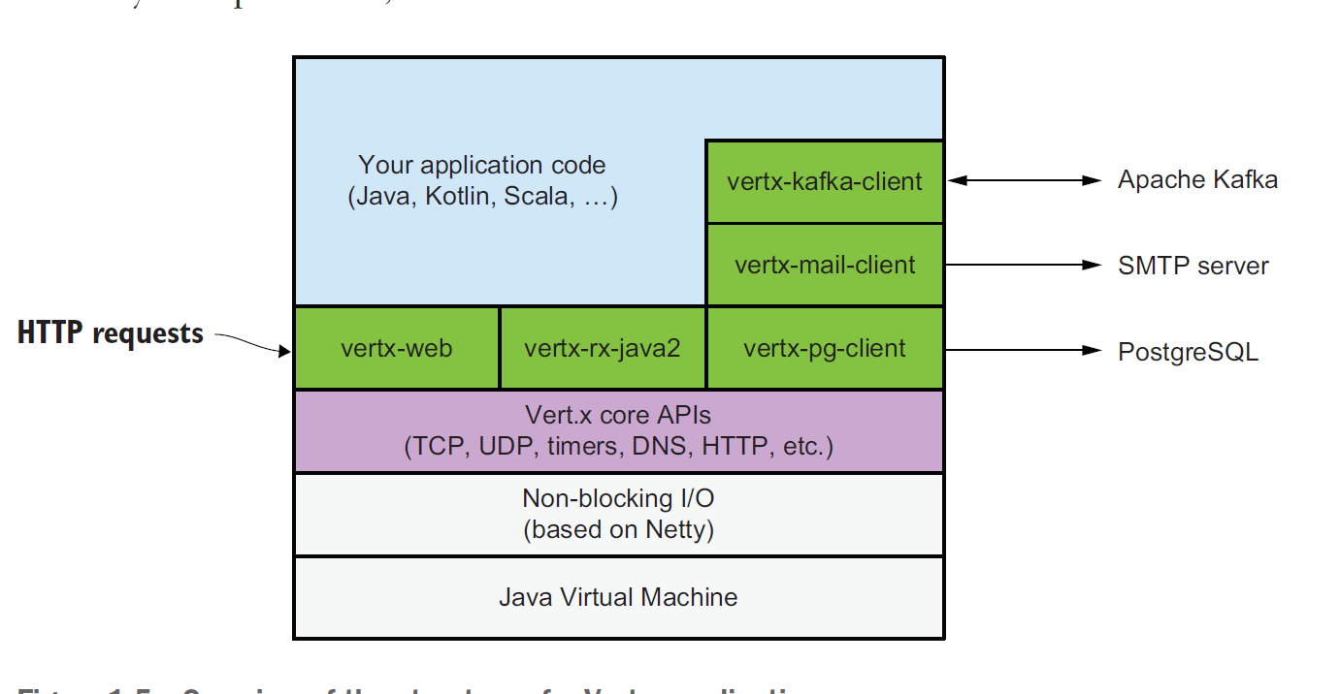
Vertx Modules

Slide 45

Thank you
Subramanian Murugan

