Slide 1

Angular
Subramanian Murugan

Slide 2
Angular Getting Started
What is Angular
Angular Architecture
Building Blocks of Angular

Slide 3
What is Angular
Angular is a platform and framework for building client applications in HTML and TypeScript.
Angular is written based on many web Standards such as MVC,Dependency Injection, Web Components Spec.
Angular is Object Oriented Development Platform, In Angular many things are Objects.

Slide 4
Angular Architecture

Slide 5
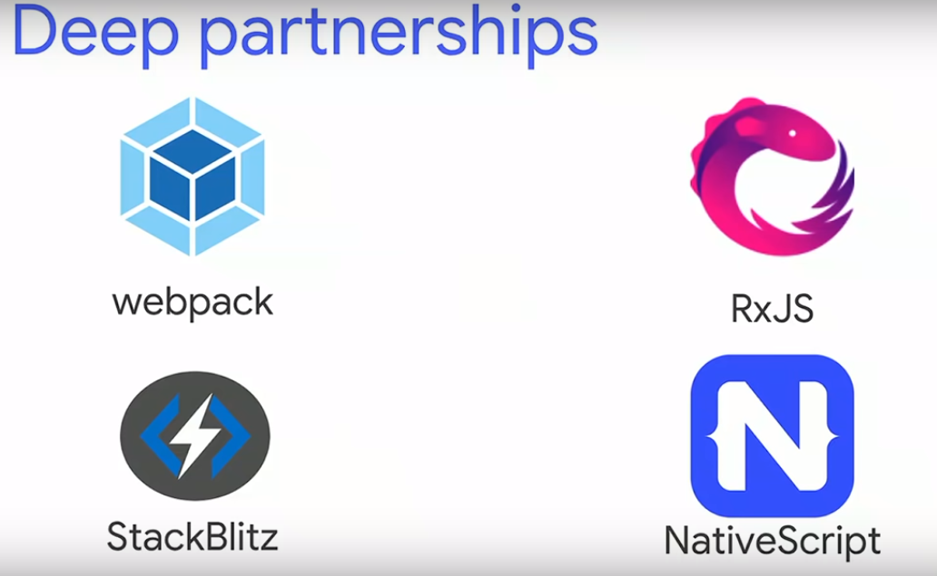
Angular Implementation Technologies

Slide 6
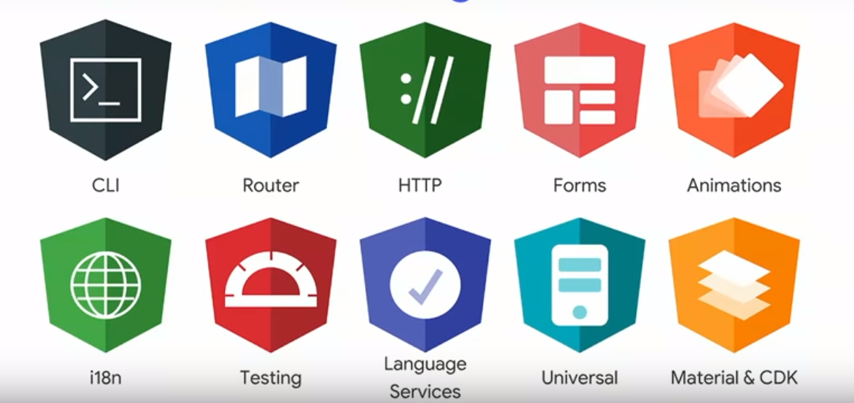
Move fast with Integrated tools

Slide 7
Java script Application Architecture
Java script Apps
Java Script Engine – V8
Browser - Chrome

Slide 8
Framework /Lib Application Architecture
Written in javascript
Written in javascript
Written in C++
JQuery
Angular Apps
Jquery Engine/Runtime
Angular Engine/Runtime
Java Script Engine – V8
Java Script Engine – V8
Browser - Chrome
Browser - Chrome

Slide 9
Project Ivy / Angular Ivy
Ivy is the code name for Agular's next-generation compilation and rendering pipeline / Runtime/ Engine
Every Angular Apps are running on Ivy

Slide 10
Angular IVY
Angular Apps
IVY
Java Script Engine – V8
Browser - Chrome

Slide 11
Flow – Compile to JS – JS to Execution Pipe line
Development Time

Slide 12
Type definition file
.d.ts
Angular Typescript Source code
AST
JavaScript Source
AST
TS Compiler
transforms
parse
prints
errors

Slide 13
Flow – Compile to JS – JS to Execution Pipe line
Run Time

Slide 14
Ivy Rendering Pipeline
Template HTML
Template Instructions
DOM

Slide 15
Helloworld
<div class="greeting"> Hello, world! </div>
// GENERATED CODE (you don't write this)
elementStart(0, 'div', ['class', 'greeting']); text(1, 'Hello, world!'); elementEnd();
function elementStart(index, name, attrs) { const native = renderer.createElement(name); createLNode(index); setUpAttributes(attrs); }
function text(index, value) { const native = renderer.createTextNode(value); createLNode(index); }

Slide 16
bundle.js
function container() {...}
function listener() {...}
function pipe() {...}
function elementEnd() {...}
function text() {...}
function elementStart() {...}

Slide 17
Angular Application Building Blocks

Slide 18
Angular Apps
In Angular Every thing is Object
Every Object is Created by Angular Framework Dependency Injection System called Injector
Angular apps are collection of objects which interact each other to achieve app functionalities
Angular is written using type script rich functionalities such as classes,interfaces,decorators,Generics
Angular extends functionality with reactive Extension libs to build powerful async Programming
Angular uses powerful modular pattern to organize code called ngModules
Angular uses ES6 Modules for code sharing and file linking

Slide 19
Angular Objects
Angular Infrastructure Objects
Angular Domain (Model) Objects

Slide 20
Angular Domain Objects – Store Application state
const employess = [
{
id:1,
name: 'Subramanian’
},
{
id:2,
name :’Ram’
}
]

Slide 21
Angular Infrastructure Objects
Modules
Components
Directives
Pipe
Services and Providers
Meta Objects- Component,Module,Pipe,Directive

Slide 22
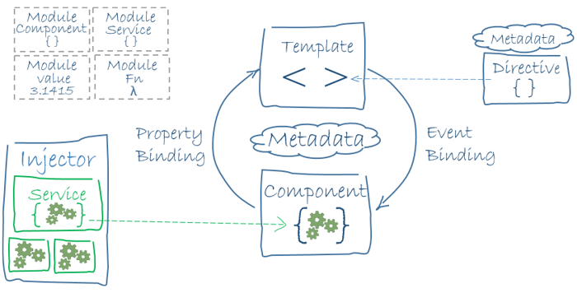
Angular Apps Big Picture

Slide 23
Breaking Angular Apps
App Module
App Component
Sub module-A
Component A
Sub module-B
Component B

Slide 24
Angular App start up Flow
http://www.example.com/index.html
Browser loads index.html
Browser Parses html
Loads Parsed html into memory

Slide 25
Browser creates tree Structure
JS engine constructs initial DOM tree
Browser finds <app-root> element – custom element
Browser starts loading angular related js Files

Slide 26
<script type="text/javascript"src="runtime.js"></script>
<script type="text/javascript"src="polyfills.js"></script>
<script type="text/javascript" src="styles.js"></script>
<script type="text/javascript" src="vendor.js"></script>
<script type="text/javascript" src="main.js"></script>
main.js -main.ts
app.module.js app.module.ts
app.component.js app.component.ts
First View - DOM Tree

Slide 27

Thank You
Subramanian Murugan

