Slide 1
GraalVM
Subtitle

Slide 2
Title and Content Layout with List
Add your first bullet point here
Add your second bullet point here
Add your third bullet point here

Slide 3
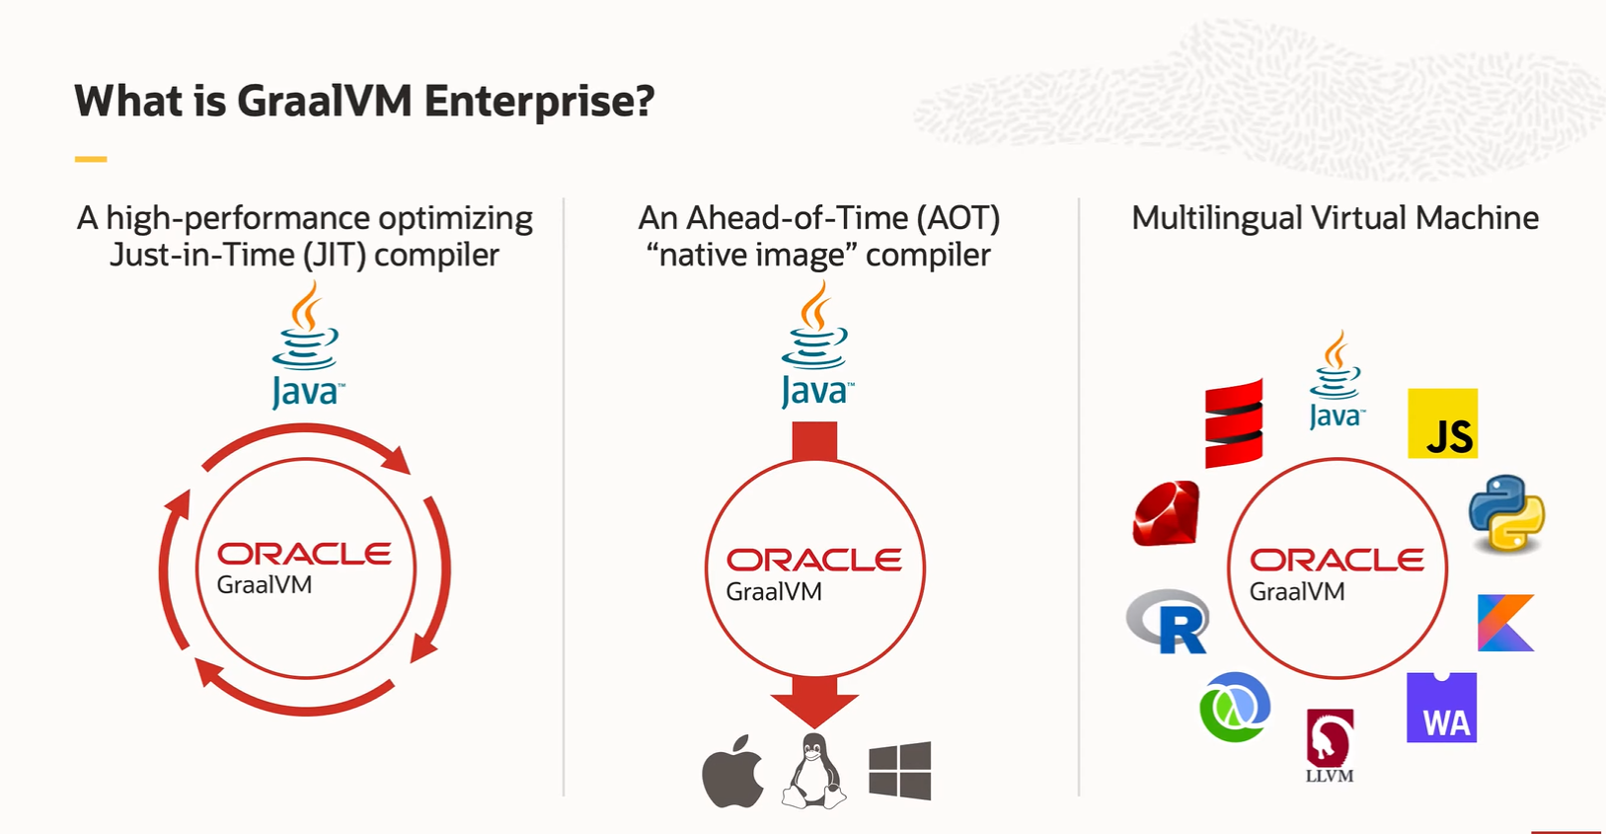

Slide 4

Picture with Caption Layout
Caption

