Slide 1
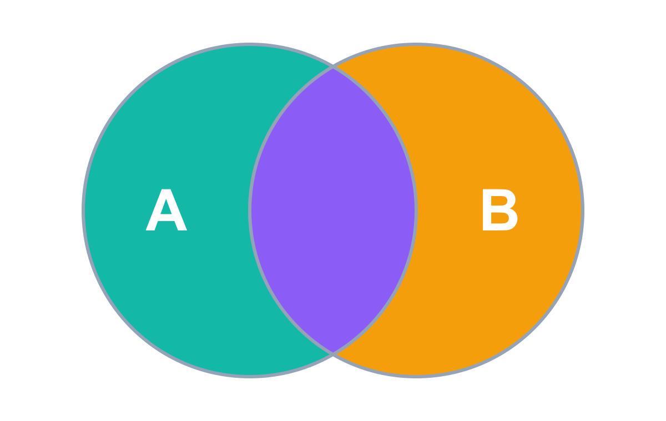
MODULE 03 · ADVANCED SQL QUERIES
SQL Joins
The basics, visually explained
INNER
LEFT
RIGHT
FULL

Slide 2
Two Ways to Combine Tables
First decide: do you want to combine the columns or the rows?
JOINS Combine columns
SET OPERATORS Combine rows
Left (A)
Right (B)
+
+
Side by side → a WIDER table
Stacked below → a LONGER table

Slide 3
Method → Type → Rules
Every way of combining data follows the same decision path
1
Pick the method
2
Pick the type
3
Follow the rules
JOINS
Combine columns (focus of this module)
SET OPERATORS
Combine rows
INNER JOIN
LEFT JOIN
UNION
UNION ALL
RIGHT JOIN
FULL JOIN
EXCEPT
INTERSECT
Rule: you must define key columns shared by both tables.
Rule: all queries must return the same number of columns — no key needed.

Slide 4
What Is a SQL Join?
Connect two tables through a common key, then pair up the rows that match
Left table
Right table
Joined result
id
name
id
country
name
country
1
Maria
1
Germany
Maria
Germany
2
John
2
USA
John
USA
✘ no match
3
Georg
4
Germany
Martin
Germany
4
Martin
🔑 common key: id
How it works: SQL compares the key values on both sides. Where they are equal, the two rows are connected and returned together. id 3 has no partner on the right, so it can't be connected.

Slide 5



Why Do We Need Joins?
Three everyday reasons
Recombine data
Enrich data
Check existence
Data about one topic is often spread over many tables. Join them to see the big picture in one result.
Start from a master table and pull one extra detail from a reference / lookup table.
Use another table only as a filter: keep rows that exist there — or rows that don't.
customers + addresses + orders + reviews → one view
customers + country zip codes
customers that placed an order?

Slide 6
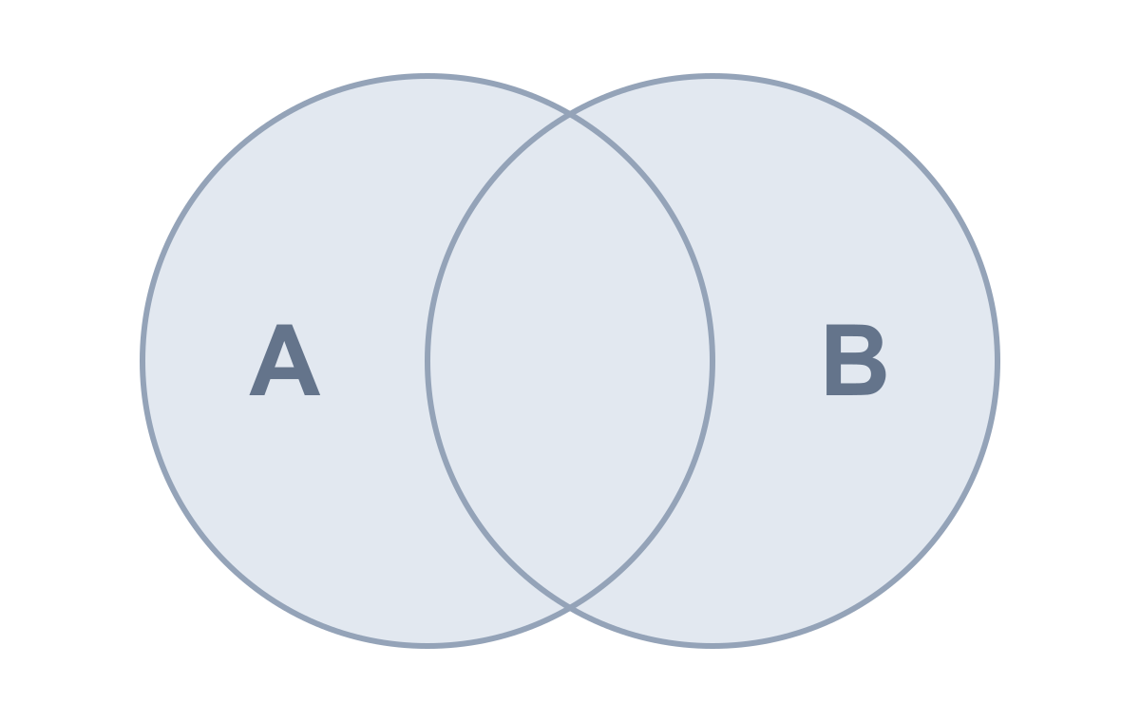
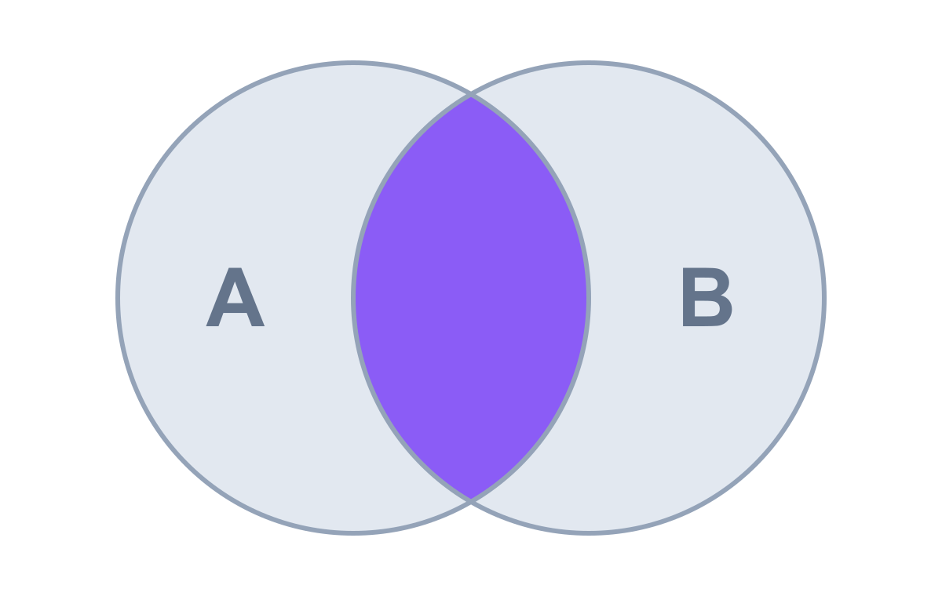
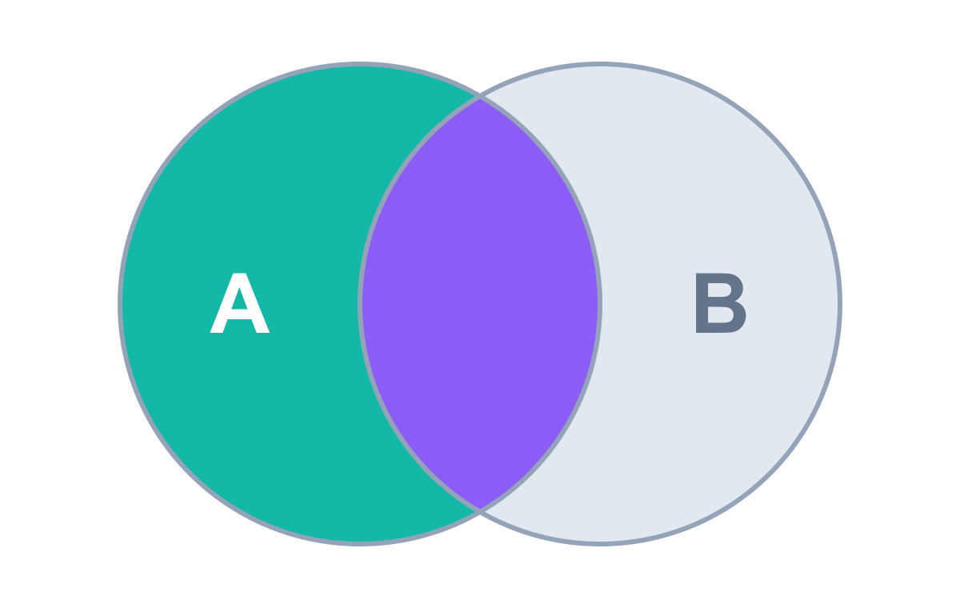
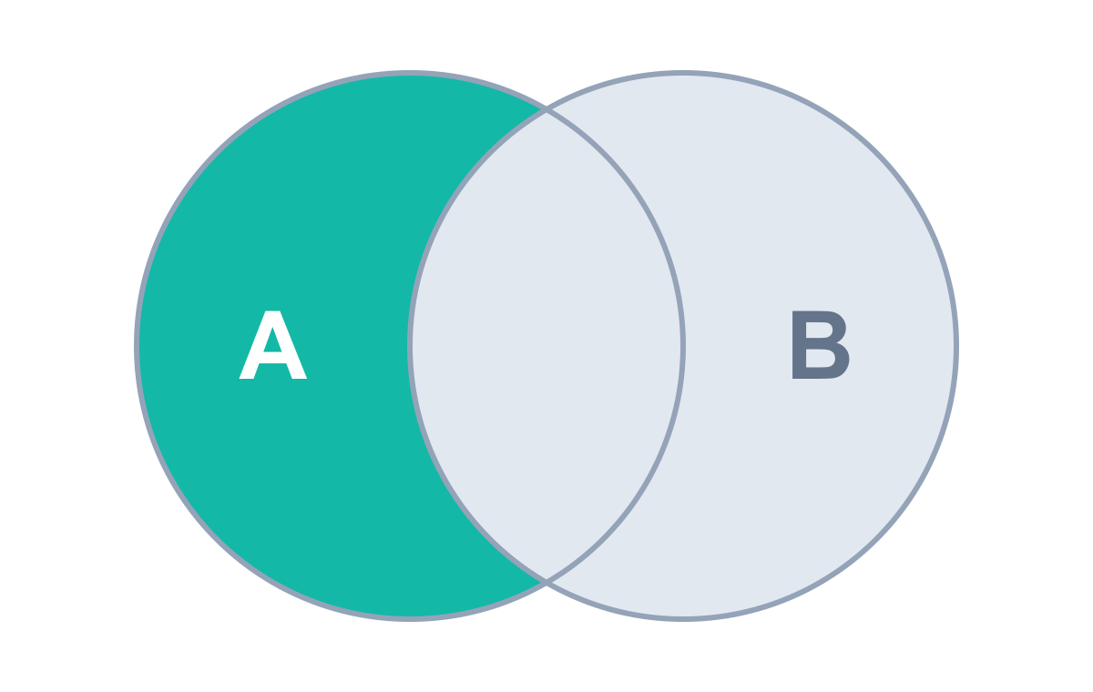
Thinking in Circles
Picture each table as a circle — the side (left or right) matters
Only matching data
rows found in both A and B (the overlap)
All rows of one table
the whole circle, matched or not
Only unmatching data
rows in one table but missing from the other
A = LEFT table
B = RIGHT table
Basic joins matching / all rows
Advanced joins focus on unmatching data

Slide 7
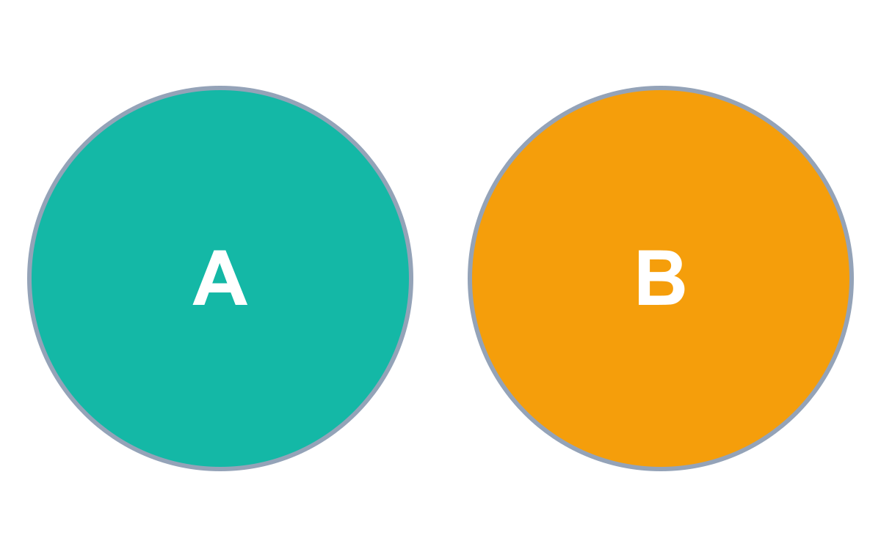
Option 0: No Join
Return all data from both tables — as two separate results
Result 1 · customers
id
first_name
country
score
1
Maria
Germany
350
2
John
USA
900
3
Georg
UK
750
4
Martin
Germany
500
5
Peter
USA
0
Result 2 · orders
order_id
customer_id
order_date
sales
SELECT * FROM customers;
1001
1
2021-01-11
35
SELECT * FROM orders;
1002
2
2021-04-05
15
1003
3
2021-06-18
20
TASK Retrieve all data from customers and orders in two different results.
1004
6
2021-08-31
10

Slide 8
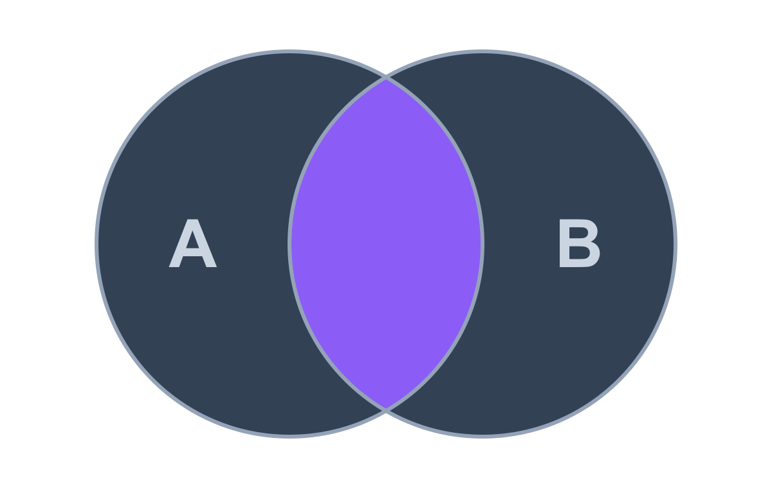
01
INNER JOIN
Only the matching rows from both tables

Slide 9
INNER JOIN — The Concept
Returns only the rows that match in both tables.
syntax
SELECT *
FROM A
INNER JOIN B
ON A.key = B.key
Left table
Right table
Order doesn't matter: A JOIN B = B JOIN A. Plain JOIN defaults to INNER — still write INNER for clarity.
From A: Only matching rows
From B: Only matching rows
Use it to:
Recombine
Enrich
Check existence

Slide 10

INNER JOIN — In Practice
TASK Get all customers along with their orders, but only for customers who have placed an order.
Result
SELECT
id
first_name
order_id
sales
c.id,
c.first_name,
1
Maria
1001
35
o.order_id,
2
John
1002
15
o.sales
3
Georg
1003
20
FROM customers AS c
INNER JOIN orders AS o
ON c.id = o.customer_id;
3 of 5 customers returned — Martin and Peter have no orders. Swapping the tables gives the same result.

Slide 11
Best Practices When Joining
Clean, readable, error-free join queries
1
2
3
Select needed columns
Qualify every column
Use short table aliases
SELECT * repeats key columns from both tables. Pick the columns that matter.
If both tables have a column called id, SQL throws an ambiguous-column error.
Long table names get tedious. Alias once, reuse everywhere.
✘ SELECT *
✘ SELECT id, id
FROM customers AS c
✔ SELECT c.id,
✔ SELECT customers.id,
INNER JOIN orders AS o
o.order_id, o.sales
orders.id
ON c.id = o.customer_id

Slide 12
Under the Hood: INNER JOIN
How SQL walks through the rows to build the result
customers (left)
orders (right)
result
id
first_name
order_id
customer_id
sales
id
first_name
order_id
sales
1
Maria
1001
1
35
1
Maria
1001
35
2
John
1002
2
15
2
John
1002
15
3
Georg
1003
3
20
3
Georg
1003
20
4
Martin
✘
1004
6
10
5
Peter
✘
STEP LOG
id 1 · Maria → order 1001 ✔ match → row added
A row appears only when the join condition finds a match on both sides.
id 2 · John → order 1002 ✔ match → row added
id 3 · Georg → order 1003 ✔ match → row added
id 4 · Martin → no order found ✘ excluded
id 5 · Peter → no order found ✘ excluded

Slide 13
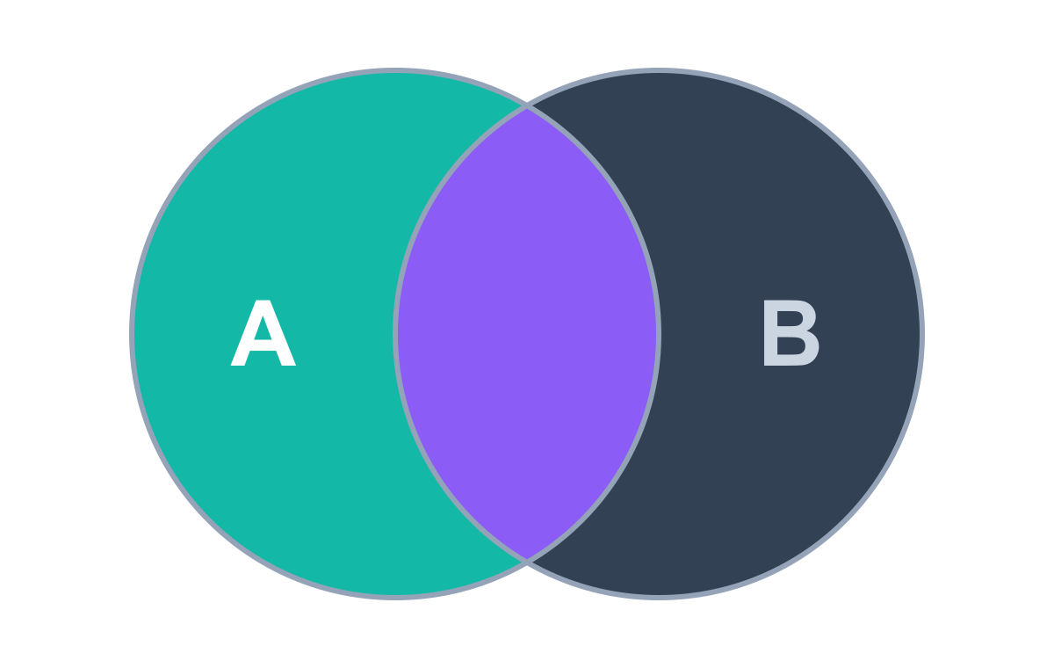
02
LEFT JOIN
Everything from the left, matches from the right

Slide 14
LEFT JOIN — The Concept
Returns all rows from the left table and only the matching rows from the right.
syntax
SELECT *
FROM A
LEFT JOIN B
ON A.key = B.key
Left table
Right table
Order matters! Put the table you need in full in FROM; the right table goes after LEFT JOIN.
From A: All rows · primary source
From B: Only matching · extra data
Use it to:
Recombine
Enrich
Check existence *
* with a twist — covered in advanced joins

Slide 15
LEFT JOIN — In Practice
TASK Get all customers along with their orders, including those without orders.
Result
SELECT
id
first_name
order_id
sales
c.id,
c.first_name,
1
Maria
1001
35
o.order_id,
2
John
1002
15
o.sales
3
Georg
1003
20
FROM customers AS c
4
Martin
NULL
NULL
LEFT JOIN orders AS o
5
Peter
NULL
NULL
ON c.id = o.customer_id;
All 5 customers kept; missing order data shows as NULL. Swap the tables and the result changes!

Slide 16
Under the Hood: LEFT JOIN
How SQL walks through the rows to build the result
customers (left)
orders (right)
result
id
first_name
order_id
customer_id
sales
id
first_name
order_id
sales
1
Maria
1001
1
35
1
Maria
1001
35
2
John
1002
2
15
2
John
1002
15
3
Georg
1003
3
20
3
Georg
1003
20
4
Martin
✘
1004
6
10
4
Martin
NULL
NULL
5
Peter
✘
5
Peter
NULL
NULL
STEP LOG
copy Maria → search orders → order 1001 found
Every left row is kept without any check. Missing right-side data becomes NULL.
copy John → search orders → order 1002 found
copy Georg → search orders → order 1003 found
copy Martin → search orders → no match → NULL
copy Peter → search orders → no match → NULL

Slide 17
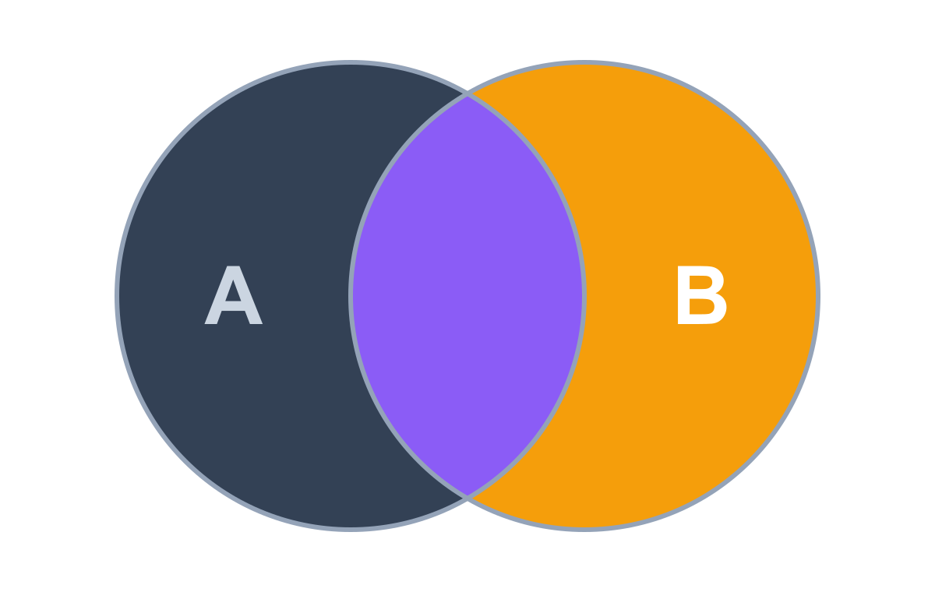
03
RIGHT JOIN
Everything from the right, matches from the left

Slide 18
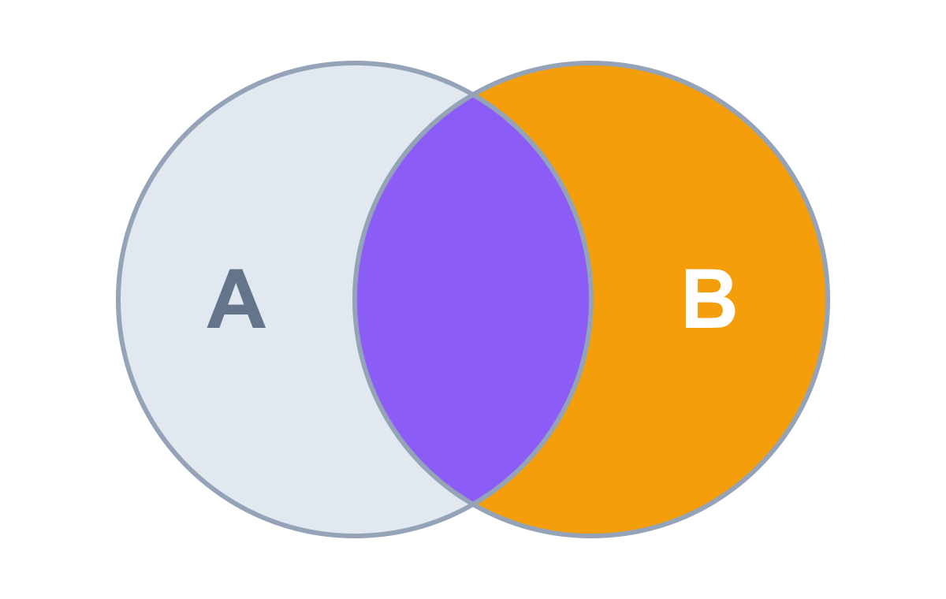
RIGHT JOIN — The Concept
Returns all rows from the right table and only the matching rows from the left.
syntax
SELECT *
FROM A
RIGHT JOIN B
ON A.key = B.key
Left table
Right table
Order matters! The table after RIGHT JOIN is the one returned in full.
From A: Only matching · extra data
From B: All rows · primary source
Use it to:
Recombine
Enrich
Check existence *
* with a twist — covered in advanced joins

Slide 19
RIGHT JOIN — In Practice
TASK Get all customers along with their orders, including orders without matching customers.
Result
SELECT
id
first_name
order_id
sales
c.id,
c.first_name,
1
Maria
1001
35
o.order_id,
2
John
1002
15
o.sales
3
Georg
1003
20
FROM customers AS c
NULL
NULL
1004
10
RIGHT JOIN orders AS o
ON c.id = o.customer_id;
All 4 orders kept; order 1004 has no known customer, so the customer columns are NULL.

Slide 20
Challenge: Solve It With LEFT JOIN Only
Same task — all orders plus matching customers — without RIGHT JOIN
RIGHT JOIN
LEFT JOIN (tables swapped)
SELECT c.id, c.first_name,
SELECT c.id, c.first_name,
o.order_id, o.sales
=
o.order_id, o.sales
FROM customers AS c
FROM orders AS o
RIGHT JOIN orders AS o
LEFT JOIN customers AS c
ON c.id = o.customer_id;
ON c.id = o.customer_id;
Swap both the table order and the join type → identical result
Practical tip: most SQL developers rarely use RIGHT JOIN. Start FROM the table you need in full and LEFT JOIN the others — queries stay consistent and easier to read.

Slide 21
04
FULL JOIN
Everything from both tables

Slide 22
FULL JOIN — The Concept
Returns all rows from both tables — matched and unmatched.
syntax
SELECT *
FROM A
FULL JOIN B
ON A.key = B.key
Left table
Right table
Order doesn't matter: both tables are equally important. A FULL JOIN B = B FULL JOIN A.
From A: All rows
From B: All rows
Use it to:
Recombine
Enrich
Check existence *
* with a twist — covered in advanced joins

Slide 23
FULL JOIN — In Practice
TASK Get all customers and all orders, even if there is no match.
Result
SELECT
id
first_name
order_id
sales
c.id,
c.first_name,
1
Maria
1001
35
o.order_id,
2
John
1002
15
o.sales
3
Georg
1003
20
FROM customers AS c
4
Martin
NULL
NULL
FULL JOIN orders AS o
5
Peter
NULL
NULL
ON c.id = o.customer_id;
NULL
NULL
1004
10
Nothing is lost on either side — NULLs fill every gap where a match is missing.

Slide 24
Under the Hood: FULL JOIN
How SQL walks through the rows to build the result
customers (left)
orders (right)
result
id
first_name
order_id
customer_id
sales
id
first_name
order_id
sales
1
Maria
1001
1
35
1
Maria
1001
35
2
John
1002
2
15
2
John
1002
15
3
Georg
1003
3
20
3
Georg
1003
20
4
Martin
✘
1004
6
10
4
Martin
NULL
NULL
5
Peter
✘
5
Peter
NULL
NULL
NULL
NULL
1004
10
STEP LOG
1 · Take all rows from the left table (customers)
Left side first, then any right rows still missing. Nothing is lost.
2 · Customers 1–3 match → order data filled in
3 · Martin & Peter: no order → NULL
4 · Order 1004 not in output yet → added, NULL customer

Slide 25
The Four Basic Joins at a Glance
INNER JOIN
LEFT JOIN
RIGHT JOIN
FULL JOIN
RETURNS
Only matching rows
RETURNS
All left + matching right
RETURNS
All right + matching left
RETURNS
All rows from both
TABLE ORDER
Doesn't matter
TABLE ORDER
Matters
TABLE ORDER
Matters
TABLE ORDER
Doesn't matter
BEST FOR
Recombine · Filter
BEST FOR
Recombine · Enrich
BEST FOR
Prefer LEFT JOIN instead
BEST FOR
Recombine everything

Slide 26
Key Takeaways
1
Joins combine columns (wider); set operators combine rows (longer).
2
Every join needs a key and a condition: ON a.key = b.key.
3
INNER = matches only · LEFT / RIGHT = all of one side · FULL = everything.
Up next Advanced joins — working with unmatching data
4
Order matters for LEFT/RIGHT — put your main table in FROM and prefer LEFT JOIN.

Slide 27
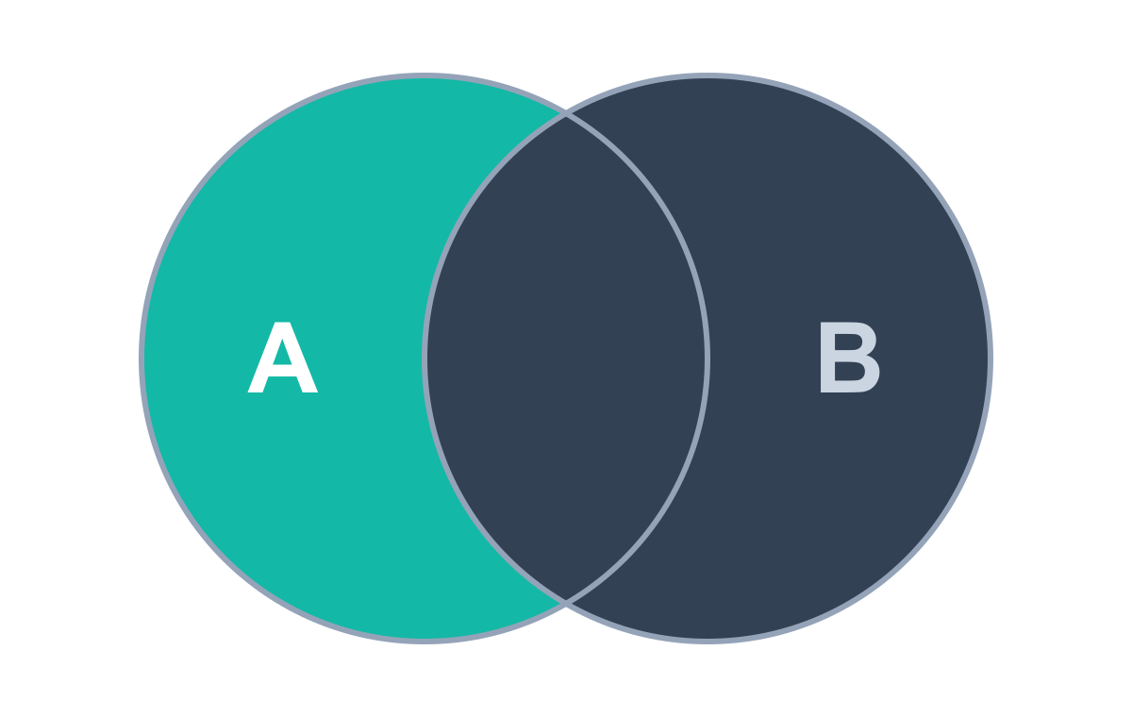
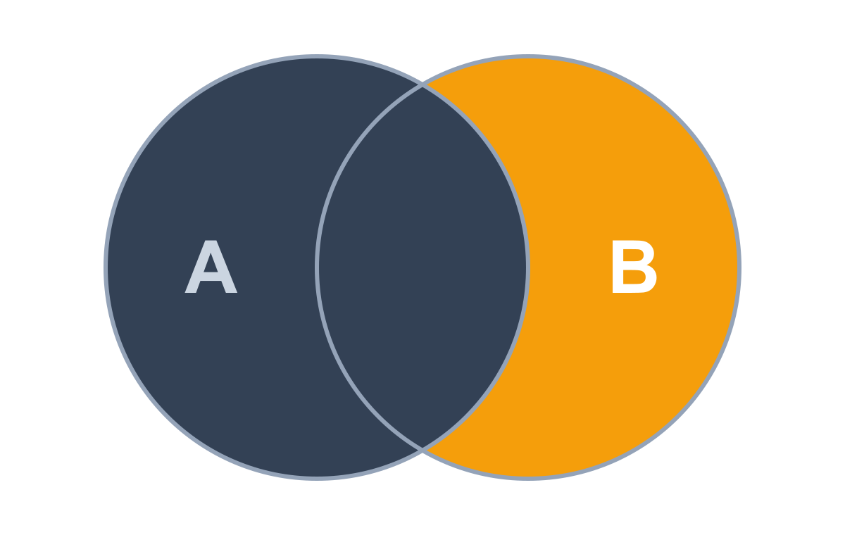
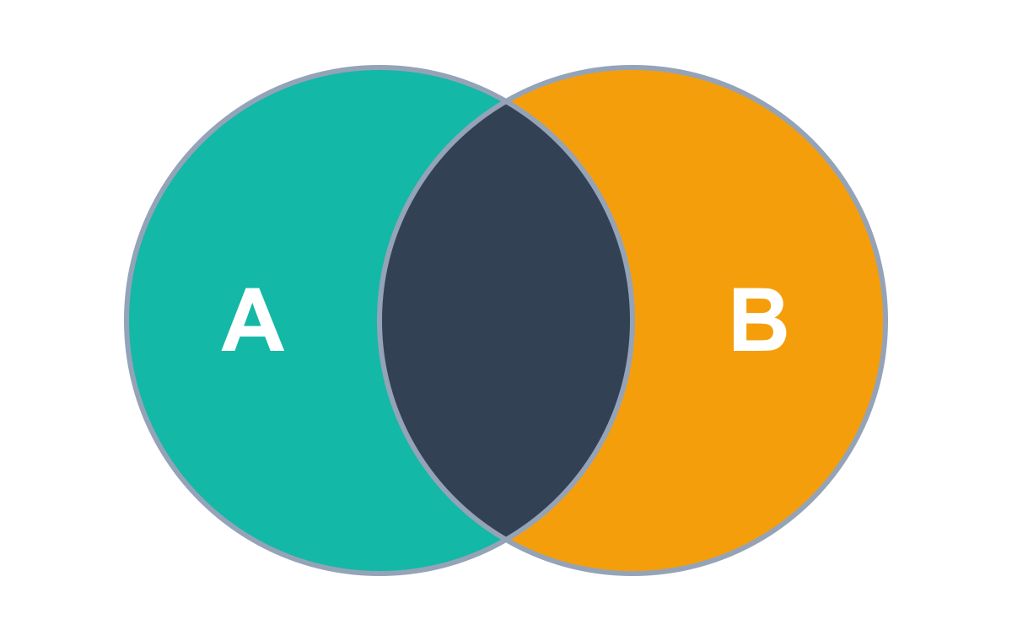
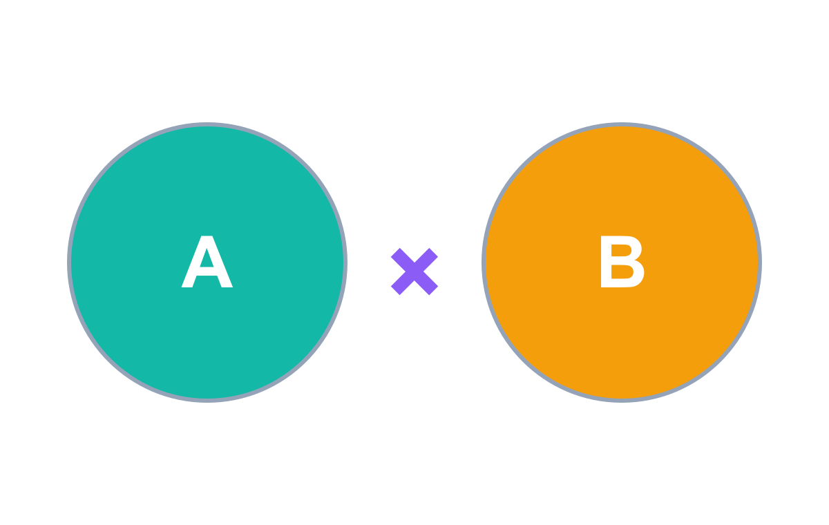
PART 2
Advanced SQL Joins
Finding unmatching data — and combining everything with everything
LEFT ANTI JOIN
RIGHT ANTI JOIN
FULL ANTI JOIN
CROSS JOIN
Left rows with no match
Right rows with no match
Unmatched rows on both sides
Every possible combination

Slide 28
05
LEFT ANTI JOIN
Rows from the left table that have no match on the right

Slide 29
LEFT ANTI JOIN — The Concept
Returns rows from the left table that have no match in the right table.
syntax
SELECT *
Step 1
LEFT JOIN
Step 2
WHERE B.key IS NULL
FROM A
LEFT JOIN B
ON A.key = B.key
From A: Only unmatching rows
WHERE B.key IS NULL
From B: Nothing — used only as a filter
Order matters! A NULL right-side key means "no match" — that's the filter.
There is no ANTI JOIN keyword (e.g. in SQL Server). Build it from a classic join plus a WHERE filter.
Use it to:
Recombine
Enrich
Check existence

Slide 30
LEFT ANTI JOIN — In Practice
TASK Get all customers who haven't placed any order.
Step 1 · LEFT JOIN result
Step 2 · WHERE filter
SELECT
id
first_name
order_id
customer_id
sales
c.id, c.first_name,
1
Maria
1001
1
35
o.order_id, o.customer_id,
2
John
1002
2
15
o.sales
3
Georg
1003
3
20
FROM customers AS c
LEFT JOIN orders AS o
4
Martin
NULL
NULL
NULL
ON c.id = o.customer_id
5
Peter
NULL
NULL
NULL
WHERE o.customer_id IS NULL;
Only Martin and Peter remain — customers in the database who never ordered.

Slide 31
06
RIGHT ANTI JOIN
Rows from the right table that have no match on the left

Slide 32
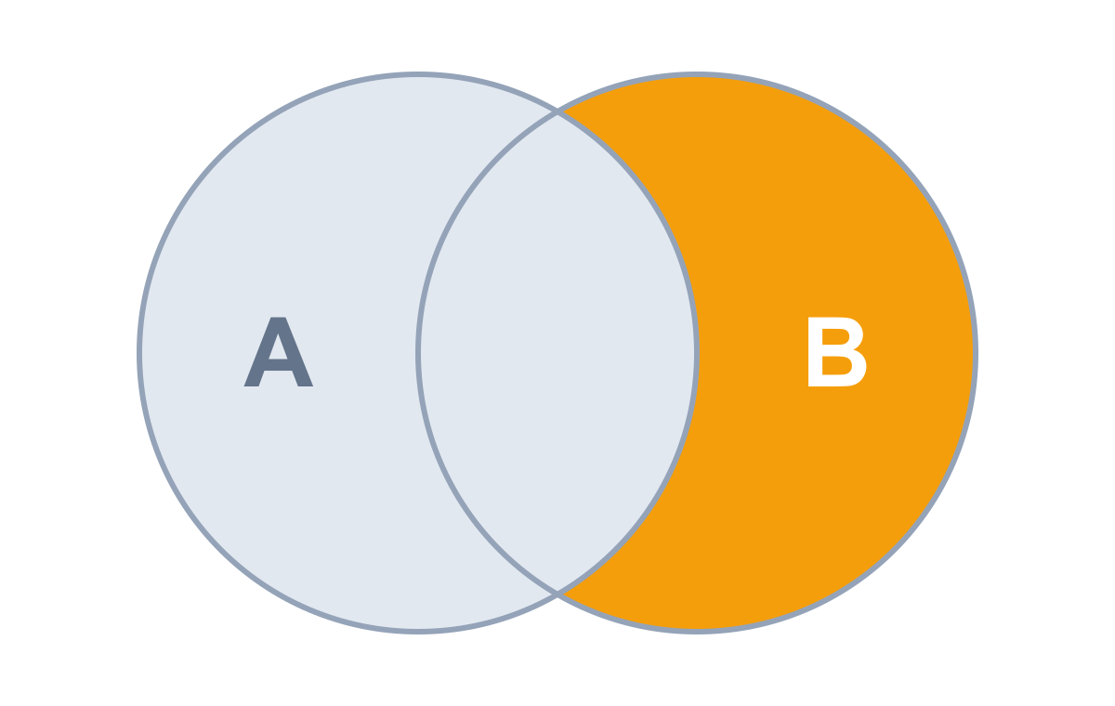
RIGHT ANTI JOIN — The Concept
Returns rows from the right table that have no match in the left table.
syntax
SELECT *
Step 1
RIGHT JOIN
Step 2
WHERE A.key IS NULL
FROM A
RIGHT JOIN B
ON A.key = B.key
From A: Nothing — used only as a filter
WHERE A.key IS NULL
From B: Only unmatching rows
Order matters! This time filter on the LEFT table's key.
There is no ANTI JOIN keyword (e.g. in SQL Server). Build it from a classic join plus a WHERE filter.
Use it to:
Recombine
Enrich
Check existence

Slide 33
RIGHT ANTI JOIN — In Practice
TASK Get all orders without matching customers.
Step 1 · RIGHT JOIN result
Step 2 · WHERE filter
SELECT
id
first_name
order_id
customer_id
sales
c.id, c.first_name,
1
Maria
1001
1
35
o.order_id, o.customer_id,
2
John
1002
2
15
o.sales
3
Georg
1003
3
20
FROM customers AS c
RIGHT JOIN orders AS o
NULL
NULL
1004
6
10
ON c.id = o.customer_id
WHERE c.id IS NULL;
Order 1004 points to customer 6, who doesn't exist — a data-quality problem worth catching.

Slide 34
Challenge: Right Anti Join Without RIGHT JOIN
Same orphan orders — using LEFT JOIN only
RIGHT JOIN version
LEFT JOIN (tables swapped)
SELECT *
SELECT *
FROM customers AS c
FROM orders AS o
RIGHT JOIN orders AS o
=
LEFT JOIN customers AS c
ON c.id = o.customer_id
ON c.id = o.customer_id
WHERE c.id IS NULL;
WHERE c.id IS NULL;
Swap tables + join type; ON and WHERE stay the same
Tip: start FROM the table you want to keep (orders) and LEFT JOIN the lookup. With SELECT * the left table's columns simply come first — the rows are identical.

Slide 35
07
FULL ANTI JOIN
Unmatched rows from both tables — the opposite of INNER JOIN

Slide 36
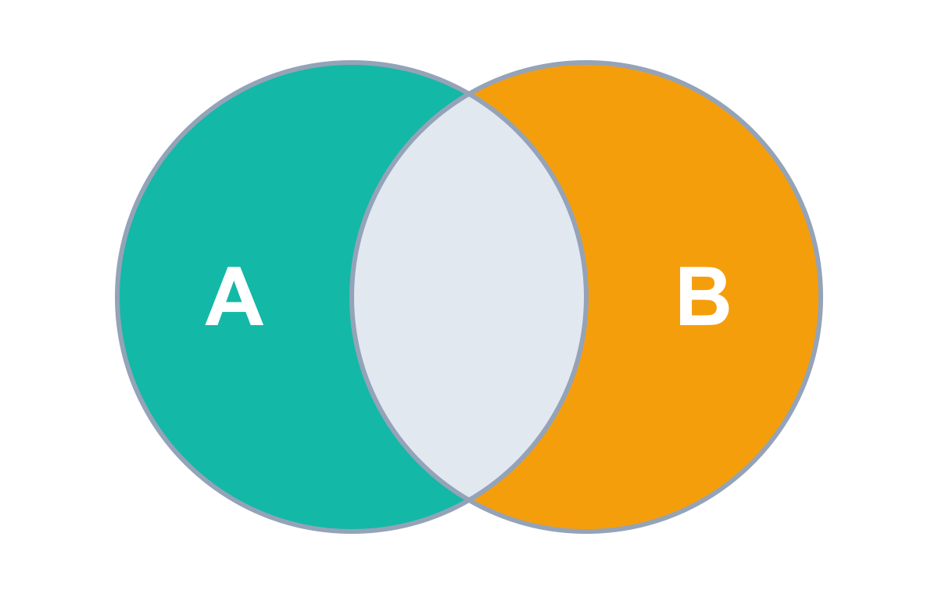
FULL ANTI JOIN — The Concept
Returns only the rows that don't match in either table — the opposite of INNER JOIN.
syntax
SELECT *
Step 1
FULL JOIN
Step 2
WHERE either key IS NULL
FROM A
FULL JOIN B
ON A.key = B.key
From A: Only unmatching rows
WHERE A.key IS NULL
OR B.key IS NULL
From B: Only unmatching rows
Use OR, not AND. Missing on either side qualifies. Table order doesn't matter.
There is no ANTI JOIN keyword (e.g. in SQL Server). Build it from a classic join plus a WHERE filter.
Use it to:
Recombine
Enrich
Check existence

Slide 37
FULL ANTI JOIN — In Practice
TASK Find customers without orders and orders without customers.
Step 1 · FULL JOIN result
Step 2 · WHERE filter
SELECT
id
first_name
order_id
customer_id
sales
c.id, c.first_name,
1
Maria
1001
1
35
o.order_id, o.customer_id,
2
John
1002
2
15
o.sales
3
Georg
1003
3
20
FROM customers AS c
FULL JOIN orders AS o
4
Martin
NULL
NULL
NULL
ON c.id = o.customer_id
5
Peter
NULL
NULL
NULL
WHERE c.id IS NULL
NULL
NULL
1004
6
10
OR o.customer_id IS NULL;
The 3 “boring” matched rows are dropped; only the odd cases on either side remain.

Slide 38
Bonus: INNER JOIN Without INNER JOIN
TASK Customers with their orders, only for those who ordered — without using INNER JOIN.
Step 1 · LEFT JOIN result
Step 2 · WHERE filter
SELECT
id
first_name
order_id
customer_id
sales
c.id, c.first_name,
1
Maria
1001
1
35
o.order_id, o.customer_id,
2
John
1002
2
15
o.sales
3
Georg
1003
3
20
FROM customers AS c
LEFT JOIN orders AS o
4
Martin
NULL
NULL
NULL
ON c.id = o.customer_id
5
Peter
NULL
NULL
NULL
WHERE o.customer_id IS NOT NULL;
IS NOT NULL keeps only matched rows — exactly the INNER JOIN result. Build queries step by step.

Slide 39
08
CROSS JOIN
Every row from the left combined with every row from the right

Slide 40

CROSS JOIN — The Concept
products (A)
colors (B)
Returns every row of A combined with every row of B — all possible combinations (a Cartesian product).
Red
T-shirt
Blue
syntax
SELECT *
Cap
Green
FROM A
CROSS JOIN B
T-shirt · Red
T-shirt · Blue
T-shirt · Green
No ON condition. Matching doesn't matter — nothing to compare.
Cap · Red
Cap · Blue
Cap · Green
Use with care: rows multiply — big tables mean huge, slow results.
2 rows × 3 rows = 6 combinations
Good for:
Test data
Simulations
All combinations

Slide 41
CROSS JOIN — In Practice
TASK Generate all possible combinations of customers and orders.
Result (first 6 of 20 rows)
SELECT *
id
first_name
order_id
customer_id
sales
FROM customers
1
Maria
1001
1
35
CROSS JOIN orders;
2
John
1001
1
35
3
Georg
1001
1
35
5 × 4 = 20
customers × orders = rows in the result
4
Martin
1001
1
35
5
Peter
1001
1
35
1
Maria
1002
2
15
⋮ 14 more rows
Order 1001 belongs only to Maria — yet CROSS JOIN pairs it with every customer. No rules, just combinations.

Slide 42
The Advanced Joins at a Glance
LEFT ANTI JOIN
RIGHT ANTI JOIN
FULL ANTI JOIN
CROSS JOIN
RETURNS
Left rows with no match
RETURNS
Right rows with no match
RETURNS
Unmatched, both sides
RETURNS
Every combination (A × B)
BUILD WITH
LEFT JOIN + WHERE B.key IS NULL
BUILD WITH
RIGHT JOIN + WHERE A.key IS NULL
BUILD WITH
FULL JOIN + WHERE A.key IS NULL OR B.key IS NULL
BUILD WITH
CROSS JOIN — no ON clause
TABLE ORDER
Matters
TABLE ORDER
Matters
TABLE ORDER
Doesn't matter
TABLE ORDER
Doesn't matter

Slide 43
Key Takeaways · Advanced Joins
1
No ANTI JOIN keyword: use a classic join, then WHERE key IS NULL.
2
Filter on the key of the table you are only using as a lookup.
3
FULL ANTI JOIN is the opposite of INNER JOIN — combine the two IS NULL checks with OR.
Bonus LEFT JOIN + WHERE key IS NOT NULL gives the INNER JOIN result
4
CROSS JOIN has no ON clause; rows multiply (5 × 4 = 20), so use it sparingly.

Slide 44
PART 3
SQL Set Operators
Combine the rows of multiple queries into one result set
UNION
UNION ALL
EXCEPT
INTERSECT
All rows, no duplicates
All rows, duplicates kept
In the 1st query but not the 2nd
Rows found in both

Slide 45
Joins vs. Set Operators
Both combine data from multiple queries into a single result — but in different directions
JOINS
SET OPERATORS
Combines
Columns — side by side (wider table)
Rows — stacked below (longer table)
Requirement
A key column to match rows
Same columns in each query — no key needed
Types
INNER · LEFT · RIGHT · FULL
UNION · UNION ALL · EXCEPT (MINUS) · INTERSECT
Rule of thumb: need more columns? Join. Need more rows? Use a set operator.

Slide 46
Set Operator Syntax
Two complete SELECT statements with the operator placed between them
SELECT FirstName, LastName
1st query
FROM Sales.Customers
UNION
Set operator
SELECT FirstName, LastName
2nd query
FROM Sales.Employees;
Any of the four operators can go in the middle:
UNION
UNION ALL
EXCEPT
INTERSECT

Slide 47
The 6 Rules of Set Operators
1
2
3
ORDER BY once
Same number of columns
Matching data types
Allowed only once, at the very end of the whole query.
Every query must return the same column count.
Columns in the same position must have compatible types.
4
5
6
Same column order
First query names columns
Map the right information
Columns are matched by position, not by name.
Output names and aliases (and types) come from the 1st query.
No error doesn't mean correct data — check the meaning.

Slide 48
Rule 1 · ORDER BY Only Once, at the End
Each query may use WHERE, JOIN, GROUP BY, HAVING — but not its own ORDER BY
✘ Not allowed
✔ Correct
SELECT FirstName, LastName
SELECT FirstName, LastName
FROM Sales.Customers
FROM Sales.Customers
ORDER BY FirstName
WHERE Score > 500
UNION
UNION
SELECT FirstName, LastName
SELECT FirstName, LastName
FROM Sales.Employees;
FROM Sales.Employees
ORDER BY FirstName;
Why: ORDER BY sorts the final combined result, so it belongs after the last query.

Slide 49
Rules 2 & 3 · Column Count and Data Types
Rule 2 · Same number of columns
Rule 3 · Matching data types
SELECT CustomerID, FirstName, LastName
SELECT CustomerID, LastName
FROM Sales.Customers
FROM Sales.Customers
UNION
UNION
SELECT FirstName, LastName
SELECT FirstName, LastName
FROM Sales.Employees;
FROM Sales.Employees;
✘ Error: all queries combined with UNION, INTERSECT or EXCEPT must have an equal number of expressions.
✘ Error: conversion failed when converting the varchar value 'Frank' to data type int.
✔ Fix: 3 columns vs 2 — remove CustomerID so both return 2.
✔ Fix: INT vs VARCHAR — use EmployeeID (INT) in the 2nd query.

Slide 50
Rule 4 · Same Column Order
SQL maps columns by position — 1st to 1st, 2nd to 2nd — never by name
✘ Swapped order
✔ Same order
1st query
LastName · VARCHAR
CustomerID · INT
CustomerID · INT
LastName · VARCHAR
✘
✘
✔
✔
2nd query
EmployeeID · INT
LastName · VARCHAR
EmployeeID · INT
LastName · VARCHAR
Same information isn't enough. Both queries hold an ID and a last name, but in different positions — so SQL pairs LastName with EmployeeID and fails converting a name to INT. Keep the column order identical.

Slide 51
Rule 5 · The First Query Names the Columns
Aliases in later queries are ignored
Result columns
SELECT
CustomerID AS ID,
ID
LastName
LastName
FROM Sales.Customers
✔ ID — alias from the 1st query is used
UNION
✘ Last_Name — alias in the 2nd query is ignored
SELECT
EmployeeID,
Rename columns only in the first query. It also sets the data types of the combined result.
LastName AS Last_Name
FROM Sales.Employees;

Slide 52
Rule 6 · Map the Right Information
SQL checks types, not meaning — no error doesn't mean a correct result
FirstName
LastName
SELECT FirstName, LastName
Joseph
Goldberg
FROM Sales.Customers
Kevin
Brown
UNION
Mary
NULL
SELECT LastName, FirstName
Mark
Schwarz
FROM Sales.Employees;
Anna
Adams
Lee
Frank
It runs — and it's wrong. Both columns are VARCHAR, so SQL happily combines them. You are responsible for mapping columns that mean the same thing.
Brown
Kevin
NULL
Mary
Ray
Michael
Baker
Carol
last names in FirstName ✘

Slide 53
09
UNION
All distinct rows from both queries — duplicates removed

Slide 54
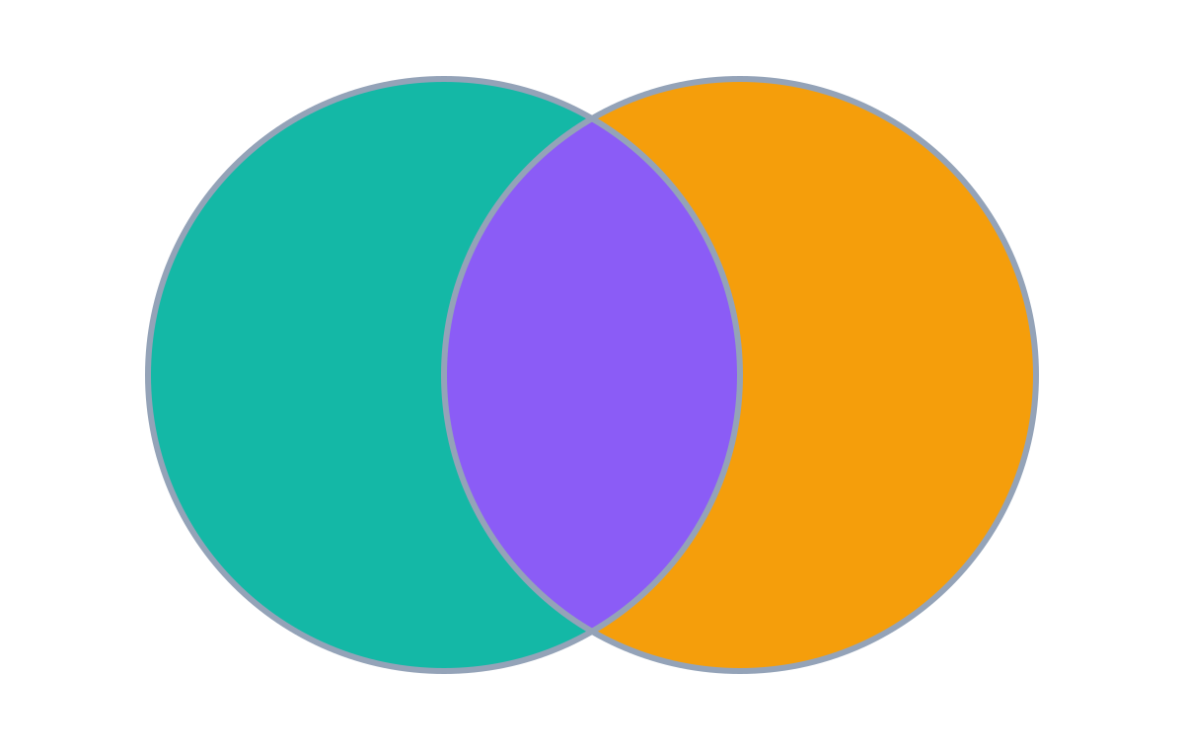
UNION — Concept & Query
Returns all distinct rows from both queries; duplicate rows are removed.
Frank
Joseph
SELECT FirstName, LastName
Kevin
Michael
Mark
FROM Sales.Employees
Mary
Carol
Anna
UNION
SELECT FirstName, LastName
FROM Sales.Customers;
Employees (1st query)
Customers (2nd query)
Result · 8 rows
Frank
Kevin
Mary
Michael
Carol
Duplicates: removed — each row appears once
Joseph
Mark
Anna
Query order: doesn't matter

Slide 55
Under the Hood: UNION
Combine the data from employees and customers into one table
1st query · Employees
2nd query · Customers
result
8 people. SQL adds a row only if it isn't already in the result.
FirstName
LastName
FirstName
LastName
FirstName
LastName
Frank
Lee
Joseph
Goldberg
✔
Frank
Lee
Kevin
Brown
Kevin
Brown
✘
Kevin
Brown
Mary
NULL
Mary
NULL
✘
Mary
NULL
Michael
Ray
Mark
Schwarz
✔
Michael
Ray
Carol
Baker
Anna
Adams
✔
Carol
Baker
Joseph
Goldberg
STEP LOG
Mark
Schwarz
1 · Column names come from the 1st query
2 · Add all employee rows
Anna
Adams
3 · Joseph → not in result yet → added
4 · Kevin Brown → already in result → skipped
5 · Mary → already in result → skipped
6 · Mark → not in result yet → added
7 · Anna → not in result yet → added

Slide 56
10
UNION ALL
All rows from both queries — duplicates kept

Slide 57
UNION ALL — Concept & Query
Returns all rows from both queries — duplicates are NOT removed.
Frank
Joseph
SELECT FirstName, LastName
Kevin
Michael
Mark
FROM Sales.Employees
Mary
Carol
Anna
UNION ALL
SELECT FirstName, LastName
FROM Sales.Customers;
Employees (1st query)
Customers (2nd query)
Result · 10 rows
Frank
Kevin
Mary
Michael
Carol
Duplicates: kept (the only operator that does)
Joseph
Kevin
Mary
Mark
Anna
Query order: doesn't matter

Slide 58
UNION vs UNION ALL
When to choose which
UNION
UNION ALL
8 rows
Removes duplicates
10 rows
Keeps duplicates
● Extra step: compares rows to drop duplicates
● No duplicate check → faster
● Use when duplicates must be removed
● Use when you know there are no duplicates
● Use to find duplicates (data quality checks)
Tip: if you're sure the queries can't overlap, prefer UNION ALL for performance.

Slide 59
Under the Hood: UNION ALL
Combine employees and customers into one table, including duplicates
1st query · Employees
2nd query · Customers
result
10 rows. No checks — rows are simply appended, so it's the fastest.
FirstName
LastName
FirstName
LastName
FirstName
LastName
Frank
Lee
Joseph
Goldberg
Frank
Lee
Kevin
Brown
Kevin
Brown
Kevin
Brown
Mary
NULL
Mary
NULL
Mary
NULL
Michael
Ray
Mark
Schwarz
Michael
Ray
Carol
Baker
Anna
Adams
Carol
Baker
Joseph
Goldberg
STEP LOG
Kevin
Brown
1 · Column names come from the 1st query
2 · Append all employee rows — no checks
Mary
NULL
3 · Append all customer rows — no checks
Mark
Schwarz
Kevin and Mary now appear twice
Anna
Adams

Slide 60
11
EXCEPT
Rows from the first query that are not in the second (MINUS in some databases)

Slide 61
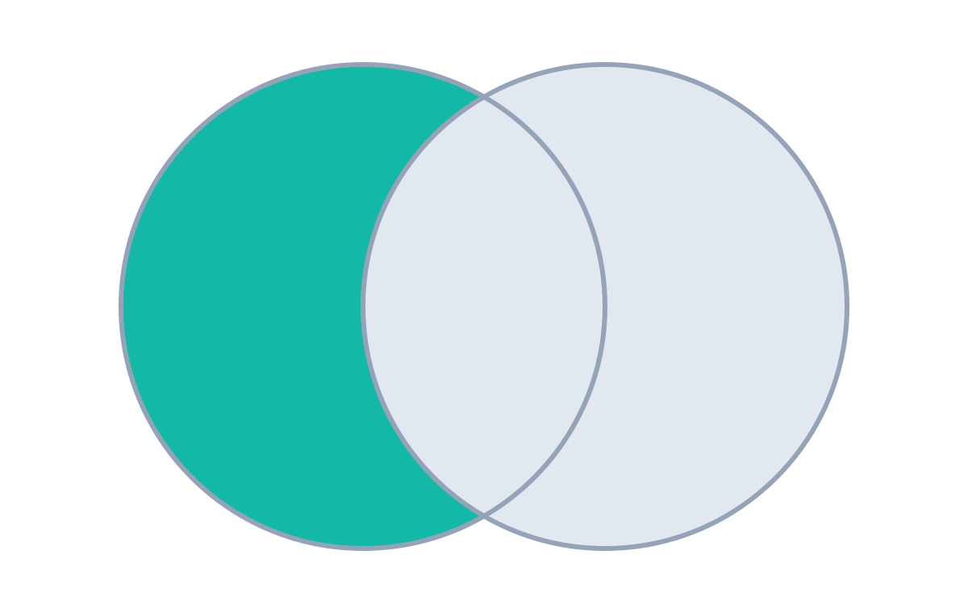
EXCEPT — Concept & Query
Returns distinct rows from the 1st query that are not found in the 2nd query.
Frank
Joseph
SELECT FirstName, LastName
Kevin
Michael
Mark
FROM Sales.Employees
Mary
Carol
Anna
EXCEPT
SELECT FirstName, LastName
FROM Sales.Customers;
Employees (1st query)
Customers (2nd query)
Result · 3 rows
Frank
Michael
Carol
Duplicates: removed
Query order: MATTERS — the only one where it does

Slide 62
Under the Hood: EXCEPT
Find the employees who are not customers at the same time
1st query · Employees
2nd query · Customers (lookup)
result
Swap the queries and you get Joseph, Mark, Anna instead. Order matters!
FirstName
LastName
FirstName
LastName
FirstName
LastName
Frank
Lee
✔
Joseph
Goldberg
Frank
Lee
Kevin
Brown
✘
Kevin
Brown
Michael
Ray
Mary
NULL
✘
Mary
NULL
Carol
Baker
Michael
Ray
✔
Mark
Schwarz
Carol
Baker
✔
Anna
Adams
STEP LOG
1 · Column names come from the 1st query
2 · Frank → not a customer → kept
3 · Kevin → found in customers → excluded
4 · Mary → found in customers → excluded
5 · Michael → not a customer → kept
6 · Carol → not a customer → kept

Slide 63
12
INTERSECT
Only the rows that appear in both queries

Slide 64
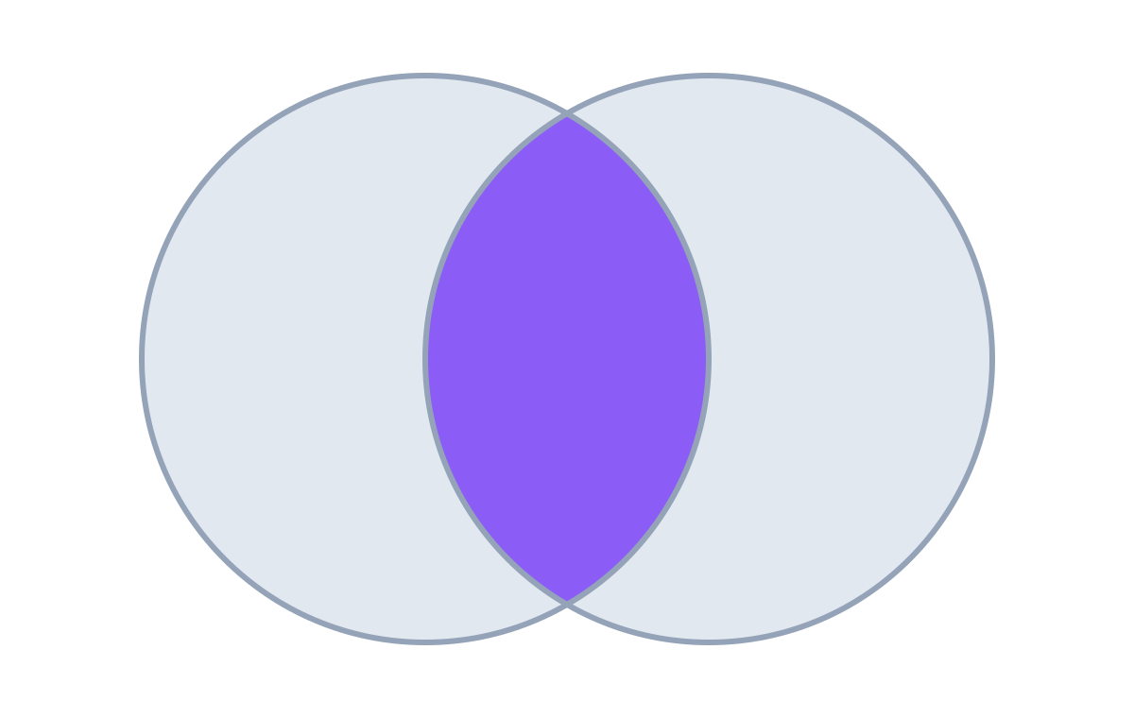
INTERSECT — Concept & Query
Returns only the rows common to both queries — similar in spirit to INNER JOIN.
Frank
Joseph
SELECT FirstName, LastName
Kevin
Michael
Mark
FROM Sales.Employees
Mary
Carol
Anna
INTERSECT
SELECT FirstName, LastName
FROM Sales.Customers;
Employees (1st query)
Customers (2nd query)
Result · 2 rows
Kevin
Mary
Duplicates: removed
Query order: doesn't matter

Slide 65
Under the Hood: INTERSECT
Find the employees who are also customers
1st query · Employees
2nd query · Customers (lookup)
result
Only common rows survive. Swapping the queries gives the same result.
FirstName
LastName
FirstName
LastName
FirstName
LastName
Frank
Lee
✘
Joseph
Goldberg
✘
Kevin
Brown
Kevin
Brown
✔
Kevin
Brown
Mary
NULL
Mary
NULL
✔
Mary
NULL
Michael
Ray
✘
Mark
Schwarz
✘
Carol
Baker
✘
Anna
Adams
✘
STEP LOG
1 · Column names come from the 1st query
2 · Frank → not a customer → excluded
3 · Kevin → also a customer → kept
4 · Mary → also a customer → kept
5 · Michael → not a customer → excluded
6 · Carol → not a customer → excluded
7 · Joseph, Mark, Anna → only customers → excluded

Slide 66



Set Operators in Real Projects
Three use cases for data analysis and data engineering
Combine tables
Find the delta
Check completeness
Merge tables with the same kind of data into one before analysis.
Compare a new batch with the previous load to find only new rows.
After a migration, prove no rows are missing on either side.
UNION · UNION ALL
EXCEPT
EXCEPT (both ways)

Slide 67
Use Case 1 · Combine Similar Tables First
Example: a report that needs every person in the database
✘ Four separate queries
✔ UNION first, then one query
Employees
Customers
Suppliers
Students
Employees
Customers
Suppliers
Students
query
query
query
query
UNION
Persons
Report
one query → Report
Same logic written 4 times — update one, forget another → inconsistent reports.
One place to change the logic — every person is always included.

Slide 68
Use Case 1 · Tables Split for Performance
Large tables are sometimes divided (e.g. by year) — combine them before analysis
Orders_2022
Orders_2023
UNION
Orders
Analysis query
Report
Orders_2024
Analyze orders over time from one central result instead of querying each year separately.
SELECT * FROM Sales.Orders_2022
UNION
SELECT * FROM Sales.Orders_2023
UNION
SELECT * FROM Sales.Orders_2024;

Slide 69
Use Case 1 · In Practice
TASK Orders live in Orders and OrdersArchive. Combine all orders into one report without duplicates.
List the columns — avoid SELECT *
If one table's schema changes (e.g. two columns swap), * silently mixes OrderIDs with ProductIDs.
SELECT
1
'Orders' AS SourceTable,
OrderID, ProductID, CustomerID,
/* ...list every column */
FROM Sales.Orders
Add a SourceTable column
OrderID 1 can exist in both tables. A static label shows where each row came from.
UNION
2
SELECT
'OrdersArchive' AS SourceTable,
OrderID, ProductID, CustomerID,
Sort once, at the end
ORDER BY OrderID after the last query puts both sources side by side.
/* ...list every column */
3
FROM Sales.OrdersArchive
ORDER BY OrderID;

Slide 70
Use Case 2 · Find the Delta With EXCEPT
Data pipelines load only what's new since the previous load
source
load everything
data warehouse
Day 1
1
2
1
2
source
new
data warehouse
insert
Day 2
1
3
EXCEPT Day 1
3
1
2
3
Customer 1 was already loaded, so only customer 3 is inserted — no duplicates in the warehouse.
SELECT * FROM Staging.Customers_Day2
EXCEPT
SELECT * FROM Staging.Customers_Day1;
-- returns only customer 3

Slide 71
Use Case 3 · Check Migration Completeness
Run EXCEPT in both directions — both results should be empty
migrate Customers table
Database A
Database B
Check 1 · anything missing in B?
Check 2 · anything extra in B?
SELECT * FROM DatabaseA.dbo.Customers
SELECT * FROM DatabaseB.dbo.Customers
EXCEPT
EXCEPT
SELECT * FROM DatabaseB.dbo.Customers;
SELECT * FROM DatabaseA.dbo.Customers;
✔ 0 rows returned
✔ 0 rows returned
Both checks empty → the two tables are identical. Nothing was lost or added during migration.

Slide 72
The Four Set Operators at a Glance
UNION
UNION ALL
EXCEPT
INTERSECT
RETURNS
All rows from both
RETURNS
All rows from both
RETURNS
Only in the 1st query
RETURNS
Rows found in both
DUPLICATES
Removed
DUPLICATES
Kept (fastest)
DUPLICATES
Removed
DUPLICATES
Removed
QUERY ORDER
Doesn't matter
QUERY ORDER
Doesn't matter
QUERY ORDER
Matters
QUERY ORDER
Doesn't matter
Rules: same column count · compatible types · same order · 1st query names the columns · ORDER BY once at the end

Slide 73
Key Takeaways · Set Operators
1
Set operators stack rows from multiple queries; joins add columns.
2
Queries must match in column count, types and order — the 1st query names the result.
3
UNION removes duplicates; UNION ALL keeps them and is faster.
Up next CASE statements — conditional logic and derived values
4
EXCEPT finds differences (order matters); INTERSECT finds what's common.

