Slide 1
MODULE 07 · NOSQL & REDIS
Redis as a Cache
TTL, eviction and cache patterns - then a real banking app built around them
TTL
LRU
ASIDE
REFRESH
Deck 9 · Module 07 · NoSQL & Redis

Slide 2
Why Put a Cache in Front of the Database
Most of what a banking dashboard reads, it has read a moment ago
1
2
3
Reads repeat
RAM beats SQL
The DB is shared
SAME QUESTION, AGAIN
MEASURED ON THIS LAPTOP
PROTECT THE SYSTEM OF RECORD
· Open statement, refresh, open again
· Cache HIT 0.9 ms median
· Every hit is a query PostgreSQL skips
· Answer is identical until money moves
· Cache MISS 3.3 ms (warm, idle DB)
· Its capacity is kept for the writes
NOTE The gap on an idle laptop is 3-4x. On a busy database with millions of rows it is much larger - but the real win is the load that never reaches PostgreSQL at all.
ICICI Bank Learning Academy · Enterprise Data Engineering with SQL, Redis & Kafka
9 · Caching

Slide 3
Seven Words to Know
The whole vocabulary of caching fits on one slide
Term
Meaning
Where you see it in Redis
Hit
The answer was already in the cache
GET returns a value · keyspace_hits
Miss
Not cached - load from the DB, then store it
GET returns (nil) · keyspace_misses
TTL
Seconds until Redis deletes the key by itself
SET k v EX 300 · TTL k
Expiry
Removed because its TTL ran out
expired_keys
Eviction
Removed because memory is full
maxmemory-policy · evicted_keys
Invalidation
Removed by the app because the data changed
DEL k · UNLINK k
Hit ratio
hits / (hits + misses)
INFO stats
ICICI Bank Learning Academy · Enterprise Data Engineering with SQL, Redis & Kafka
9 · Caching

Slide 4
01
SET EX · TTL
KEEPTTL · GETEX
Cache Commands
DEL · UNLINK · SCAN
Keys with a lifetime, cache-aside by hand, invalidation and expiry
Lazy + active expiry

Slide 5
A Key With a Lifetime
EX sets the TTL at write time - TTL reads it back
measured · Redis 7.4.11
TTL returns
Means
127.0.0.1:6379> SET bank:bal:602501000101 111053.04 EX 60
n > 0
Expires in n seconds
OK
127.0.0.1:6379> TTL bank:bal:602501000101
-1
Exists, never expires - a bug in a cache
(integer) 59
127.0.0.1:6379> EXPIRE bank:bal:602501000101 300
-2
Does not exist (expired, evicted, deleted)
(integer) 1
127.0.0.1:6379> PERSIST bank:bal:602501000101
(integer) 1
RULE Every cache write carries an expiry. The TTL is the safety net that bounds staleness even when invalidation is forgotten.
127.0.0.1:6379> TTL bank:bal:602501000101
(integer) -1
127.0.0.1:6379> TTL bank:nosuchkey
(integer) -2
ICICI Bank Learning Academy · Enterprise Data Engineering with SQL, Redis & Kafka
9 · Caching

Slide 6
The Overwrite Trap
A plain SET on an existing key silently removes its TTL
measured
127.0.0.1:6379> EXPIRE bank:bal:602501000101 120
(integer) 1
127.0.0.1:6379> SET bank:bal:602501000101 108453.04 KEEPTTL # update the value, keep the clock
OK
127.0.0.1:6379> TTL bank:bal:602501000101
(integer) 119
127.0.0.1:6379> SET bank:bal:602501000101 999 NX # only if missing
(nil)
127.0.0.1:6379> GETEX bank:bal:602501000101 EX 600 # read + re-arm (sliding TTL)
"108453.04"
EX seconds
PX millis
NX if absent
XX if present
KEEPTTL
GETEX
ICICI Bank Learning Academy · Enterprise Data Engineering with SQL, Redis & Kafka
9 · Caching

Slide 7
Cache-Aside, by Hand
The application - not Redis - fills the cache, one miss at a time
1
Look in Redis
GET key
the same steps the Horizon Bank API runs
127.0.0.1:6379> GET bank:txns:602501000101
2
Miss? Ask PostgreSQL
SELECT ... LIMIT 50
(nil) <- MISS
# app runs the SQL, then:
127.0.0.1:6379> SET bank:txns:602501000101 '[{...}]' EX 300
OK
3
Store with a TTL
SET key json EX 300
127.0.0.1:6379> GET bank:txns:602501000101
"[{\"txnId\":91,...}]" <- HIT
127.0.0.1:6379> TTL bank:txns:602501000101
4
Next time: hit
GET key returns the JSON
(integer) 299
ICICI Bank Learning Academy · Enterprise Data Engineering with SQL, Redis & Kafka
9 · Caching

Slide 8
Invalidation - Removing What Changed
Delete the key; the next read is a miss and reloads fresh data
measured
Command
Verdict
127.0.0.1:6379> DEL bank:txns:602501000101
DEL
Known keys; frees on the main thread
(integer) 1
UNLINK
Big values; frees in the background
127.0.0.1:6379> SCAN 0 MATCH bank:txns:* COUNT 100
1) "0"
SCAN MATCH
Find keys incrementally - safe
2) 1) "bank:txns:602501000102"
2) "bank:txns:602501000103"
KEYS *
Never in production - blocks
127.0.0.1:6379> UNLINK bank:txns:602501000102 \
bank:txns:602501000103
FLUSHALL
Never on a shared server
(integer) 2
DESIGN Best of all: design keys the writer can compute. A transfer from A to B knows it must touch bank:txns:A and bank:txns:B - no search needed.
ICICI Bank Learning Academy · Enterprise Data Engineering with SQL, Redis & Kafka
9 · Caching

Slide 9
How Expiry Really Happens
Two mechanisms - one guarantees correctness, the other reclaims memory
L
A
Lazy (passive)
Active
ON EVERY ACCESS
hz TIMES PER SECOND
· Touch an expired key: deleted, (nil)
· Samples keys that have a TTL
· An expired key is never returned
· Repeats while >10% were expired
127.0.0.1:6379> SET bank:short 1 EX 2
OK
127.0.0.1:6379> GET bank:short # 3 seconds later
(nil)
127.0.0.1:6379> INFO keyspace
db0:keys=3,expires=3,avg_ttl=235911,subexpiry=1
ICICI Bank Learning Academy · Enterprise Data Engineering with SQL, Redis & Kafka
9 · Caching

Slide 10
02
maxmemory
maxmemory-policy
Configuration & Eviction
LRU vs LFU
Memory ceiling, eviction policy, measurement
INFO stats

Slide 11
Two Settings Make It a Cache
A fresh redis:7-alpine reports maxmemory 0 and noeviction - that is a database
redis-cache.conf
maxmemory the ceiling for the dataset
# redis/redis-cache.conf (the app's Redis)
policy what to throw away at the ceiling
maxmemory 64mb
maxmemory-policy allkeys-lru
samples LRU/LFU are sampled approximations
maxmemory-samples 5
lazyfree-lazy-eviction yes
lazyfree free memory off the main thread
lazyfree-lazy-expire yes
lazyfree-lazy-user-del yes
no persistence a cache is rebuilt from the DB
hz 10
save ""
appendonly no
! No comment on the same line as a directive - Redis refuses to start.
ICICI Bank Learning Academy · Enterprise Data Engineering with SQL, Redis & Kafka
9 · Caching

Slide 12
The Eviction Experiment
maxmemory 2mb · 5,000 x 1 KB SETs through redis-cli --pipe · three policies
noeviction
allkeys-lru
volatile-lru
errors: 4089
errors: 0
errors: 0
911 keys fit
evicted_keys: 4192
evicted_keys: 4170
every later write:
bank:txns:1 gone
key with no TTL
OOM command not allowed
bank:txns:5000 kept
survives - EXISTS 1
! noeviction is the worst choice for a cache: once full, the SET after every miss fails - so new hot data can never get in.
ICICI Bank Learning Academy · Enterprise Data Engineering with SQL, Redis & Kafka
9 · Caching

Slide 13
Eight Eviction Policies
Two questions: which keys are candidates, and how to pick among them
Policy
Candidates
Chooses
Use when
noeviction
none - writes fail
-
Redis is the database (queues, sessions)
allkeys-lru
all keys
least recently used
Pure cache - Horizon Bank
allkeys-lfu
all keys
least frequently used
Stable set of hot keys
allkeys-random
all keys
random
Uniform access, lowest CPU
volatile-lru
keys with a TTL
least recently used
Cache + permanent keys together
volatile-lfu
keys with a TTL
least frequently used
Same, frequency-based
volatile-ttl
keys with a TTL
shortest TTL left
Items about to expire anyway
volatile-random
keys with a TTL
random
Rarely right
ICICI Bank Learning Academy · Enterprise Data Engineering with SQL, Redis & Kafka
9 · Caching

Slide 14
What LRU and LFU Look At
Every key carries either an idle clock or a frequency counter
measured
LFU counter logarithmic - 50 reads gave 10, not 50
127.0.0.1:6379> CONFIG SET maxmemory-policy allkeys-lfu
OK
Starts at 5 so a brand-new key is not evicted at once
# GET bank:txns:hot executed 50 times
127.0.0.1:6379> OBJECT FREQ bank:txns:hot
(integer) 10
Decays lfu-decay-time - old popularity fades
127.0.0.1:6379> OBJECT FREQ bank:txns:cold
(integer) 5
127.0.0.1:6379> CONFIG SET maxmemory-policy allkeys-lru
OK
LRU OBJECT IDLETIME = seconds since last touch
# 4 seconds after SET bank:txns:idle
127.0.0.1:6379> OBJECT IDLETIME bank:txns:idle
(integer) 4
ICICI Bank Learning Academy · Enterprise Data Engineering with SQL, Redis & Kafka
9 · Caching

Slide 15
Measuring a Cache
Four numbers from INFO tell you whether the cache is working
measured
Metric
Worry when
$ redis-cli INFO stats | grep -E
hit ratio
Below ~80 % on read-heavy data
'keyspace_|expired|evicted'
expired_keys:1
evicted_keys
Climbs fast: maxmemory too small
evicted_keys:0
expired_keys
Flat while keys pile up: no TTLs
keyspace_hits:17
keyspace_misses:5
used_memory
Pinned at maxmemory + evictions
# ratio = 17 / (17 + 5) = 77.3 %
! MONITOR shows every command live - perfect in class, dangerous in production (it can halve throughput). SLOWLOG GET is the production-safe view.
ICICI Bank Learning Academy · Enterprise Data Engineering with SQL, Redis & Kafka
9 · Caching

Slide 16
03
Cache-aside
Write-through
Caching Patterns
Write-behind
Who fills the cache, who updates it, and how it goes wrong
Stampede · avalanche

Slide 17
Five Patterns
Horizon Bank uses cache-aside for reads and write-through after transfers
Pattern
Read
Write
Trade-off
Cache-aside
App: GET; on miss DB + SET
DB, then DEL or SET
Simple; first read after change is slow
Read-through
Cache library loads the DB
-
Cleaner code; smarter cache layer
Write-through
Always a hit after a write
DB, then SET new value
Fresh reads; writes do more work
Write-behind
From cache
Cache now, DB later
Fast; can lose data - never money
Refresh-ahead
From cache
Job reloads before TTL
No misses; loads unused data
ICICI Bank Learning Academy · Enterprise Data Engineering with SQL, Redis & Kafka
9 · Caching

Slide 18
Four Ways a Cache Goes Wrong
Each has a one-command fix
1
2
3
4
Stampede
Avalanche
Penetration
Stale write
SET lock NX EX 5
EX 300 + rand(30)
SET k "null" EX 30
SET/DEL after COMMIT
· A hot key expires; 500 misses hit the DB together
· Keys written together expire together
· Unknown IDs miss every single time
· UI shows an old or rolled-back balance
· Fix: one loader holds a lock
· Fix: add random jitter to TTLs
· Fix: cache "not found" briefly
· Fix: touch the cache after COMMIT
127.0.0.1:6379> SET lock:bank:txns:602501000101 api-1 NX EX 5
OK <- api-1 loads from the DB
127.0.0.1:6379> SET lock:bank:txns:602501000101 api-2 NX EX 5
(nil) <- api-2 waits, then GETs again
ICICI Bank Learning Academy · Enterprise Data Engineering with SQL, Redis & Kafka
9 · Caching

Slide 19
THE GOLDEN RULE
Money never moves on a cached number.
The balance that authorises a transfer is read from PostgreSQL with SELECT ... FOR UPDATE. Redis serves the display of balances and statements - at worst a few seconds old, never able to let an account go overdrawn.
DB = truth
cache = copy
TTL = bound
COMMIT first
ICICI Bank Learning Academy · Enterprise Data Engineering with SQL, Redis & Kafka
9 · Caching

Slide 20
04
Architecture
Enquiry flow
Horizon Bank
Transfer flow
React · Express · PostgreSQL · Redis - four containers, one dashboard
Run & test

Slide 21
Architecture
The browser talks to nginx; exactly one module in Express talks to Redis
bank-api · Express
routes
bank-redis
Browser
bank-web
the CACHE
64 MB · allkeys-lru
React 18 SPA
localhost:8080
nginx
static bundle
proxy /api/*
services
cacheService
repositories
bank-postgres
Read: Redis first, PostgreSQL on a miss
Write: PostgreSQL first, then Redis
SOURCE OF TRUTH
3 tables · volume
infra: pg · redis
ICICI Bank Learning Academy · Enterprise Data Engineering with SQL, Redis & Kafka
9 · Caching

Slide 22
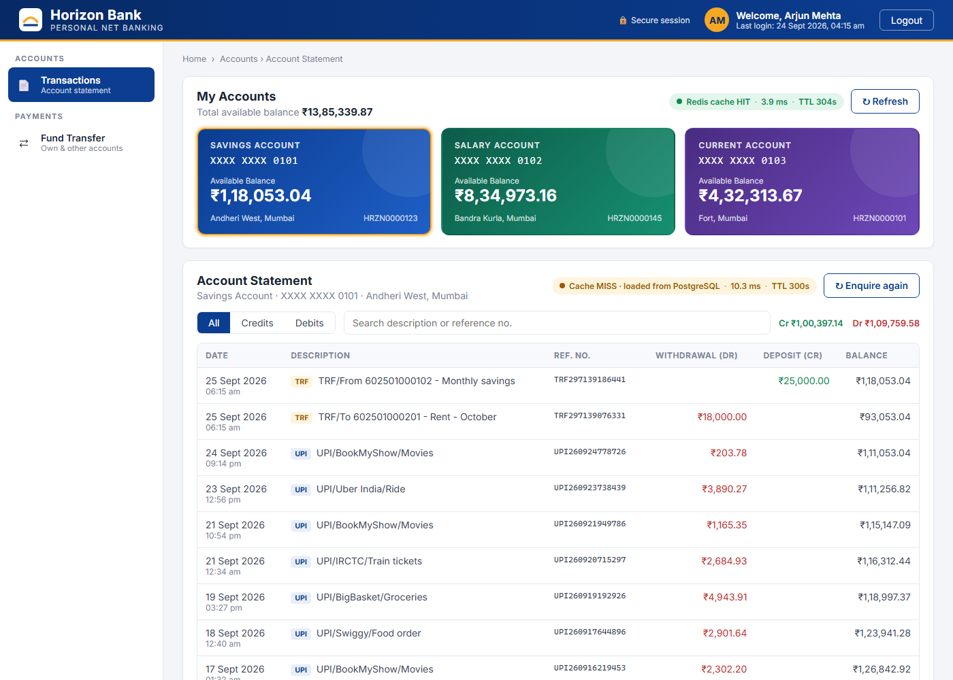
One Screen, Two Menu Items
A realistic net-banking dashboard - with a HIT/MISS badge on every panel
Transactions latest 50, filters, search - cached
Fund Transfer details, review, acknowledgement
Badge amber MISS -> green HIT + TTL
Cache Inspector live bank:* keys, hit rate, Clear cache
ICICI Bank Learning Academy · Enterprise Data Engineering with SQL, Redis & Kafka
9 · Caching

Slide 23
Flow 1 · Transaction Enquiry
Cache-aside - PostgreSQL is only asked on a miss
1
GET bank:txns:<acc> + TTL
one pipelined round trip
100 requests each
p50
p95
Cache MISS
3.3 ms
5.4 ms
2
HIT: return JSON
X-Cache: HIT · no SQL at all
Cache HIT
0.9 ms
1.6 ms
3
MISS: check account, SELECT 50 rows
existence check runs only here
LESSON An earlier draft checked the account in PostgreSQL before looking in Redis - so every HIT still ran a query (2.8 ms). Moving that check inside the miss path gave 0.9 ms. A cache that queries the database on a hit is not a cache.
4
SET key json EX 300..330
TTL + jitter, then X-Cache: MISS
ICICI Bank Learning Academy · Enterprise Data Engineering with SQL, Redis & Kafka
9 · Caching

Slide 24
Flow 2 · Fund Transfer
Database first, cache second - never the other way round
transferService.transfer()
measured response
BEGIN
"cacheUpdates":[
SELECT ... FOR UPDATE
{"key":"bank:txns:602501000101",
-- both rows, ORDER BY account_no
"action":"refreshed","ttl":305},
check ACTIVE, balance >= amount
{"key":"bank:txns:602501000201",
UPDATE accounts (-amt / +amt)
"action":"refreshed","ttl":302},
INSERT DEBIT + CREDIT (TRF ref)
{"key":"bank:accounts:1", ...},
COMMIT
{"key":"bank:accounts:2", ...}]
-- only now touch Redis:
SET bank:txns:<from> EX
i Next statement read: a HIT that already shows the TRF row. CACHE_ON_WRITE=invalidate DELs instead.
SET bank:txns:<to> EX
SET bank:accounts:<owner> EX
ICICI Bank Learning Academy · Enterprise Data Engineering with SQL, Redis & Kafka
9 · Caching

Slide 25
Cache Parameters of the App
All in docker-compose.yml - override any of them from the shell
Variable
Default
Effect
CACHE_ENABLED
true
false = every request goes to PostgreSQL
CACHE_TTL_SECONDS
300
Base lifetime of every cached value
CACHE_TTL_JITTER_SECONDS
30
0..30 s extra - keys do not expire together
CACHE_ON_WRITE
refresh
refresh = SET after COMMIT · invalidate = DEL
STATEMENT_SIZE
50
Rows per cached statement
$ CACHE_TTL_SECONDS=20 CACHE_TTL_JITTER_SECONDS=0 docker compose up -d api
$ CACHE_ON_WRITE=invalidate docker compose up -d api
$ docker compose up -d api # back to the defaults
ICICI Bank Learning Academy · Enterprise Data Engineering with SQL, Redis & Kafka
9 · Caching

Slide 26
Run It
One command to start; one script to watch the cache work
measured on this machine
$ cd cache_banking_app && docker compose up -d --build
$ bash scripts/cache-demo.sh
== 2. First enquiry -> MISS, loaded from PostgreSQL, stored in Redis
source=database ttl=300s took=22.2ms
== 3. Same enquiry again -> HIT, served from Redis
source=cache ttl=300s took=2.4ms
== 5. Transfer Rs 100 -> DB COMMIT, then cache refreshed
{"reference":"TRF295949631951",...,"cacheUpdates":[... 4 keys ...]}
== 6. Enquire again -> still a HIT, and the newest row is the transfer
"source":"cache" "description":"TRF/To 602501000201 - cli demo"
$ docker stop bank-redis # dashboard keeps working: source = database (redis down)
ICICI Bank Learning Academy · Enterprise Data Engineering with SQL, Redis & Kafka
9 · Caching

Slide 27
Key Takeaways
1
Two settings make Redis a cache
maxmemory plus an eviction policy - allkeys-lru for a pure cache. noeviction refuses writes when full.
2
Every cache write carries a TTL
TTL -1 in a cache is a bug. Watch the overwrite trap: plain SET drops the TTL; KEEPTTL keeps it.
3
Cache-aside for reads, database first for writes
Update or delete the affected keys only after COMMIT - and design keys the writer can compute.
UP NEXT
Redis_Caching_Guide.pdf labs C.1-C.7 · then run the Horizon Bank app
4
A hit must not touch the database
Measured: 0.9 ms vs 3.3 ms. Existence checks belong on the miss path.
5
Money never moves on a cached number
Authorise with SELECT ... FOR UPDATE; the cache is for display.

