Slide 1
LoadRunner download guide

Slide 2
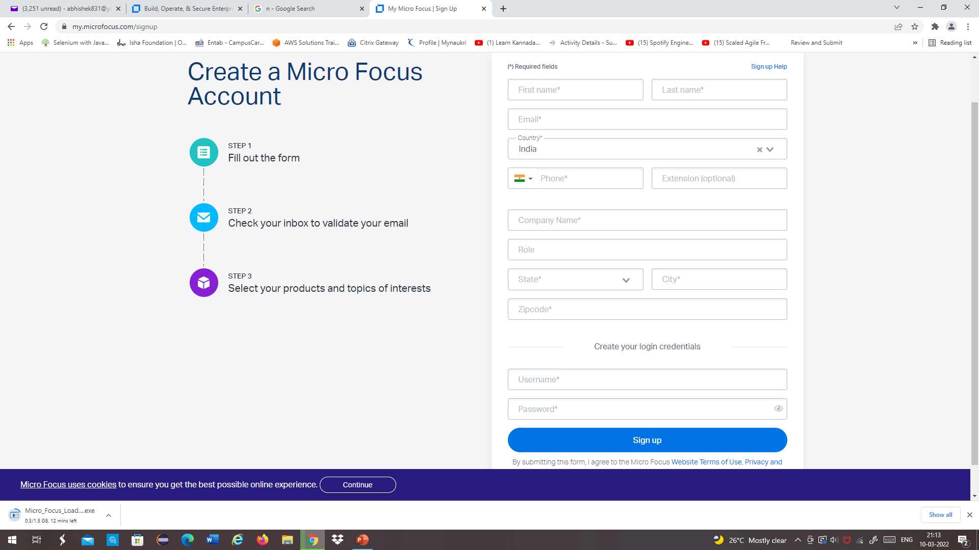
Go to https://www.microfocus.com/en-us/signup
Please enter all the information (company name is Mandatory)
Complete email verification process

Slide 3
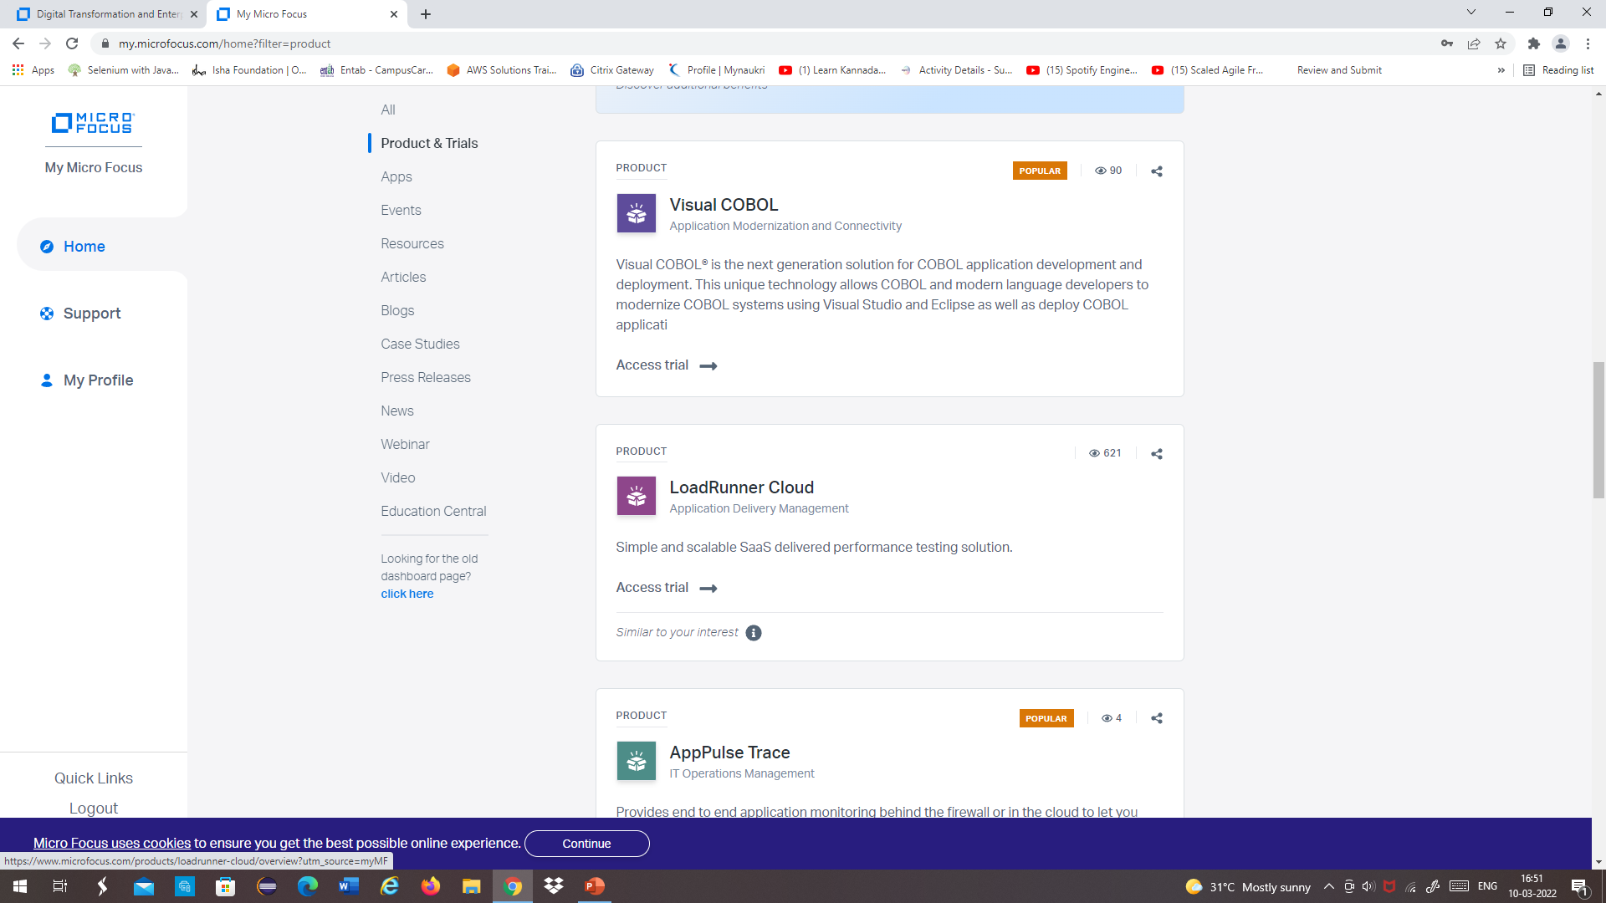
Login in account and click on product & trial
Search for LoadRunner Professional and click on the Link

Slide 4
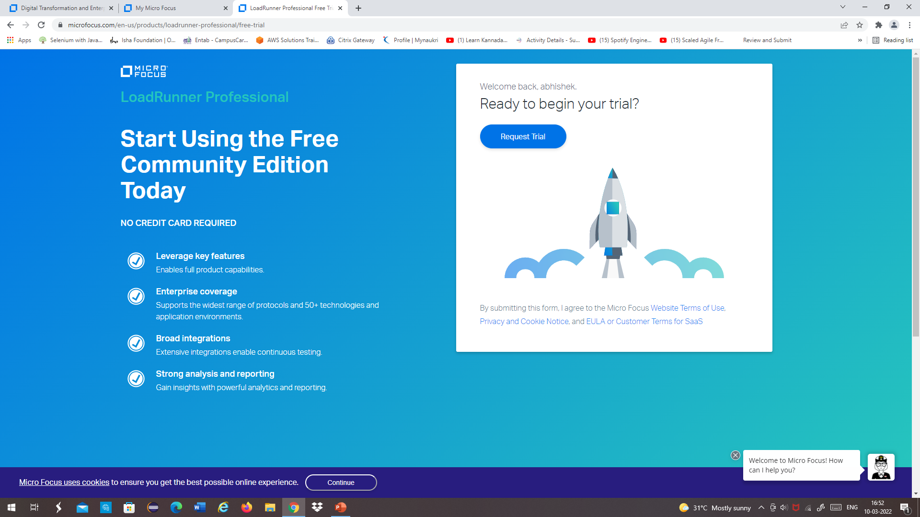
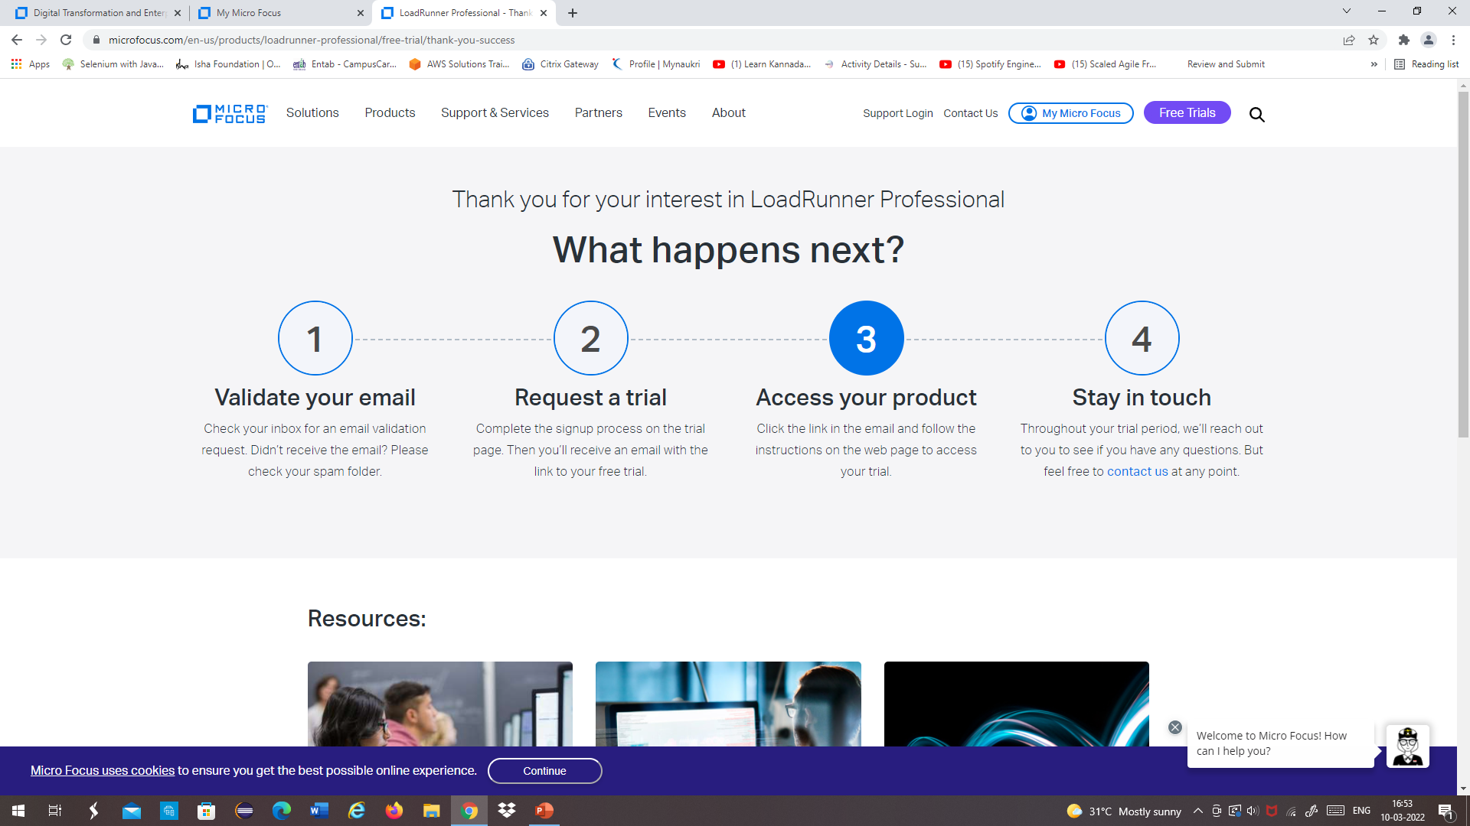
Click on Request Trial link
Wait for the email to your registered account ( it will take 24 to 48 hours)

Slide 5
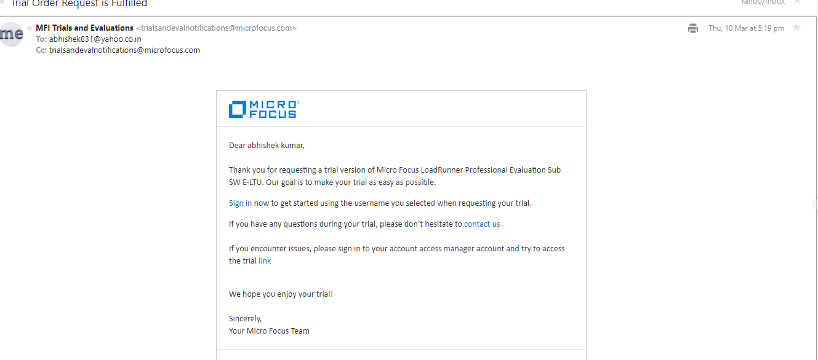
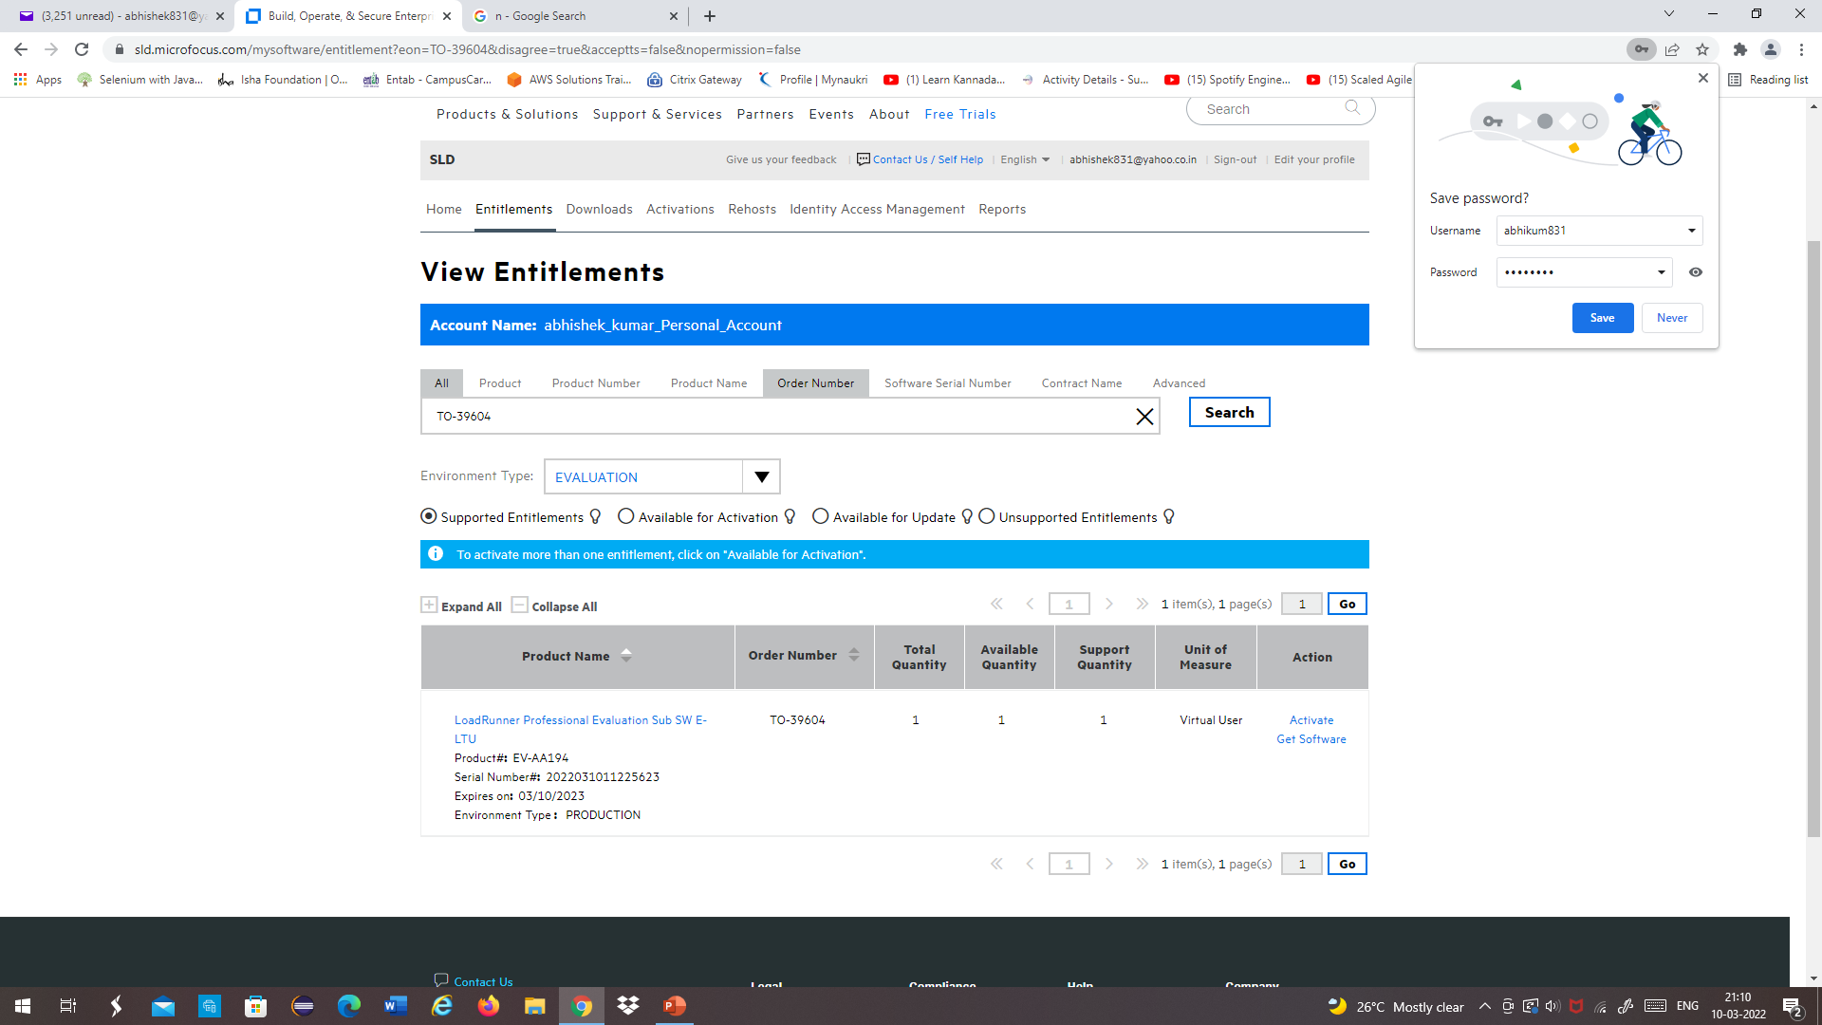
Email detail: Click on sign in link
Click on LoadRunner professional link

Slide 6
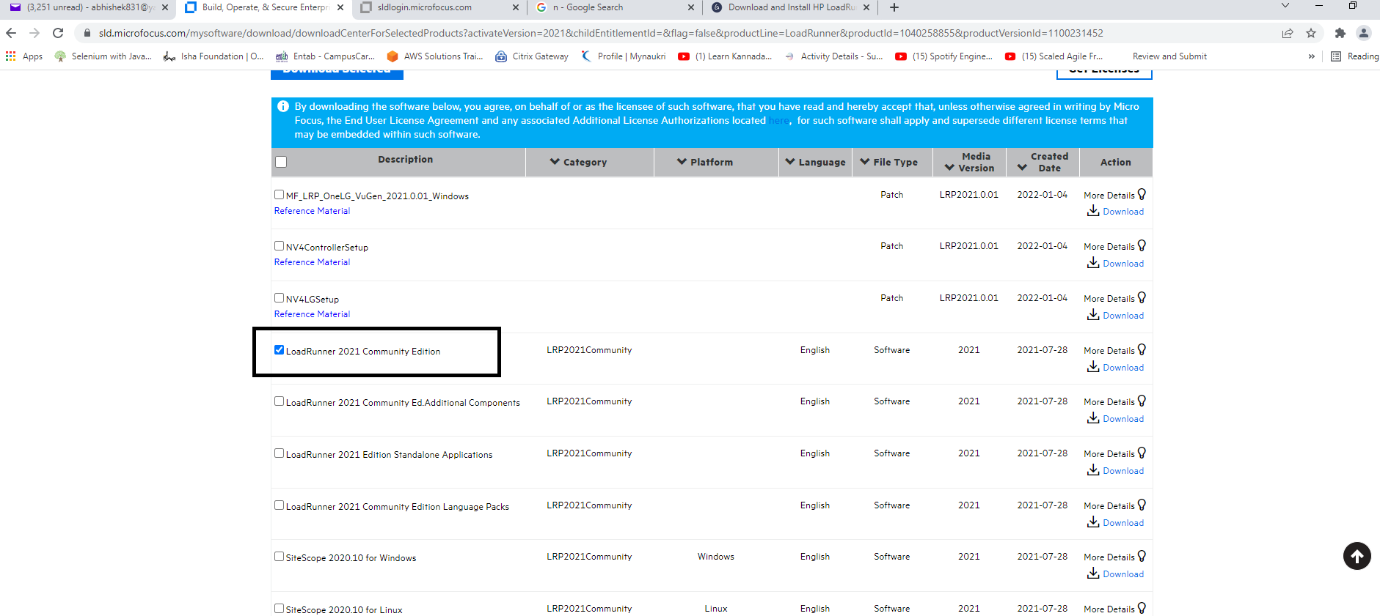
Click on down Load Button
Down Load LoadRunner 2021 community edition

