Slide 1
Defect / Bug Life Cycle
Defect Life Cycle or Bug Life Cycle in software testing is the specific set of states that defect or bug goes through in its entire life. The purpose of Defect life cycle is to easily coordinate and communicate current status of defect which changes to various assignees and make the defect fixing process systematic and efficient.
The bug should go through the life cycle to be closed. The bug life cycle varies depends upon the tools (QC, JIRA, etc.,) used, and the process followed in the organization.

Slide 2
Software Bug / Defect
A software bug can be defined as the abnormal behavior of the software. The bug starts when the defect is found and ends when a defect is closed, after ensuring it is not reproduced.
A Defect, in simple terms, is a flaw or an error in an application that is restricting the normal flow of an application by mismatching the expected behavior of an application with the actual one.
The defect occurs when any mistake is made by a developer during the designing or building of an application and when this flaw is found by a tester, it is termed as a defect.
It is the responsibility of a tester to do thorough testing of an application to find as many defects as possible to ensure that a quality product will reach the customer.

Slide 3
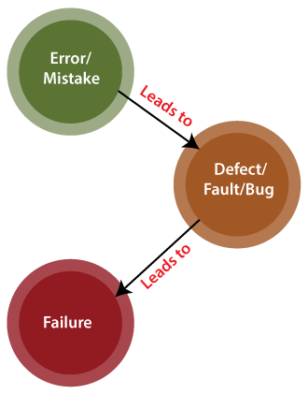
Software Bug / Defect Life Cycle

Slide 4
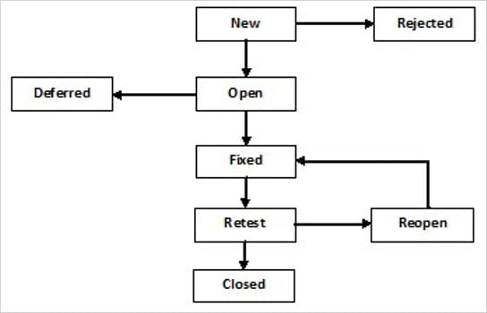
Software Bug / Defect Life Cycle

Slide 5
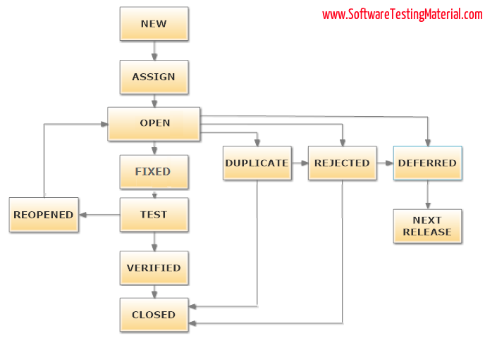
Software Bug / Defect Life Cycle

Slide 6
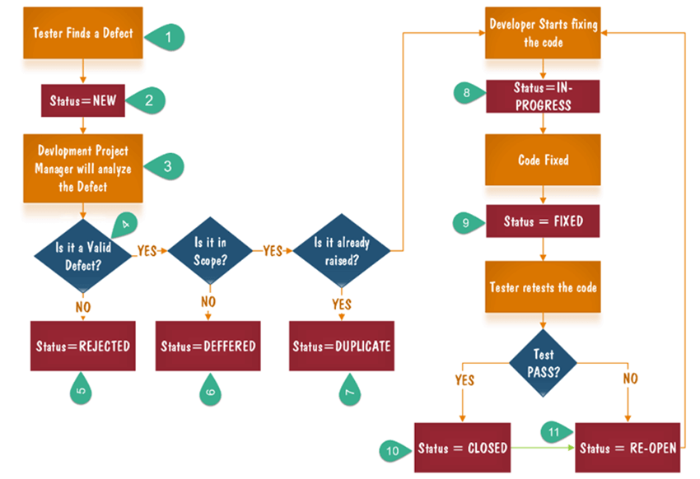
Software Bug / Defect Life Cycle

Slide 7
Defect Life Cycle States
New
When a tester finds a new defect. He should provide a proper Defect document to the Development team to reproduce and fix the defect. In this state, the status of the defect posted by the tester is “New”
Assigned
Defects that are in the status of New will be approved (if valid) and assigned to the development team by Test Lead/Project Lead/Project Manager. Once the defect is assigned then the status of the bug changes to “Assigned”
Open
The development team starts analyzing and works on the defect fix
Fixed
When a developer makes the necessary code change and verifies the change, then the status of the bug will be changed as “Fixed” and the bug is passed to the testing team.
Test
If the status is “Test”, it means the defect is fixed and ready to do test whether it is fixed or not.

Slide 8
Defect Life Cycle States
Verified
The tester re-tests the bug after it got fixed by the developer. If there is no bug detected in the software, then the bug is fixed and the status assigned is “verified.”
Closed
After verified the fix, if the bug is no longer exits then the status of the bug will be assigned as “Closed.”
Reopen
If the defect remains the same after the retest, then the tester posts the defect using the defect retesting document and changes the status to “Reopen”. Again the bug goes through the life cycle to be fixed.
Duplicate
If the defect is repeated twice or the defect corresponds to the same concept of the bug, the status is changed to “duplicate” by the development team.

Slide 9
Defect Life Cycle States
Deferred
In some cases, the Project Manager/Lead may set the bug status as deferred.
If the bug found during the end of the release and the bug is minor or not important to fix immediately.
If the bug is not related to the current build.
If it is expected to get fixed in the next release.
The customer is thinking to change the requirement.
In such cases the status will be changed as “deferred” and it will be fixed in the next release.
Rejected
If the system is working according to specifications and the bug is just due to some misinterpretation (such as referring to old requirements or extra features) then the Team lead or developers can mark such bugs as “Rejected”

Slide 10
Defect Life Cycle States
Deferred
In some cases, the Project Manager/Lead may set the bug status as deferred.
If the bug found during the end of the release and the bug is minor or not important to fix immediately.
If the bug is not related to the current build.
If it is expected to get fixed in the next release.
The customer is thinking to change the requirement.
In such cases the status will be changed as “deferred” and it will be fixed in the next release.
Rejected
If the system is working according to specifications and the bug is just due to some misinterpretation (such as referring to old requirements or extra features) then the Team lead or developers can mark such bugs as “Rejected”

Slide 11
Severity & Priority
Bug Severity or Defect Severity in testing is a degree of impact a bug or a Defect has on the software application under test. A higher effect of bug/defect on system functionality will lead to a higher severity level. A Quality Assurance engineer usually determines the severity level of a bug/defect.
Priority is defined as the order in which a defect should be fixed. Higher the priority the sooner the defect should be resolved.
Defects that leave the software system unusable are given higher priority over defects that cause a small functionality of the software to fail.

Slide 12
Types of Severity & Priority
Critical: This defect indicates complete shut-down of the process, nothing can proceed further
Major: It is a highly severe defect and collapses the system. However, certain parts of the system remain functional
Medium: It causes some undesirable behavior, but the system is still functional
Low: It won't cause any major break-down of the system
Priority :
Low: The Defect is an irritant but repair can be done once the more serious Defect has been fixed
Medium: During the normal course of the development activities defect should be resolved. It can wait until a new version is created
High: The defect must be resolved as soon as possible as it affects the system severely and cannot be used until it is fixed

Slide 13
Examples
A very low severity with a high priority: A logo error for any shipment website, can be of low severity as it not going to affect the functionality of the website but can be of high priority as you don't want any further shipment to proceed with the wrong logo.
A very high severity with a low priority: Likewise, for flight operating website, a defect in reservation functionality may be of high severity but can be a low priority as it can be scheduled to release in a next cycle

Slide 14
Examples
High Priority, Low Severity bug :- If the company name is misspelled in the home page of the website,then the priority is high and severity is low to fix it.
High Severity, Low Priority :- Web page not found when user clicks on a link (user&#39;s does not visit that page generally)
Low Priority, Low Severity :- Any cosmetic or spelling issues which is within a paragraph or in the report
High Priority, High Severity :- An error which occurs on the basic functionality of the application and will not allow the user to use the system (E.g. user is not able to login to the application)

Slide 15
More Examples
High Priority & High Severity: An error which occurs on the basic functionality of the application and will not allow the user to use the system. (Eg. A site maintaining the student details, on saving record if it, doesn’t allow to save the record then this is high priority and high severity bug.)
High Priority & Low Severity: The spelling mistakes that happens on the cover page or heading or title of an application.
High Severity & Low Priority: An error which occurs on the functionality of the application (for which there is no workaround) and will not allow the user to use the system but on click of link which is rarely used by the end user.
Low Priority and Low Severity: Any cosmetic or spelling issues which is within a paragraph or in the report (Not on cover page, heading, title).

