Slide 1

Software as storytelling to epics and user stories

Slide 2
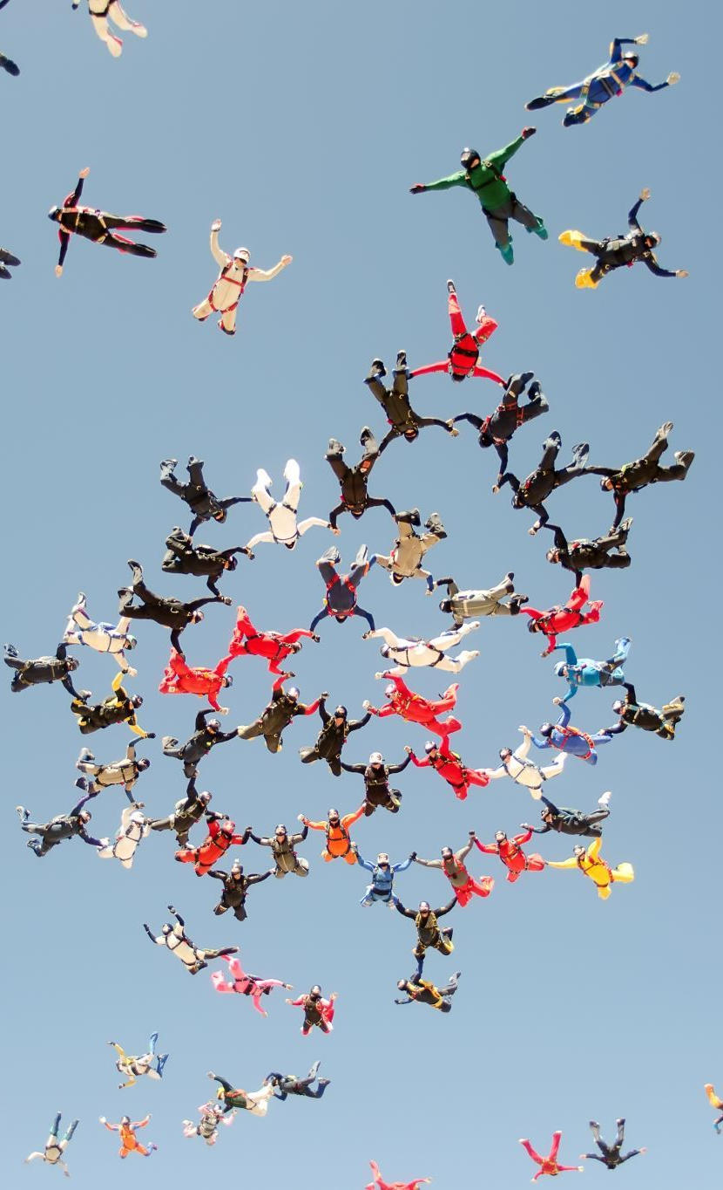
Storytelling
Story telling refers to a tool that aids the team members to visualize the events of the product development and helps them to corroborate it back to the epic. In storytelling, the key idea is to create chunks out of the epics such that the team can select from them and deliver it in the Sprint period

Slide 3

Workflow break down
Workflow breakdown refers to splitting the epic based on the work that has to be done during the epic.
Based on this kind of workflow, the work among the team members can be divided.
Applying the same example during product development, to complete a specific epic, there have to be many workflows attached that have to be completed to finish the epic.
This strategy also helps the Product Owner to prioritize the work that requires to be completed immediately for the product.

Slide 4

Role-based breakdown
many roles have to be completed so that the epic which is the project has to be successful.
It could be the role of X, Y, or Y in the project.
When focused on Agile management, the roles could be based on the product.
When every person has a specific task, and if that task is the specialty of that person, it could be a great help in breaking down epics into User Stories

Slide 5
Breakdown around the timeline
Few epics can be broken according to the time that it takes to complete.
These epics are divided such that the work gets completed as long as a Sprint lasts.
The whole Sprint is taken up by that particular User Story (1 or more) that has been broken down.
Hence, the User Story that is a high priority will be completed and slowly the epic is completed.
As breaking down the Epics and User Stories involves several factors such as priority, interdependency, etc., there are two approaches for dividing the User Story.
It is either a horizontal or vertical approach.

Slide 6
Other techniques
Data Boundaries: An epic could be divided into separate bits of functionality based on the same data lines. If one User Story is about the company's data display, another one could be based on the display of the company's contact information.
Operational boundaries: In this method, the epic is reduced to its minimum viable feature, and later additional slices of functionality are added to it.
Cross-cutting concerns: Here the method is to separate specific properties that all the features need to incorporate such that each of them can be addressed as separate User Stories. These items could include validation, security, and exceptions.
CRUD: The Abbreviation stands for creating, read, update, and delete. By breaking up the feature based on these terms, we can separate the feature into separate User Stories.
Non-functional requirements: In this method, the overarching items such as performance and capacity are treated as separate User Stories. For example, suppose an app needs to handle almost a million users. The issue of handling such a huge capacity need not be addressed in the first User Story. The capacity issue could be handled by treating it as a separate User Story.

Slide 7

Steps
Using software development as a form of storytelling involves translating the project requirements into narratives that guide the development process. This often includes breaking down the overall story into smaller, manageable parts known as epics and user stories.
1. Understand the Project Vision:
- Begin by understanding the overall vision and objectives of the project. What problem is the software solving? Who are the end users? What are the key features?
2. Identify Epics:
- Epics are high-level functionalities or features that capture the essence of the project. Break down the project into major components or themes. These could be the main story arcs in your software narrative.
3. Define User Stories:
- User stories are smaller, more detailed components that make up an epic. Each user story represents a specific functionality or feature from the user's perspective. They are typically written in a simple, user-centric language.

Slide 8
Steps
4. Use the "As a, I want, So that" Format for User Stories:
- Structure your user stories using the format "As a [user type], I want [an action], so that [benefit or value]." This format helps ensure that each user story has a clear purpose and context.
5. Prioritize User Stories:
- Prioritize user stories based on business value, dependencies, and other factors. This ensures that the most critical and valuable features are developed first.
6. Create a Story Map:
- Use a story map to visualize the relationship between epics and user stories. This tool helps teams understand the flow of features and how they contribute to the overall user experience.
7. Estimate Effort for Each User Story:
- Assign relative effort estimates (e.g., story points) to each user story. This helps in planning and resource allocation.

Slide 9

8. Iterative Development:
- Adopt an iterative development approach. Divide the development process into sprints, each focused on delivering a set of user stories. This allows for regular review, feedback, and adaptation.
9. Develop Prototypes and Mockups:
- Create prototypes or mockups for user stories to visualize the expected user interface and interactions. This aids in better communication between the development team and stakeholders.
10. Continuous Integration and Testing:
- As each user story is developed, integrate it into the existing codebase and conduct thorough testing. This ensures that new features do not negatively impact existing functionality.

Slide 10

11. Review and Iterate:
- Regularly review progress with stakeholders, and be open to iterating on user stories based on feedback and changing requirements.
12. Release and Gather Feedback:
- Release increments of the software to gather real-world feedback. This information can be used to refine existing user stories or create new ones for future development cycles.
13. Document Changes and Lessons Learned:
- Maintain documentation that captures changes made during development and lessons learned. This documentation can be valuable for future iterations or similar projects.

Slide 11
Definition
Epic: It is a requirement that is large enough to be delivered in a single Sprint. It must be broken down into smaller and shippable items called User Stories.
Story: It is the requirement that the business needs and is deliverable within a single Sprint.
Tasks: It is the technical essentials of the story and are on-the-ground activities that take the story to "done".

Slide 12

References
https://www.scrum.org/resources/blog/9-reasons-slice-user-stories-better
https://premieragile.com/splitting-epics-and-user-stories/

