Slide 1
IMPLEMENTATION GUIDE
Azure VMware Solution
Planning, migration, security, and day-two operations
A consultant reference for connecting on-premises vSphere estates to Azure dedicated infrastructure without disrupting production workloads.
Quisitive
Notes:
Framing: AVS is a hybrid integration project, not a standalone cloud deployment. The risk sits in the seams between two operational worlds.

Slide 2
CONTENTS
What this guide covers
01
Service model and scale
02
Capacity and storage
Architecture, host SKUs, and the hard limits that govern design.
Quota lead time, reserved overhead, and vSAN slack space.
03
Network foundation
04
Identity and control plane
Addressing, ExpressRoute, BGP controls, and firewall ports.
LDAPS, CloudAdmin, RBAC, and privileged access.
05
Migration and resilience
06
Day-two operations
HCX design, the EVC trap, backup, DR, and stretched clusters.
Patching windows, Arc, Defender, scaling, and alerting.
Azure VMware Solution
1
Notes:
Six workstreams. They are interdependent: capacity, addressing, identity, and lifecycle must be designed together.

Slide 3
01
Service Model and Scale
What Microsoft runs, what you run, and where the hard limits sit.
Azure VMware Solution
2

Slide 4
SECTION 1
Purpose and deployment context
Purpose
Use case
Implementation risk
Consultant role
VMware private clouds on Azure dedicated infrastructure, with familiar vSphere operations and Azure service integration.
Migrate and operate VMware workloads without an immediate application refactor.
Tier-one workloads need migration planning that avoids downtime, packet loss, routing failure, and storage exhaustion.
Explain the service model, identify hard limits, design network and identity, plan migration, prepare day-two operations.
The framing that matters
AVS is not a standalone cloud server deployment. It is a hybrid integration project. The challenge is safely docking two operational worlds together, so networking, identity, and capacity decisions carry more risk than the deployment itself.
Azure VMware Solution
3
Notes:
Anchor example: a tier-one SQL estate processing thousands of card transactions per minute. Downtime is not an option, so the plan has to be right before hosts are ordered.

Slide 5
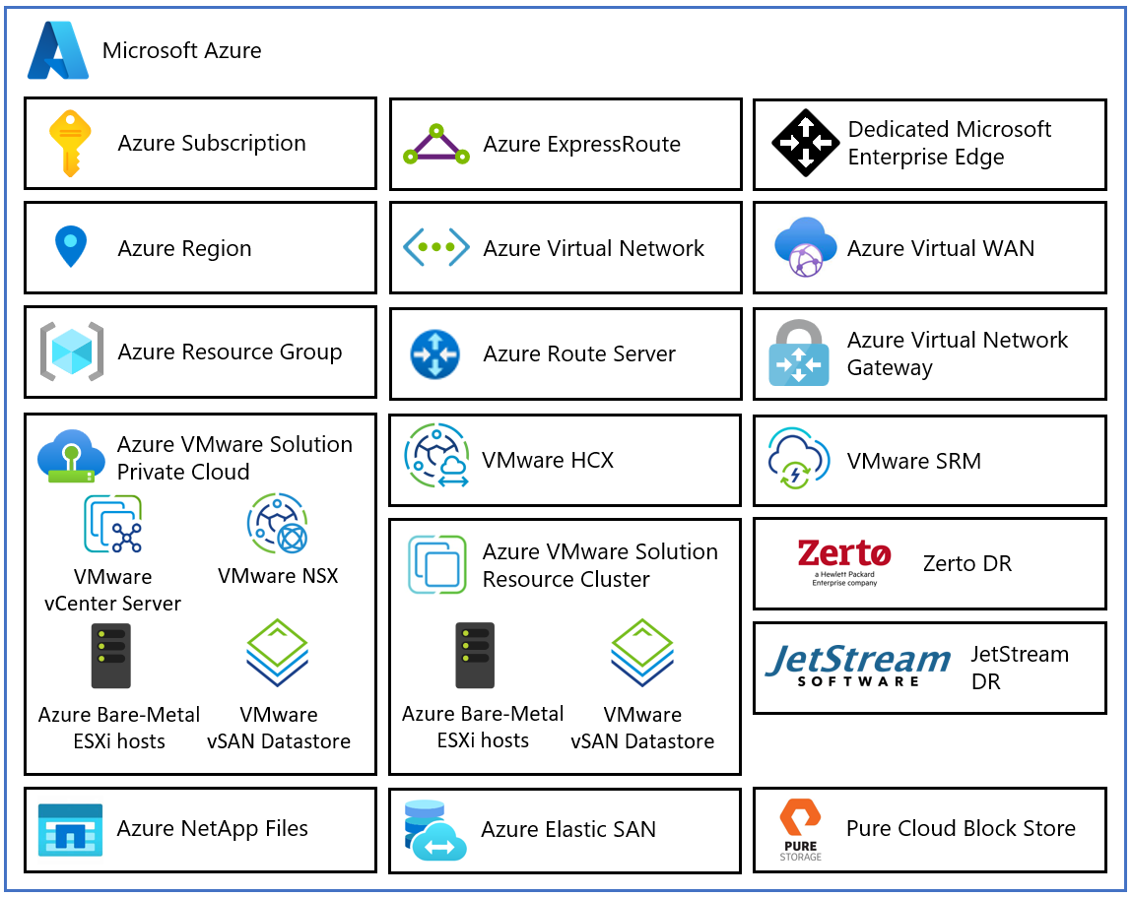
SECTION 1
Service model and core architecture
Dedicated bare metal, not nested virtualization.
Microsoft provides dedicated bare-metal hosts in Azure data centers. Private-cloud hosts and clusters are not shared with other customers, and Azure automates deployment and lifecycle of the VMware stack.
vCenter Server
Central management plane
vSAN
Software-defined storage pooling local drives
vSphere / ESXi
Compute virtualization layer
NSX
Software-defined networking and security
Source: Microsoft Learn, private cloud and cluster concepts
Azure VMware Solution
4
Notes:
Managed stack means the customer never gets ESXi root. That single fact drives most third-party tooling decisions later in the deck.

Slide 6
SECTION 1
Cluster and private cloud limits
3
16
12
96
hosts minimum
hosts per cluster
clusters
ESXi hosts
Smallest supported cluster
Single cluster maximum
Per private cloud
Hard cap per private cloud
Correction: do not multiply the two limits
12 clusters multiplied by 16 hosts gives 192, but that number is not deployable. Microsoft separately enforces 96 ESXi hosts per private cloud, so all 12 clusters cannot each hold 16 hosts. Size against the 96-host ceiling, not the arithmetic.
Azure VMware Solution
5
Notes:
This is a common sizing error in customer conversations. Catch it before a capacity plan gets approved.

Slide 7
SECTION 1
Host SKUs and hardware planning
SKU | Processor | Generation | Cores (physical / logical) | Memory
AV36 | Dual Intel Xeon Gold 6140 | Skylake | 36 / 72 | 576 GB
AV36P | Dual Intel Xeon Gold 6240 | Cascade Lake | 36 / 72 | 768 GB
AV48 | Dual Intel Xeon Gold 6442Y | Sapphire Rapids | 48 / 96 | 1,024 GB
AV52 | Dual Intel Xeon Platinum 8270 | Cascade Lake | 52 / 104 | 1,536 GB
AV64 | Dual Intel Xeon Platinum 8370C | Ice Lake | 64 / 128 | 1,024 GB
Gen 1 AV64 prerequisite
Gen 2 changes this
Migration implication
An existing AV36, AV36P, AV48, or AV52 private cloud is required before adding a separate AV64 cluster.
Generation 2 deploys directly as a minimum three-host AV64 private cloud with no seed cluster.
Adding AV64 to a Gen 1 private cloud creates a heterogeneous CPU estate with documented EVC issues.
Azure VMware Solution
6
Notes:
AV64 uses OSA in Generation 1 and ESA in Generation 2. AV48 uses ESA. Confirm current specs before quoting.

Slide 8
SECTION 1
Operational responsibility boundaries
Microsoft manages
The customer manages
Physical infrastructure and dedicated host hardware
Lifecycle of ESXi, vCenter Server, vSAN, and NSX
Platform patching, updates, and upgrades
The vSAN witness in stretched cluster designs
Guest operating systems, applications, and workload VMs
vSAN storage policies and capacity consumption
NSX workload networking and segmentation
Third-party solutions within exposed permissions
No ESXi root access
Customers do not receive ESXi administrator or root access. Elevated operations, where supported, run through curated Run Commands or product-specific installation workflows.
Azure VMware Solution
7
Notes:
Useful analogy: leasing a commercial kitchen. Microsoft owns the building and equipment. The customer controls the menu and the service.

Slide 9
SECTION 1
Third-party tooling requirements
Audit every backup, monitoring, security, and performance tool against the responsibility boundary before the design is approved.
01
Discovery
Inventory all tools that touch the hypervisor and check each against the supported integration model.
02
Failure condition
Legacy tools that need ESXi root access or customer-installed VIBs may be blocked entirely.
03
Preferred remediation
Use backup products supporting VMware VADP with HotAdd transport, which Microsoft says works out of the box.
04
Exception path
For tools needing elevated host operations, validate the Run Command or partner workflow and engage support first.
Operational warning: do not assume Microsoft will approve or deploy custom host agents.
Azure VMware Solution
8
Notes:
VADP helps because it integrates through supported VMware data-protection APIs rather than unrestricted host administration.

Slide 10
02
Capacity and Storage
The reservations and thresholds that quietly reduce usable capacity.
Azure VMware Solution
9

Slide 11
SECTION 2
Quotas, reservations, and the capacity you do not get
Host quota lead time
Management resource pool
High availability reserve
vSAN slack space
Up to five business days
46 GHz CPU, 171.88 GB RAM
One node in a three-node cluster
25 percent kept free
Request AVS host quota early. Hosts are dedicated bare metal allocated from regional capacity, so do not schedule work that assumes instant availability.
AVS creates MGMT-ResourcePool for vCenter, NSX appliances, ESXi system usage, and add-ons such as HCX. The reservation cannot be changed.
One node of resources is held for node failure. Stretched clusters use an N+2 percentage-based admission control policy instead.
Utilization is limited to 75 percent of usable capacity. Above that is an error condition that can degrade performance and block maintenance.
Azure VMware Solution
10
Notes:
These are the invisible taxes. Explain all four before purchase approval, or the client will feel misled when usable capacity lands well below the purchased figure.

Slide 12
SECTION 2
Worked example: what three AV36 hosts actually give you
3 x 576 GB
minus 172 GB
minus HA reserve
minus overhead
Raw memory
Management reservation
One node held for failure
Storage policy and workload overhead
>
>
>
1,728 GB
1,556 GB
Roughly one host less
Lower still
How to present this
The client does not receive all purchased RAM. Management appliances consume reserved capacity first.
Real usable capacity also depends on HA reserve, workload overhead, storage policy, and cluster configuration.
Set this expectation before purchase approval, not after the first capacity review.
Azure VMware Solution
11
Notes:
Microsoft publishes the fixed management reservation and the one-node reserve. The just over one host estimate is an interpretation, so present it as planning guidance.

Slide 13
SECTION 2
vSAN storage design and failure tolerance
Cluster size | Policy example | Protection | Capacity impact
3 hosts | Default RAID-1, FTT-1 | Tolerates one failure | Roughly 2x data-component capacity before overhead
4 or more hosts | RAID-5, FTT-1 where supported | Tolerates one failure | Erasure coding is more capacity efficient than RAID-1
More than 6 hosts | RAID-6, FTT-2 where supported | Tolerates two failures | More efficient than RAID-1 FTT-2 for the same protection
Policy notes
The 75 percent wall
FTT defines how many failures a vSAN object is configured to tolerate.
RAID-1 mirrors data components. The doubling figure excludes metadata, witnesses, checksums, and snapshots.
RAID-5 becomes possible at four hosts. Microsoft states more than six hosts for an AVS FTT-2 policy under the referenced SLA condition.
Free capacity supports maintenance, repair, rebalance, policy changes, and object growth. Cross the threshold and those operations can be impaired or blocked, which makes the cluster hard to maintain.
Azure VMware Solution
12
Notes:
Analogy: RAID-1 is printing two full copies of a book. Erasure coding splits the book into chunks and stores parity so missing pieces can be reconstructed.

Slide 14
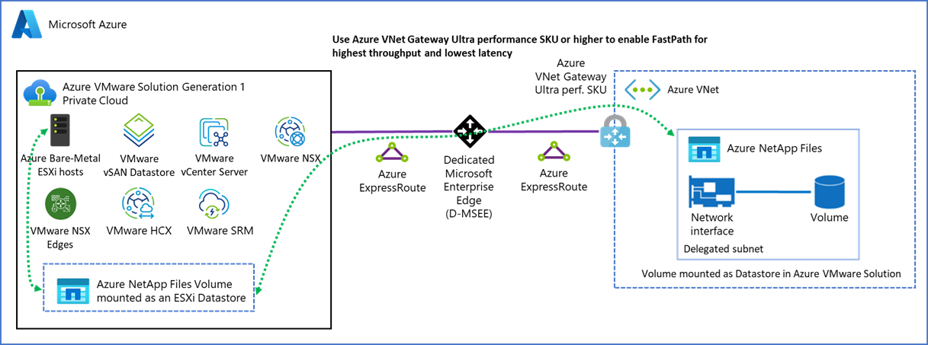
SECTION 2
Provisioning format and external storage
Default policy is RAID-1 FTT-1 and thin provisioned.
Verify the target storage policy and migration format rather than assuming thick provisioning. HCX lets you specify the destination format. Migrating many VMs with oversized empty disks can hit the 75 percent wall immediately.
External datastore options
Azure NetApp Files
NFS datastores
Azure Elastic SAN
iSCSI block storage, not NFS
Azure Native Pure Storage
Source: Microsoft Learn, attach Azure NetApp Files datastores to AVS hosts
Partner block storage integration
Latency caveat: storage traffic leaves AVS and returns. Placement, generation, protocol, gateway design, and availability-zone alignment all affect performance and cost.
Azure VMware Solution
13
Notes:
Gen 1 NetApp Files connectivity needs ExpressRoute through a virtual network. Gen 2 can use the same or a peered VNet. Ultra Performance gateway with FastPath is recommended for the 10 Gbps soft limit.

Slide 15
03
Network Foundation
The highest-risk domain. Addressing and routing decide whether the estate works.
Azure VMware Solution
14

Slide 16
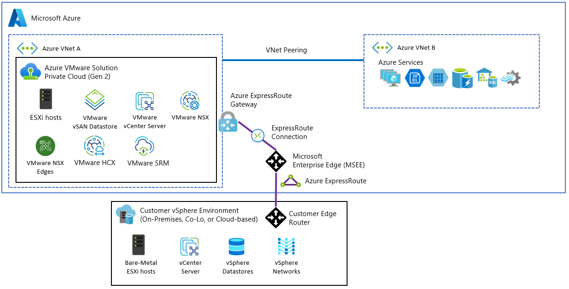
SECTION 3
Addressing and reserved NSX ranges
Generation 1 requires a /22
A non-overlapping private /22 block, giving 1,024 addresses, is subdivided for platform and host services.
HCX needs separately planned network profiles and appliance IP pools.
Generation 2 deploys inside an Azure virtual network with delegated subnets and a different addressing model.
Reserved ranges to avoid
169.254.0.0/24
Internal transit
Source: Microsoft Learn, Generation 2 private clouds
169.254.2.0/23
Inter-VRF transit
Failure condition: overlap causes routing ambiguity, dropped packets, black holes, or private cloud isolation. Advertising a reserved range can collide with NSX internal plumbing and create routing loops.
100.64.0.0/16
Internal T1 to T0 connectivity
Azure VMware Solution
15
Notes:
Correction: the second reserved range is 169.254.2.0/23, not 169.254.0.0/23. Gen 2 design docs also reserve 100.73.x.x for Microsoft management networking.

Slide 17
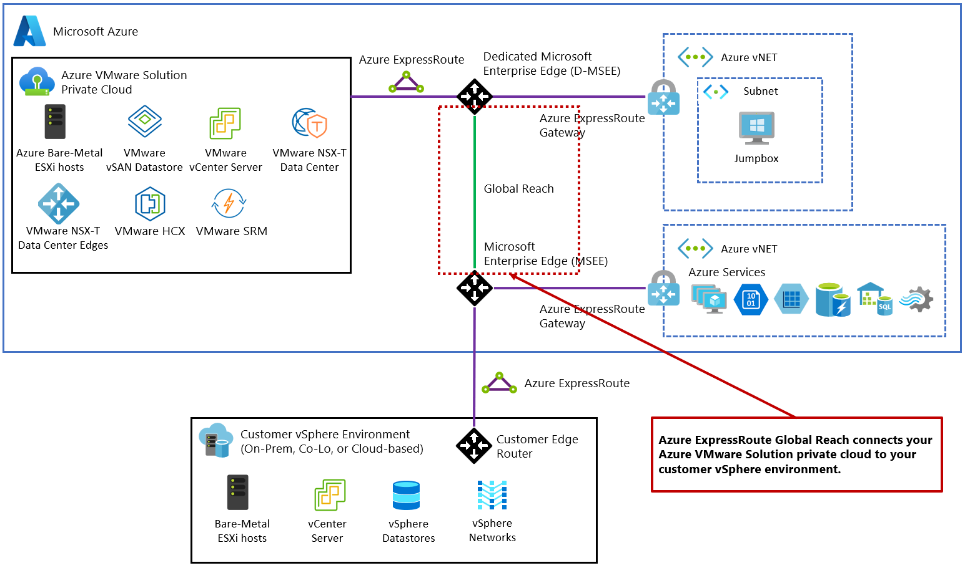
SECTION 3
ExpressRoute and Global Reach
Generation 1 circuit
Includes a Microsoft-managed ExpressRoute circuit for private cloud connectivity.
Global Reach
Connects the on-premises circuit to the Gen 1 AVS circuit at the Microsoft Edge.
Preferred path
Direct circuit-to-circuit connection rather than relying on an ExpressRoute gateway for transit.
Generation 2
Source: Microsoft Learn, peer on-premises environments to AVS
Attaches to an Azure virtual network and does not require ExpressRoute for native VNet connectivity.
Realized latency depends on circuit, peering, geography, and workload path. Global Reach avoids using a VNet gateway as a transit router.
Azure VMware Solution
16
Notes:
For the standard Gen 1 on-premises pattern, Global Reach is the connectivity design. Confirm the generation before quoting any topology.

Slide 18
SECTION 3
BGP route controls and the default route trap
Route hygiene
Advertising only 0.0.0.0/0 breaks admin access
ExpressRoute uses BGP to exchange prefixes between customer and Microsoft edge routers.
On-premises advertisements must comply with ExpressRoute route and prefix requirements. Filter invalid or unintended prefixes.
Route limits are architecture specific. Generation 2 documents a combined prefix and host-route limit of 1,000 in its internal routing architecture.
Azure Route Server and ExpressRoute gateways carry their own separately documented limits.
Summarize routes where the design safely permits and stay inside the limit for the architecture actually deployed.
Request
A user sends a request from on-premises to AVS vCenter.
Return path
vCenter may have no more specific route back to the user subnet.
Platform behavior
A single 0.0.0.0/0 route is discarded by the AVS management network to preserve service operation.
Fix
When advertising a default route, also advertise the more specific on-premises routes needed for AVS management access.
Azure VMware Solution
17
Notes:
The reviewed documentation does not confirm that a bogon advertisement automatically drops the session, or that 2,000 routes universally severs BGP. Present the requirement, not the folklore.

Slide 19
SECTION 3
Firewall ports and HCX tunnels
Purpose | Protocol and port
vCenter Server web access | TCP 443
NSX Manager web access | TCP 443
Active Directory / LDAP authentication | TCP 389, with TCP 636 recommended for LDAPS
Active Directory Global Catalog | TCP 3268, TCP 3269 for secure Global Catalog
HCX Cloud Manager appliance administration | TCP 9443
HCX Manager to Interconnect and Network Extension REST API | TCP 9443
HCX source-to-destination IPsec / IKEv2 tunnels | UDP 4500
HCX Network Extension provides Layer-2 extension across the IPsec interconnect between paired sites.
Blocking UDP 4500 prevents the required interconnect and network-extension tunnels from forming.
Azure VMware Solution
18
Notes:
Correction: documented LDAP ports are TCP 389 and 636. Microsoft recommends 636 for secure LDAP. Prepare these rules before anyone attempts administrative access or migration.

Slide 20
04
Identity and Control Plane
Two control planes, two attack surfaces, one break-glass account.
Azure VMware Solution
19

Slide 21
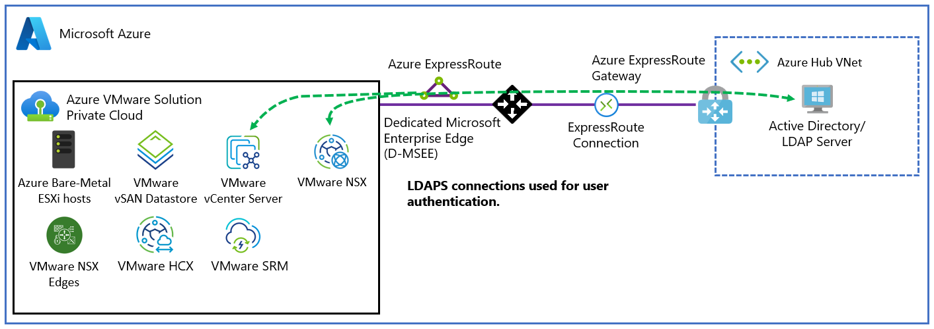
SECTION 4
Identity design and external authentication
Do not depend on the WAN for administration
Deploy resilient AD DS and DNS reachable from AVS, commonly including Azure-resident domain controllers.
Relying only on on-premises controllers makes authentication depend on ExpressRoute.
If the circuit fails, workloads keep running but administrators may be unable to sign in to vCenter or NSX.
Configure AD Sites and Services and DNS so AVS uses an appropriate reachable controller.
Add Active Directory over LDAPS as the external vCenter identity source. TLS protects directory traffic in transit.
Use named AD identities and groups, then assign vCenter and NSX roles by least privilege.
Source: Microsoft Learn, set an external identity source for vCenter Server
Design goal
Local AVS administration should remain possible even when the on-premises connection is down. Test that assumption before go-live rather than discovering it during an outage.
Azure VMware Solution
20
Notes:
Microsoft documents the need for connected AD and DNS resolution but does not mandate a dedicated identity subscription or specific controller placement. Adapt to the customer identity model.

Slide 22
SECTION 4
CloudAdmin as break-glass, not a daily account
Handling cloudadmin@vsphere.local
Custom vCenter RBAC
Use it initially to configure LDAPS and grant named accounts the rights they need.
Store the credential in an enterprise secrets vault with controlled access and auditing.
Rotate after emergency use or suspected exposure, after checking dependent services.
Identify dependencies before rotation. If a script or service account locks out CloudAdmin, top-tier access may be lost.
Administrators operate within CloudAdmin privileges and cannot manage Microsoft-controlled platform objects.
vCenter rejects role creation if the role includes privileges higher than CloudAdmin holds.
Build least-privilege roles from the available permissions and test them on noncritical objects first.
Example: a tier-one support role allowing VM reboot and console access while denying datastore deletion and segment changes.
Azure VMware Solution
21
Notes:
Microsoft documents role assignment but does not prescribe cloning CloudAdmin as the only method. Least privilege is the goal, not a specific technique.

Slide 23
SECTION 4
Azure control plane security and PIM
Azure plane
VMware plane
Azure Resource Manager controls the AVS resource lifecycle, including deployment, scaling, and destructive cluster operations.
vCenter Server and NSX Manager control permitted workload compute, storage policy, networking, and security operations.
Privileged Identity Management
Eligible users activate roles when needed. PIM supports just-in-time, time-bound, approval-based access with MFA, justification, notifications, and audit history. Role settings can require approval, MFA, justification, a maximum activation duration, and notifications.
Correction: alerting does not need a standing privileged identity
Azure Monitor, Service Health, and Resource Health alerts do not require a human administrator to hold an active PIM role at the time of the event. Route notifications through action groups, distribution lists, webhooks, ITSM connectors, or a pager workflow instead of creating standing permissions for SMTP delivery.
Azure VMware Solution
22
Notes:
A compromise in either control plane can affect the private cloud. Design notification endpoints as nonhuman integrations, not privileged alert receiver accounts.

Slide 24
05
Migration and Resilience
HCX design, the AV64 EVC trap, backup, DR, and stretched clusters.
Azure VMware Solution
23

Slide 25
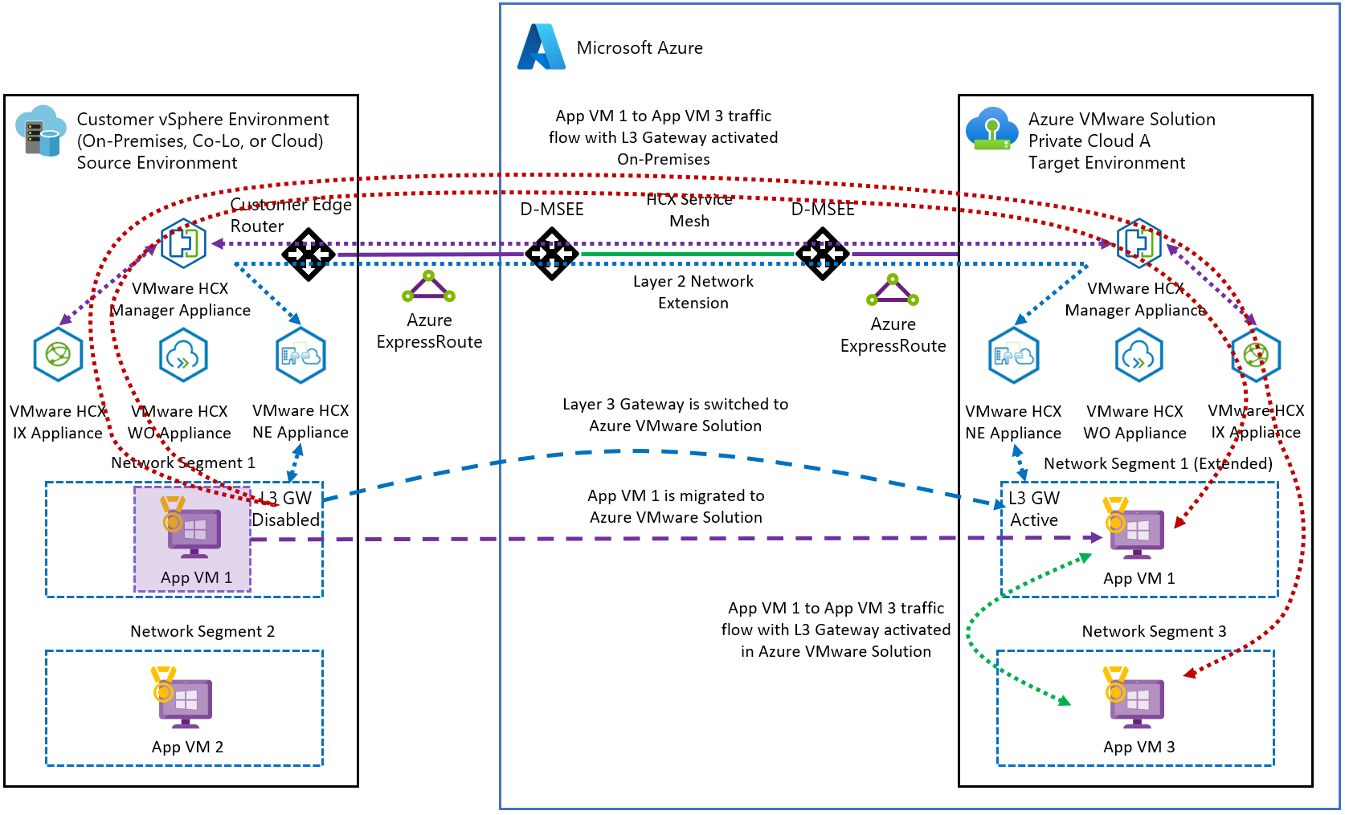
SECTION 5
HCX migration design and Mobility Optimized Networking
Migration direction
The on-premises HCX Connector pairs with HCX Cloud Manager in AVS and deploys paired service-mesh appliances. In the standard Connector-to-Cloud topology the Connector is the source for mobility and network extension. Do not initiate bulk migrations from the cloud-side appliance.
Why MON matters
Without MON, cloud-based VMs may route traffic back to an on-premises gateway and then return to Azure. That tromboning adds latency and reduces application performance. Properly configured MON keeps eligible destination-site traffic local.
Source: Microsoft Learn, HCX Mobility Optimized Networking guidance
Validate scale figures before design approval. Transcript-stated MON limits of roughly 400 VMs on a standard appliance, 1,000 on a large appliance, 100 stretched networks, and a 500 Mbps WAN optimization trigger were not confirmed in current documentation. Check the Broadcom configuration maximums for the exact HCX version.
Azure VMware Solution
24
Notes:
Large estates may need phased network migration and gateway retirement. WAN Optimization provides deduplication and compression, selected on measured bandwidth and latency.

Slide 26
SECTION 5
The AV64 heterogeneous CPU and EVC trap
In Generation 1, adding an Ice Lake AV64 cluster to a private cloud seeded by AV36, AV36P, AV48, or AV52 creates a heterogeneous CPU environment with documented EVC implications.
Forward motion works
Backward motion is the risk
Microsoft documents that live vMotion from a base-SKU cluster to an AV64 cluster succeeds in the described EVC scenario.
A powered-on VM exposed to newer CPU features might not be live-migratable back to an older baseline. EVC blocks the move because the target cannot supply the instructions the VM has already seen.
Approach | Description | Operational impact
Reactive cold migration | Power off the VM, move it, and boot it on the older host. | Requires downtime and is unacceptable for many tier-one workloads.
Proactive VM-level EVC | Configure per-VM EVC before migration to mask newer CPU features. | Enables bidirectional live vMotion across heterogeneous clusters.
Azure VMware Solution
25
Notes:
Rule: configure per-VM EVC to a baseline supported by all intended source and destination hosts before the VM is exposed to newer CPU features. Otherwise AV64 becomes a place VMs check in but cannot check out of without downtime.

Slide 27
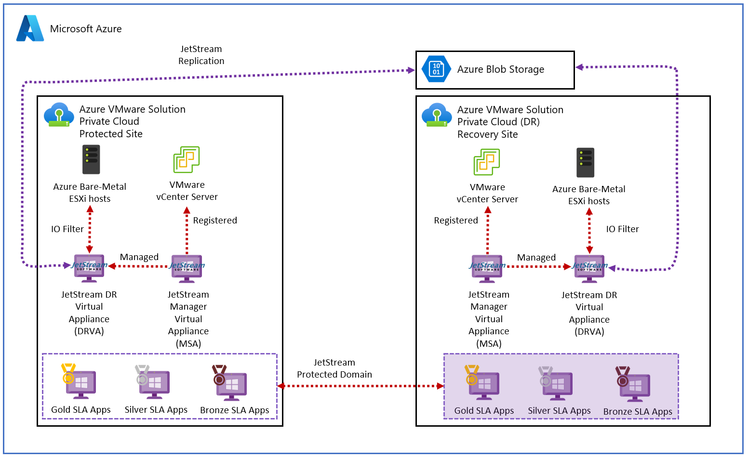
SECTION 5
Backup placement and disaster recovery
Keep backups off the workload datastore
vSAN is high-performance NVMe capacity intended for active workloads.
Large backup files can push the datastore past the 75 percent threshold.
Use Azure Blob-backed protection or an external datastore, based on the vendor AVS design.
DR approach | Use case
Azure Site Recovery | Fail VMware workloads into native Azure IaaS virtual machines.
VMware Site Recovery Manager | Fail VMware workloads to a secondary AVS private cloud.
Zerto or JetStream | Third-party VMware-to-VMware replication options.
Source: Microsoft Learn, deploy disaster recovery using JetStream DR
Use non-overlapping routed address spaces between connected private clouds. Overlap is rejected by supported interconnect workflows. Example: 10.0.0.0/16 primary, 192.168.0.0/16 secondary.
Azure VMware Solution
26
Notes:
Microsoft documents supported VADP backup solutions and external storage but does not phrase backup placement as an absolute prohibition. Present it as a failure-domain recommendation.

Slide 28
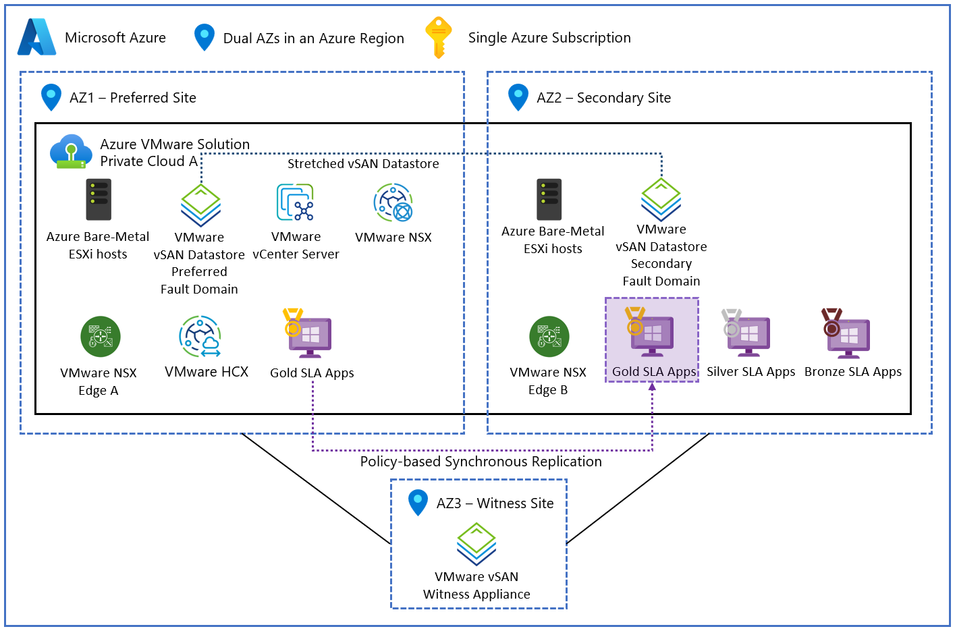
SECTION 5
Stretched clusters and vSAN witness behavior
6
hosts minimum, three per data availability zone
16
hosts maximum, scaled in and out in pairs
3rd
availability zone holds the Microsoft-managed witness
Availability, not disaster recovery
Source: Microsoft Learn, design vSAN stretched clusters
A stretched cluster spans two zones in one region with a single management plane. It does not replace regional DR. Design redundant connectivity so the surviving zone keeps required on-premises reachability.
If one data zone fails, the surviving zone plus witness maintain quorum. The exact list of blocked repair and rebalance operations during a witness-only outage was not confirmed in current documentation.
Azure VMware Solution
27
Notes:
The transcript claim that two customer ExpressRoute circuits and two Global Reach connections are universally required is not stated in the reviewed design article. Design for surviving-zone reachability instead.

Slide 29
SECTION 5
AV64 fault domains and the scale-down trap
How the balance rule works
Scale-down procedure
A fault domain represents physical separation such as server racks.
Microsoft documents five or seven fault domains depending on region and deployment context.
Scale-out spreads AV64 hosts across available fault domains to maintain balance.
1
Open the vSphere client.
2
Inspect the vSAN cluster fault-domain layout.
3
Identify the most populated fault domain.
HTTP 409 Conflict
4
Select a host from that domain for removal.
A removal request is checked for resulting fault-domain imbalance. If the difference between the most and least populated domains would exceed one, the request is rejected.
5
Submit the request only for a host that preserves balance.
Azure VMware Solution
28
Notes:
Check the current region mapping table during design. Fault-domain counts vary by region.

Slide 30
06
Day-Two Operations
Patching windows, governance, scaling limits, and alert thresholds.
Azure VMware Solution
29

Slide 31
SECTION 6
Microsoft-managed patching and maintenance windows
What Microsoft does
What breaks temporarily
What you must not do
Applies patches, updates, and upgrades to ESXi, vCenter Server, vSAN, and NSX.
Uses host maintenance mode and vMotion, upgrading hosts sequentially.
Avoids workload impact when cluster capacity and VM constraints permit.
During vCenter maintenance, vCenter is unavailable.
During NSX maintenance, management access or configuration can be blocked.
Workloads continue running throughout.
Avoid scaling and provisioning during the maintenance window.
Avoid network changes and HCX configuration changes.
Do not start migrations. Pause automated provisioning scripts.
Workloads stay online like tenants remaining in an apartment building, but management actions are blocked while maintenance is underway. Plan change freezes around the documented window.
Azure VMware Solution
30
Notes:
The management plane lock is the part clients forget. Build it into the change calendar.

Slide 32
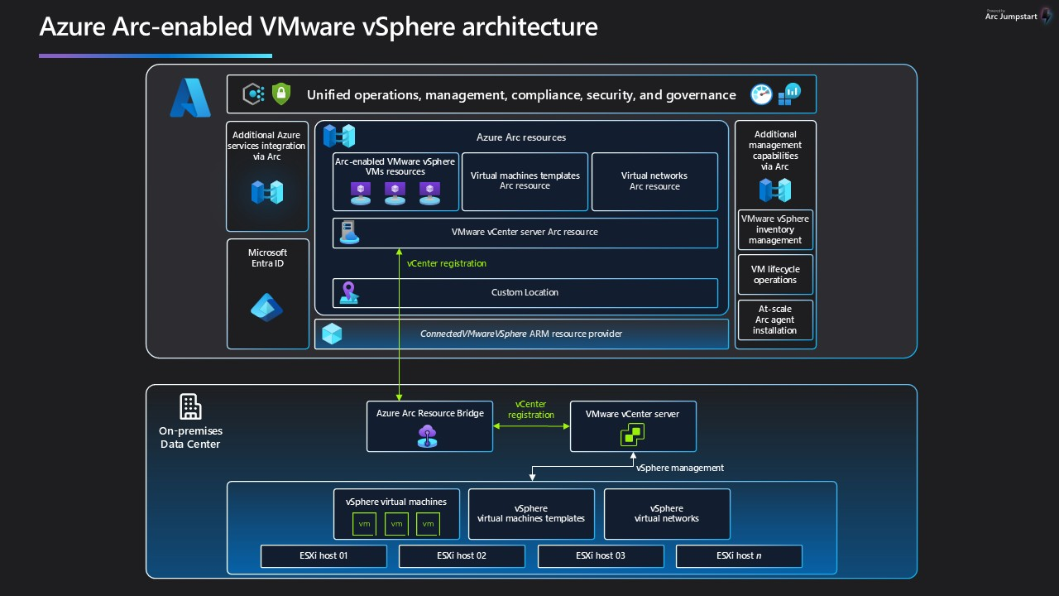
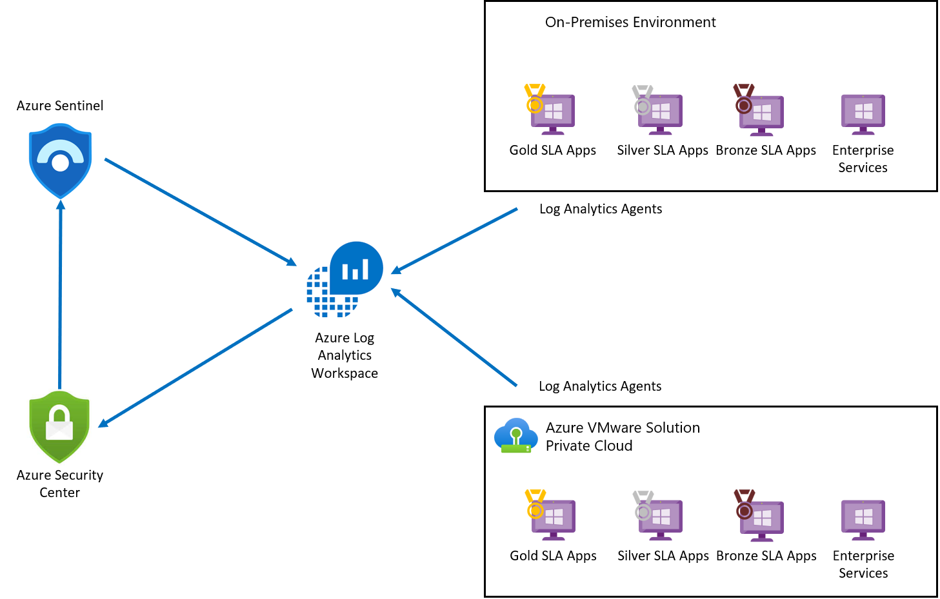
SECTION 6
Governance and security tooling
Azure Arc-enabled VMware vSphere
Defender for Cloud integration
Registers vCenter inventory with Azure. Guest management installs the Connected Machine agent so Azure services can govern, monitor, patch, and secure selected VMs.
Microsoft Defender for Cloud can assess and protect AVS VMs, commonly through Azure Arc and Azure monitoring and security agents.
Source: Microsoft Learn, Azure Arc-enabled VMware vSphere
Source: Microsoft Learn, integrate Defender for Cloud with AVS
vDefend: revalidate before licensing. Add-on firewall capabilities require customer-provided Broadcom licensing. Microsoft lists unsupported capabilities including Security Intelligence, Malicious IP Filtering, Distributed Malware Detection and Prevention, Cloud Sandboxing, Network Detection and Response, and Gateway Malware Detection.
Azure VMware Solution
31
Notes:
Check the vDefend support matrix immediately before licensing or architecture approval. Capabilities depend on both AVS platform support and Broadcom entitlement.

Slide 33
SECTION 6
Automated scaling and alert thresholds
Scaling automation
Monitoring stack
Scaling can be automated through Azure APIs and orchestration, but must respect quota, cluster limits, and maintenance states.
Treat scale operations as long running and serialize them unless Microsoft Support confirms safe concurrency.
Queue and monitor operations, handle conflict and throttling responses, and verify completion before dependent changes.
Use idempotency, state checks, retry with backoff, and hard capacity limits.
Set a hard maximum so a runaway script cannot order excessive bare-metal hosts.
Azure Monitor, Log Analytics, Resource Health, Service Health, vCenter and vSAN monitoring, and guest-level monitoring. AMBA gives a structured baseline-alert approach to customize for AVS, connected services, and guest VMs.
Alert before the wall, not at it
70 percent
A reasonable vSAN planning threshold, giving time to migrate data or add hosts before the documented 75 percent ceiling. It is a planning value, not a Microsoft mandate.
Azure VMware Solution
32
Notes:
A sustained cluster CPU threshold such as 80 percent is a useful starting point, but Microsoft does not publish it as a universal requirement. Tune to workload patterns, HA reserve, and scaling lead time.

Slide 34
REFERENCE
Corrections and claims to verify
Carry these into the design review. The left column corrects common misstatements. The right column lists claims that current documentation did not confirm.
Material corrections
Not confirmed in reviewed documentation
Limits are 12 clusters, 16 hosts per cluster, and 96 hosts per private cloud. Do not multiply to 192.
LDAP uses TCP 389 and LDAPS uses TCP 636.
The reserved NSX range is 169.254.2.0/23.
The default vSAN datastore policy is RAID-1 FTT-1 and thin provisioned.
Azure Elastic SAN is iSCSI block storage, not NFS.
AV36 is Skylake, AV36P and AV52 are Cascade Lake, AV48 is Sapphire Rapids, AV64 is Ice Lake.
HCX MON limits of 400 and 1,000 VMs, and 100 stretched networks.
The 500 Mbps WAN optimization trigger.
A required standing privileged identity with SMTP for infrastructure alerts.
Detailed vSAN witness-only outage restrictions.
A private-cloud-wide single concurrent scale operation limit.
That a bogon advertisement automatically drops the BGP session.
Azure VMware Solution
33
Notes:
Also note the generation distinction: Gen 1 uses the AVS-managed ExpressRoute attachment and a /22 management block. Gen 2 deploys into an Azure VNet with delegated subnets and needs no seed cluster.

Slide 35
ARCHITECTURE SUMMARY
Design the pieces together, or they fail together
Capacity
Connectivity
Identity
Quota lead time, fixed management reservation, HA reserve, and the 75 percent vSAN ceiling.
Non-overlapping addressing, Global Reach or VNet attachment, controlled BGP, and open ports.
Reachable AD DS and DNS, LDAPS, named accounts, least privilege, CloudAdmin as break-glass.
Migration
Resilience
Operations
Connector-to-Cloud direction, MON for local routing, per-VM EVC before AV64 exposure.
Backups off vSAN, non-overlapping DR address space, stretched clusters for zone failure.
Microsoft patching windows, Arc and Defender governance, serialized scaling, early alerts.
Success depends on capacity reservations, storage policy, IP addressing, routing, identity, and lifecycle operations being designed as one system.
Azure VMware Solution
34
Notes:
Close on the interdependence. Any one of these designed in isolation becomes the constraint that limits the others.

