Slide 1
AZURE INFRASTRUCTURE | ARCHITECTURE BRIEFING
Azure VMware Solution
Generation 1 vs. Generation 2
Architecture, networking, migration, resilience, and operational constraints
Prepared for infrastructure architecture, network, and migration planning teams.
All platform limits and specifications require validation against current Microsoft documentation.
Notes:
Objective of this briefing: establish that the Gen 1 / Gen 2 decision is an architecture decision, not a hardware refresh. Every claim traceable to Microsoft Learn is cited in the source guide; items flagged for validation are marked throughout.

Slide 2
CONTENTS
What this briefing covers
01
02
03
Architectural decision
Hardware and storage
Networking
Why the generation choice drives hardware, network, and resilience design.
Host profiles, AV64 characteristics, and the vSAN OSA to ESA shift.
Gen 1 ExpressRoute adjacency versus Gen 2 VNet injection and route limits.
04
05
06
Migration
Resilience
Decision framework
HCX Mobility Optimized Networking, route budgets, and data-transfer performance.
Stretched clusters, fault domains, and cross-region disaster recovery.
Conditions favoring each generation, plus preselection calculations.
Azure VMware Solution: Generation 1 vs. Generation 2
1
Notes:
Six sections. Sections 3 and 4 carry the highest project risk: route scale and migration sequencing are where Gen 2 deployments most often fail late.

Slide 3
1. PURPOSE
Why organizations select AVS
AVS runs a VMware software-defined data center on dedicated bare-metal hardware inside Azure data centers. It is positioned for enterprises with large VMware estates, legacy applications, and fragile network dependencies.
AVS lift-and-shift path
Conventional cloud-native migration
Dedicated bare-metal servers running a VMware stack comparable to the existing estate.
vSphere, vSAN, and NSX remain the core technologies.
Virtual machines move without first rewriting applications for native cloud platforms.
Operations teams continue to manage workloads through vCenter and familiar VMware tooling.
Existing network dependencies can be preserved temporarily through network-extension tools.
Application refactoring, code changes, and microservices adoption.
Extensive retesting and changes to network dependencies.
For estates of thousands of VMs and decades of legacy code, a potentially multiyear and multimillion-dollar undertaking.
AVS is intended to bypass much of that application-level reengineering.
Takeaway AVS reduces application transformation work. It does not eliminate infrastructure architecture; it relocates that architecture into a managed environment with specific constraints.
1. Purpose and architectural decision
2
Notes:
Use this slide to reset expectations with application owners. The migration avoids code change, not design work.

Slide 4
1. PURPOSE
A structural redesign, not a product upgrade
Generation 1
Generation 2
Original AVS architecture
Structural redesign of the platform
Isolated VMware environment connected to Azure networking through Microsoft-managed ExpressRoute infrastructure.
Supports several host profiles (AV36, AV36P, AV52, AV48).
Greater flexibility for complex routing designs.
Supports multi-zone stretched-cluster topologies.
Host placement across racks is managed by Azure and largely hidden from the customer.
The AVS private cloud is injected directly into an Azure virtual network.
Tied to the AV64 hardware profile and Azure Boost architecture.
Direct Azure integration, with vSAN Express Storage Architecture.
Subject to Azure-native networking limits and placement constraints.
Explicit vSAN fault domains replace hidden rack placement.
Analogy
Generation 1 is a secure private estate in the country that needs a dedicated highway to reach the city. Generation 2 places the same estate inside the city grid: services are immediately accessible, but zoning laws and traffic limits become mandatory.
1. Purpose and architectural decision
3
Notes:
The key framing sentence: the selected generation determines hardware platform, storage architecture, connectivity model, route-scale limits, migration behavior, availability design, security integration, and operational procedures.

Slide 5
1. PURPOSE
High-level comparison
Design area | Generation 1 | Generation 2
Azure integration | Logically isolated from Azure virtual networks | Injected directly into an Azure virtual network
Primary internal connectivity | Microsoft-managed ExpressRoute | Native VNet connectivity and VNet peering
Hardware flexibility | Multiple host profiles | Tied to AV64
Storage architecture | Primarily vSAN OSA; AV48 uses ESA | vSAN Express Storage Architecture
Route-scale exposure | ExpressRoute and NSX routing model | Azure VNet and T0 NIC route limits
Multi-zone stretched cluster | Supported for specified Gen 1 profiles | Not supported in the source material
Local rack resilience | Managed placement largely hidden from the customer | Explicit vSAN fault domains
Deployment mobility | Loosely coupled compared with Generation 2 | Private cloud and host VNet permanently associated
Primary advantage | Established routing flexibility and multi-zone resilience | Native Azure integration and high-performance hardware
Primary risk | Connectivity complexity and ExpressRoute overhead | Rigid route, placement, and operational constraints
Takeaway Generation 2 should not be selected because its hardware is newer. Match the generation to application performance, network scale, migration method, availability requirements, and governance.
1. Purpose and architectural decision
4
Notes:
Walk the two bottom rows first: primary advantage and primary risk. Those two rows drive most client decisions.

Slide 6
2. OPERATING MODEL
What stays the same, and what does not
Bare-metal deployment
The VMware hypervisor is installed on dedicated physical servers, not nested inside ordinary Azure virtual machines.
1
Operational continuity
The environment appears as another VMware cluster managed through vCenter. Workloads move using VMware mobility technologies rather than format conversion.
2
Application continuity
A VM continues running its existing operating system and application stack after migration. No inherent code rewrite is required.
3
Architectural consequence
Physical host characteristics, vSAN behavior, network routes, failure domains, and CPU compatibility all still require design attention.
4
Takeaway AVS shifts infrastructure architecture into a managed environment with defined hardware and software-defined constraints. It does not remove the need for that architecture.
2. AVS operating model
5
Notes:
This slide answers the most common client question: what does my team actually have to do differently on day two?

Slide 7
02
Hardware and storage
Host profiles determine available CPU, memory, storage architecture, and workload density. Generation 1 supports multiple hardware generations; Generation 2 is tied to AV64 and vSAN Express Storage Architecture.
Section
6
Notes:
Transition: the hardware conversation is where cost sensitivity usually surfaces.

Slide 8
3. HARDWARE PROFILES
Host profiles and compute characteristics
Host | Processor and cores | Memory | vSAN | Local storage | Positioning
AV36 | 2x Xeon Gold 6140 (Skylake), 36 physical / 72 logical | 576 GB | OSA | 3.2 TB NVMe cache; 15.20 TB SSD capacity | Established general-purpose Gen 1 host
AV36P | 2x Xeon Gold 6240 (Cascade Lake), 36 physical / 72 logical | 768 GB | OSA | 1.5 TB Intel cache; 19.20 TB NVMe capacity | Memory- and storage-oriented Gen 1 host
AV52 | 2x Xeon Platinum 8270 (Cascade Lake), 52 physical / 104 logical | 1,536 GB | OSA | 1.5 TB Intel cache; 38.40 TB NVMe capacity | Memory-intensive workloads
AV48 | 2x Xeon Gold 6442Y (Sapphire Rapids), 48 physical / 96 logical | 1,024 GB | ESA | No dedicated cache tier; 25.6 TB NVMe capacity | Newer Gen 1 ESA platform
AV64 | 2x Xeon Platinum 8370C (Ice Lake), 64 physical / 128 logical | 1,024 GB | OSA (Gen 1 expansion) / ESA (Gen 2) | 3.84 TB cache + 15.36 TB (OSA); 19.25 TB (ESA) | Generation 2 compute and storage platform
Microsoft documents 100-Gbps network-interface throughput for all listed AVS host types.
Validate: Specifications, regional availability, and generation assignments change over time. Confirm all host-profile values before procurement.
3. Hardware profiles and compute characteristics
7
Notes:
Note AV48 is the Gen 1 host that already uses ESA. That matters: ESA is not exclusively a Gen 2 feature.

Slide 9
3.3 AV64
The Generation 2 host at a glance
64
1 TB
19.25 TB
100 Gbps
Physical cores per node
(128 logical with hyper-threading)
RAM per node
NVMe capacity, Gen 2 ESA
(no separate cache tier)
Network-interface throughput
Processor and storage detail
Dual Intel Xeon Platinum 8370C processors based on the Ice Lake architecture.
Two documented storage layouts: 15.36 TB NVMe capacity with a 3.84 TB NVMe cache for OSA, and 19.25 TB NVMe capacity with no separate cache tier for Gen 2 ESA.
Generation dependency: the commercial consequence
Microsoft documents Gen 2 private clouds as using the AV64 SKU and a virtual-network attachment model.
Generation 2 networking cannot be applied to an AV36 or other lower-cost Generation 1 node.
An organization must purchase AV64 capacity even when its workloads do not need the full processor, memory, storage, or network capability.
3.3 AV64 Generation 2 host
8
Notes:
The last bullet is the one finance stakeholders react to. Gen 2 networking is only available with the premium host.

Slide 10
3.4 WORKLOAD FIT
Where AV64 earns its cost, and where it does not
+
Strong AV64 candidates
!
Likely overprovisioning
Highly transactional SQL databases.
Latency-sensitive trading or analytics platforms.
Applications with large east-west traffic volumes.
Large virtual desktop infrastructure deployments.
Workloads with sustained high storage I/O requirements.
Standard domain controllers and legacy file servers.
Ordinary intranet applications.
Low-intensity line-of-business systems.
In these cases the organization pays for processing and storage capability its applications cannot consume.
A lower-cost Generation 1 host provides a better cost-to-performance ratio.
Worked example: VDI boot storm
A virtual desktop environment in which 5,000 users start desktops at 8:00 a.m. creates a concentrated burst of read and write operations. An OSA cache tier could become saturated under this pattern. AV64 with NVMe and ESA is better able to absorb the burst.
Takeaway Generation 2 is a fixed premium platform. Its value depends on whether the workload can use the performance and whether the hardware can be obtained in the required region.
3.4 Workload fit
9
Notes:
The boot-storm example is the clearest illustration of why the storage architecture, not the core count, is often the deciding factor.

Slide 11
3.5 CAPACITY AND QUOTA
AV64 availability is a schedule dependency
Regional dependency
AV64 capacity must exist in the target Azure region. Regional and availability-zone support is published in a current host-type mapping table and changes over time.
1
Quota dependency
Microsoft quota approval must be obtained before relying on AV64 capacity. This is a lead-time item, not a deployment-day task.
2
Supply-chain risk
Hardware availability may not match Generation 1's geographic footprint. Treat regional coverage as a live question at every design review.
3
Operational recommendation
Confirm region support, physical capacity, quota approval, required node count, and procurement lead time before making AV64 a dependency in a migration schedule.
3.5 Regional capacity and quota
10
Notes:
Escalate this early. A quota delay on AV64 can move an entire migration wave by a quarter.

Slide 12
4.1 VSAN OSA
Original Storage Architecture: cache and destage
OSA organizes physical devices into disk groups. Each disk group contains a cache tier and a capacity tier.
Write path
Why the design exists, and where it strains
1
A virtual machine issues a storage write.
The cache tier compensated for slower capacity media, including designs originating when spinning disks were common.
The hypervisor must manage disk groups, decide when to destage, and move data between tiers.
If incoming writes fill the cache faster than vSAN can destage them, performance can decline sharply.
2
The write enters a high-speed cache device.
3
vSAN acknowledges the protected write.
4
vSAN later destages the data from cache into the capacity devices.
Workloads that expose the limitation
Large database operations • Bulk data ingestion • Large migration waves • VDI boot storms • Any workload with sustained writes rather than short bursts
Takeaway The cache tier is a fast lobby. Data enters quickly, but congestion develops when arrivals exceed the rate at which data can be moved into long-term rooms.
4. vSAN storage architecture
11
Notes:
Destaging is the mechanism to explain. Most sustained-write performance complaints on OSA trace back to it.

Slide 13
4.2 VSAN ESA
Express Storage Architecture: a single NVMe tier
ESA removes the traditional disk-group and dedicated cache-tier structure. Data is written directly to the NVMe capacity pool.
1
Single-tier behavior
2
Media dependency
3
Connection architecture
Data is written directly to the NVMe capacity pool. There is no separate cache device to fill and drain.
Modern NVMe devices have low enough latency and high enough throughput that a separate cache device would add unnecessary overhead.
NVMe devices connect directly through the PCI bus rather than relying on traditional legacy storage-controller paths.
CPU benefit
Performance benefit
ESA eliminates much of the processing associated with cache management and destaging, returning that capacity to workloads.
The design is positioned for workloads requiring high throughput and low latency, including sustained write patterns.
Takeaway AV64's value is not limited to additional CPU cores. ESA changes the storage path and removes the cache-destaging behavior that constrains sustained write-heavy workloads.
4. vSAN storage architecture
12
Notes:
Note the bottleneck does not disappear; it moves to other system components.

Slide 14
4.3 COMPARISON
vSAN OSA and ESA side by side
Characteristic | vSAN OSA | vSAN ESA
Device organization | Disk groups | Single storage pool
Cache tier | Dedicated cache device | No separate cache tier
Capacity tier | Separate capacity devices | Direct NVMe capacity
Write behavior | Write to cache, then destage | Write directly to NVMe pool
Main historical advantage | Masks slower capacity media | Optimized for modern NVMe
Main processing overhead | Cache management and destaging | Reduced cache-management overhead
Congestion risk | Cache fills faster than destaging | Bottleneck moves to other system components
Associated hosts | AV36, AV36P, AV52 | AV48 and AV64 Generation 2
Validate: Confirm exact storage capacities, disk layouts, supported storage architectures, and host-generation associations in current product documentation.
4.3 OSA and ESA comparison
13
Notes:
Useful handout slide for storage teams.

Slide 15
03
Networking
Generation 1 places the private cloud adjacent to Azure and connects it through ExpressRoute. Generation 2 injects the private cloud into an Azure virtual network and inherits Azure-native route limits.
Section
14
Notes:
This is the section that most often changes the recommendation.

Slide 16
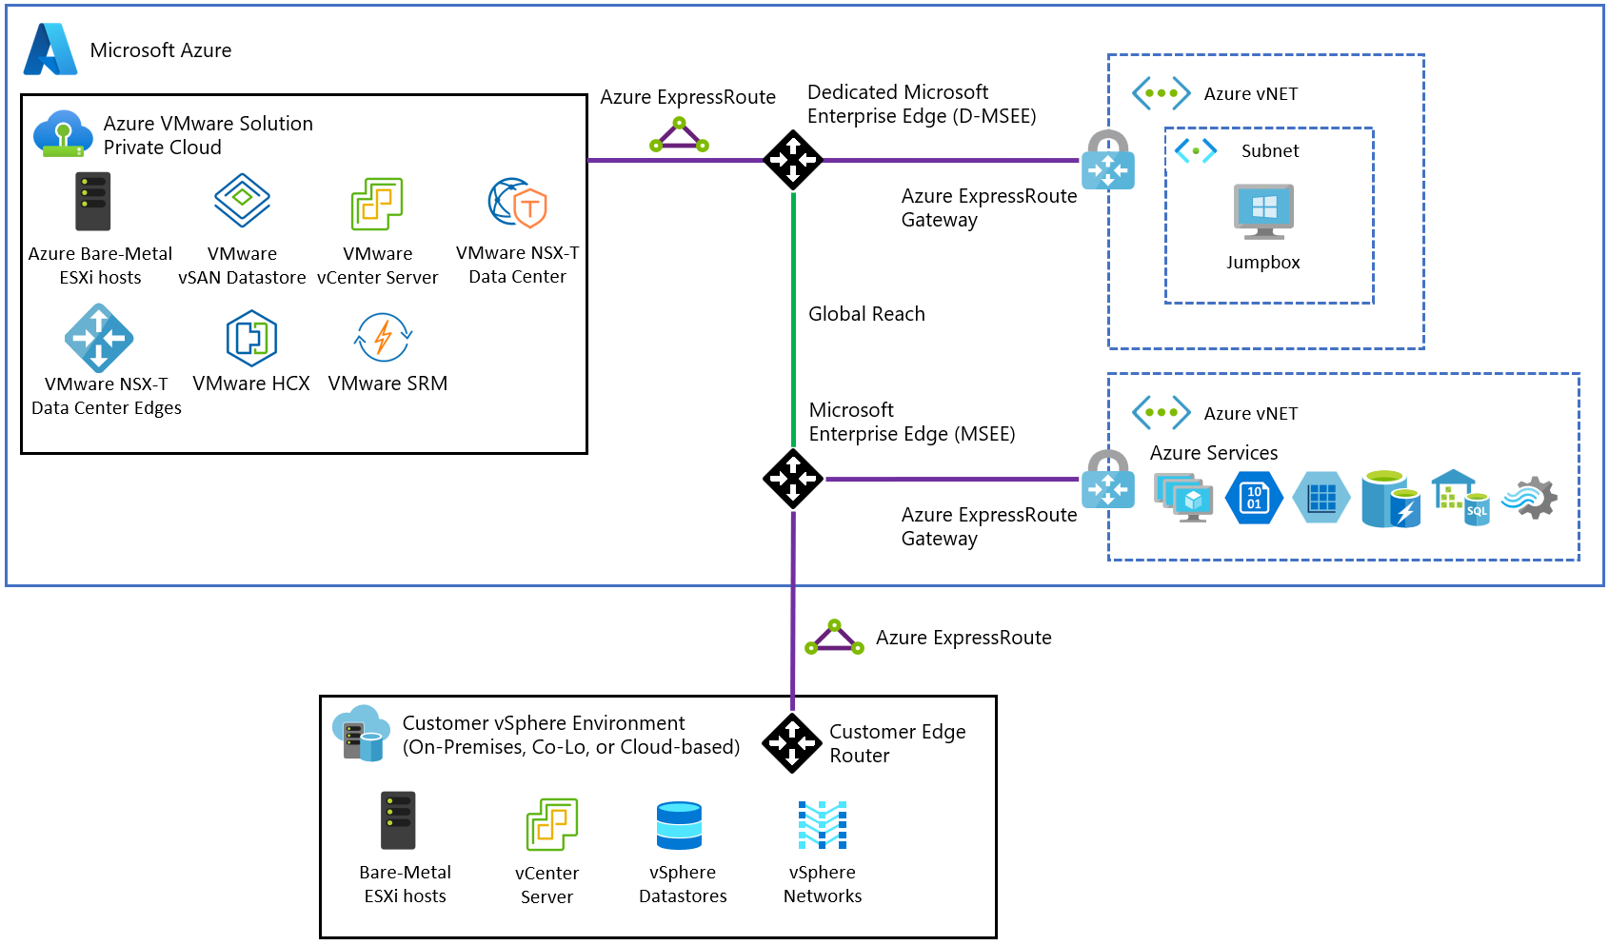
5. GENERATION 1 CONNECTIVITY
ExpressRoute adjacency
Connectivity model
The AVS private cloud and Azure virtual networks do not occupy the same routing domain.
Communication between Gen 1 AVS and Azure VNets uses ExpressRoute.
ExpressRoute Global Reach connects AVS with on-premises networks.
BGP exchanges routes between the domains.
Components in the path
Microsoft Enterprise Edge devices
ExpressRoute gateways
Gateway subnets
BGP peering sessions
Firewalls and port rules
Source: Microsoft Learn, Azure VMware Solution networking and interconnectivity concepts
Takeaway Generation 1 keeps AVS logically separate from Azure VNets. Every internal Azure conversation crosses a perimeter designed to join two routing domains.
5. Generation 1 connectivity architecture
15
Notes:
Point out that the ExpressRoute here is Microsoft-managed for the AVS side; the customer still owns gateway and BGP configuration on the Azure side.

Slide 17
5.2 PACKET PATH
A web server in AVS querying Azure SQL
Hop sequence
!
Consequences
1
The packet leaves the VMware NSX network.
Hairpin behavior: even when hosts and services are physically close, logical separation forces traffic across ExpressRoute.
Additional hops can increase latency.
Gateway and BGP configuration create operational complexity and multiple points of misconfiguration.
ExpressRoute gateway SKUs introduce additional cost.
2
It enters the ExpressRoute connectivity path.
3
It reaches Microsoft Enterprise Edge routing infrastructure.
4
It is routed into the Azure virtual network.
5
It reaches the Azure SQL service.
+
Generation 1 strengths
6
The response follows the reverse path.
ExpressRoute is robust, mature, and suitable for enterprise connectivity.
Architects retain a routing model less constrained by Gen 2 VNet-injection mechanics.
Enterprises with mature ExpressRoute, firewall, and BGP architectures may avoid a large redesign.
Takeaway Generation 1 adds connectivity overhead, but the separation is valuable when an organization needs established ExpressRoute behavior or complex enterprise routing.
5. Generation 1 connectivity architecture
16
Notes:
The hairpin is the operative concept: internal cloud traffic depends on a perimeter.

Slide 18
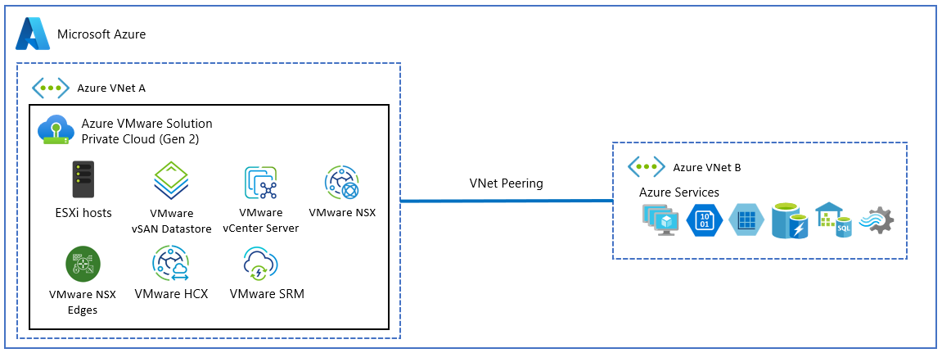
6. GENERATION 2
VNet injection replaces the ExpressRoute path
Operational benefits
Reduced ExpressRoute plumbing.
Fewer customer-managed BGP peering sessions.
Simpler routing tables.
Potentially lower latency to Azure-native services.
Avoids ExpressRoute gateway compute costs for applicable internal traffic.
Source: Microsoft Learn, Connectivity to an Azure Virtual Network
Security and platform integration
How the model changes
Workloads participate more directly in Azure-native networking and security services.
Customer-managed NSGs apply to documented delegated Gen 2 subnets; Azure applies system-managed NSGs to critical management interfaces.
Azure private DNS resolution integrates more directly.
The AVS private cloud is injected into an Azure virtual network.
ExpressRoute is no longer required for communication with native Azure services in connected VNets.
Standard VNet peering connects the AVS host VNet to other Azure VNets.
Packets traverse the Azure SDN backbone directly rather than hairpinning through a gateway.
Takeaway VNet injection reduces connectivity plumbing but transfers architectural control to Azure-native network behavior.
6. Generation 2 VNet injection
17
Notes:
The simplification is real. The cost is that route limits, deployment permanence, and managed security behavior now apply.

Slide 19
6.3 ADDRESS SPACE
A minimum /22, subdivided by Azure
/22
How the block is used
Azure divides the block into read-only management and infrastructure subnets.
The customer cannot modify these managed subnets.
The managed gateway subnets translate between the VMware NSX overlay and the Azure underlay, carrying traffic between encapsulated VMware segments and Azure VNet resources.
Minimum CIDR block required for a Gen 2 private cloud, containing 1,024 IP addresses.
Documented system-created subnets
avs-mgmt
Fronts management appliances including vCenter Server, NSX Manager, and HCX Cloud Manager.
esx-vmotion-vmk2
Carries vMotion VMkernel traffic.
avs-nsx-gw / avs-nsx-gw-1
Handle outbound traffic from AVS to the VNet and beyond.
avs-network-infra-gw
Handles inbound traffic to NSX workloads; carries NSX segment prefixes as secondary IP configurations.
avs-vnet-sync, avs-services, esx-mgmt-vmk1, esx-vsan-vmk3
Plus reserved ranges.
Validate: Microsoft distinguishes the initial Gen 2 architecture from the current architecture. UDR and NSG placement differs between them. Confirm which architecture a given private cloud uses before designing route tables.
6.3 Deployment address space
18
Notes:
The /22 is a hard floor. Address planning has to happen before the private cloud is created, because the block cannot be changed afterward.

Slide 20
7. SYSTEM-MANAGED NSGS
A control that enforces without appearing
The compliance problem
Azure applies system-managed network security groups to critical Generation 2 interfaces. These controls can exist at the API or platform level without being rendered in the standard portal experience.
Documented behavior
!
Where teams get this wrong
Inbound internet traffic to management components such as vCenter is blocked by default.
Azure applies system-managed NSGs to critical interfaces.
The system-managed control still intercepts and drops unauthorized packets.
Management access from on-premises or a jump host still requires explicit routing and allowed access paths.
A vulnerability scanner may report that an interface is exposed or lacks an attached customer-visible NSG.
Security and compliance teams may read the absence of a visible NSG as the absence of protection.
Troubleshooting and compliance processes must distinguish configuration visibility from enforcement behavior.
Validation procedure
1. Identify the management endpoint. 2. Confirm the source network and intended route. 3. Review customer-visible NSGs and route tables. 4. Verify whether the endpoint is protected by platform-managed controls. 5. Test access from an authorized source. 6. Test from an unauthorized source. 7. Record the difference between portal visibility and observed packet behavior. 8. Escalate to Microsoft support when compliance evidence requires confirmation of hidden controls.
7. System-managed network security groups
19
Notes:
Prepare this evidence before the audit, not during it. Packet-level testing is the defensible artifact.

Slide 21
8. DEPLOYMENT PERMANENCE
Placement decisions are effectively final
!
The constraint
Governance implication
A Generation 2 private cloud cannot be moved to another Azure resource group or tenant after creation.
The private cloud and its host VNet are permanently associated.
A merger, tenant consolidation, subscription redesign, or resource-group restructuring cannot be handled by moving the environment.
The private cloud must be torn down and rebuilt in the required destination.
A destructive rebuild requires workloads and data to be migrated or protected separately first.
Resource naming, subscription ownership, identity boundaries, VNet design, tenant placement, billing ownership, and long-term organizational structure must all be approved before deployment.
A production environment mistakenly deployed into a resource group named like a temporary test environment stays associated with that resource group.
Predeployment governance sequence
1
Select the long-term Azure tenant.
2
Select the subscription and billing owner.
3
Define the permanent resource group and naming model.
4
Design the host VNet and address space.
5
Confirm peering, DNS, security, and routing dependencies.
6
Confirm regional AV64 capacity and quota.
7
Obtain architecture, security, finance, and operations approval.
8
Record placement decisions as nontrivial-to-change dependencies.
9
Deploy only after the target administrative boundary is final.
Takeaway Treat a Generation 2 deployment as a durable infrastructure placement decision, not an experimental resource that can be reorganized later.
8. Deployment permanence and governance
20
Notes:
Also flag for validation: confirm current support for resource-group moves, subscription moves, and tenant transfers before relying on this constraint being permanent.

Slide 22
9. ROUTE-SCALE LIMITS
Two separate limits must be calculated
Ledger 1: Azure VNet prefix limit
Ledger 2: T0 NIC prefix limit
1,000
1,024
prefixes maximum in the Gen 2 virtual-network address space
prefixes per NSX T0 NIC for NSX segment prefixes
Includes NSX segment prefixes, NSX service /32 routes, and HCX MON /32 routes.
Each subnet or specific route advertised from NSX into the Azure VNet counts against the total.
Development, test, QA, production, DMZ, database, legacy, and migration segments can collectively approach the limit.
Azure uses equal-cost multipath routing (ECMP) to distribute traffic across multiple interfaces.
NSX segment advertisements are divided into /28 units for programming across the T0 NICs.
A subnet may consume one VNet prefix entry but multiple /28 programming entries.
Takeaway Route planning requires two ledgers: total VNet prefixes and subdivided /28 T0 programming units. Passing one calculation does not imply the other is safe.
Failure behavior: Provisioning can fail when a segment cannot be programmed within the limits, and traffic may be silently dropped or black-holed when routes are absent or cannot converge.
9. Generation 2 route-scale limits
21
Notes:
This is the single most important slide in the networking section. Both numbers must be modeled at peak migration state.

Slide 23
9.3 PREFIX SUBDIVISION
Converting segments into /28 programming units
Number of /28 units = 2 ^ (28 − P)
Where /P is the network prefix. Applies when P is less than or equal to 28. A /28 contains 16 IP addresses.
/24
/22
/16
256 addresses
1,024 addresses
65,536 addresses
2^(28−24) = 2^4
2^(28−22) = 2^6
2^(28−16) = 2^12
16
64
4,096
/28 units
/28 units
/28 units
One /24 consumes one VNet prefix but 16 T0 NIC programming entries.
A single flat /22 application segment consumes 64 T0 NIC entries.
Exceeds the 1,024-per-NIC limit; requires distribution across multiple interfaces.
Factors that could change the real result: The effective limit depends on prefix distribution across T0 NICs, other infrastructure routes, cluster size, T0 interface count, and current platform behavior. Managed infrastructure address spaces and customer workload segments may be counted differently.
9.3 Prefix-subdivision formula
22
Notes:
Ask the client to name their largest flat segment. Most enterprise estates have at least one /16 or /22 that nobody has recalculated.

Slide 24
9.4 CLUSTER CAPACITY
Cluster size and /28 slice capacity
Equivalent /24 count
Three nodes: 4,096 ÷ 16 = 256 /24 segments.
Four nodes: 6,144 ÷ 16 = 384 /24 segments.
Adding a fourth host provides additional edge interfaces and increases segment-programming capacity.
!
The limit that does not move
Increasing cluster size does not raise the overarching 1,000-prefix Azure VNet limit. Scaling the cluster buys T0 programming capacity only.
Failure behavior to design against
A large segment can exhaust T0 NIC capacity even when the number of advertised top-level networks appears small. A migration can exhaust the 1,000-prefix VNet limit even when ordinary workload subnet count appears acceptable.
Validate: Confirm whether these capacities are cluster-wide, interface-specific, generation-specific, and still applicable to the current service version.
9.4 Cluster-level route capacity
23
Notes:
Scaling out for route capacity is a legitimate design lever, but only for ledger 2.

Slide 25
9.6 PROCEDURE
Building a route budget before deployment
1
Inventory all existing NSX segments.
7
Compare total VNet entries with the 1,000-prefix limit.
2
Record the CIDR size of each segment.
8
Compare /28 units with cluster and T0 NIC capacities.
3
Count one VNet entry for each advertised segment or host route.
9
Model peak migration state, not only the final summarized state.
4
Convert every segment of /28 or larger into its number of /28 programming units.
10
Reserve operational headroom for failures, temporary routes, and future growth.
5
Inventory HCX MON /32 routes expected during each migration wave.
11
Reject or redesign any plan that reaches the limit without sufficient reserve.
6
Include management, gateway, DNS, VPN, DNAT, and other service routes.
9.6 Route-budget procedure
24
Notes:
Deliver this as a spreadsheet artifact, not a slide. It is the network team's acceptance gate.

Slide 26
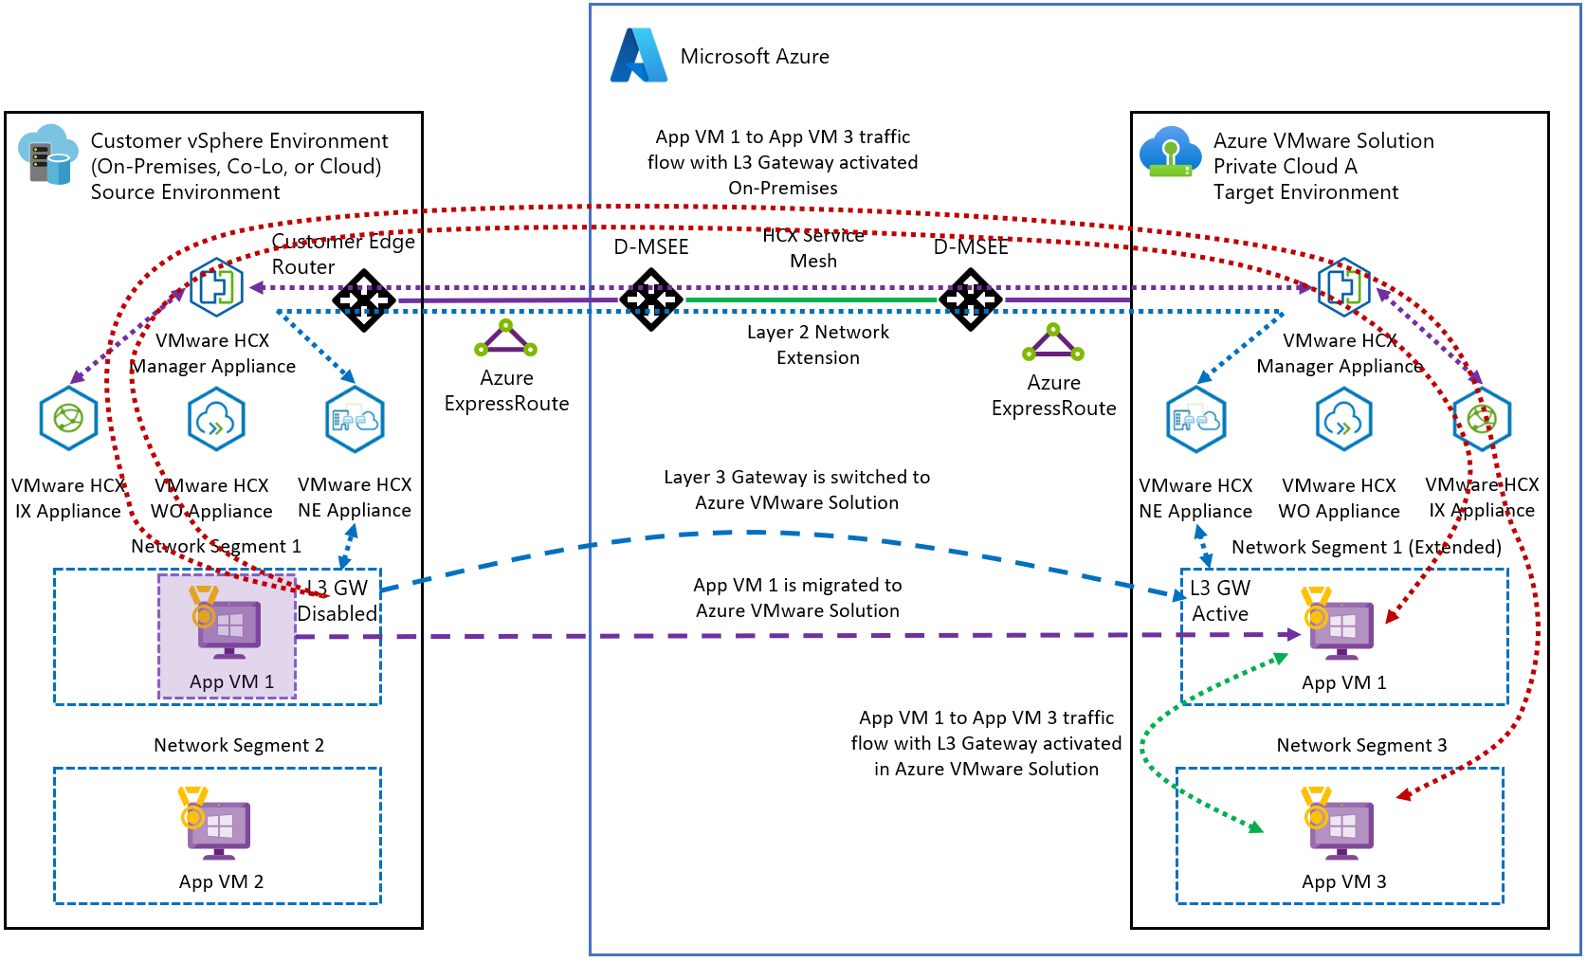
10. HCX MON
Mobility Optimized Networking and what it costs
What MON provides
A migrated VM retains its original IP address.
Applications, DNS records, firewall rules, and dependencies need not change immediately.
MON creates a local cloud gateway, avoiding high-latency trombone routing back through the on-premises router.
!
What MON consumes
HCX MON uses /32 host routes for migrated VMs.
Microsoft counts those routes against the Gen 2 virtual-network prefix limit.
A /32 identifies one specific IP address.
Azure needs one VNet route entry for every VM remaining in the MON transition state.
Source: Microsoft Learn, VMware HCX Mobility Optimized Networking guidance
Takeaway MON preserves IP addresses but converts every transitional VM into a route-scale consumer. Migration sequencing becomes a network-capacity problem.
10. HCX Mobility Optimized Networking
25
Notes:
MON is a transition mechanism, not a permanent routing architecture. Say that explicitly to migration teams.

Slide 27
10.3 WORKED EXAMPLE
One migration wave against the 1,000-prefix limit
Inputs and calculation
800 migrated virtual machines.
One /32 route per migrated VM.
1,000 total VNet prefix limit.
800 VMs × 1 route per VM = 800 routes
A single migration wave consumes 80% of the entire route budget, leaving 200 entries for infrastructure, workload segments, gateways, native Azure dependencies, and later waves.
Factors that could change the result
Existing routes may already consume part of the limit.
Address space and service routes reduce usable capacity.
Summarization, failover state, and HCX behavior affect the count.
Takeaway The apparent success of an initial migration does not prove the full program is safe. Monitoring VM count without monitoring route count conceals the approach to the limit.
10.3 Eight-hundred-VM migration example
26
Notes:
Failure scenario to narrate: a department migrates successfully over a weekend; a later wave hits the limit and new workloads lose routing or fail provisioning.

Slide 28
10.5 SUMMARIZATION
Reclaiming route capacity between waves
1
Identify a source subnet whose workloads can move as one controlled wave.
6
Move or fail over the subnet gateway to the NSX router in AVS.
2
Calculate the number of temporary /32 routes required during the wave.
7
Finalize the migration.
3
Confirm sufficient VNet route capacity before starting.
8
Remove the temporary individual host routes.
4
Migrate the VMs while MON advertises their individual /32 routes.
9
Advertise one summarized subnet route, such as a /24.
5
Verify that all VMs belonging to the subnet have moved successfully.
10
Confirm that route capacity has been reclaimed before the next wave.
Summarization example
Operational recommendation
Include “temporary routes removed and subnet summarized” in the migration-wave definition of done. Route reclamation is a completion criterion, not a cleanup task.
200 migrated VMs from one /24 hold 200 individual /32 routes in the temporary state. The final state is one summarized /24 route. Routes reclaimed: 200 − 1 = 199.
Takeaway Size migration waves by peak route consumption, not by data-copy duration. A partially migrated subnet left indefinitely turns temporary routes into a permanent constraint.
10.5 Route summarization workflow
27
Notes:
The network team and migration team must share one route-capacity model. This is a governance point, not a technical one.

Slide 29
11. MIGRATION PERFORMANCE
A wide pipe does not guarantee a fast base sync
Base-sync process
!
Why Gen 2 can be slower
1
The source VM continues to run on premises.
Microsoft documents that HCX RAV and Bulk migrations on Gen 2 can experience slower Base Sync and Online Sync performance, and advises planning longer migration windows.
Replication traffic traverses the Azure underlay and passes through managed gateway subnets.
Traffic is translated or encapsulated between the underlay and the NSX overlay.
MTU constraints may cause packet fragmentation and reassembly.
2
HCX or vSphere Replication copies the initial disk contents.
3
Changed blocks are tracked while the base copy runs.
4
Later synchronization transfers remaining changes.
5
The workload is cut over per the selected migration method.
Planning consequences
1
A 100-Gbps interface does not guarantee a 100-Gbps migration stream.
2
Initial synchronization may take longer than on a Gen 1 ExpressRoute path.
3
Large database migrations may require smaller waves.
4
Weekend migration windows should include additional contingency.
5
Cutover plans must account for prolonged sync and accumulated changed blocks.
6
Performance testing should use representative VM sizes, write rates, latency, MTU, and concurrency.
Takeaway Workload runtime performance and migration data-path performance are different design questions. Generation 2 can deliver the first while still requiring conservative windows for the second.
11. Migration data-transfer performance
28
Notes:
Analogy: the pipe may be wide, but the toll booth processing each vehicle still creates a queue.

Slide 30
04
Resilience and operations
Rack-level resilience, zone-level high availability, and cross-region disaster recovery solve different failure problems. They are not interchangeable.
Section
29
Notes:
Compliance stakeholders should be in the room for this section.

Slide 31
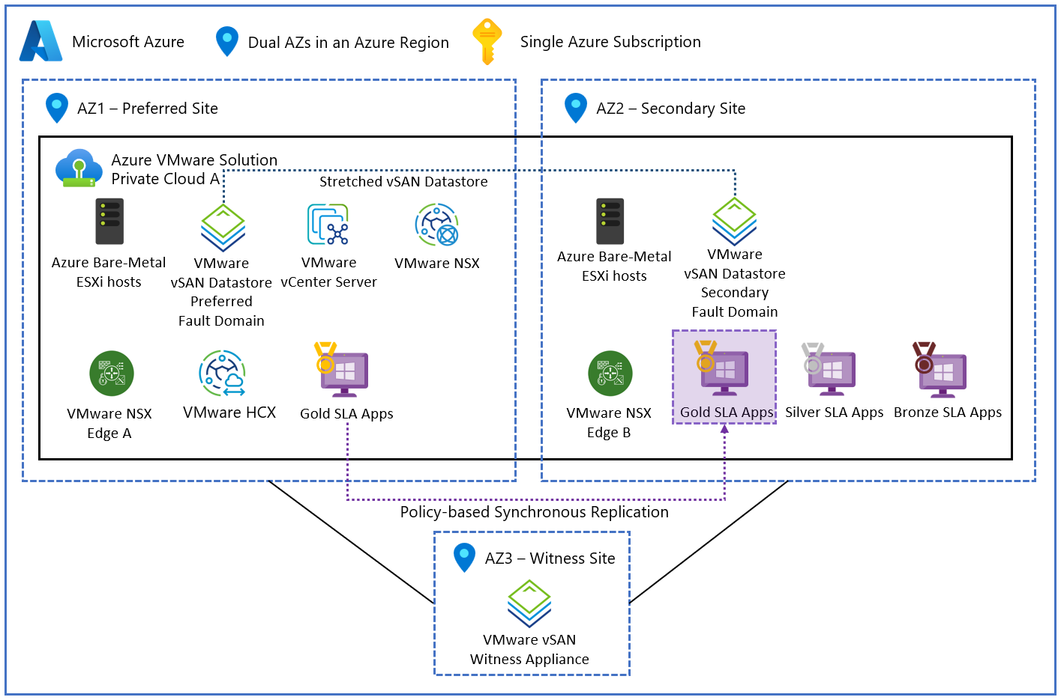
12. GENERATION 1 RESILIENCE
vSAN stretched clusters across availability zones
Minimum six-host topology
Three data hosts
Availability Zone 1
Three data hosts
Availability Zone 2
Witness appliance
A separate third zone
VMware management
One logical cluster
Workload operation
Both data zones run workloads
Data protection behavior
Synchronous replication: vSAN writes data to both data zones.
A write is not complete until both zones confirm storage according to policy.
The witness provides quorum and prevents split-brain behavior.
The witness does not hold the workload data itself.
Source: Microsoft Learn, Design vSAN stretched clusters
Takeaway Availability-zone resilience is the strongest Generation 1 advantage. Separate zones have independent power, backup generation, cooling, and network paths.
12. Availability zones and Generation 1 stretched clusters
30
Notes:
Six hosts minimum plus a witness. Cost is the main objection; quantify it against the RPO requirement.

Slide 32
12.3 FAILURE SCENARIO
Availability Zone 1 loses power completely
Sequence of events
99.99%
1
Hosts in Zone 1 become unavailable.
2
An up-to-date data copy exists in Zone 2 because writes were synchronously replicated.
Uptime SLA associated with the stretched-cluster architecture
3
VMware High Availability detects the host failures.
4
The affected virtual machines power on using surviving storage in Zone 2.
Active-active qualification
5
Guest operating systems and applications recover after restart.
The design is called active-active because hosts in both zones can run workloads. This does not necessarily mean one VM executes simultaneously in both zones. Distinguish cluster activity from application-level simultaneous execution.
6
Zero expected data loss for committed writes.
7
Recovery occurs in minutes rather than requiring a backup restoration.
Validate: Confirm supported host profiles, storage policies, witness behavior, failure semantics, recovery time, SLA prerequisites, and whether AV48 or other profiles support this topology.
Takeaway Generation 1 is the preferred option when synchronous multi-zone protection and a near-zero recovery point objective are mandatory.
12.3 Zone-failure scenario
31
Notes:
Recovery is a VM restart, not a restore. That distinction is what justifies the host count.

Slide 33
13. GENERATION 2 AVAILABILITY
Single zone, with cross-region disaster recovery
!
Single-zone constraint
Compliance impact
A Generation 2 private cloud is deployed within one availability zone.
The AV64 cluster cannot be split into a vSAN stretched cluster across multiple zones.
A complete failure of the selected zone can make the entire private cloud unavailable.
Service remains unavailable until the zone recovers or a separate DR environment is activated.
Organizations requiring multi-zone synchronous protection may be unable to use Generation 2 for the affected workloads.
Hospitals, financial institutions, trading platforms, and other regulated environments may have recovery policies that prohibit a single-zone infrastructure dependency.
Where that requirement applies, Generation 1 becomes the required choice.
Cross-region alternative
Example topology
East US replicates to West US.
Products mentioned
VMware Live Site Recovery, Zerto, and other third-party DR tools.
Replication model
Data is copied asynchronously rather than synchronously.
Recovery-point effect
The latest seconds or minutes of transactions may be lost after an abrupt failure.
Recovery-time effect
Workloads require orchestration and startup in the recovery environment.
Validate: Gen 2 availability must be checked against current regional and host-type documentation. Confirm Zerto versions, AV64 support, Secure Boot requirements, and VIB signing before committing to a DR product.
13. Generation 2 availability and cross-region DR
32
Notes:
Do not state as a universal rule that every Gen 2 deployment is single-zone. Check the region and host-type mapping table for the specific target region.

Slide 34
13.5 RESILIENCE COMPARISON
Two designs, two different failure problems
Requirement | Generation 1 stretched cluster | Generation 2 cross-region DR
Primary failure boundary | Availability zone | Zone, site, or region
Replication | Synchronous | Asynchronous
Expected data loss | None for acknowledged writes | Possible loss of recent writes
Recovery method | VMware HA restarts VMs in surviving zone | DR system fails over to a separate environment
Topology | One logical stretched cluster | Separate primary and recovery private clouds
Main advantage | Strong intra-region continuity | Geographic separation
Main limitation | Host count, cost, and topology requirements | Nonzero RPO and additional orchestration
Takeaway Rack-level resilience, zone-level high availability, and cross-region disaster recovery solve different failure problems. They must not be treated as interchangeable.
13.5 Resilience comparison
33
Notes:
Ask which failure the client is actually insuring against. Most answer 'all of them' until this table is on screen.

Slide 35
14. GENERATION 2 FAULT DOMAINS
Explicit rack-level failure boundaries
Generation 1 placement model
Generation 2 explicit fault domains
Azure distributes Generation 1 hosts across racks.
The placement logic is largely hidden from the customer.
Customers rely on Microsoft to avoid concentrating the cluster behind one top-of-rack switch or power boundary.
AV64 regions use five or seven vSAN fault domains; the region-specific count is in the host-type mapping table.
A fault domain is an independent rack-level failure boundary with separate power and top-of-rack networking.
Azure automatically balances hosts across domains as the cluster grows.
Fourteen-node example
Rack-failure scenario
14 hosts ÷ 7 fault domains = 2 hosts per domain
The top-of-rack switch or power supply for one fault domain fails.
Hosts in that fault domain become unavailable.
vSAN erasure coding (RAID-5 or RAID-6 behavior) protects data using chunks and parity stored in other fault domains.
The surviving hosts retain access to the data and the cluster continues operating without the failed rack.
A failure of one rack removes two hosts while the remaining domains continue to provide compute and storage.
Regional fault-domain count, maintenance state, host availability, and Azure placement behavior may affect the actual distribution.
Takeaway Explicit fault domains improve local failure isolation, but they do not protect against loss of the entire availability zone and do not replace a multi-zone stretched cluster.
14. Generation 2 vSAN fault domains
34
Notes:
Fault domains are the answer to 'what does Gen 2 give me instead of a stretched cluster?' The answer is: less, and at a different layer.

Slide 36
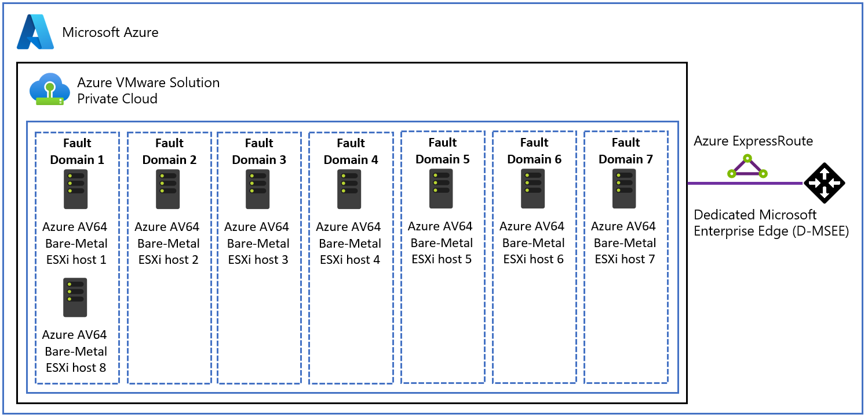
15. HOST REMOVAL
Fault-domain balance constrains scale-in
Maximum hosts in any fault domain − Minimum hosts in any fault domain ≤ 1
Imbalance example
Initial state: Fault Domain 1 has two hosts; Fault Domain 2 has one host.
Proposed operation: remove the only host from Fault Domain 2.
Resulting state: 2 hosts and 0 hosts. The difference is 2 − 0 = 2, which exceeds the permitted difference of one.
Azure rejects the removal with an HTTP 409 Conflict.
The host must be selected from a domain whose removal preserves balance.
Source: Microsoft Learn, AV64 host removal workflow and best practices
Troubleshooting an HTTP 409
1. Stop repeating the same removal request. 2. Open the vSphere client. 3. Review the vSAN fault-domain configuration. 4. Map each host to its domain. 5. Count hosts in every domain. 6. Simulate the distribution after removing each candidate. 7. Select a host from the most populated eligible domain. 8. Confirm the post-removal difference is no greater than one. 9. Ensure workload and storage evacuation requirements are satisfied. 10. Retry the scale-in. 11. Record the constraint in the runbook.
Takeaway AV64 scale-in is a topology-aware operation. The removable host is determined by structural balance, not by administrative convenience.
15. Host removal and fault-domain balance
35
Notes:
Add the fault-domain check to the standard scale-in runbook. Repeated 409s usually mean the operator is retrying the same invalid host.

Slide 37
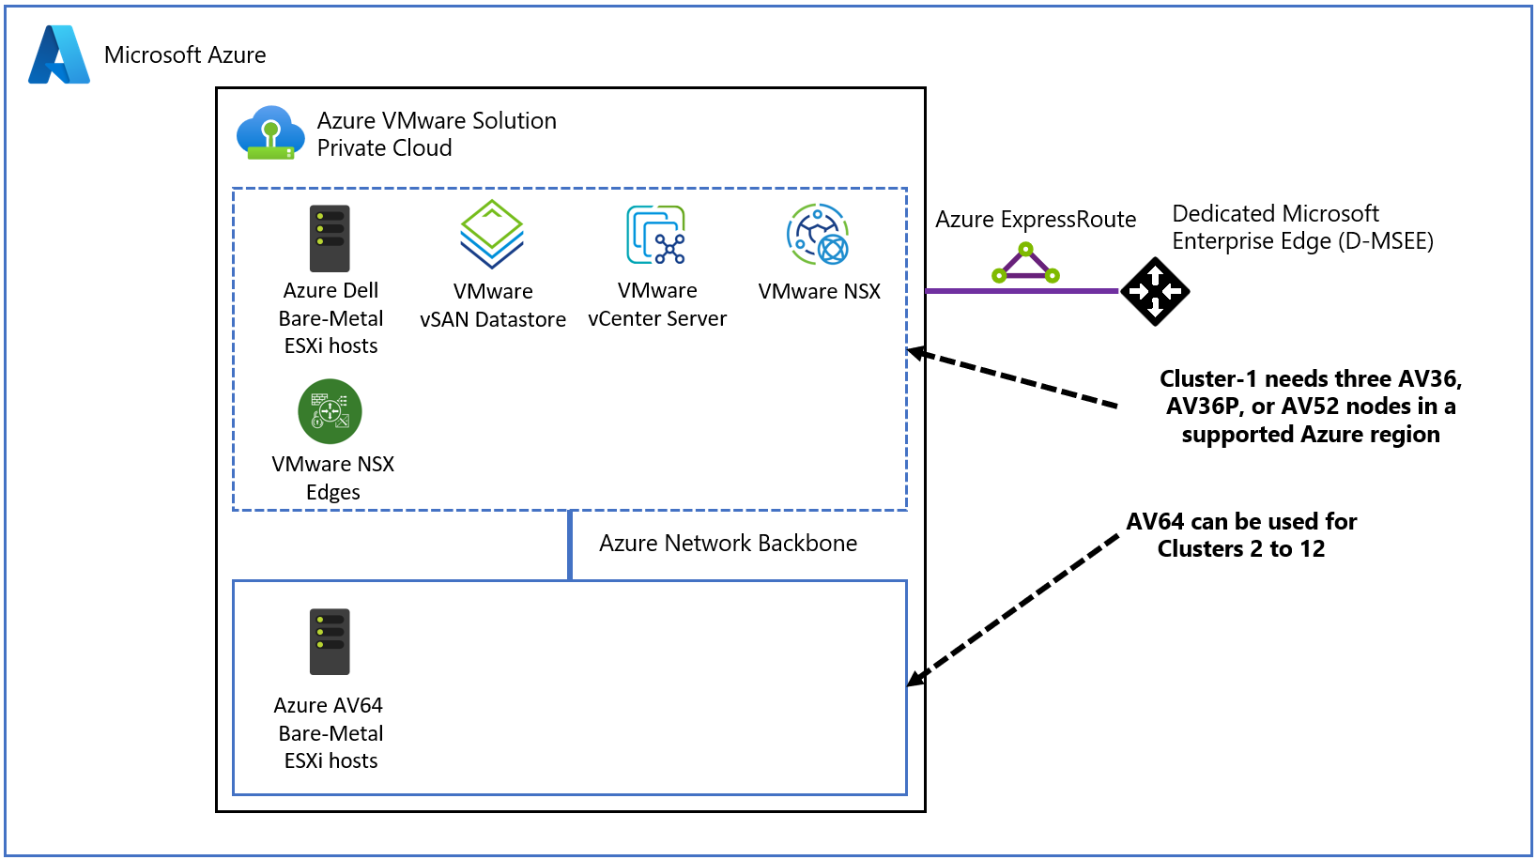
16. MIXED ENVIRONMENTS
AV64 expansion clusters under one vCenter
Topology
The original Generation 1 cluster remains Cluster 1.
Clusters two through twelve can use AV64 hardware.
At least three AV64 nodes are required to form a vSAN cluster.
Quota approval is required before deploying the nodes.
One vCenter manages both older and newer clusters.
Primary use case
Existing mission-critical databases remain on Gen 1 stretched-cluster infrastructure.
New high-performance or stateless workloads, such as a large VDI farm, use AV64.
The organization gains established resilience and newer hardware without rebuilding the private cloud.
Source: Microsoft Learn, Private cloud extension with AV64 node size
CPU heterogeneity
Generation 1 hosts may use Skylake or Cascade Lake processors; AV64 uses Ice Lake. Newer CPUs expose instruction sets that do not exist on older CPUs, so live workload movement is not necessarily symmetrical.
Takeaway A mixed environment provides a transition path, but CPU compatibility must be governed before workloads are allowed to move freely between clusters.
16. Mixed Generation 1 and Generation 2 environments
36
Notes:
Also validate: whether added AV64 clusters in an existing Gen 1 private cloud use all Gen 2 networking characteristics.

Slide 38
17. ENHANCED VMOTION COMPATIBILITY
Mobility between generations is asymmetric
Why EVC is required
A guest operating system detects processor capabilities when the VM powers on, and may begin using instructions available on the current CPU. A newer processor can execute older instructions, but an older processor cannot execute every newer instruction. vCenter performs a compatibility check and blocks unsafe migrations.
Migration direction | Expected behavior
Older Generation 1 CPU to AV64 Ice Lake | Usually succeeds, because the newer CPU includes the older instruction set
AV64 Ice Lake to older Gen 1 CPU before using newer features | May depend on the VM's exposed baseline
AV64 to older CPU after power-on or reboot with newer features exposed | Live vMotion is blocked
Powered-off VM moved from AV64 to older CPU | Cold migration can reset the exposed baseline after reboot
Analogy
Moving from Generation 1 to AV64 is like an upgrade from economy to first class. Once the VM powers on and accepts the first-class glassware represented by newer CPU instructions, it cannot carry those instructions back into the older cabin.
17. Enhanced vMotion Compatibility
37
Notes:
The direction that matters operationally is the return trip. Most teams only discover the constraint when they need to move back.

Slide 39
17.4 EVC GOVERNANCE
The trap, and the preventive baseline
!
The trap scenario
Preventive VM-level EVC
1
A VM runs on an older Generation 1 host.
1
Determine the lowest CPU baseline required for all intended destination clusters.
2
The administrator live-vMotions it to AV64. The migration succeeds.
2
Open the advanced settings for each VM.
3
The VM is rebooted on AV64.
3
Apply a VM-level EVC mode matching the older Gen 1 baseline.
The guest detects and begins using newer Ice Lake CPU capabilities.
4
Power-cycle or otherwise apply the setting per the supported procedure.
4
5
Validate live migration from Gen 1 to AV64.
5
The administrator later attempts to live-vMotion it back.
6
Validate live migration back to Gen 1.
6
vCenter detects the destination lacks required features.
7
Incorporate the setting into VM provisioning templates.
7
The migration precheck fails with an EVC compatibility error.
Audit new VMs for compliance.
8
Cold migration recovery
Trade-off
Governance risk
Shut down the guest, power off, move to the older cluster, power on, let the guest detect the lower baseline, then validate. Roughly five to ten minutes of downtime in the source example; actual duration varies.
The VM does not use some advanced AV64 instructions. This is a deliberate exchange of peak performance for guaranteed mobility.
One VM created without the baseline can become stranded for live migration after it boots on AV64. Templates, automation, policy checks, and change control must enforce the selected EVC mode.
Takeaway Treat VM-level EVC as a mandatory design decision before the first mixed-generation migration, not as an emergency correction after workloads have moved.
17. Enhanced vMotion Compatibility
38
Notes:
The mission-critical risk is the outage: for patient, trading, or database systems, the required cold-migration downtime may simply be unacceptable.

Slide 40
05
Decision framework
Neither generation is universally superior. Selection depends on which constraints the organization is prepared to manage, and on calculations completed before the private cloud is created.
Section
39
Notes:
Bring the conversation back to requirements.

Slide 41
18. DECISION FRAMEWORK
Conditions favoring each generation
Choose Generation 1 when
Choose Generation 2 when
Multi-zone synchronous stretched-cluster protection is mandatory.
Compliance requires near-zero RPO for a zone failure.
The enterprise network contains many segments that may exceed Gen 2 route limits.
A migration must retain a large number of MON /32 routes for an extended period.
The organization already has mature ExpressRoute, BGP, firewall, and routing infrastructure.
Existing applications do not require AV64 compute and NVMe capability.
Lower-cost host profiles provide adequate capacity.
Operational teams prefer established placement and routing behavior.
Applications require direct integration with Azure-native services.
The organization wants to eliminate ExpressRoute for internal Azure connectivity.
The environment benefits from simplified VNet peering and private DNS integration.
Workloads require high storage I/O, low latency, or substantial east-west bandwidth.
AV64 CPU, memory, NVMe, and network capacity can be used efficiently.
Single-zone infrastructure is acceptable when paired with a separate DR design.
The network stays within both the 1,000-prefix VNet limit and the T0 NIC /28 limits.
Migration teams can summarize routes rapidly and avoid permanent MON sprawl.
Governance can accommodate fixed VNet, tenant, and resource-placement dependencies.
Takeaway Neither generation is universally superior. Selection depends on which constraints the organization is prepared to manage.
18. Operational decision framework
40
Notes:
Score each line as met, not met, or unknown. The unknowns are the real project risks.

Slide 42
18.3 DECISION MATRIX
Requirement to preferred direction
Requirement | Preferred direction
Synchronous multi-zone cluster | Generation 1
Existing complex ExpressRoute architecture | Generation 1
More flexible route scale | Generation 1
Lower-cost hardware for ordinary workloads | Generation 1
Direct Azure VNet integration | Generation 2
Avoid internal ExpressRoute gateway costs | Generation 2
AV64 and ESA performance | Generation 2
Large VDI or transactional workload | Generation 2, subject to sizing
Large HCX MON migration | Generation 1, or tightly controlled Generation 2 waves
Single-zone acceptable with cross-region DR | Generation 2
Need both resilience and AV64 capacity | Mixed clusters with strict EVC governance
Takeaway The correct generation emerges from calculated requirements. Selecting based on the newest hardware or the simplest diagram can conceal unacceptable routing, resilience, or cost consequences.
18.3 Decision matrix
41
Notes:
This is the slide clients photograph. Keep it clean and let it stand alone.

Slide 43
18.4 PRESELECTION
Fifteen calculations to complete before choosing
Required physical cores, memory, and storage per host.
VNet prefix count.
Availability-zone failure tolerance.
1
6
11
Expected host utilization and overprovisioning.
/28 T0 programming-unit count.
Cross-region DR capacity and licensing.
2
7
12
Storage I/O patterns and cache-pressure risk.
Peak HCX MON /32 count.
EVC requirements for mixed clusters.
3
8
13
East-west and north-south network throughput.
Migration base-sync duration.
Regional AV64 availability and quota.
4
9
14
Number and size of NSX segments.
Required RPO and recovery time objective.
Long-term tenant, subscription, resource-group, and VNet placement.
5
10
15
18.4 Required preselection calculations
42
Notes:
Items 5 through 8 are the ones most often skipped, and they are the ones that cause late-stage failures.

Slide 44
19. CHECKLIST
Implementation and validation
Architecture
Capacity
Networking
Confirm Gen 1, Gen 2, or mixed.
Document the reasons for the selection.
Identify dependencies that cannot change after deployment.
Validate tenant, subscription, resource group, region, and zone.
Size CPU, memory, storage, and network from measured workload data.
Confirm whether AV64 is required or creates material overprovisioning.
Verify quota and physical capacity in the target region.
Include the three-node minimum for a new AV64 cluster.
Inventory every NSX segment and service route.
Calculate total VNet prefix count.
Convert each segment into /28 programming units.
Calculate temporary HCX MON routes at wave peak.
Reserve headroom for growth and operational change.
Security
Migration
Resilience and operations
Document customer-visible and system-managed controls separately.
Test management-plane reachability from allowed and denied sources.
Prepare compliance evidence for controls not shown in the portal.
Validate routing and firewall paths to vCenter and NSX Manager.
Benchmark base-sync throughput.
Account for encapsulation, MTU, and gateway processing.
Organize waves by complete subnet where possible.
Track temporary /32 routes and summarize after each wave.
Do not treat a working MON state as a completed migration.
Confirm whether rack, zone, region, or application resilience is required.
Design cross-region replication for Generation 2.
Train administrators on AV64 fault-domain placement.
Set and audit VM-level EVC for mixed-generation mobility.
Document when cold migration and downtime would be required.
19. Implementation and validation checklist
43
Notes:
Use this as the running project checklist. Each group maps to a named owner.

Slide 45
THE CENTRAL ARCHITECTURE RULE
Do not treat Generation 2 as a faster Generation 1 deployment.
Treat it as a different network, resilience, hardware, and operating model whose limits must be calculated before the private cloud is created.
Generation 1
Established routing flexibility and the strongest multi-zone availability option, carrying ExpressRoute cost and complexity.
Generation 2
Direct Azure integration and premium AV64 performance, requiring disciplined route budgeting, migration summarization, fixed deployment governance, and a separate DR strategy.
Architecture summary
44
Notes:
Close on the requirement question, not the product question: which constraints is this organization prepared to manage?

