Slide 1

Identify discussions on a topic: An analysis of CodeProject messages regarding workplace fairness issues related to software developers
Author : Tudor Grigorescu (s4079442)
First Supervisor : Dr. Ayushi Rastogi
Second Supervisor : Prof. Dr. Vasilios Andrikopoulu

Slide 2
Introduction
Workplace fairness has become a significant topic of discussion, especially in fields like software development, where the fast-paced and high-pressure environment can often lead to perceived or real inequities.
The rapid advancement of Large Language Models (LLMs) has sparked significant interest in their application across various fields, particularly in Information Retrieval (IR) and Natural Language Processing (NLP).
With these ideas in mind, it is evident that the latter could be used to analyze information relevant to the former. The problem is how?

Slide 3
The Research Questions
Considering the stated problem, the following research questions can be derived to guide the project:
What social media platform can be used as a source of information?
How can we automate the process of identifying fairness issues from messages on a social media website?
How many of the identified topics are directly or indirectly related to fairness issues?

Slide 4
Methodology
To answer those questions, the following methodology has been designed:
The first step was identify a social media website that had an accessible API with enough documentation to retrieve messages from.
The second step was the figure out what kind of model could be used to accomplish the desired NLP tasks and in what way.
The next step was to preprocess the dataset obtained from the target website to remove any stopwords and irrelevant text.
The final step is to do a manual annotation of the results obtained from the topic modeling and determine the relevancy of the topics in relation to fairness issues.

Slide 5
Information Retrieval
For this part of the project I decided to retrieve messages from the CodeProject website, which is an active social media platform for software developers with an easy to use API documentation as well as a dedicated forum page titled “Work Issues”, which is about problems people have in relation to their workplace.
The API documentation included code samples regarding retrieving messages from a forum, therefore I used that as the basis for this part of the project with the addition of generating a JSON file, which is then written on an Excel sheet titled “JSONData” for ease of use. This is done in the C# programing language.

Slide 6
BERTopic Modeling
BERTopic is a topic modeling technique that leverages transformers and c-TF-IDF to create dense clusters, resulting in easily interpretable topics while retaining important words in the topic descriptions.
It supports various topic modeling techniques, including Guided, Supervised, and Semi-supervised approaches, therefore it is particularly useful for extracting meaningful topics from text data.
While it has its challenges and considerations, BERTopic’s strengths in adaptability, interpretability, and robustness make it a compelling choice for modern text analysis tasks.
It is considered the baseline approach for this kind of research, which means there is plenty of material regarding how to work with it.

Slide 7
Topic Modeling
Per the reasons previously stated, I decided to use BERTopic since it is a well known LLM specifically used in NLP tasks.
That said, the first iteration of the Jupyter Notebook only generated 44 topics. However, these topics are a generalised overview of the messages dataset. Also the preprocessing only removed HTML tags.
The second iteration used seed words to make sure that certain domain specific words are weighted higher and are more often used in topic representations. That and stopwords were removed. This generated 38 topics.
The third iteration tried to narrow down on the fairness issue topics based on the previous attempt, therefore a dictionary of synonyms was used. This generated 15 topics.

Slide 8
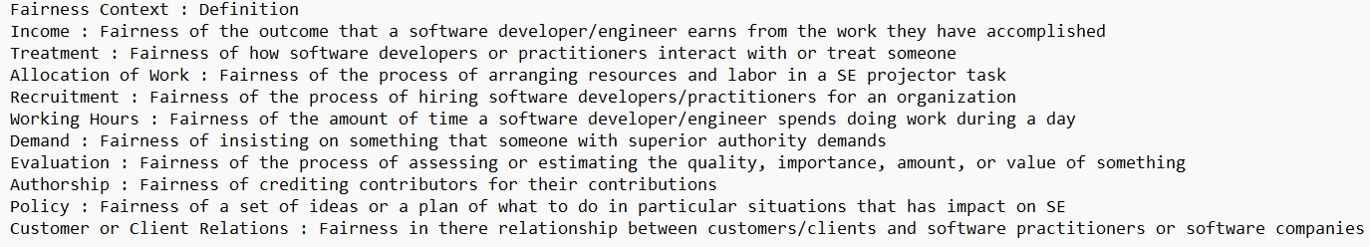
Defining Fainess Issues
I have used the paper by Sessari et al. (2024) as an reference to create the following rubric for identifying fairness issues.
I excluded any topic related to fairness in computation paths, modern software or algorithm as well as messages related to technical issues, job advertisemnents, CV reviews, unrelated quotes, and other irrelevant information.

Slide 9
Results
Once I obtained the results from the topics modeled by the three iterations of the topic modeling script, I started checked each dataset to see how many topics were directly or indirectly related to fairness issues as defined by the rubric.
The annotations I used were a basic “Yes” or “No” to mark if the topic was about a fairness issues, mentioned one or alluded to one. Additional notations were used to distinquish which docs in said topic cluster out of the total were relevant.
These were the results: for the first iteration 27 out of 44 topics were marked as “Yes”; for the second iteration 15 out of 38 topics were generally marked as “Yes”; for the third iteration 8 out of 16 topics were generally marked as “Yes”.

Slide 10
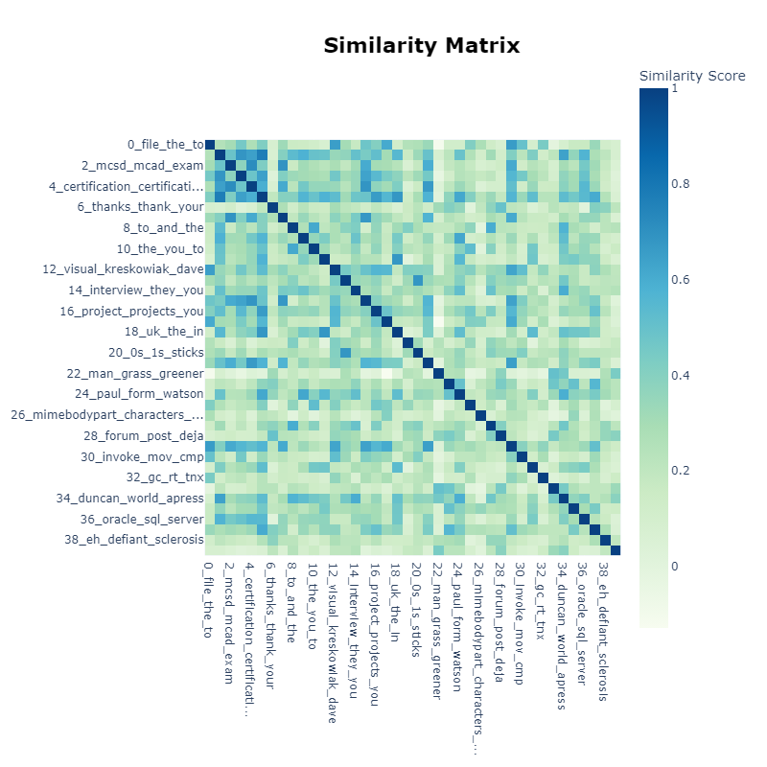
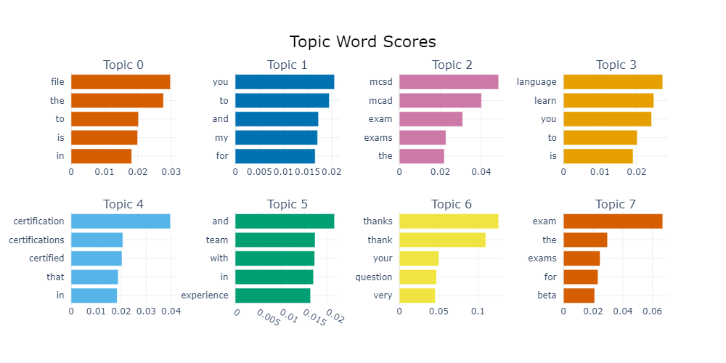
Results from the first iteration

Slide 11
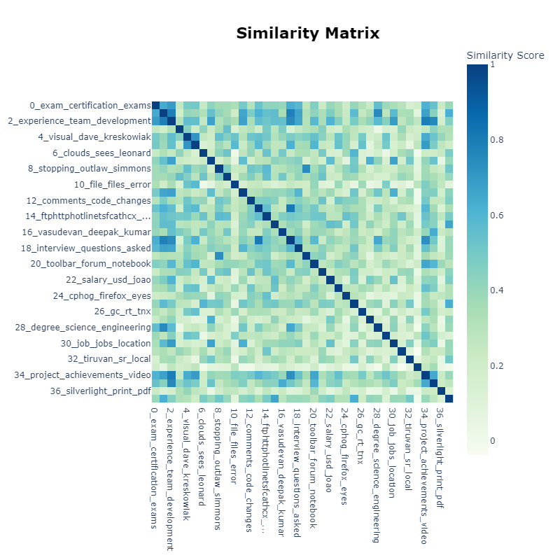
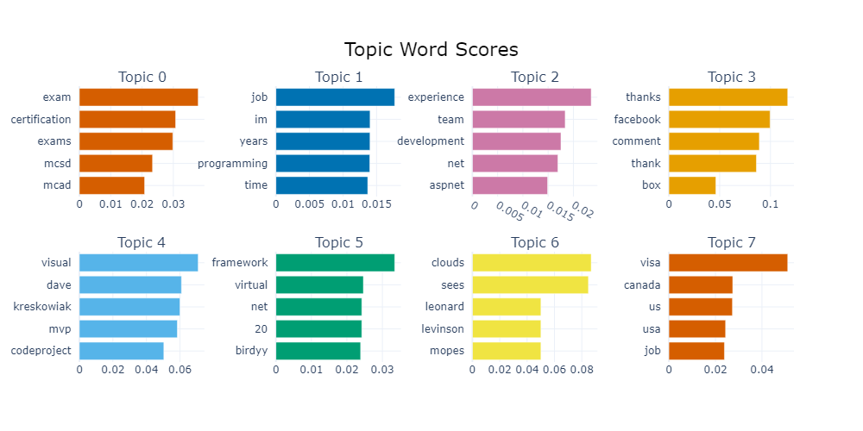
Results from the second iteration

Slide 12
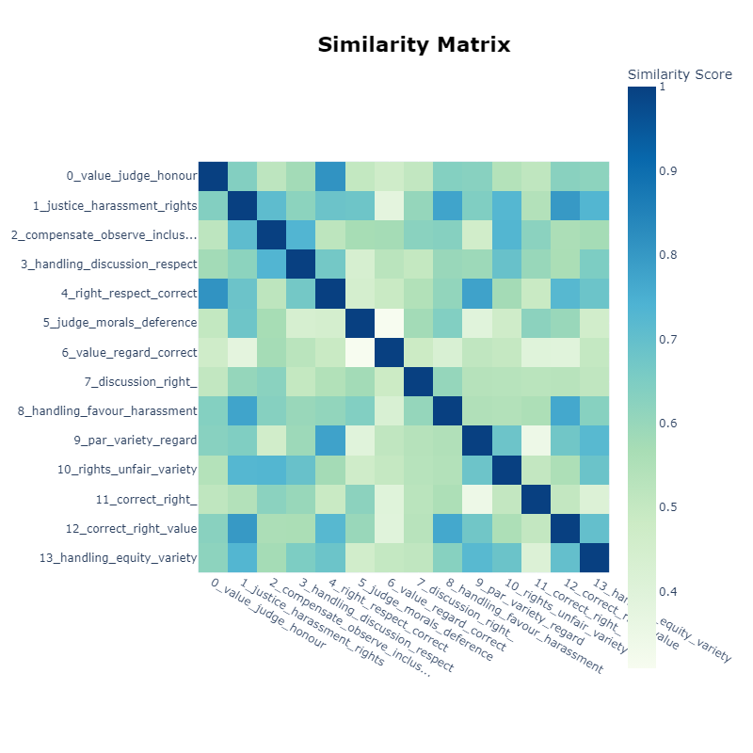
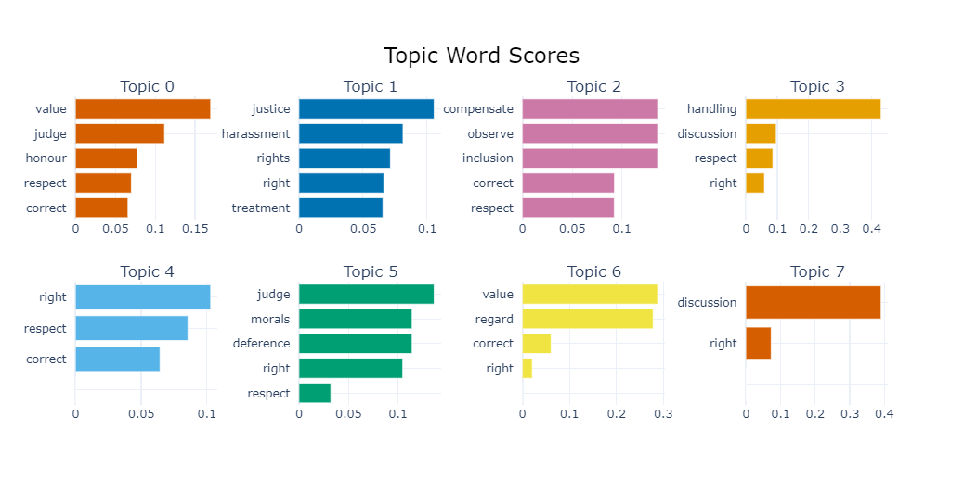
Results from the third iteration

Slide 13
Discussion
Statistically speaking the following percentages show how many topics were related to fairness issues per each iteration: the first iteration of the model had a 61.36% topics related to fairness issues; the second iteration of the model had a 39.37% topics related to fairness issues; the third iteration of the model had a 29.17% topics related to fairness issues. The reason for the low number in the third iteration is that few docs in a topic were related to fairness issues.
As it can be observed rather than increase the chances to obtain topics related to fairness issues, the seed words decreased the amount of topics related to fairness issues.
That’s not all, while the topics found by each model were different from one another, going through the original CodeProject messages dataset, I have managed to identify an additional six messages that were about fairness issues that model iterations did not pick up at all.

Slide 14
Conclusion
Based on the previously-mentioned results, it can be inferred that weighing specific words more than others is not as efficient or bound to produce expected results as analysing the context of the docs by hand.
Inexperience with using topic modeling could account for these results, but the results do indicate that keywords might not be as relevant to identifying specific topics as one could expect.
With these ideas in mind, future works could focus on attempting to study the performance of context specific topic modeling LLMs versus manual annotators to see which can better identify topics relevant to a specific subject.

Slide 15
Thank you for your time! Questions?

