Slide 1
Contact Info
Oleh Skoropad (presenter)
Lead Maintenance Engineer
Oleh_Skoropad@epam.com
Volodymyr Veres
Lead Maintenance Engineer
Volodymyr_Veres@epam.com
Confidential

Slide 2
Training materials
http://en.wikipedia.org/
http://www.makelinux.com/
https://access.redhat.com/documentation/en-US/
https://help.ubuntu.com/
Internet
Confidential

Slide 3

Introduction to Linux
Linux (/ˈlɪnəks/ ) is a Unix-like computer operating system assembled under the model of free and open-source software development and distribution.
The defining component of Linux is the Linux kernel
Operating system kernel first released on 5 October 1991 by Linus Torvalds
Confidential

Slide 4
LINUX BASICS

Slide 5
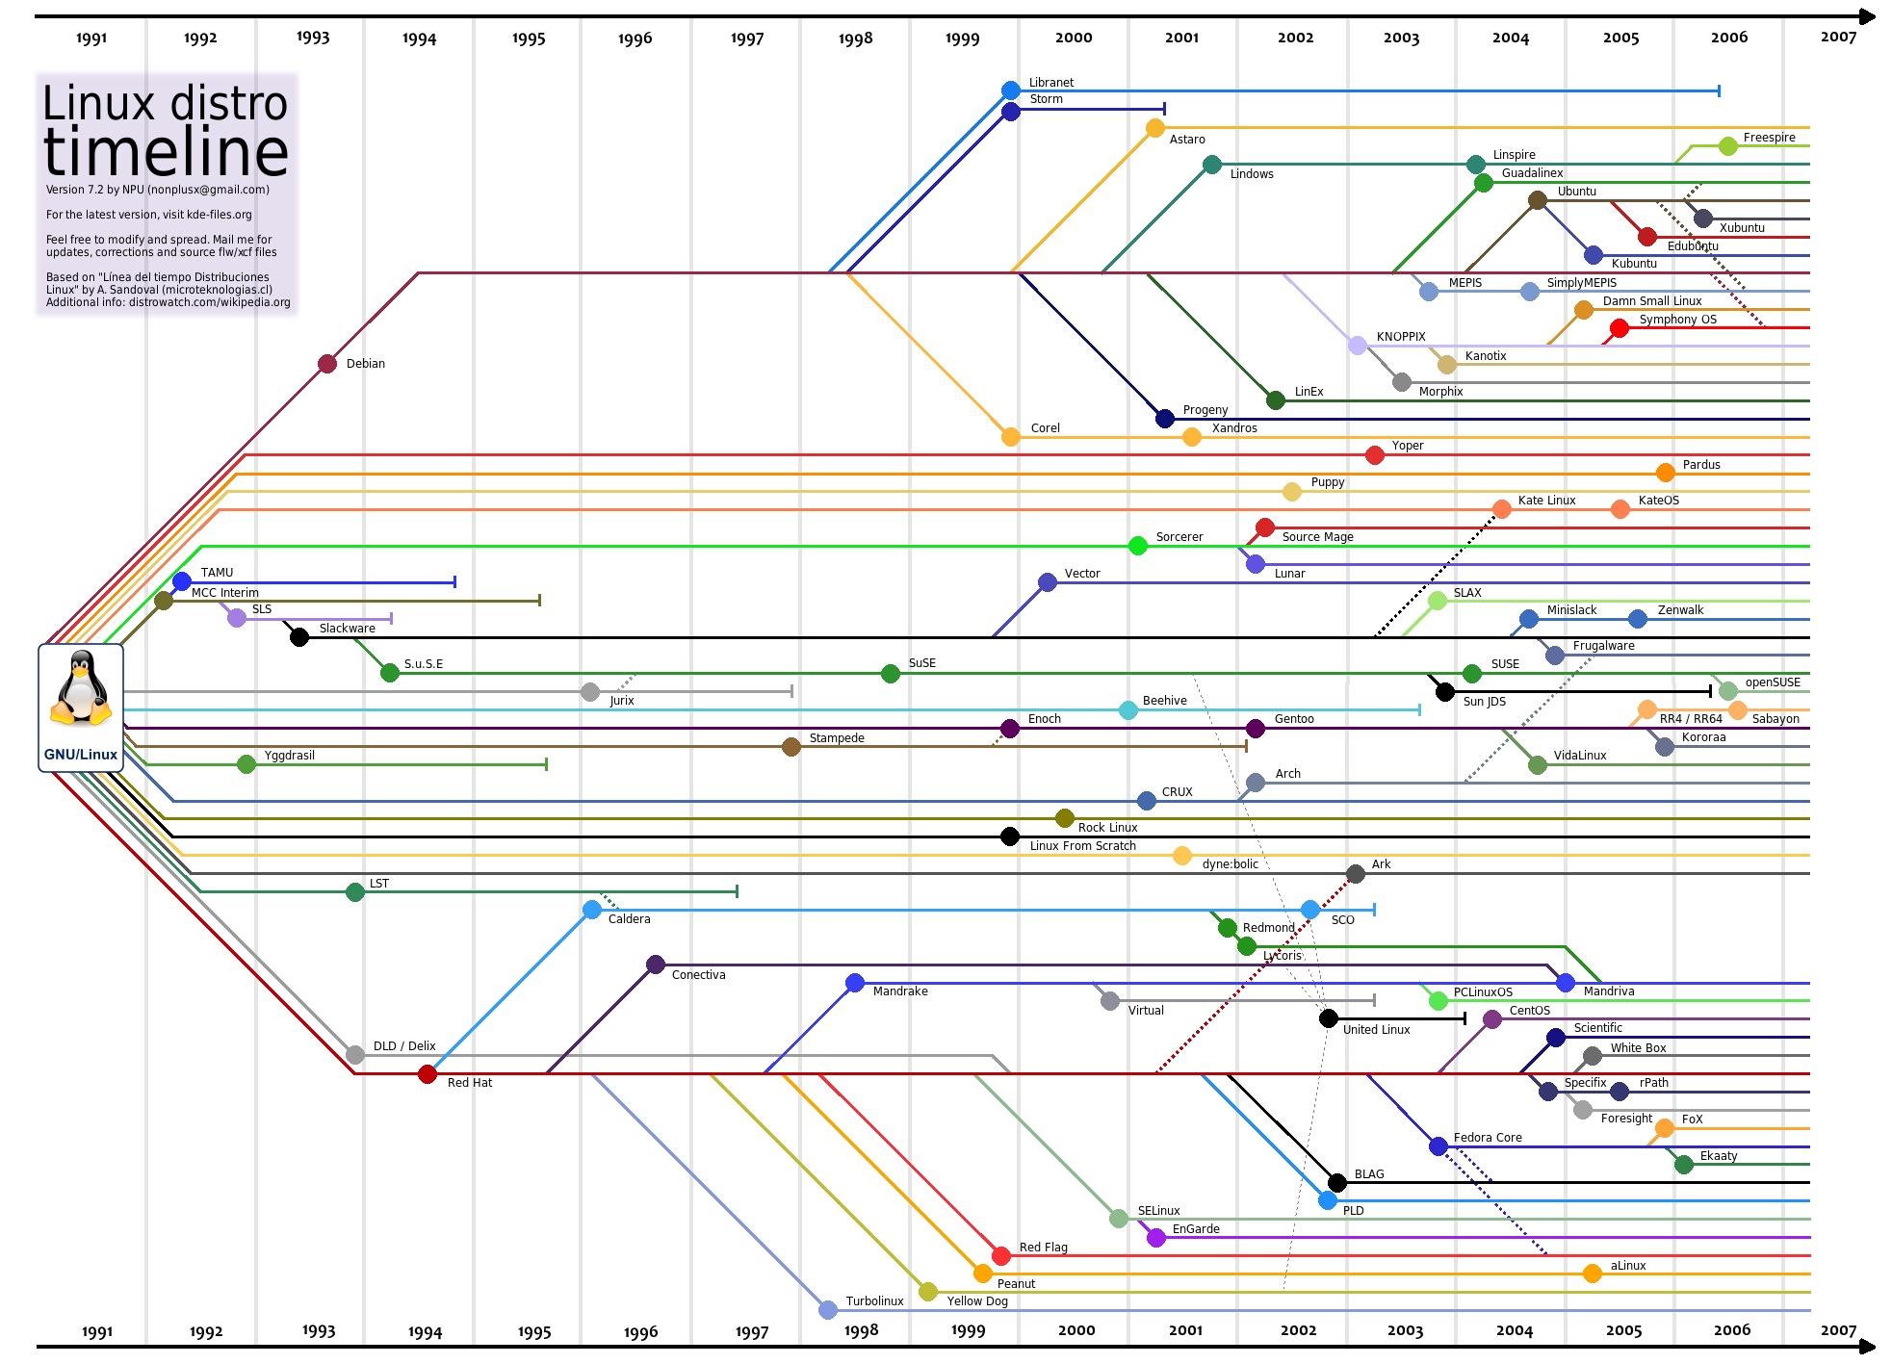
Confidential

Slide 6
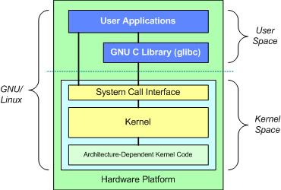
Kernel
The Linux kernel is a Unix-like computer operating system kernel
Linux kernel is a monolithic kernel. Device drivers and kernel extensions run in kernel space (ring 0 in many CPU architectures), with full access to the hardware, although some exceptions run in user space

Slide 7
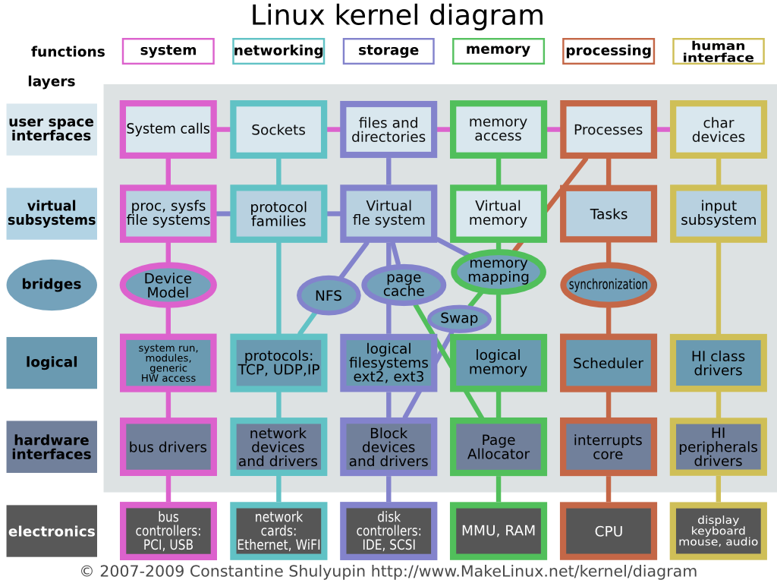
Linux kernel diagram

Slide 8
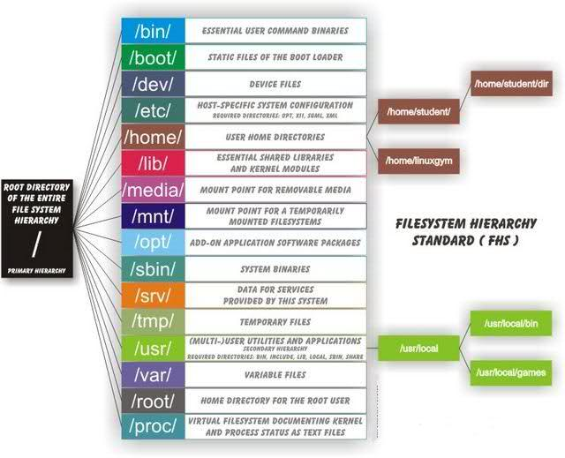
Filesystem structures

Slide 9
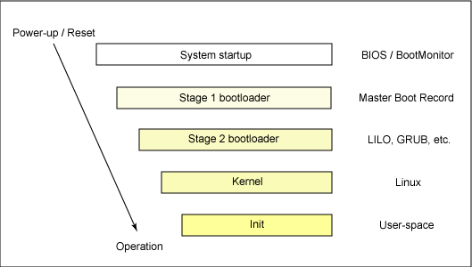
Linux startup process

Slide 10
Runlevels
Runlevels define what tasks can be accomplished in the current state (or runlevel) of a Linux system. Every Linux system supports three basic runlevels, plus one or more runlevels for normal operation.
ID | Information
0 | Shut down (or halt) the system
1 | Single-user mode; usually aliased as s or S
6 | Reboot the system
Red Hat Linux and Fedora/Centos
Debian GNU/Linux runlevels
ID | Information
0 | Halt
1 | Single-user text mode (without networking)
2 | Not used (user-definable)
3 | Full multi-user text mode
4 | Not used (user-definable)
5 | Full multi-user graphical mode (with an X-based login screen)
6 | Reboot
ID | Information
S | Only run on boot (replaces /etc/rc.boot)
0 | Halt
1 | Single-user mode
2-5 | Full Multi-user with console logins and display manager if installed
6 | Reboot

Slide 11
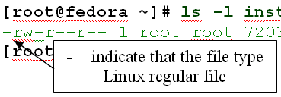
File types in Linux
regular file: readable file/binary file/image files/compressed files
directory file: contains regular files/folders/special files;
character device file: provide only a serial stream
of input or output.
For example: /dev/null; /dev/tty0
block device file: used to communicate with hardware a block of data at a time: 512 bytes, 1024 bytes, 2048 bytes.
For example: /dev/sda
socket files is used for inter-process communication.
For example: /var/run/acpid.socket
named pipe file: a file that passes data between processes. It stores no data itself, but passes data between one process writing data into the named pipe and another process reading data from the named pipe;
symbolic link file: is a reference to another file;
Symbol | Type
- | regular file
d | directory
c | character device
b | block device
s | socket
p | named pipe
l | symbolic link

Slide 12
BASE TOOLS

Slide 13
Command line interface:
Usefull keyboard shortcuts:
Up/Down arrows – search command history
Ctrl-r – interactive search history
history – print command history
!<num> - run <num> command from history
Alt-f – move cursor one word forward
Alt-b – move cursor one word backward
Ctrl-k – delete from cursor to end of line
Ctrl-u – delete from cursor to start of line
Confidential

Slide 14
Command: screen
What screen allows:
Use multiple shell windows from a single SSH session.
Keep a shell active even through network disruptions.
Disconnect and re-connect to a shell sessions from multiple locations.
Run a long running process without maintaining an active shell session.
How to start:
or
where “SSHTunels” - session name
vveres@bastion:~$ screen
vveres@bastion:~$ screen -S SSHTunnels
Confidential

Slide 15
Command: &, bg, fg, jobs
&
Send a command to the background
If a command is terminated by the control operator &, the shell executes the command in the background in a subshell
Ctrl-z
Suspend execution of a running process
bg: bg [%JOB_SPEC]
Move jobs to the background.
Place the jobs identified by each JOB_SPEC in the background, as if they had been started with `&'. If JOB_SPEC is not present, the shell's notion of the current job is used.

Slide 16
Command: &, bg, fg, jobs
fg: fg [% JOB_SPEC]
Move job to the foreground.
Place the job identified by JOB_SPEC in the foreground, making it the current job. If JOB_SPEC is not present, the shell's notion of the current job is used.
jobs: jobs [-lnprs] [jobspec ...] or jobs -x command [args]
Display status of jobs

Slide 17
Command: &, bg, fg, jobs
Send a process to the foreground:
vveres@bastion:~$ jobs -l
[1]- 2892 Running sudo tcpdump -ni eth1 port 22 > /tmp/tcpdump_port-22 &
[2]+ 2894 Running yes > /dev/null &
vveres@bastion:~$ fg %2
yes > /dev/null

Slide 18
Command: &, bg, fg, jobs
Send a process to the background:
vveres@bastion:~$ yes > /dev/null &
[3] 2582
or
vveres@bastion:~$ yes > /dev/null
^Z
[1]+ Stopped yes > /dev/null
vveres@bastion:~$ bg
[1]+ yes > /dev/null &

Slide 19
Command: screen
Control Command:
Command: “Ctrl-a”
Screen uses the command “Ctrl-a” that’s the control key and a lowercase “a” as a signal to send commands to screen instead of the shell.
Detaching From Screen:
Command: “Ctrl-a” “d”
Detaching is the most powerful part of screen. Screen allows you to detach from a window and reattach later.
Creating Windows:
Command: “Ctrl-a” “c”
Switching Between Windows:
Command: “Ctrl-a” “n”
Help:
Command: “Ctrl-a” “?”
Confidential

Slide 20
Command: screen
Show Screen session list:
Reattach to Screen:
or
vveres@bastion:~$ screen -ls
There are screens on:
1165.SSHTunnels (11/24/2014 10:36:26 PM) (Detached)
1132.pts-0.bastion (11/24/2014 10:33:42 PM) (Detached)
1100.pts-0.bastion (11/24/2014 10:27:58 PM) (Detached)
3 Sockets in /var/run/screen/S-vveres.
vveres@bastion:~$ screen –r
vveres@bastion:~$ screen -r 1165.SSHTunnels
Confidential

Slide 21
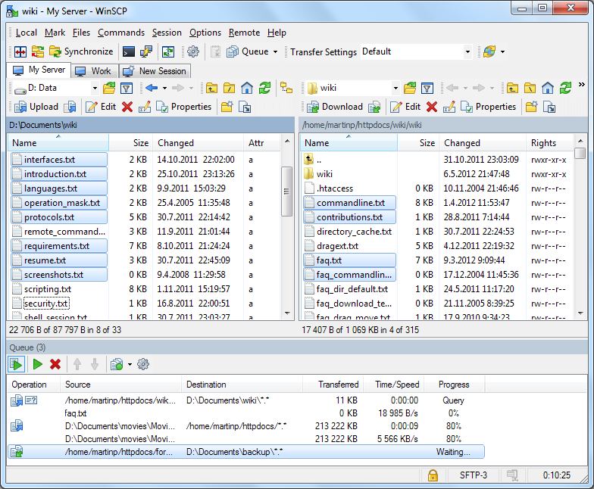
WinSCP
WinSCP (Windows Secure CoPy) is a free and open-source SFTP, SCP and FTP client for Microsoft Windows. Its main function is secure file transfer between a local and a remote computer. Beyond this, WinSCP offers basic file manager and file synchronization functionality. For secure transfers, it uses Secure Shell (SSH) and supports the SCP protocol in addition to SFTP.:

Slide 22
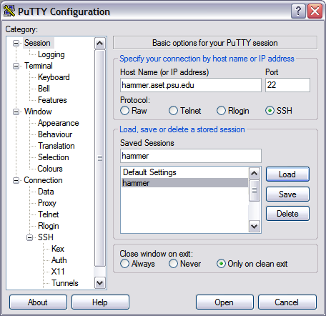
PuTTY
PuTTY is a free ssh client for windows. It also supports pubkey login and port forwarding. More information on official site: www.putty.org

Slide 23



Section
SSH pubkey login
LINUX SYSTEM1
LINUX SYSTEM2
USR1@SYSTEM1
~/.ssh/
- id_rsa
- id_rsa.pub
USR2@SYSTEM2
~/.ssh/
- id_rsa
- id_rsa.pub
- authorized_keys
Confidential

Slide 24
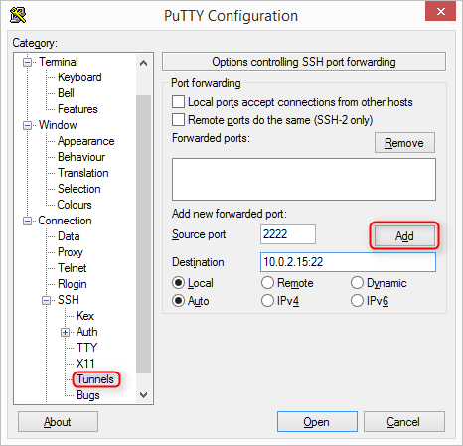
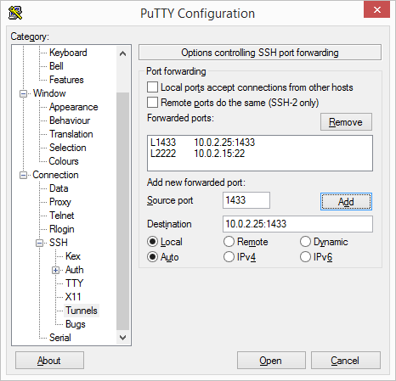
SSH Tunneling
SSH Tunnel from Windows
Add the tunnel in putty
***IMPORTANT: Don’t forget click Add button

Slide 25
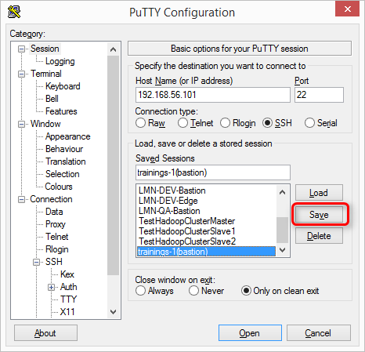
SSH Tunneling
Save session in putty

Slide 26
SECURITY
&
PERMISSIONS

Slide 27
Users & Groups
The user of the system is either a human being or an account used by specific applications identified by a unique numerical identification number called user ID (UID).
A group is an organization unit tying users together for a common purpose. Similar to, UID, each group is associated with a group ID (GID).
Files store users and groups information:
/etc/passwd stores user accounts information;
/etc/shadow stores secure user account information;
/etc/group stores group account information;
/etc/gshadow stores secure group account information.
vveres@bastion:~$ cat /etc/passwd | grep vveres
vveres:x:1000:1000:Volodymyr Veres:/home/vveres:/bin/bash
vveres@bastion:~$ cat /etc/group | grep vveres
adm:x:4:syslog,vveres
sudo:x:27:vveres
vveres:x:1000

Slide 28
Users & Groups
Commands useradd, usermod, userdel, groupadd, groupmod, groupdel, passwd:
Usage:
$ sudo useradd test
$ sudo useradd -c "Test User" -m -s /bin/bash -G adm test
$ sudo usermod -a -G sudo test
$ sudo userdel test
$ sudo passwd test
$ sudo groupadd test
$ sudo groupmod -n testnew test
$ sudo groupdel testnew
create a new user test
add user test to group sudo
delete user test
change password for user test
create group test
change group name test
delete group testnew

Slide 29
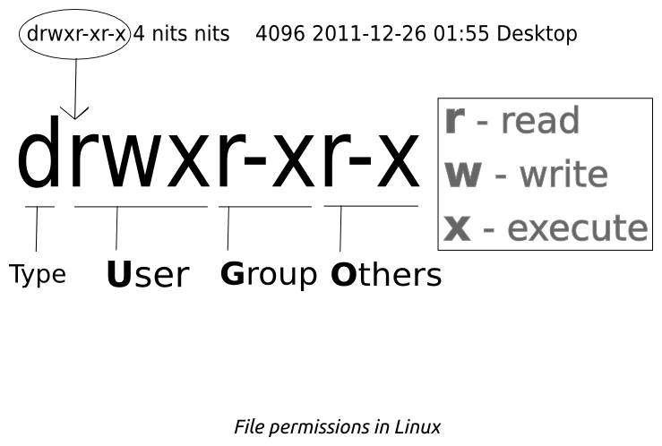
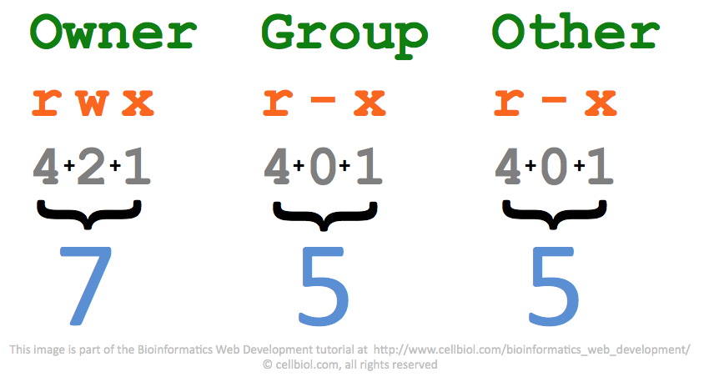
File and directory permissions

Slide 30
chmod & chown
chmod change file mode bits:
Usage:
$ chmod 755 /tmp/test.sh
$ chmod u=rwx,go=rx /tmp/test.sh
$ chmod g+w,o-x /tmp/test.sh
chown change file owner and group
Usage:
$ sudo chown test /tmp/test.sh
$ sudo chown :test -R /tmp
$ sudo chown test:test -R /tmp
set read,write,execute for user and read, execute for group and other
add write for group and remove execute for other
change the owner to test
change group of /tmp to test
change owner and group of /tmp to test

Slide 31
SUID, SGID & Sticky
SUID (Set owner User ID up on execution) is defined as giving temporary permissions to a user to run a program/file with the permissions of the file owner rather that the user who runs it.
SGID (Set Group ID up on execution) is defined as giving temporary permissions to a user to run a program/file with the permissions of the file owner rather that the user who runs it.
Sticky Bit is mainly used on folders in order to avoid deletion of a folder and its content by other users though they having write permissions on the folder contents
Permissions | Meaning
--S------ | SUID is set, but user (owner) execute is not set.
--s------ | SUID and user execute are both set.
-----S--- | SGID is set, but group execute is not set.
-----s--- | SGID and group execute are both set.
--------T | Sticky bit is set, bot other execute is not set.
--------t | Sticky bit and other execute are both set.

Slide 32
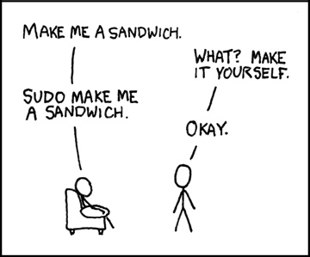
sudo
sudo allows users to run programs with the security privileges of another user (normally the superuser, or root). Users typically supply their own password to sudo rather than the root password
Files:
/etc/sudoers file allows listed users access to execute a subset of commands
Example:
$ sudo ip link set eth0 up

Slide 33
DISK MAINTENANCE

Slide 34
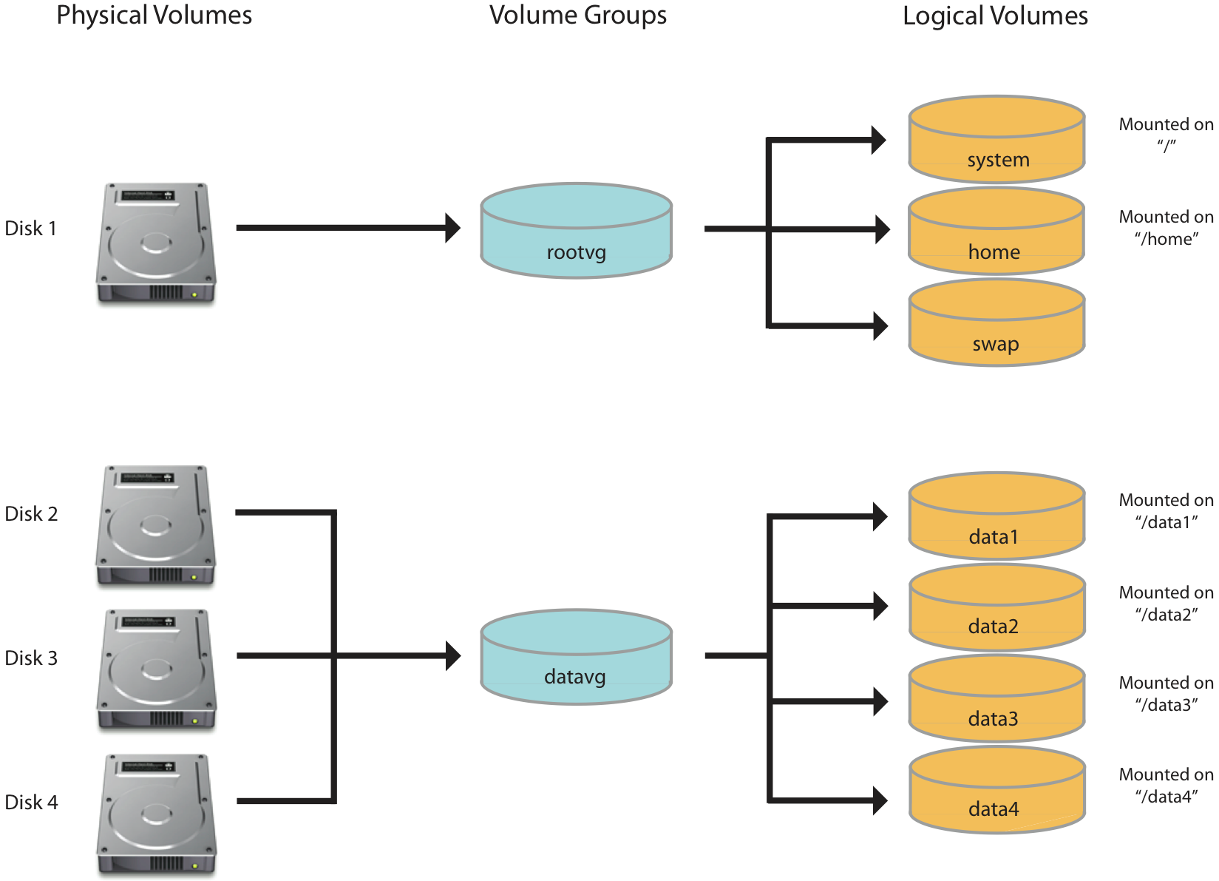
Disk maintenance. LVM.

Slide 35
NETWORK

Slide 36
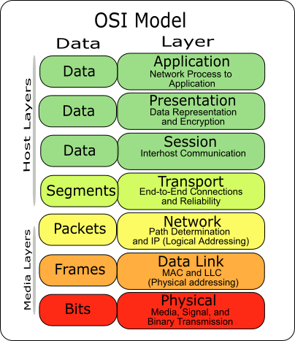

Slide 37
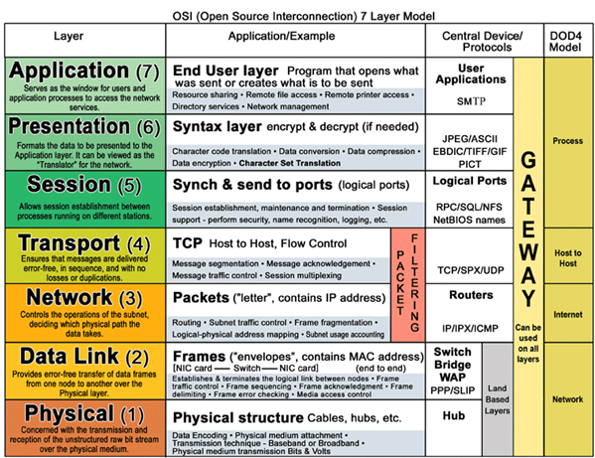

Slide 38
Network configuration
ifconfig allows:
view the configuration network interface;
configure network interface.
Usage:
$ ifconfig [-a]
$ ifconfig eth0
$ sudo ifconfig eth0 up
$ sudo ifconfig eth0 down
$ sudo ifconfig eth0 10.0.2.4 netmask 255.255.255.0
display all interfaces which are currently available, even if down
display information about eth0 interface
up or down eth0 interface
configure eth0 interface

Slide 39
ip addr add 192.168.0.77/24 broadcast 192.168.0.255 dev eth0
Network configuration
ip allows:
view the configuration network interface;
manipulate routing, policy routing;
configure devices, and tunnels.
Usage:
$ ip addr show
$ ip addr show eth0
$ sudo ip link set eth0 up
$ sudo ip link set eth0 down
$ sudo ip addr add 10.0.2.4/24 dev eth0
display all interfaces which are currently available, even if down
display information about eth0 interface
up or down eth0 interface
configure eth0 interface

Slide 40
Network configuration
Deprecated command | Replacement command(s)
arp | ip n (ip neighbor)
ifconfig | ip a (ip addr), ip link, ip -s (ip -stats)
iptunnel | ip tunnel
iwconfig | iw
nameif | ip link, ifrename
netstat | ss, ip route (for netstat-r), ip -s link (for netstat -i), ip maddr (for netstat-g)
route | ip r (ip route)

Slide 41
Network commands
Commands:
$ ping gmail.com
$ ping -c 4 gmail.com
$ traceroute -n gmail.com
$ tracepath -n gmail.com
$ nslookup gmail.com
$ nslookup 8.8.8.8
$ host gmail.com
$ dig gmail.com
$ dig @8.8.8.8 -t mx gmail.com
send ICMP ECHO_REQUEST to network hosts
print the route packets trace to network host
traces path to a network host discovering MTU along this path
DNS lookup utility
Display all mail servers(MX) for gmail.com domain

Slide 42
Network configuration files
Redhat/Fedora/Centos based
/etc/hosts
/etc/sysconfig/network - specifies routing and host information for all network interfaces
/etc/sysconfig/network-scripts/ifcfg-<interface-name> -config files for each network interface
Sample config /etc/sysconfig/network-scripts/ifcfg-eth0 for network interface:
DEVICE=eth0
BOOTPROTO=none
ONBOOT=yes
NETMASK=255.255.255.0
IPADDR=10.0.2.4
USERCTL=no
PEERDNS=yes
DNS1=10.25.0.10
DNS2=10.25.0.2
Debian/Ubuntu based
/etc/hosts
/etc/network/interfaces - config file for network interfaces
Sample config /etc/network/interfaces for network interface:
auto eth0
iface eth0 inet static
address 10.0.2.4
netmask 255.255.255.0
gateway 10.0.2.1
dns-nameservers 10.25.0.10 10.25.0.2
dns-search kyiv.epam.com

Slide 43

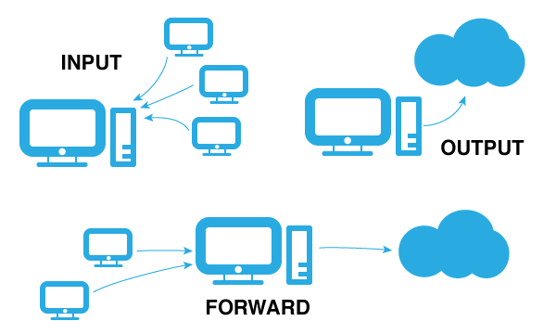
Firewalls
iptables — is a user-space application program that allows a system administrator to configure the tables provided by the Linux kernel firewall (implemented as different Netfilter modules) and the chains and rules it stores

Slide 44
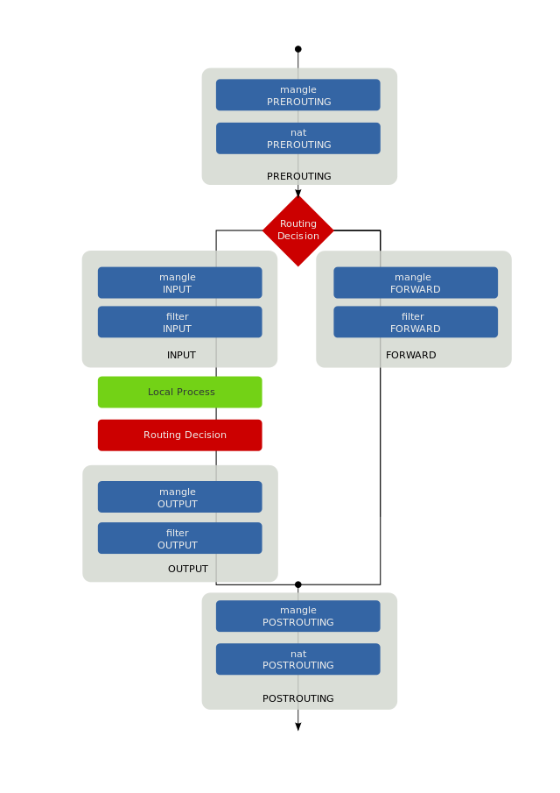
Iptables: Packet flow
filter table :
INPUT Chain : For packets coming into the system or destined for the system.
FORWARD Chain : For packets travelling (being routed) through the system.
OUTPUT Chain : For packets leaving the system or originating from the system.
nat table :
PREROUTING Chain : For altering the packets just after they enter the system
INPUT Chain
OUTPUT Chain : For packets which are leaving the system.
POSTROUTING Chain : For altering the packets which are about to leave the system.
mangle table :
PREROUTING
OUTPUT
INPUT
FORWARD
POSTROUTING

Slide 45
Iptables: commands
$ sudo iptables -L -t filter
$ sudo iptables -L
$ sudo iptables -L PREROUTING -t nat
$ sudo iptables -P INPUT DROP
$ sudo iptables -P FORWARD DROP
$ sudo iptables -P OUTPUT ACCEPT
$ sudo iptables -I INPUT 1 -p tcp -t filter -s 192.168.0.0/24 --dport 25 -j ACCEPT
$ sudo iptables -A INPUT -s 192.168.0.0/24 -j DROP
$ sudo iptables -D INPUT -s 192.168.0.0/24 -j DROP
List all rules in all chains in table filter
List all rules in chain PREROUTING in table filter
Set a policy for chains in table filter

Slide 46
PROGRAMS SETUP
&
TROUBLESHOOTING

Slide 47
Section
Internet
(repositories)
Install programs
Package manager (front- and backend)
package
Commands:
install
remove
erase/purge
update
upgrade
lib
yum
(apt-get)
rpm
(dpkg)
Repos-list
depend
LINUX SYSTEM
Confidential

Slide 48
Section
1. yum (apt-get) install (or download package + rpm (dpkg))
2. Configure by edit : /etc/*** . Don’t forget make a copy before modification
3. Run service (service/systemctl … start)
4. Check service startup with chkconfig
5. Check service process in memory ( ps axfu)
6. Check open ports, if service use network (ss -nlp)
7. Check system log (tail -f /var/log*) and application log.
8. Debug application (tail -f, dstrace, … )
Common steps to install application:
Confidential

Slide 49
Section
Usefull commands summary:
File commands:
ls, cp, mv, mkdir, rm, touch, ln, cat,
Permissions:
chmod, chown, su, sudo, umask
Disk commands:
mk2fs, fdisk, mount, df, du, fsck
Processes&memory:
ps axfu, kill, free, top, uptime,
Daemons:
/etc/init.d/, service , chkconfig, systemctl
Network control:
ip (ifconfig), ss (netstat), ping, traceroute, nslookup, iptables
Install/remove packages:
yum (apt-get), rpm (dpkg)
User control commands:
w, useradd, userdel, usermod, groupmod, groupadd, groupdel
Text commands:
cat , less, (vi) vim, grep, cut, tr, sort, uniq, sed, awk, tail, head
Tools:
mc, screen,
Log check: dmesg
See also: https://goo.gl/fQKW9Q
Confidential

