Slide 1
Exercise Session 3: Unit Testing
Gregory Gay
DIT636/DAT560 - February 8, 2024

Slide 2

Enter… The Planning System
Everybody likes meetings.
Not true - but we need to book them.
We don’t want to double-book rooms or employees for meetings.
System to manage schedules and meetings.
Notes:
(read)

Slide 3
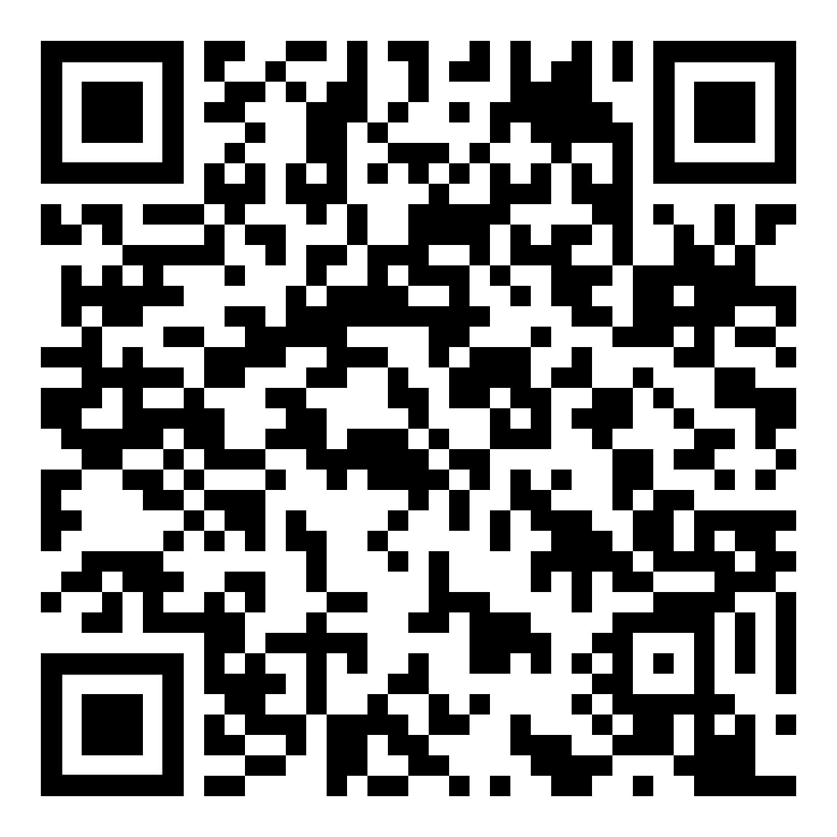
The Planning System
Offers the following high-level features:
Booking a meeting
Booking vacation time
Checking availability for a room
Checking availability for a person
Printing the agenda for a room
Printing the agenda for a person
Notes:
Go over, then give demo of Driver

Slide 4
Develop a Test Plan
In groups, come up with a test plan for this system.
Given the features and the code documentation, plan unit tests to ensure that these features can be performed without error.
Notes:
Go over,

Slide 5
Food for Thought
Try running the code!
Perform exploratory testing to test it at the system level.
Think about normal and erroneous inputs/actions.
How many things can go wrong?
You will probably be able to add a normal meeting, but can you add a meeting for February 35th?
Try it out - you have the code.
Notes:
Go over,
GET thumb drives for each team, pass out with code.
(10-15 minutes, then talk over)

Slide 6
Develop Unit Tests
If a test is supposed to cause an exception to be thrown, make sure you check for that exception.
Make sure that expected output is detailed enough to ensure that - if something is supposed to fail - that it fails for the correct reasons.
Use proper assertions.
Notes:
Sample test in Calendar class, bring it up, then come back

Slide 7
Example - Adding Midsommar
@Test
public void testAddMeeting_holiday() {
Calendar calendar = new Calendar();
try {
Meeting midsommar = new Meeting(6, 26, "Midsommar"); // Create holiday
calendar.addMeeting(midsommar); // Add to calendar object.
Boolean added = calendar.isBusy(6, 26, 0, 23); // Verify that it was added.
assertTrue("Midsommar should be marked as busy on the calendar",added);
} catch(TimeConflictException e) {
fail("Should not throw exception: " + e.getMessage());
}
}
Setup
Test Steps
Input
Oracle
Oracle

Slide 8
Can you expose the faults?
Notes:
(discuss)

Slide 9
Can you expose the faults?
1: getMeeting and removeMeeting perform no error checking on dates.
public Meeting getMeeting(int month, int day, int index){
return occupied.get(month).get(day).get(index);
}
public void removeMeeting(int month, int day, int index){
occupied.get(month).get(day).remove(index);
}
Notes:
Go over,
(give them time to program)

Slide 10
Can you expose the faults?
2: Calendar has a 13th month.
public Calendar(){
occupied = new ArrayList<ArrayList<ArrayList<Meeting>>>();
for(int i=0;i<=13;i++){
// Initialize month
occupied.add(new ArrayList<ArrayList<Meeting>>());
for(int j=0;j<32;j++){
// Initialize days
occupied.get(i).add(new ArrayList<Meeting>());
}
}
}
Notes:
Go over,
(give them time to program)

Slide 11
Can you expose the faults?
3: November has 30 days.
Oh - and we just added a meeting to a day with a date that does not match that date.
occupied.get(11).get(30).add(new Meeting(11,31,"Day does not exist"));
Notes:
Go over,
(give them time to program)

Slide 12
Can you expose the faults?
4: Used a >= in checking for illegal times. December no longer exists.
if(mMonth < 1 || mMonth >= 12){
throw new TimeConflictException("Month does not exist.");
}
Notes:
Go over,
(give them time to program)

Slide 13
Can you expose the faults?
5: We should be able to start and end a meeting in the same hour.
if(mStart >= mEnd){
throw new TimeConflictException("Meeting starts before it ends.");
}
Notes:
Go over,
(give them time to program)

Slide 14
What Other Faults Can You Find?
Notes:
(pull in their tests, run them, see what happens)

