Slide 1
Software Architecture
CSCE 247 - Lecture 15 - 03/18/2019

Slide 2
In the beginning…

Slide 3
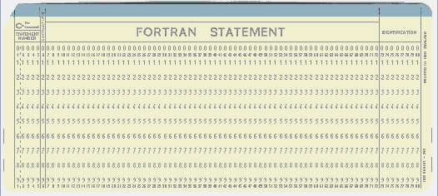
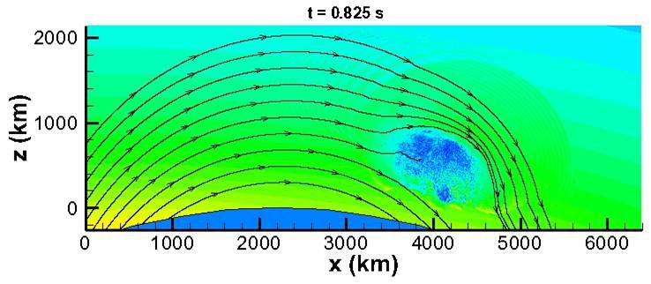
Software Was Small
Both physically…
And in scope.
Notes:
In the beginning, software was small. This was true physically - punch cards are annoying, computing power was limited. By necessity and because of lack of experience, in scope too. Important - very important - but focused on particular problems. Missile trajectories, Simulations, wargames, code breaking. Single task - no API or code reuse, limited functionality

Slide 4
Software Starts to Grow Up
Languages like C introduce file linking.
Enables organization of code and reuse of code.
SIMULA-67, Smalltalk introduce objects.
Enables organization of code into focused units that work with other objects to perform larger tasks.
Sections of the code “activate” when needed.
We can group together related functionality, ignore unrelated functionality, and find what we need when making changes.
Code can be reused in future projects.
Notes:
Then, however, our experience andcomputing power grew and matured, and we started to expand our ideas of what could be done with software.

Slide 5
Flash forward to the present day...
Notes:
Just start with a question - want you to start thinking about this. (read)
This isn’t something with one answer, or even a right answer. It’s something we’ll keep returning to

Slide 6
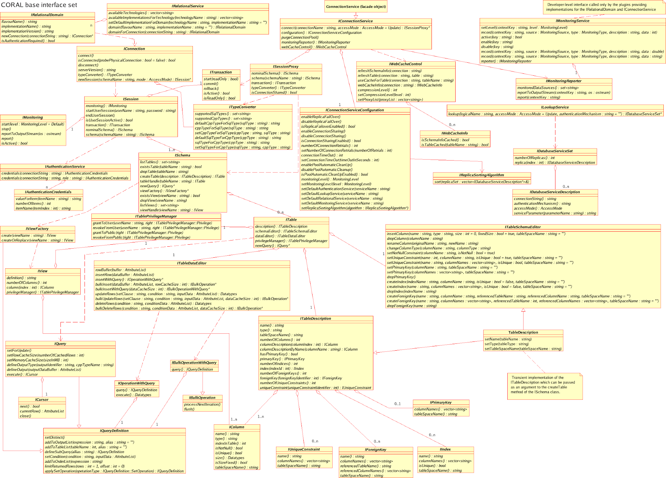
Under the Hood
Systems have millions of lines of code.
Divided into hundreds of classes.
Notes:
The scope has expanded.However, growth in scope means growth in the size and complexity of the code base. (1-2). If not more - it came out last year that Facebook’s iOS app had 18000 classes. Now, this is a bit more than usual, and partially the result of automated code generation. However - hundreds is common. Keeps growing.

Slide 7
Growing Pains
No person can understand an entire million-line codebase.
Classes organize code, but how can you find the right clases when there are thousands?
Results in chaos.
Only 16.1% of projects delivered on time and within budget, with all planned features complete as specified.
31.1% of projects are cancelled before delivery.
Delivered projects may be slow, insecure, missing features, have duplicate code, go down often, etc.
Notes:
Ultimately, this growth is good - we can do incredible things with software that were impossible before. But it comes at a cost, and there are some growing pains. (go over)

Slide 8
The Concept: “Architect” Software
The key to delivering robust software?
Designing an understandable, organized system.
AKA: “taming the complexity”
Architecting software is the practice of partitioning a large system into smaller ones.
That can be created separately
That individually have business value
That can be straightforwardly integrated with one another and with existing systems.
Notes:
So, the key to delivering robust software is through a thorough design process (go over). This is one of, if not the most important task you perform when developing software

Slide 9

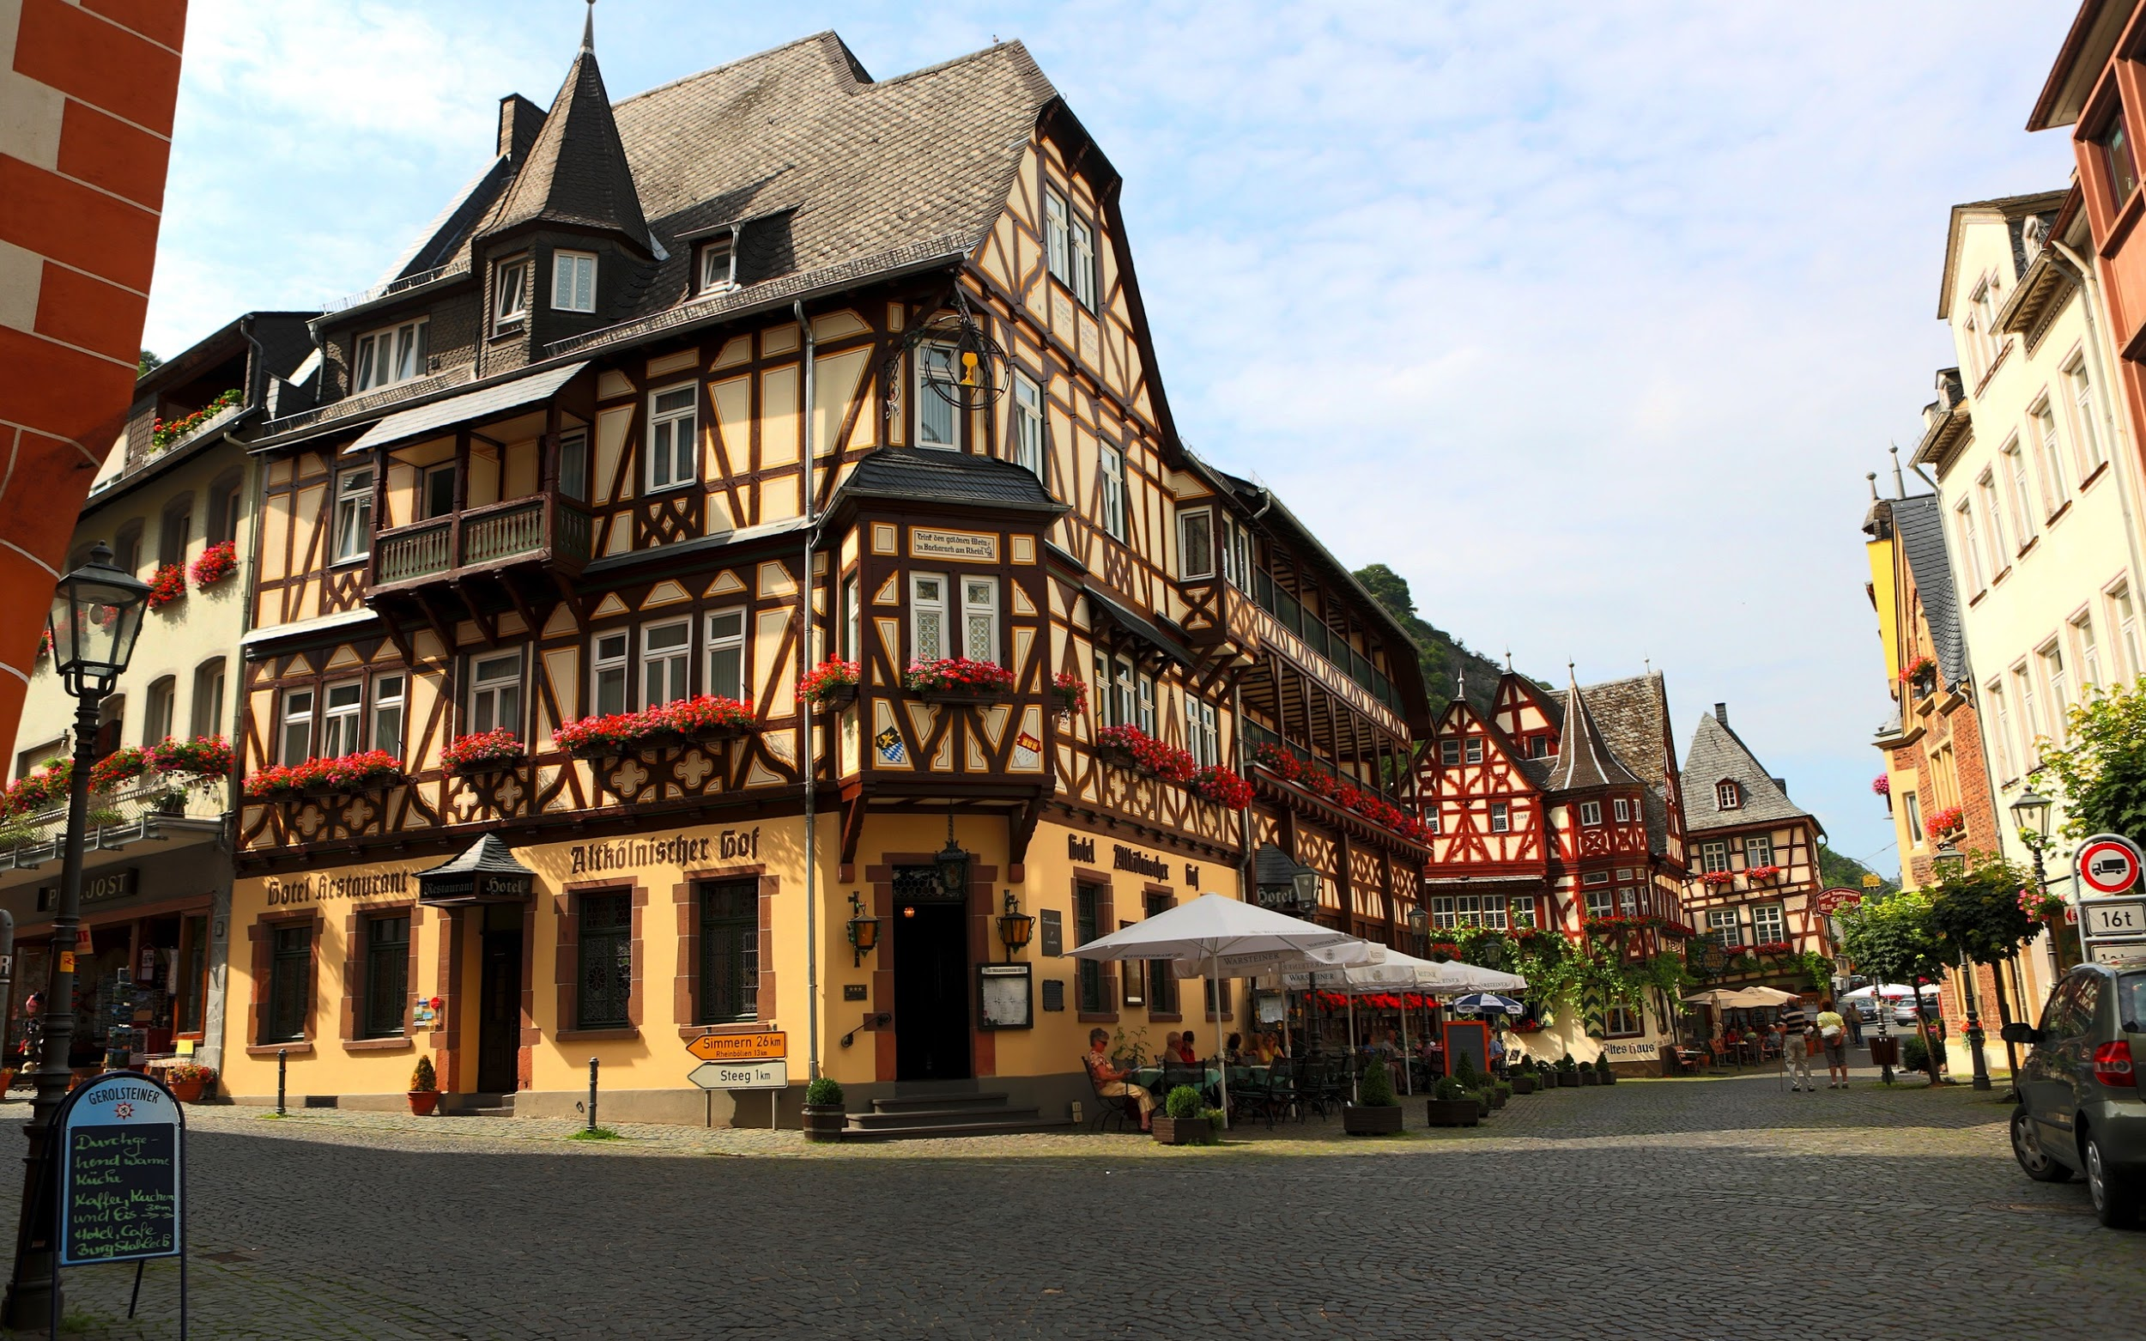

Architectural Styles
Notes:
Let’s talk about buildings. You see a few on this slide, you’re in one right now. Good, solid engineered products. Now, the buildings on this slide are all very different - you’ve got a castle, you’ve got a skyscraper, you’ve got some kind of german beer hall thing. They’re still different versions of the same fundamental concept - a permanent structure to protect inhabitants from the elements, offer privacy to conduct business or live, and all of those other things we use buildings for. But, each does belong to a distinct category. The top left one is clearly a castle. Every castle has its variations, but they are still distinctly castles. Same for skyscrapers. All skyscrapers are a little different, but they are built using the same materials, with similar support structures, elevator placement, hvac structures, and so on. So, over time, we see styles of building appear - different architectures that, although they allow variation, enable us to take the lessons learned from others of that type and distill those into new buildings. When you go to build a skyscraper now, there isn’t much need for experimentation, there isn’t much cause to worry that it’ll all collapse. We know how to build a skyscraper because we have a template to follow - a framework we can be creative within, but still offers structure. Software offers similar architectural styles that can inform and structure the design of new projects.

Slide 10
What is Software Architecture?
“The architecture of a software-intensive system is the structure or structures of the system, which comprise software elements, the externally-visible properties of those elements, and the relationships among them.”
Carnegie-Mellon Software Engineering Institute (SEI)
Notes:
(go over). Now, there are a few highlighted terms here, and these are some basic components that inform our architecture.

Slide 11
Architectural Design
First stage of design.
Partitions the requirements into self-contained subsystems.
Later, each subsystem will be decomposed into one or more classes.
Plan how those subsystems cooperate and communicate.
Notes:
Planning the architecture of a system is the first step in design. It’s how we take this idea of a monolithic system, break it down into independent layers and subsystems, and structure how those parts connect. Before we design classes, before we choose algorithms, we should take the idea we have, the list of features, and broadly lay out how we will deliver that functionality.
(2), portions of the software responsible for certain features, and (4) to deliver the promised functionality.
(3), but for now, we’re concerned with the design at a higher level. Before we can effectively lay out the classes, we need to lay down a broader structure

Slide 12
Static Structures
The static structures of a system define its internal design-time elements and their arrangement.
Software elements: modules, classes, packages.
Data elements: Database entries/tables, data files.
Hardware elements: Servers, CPUs, disks, networking environment
The static arrangement of elements defines associations, relationships, or connectivity between these elements.
Notes:
There are two types of system structure of interest to the software architect: static structures, which matter at design-time, and dynamic, which matter at runtime. The static structures of a system tell you what the design-time form of a system is—that is, what its elements are and how they fit together. These might be (2), or services. Any self-contained code unit. Internal data elements include relational (3). (4) - such as cables, routers, hubs, and how the network is arranged. The static arrangement of these elements defines—depending on the context—the associations, relationships, or connectivity between these elements.

Slide 13
Static Structure Arrangement
For software elements, static relationships define hierarchy (inheritance) or dependency (use of variables or methods).
For data elements, static relationships define how data items are linked.
For hardware elements, static relationships define physical interconnections between hardware elements.
Notes:
(1) between modules. Flesh out hierarchy/dependency.(2) - ie., elements from a database may collectively define an entry in a relational database, or two tables may be part of the same overall database. (3) In a networked environment, for instance, we would define how the machines are connected together - are they in the same datacenter or office? What network topology are we using?

Slide 14
Dynamic Structures
The dynamic structures of a system define its runtime elements and their interactions.
May depict flow of information between elements
A sends messages to B
May depict flow of control in a particular scenario.
A.action() invokes B.action()
May depict effect an action has on data.
Entry E is created, updated, and destroyed.
Notes:
(1) The system’s dynamic structures show how the system actually works— that is, what happens at runtime and what the system does in response to external (or internal) stimulus. (2-7)

Slide 15
Architectural Elements
An architectural element is a fundamental piece from which a system can be constructed.
The scope of an element depends on the type of system.
A single method, a class, a set of related classes (a subsystem), an imported library can all be elements.
“Component”, “module”, and “unit” are often used interchangeably, but are overloaded terms.
Notes:
Whether looking at a static or dynamic view of the design, (1). The nature of an architectural element depends very much on the type of system you are considering and the context within which you are considering its elements. Programming libraries, subsystems, deployable software units (e.g., Enterprise Java Beans and Active X controls), reusable software products (e.g., database management systems), or entire applications may form architectural elements in an information system, depending on the system being built. Architectural elements are often known informally as components or modules or units, but these terms are overloaded - already widely used with established specific meanings (component tends to suggest the use of a programming-level component model (such as J2EE or .NET), while module tends to suggest a programming language construct). Although these are valid architectural elements in some contexts, they won’t be the type of fundamental system element used in others.So, not to get pedantic, but element is our generic term.

Slide 16
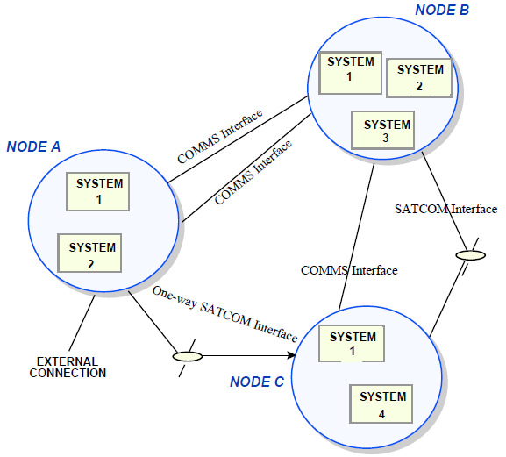
Architectural Elements
An element must possess key attributes:
A clearly defined set of responsibilities.
A clearly defined boundary.
A set of defined interfaces.
Define the services that the element provides to other elements.
Notes:
(1-2). What jobs does the element perform in the system?
(3) Where does it end? What exact classes belong to this subsystem? Or library?
(4-5)

Slide 17
Externally Visible Behavior
The externally visible behavior of a system defines the functional interactions between the system and its environment.
Flow of information in and out of the system.
How the system responds to input.
The defined interfaces available to the outside world.
Can be modeled in architecture as a black box (ignoring any internal information).
Can also be modeled by including how internal state responds to external input.
Notes:
External properties manifest themselves in two different ways: externally visible behavior (what the system does) and quality properties (how the system does it). (1) Externally visible behavior tells you what a system does from the viewpoint of an external observer. These external interactions form a set similar to the ones we considered for dynamic structure. This includes flows of information in and out of the system, the way that the system responds to external stimuli - to method input or interactino with a user interface, and the published interfaces - the “contract” or API that the architecture has with the outside world. External behavior may be modeled by treating the system as a black box so that you don’t know anything about its internals (if you make request to a system built in compliance with the architecture, you are returned this response). Alternatively, you can consider changes to internal system state in response to input (submitting this request causes a timer to start, and on completion of that timer, an electrical impulse is released).

Slide 18
Quality Properties
A quality property is an externally visible, nonfunctional property.
Performance, security, availability, safety, modifiability, testability, usability, etc.
How does the system perform under load?
How is information protected from unauthorized use?
How long will it be down on a crash?
How easy is it to manage, maintain, and enhance?
Tell us how an observer views the behavior of a system.
Notes:
Quality properties tell you how a system behaves from the viewpoint of an external observer (often referred to as its nonfunctional characteristics). We talked about these some last time, but (1) (2-6).

Slide 19
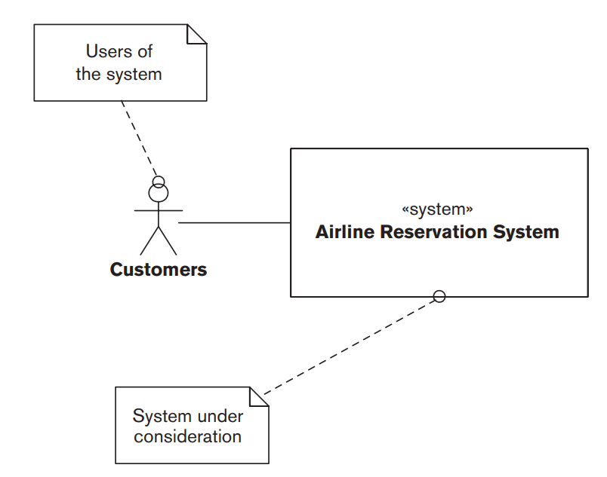
Airline Reservation System
Airline Reservation System
Allows seat booking, updating, cancellation, upgrading, transferring.
Externally visible behavior: How it responds to submitted transactions.
Quality properties: average response time, max throughput, availability, time required to repair issues.
Notes:
Let’s bring these concepts together now. We have to design the architecture for an airline reservation system supports a number of different transactions to book airline seats, update or cancel them, transfer them, upgrade them, and so forth.The externally visible behavior of the system (what it does) is its response to the transactions that can be submitted by customers, such as booking a seat, updating a reservation, or canceling a booking. The quality properties of the system (how it does it) include the average response time for a transaction under a specified load, the maximum throughput the system can support, system availability, and the time required to repair defects.
Now, we haven’t talked over any concrete details yet, but how would you architect this? (discuss)

Slide 20
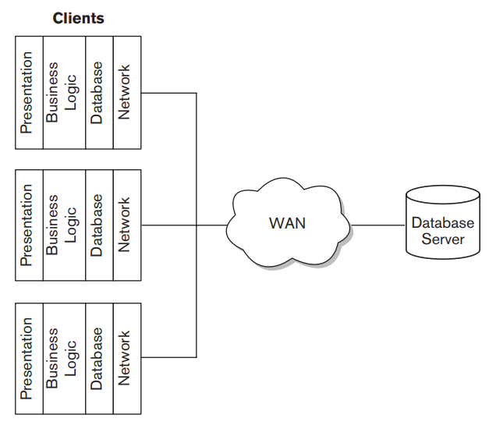
Option 1: Client/Server Architecture
Clients communicate with a central server (with a database) over a network.
Static Structure: Client programs, broken into layered elements, a server, and connections.
Dynamic Structure: Request/response model.
Notes:
Faced with these requirements, there are a number of ways that an architect could design a system for it. Let’s talk about two. First, we could approach this through what is a basic Client/Server Architecture - which we’ll talk over more today. In this approach, a number of clients (which present information to customers and accept their input) communicate with a central server (which stores the data in a relational database) via a wide-area network (WAN). The static structure (design-time organization) for this client/server architecture consists of the client programs -Three different clients shown here, all subsystems that serve different purposes in the overall system - (which in this example are further broken down into presentation, business logic, database, and network layers - what we call a layered architecture), the server, and the connections between them. The dynamic structure (runtime organization) is based on a request/response model: Requests are submitted by a client to the server over the WAN, and responses are returned by the server to the client

Slide 21
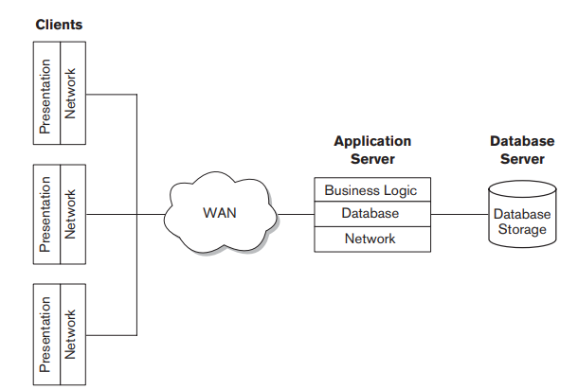
Option 2: “Thin Client” (Client/Server) Architecture
Clients communicate with a central server (with a database) over a network.
Static Structure: Client programs only perform presentation. An application server performs logic computations.
Dynamic Structure: Request/response model. Requests submitted to application server, then database server.
Notes:
Our second option is a three-tier or thin-client approach - still a client/server architecture, but architected a little differently), where only the presentation processing is performed on the clients, with the business logic and database access performed in a new application server. The static structure for this architecture consists of the client programs still (which are further broken down into presentation and network layers), the application server (here, business logic, database, and network layers), the database server, and the connections between them. The dynamic structure is based on a three-tier request/response model: Requests are submitted by a client to the application server over the WAN, the application server submits requests to the database server if necessary, and responses are returned by the application server to the client. So, which would you prefer? Why? (discuss)

Slide 22
Which Would You Choose?
Both display same externally behavior, but may differ in quality properties.
First approach is simpler.
Second might provide better options for scalability, or be more secure.
Must select a candidate architecture that satisfies all requirements and meets the proposed quality properties.
Extent that a model exhibits behaviors and quality properties must be studied further.
Notes:
Although the candidate architectures have different static and dynamic structures, each must be able to meet the system’s overall requirements. Each of these should share the same externally visible behaviors (in this case, responses to booking transactions) and general quality properties (such as acceptable response time, throughput, availability, and time to repair), they are likely to differ in the specific set of quality properties that each exhibits. The architect might identify the two-tier approach as appropriate for the architecture because of its relative operational simplicity, because it can be developed quickly by the organization’s software developers, because it can be delivered at lower cost than other options, or for a range of other reasons. Alternatively, the architect may consider the three-tier approach to be right for the architecture because it provides better options for scalability as workload increases, because less powerful client hardware is needed, because it may offer better security, or for other reasons.
Whichever approach the architect considers to be most appropriate, you chooses because it provides the best match between the favored quality properties and the requirements of the system. In each case, the extent to which the candidate actually exhibits these behaviors and properties must be determined by further analysis of its static and dynamic structures. For example, the client/server model might meet the functional requirements better because it supports functionally richer clients; the three-tier model might deliver better throughput and response time because it is more loosely coupled. It is part of the architect’s role to derive the static and dynamic structures for a candidate architectures, understand the extent to which they exhibit the required behaviors and quality properties, and select the best one. Of course, what is meant by “best” may not always be clear. What should I choose might not always be obvious.

Slide 23
Static Structuring
Notes:
(discussion) what entails a good design?

Slide 24
Static Structuring
How we decompose the system into interacting elements.
Can be visualized as block diagrams presenting an overview of the system structure.
Vision System
Arm Controller
Gripper Controller
Packaging Selection System
Object Database
Object ID System
Conveyor Controller
Packing System
Notes:
This leads us to the first major part of the architecture design process - static structuring. Breaking down the system into several principal subsystems and identifying how they communicate.
this is normally expressed as a block diagram presenting a high-level overview of the system structure - not very detailed yet, but a good start for brainstorming and explaining how the system is constructed. So, pretty straightforward - each block is a element., lines mark channels of communication and control. Sometimes, we group elements together into a single subsystem. This is fairly informal right now, but gives you an idea of where the components of the final system will go and how they relate/communicate/and work together (go over packaging robot control system)

Slide 25
Basic Architectural Styles
Four common styles: layered, shared repository, client/server, pipe & filter
The style used affects the performance, robustness, availability, maintainability, etc. of the system.
Complex systems might not follow a single model - mix and match.
Notes:
We’re going to cover four common models - (read),
In practice, the style of architecture you cover will dictate many of the characteristics of your system. (read). Your task is to choose the right style for the job - you wouldn’t grab the blueprints for a skyscraper when building a castle. Same for software.
That said, as many of these qualities conflict, and as real-world projects are complex - you generally don’t just apply one of these models and call it a day. These should be taken as advice, patterns that can help you design a robust project, but can’t guarantee anything. You usually will adapt multiple patterns, or steal lessons from several, and merge them into different parts of your project where they will be helpful.

Slide 26
Layered Model
System functionality organized into layers, with each layer only dependent on the previous layer.
Allows elements to change independently.
Supports incremental development.
User Interface
Interface Management, Authentication, Authorization
Core Business Logic (Functionality)
System Support (OS interface, Databases, etc.)
Notes:
- In the layered architecture, (read). Each layer provides services to the layer immediately above it. The lowest layers represent core services likely to be used throughout the system and the higher layers represent user-facing functionality or security features such as authetnication.
- The big idea here is to separate functionality into logical layers where each layer can change independently of the others - if we want to swap out the user interface, we can do so without impacting all of the back-end functionality. This can be a big boon to maintenance - keeping software alive long past where we would be able to otherwise.
- This also (read). As a layer is developed, some of the services provided by that layer can be made available to users. We can slot in new functionality as it is completed.

Slide 27
Copyright Management Example
Web-based Interface
Login, Forms and Query Manager, Print Manager
Search, Document Retrieval, Rights Management, Accounting
Search Index, Support
Databases and Database Handlers
Notes:
Here is an example of the layered architecture for a copyright management system in a university librar
(walk through, relate layers) these might be seperate subsystems, but at the same layer.

Slide 28
Layered Model Characteristics
Advantages
Allows replacement of entire layers as long as interface is maintained.
When changes occur, only the adjacent layer is impacted.
Redundant features (authentication) in each layer can enhance security and dependability.
Disadvantages
Clean separation between layers is often difficult.
Performance can be a problem because of multiple layers of processing between call and return.
Notes:
(discussion - advantages?)
(read). The architecture is changeable and portable. Like I mentioned, as layers are done, those features can be made available to users, with more features added as other layers are complete. As long as the interface is unchanged, a layer can be replaced by another at any time, adding features or chaging how they work without requiring that the rest of the system be changed. This can be incredibly powerful.
When interfaces or features do change, only the adjacent layer is impacted. And, since the machine dependencies are restricted to lower layers, it is easier to port these systems to other OSes. Only the lowest layers need to be recoded for a new OS or to adapt to database changes.
(read), this is a powerful way to protect important data.
(disadvantages)
(read). In practice, a high-level layer may have to interact with a low-level layer through multiple levels of access. That adds communication overhead.
(read).

Slide 29
The Repository Model
Subsystems often exchange and work with the same data. This can be done in two ways:
Each subsystem maintains its own database and passes data explicitly to other subsystems.
Shared data is held in a central repository and may be accessed by all subsystems.
Repository model is structured around the latter.
Notes:
One big factor to consider in deciding on architecture is what data your system works with. In the layered architecture, we can bundle data and subsystem in the same layer, but if you have a bunch of subsystems across the entire system that work with the same data, you can get in trouble and increase dependency across multiple layers. If (1,2,3)
Each has its pros and cons. At the local level, the former is often a good idea - we talked about that last time, local data decreases coupling. Still, this doesn’t always work or make sense.
If several subsystems need the same data, it can be hard to figure out where to stash parts of it and it can be inefficient - results in a lot of communication.
The repository model is structured around the latter - many structured around large amounts of data, used by many different system function, are organized around a central database.

Slide 30
IDE Example
Model Editor
Code Generator
Java Editor
Project Information and Code
Suggested Refactorings
Python Editor
Design Analyzer
Report Generator
Notes:
This kind of model is useful when data is produced by one component and used by another. This is useful when components don’t need to interact directly, but rather through the manipulation of information.
(describe example)
Consider an IDE - the central data is our source code, the project we’re building. The data repository is the code.
walk through components

Slide 31
Repository Model Characteristics
Advantages
Efficient way to share large amounts of data.
Components can be independent.
May be more secure.
All data can be managed consistently (centralized backup, security, etc)
Disadvantages
Single point of failure.
Subsystems must agree on a data model (inevitably a compromise).
Data evolution is difficult and expensive.
Communication may be inefficient.
Notes:
(discussion - advantages?)
(read).
(read). They do not need to be aware of the existence of other components. They are just concerned with the data. This can be pretty secure - you can completely wall off each of those systems.
(read). Data can be controlled centrally, we don’t need to synchronize all subsystems. We can centralize backups, we can use a single security policy to manage data.
(disadvantages)
(read). Problems with the repository affect the whole system. If you can get in there and corrupt that data, then you wreck everything.
Everybody needs to work with the same data, not their own interpretation of that data. (read).
(read) - say we want to change that central data and how it works, how it is stored - that requires changes to all subsystems, not just one subsystem that stores data locally.
Since components communicate through the central repository, rather than with each other (read) - more overhead is needed

Slide 32
Client-Server Model
Functionality organized into services, distributed across a range of components:
A set of servers that offer services.
Print server, file server, code compilation server, etc..
Set of clients that call on these services.
Through locally-installed front-end.
Network that allows clients to access these services.
Distributed systems connected across the internet.
Notes:
can just read this
That said, while this is usually the architecture used for distributed systems across the internet, this can also be a logical model used a system on a single local machine. An important benefit is separation and independence. Services and servers can be changed without affecting the other parts of the system.

Slide 33
Film Library Example
Client N
...
Client 2
Client 1
Catalog Server
Video Server
Search Server
HTML Server
Notes:
something like Netflix might use this architecture.
Each local system operates lightweight client software that calls the appropriate servers - an html server when it needs to serve a webpage to the interface, the video server when a video needs to be streamed, and so on.
Multiple clients can be connected at once, and when pinged, a server provides the service is was written for.

Slide 34
Client-Server Model Characteristics
Advantages
Distributed architecture.
Failure in one server does not impact others.
Makes effective use of networked systems and their CPUs. May allow cheaper hardware.
Easy to add new servers or upgrade existing servers.
Disadvantages
Performance is unpredictable (depends on system and network).
Each service is a point of failure.
Data exchange may be inefficient (server -> client -> server).
Management problems if servers owned by others.
Notes:
(discussion - advantages?)
read these
(disadvantages)
read these

Slide 35
Pipe and Filter Model
Input is taken in by one component, processed, and the output serves as input to the next component.
Each processing step transforms data.
Transformations may execute sequentially or in parallel.
Data can be processed as items or batches.
Similar to Unix command line:
cat file.txt | cut -d, -f 2 | sort -n | uniq -c
Notes:
(read) In the repository model, we had a bunch of subsystems that needed to work with the same data, here, we have a sequence of steps where we take data, transform it, and pass it to the next system.
read rest

Slide 36
Customer Invoicing Example
Receipt Generation
Receipts
Invoice Processing
Payment Identification
Payment Management
Payment Reminders
Reminders
Invoices
Payments
Notes:
Application that issues invoices to customers. Once a week, payments made are checked and invoices are adjusted. If invoices have been paid, a receipt is issued. If not, a reminder is issued.
(walk through)

Slide 37
Pipe and Filter Characteristics
Advantages
Easy to understand communication between components.
Supports subsystem reuse.
Can add features by adding new subsystems to the sequence.
Disadvantages
Format for data communication must be agreed on. Each transformation needs to accept and output the right format.
Increases system overhead.
Can hurt reuse if code doesn’t accept right data structure.
Notes:
(discussion - advantages?)
- read, we have a pretty clear idea of who needs to communicate with whom.
- (read) - since communication progresses in a line, we don’t tend to have many dependencies between multiple components
- (read) - similarly, we can just slot in new subsystems without much integration work
(disadvantages)
-read
- read, there is some performance overhead since subsystems aren’t well connected
- read

Slide 38
Dynamic Structuring
Notes:
(discussion) what entails a good design?

Slide 39
Control Models
A model of the control relationships between the different parts of the system is established.
During execution, how do the subsystems work together to respond to requests?
Centralized Control:
One subsystem has overall responsibility for control and stops/starts other subsystems.
Event-Based Control:
Each subsystem can respond to events generated by other subsystems or the environment.
Notes:
(read). This is distinct from system decomposition - that is more of a static idea, what are the components? Control modeling looks at runtime - when the system executes - when a command comes in or an event occurs - (read). Where are requests routed, and when?
The control model typically takes on two forms:
(read, read)

Slide 40
Centralized Control: Call-Return
A central piece of code (Main) takes responsibility for managing the execution of other subsystems.
Call-Return Model
Applicable to sequential systems.
Top-down model where control starts at the top of a subroutine and moves downwards.
Main program
Subsystem 1
Subsystem 2
Class 1.1
Class 1.2
Class 2.1
Class 2.2
Notes:
When control is centralized, one piece of the system - usually just your Main in the program - takes responsibility for managing the execution of all of the subsystems. The most common form of this for sequential programs is the call-return model:
(read, read).
So, a request comes in to the control module, and it calls the appropriate subsystem, which calls methods in its modules, stepping down into the system hierarchy and returning the result up that tree until it reaches the control subsystem again. Like I said, kind of your default contro lstructure.

Slide 41
Centralized Control: Manager Model
Sensor Processes
Actuator Processes
Manager Model
Applicable to concurrent systems.
One process controls the stopping, starting, and coordination of other system processes.
Sensor Processes
Actuator Processes
Sensor Processes
Actuator Processes
System Controller Process
Computation Processes
Fault Handler Processes
Control Processes
Fault Handler
Control Processes
Fault Handler
User Interface Process
Notes:
In a concurrent system, with many parallel components, the manager model is common, where (read)
(walk through system)

Slide 42
Decentralized Control:
Event-Driven Systems
Control is driven by externally-generated events where the timing of the event is out of control of subsystems that process the event.
Broadcast Model
An event is broadcast to all subsystems.
Any subsystem that needs to respond to the event does do.
Interrupt-Driven Model
Events processed by interrupt handler and passed to proper component for processing.
Notes:
Many embedded systems and systems distributed over networks follow more of a decentralized control style - driven instead by input events. (read)
Tends to either be a broadcast model, where (read)
or more of a centralized interrupt-driven model where (read)

Slide 43
Broadcast Model
An event is broadcast to all subsystems, and any that can handle it respond.
Subsystems can register interest in specific events. When these occur, control is transferred to the registered subsystems.
Effective for distributed systems. When one component fails, others can potentially respond.
However, subsystems don’t know when or if an event will be handled.
Notes:
(read).
a publisher-subscriber model (read).
This can be very effective because it doesn’t need a central authority. On a network, any live computers can listen, and the ones that see the event and can respond do so. Even if failures occur, the working components can react.
The downside is that (read). There is no guarantee that the system will respond to an event.

Slide 44
Interrupt-Driven Model
Events processed by interrupt handler and passed to proper component for processing.
For each type of interrupt, define a handler that listens for the event and coordinates response.
Each interrupt type associated with a memory location. Handlers watch that address.
Used to ensure fast response to an event.
However, complex to program and hard to validate.
Notes:
(read).
- So, how this works is that you (read). In centralized control, you had a unit - maybe your main - that would interpret input and call the appropriate subsystem. Here, you have a set of managers, each tuned to a particular event type
- You attach listeners to a particular input port, and when that memory location fires up with information, it notifies the appropriate subsystem.
- (read)
- The downside is that (read)

Slide 45
Nuclear Plant Interrupt Example
Interrupt Array
Temperature Event Handler
Radiation Event Handler
Fire Alarm Event Handler
Fuel Event Handler
Process 1
Process 2
Process 3
Process 4
Notes:
Say we have a nuclear plant controller, where we regulate temperature and other factors with our plutonium rods.
We have a bunch of events that we need to watch for, tied to certain sensors.
We define a handler for each event type, and they watch that memory location for events. When something hits that channel, they scramble a response
(name specifics)

Slide 46
Example: The ASW
You are designing control software for an aircraft. In such software, multiple behaviors are based on altitude. The software interfaces with one of more altimeters, makes autopilot decisions based on this information, and outputs status information to a monitor that is viewed by the pilot. If altitude drops below certain thresholds, the system will send warnings to that monitor and, if autopilot is engaged, will attempt to correct the plane’s orientation.
Perform static structuring. Try to use one or more of the models covered.
Perform dynamic structuring. How should control be routed?
Notes:
(read and discuss).
activity

Slide 47
ASW Solution
Perform system structuring. Try to use one or more of the models covered.
Option 1: Repository Model
Monitor Output
Altimeter History Repository
Altimeter Reading
Autopilot Control
Notes:
talk through

Slide 48
ASW Solution
Perform system structuring. Try to use one or more of the models covered.
Option 2: Pipe and Filter
Altimeter Reading
Monitor Output
Altimeter Response
Autopilot Control
Notes:
talk through

Slide 49
ASW Solution
Perform control modeling. How should events be handled?
Depends on how you answered the previous question, but a natural option would be an Interrupt-Driven Model.
Handlers for new altimeter readings, for error flags triggered by altimeter processing code.

Slide 50
Key Points
The software architecture must consider static structure, dynamic structure, externally-visible behaviors, and quality properties.
Architectural models can help organize a system.
Layered, repository, client-server, and pipe and filter models - also many others.
Control models include centralized control and event-driven models.
Notes:
(read)

Slide 51
Next Time
Object-oriented design and class diagrams
Reading
Sommerville, chapter 5, 7
Fowler UML, chapter 3
(or any resource on class diagrams)
Homework: Assignment 3 is out!
Notes:
(read)

