Slide 1
Lecture 14:
Finite State Verification
Gregory Gay
DIT636/DAT560 - March 5, 2025

Slide 2
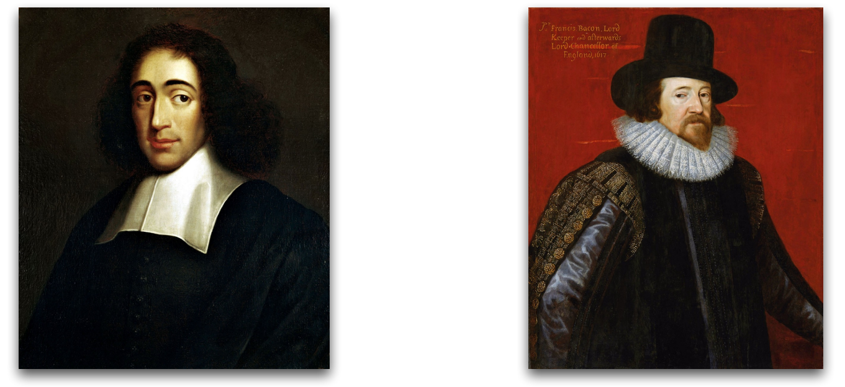
How do we know a system is correct?
Rationalists
Empiricists
“It is correct because I proved that certain errors do not exist in the system.”
“It is correct because I never observed incorrect behaviors.”
Adapted from Shin Yoo (KAIST)
Notes:
Back in the first lecture, we brought in our friends the rationalists and the empiricists and asked them the question (title) The rationalist would say that (read), while the empiricists would suggest (read). These two sides lead to the two primary families of verification techniques - what we call static and dynamic verification.

Slide 3
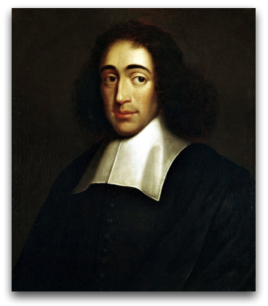
So, You Want to Perform Verification...
You have a requirement the program must obey.
Great! Let’s write some tests!
Does testing prove the requirement is met?
“It is correct because I proved that certain errors do not exist in the system.”
Not quite…
Testing can only make a statistical argument.
Notes:
We’ve spent a lot of time on the empiricist point of view. Today, the rationalist wants to have their opinion heard (1-3). discuss (click)
Not quite… Testing can make a statistical argument in favor of verification, but usually cannot guarantee that the requirement holds in all situations.
It builds evidence that we’re doing the right thing. We can show individual situations where the property holds, but usually, we cannot guarantee that the requirement holds in all situations.

Slide 4
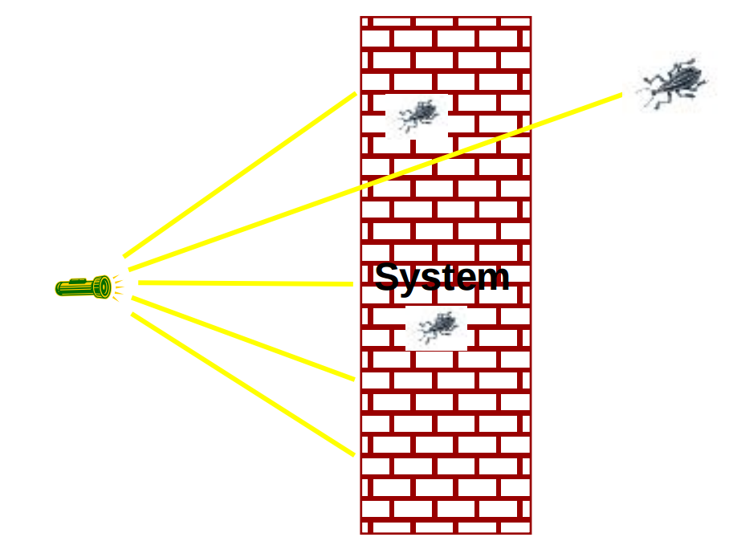
Testing
Most systems have near-infinite possible inputs.
Some failures are rare or hard to recreate.
Or require very specific input.
How can we prove that our system meets the requirements?
Notes:
(1)Some faults, like synchronization faults in multi-threaded systems, trigger failures extremely rarely, or require very specific input, or only fail under conditions that are hard to control and recreate through testing. (3)

Slide 5
What About a Model?
We have previously used models to create tests.
Models are simpler than the real program.
Models can be used to verify full programs.
Can see if properties hold exhaustively over a model.
Notes:
1, Models can be used to “tame” the complexity of the program. (2) By abstracting away unnecessary details, we can learn important insights. (3-4)

Slide 6
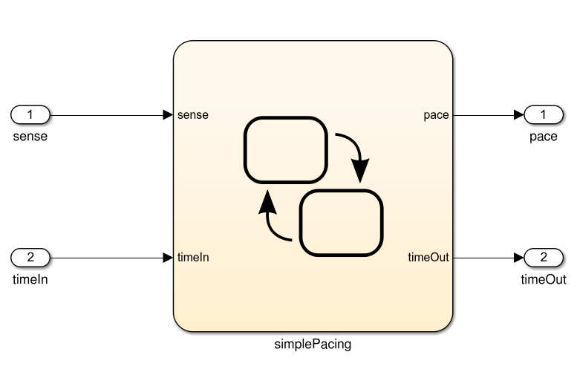
What Can We Do With This Model?
If we can prove that the model satisfies the requirement, then we can argue that the program should as well.
Specification
public static void Main(){
System.out.println(“Hello world!”);
}
And If the model is well-formed, consistent, and complete.
And If the model accurately represents the program.
If the model satisfies the specification...
Notes:
Ultimately, we need to make the argument that the the system we built fulfills the specification - make the argument for verification. The model represents the first step in making that argument. If we take the specification and formulate it as a series of logical properties, we can check whether those properties hold by analyzing the model. As the model comes directly from our requirements and our understanding of the system, if there are violations, there is an issue with our plans - somewhere, our requirements and specifications are wrong. They might be contradictory, incomplete, or just have a mistake. By verifying properties over the model, we can find out if there are issues and fix them. So, the train of thought is that if the model satisfies the properties, AND if the model is well-formed, consistent, and complete, AND if the model actually represents the final program, then proving properties over the model is an argument that your specifications are correct and that the final product will actually meet them. Basically, the model is a simpler form of the program that we can analyze. If it is representative, then a property that holds over the model will hold over the full system as well.
Where do you think you can get in the most trouble here? (discuss - last one, but if it is representative, then great - and we can, if nothing else, generate tests based on these properties using the model and apply them to the real system)

Slide 7
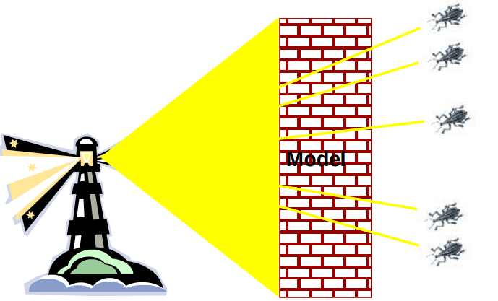
Finite State Verification
Express requirements as Boolean formulae.
Exhaustively search state space of the model for violations of those properties.
If the property holds - proof of correctness.
Contrast with testing - no violation might mean bad tests.
Notes:
Often, on a real program, testing is the best you can do. You can’t cover the full input space, but you try to do enough to feel confident. In this case, however, we’ve simplified things dramatically by building a model. A model is much, much simpler than the real system - it represents one functionality, it doesn’t replicate it in every detail, it’s abstract in some manner. So, we can perform a more thorough analysis. This is a process called finite state verification. Express specification as a set of logical properties, written as Boolean formulae. Exhaustively search the state space of the model for violations of those properties. We examine the different states the model can enter for one where a property does not hold true.

Slide 8
Today’s Goals
Formulating requirements as logical expressions.
Introduction to temporal logic.
Building behavioral models in NuSMV.
Performing finite-state verification over the model.
Exhaustive search algorithms.
Notes:
(read)

Slide 9
Expressing Requirements in Temporal Logic
Notes:
10 minute break

Slide 10
Expressing Properties
Properties expressed in a formal logic.
Boolean expressions, representing facts we asset over execution paths.
Expressions contain boolean variables, subexpressions, and operators… as well as temporal operators.
Ensures that properties hold over execution paths, not just at a single point in time.
Notes:
To ensure that the requirements hold, we need to express them in a form that can be logically assessed, as a boolean expression written in a formal logic. These are (2-3). operators, and/or/not/implication
If we just write out a property as an simple boolean expression, we can check whether that property holds at a particular single point in time - over a model, we could check whether something is true or false at any one state, over all states, but that’s usually not quite expressive enough - many requirements are properties over paths of execution. So typically, we use a form of what is called temporal logic. Temporal logics contain a set of temporal operators that can be used to express properties over execution paths, allowing you to ensure that complex properties hold over any possible execution of the system.

Slide 11
Expressing Properties
Safety Properties
Check that a specific event or sequence happens exactly as specified.
“If the traffic light is red, it will always turn green within 10 seconds.”
“If an emergency vehicle arrives at a red light, it must turn green in the next time step.”
Notes:
Typically, we can break down these properties into two forms - safety properties and liveness properties. Safey properties (2). Most properties are written this way - we say that the system never will do something or that it will always do something specific. These can be specified over sequences of events too, where we treat the history of events preceeding a state as an attribute of that state. Think about a traffic light, we could write properties asserting that the order must always be green, then yellow, then red. If there is a situation where these could go out of order, then we’re in trouble. There is a violation of that property. (last two points)

Slide 12
Expressing Properties
Liveness Properties
Eventually something specific happens.
Fairness criteria.
Reason over paths of unknown length.
“If the light is red, it must eventually become green.”
“If the package is shipped, it must eventually arrive.”
“If Player A is taking a turn, Player B must be allowed a turn at some time in the future.”
Notes:
Liveness properties deal with eventualities - they say that at some point, a thing must happen. We don’t know when - that’s what differentiates liveness from safety. Safety properties are exact - this sequence must happen, this property must never be violated. Liveness is something we want to eventually be true. A safety property says that something bad will never happen- the light will always turn green in exactly five seconds - while liveness properties say that something will eventually happen - if the light is red, it will eventually be green but it doesn’t matter when. Liveness properties are used to reason over paths of unknown length. (examples)

Slide 13
Temporal Logic
Linear Time Logic (LTL)
Reason about events over a single timeline.
Computation Tree Logic (CTL)
Branching logic that can reason about multiple timelines.
There are clouds now.
It will rain now.
It will rain now.
There are clouds now.
It will snow now.
The sun is out now.
Notes:
temporal logics are systems of rules and symbolism for representing, and reasoning about, propositions qualified in terms of time. Consider the statement: "I am hungry." The truth value of the statement can vary in time. Sometimes the statement is true, and sometimes the statement is false. In traditional logic, you can only discuss statements whose truth value is constant in time. We can only assert that something is always true or always false. That limits severly in what we could verify over a program - and many requirements actually ask for sequences of events over types of paths. We can address this in temporal logic, where statements can have a truth value which can vary in time. In a temporal logic we can then express statements like "I am always hungry", "I will eventually be hungry", or "I will be hungry until I eat something". Typically, two types of temporal logic are used to express properties. Linear time logic, or LTL, has the ability to reason about a single time line. One can encode formulae about the future of paths, for instance, that a condition will eventually be true or that a condition will be true until another fact becomes true. We could say - there are clouds now, and as a result, it will rain later. Branching logics, such as computation tree logic or CTL, however, can reason about multiple timelines, making them more complicated to understand but also more robust in what they can encode. In a branching logic we may state that "there is some timeline in which that I will stay hungry forever." Or, "there is a possibility that eventually I am no longer hungry." Or, if there are clouds now, we can talk about what will definitely happen in all futures or could happen a subset of futures. Maybe in one future, it will rain, and in another it will snow. CTL can discuss probabilities, while LTL cannot.

Slide 14
Linear Time Logic Formulae
Formulae written with boolean predicates, logical operators (and, or, not, implication), and operators:
X (next) | X (weather == rain) | In the next state, it will be raining.
G (globally) | G (weather == rain) | Now and in all future states, it will be raining.
F (finally) | F (weather == rain) | Eventually, there will be a state where it is raining.
U (until) | (weather == rain) U (temperature < 0) | It will rain until the temperature drops below 0. (The value of “weather” can change once temperature is less than 0)
R (release) | weather == rain) R (temperature < 0) | It will cease to rain after the temperature drops below 0. (Both operands must be true at the same time for at least one state before the value of “weather” can change)
Notes:
(go over) U and R are very similar, the difference is that U means that the first property can stop being true in the same state that the latter becomes true.
R is stronger, R requires that both be true for at least one state, then in the next state, the first property can become false. If the latter property never becomes true, then the former can never be false.

Slide 15
LTL Examples
X (next) - This operator provides a constraint on the next moment in time.
((emotion == sad) && (money == 0)) -> X(emotion == sad)
((emotion == hungry) && (money > 0)) -> X(pizza == ordered)
sad
money = 0
sad
hungry
money > 0
pizza == ordered
Notes:
read, ask them to explain formulae

Slide 16
LTL Examples
F (finally) - At some unknown point in the future, this property will be true.
((status == funny) && ownCamera) -> F(status == famous)
(emotion == sad) -> F(emotion == happy)
(letter == sent) -> F(letter == received)
sad
sad
…
happy
Notes:
read, ask them to explain formulae

Slide 17
LTL Examples
G (globally) - Property must be true now and forever.
G(winLottery -> G(rich))
G((light==green) -> F(light==red))
!rich
winLottery
rich
rich
rich
red
green
…
red
Notes:
note - g whole expression means that if at any point the first item happens, the F half must happen too. Without the G, we are only talking about the present moment.

Slide 18
LTL Examples
U (until) - One property must be true until the second becomes true.
(lecture==started) -> ((teacher==talking) U (lecture==ended))
born -> (alive U dead)
requested -> (!replied U acknowledged)
!talk
lecture == started
teacher == talking
teacher == talking
…
lecture==ended
teacher != talking
Notes:
note - g whole expression means that if at any point the first item happens, the F half must happen too. Without the G, we are only talking about the present moment.

Slide 19
More LTL Examples
requested = action requested
received = request received
processed = request processed
done = action completed
G (requested -> F (received))
G (received -> X (processed))
G (processed -> F (G (done)))
G (requested -> G (!done)) not possible, based on above.
requested
!received
…
received
processed
done
done
!done
…
…
Notes:
read, ask them to explain formulae
F G done = final state, once done it can’t be undone
this says (request is true and stays true on all states from then on) and (done is false and stays false on all states from now on). Might be true for a bit, but will eventually be falsified if the above hold
if it’s requested, it will eventually be received, then processed, then eventually done

Slide 20
More LTL Examples
requested = action requested
received = request received
processed = request processed
done = action completed
G (requested -> F (received))
At any point in this timeline, if the action is requested, the request must eventually be received.
X (requested -> F (recieved))
If a request is made in the next step, it must eventually be received.
A request made now or after the next step does not have this guarantee.
Notes:
note - g whole expression means that if at any point the first item happens, the F half must happen too. Without the G, we are only talking about the present moment.
purpose of this slide is to contrast G and X

Slide 21
Computation Tree Logic Formulae
Combines multi-path quantifiers (A,E) with path-specific quantifiers:
A (all) | Affects all paths branching out from the current state.
E (exists) | Affects at least one path branching out from the current state.
X (next) | X (weather == rain) | In the next state on this path, it will be raining.
G (globally) | G (weather == rain) | Now and in all future states on this path, it will be raining.
F (finally) | F (weather == rain) | Eventually on this path, there will be a state where it is raining.
U (until) | (weather == rain) U (temperature < 0) | On this path, it will rain until the temperature drops below 0. (The temperature must eventually be less than 0)
W (weak until) | weather == rain) W (temperature < 0) | On this path, it will rain until the temperature drops below 0. (The temperature could remain above 0 forever)
Notes:
As computation tree logic poses properties over all possible branching paths, not just over a specific path, there quantifiers get a little more complex. Rather than just using X, G, F, and U, we combine those with a quantifier (A or E) describing whether we are talking about all possible branching paths from this point or a subset of them (E). A for all- for certainties-, E for probabilities that we donä’t know will happen for certain, but we know can happen. (go over) U and W are similar - the difference is that W is a weaker property - it never guarantees that the latter property will be verified. I could always be hungry and hunger W burger would be considered true. For hunger U burger to be verified, you must eventually eat a burger and you must be hungry until then.
The path specific and all path quantifiers are alwayscombined, so that you specify properties saying things like, along all path, something will happen next, or there exists some path where this becomes true.

Slide 22
CTL Examples
requested: a request has been made
acknowledged: request has been acknowledged.
AG (requested -> AF acknowledged)
On all paths, at every state in the path (AG)
If a request is made, then for all paths starting at that point, eventually (AF), it must be acknowledged.
!acknowledged
!acknowledged
acknowledged
requested
acknowledged

Slide 23
CTL Examples
requested: a request has been made
acknowledged: request has been acknowledged.
AG (requested -> EF acknowledged)
On all paths, at every state in the path (AG)
If a request is made, then for a subset of paths starting at that point, eventually (EF), it must be acknowledged.
!acknowledged
!acknowledged
acknowledged
requested
!acknowledged

Slide 24
CTL Examples
AG chocolate
chocolate
chocolate = “I like chocolate.”
chocolate
chocolate
AF (EG chocolate)
EF chocolate
chocolate
chocolate
!chocolate
chocolate
!chocolate
!chocolate
chocolate
!chocolate
!chocolate
!chocolate
chocolate
chocolate
!chocolate
!chocolate
Notes:
read, ask them to explain formulae
AG.P "I will like chocolate now and from now on, no matter what happens." All paths branching from present state
EF.P"There is a certain probability that I will like chocolate someday" E = at least one timeline, but potential not all. F = eventually, don’t know when
AF.EG. "It's always possible that in the future (AF) that I will suddenly start liking chocolate for the rest of time."

Slide 25
CTL Examples
EG (AF chocolate)
!chocolate
chocolate = “I like chocolate.”
warm = “it is warm”
!chocolate
!chocolate
AG (chocolate U warm)
!chocolate
chocolate
!chocolate
chocolate
warm
!chocolate
!warm
chocolate
chocolate
!warm
chocolate
!warm
!chocolate
!warm
chocolate
warm
chocolate
warm
chocolate
warm
!chocolate
warm
Notes:
EG.AF.P "This is a critical time in my life. At a certain probability (E), it's possible that for the rest of time (G), there will always be some time in the future (AF) when I will like chocolate. However, if the wrong thing happens next, then all bets are off and there's no guarantee about whether I'll ever like chocolate."
(one of these paths, I never do like chocolate, but on this timeline, all paths branching from this timeline, I eventually like chocolate)
AG(PUQ)"From now until it's warm outside, I will like chocolate every single day. Once it's warm outside, all bets are off as to whether I'll like chocolate anymore. Oh, and it's guaranteed to be warm outside eventually, even if only for a single day."

Slide 26

Example - Elevator
If the cabin is moving, the direction is up, and it is on floor 3, then it will be at floor 4 next.
G (((floor==3) && (status==moving) && (direction==up)) -> X (floor==4))
If I request the elevator on floor 1, and the cabin is not at that floor, it must eventually reach me (or be broken).
AG ((request_floor1 && floor!=1) -> AF (floor==1 || status==broken))

Slide 27
Example - Elevator
If the elevator is requested on floor 1, and the cabin is at floor 4, it could stop at floor 3 along the way to let passengers in.
AG ((request_floor1 && floor==4) -> EX (floor==3 && door==open))
Leaves open possibility that the cabin is moving up, could break, could remain at floor 4 longer, no one requested it on floor 3, …
The door must not be open while cabin moving.
G (status==moving -> door==closed)

Slide 28
Let’s Take a Break
Notes:
15 minute break

Slide 29
Building Models
Notes:
10 minute break

Slide 30
Building Models
Many different modeling languages.
Most verification tools use their own language.
Most map to finite state machines.
Define list of variables.
Describe how values are calculated.
Each “time step”, recalculate values of these variables.
State is the current values of all variables.
Notes:
You have these properties you wish to prove. To do so, you’re going to need a model.

Slide 31
Building Models in NuSMV
NuSMV is a symbolic model checker.
Models written in a basic language, represented using Binary Decision Diagrams (BDDs).
BDDs translate concrete states into compact summary states.
Allows large models to be processed efficiently.
Properties may be expressed in CTL or LTL.
If a model may be falsified, it provides a concrete counterexample demonstrating how it was falsified.
Notes:
(1). It translates models written in a basic programming language into what are called binary decision diagrams (BDD). (3-end)

Slide 32
A Basic NuSMV Model
MODULE main
VAR
request: boolean;
status: {ready, busy};
ASSIGN
init(status) := ready;
next(status) :=
case
status=ready & request: busy;
status=ready & !request : ready;
TRUE: {ready, busy};
esac;
SPEC AG(request -> AF (status = busy))
Models consist of one or more modules, which execute in parallel.
The state of the model is the current value of all variables.
Expressions define how the state of each variable can change.
“request” is set randomly. This represents an environmental factor out of our control.
Property we wish to prove over the model.
Notes:
- (read). Each time step, their state changed according the defined variables and transitions.
- (read) VAR - the state of the model is the combination of the variables request and status.
- (read) ASSIGN - go over status,
- notice - didn’t mention request - that will be set randomly to one of the values we’ve allowed it to take on. In this case, we’re modeling status as an input coming from an external environment. We don’t control it, we just react to it.

Slide 33
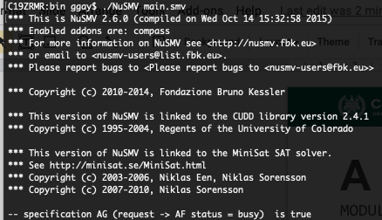
Checking Properties
Execute from command line: NuSVM <model name>
Properties that are true are indicated as true.
If property is false, a counter-example is shown (input violating the property).
Notes:
NuSMV is a command-line tool. It is available for all major operating systems. To check your properties, you can simply run from the command line:
NuSMV <model filename> (2-3). Let’s look at one of those.

Slide 34
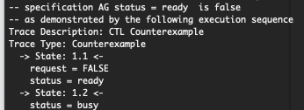
Checking Properties
New property: AG (status = ready)
(Obviously not true - we set it randomly in the absence of a request)
Counterexample:
In first state, request = false, status = ready.
We set status randomly for second state (because request was false). It is set to busy, violating property.
Notes:
The property states that the value of state is always “ready”, and will always remain “ready”. This is absolutely not going to be the case. Therefore, when we run NuSMV, we get a counterexample illustrating a situation where the property is violated (the value of state becomes “busy”): Because we set the value randomly in the absence of a request, it will eventually become “busy” no matter what we do, as is the case in this example. The counterexample consists of two steps (two state transitions). In the first, request is “false”, and state is “ready”. Because request is “false”, we set the next value of state randomly. As a result, in the second step, state becomes “busy” (request is not printed, as its value is not relevant).

Slide 35
MODULE main
VAR
traffic_light: {RED, YELLOW, GREEN}; ped_light: {WAIT, WALK, FLASH}; button: {RESET, SET};
ASSIGN
init(traffic_light) := RED;
next(traffic_light) := case
traffic_light=RED & button=RESET: GREEN;
traffic_light=RED: RED;
traffic_light=GREEN & button=SET: {GREEN,YELLOW};
traffic_light=GREEN: GREEN;
traffic_light=YELLOW: {YELLOW, RED};
TRUE: {RED};
esac;
init(ped_light) := WAIT;
next(ped_light) := case
ped_light=WAIT & traffic_light=RED: WALK;
ped_light=WAIT: WAIT;
ped_light=WALK: {WALK,FLASH};
ped_light=FLASH: {FLASH, WAIT};
TRUE: {WAIT};
esac;
next(button) := case
button=SET & ped_light=WALK: RESET;
button=SET: SET;
button=RESET & traffic_light=GREEN: {RESET,SET};
button=RESET: RESET;
TRUE: {RESET};
esac;
Notes:
A More Complicated NuSMV Model representing a basic traffic light
(go over each variable)

Slide 36
Describe a safety property (something does or does not happen at a specific time) and formulate in CTL.
Describe a liveness property (something eventually happens) and formulate in LTL.
MODULE main
VAR
traffic_light: {RED, YELLOW, GREEN}; ped_light: {WAIT, WALK, FLASH}; button: {RESET, SET};
ASSIGN
init(traffic_light) := RED;
next(traffic_light) := case
traffic_light=RED & button=RESET: GREEN;
traffic_light=RED: RED;
traffic_light=GREEN & button=SET: {GREEN,YELLOW};
traffic_light=GREEN: GREEN;
traffic_light=YELLOW: {YELLOW, RED};
TRUE: {RED};
esac;
init(ped_light) := WAIT;
next(ped_light) := case
ped_light=WAIT & traffic_light=RED: WALK;
ped_light=WAIT: WAIT;
ped_light=WALK: {WALK,FLASH};
ped_light=FLASH: {FLASH, WAIT};
TRUE: {WAIT};
esac;
next(button) := case
button=SET & ped_light=WALK: RESET;
button=SET: SET;
button=RESET & traffic_light=GREEN: {RESET,SET};
button=RESET: RESET;
TRUE: {RESET};
esac;
Notes:
A More Complicated NuSMV Model representing a basic traffic light
(go over each variable)

Slide 37
Activity - Example
Safety Property
A specific event/sequence happens as specified.
The pedestrian light cannot indicate that I should walk when the traffic light is green.
This is a safety property. We are saying that this should NEVER happen.
AG (pedestrian_light = walk -> traffic_light != green)
Notes:
Let’s do two examples to get started (animate by paragraph, do it together - answer on last line)

Slide 38
Activity - Example
Liveness Property
Eventually something of interest happens.
G (traffic_light = RED & button = RESET -> F (traffic_light = green))
If the light is red, and the button is reset, then eventually, the light will turn green.
This is a liveness property, as we assert that something will eventually happen.
Notes:
Let’s do another example to get started (animate by paragraph, do it together - answer on last line)
(open other doc and do together)

Slide 39
Proving Properties Over Models
Notes:
10 minute break

Slide 40
Proving Properties
Search state space for property violations.
Violations give us counter-examples
Path that demonstrates the violation.
(useful test case)
Implications of counter-example:
Property is incorrect.
Model does not reflect expected behavior.
Real issue found in the system being designed.
Notes:
To perform verification, we take properties and exhaustively search the state space of the model for violations.
(read) - (read). This is really helpful, as we don’t just know that something is wrong, we can trace our way through the model to see exactly what is wrong. Also a useful test case for the real system as it provides concrete input that we could replicate.
If you get a violation, this can mean three things
(read) - you made a mistake when you translated specification to the temporal logic
(read) - the model is wrong, and needs to be fixed
or, and this is what we want to find - (read) - identified something that you left out, or that is contradictory, or that is just plain wrong. This is what we want to see, if we get violations, we can fix our specification before we design and code the system.

Slide 41
Test Generation from FS Verification
We can also take properties we know to be true and negate them.
Called a “trap property” - we assert that a known property can never be met.
Produces a counterexample showing the property can be met.
Can be used as a test for the real system.
Demonstrates that final system meets specification.
Notes:
Now, this same process isn’t just useful for analyzing our requirements, but is useful for verification of the final system as well. You can (read)
(read) - we can take that, extract inputs from it, then run those inputs as a test for the final system This can be used as a test for the real system - to demonstrate that the final system meets its specification.

Slide 42
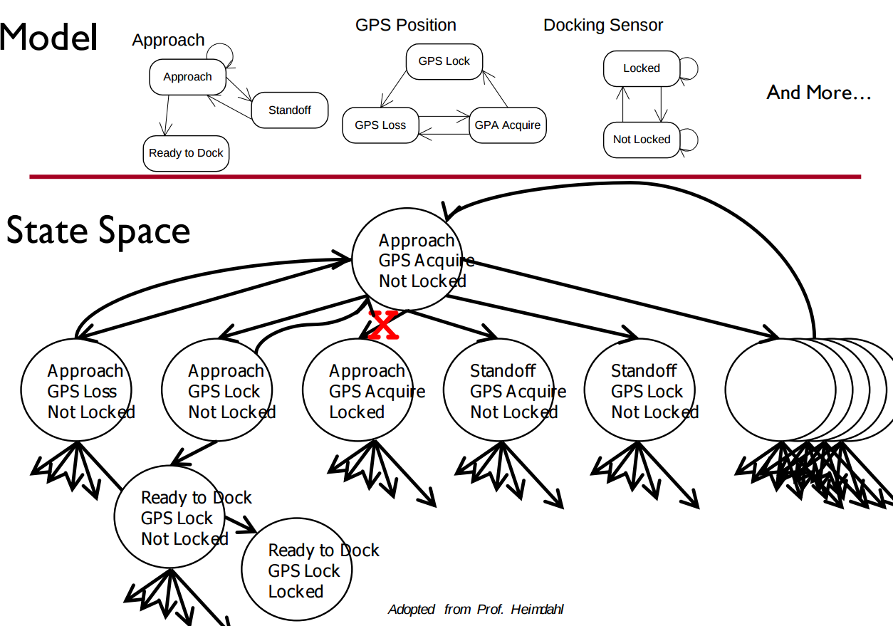
Exhaustive Search
Algorithms examine all execution paths through the state space.
Major limitation - state space explosion.
Limit number of variables and possible values to control state space size.
Notes:
Now, how does this work under the hood? This form of verification depends on a family of techniques that exhaustively search the state space - the set of all possible paths of execution over the model - at each state, examining all reachable states, then from there, examine all possible reachable states, and so on.
very quickly, the problem that we run into is that the number of possible states and paths through those states explodes. Let’s say we define three variables - approach, GPS position, and Docking Sensor - and we define how those variables can
change values. The state of the system describes the combination of assignments to those three variables. Even if the number of possible values is small, the number of possible states is massive, and the number of reachable states at any given time can be quite large. Quickly, an exhaustive search of the state space becomes extremely difficult.

Slide 43
Search Based on SAT
Express properties in conjunctive normal form:
f = (!x2 || x5) && (x1 || !x3 || x4) && (x4 || ! x5) && (x1|| x2)
Examine reachable states and choose a transition based on how it affects the CNF expression.
If we want x2 to be false, choose a transition that imposes that change.
Continue until CNF expression is satisfied.
Notes:
This search is based on satisfaction of what is called a SAT problem - or boolean satisfiability - the problem of determining if there exists a solution that satisfies a boolean formula. To check these properties, (read) - a conjunction of clauses - AND statement -, where each clause is a disjunction of boolean variables - OR statements.
(read rest)

Slide 44
Boolean Satisfiability (SAT)
Find assignments to Boolean variables X₁,X₂,...,X_{n} that results in expression φ evaluating to true.
Defined over expressions written in conjunctive normal form.
φ = (X₁ ∨ ￢X₂) ∧ (￢X₁ ∨ X₂)
(X₁ ∨ ￢X₂) is a clause, made of variables, ￢, ∨
Clauses are joined with ∧
Notes:
I’ve mentioned this SAT solver thing a couple of times. What is it? Boolean Satisfiability refers to the process of identifying a satisfying assignment that makes a Boolean formula resolve to true. The problem is defined over formula written a set of m clauses in conjunction, c1 ^ c2 ^ c3, where each clause Ci is formed by the disjunction of Boolean variables, x1,x2,...xn, or their negations. This form of the conjunction (AND) of clauses and the disjunction (OR) of literals (variables and their negation) is called Conjunctive Normal Form (CNF). In SAT the problem asks if there exists a truth assignment such that the expression is true.

Slide 45
Boolean Satisfiability
Find assignment to X₁,X₂,X₃,X₄,X₅ to solve
(￢X₂ ∨ X₅) ∧ (X₁ ∨￢X₃ ∨ X₄) ∧ (X₄ ∨ ￢X₅) ∧ (X₁ ∨ X₂)
One solution: 1, 0, 1, 1, 1
(￢X₂ ∨ X₅) ∧ (X₁ ∨￢X₃ ∨ X₄) ∧ (X₄ ∨ ￢X₅) ∧ (X₁ ∨ X₂)
(￢0 ∨ 1) ∧ (1 ∨￢1 ∨1) ∧ (1 ∨ ￢1) ∧ (1 ∨ 0)
(1) ∧ (1) ∧ (1) ∧ (1)
1
Notes:
Here's what we are concerned about. We are interested in finding out if there exists a Boolean assignments for each variable such that the formula evaluates to true. An example of a satisfying assignment for this formula would be: 1, 0, 1, 1, 1. When we substitute each of the values of into we get (4-end) The result is that the expression is true. That sounds simple doesn't it? Well it's not. This problem can be NP-Complete, and NP-Complete problems get harder and harder as the problem becomes larger. So when the number of variables in the formula increase, the problem gets more difficult. We, however, have a couple of search algorithms that can efficiently prune bad solutions away without trying them.

Slide 46
Branch & Bound Algorithm
Set variable to true or false.
Apply that value.
Does value satisfy the clauses that it appears in?
If so, assign a value to the next variable.
If not, backtrack (bound) and apply the other value.
Prunes branches of the boolean decision tree as values are applied.
Notes:
Our first complete search algorithm is the branch-and-bound algorithm. This algorithm is conceptually simple: set a variable in the boolean formula to a particular value, apply that value to the formula, and check to see if the value satisfies all of the clauses that it appears in. If so, assign a value to the next variable and so on. However, if setting a value unsatisfies a clause, then a backtracking step (a bound) is initiated and the other possible value is applied. This process prunes branches of the formed boolean decision tree. Although we have reduced the number of checks we performed it does not mean that the problem has become any easier. It is still hard to solve, and it is NP-Complete. However, by trying assignments carefully, we get to a solution more quickly, generally without trying everything.

Slide 47
Branch & Bound Algorithm
φ = (￢x2 ∨ x5) ∧ (x1 ∨ ￢x3 ∨ x4) ∧ (x4 ∨ ￢x5) ∧ (x1 ∨ x2)
Set x1 to false. φ = (￢x2 ∨ x5) ∧ (0 ∨ ￢x3 ∨ x4) ∧ (x4 ∨ ￢x5) ∧ (0 ∨ x2)
Set x2 to false. φ = (1 ∨ x5) ∧ (0 ∨ ￢x3 ∨ x4) ∧ (x4 ∨ ￢x5) ∧ (0 ∨ 0)
Backtrack and set x2 to true. φ = (0 ∨ x5) ∧ (0 ∨ ￢x3 ∨ x4) ∧ (x4 ∨ ￢x5) ∧ (0 ∨ 1)
Notes:
-We first set a value of false to x1. This inserts a zero into clauses two and four, but does not satisfy or unsatisfy either clause yet.
-Next, we insert a value of zero for x2. This satisfies the first clause, but unsatisifies the fourth clause (as both x1 and x2 are set to zero).
-Therefore, we stop and backtrack, assigning a new value of one to x2. This satisifies the fourth clause. We can continue this process with all variables until the complete formula is satisified. If we hit a dead end, where applying either value unsatisfies something, we will backtrack again to the assignment before that and see if we can change the outcome. So, this is almost like a depth-first search in a graph, we go as deeply as we can in the formed decision tree and backtrack when we cannot make any additional assignments without unsatisfying something.

Slide 48
DPLL Algorithm
Set a variable to true/false.
Apply that value to the expression.
Remove all satisfied clauses.
If assignment does not satisfy a clause, then remove that variable from that clause.
If this leaves any unit clauses (single variable clauses), assign a value that removes those next.
Repeat until a solution is found.
Notes:
Another common complete method is the Davis-Putnam-Logemann-Loveland, or DPLL, algorithm [13]. It is basically the same as Branch and bound, but there is a slight difference which makes it more powerful. The way it works is this, select a variable or its negation. Assign the variable a value. If the result is true, and hence satisfies the clause, then remove all clauses containing that variable from the formula, creating a simplified formula. On the other hand, if the literal is false due to its negation, remove only that specific variable from the clause. So far this is sort of like branch and bound except that we are looking at it from the point of view of the clauses. We recursively do this until we find a solution. To make this even better, if a clause contained a single literal, then assign that literal a value that makes it true, and perform the same procedure. That is called unit clause elimination. You can imagine how this would have a cascading, domino effect. As more variables are eliminated from clauses the more clauses turn into unit clauses - which we identify and get rid of as soon as we see them.

Slide 49
DPLL Algorithm
φ = (￢x2 ∨ x5) ∧ (x1 ∨ ￢x3 ∨ x4) ∧ (x4 ∨ ￢x5) ∧ (x1 ∨ x2)
Set x2 to false. φ = (￢0 ∨ x5) ∧ (x1 ∨ ￢x3 ∨ x4) ∧ (x4 ∨ ￢x5) ∧ (x1 ∨ 0) φ = (x1 ∨ ￢x3 ∨ x4) ∧ (x4 ∨ ￢x5) ∧ (x1)
Set x1 to true. φ = (1 ∨ ￢x3 ∨ x4) ∧ (x4 ∨ ￢x5) ∧ (1) φ = (x4 ∨ ￢x5)
Set x4 to false, then x5 to false. φ = (0 ∨ ￢x5) φ = (￢0)
Notes:
-If we assign a value of zero to x2, the first clause is rendered true (¬x2 = ¬0 = 1). We can eliminate the first cause from the formula and x2 from clause four. This leaves the following: (read)
- As the third clause is now a unit clause, we assign x1 = 1. We can now remove both clauses one and three from the formula:(read)
- From this point, the example is trivially solved with x4 = 0 and x5 = 0

Slide 50
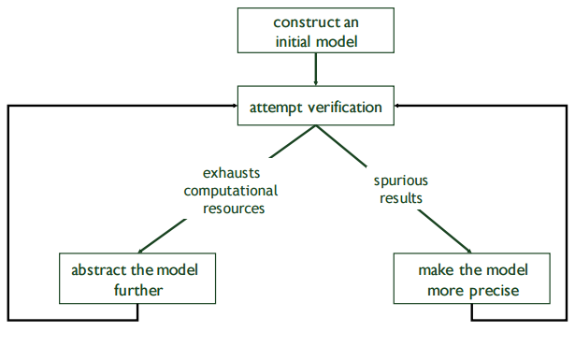
Model Refinement
Must balance precision with efficiency.
Models that are too simple introduce failure paths that may not be in the real system.
Complex models may be infeasible due to resource exhaustion.
Notes:
(read all).
So, you often find that your first attempt at a model is not good enough. You need to get into a loop of iterative refinement. If it’s too complex, simplify it. It it’s too simple, add detail. Continue until you are able to perform verification.

Slide 51
Who Uses This Stuff?
Used heavily in safety-critical development.
Verifies certain complex, critical functions.
Used extensively in automotive, aerospace, medical.
Amazon Web Services
Used to verify security policies, stateful behaviors.
Used to verify LLM correctness.
Not used for all functionality.
Time-consuming, requires additional effort.
Notes:
Now, there are probably a few of you wondering where this stuff ever gets used. It sounds very theoretical - very math-heavy - very time-consuming - building a model when you could just get on with coding. If you look at NuSMV, which we’re focusing on, it’s an academic tool and its website looks like something from the 90’s. So, is this a real thing used in industry? The answer is yes, but certainly not widespread for all of those reasons. It requires additional effort. It is time-consuming. However, these approaches are used in MANY companies writing safety critical code like Volvo, Boeing, Medtronic - companies that want to verify certain functionality that could risk human life or cause massive equipment failure. It is used heavily in medical device development, automotive development, and aerospace industries. It is also even used for verifying security policies and other specific stateful functions at companies like Amazon Web Services. Verification is not used in all cases, but is applied selectively to analyze really complex functionality. It’s worth understanding and knowing a little about. Now, there are fancier tools than NuSMV - which we focused on - but it is
FREE (most industrial tools are either not available or cost $$$$$$), and NuSMV is the most beginner-friendly tool. Knowing how to use any of these tools could prove very useful in getting a job in a verification role, so pay some attention here.

Slide 52
We Have Learned
We can perform verification by creating models of function behavior and proving that the requirements hold over the model.
To do so, express requirements as logical formulae written in a temporal logic.
Finite state verification exhaustively searches the state space for violations of properties.
Presents counter-examples showing properties are violated.

Slide 53
We Have Learned
By performing this process, we can gain confidence that the system will meet the specifications.
Can also generate test cases to demonstrate that properties hold over the final system.
Negate a property, the counter-example shows that the property can be met.
Execute the input from the counter-example on the real system - should give the same result!

Slide 54
Next Time
Exercise Session: Finite-State Verification
Lec 15: Automated Test Generation
Lec 16: Course Review (Practice Exam)
Assignment 4 - Questions?

