Slide 1
Lecture 3: Quality Scenarios
Gregory Gay
DIT636/DAT560 - January 26, 2026

Slide 2
When is Software Ready for Release?
When you can argue that it shows sufficient quality.
Requires choosing quality attributes.
  … specifying measurements and thresholds.
  … different measurements and thresholds for different functionality and execution scenarios.
Assessed through Verification and Validation.
Notes:
Last time I posed a question is (title). And the basic, but not really simple answer, is that (go over)

Slide 3
Quality Attributes
Dependability
  Ability to offer correct functionality, even under unforeseen or unsafe conditions. Encompasses correctness, reliability, safety, robustness
Availability
  Ability to avoid, ignore, and to recover from failures.
Performance
  Ability to meet timing requirements.
Scalability
  Ability to maintain reliability and performance as the available resources grow or shrink.
Notes:
As a reminder, these are the four attributes we have focused on. (go over)
availability, related to dependability, how systems recover
scalability, related to performance, how the system is designed to scale its resource usage to maointan performance at a consistent level as the userbase increases
there are others, but these are the four we will focus on - dependability, availability, performance, scalability

Slide 4
Today’s Goals
We have discussed what “quality” can mean (attributes).
We have discussed how to measure reliability, availability, performance, and scalability.
Today: How to assess each using scenarios.

Slide 5
Assessing Quality
Quality goals differ between parts of the system.
  (e.g., user-facing functionality, code components).
For those parts, required quality may differ:
  Between situations.
    (e.g., system under normal use, heavy load, partially down)
  Between different groups of users.
    (e.g., new versus experienced users)
Scenarios describe different execution conditions.
Notes:
So, how do we assess quality? There are different ways, but the most basic - the root of most dynamic verification techniques - is to run the system, and to measure the level of attainment of the quality of interest when we run it. Couple of caveats there. As we said last time, you can’t derive one single quality value for the whole system. Different aspects of the system may have different potential levels of quality and different quality goals. Some functions or code elements may need to be more reliable than others, or may have different needed performance levels. Further, even those goals may differ for the same aspect of the system under different operating conditions or for different groups of users. So, we first need to establish different execution scenarios - different ways ot executing the functionality or code element of interest.

Slide 6
Assessing Quality
For each scenario, set quality thresholds (targets).
Execute the scenario, measure quality, compare to the threshold.
  If the threshold is met, good!
  If not, there is a fault in the system.
Is that enough?
Notes:
We have these scenarios now. For each, we then can set thresholds on the required level of quality under that scenario. That gives us a target. Now, we can run the system in that scenario, take measurements, compare to the threshold. If it’s met, good. If not, there is a problem we need to fix. Is that enough? (discuss)

Slide 7
Assessing Quality
Quality is often non-deterministic.
  Performance differs every time code is run.
Quality evolves with the code.
Scenarios must be executed many times.
  Thresholds usually set based on averages or probabilities (“95% of the time…”).
  Absolute thresholds when there must never be a violation.
Notes:
Quality is often non-deterministic. For example, performance will always vary. Hopefully, it only varies a little, but sometimes, it might vary quite a lot - for example, if you have a weak network connection, you may lose packets, or if other programs are using CPU cycles, you might lose some speed in the program under test. So, one run doesn’t give the complete picture of quality. Similarly, the project evolves. We will make many code changes. Those may affect quality in good or bad ways. So, again, one run is not enough. Quality needs to be assessed over time, and scenarios need to be re-executed many times. The result of this is that when we set quality thresholds, we set them in terms of either average or probabilities - on average, the function runs in 10 seconds, 99% of the time, it runs in 12 seconds or less - or we set absolute limits that must never be broken. However, we only do that in severe cases, where the safety of the user is at stake.

Slide 8
Writing Scenarios
Notes:
How do we assess quality? One popular way is to use what we call scenarios.

Slide 9
Scenarios
Description of interaction between external entity and system. Defines:
  Event that triggers the scenario.
  Interaction initiated by the external entity.
  Response required (in terms of quality attribute).
Similar to use cases or user stories, but examines both quality and functionality.
Notes:
A scenario is a well-defined description of an interaction between an external entity (e.g., a user) and the system. It defines the event that triggers the scenario, the interaction initiated by the external entity, and the response required of the system, defined in terms of a measurement based on an appropriate quality attribute - for instance, if we are interested in performance, we might define a task and the current load, and measure the performance of the system against a threshold - number of jobs completed in a time frame, average speed of a job, and so on. Similar to use cases or user stories, but examines both quality and functionality.

Slide 10
Scenarios
Capture a range of requirements:
A set of interactions with users to which a system must respond.
Processing in response to timed events.
Peak load situations that could occur.
Regulator demands.
Failure response.
A change that a maintainer might make.
Any situation that the design must handle.
Notes:
Scenarios can be used to capture a wide range of requirements, such as: • A particular set of interactions with its users to which the system must be
able to respond • The processing that must happen automatically at a particular point in time,
such as month end • A particular peak load situation that could occur • A demand that an external regulator might make of a system • How the system must respond to a particular type of failure • A change that a maintainer might need to be made to the system • Any other situation with which the design of the system must be able to cope

Slide 11
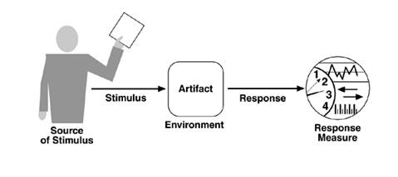
Scenario Format
Overview:
Brief description of the scenario.
System State:
Aspects of internal state that affect quality (e,g., important information stored in the system, current load)
Environment State:
Observations about the environment (e.g., network connection, external system availability).
Notes:
There are different formats for writing scenarios. I know you used one in the architecture class, but we are going to use a slightly different one here that prepares us nicely for writing test cases. When creating a scenario, you define six pieces of information. (click) First, you give a brief overview, desribing the goal of the scenario. What do you hope to show about the system using a scenario? What are the execution conditions you want to highlight for that part of the system? (click) Then, we set pre-considitions. What is the the internal state of the system when the stimulus occurs (if significant). This may revolve around information stored in the system that will affect the execution, current number of concurrent users, number of waiting tasks in a queue, that could influence the resulting quality with regard to the attribute we care about. (click) we then look at the relevant factors in the system’s external environment - any significant observations about the environment that the system is running in, related to other pieces of software, infrastructure, even the physical world - such as the unavailability of external systems, current network conditions, particular infrastructure behavior, whether we can access a piece of hardware, if there is a fire in a room, and so on. Is there any special external factor that might influence system quality beyond the direct stimulus.

Slide 12
Scenario Format
External Stimulus:
Event (input or environmental factor) that triggers a response from the system.
(e.g., user request, infrastructure changes or failures, attacks, expiration of time limit)
Notes:
then, we define the stimulus. All scenarios start with a stimulus. This is some kind of event that forces the systme to act. This can be a request made to the system by a user or exernal system, or some change in the system’s environment that forces it to act, like a timer going off or a sensor getting a reading. It could be a failure of the system that triggers a sequence of events. This is some kind of trigger that makes the system act. This could be a user request, infrastructure changes or failures, changes in external system behavior, security attacks, required modifications, or any of the other factor that requires the system to act and to possess a particular quality property in order to deal with the stimulus successfully.

Slide 13
Scenario Format
Required System Response:
How does the system respond and meet the quality goal?
(e.g., how should it handle a defined increase in requests?)
Response Measure:
How we judge whether the system meets the quality goal.
(e.g., throughput, timing, availability)
Notes:
Finally, the last two items. (click) The required system response is a definition of how the system must behave in response to the stimulus. This is the functional response - what does it do when faced with this stimulus in this environment and state? This should include specifically how the system meets the quality goal - for instance, how does the system respond, from a functional point of view, to a defined increase in the number of requests arriving per minute (click) the response measure - this is how we judge whether the sysgtem met the quality goal. This should include a measurement - throuhput, timing, availability, mean time to repair, time to detect an intruder, etc - and a threshold that must be met. This is how we prove the system met our quality goal successfullly.

Slide 14
Response Measures
Many quality measurements are non-deterministic.
  May be OK if quality goals are violated occasionally.
  Most time measures should be probabilistic.
    95% of the time, the response should be N. (common case)
    99% of the time, the response should be M. (worst case)
If not non-deterministic, give an absolute threshold.
  When safety is affected, measurements should also give a worst-case limit.
Notes:
(1) - Performance, availability, scalability especially- Due to a variety of factors, you won’t always get the same exact measurement back. This is especially true with time bounds, like those you see in performance measurements. (2) If your performance goals aren’t met in 1% of cases, that might be acceptable. Therefore in most cases, you should present the response measure probabilistically. Give a standard case, then give one or two worst-case scenario - (4-5). Reliability measures like POFOD or ROCOF, those you can give as absolute. I will accept a ROCOF of 2 per hour. That still reflects the fact that the system will fail occasionally, but the measurement itself is not non-deterministic. Now, if you have strict time requirements, if user safety is at risk, should also present present absolute deadlines - the worst case you will possibly accept.

Slide 15

Running Example: Food Delivery
We have an online service for ordering food.
Users can:
  Search for restaurants.
  View menus of restaurants.
  Add items to their cart.
  Order items for delivery.
May be used by thousands of concurrent users.

Slide 16
Reliability Example
Overview: A basic scenario where we check that a user can add multiple items to their cart from a restaurant.
System State: A valid user is logged in. Their cart is currently empty. The system is under a normal load (5000 concurrent users).
Environment State: The deployment environment is working correctly. The network connection is adequate.
External Stimulus: The user selects a restaurant. They then add three different items to their cart (quantity of one for each item).
Required System Behavior: When each item is added, it should appear in the cart. The total cost of the order should reflect the new item. The number icon in the top-right of the screen should be incremented by one each time.
Response Measure: The POFOD when executing this scenario should be < 1 failure /1000 requests.
Notes:
Let’s do a couple of examples so you can see what these look like, then we can break down by quality attrbitute a bit later. Here is a basic reliability scenario

Slide 17
Availability Example
Overview: How the system should respond when BankID fails to respond.
System State: A valid user is logged in. They have added a single item to their cart. The system is under a normal load (5000 concurrent users).
Environment State: The deployment environment is working correctly. The network connection is adequate.
External Stimulus: The user attempts to submit their order. Internally, the logic reaches the step where the user must authenticate in BankID. The call to the BankID API fails to yield a response.
Required System Behavior: After waiting for 30 seconds, the system should stop trying to communicate with the BankID API. The order submission should be aborted. An error message should be sent to the user.
Response Measure: The error message should be displayed within 35 seconds in 95% of executions, and within 45 seconds in 99% of executions.
Notes:
Let’s go over an example. We’ll talk more about availability specifically later, but as a quick example. (go over)

Slide 18
Is a Scenario a Test Case?
Scenarios prescribe general execution conditions and goals under those conditions.
  Describe the “type” of event and response that occurs, not the specific input or output.
Test cases require concrete, specific input.
One scenario can be used to create many concrete test cases.
Notes:
A major focus of this class is software testing. And a question that might be occurring to you is whether a scenario is a test case. The answer is that it’s not quite, it’s more like a recipe for many similar test cases. A scenario outlines general execution conditions and general goals under those conditions, but it does not prescribe the exact input that occurred. The scenario doesn’t say that the user pressed a particular equation into the calculator, just that the put in a valid equation or an invalid one. A test case is concrete and repeatable. From a scenario, we can create many individual concrete test cases. Therefore, scenarios are typically used to guide the creation of actual test cases that we can execute later on.

Slide 19
“Good” Scenarios
Credible
  Describes a realistic scenario.
Valuable
  Can be directly used to design and verify system.
Specific
  Addresses a single, concrete situation.
Precise
  User should be clear about the described situation and response.
Comprehensible
  Writing should be unambiguous and free of jargon.
Notes:
What Makes a Good Scenario? Key ones are Credible: A scenario should describe a realistic situation that could occur, and it should include enough detail for the reader to accept the scenario as a valid situation. • Valuable: a scenario should be of direct use somewhere in the development process, whether that is explaining the architecture to a stakeholder, ensuring the architecture is sound, or illustrating how the system works to a development team. It should then be useful during the testing process to help verify the requirements, as a source of potentially many concrete test cases. • Specific: A good scenario describes a particular situation accurately, rather than trying to generalize the system’s behavior over a whole class of situations. it becomes difficult to describe many situations succinctly. • Precise: The definition of the scenario should be precise enough for the intended user of the scenario to be quite clear about what situation the scenario is describing and the required response of the system. • Comprehensible: scenarios should be comprehensible by those stakeholders who need to use them. This means writing them clearly, using widely understood terms, and avoiding acronyms and jargon.

Slide 20
Effective Scenario Use
Identify a focused scenario set
  Too many scenarios can be distracting.
  Prioritize no more than 15-20.
Use distinct scenarios
  Avoid redundant scenarios.
  Consider demands placed on the system.
Use scenarios early
  Can focus design activities.
Notes:
Scenarios are a straightforward technique. However, here are a few general practices that are helpful in applying scenarios effectively. (1) it isn’t often useful to end up with dozens and dozens of them. the net result is a lack of focus that prevents them from providing guidance. It is difficult to be prescriptive about the precise number of scenarios. However, more than 15 or 20 important scenarios across ALL quality attributes, not just one, is likely to be too many to use effectively for most systems, so work with your stakeholders to prioritize the set you end up with and focus on the riskiest and most important ones to guide decision making. (4) It is easy to create a number of scenarios that, although they seem different initially, are really very similar in terms of the requirements they place on the system. to avoid this situation, revisit the scenarios you identify and consider what demands each places on the system. (7) scenarios can be used throughout the software development lifecycle, but they have the most impact when applied early, when the design of the system is taking shape. If you don’t consider scenarios at an early stage but leave them until, say, they are needed for system testing, much of their potential benefit is likely to be lost. Of course, you may identify additional scenarios as development progresses ( for testing purposes). Still, the biggest role these have to play is to help you focus design activities on the most important aspects of the system. Later, we can use these as the basis for creating test cases

Slide 21



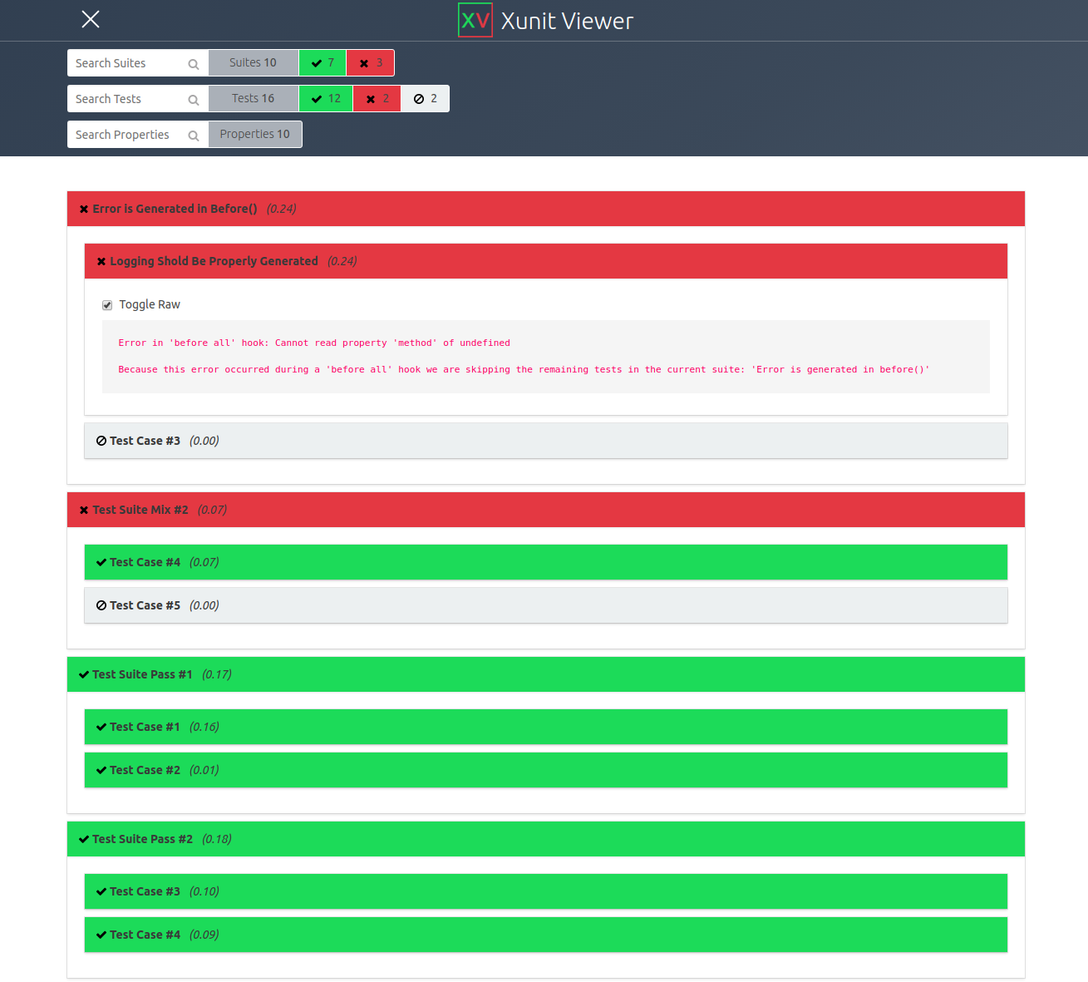
What do we do with Scenarios?
System Design
Stakeholder Negotiation
Exploratory Testing
  Human experiments with app.
Formal Test Cases
  Assign specific input and check response.
Notes:
So, (title). They are used at multiple stages of development. Often, these are used as a design brainstorming tool. We design them when we design the system architecture and perform mental exercises to see if we think the designed the system will meet our goals. This often leads to architecture redesign and additional requirements - both functional and non-functional. They are also used to communicate and negotiate with stakeholders. We can persent them and see if the stakeholders have feedback - do they agree with your views on quality? will they accept a system behavior that reduces attainment of one quality for gains in another - for example, performance and security are often at odds with each other. Third, we can assess them during exploratory testing - when human users interact with the system - either internal or an alpha/beta test. We can execute these scenarios in multiple ways and see if the quality goals are met. Foruth, we can translate these into one or more formal test cases by assigning specific input and including calculations of the response measure.

Slide 22

Reliability
Scenarios
Notes:
How do we assess quality? One popular way is to use what we call scenarios.

Slide 23
Reliability Scenarios
Ability to operate correctly over an observation period (time or executions).
  A statistical approximation of correctness.
Scenarios revolve around one function/code component (or closely-related components).
  Demonstrates that the function operates correctly.
  Give context on type of user or system load if it impacts system execution or perceived reliability.
Notes:
Reliability is a statistical approximation of correctness. Over an observed period, how likely is the system to fail in an observable manner. As a quality, reliability is the ability of the system to function correctly. Scenarios show that it operated in the correct manner. Reliability is something again that cannot be stated universally, but is instead dependent on the functionality accessed or the type of user, and that context must be given when we write scenarios. We must specify a specific user-level function of the system or small set of functions, and if we can, may even want to give context about the type of user - what frequency and ordering of functions do they use - or on the gorup of users - the load on the system. Functionlity is accessede by an user or external system through a defined interface.

Slide 24
Reliability Metrics
Time Available: (uptime) / (total time observed)
POFOD: (# failures) / (# requests)
ROCOF: (# failures) / (period of time)
MTBF: Average time between failures

Slide 25
Reliability Scenarios
Overview: Highlight the function(s)
being used and the context used in.
Explain the type of user/load, if relevant.
System State: Data stored in system, past events (multiple failures may leave system vulnerable), load may impact reliability.
Environment State: Available resources may impact reliability (resources, networking).
Notes:
(1-2). You might want to examine reliability in specific scenarios, like following a specific type of failure, and the impact that leaves on reliability after the face. Same for environment state (3) - available disc space, memory, CPU capacity, networking environment - all of these can have a major impact on the reliability. If the network connection is flaky, requests to certain services might fail, leading to a visible system failure. Likewise, if the disc can’t be written to, we might see additional failures. These factors can be examined when we write scenarios, noting the expected outcome in resource-restricted environments.

Slide 26
Reliability Scenarios
External Stimulus:
  User or external software performs one or more input interactions.
  State specific interaction(s) performed.
  If relevant, explain the type of user and reason they would perceive reliability differently.
Notes:
(1) through a system interface. The user or external system wants to use your system to perform some functionality. (2) In general, we do NOT state reliability universally, but focus on a specific functionality of the system we are examining. When we use this function in this scenario, we expect this reliability. Not availability is 99.999999% no matter what we do. This is because we have to actually be able to run a scenario, and for that, we need to look at specific situation and not state some universal truth. (3)

Slide 27
Reliability Scenarios
Required Response:
  The functional response of the system.
  Generally, the normal operation of that function.
Reliability Measure:
  ROCOF, POFOD, Time Available, MTBF
  Measures establish general thresholds (i.e., not a single execution, but all executions of this scenario)
Notes:
(go over all). By that, I mean that, the scenario might say “add an item to your cart”. That is a single request, but your measurement might say <1 /1000 requests should fail. So, you might run this many times and then compare to the threshold.

Slide 28
Example Reliability Scenario
Requirement: The system shall allow the user to view the menu of a chosen restaurant. This function must be accessible at least 99.99% of the time.
Notes:
typically we start with a requirement. (go over). Now, let’s craft a scenario together that verifies the requirement (go to doc)

Slide 29
Example Reliability Scenario
Overview: Demonstrates that the user can view the menu of a chosen restaurant under “typical” conditions.
System State: A valid user is logged in. The system is under normal load (5000 concurrent users).
Environment State: The network connection is adequate. The deployment environment is operating under normal conditions.
External Stimulus: The user selects a restaurant, then clicks on “menu”.
Required Response: The menu is displayed to the user.
Response Measure: The time available is 99.999%.
  (higher than requirement)
Notes:
fairly basic, we’ll do more complicated, but gives you a good starting place.

Slide 30
Example Reliability Scenario (2)
Overview: Demonstrates that the user can view the menu of a chosen restaurant, even under heavy load.
System State: A valid user is logged in. The system is under heavy load (25000 concurrent users).
Environment State: The network connection is adequate. The load balancer is operating correctly, but available resources are very low.
External Stimulus: The user selects a restaurant, then clicks on “menu”.
Required Response: The menu is displayed to the user.
Response Measure: The time available is 99.99%.
  (matches the requirement)
Notes:
fairly basic, we’ll do more complicated, but gives you a good starting place.

Slide 31
Let’s take a break.
Notes:
8 min break

Slide 32
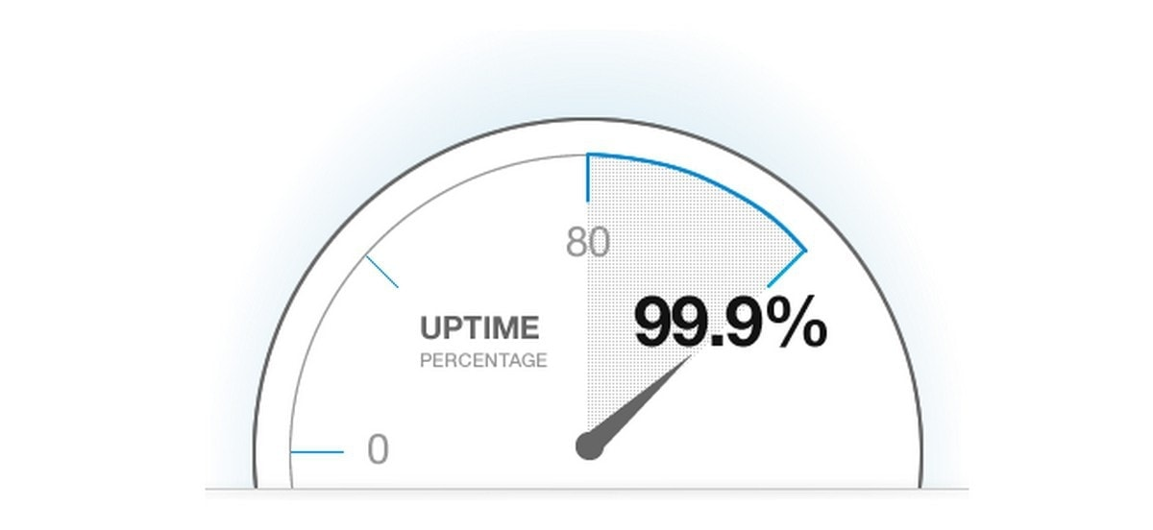
Availability Scenarios
Notes:
How do we assess quality? One popular way is to use what we call scenarios.

Slide 33
Availability Scenarios
Ability to avoid, ignore, or recover from failure.
Measure how the system responds to failure.
  How is the failure detected or prevented?
  What does the system do to return to normal or work around the failure?
  How long does all of this take?
Stimuli: Conditions that trigger the failure.
Notes:
As a reminder, availability is (1). Availability scenarios (rest)

Slide 34
Availability vs Reliability
Reliability scenarios:
  Functionality operates without failing.
  Measures how often it is allowed to fail.
Availability scenarios:
  How system avoids, handles, or recovers from a failure.
  Response measures:
    Avoiding or ignoring: reliability measurements
    Recovery: time to recover or resulting “Time Available”
Notes:
Reliability scenarios show how the system should operate under normal usage. In a normal situation, what does this function do? As a result, the response measures show how often it is allowed to fail. Availability scenarios focus on what happens when it fails. The scenarios show how the failure is avoided, or how the system recovers when it does fail. As a result, the response measures are based on how the system handles the failure. (last point)

Slide 35
Availability Scenarios
Distinguish between failures and software’s perception of the failure.
  Do not assume software is omniscient.
Scenarios tend to deal with:
  Failure of internal component or external system.
  Reconfiguration of hardware.
  Maintenance or reconfiguration of software.
Notes:
(1). This can be failures internally in the software or in the environment. For example, given a network connection failure, if there is no traffic from the system over the link, then the software may not perceive the network failure until it attempts to use the network. Do not assume the software is omniscient, that is, all-knowing; there must be a mechanism in the architecture to perceive failures before the system can respond to them. The kinds of scenarios that are managed by availability fall into three types: failure of a component of the software itself (code or hardware) or failure in an external system that is used by the software, reconfiguration of the physical system (e.g., adding or removing additional hardware resources), or maintenance or reconfiguration of the software: for example, patching the running software, especially if it requires restarting different processes that are part of the system, or entering a “maintenance mode” that requires that the software is offline or functions in a reduced capacity.

Slide 36
Availability Scenarios
Overview: Be clear about what failed
and what needs to be available.
System/Environment State: The state before failure occurs may affect the response.
  If this is the first failure, may choose degradation of response time or functionality.
  If the system has already failed and is not in normal mode, may choose to shut it down.
Notes:
■ We need to specify the resource or element of the system that is required to be highly available, such as a subsystem, a processor, acommunication channel, process, or storage.
■ State and Environment. The state of the system when the fault or failure occurs may also affect the desired system response. For example, if the system has already seen some faults and is operating in other than normal mode, it may be desirable to shut it down totally. However, if this is the first fault observed, some degradation of response time or function may be preferred.

Slide 37
Availability Scenarios
External Stimulus: Differentiate
internal/external failure - desired
response may differ.
Stimuli is:
  An omission (component fails to respond)
  A crash
  timing (component responds but is early/late)
  incorrect response
Notes:
Source of stimulus. We differentiate between internal and external origins of faults or failure because the desired system response may be different.
■ Stimulus. A fault of one of the following classes occurs: ■ Omission. A component fails to respond to an input. ■ Crash. The component repeatedly suffers omission faults. ■ Timing. A component responds but the response is early or late. ■ Response. A component responds with an incorrect value.

Slide 38
Availability Scenarios
Required Response:
Failure must be detected and isolated before recovery. Can:
  Logging the failure
  Notifying users or systems
  Taking actions to limit the damage
  Switching to a degraded mode
  Shutting down external systems
  Becoming unavailable during repair.
Notes:
■ Response. There are a number of possible reactions to a system fault. First, the failure must be detected and isolated (correlated) before any other response is possible. (One exception to this is when the failure is prevented before it occurs.) After the failureis detected, the system must recover from it. Actions associated with these possibilities include logging the failure, notifying selected users or other systems, taking actions to limit the damage caused by the failure, switching to a degraded mode with either less capacity or less function, shutting down external systems, or becoming unavailable during repair.

Slide 39
Availability Scenarios
Response Measure:
  Avoid Failure:
    Show that reliability is high under this stimulus.
    POFOD, ROCOF
  Ignore Failure:
    Show that reliability remains high after the failure.
    Reliability measurements when failure occurs, compared to “normal” values.
    May include aspects of “recovery”.
Notes:
■ Response measure. The response measure can specify an availability percentage, or it can specify a time to detect the fault, time to repair the fault, times or time intervals during which the system must be available, or the duration for which the system must be available.

Slide 40
Availability Scenarios
Response Measure:
  Recover from Failure:
    Show that system can return to normal quickly.
    Time Available
      (“Time available must be at least 0.9999”)
    Time to detect failure
      (“95% of the time, the failure is detected within 5ms. 99% of the time, within 10ms.”)
    Time to return to normal
      (“95% of the time, system is back online within 10 minutes. 99% of the time, within 15 minutes”)
Notes:
■ Response measure. The response measure can specify an availability percentage, or it can specify a time to detect the fault, time to repair the fault, times or time intervals during which the system must be available, or the duration for which the system must be available.

Slide 41
Availability Example
Requirement:
All orders shall be saved in the order database. If an attempt to write an order to the database fails, the failure shall be detected within 30 seconds and reattempted until successful.
Notes:
(go to doc and do together)

Slide 42
Example Availability Scenario
Overview: Demonstrates that the system can recover from a failed attempt to write to the order database (when the database is full).
System State: A valid user is logged in. The system is under normal load (5000 concurrent users).
Environment State: The network connection is adequate. The deployment environment is operating correctly. However, the order database is full.
Notes:
how we stay available, when an external dependency goes down

Slide 43
Example Availability Scenario
External Stimulus: The user places an order under conditions that should normally be successful (i.e., valid payment, restaurant, items). Due to the full database, the request to write the order to the database should fail.
Required Response: After any “write” attempt, the system shall check whether the database contains the order. If not, then the system shall store the order in a temporary queue until it has been successfully written. The order fulfillment shall proceed, using the information stored in this queue. Admins shall be alerted to the failure. The system shall continue to attempt to write to the database until the attempt is successful.
Response Measure: The failure is detected and operation is resumed using the temporary queue within 15 seconds in 95% of executions, and within 30 seconds in 99% of executions.
Notes:
(point out in response measure that the worst case is intended to still meet the requirement and the normal case is safely in the bounds

Slide 44
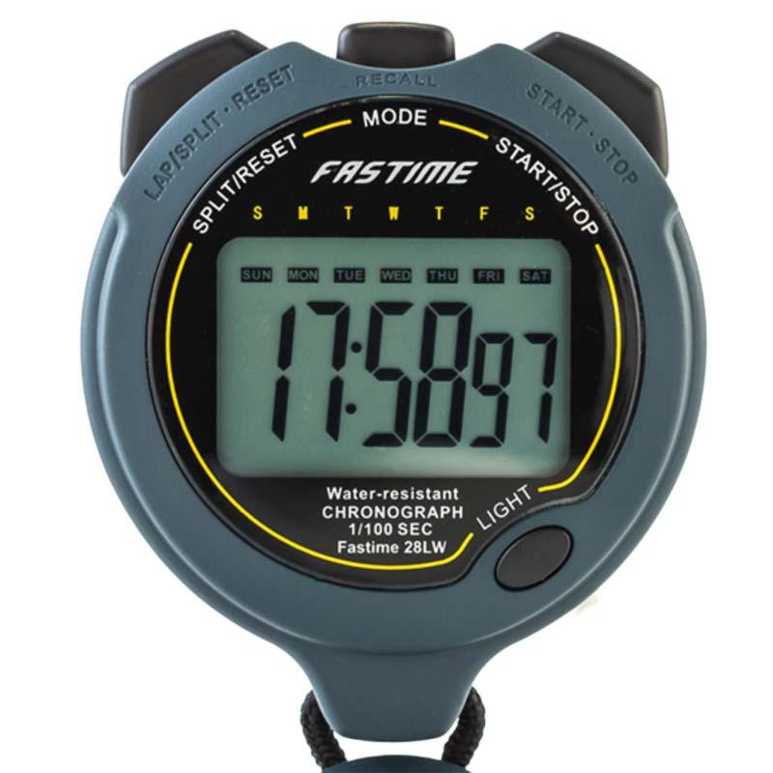
Performance and
Scalability Scenarios
Notes:
How do we assess quality? One popular way is to use what we call scenarios.

Slide 45
Performance Scenarios
Begin with events arriving at the system.
  Responding requires resources to be consumed.
Arrival pattern for events can be:
  Periodic (at regular time intervals)
  Stochastic (events arrive according to a distribution)
  Sporadic (unknown timing, but known properties)
    “No more than 600 per minute”
    “At least 200 ms between arrival of two events”
Notes:
A performance scenario begins with one or more events arriving that the system must respond to. Responding correctly to the event requires resources (including time) to be consumed. While this is happening, the system may be simultaneously servicing other events. When characterizing performance, we need to understand how those events arrive at the system. Events can arrive in predictable patterns or mathematical distributions, or be unpredictable. An arrival pattern for events is characterized as periodic, stochastic, or sporadic: Periodic events arrive predictably at regular time intervals. For instance, an event may arrive every 10 milliseconds. Periodic event arrival is most often seen in real-time systems. Stochastic arrival means that events arrive according to some probabilistic distribution. Sporadic events arrive according to a pattern that is neither periodic nor stochastic. Even these can be characterized, however, in certain circumstances. For example, we might know that at most 600 events will occur in a minute, or that there will be at least 200 milliseconds between the arrival of any two events. (This might describe a system in which events correspond to keyboard strokes from a human user.) These are helpful characterizations for understanding perfor,ance, even though we don’t know when any single event will arrive.

Slide 46
Performance Measurements
Latency: The time between the arrival of the stimulus and the system’s response to it.
Response Jitter: Allowed variation in latency.
Throughput: Number of transactions processed in a unit of time.
Deadlines in processing: Points where processing must have reached a particular stage.
Notes:
The response of the system to a stimulus can be measured by the following - we went over these last class, but to reiterate: (go over)
(6) In the engine controller, for example, the fuel should ignite when the cylinder is in a particular position, thus introducing a processing deadline.

Slide 47
Specifying Response Time
Response time targets require a defined load.
  One transaction in 3s is easy if that is the only request.
    Can you still hit 3s if there are 500 transactions per second?
  Specify a clearly-defined response time goal.
    Define when a transaction starts and ends.
Not all requests take the same amount of time, even with constant load.
Notes:
Response time targets are meaningful only in the context of a defined load. It may be easy for a computer system to process a single transaction in 3 seconds but much harder to achieve this target when it is receiving 500 transactions a second. This means that response time requirements need to specify the context as well as a clearly defined response time goal (which also defines when a transaction starts and ends). In most systems, response time under constant load will vary according to some sort of distribution curve. Most transactions will complete at or near the average response time, but some will take longer, and a few will complete more quickly. In most cases, it isn’t reasonable to expect every transaction to complete within the target response time. It is more realistic to require a certain proportion (such as 90% or 95%) of transactions to meet the target. This is why it is so important to specify these probabilitiies - 95% 99% etc.

Slide 48
Performance Scenarios
Overview: Description of the scenario.
System State: System can be in various levels of load (normal, emergency, peak load, or overload).
Environment State: Be clear on conditions that can impact performance.
  Limited resources (disc, memory, CPU)
  Networking conditions
Notes:
(1) be clear about what aspect of performance you care about and what elements of the system you are focusing on

Slide 49
Performance Scenarios
External Stimulus: Stimuli arrive from
external or internal sources.
  The stimuli are event arrivals.
  Arrival pattern can be periodic, stochastic, or sporadic, characterized by numeric parameters.
  Be clear on number, duration, concurrency of stimuli.

Slide 50
Performance Scenarios
Required System Behavior:
  System must process arriving events.
  May cause change in system
    (e.g., shift from normal to overload mode).
  May cause change in environment
    (e.g., reduction of available memory)

Slide 51
Performance Scenarios
Response Measure:
  Time to process arriving events (latency or a deadline)
  Variation in latency time (jitter)
  Number of events that can be processed within a time interval (throughput)

Slide 52
Performance Example
Requirement:
The system shall display the results of a search query to the user’s screen within 5 seconds.
Notes:
do together

Slide 53
Example Performance Scenario
Overview: Show that search queries can be completed completely under normal conditions.
System State: A valid user is logged in. The system is under normal load (5000 concurrent users).
Environment State: The network connection is adequate. The deployment environment is under normal conditions.
External Stimulus: The user searches for all pizza restaurants within their delivery radius.
Notes:
(go over - discuss. Why good?)
It is specific; it talks about response under a specific user action. It gives enough context
information to be reasonable (granted, some of it is defined elsewhere in a glossary). Also, it gives a
probabilistic guarantee, which is usually the correct way to talk about performance for non-real-
time systems, and provides a testable bound for the scenario

Slide 54
Example Performance Scenario
Required Response: The search results are retrieved and displayed to the user. The results for this query should be temporary cached (until the restaurant list or the menu of any restaurant retrieved by the query changes) to reduce the calculation time for other users who issue the same query in the delivery area.
Response Measure: The search results are displayed within 2 seconds in 95% of executions, and within 5 seconds in 99% of executions.
Notes:
(go over - discuss. Why good?)
It is specific; it talks about response under a specific user action. It gives enough context
information to be reasonable (granted, some of it is defined elsewhere in a glossary). Also, it gives a
probabilistic guarantee, which is usually the correct way to talk about performance for non-real-
time systems, and provides a testable bound for the scenario

Slide 55
Example Performance Scenario 2
Overview: Show that search queries can be completed completely under heavy load.
System State: The system is under heavy load (25000 concurrent users).
Environment State: The network connection is adequate. The deployment environment is operating correctly, but each server is at or near-capacity.
External Stimulus: 1000 users submit search requests in a 10 second window.
Notes:
thnroughput focus, under heavy load, we may care less about individual users response time and more about completing a lot of users’ requests

Slide 56
Example Performance Scenario 2
Required System Behavior: The search results are retrieved and displayed to all users. Results are cached for reuse for applicable users. Each server maintains a queue of requests and processes requests as resources become available. The load balancer distributes requests to servers, favoring servers with shorter queues.
Response Measure: All 1000 requests are completed within 10 seconds, in 85% of executions, and within 20 seconds in 99% of executions.
Notes:
thnroughput focus - all requests, not a single request. Ideally, each single request also completes in the initial requirtements

Slide 57
Scalability Scenarios
The ability to effectively use available resources
Scenarios directly deal with impact of adding or removing resources.
Response measures reflect:
  Changes to performance.
  Changes to reliability.
  Load assigned to existing and new resources.
Notes:
Ability to address more and more requests are often part of performance scenarios. Scenarios assessing scalability directly (the ability to adjust available resources to the system) deal with the impact of adding or removing resources and what that does to the system. Response measures reflect: Changes to performance after you add more resources to one unit or add more logical units to a pool - more servers to a server pool. Look at performance before and after and either quantify the improvement that should happen from adding resources or the worst allowable decrease in performance as you remove resources. Changes to availability after adding or removing resources. Look at availablility before and after. Load assigned to existing and new resources - look at how evenly load is spread among units.

Slide 58
Example Scalability Scenario
Overview: Addition of new hardware improves order transaction speed.
System State: Before addition of new hardware, 90% of order submissions were completed within 10 seconds, 99% within 15s. System is under normal load (5000 users).
Environment State: An additional server has doubled threads available for processing requests. Environment is otherwise operating normally, with adequate connectivity.
Notes:
note that change in resources is part of environment state.

Slide 59
Example Scalability Scenario
External Stimulus: Customer submits a valid order.
Required System Behavior: Order confirmation is displayed, with a list of items purchased, expected delivery time, and total cost of items.
Response Measure: In 90% of requests, submission result is loaded and displayed to user within 5 seconds. In 99% of requests, the result is loaded and displayed to user within 7.5 seconds.
Notes:
this is looking at change in performance

Slide 60
Key Points
Defining and applying scenarios ensures that desired quality attributes are shown.
Scenarios define how the system responds to factors that affect quality properties.
Should include the initial system state and environment state, external stimulus, required system response, and how to assess response.
Notes:
(1) It can also help reveal omissions and errors in the requirements and is useful when it comes to testing the system. We defined two classes of scenarios: functional scenarios, which are nearly
always defined in terms of a sequence of external events the system must respond to in a particular way; and system quality scenarios, which are defined in terms of how the system should react to a change in its environment, as a
consequence of one of the quality properties it is meant to exhibit. (4)

Slide 61
Next Time
Testing Fundamentals
Exercise session: Scenarios
Assignment 1 due Feb 8.
  Will be posted after team formation complete.

